Slide 1
JLab QA/QC
Johnny Leung for the JLab CryoModule Team
LCLS-II 1.3 GHz CM Production Readiness Review
September 13 - 14, 2016

Slide 2
Outline
JLab QA Program, ESH&Q, & Quality Plans
QA/QC Complimentary Processes between JLab and Fermilab
Acceptance Criteria Strategy (ACS) Summary
Material Handling
Incoming Inspection
Non-Conformance Report (NCR) Communication
Overview & Configuration Management of Travelers
Pansophy QA/QC Reports
Plan for Collecting/Delivering Relevant Inspection, Assy & Test Data to SLAC
Summary

Slide 3
Jefferson Lab Quality Management
Jefferson Lab Quality Management is under the umbrella of ESH&Q Division
The Quality Assurance/Continuous Improvement (QA/CI) group of ESH&Q is responsible for the overarching lab quality.
ESH&Q Mission -
To help JLAB staff, users, and contractors understand and meet their responsibility to perform their work safely and in an environmentally sound manner in an atmosphere of continuous improvement. We will meet or exceed the expectations of our external customers as well.

Slide 4
Quality Management within SRF Organization
SRF Department follows the QA, safety and work-planning requirements of the Lab-wide ESH&Q Program.
Structured deployment of quality assurance
practices through quality policy and procedures.
Pressure Systems Program
Welding Program w/ Standards & Requirements
Risk Mitigation continue to be identified:
(OSP, SOP, Task Hazard Analysis)
Define Work
Analyze Hazards
Hazard Mitigation
Conduct Work
Feedback & Conti Improvement

Slide 5
Quality Plans for LCLSII
JLab’s Supplemental Quality Assurance Plan (SQAP) for the LCLS-II Project. (Completed Aug 14, 2014)
Aligns to Jefferson Lab lab-wide Quality Program.
Complies to the SLAC LCLS-II Project QA Plan (LCLSII-1.1-PM-0007-R0).
SLAC Project QA manager conducted a QA Cross-Walk Exercise at Jlab in Nov 2014.
Conclusion from Cross-Walk Exercise:
“The JLAB SRF Supplemental LCLS II QA Program is compatible with the SLAC/LCLS II Quality Program. Many outstanding QA and QC practices were observed. Incorporation of the recommendations defined within this report will enhance the program and afford the SLAC/LCLS II Project Office additional tools to manage the program more effectively as the project continues to evolve and grow.”
- LCLSII Project Quality Systems Crosswalk report by M. Skonicki Dec 4, 2014

Slide 6
Quality Assurance Approach for LCLSII
Adapt existing infrastructure and facilities to accommodate LCLS-II components, sub-assemblies, final assembly and testing
Define processes required for component handling, assembly and testing
Develop test plans – key activities are cavity qualification from vendors and cryomodule acceptance testing
Employ SRF QA Tools used for 12 GeV 100 MV CW cryomodules (aka C100) production and SNS production
Slide by E. Daly DR 20160821

Slide 7
QA/QC Complimentary Processes between JLab and Fermilab
“Two different manufacturing sites building CMs to same requirements using similar processes and expecting similar results.”
Traveler Systems: JLab’s Pansophy vs. Fermilab’s Vector
Pansophy Travelers: 3 main categories (Cavity, Cavity String, CM)
Fermilab Travelers: RFCG Series (Work center processes based on Document Numbers, Serial number component I.D. grouped by Doc #s.)
Similar process for controlling Non-Conforming Products:
JLab’s Non-Conformance Report (NCR) for individual and bulk components.
Fermilab’s Discrepancy Report (DR) for individual and Quality Control Report (QCR) for bulk components.
Both Labs follow the same protocol for communicating NCRs with each other.
Both Labs utilize SLAC’s Project QA Acceptance Criteria Strategy.
Both Labs follow SLAC’s Project QA requirement for reporting Significant NCRs.

Slide 8
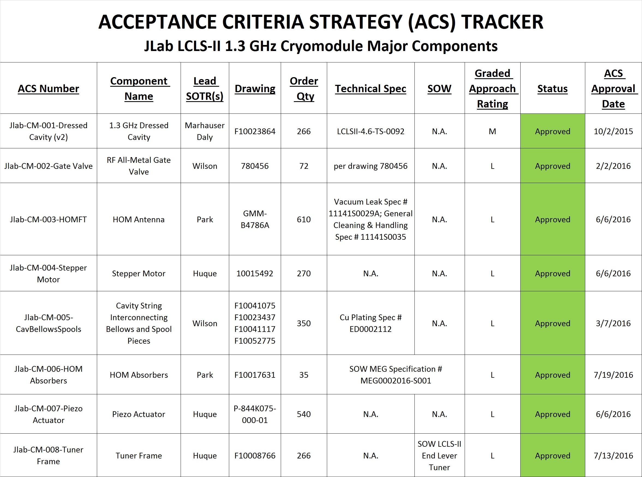
ACS Summary (JLab)
ACS Documents Completed & Ready for Production.
Graded Approach for Risk Determination.
Vendor Hold Points established, Continue Vendor Visits & Follow-ups. Data being reviewed & approved by SOTRs*.
Receiving Inspection, Assembly & Test Travelers are being put in place for Production.
* Subcontracting Officer’s Technical Representative (a.k.a. Technical Lead)

Slide 9
Material Handling (JLab)
Components are received & moved to JLAB SRF Test Lab inventory area.
A Receiving Traveler is used to record Shipment Conditions and Vendor Documents.
Project Inventory Management System (PRIMeS) is used to log component serial numbers.
Serial numbers are automatically “Pushed” into the associated work processing Travelers in Pansophy.
Components acceptable for production are granted an “Issuable” status, while others are held for appropriate Dispositions.
For Fermilab procured components, Acceptance (or Rejection) is communicated through the SOTRs.

Slide 10
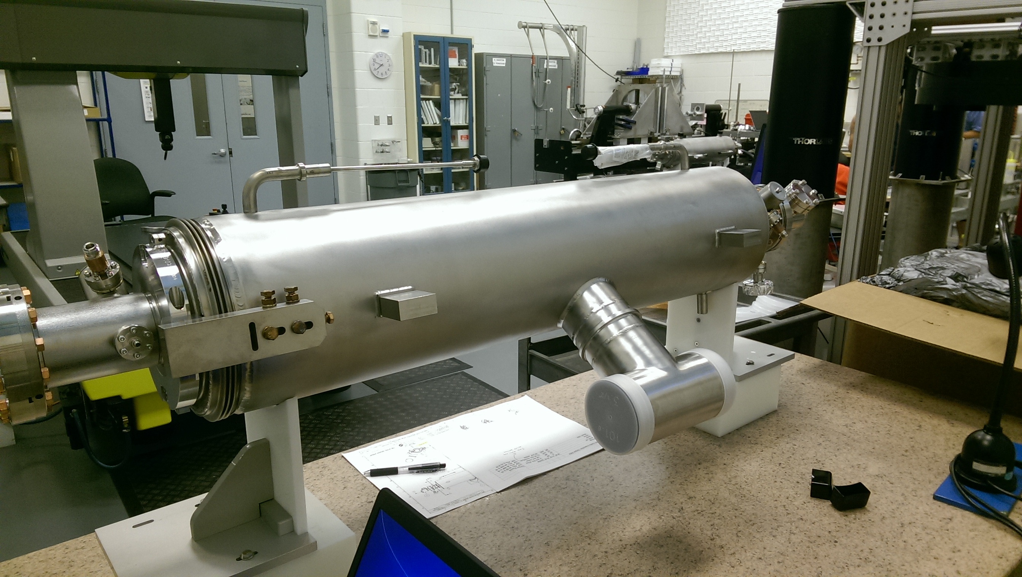
Incoming Inspection
Incoming Inspection is part of Acceptance Criteria Strategy, in addition to reviewing Vendor Hold-Point data.
Inspection Travelers are used as part of component QC.
Lessons-learned from the pCM are being incorporated into Production Travelers.
NCRs are generated for components not meeting requirements.

Slide 11
NCR Communication
NCRs mostly created at Incoming Inspection, but also apply to assemblies & tests.
SOTRs and relevant staff are automatically notified.
NCRs are internally reviewed, and with Fermilab as necessary. JLab and Fermilab SOTRs are in constant contact with each other on issues and part status.
JLab reports NCR Status at regularly scheduled meetings with Systems Mgr at SLAC.
Ones that have significant impact to Performance, Schedule, and/or Costs are elevated to a Significant Level and reported to SLAC Project QA.
Significant NCR Dashboard
Last reported to SLAC for data month August.
(5) Closed / (7) Open
All related to production Cavities VTA Tests (low Qo)

Slide 12
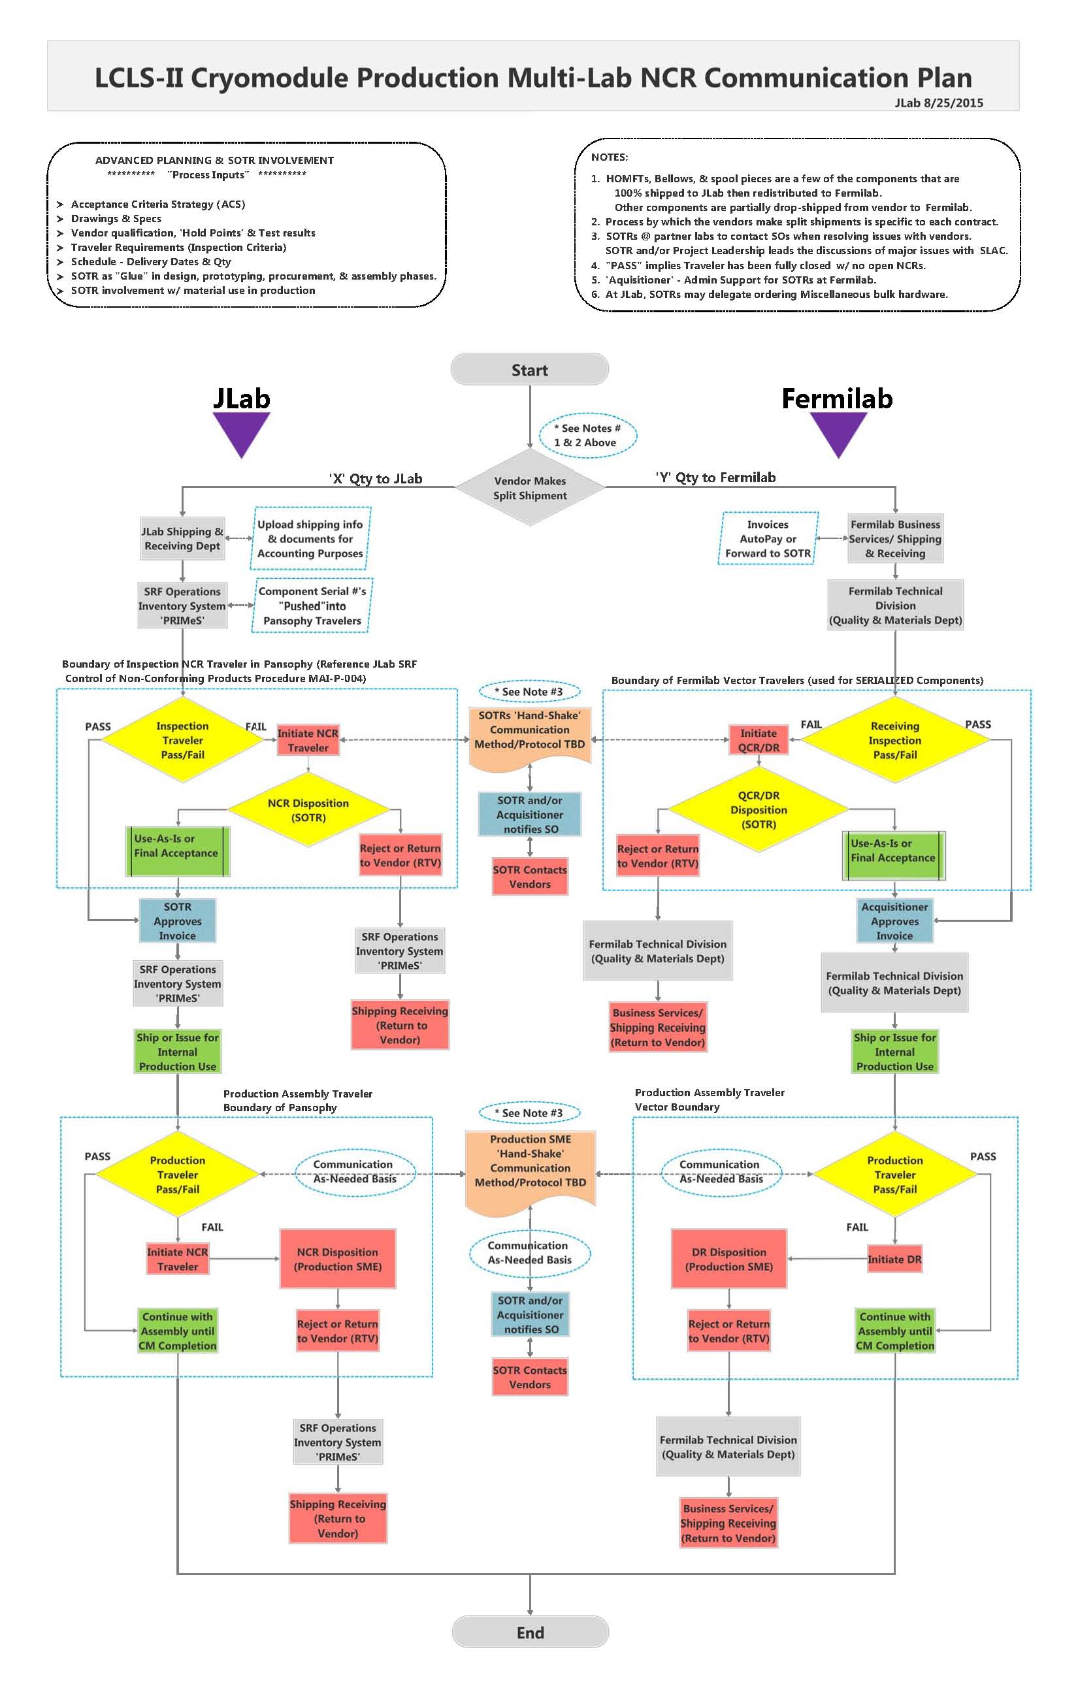
NCR Communication
Long Version
Short Version

Slide 13
Overview & Configuration Management of Travelers
Slide by Valerie Bookwalter

Slide 14
Overview & Configuration Management of Travelers
Slide by Valerie Bookwalter

Slide 15
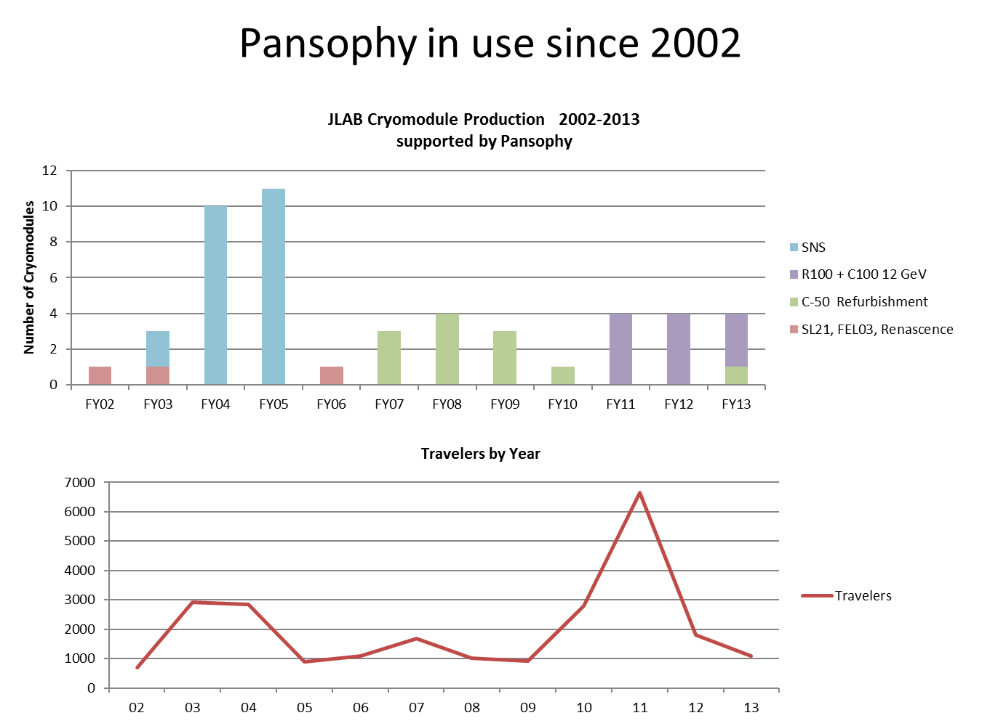
Overview & Configuration Management of Travelers
Slide by Valerie Bookwalter

Slide 16
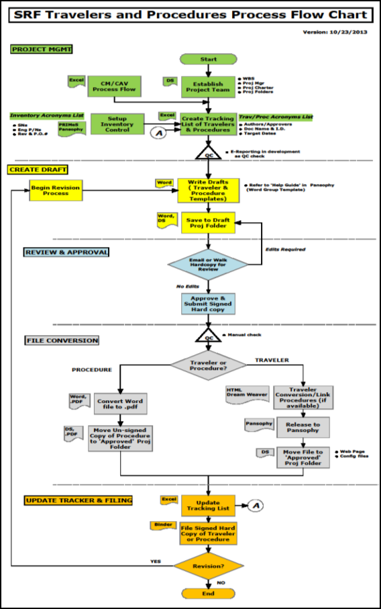
Overview & Configuration Management of Travelers
Five Stages of Traveler Development & Release
S1. Planning
I.D. Components and Assemblies
I.D. Work Center Flow
Create Tracking List using acronyms
QC Check
S2. Draft Creation
Write drafts using templates
Save file to project folder
S3. Review & Approval
Hardcopy for review
Edit as necessary
Approve & Submit Signed Hard copy
S4. File Conversion
QC Check
Traveler Conversion
Release to Pansophy
Move file to ‘Approved’ folder
S5. Update Tracking List
Copy for filing
Revisions start @ S1 or S2

Slide 17
Overview & Configuration Management of Travelers
Receiving Travelers
L2PRO-CAV-RECV-(component ID)
L2PRO-CST-RECV-(component ID)
L2PRO-CM-RECV-(component ID)
Standard Project Travelers
L2PRO-NCR
L2PRO-INSR
L2PRO-D3
Inspection Travelers
L2PRO-CAV-INSP-(component ID)
L2PRO-CST-INSP-(component ID)
L2PRO-CM-INSP-(component ID)
Shipping Travelers
L2PRO-CM-TRANS-SHP
L2PRO-CM-INSP-ENDC
Assembly Travelers
L2PRO-CAV-ASSY-(component ID)
L2PRO-CST-ASSY-(component ID)
L2PRO-CM-ASSY-(component ID)
NOTE: PRO = prototype cryomodule
For Production ‘PRO’ becomes ‘PRD’ for all Traveler I.D.
Test Travelers
L2PRO-CAV-VTRF
L2PRO-CAV-VTA-COOL
L2PRO-CM-CMTF

Slide 18
Overview & Configuration Management of Travelers
Traveler Example for Illustration Purposes

Slide 19
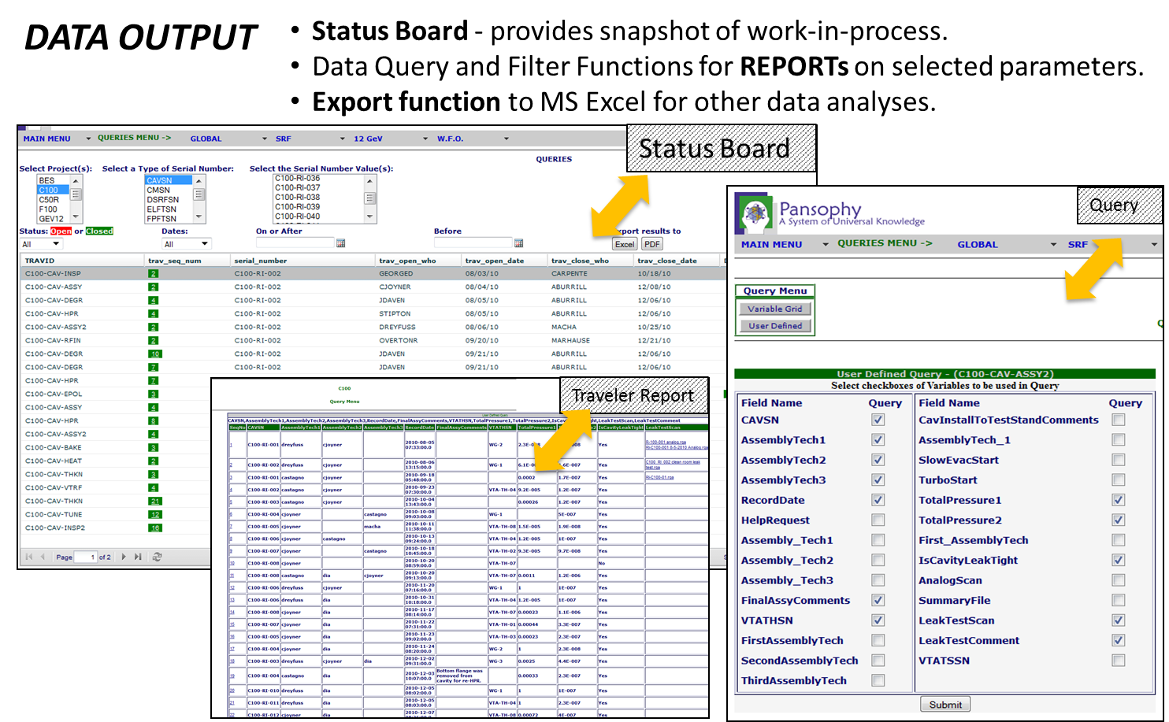
Overview & Configuration Management of Travelers
Examples for Illustration Purposes

Slide 20
Overview & Configuration Management of Travelers
Light Scratch found on sealing surface from Inspection Traveler.
NCR created. SOTR automatically notified.
1st Disposition – Hold/Modify (polish seal surface.)
Rework completed. Verification comments added.
SOTR Final Disposition – ‘Use-As-Is’
LCLSII Production HOMFT NCR Example
1
4
5
3
2

Slide 21
Overview & Configuration Management of Travelers
DocuShare – an example of file storage dbase
Web-accessible centralized file storage database (Lab-wide & SRF).
Controlled-Sharing access to site content.
Collection-Based filing structure.
Files for SRF organizational info, Quality Management System, Project Management, procedures, travelers, etc.
Plus other account and content features.

Slide 22
Pansophy QA/QC Reports
LCLS-II Traveler Reporting
(Prototype CM)
Weekly Internal Reporting by Megan Salvador

Slide 23
Pansophy QA/QC Reports
Processing Travelers by month

Slide 24
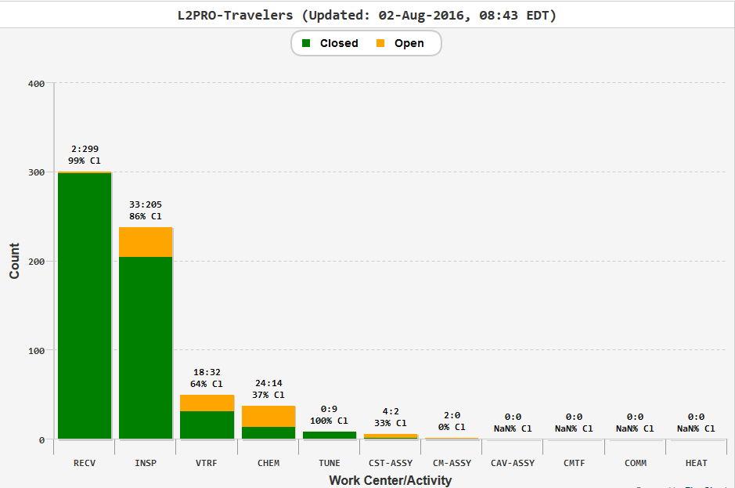
Pansophy QA/QC Reports
Processing Travelers by Work Centers

Slide 25
Pansophy QA/QC Reports
NCRs by Month

Slide 26
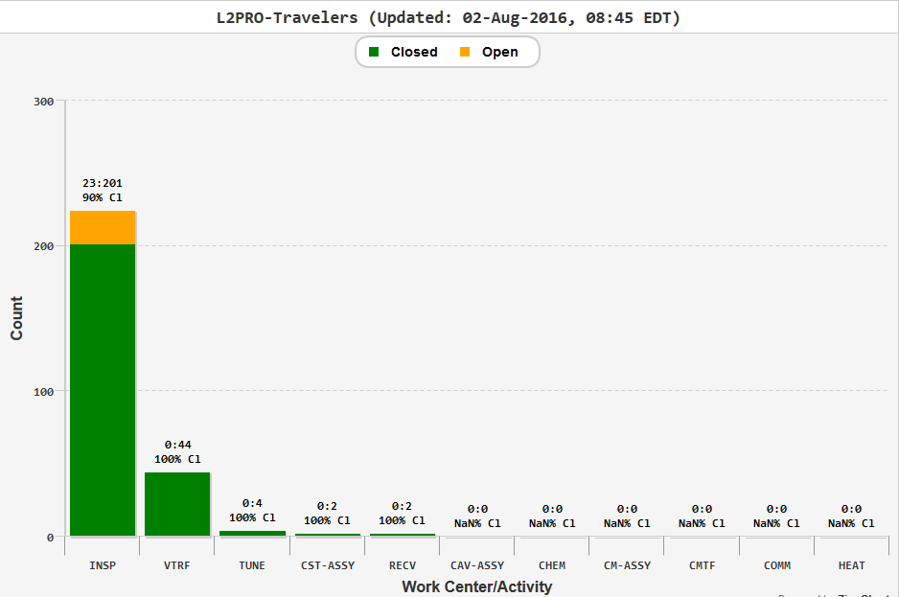
Pansophy QA/QC Reports
NCRs by Work Centers

Slide 27
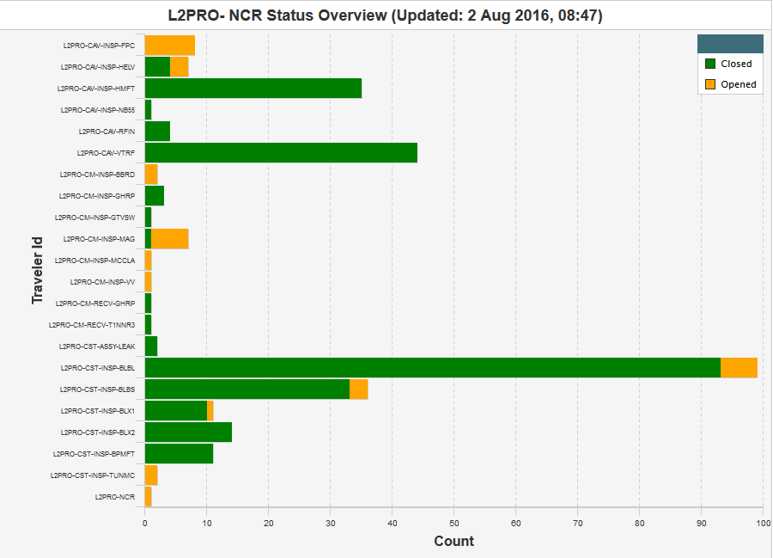
Pansophy QA/QC Reports
NCRs by Traveler I.D.

Slide 28
Pansophy QA/QC Reports
NCRs Initiated to First Response
6 new NCR this month…

Slide 29
Pansophy QA/QC Reports
NCRs By Classification

Slide 30
Pansophy QA/QC Reports
Many types of traveler reports are available in Pansophy.
Flexible & Suitable to needs of LCLSII project.
Same types of reports are available for Production usage.
Many of which are already being used for Production (i.e. Receiving, Inspection & testing of cavities, Cu-plated bellows, & etc.)
Data files, test results, and process documents are stored and protected by JLab computer center. Locations include Pansophy, DocuShare, or M:drive server.

Slide 31
Plan for Collecting/Delivering Relevant Inspection, Assy & Test Data to SLAC
Admin Support in Collecting/Delivering of Data to SLAC.
Data collection process will center around the Inspection, Assembly & Test Travelers.
Data collection can begin as soon as Travelers are “Instantiated” and Completed.
The exact types of data to submit to SLAC is currently TBD.
As example of the past, Traveler Data were saved to CDs and printed hard copies were provided to ORNL for the SNS Cryomodules Project.

Slide 32
Summary
Quality Management System exists, and adapted to SLAC’s LCLSII Project QA requirements.
QA/QC & Safety Structures are in place for LCLSII Production.
Acceptance Criteria Strategy planning scope work has been completed and ready for Production.
Traveler System fully functional with large selection of available reports.
Significant NCR Dashboards are regularly reported to SLAC Project QA.

Slide 33
Acknowledgement
JLab Pansophy team, Project Support Group, Operations Group, R&D Group, SOTRs, SOs, and ESH&Q staff.
Fermilab Technical Division, QARs, SOTRs, SOs, and technical staff.
SLAC LCLSII Project QA Manager, QARs, and technical staff.

Slide 34
Back-up Slides

Slide 35
Pansophy QA/QC Reports
NCRs Time to Closure

Slide 36
NCRs Classification Totals

Slide 37
Open NCRs: HELV & FPC
Status Report for L2PRO-NCR,L2PRO-NCR on 06-Sep-16
TRAV_SEQ_NUM | TRAV_OPEN_DATE | PARTDESCRIPTION | DESCRIBECOMMENT | SN | TRAVELERID | TRAVSEQNUMBER | DISPOSITION
86 | 6-Aug-15 | Cavity | Visual and dimensional out of tolerance, please see pictures and CMM report. | TB9AES034 | L2PRO-CAV-INSP-HELV | 7 | Hold/Modify
87 | 6-Aug-15 | Cavity | Field Probe flange has partial groove in seal surface, probably left by seal rin | TB9AES029 | L2PRO-CAV-INSP-HELV | 8
90 | 12-Aug-15 | Cavity | Please see attached for dimensional non-conforming. Beam tube flange (FP end) ha | TB9AES031 | L2PRO-CAV-INSP-HELV | 9
271 | 13-Apr-16 | UNKN | Shock recorder missing | CPI FPC Pair03 | L2PRO-CAV-INSP-FPC | 7
285 | 4-May-16 | UNKN | With main valve (SN2516) on CPC R397361-02-04 in close position, cannot achieve pressure better than 2 10-5 mbar. Suppose damaged valve. Red tagged valve - CPI should check/replace this valve. | CPI-PA-04 | L2PRO-CAV-INSP-FPC | 8
286 | 4-May-16 | UNKN | Static vacuum of CPI-PA-04 R397361-02-04 1000 mbar (normal pressure). Main valve related or improperly torque nuts on cavity flange. Leak check OK. | CPI-PA-04 | L2PRO-CAV-INSP-FPC | 8
287 | 4-May-16 | UNKN | Difficult to remove cold ceramic protection cup and found residues form the flat VITON gasket on CF100 copper plated. | CPI-PA-04 | L2PRO-CAV-INSP-FPC | 8
288 | 4-May-16 | UNKN | Push-rod 006 with weld issues on bellows. Sent back to CPI to be replaced. | CPI-PA-04 | L2PRO-CAV-INSP-FPC | 8
289 | 5-May-16 | UNKN | Dirty Swagelog nitrogen admission valves (on WP as well as on CP). | R397361-02-04A04 | L2PRO-CAV-INSP-FPC | 8
290 | 5-May-16 | UNKN | Dirty Swagelog nitrogen admission valves (on WP as well as on CP). | CPI-PA04 | L2PRO-CAV-INSP-FPC | 8
296 | 1-Aug-16 | UNKN | Missing hardware Kit Electron probe with male sex High particulate counts on external surfaces 5K copper anchor oxidized Blood like stains on test stand frame Greasy Swagelog valves | PA003 | L2PRO-CAV-INSP-FPC | 11
304 | 17-Aug-16 | LCLSII couplers | 1. Greasy nitrogen admission valves on cold ceramic protection cups. 2. SMA connectors with reverse sex. - Use adapters. 3. Particulate counts on external surfaces higher than ESD specifications ( >>100 counts). 4. Oxidized 5K copper anchors. | CPI LPA#04 | L2PRO-CAV-INSP-FPC | 12
305 | 17-Aug-16 | CPI couples for LCLSII | 1. Particulate counts on external surfaces higher than ESD specifications ( >>100 counts). 2. Oxidized 5K copper anchors. 3. Missing M8 Nitronic hardware 4. Missing manual antenna actuators | CPI LPA07 | L2PRO-CAV-INSP-FPC | 13
306 | 17-Aug-16 | CPI LCLSII couplers | 1. Particulate counts on external surfaces higher than ESD specifications ( >>100 counts). 2. Oxidized 5K copper anchors. 3. Missing M8 Nitronic hardware 4. Missing manual antenna actuators | CPI LPA#08 | L2PRO-CAV-INSP-FPC | 14

Slide 38
Open NCRs: Magnetic Shielding
Status Report for L2PRO-NCR,L2PRO-NCR on 06-Sep-16
TRAV_SEQ_NUM | TRAV_OPEN_DATE | PARTDESCRIPTION | DESCRIBECOMMENT | SN | TRAVELERID | TRAVSEQNUMBER | DISPOSITION
278 | 20-Apr-16 | Magnetic Shielding | Part number F10017757 does not match drawing; additional tabs present; Part number F10017758 does not match drawing; additional tabs present. Note:Spacer holes are NOT present on the above parts and and the drawing does not require them.Part number F10018116 does not match drawing; additional tabs present;Part number F10018117 does not match drawing; additional tabs present;Note: the above two parts DO have spacer holes not required by the drawing.Note:Part number F10017749,F10017754,F10017755,F10017756 Do Not have spacer holes. Part number: F10018116,F10018117,F10018120,F10018121,F10039382,F10039384 Do Have Spacer holes present. Drawing does not require them. | 10 | L2PRO-CM-INSP-MAG | 9 | Hold/Modify
279 | 20-Apr-16 |  | Part number F10017757 does not match drawing; additional tabs present; Part number F10017758 does not match drawing; additional tabs present. Note:Spacer holes are NOT present on the above parts and and the drawing does not require them.Part number F10018116 does not match drawing; additional tabs present;Part number F10018117 does not match drawing; additional tabs present;Note: the above two parts DO have spacer holes not required by the drawing.Note:Part number F10017749,F10017754,F10017755,F10017756 Do Not have spacer holes. Part number: F10018116,F10018117,F10018120,F10018121,F10039382,F10039384 Do Have Spacer holes present. Drawing does not require them. Part number F10018117 has a broken screw in threaded insert. | 11 | L2PRO-CM-INSP-MAG | 10 | Hold/Modify
280 | 20-Apr-16 | Magnetic Shielding | Part number F10017757 does not match drawing; additional tabs present; Part number F10017758 does not match drawing; additional tabs present. Note:Spacer holes are NOT present on the above parts and and the drawing does not require them.Part number F10018116 does not match drawing; additional tabs present;Part number F10018117 does not match drawing; additional tabs present;Note: the above two parts DO have spacer holes not required by the drawing.Note:Part number F10017749,F10017754,F10017755,F10017756 Do Not have spacer holes. Part number: F10018116,F10018117,F10018120,F10018121,F10039382,F10039384 Do Have Spacer holes present. Drawing does not require them. | 12 | L2PRO-CM-INSP-MAG | 11 | Hold/Modify
281 | 20-Apr-16 |  | Part number F10017757 does not match drawing; additional tabs present; Part number F10017758 does not match drawing; additional tabs present. Note:Spacer holes are NOT present on the above parts and and the drawing does not require them.Part number F10018116 does not match drawing; additional tabs present;Part number F10018117 does not match drawing; additional tabs present;Note: the above two parts DO have spacer holes not required by the drawing.Note:Part number F10017749,F10017754,F10017755,F10017756 Do Not have spacer holes. Part number: F10018116,F10018117,F10018120,F10018121,F10039382,F10039384 Do Have Spacer holes present. Drawing does not require them. | 13 | L2PRO-CM-INSP-MAG | 12 | Hold/Modify
282 | 20-Apr-16 |  | Part number F10017757 does not match drawing; additional tabs present; Part number F10017758 does not match drawing; additional tabs present. Note:Spacer holes are NOT present on the above parts and and the drawing does not require them.Part number F10018116 does not match drawing; additional tabs present;Part number F10018117 does not match drawing; additional tabs present;Note: the above two parts DO have spacer holes not required by the drawing.Note:Part number F10017749,F10017754,F10017755,F10017756 Do Not have spacer holes. Part number: F10018116,F10018117,F10018120,F10018121,F10039382,F10039384 Do Have Spacer holes present. Drawing does not require them. | 14 | L2PRO-CM-INSP-MAG | 13 | Hold/Modify
283 | 20-Apr-16 |  | Part number F10017757 does not match drawing; additional tabs present; Part number F10017758 does not match drawing; additional tabs present. Note:Spacer holes are NOT present on the above parts and and the drawing does not require them.Part number F10018116 does not match drawing; additional tabs present;Part number F10018117 does not match drawing; additional tabs present;Note: the above two parts DO have spacer holes not required by the drawing.Note:Part number F10017749,F10017754,F10017755,F10017756 Do Not have spacer holes. Part number: F10018116,F10018117,F10018120,F10018121,F10039382,F10039384 Do Have Spacer holes present. Drawing does not require them.Part number F10037667 has a bent corner. | 15 | L2PRO-CM-INSP-MAG | 14 | Hold/Modify

Slide 39
Open NCRs: Bellows & TUNMC & CM
Status Report for L2PRO-NCR,L2PRO-NCR on 06-Sep-16
TRAV_SEQ_NUM | TRAV_OPEN_DATE | PARTDESCRIPTION | DESCRIBECOMMENT | SN | TRAVELERID | TRAVSEQNUMBER | DISPOSITION
156 | 24-Nov-15 | Weldment Bellows Long | Dark stains and blisters remain in plating after final disposition of cleaning in NCR #155. | 19 | L2PRO-NCR | 155
234 | 16-Feb-16 | Weldment Bellows Short | Scratches in seal area and cuffs. Dent on convolution, dark spots in plating. | 10 | L2PRO-CST-INSP-BLBS | 12 | Hold/Modify
297 | 1-Aug-16 |  | Remnant field is over 5 mG, worst area measured 475 mG. Ceramic balls do not rotate while in the assembly. | 9 | L2PRO-CST-INSP-TUNMC | 2
302 | 8-Aug-16 |  | Tuner assembly missing one lid bearing. Please see attached. Ceramic balls do not rotate while in the assembly. Remnant field is over 5 mG, measured 497 mG | 13 | L2PRO-CST-INSP-TUNMC | 7
303 | 9-Aug-16 |  | Remnant field is over 5 mG, measured 392 mG. Ceramic balls do not rotate while in the assembly. | 14 | L2PRO-CST-INSP-TUNMC | 8
293 | 14-Jul-16 |  | Remnant field is over 5 mG, worst area measured 439 mG. F10008766 missing item number 2 and 12. F10006870 missing item number 2,6,9 and 13. Bolt threads damaged from set screw. Please see attached. | 7 | L2PRO-CST-INSP-TUNMC | 1 | Hold/Modify
291 | 20-Jun-16 | Vacuum Vessel | Damage and scratches present on some flanges.Damage F10030811 . Damage F10026614. See detailed inspection report attached and photos link. Scratches present on some flanges.Paint residue F10018083 (DS). Contamination found in o-ring groove F10023643..Contamination found in o-ring groove F10020935. Scratches F10030285. Scratches/damage F10030301. Refer to Vacuum Vessel Inspection report attached. Most threaded holes are contaminated with chips,burrs,and dirt making the Go Thread Gage not go for full depth. Photo link: M:\cmm\Pictures\Inspection Pictures\LCLS2\Prototype CM\Vacuum Vessel | 2 | L2PRO-CM-INSP-VV | 1 | Hold/Modify
294 | 26-Jul-16 | Rupture Disc Holder | Seal surface scratched. | 15006443A-1 | L2PRO-CM-INSP-BBRD | 1
295 | 26-Jul-16 | Rupture Disc Holder | Scratches present on seal surface. | 15001065A-2 | L2PRO-CM-INSP-BBRD | 2

Slide 40
NCRs Classification Totals

Slide 41
Open NCRs: HMFT
Status Report for L2PRD-NCR,L2PRD-NCR on 06-Sep-16
TRAV_SEQ_NUM | TRAV_OPEN_DATE | PARTDESCRIPTION | DESCRIBECOMMENT | SN | TRAVELERID | TRAVSEQNUMBER | DISPOSITION
2 | 15-Mar-16 | HOM Feedthru | Surface roughness on probe diameter;RA measures 1.8 Surface nick on probe diameter See traveler for photos. | 61 | L2PRD-CAV-INSP-HMFT | 5
10 | 15-Mar-16 | HOM Feedthru | Tear out/pitting in seal groove. Machined groove near probe base. See photos in traveler. | 83 | L2PRD-CAV-INSP-HMFT | 27
11 | 15-Mar-16 | HOM Feedthru | Scratch on probe surface. See traveler for photo. | 85 | L2PRD-CAV-INSP-HMFT | 29
36 | 5-Apr-16 | HOM Feedthru | Possible braze spot in seal groove. | 99 | L2PRD-CAV-INSP-HMFT | 43
37 | 5-Apr-16 | HOM Feedthru | Scratch in seal groove. | 112 | L2PRD-CAV-INSP-HMFT | 56 | Hold/Modify
40 | 5-Apr-16 | HOM Feedthru | Scratches in seal groove. Connector pin depth: 4.05-4.95 checks 4.03 | 119 | L2PRD-CAV-INSP-HMFT | 63
45 | 5-Apr-16 | HOM Feedthru | Scratch in seal groove. | 134 | L2PRD-CAV-INSP-HMFT | 78 | Hold/Modify
50 | 5-Apr-16 | HOM Feedthru | Scratch in seal groove. | 155 | L2PRD-CAV-INSP-HMFT | 99 | Hold/Modify
106 | 20-Jun-16 | HOM Feedthru | Scratches present in seal groove. | 157 | L2PRD-CAV-INSP-HMFT | 101
107 | 20-Jun-16 | HOM Feedthru | Scratches present in seal groove. | 159 | L2PRD-CAV-INSP-HMFT | 103
108 | 20-Jun-16 | HOM Feedthru | Scratches present in seal groove. | 167 | L2PRD-CAV-INSP-HMFT | 111
109 | 20-Jun-16 | HOM Feedthru | Scratches present in seal groove. | 171 | L2PRD-CAV-INSP-HMFT | 115
110 | 20-Jun-16 | HOM Feedthru | Scratches present in seal groove. | 174 | L2PRD-CAV-INSP-HMFT | 118
111 | 20-Jun-16 | HOM Feedthru | Scratches present in seal groove. | 178 | L2PRD-CAV-INSP-HMFT | 122
112 | 20-Jun-16 | HOM Feedthru | Scratches present in seal groove. | 181 | L2PRD-CAV-INSP-HMFT | 125
113 | 20-Jun-16 | HOM Feedthru | Scratches present in seal groove. | 182 | L2PRD-CAV-INSP-HMFT | 126
114 | 20-Jun-16 | HOM Feedthru | Scratches present in seal groove. | 184 | L2PRD-CAV-INSP-HMFT | 128
115 | 20-Jun-16 | HOM Feedthru | Scratches present in seal groove. | 186 | L2PRD-CAV-INSP-HMFT | 130
116 | 20-Jun-16 | HOM Feedthru | Scratches present in seal groove. | 190 | L2PRD-CAV-INSP-HMFT | 134
117 | 20-Jun-16 | HOM Feedthru | Scratches present in seal groove. | 192 | L2PRD-CAV-INSP-HMFT | 136
118 | 20-Jun-16 | HOM Feedthru | Scratches present in seal groove. | 196 | L2PRD-CAV-INSP-HMFT | 140
119 | 20-Jun-16 | HOM Feedthru | Scratches present in seal groove. | 198 | L2PRD-CAV-INSP-HMFT | 142
120 | 20-Jun-16 | HOM Feedthru | Scratches present in seal groove. | 199 | L2PRD-CAV-INSP-HMFT | 143
121 | 20-Jun-16 | HOM Feedthru | Scratches present in seal groove. | 201 | L2PRD-CAV-INSP-HMFT | 145
122 | 20-Jun-16 | HOM Feedthru | Scratches present in seal groove. | 203 | L2PRD-CAV-INSP-HMFT | 148
123 | 20-Jun-16 | HOM Feedthru | Scratches present in seal groove. | 204 | L2PRD-CAV-INSP-HMFT | 149
124 | 20-Jun-16 | HOM Feedthru | Scratches present in seal groove. | 205 | L2PRD-CAV-INSP-HMFT | 150
125 | 20-Jun-16 | HOM Feedthru | Scratches present in seal groove. | 206 | L2PRD-CAV-INSP-HMFT | 151
126 | 20-Jun-16 | HOM Feedthru | Scratches present in seal groove. | 207 | L2PRD-CAV-INSP-HMFT | 152

Slide 42
Open NCRs: FPFT
Status Report for L2PRD-NCR,L2PRD-NCR on 06-Sep-16
TRAV_SEQ_NUM | TRAV_OPEN_DATE | PARTDESCRIPTION | DESCRIBECOMMENT | SN | TRAVELERID | TRAVSEQNUMBER | DISPOSITION
14 | 16-Mar-16 | Field Probe Feedthru | Surface spot in seal groove.See photo in traveler. | 30 | L2PRD-CAV-INSP-FPFT | 8 | Hold/Modify
20 | 16-Mar-16 | Field Probe Feedthru | Light scratches at base of probe. Scuff mark at base of probe.See traveler for photos. | 53 | L2PRD-CAV-INSP-FPFT | 31
21 | 16-Mar-16 | Field Probe Feedthru | Roughness/machined tear out near probe base. See photos in traveler. | 54 | L2PRD-CAV-INSP-FPFT | 32
22 | 16-Mar-16 | Field Probe Feedthru | Light scratches at base of probe. Light scratches on machine boss. See traveler for photos. | 65 | L2PRD-CAV-INSP-FPFT | 43
25 | 16-Mar-16 | Field Probe Feedthru | Roughness/machined tear out on probe surface. See traveler for photos. | 76 | L2PRD-CAV-INSP-FPFT | 54
28 | 4-Apr-16 | Field probe feedthru | Braze void on outside of connector. | 82 | L2PRD-CAV-INSP-FPFT | 60
29 | 4-Apr-16 | Field probe feedthru | Minor braze void on outside of connector. | 83 | L2PRD-CAV-INSP-FPFT | 61
30 | 4-Apr-16 | Field probe feedthru | Rough spot at probe base. | 86 | L2PRD-CAV-INSP-FPFT | 64
31 | 4-Apr-16 | Field probe feedthru | Small braze void on outside of connector. | 88 | L2PRD-CAV-INSP-FPFT | 66
32 | 4-Apr-16 | Field probe feedthru | Very light scratch in seal groove. | 89 | L2PRD-CAV-INSP-FPFT | 67
33 | 4-Apr-16 | Field Probe Feedthru | Light scratches in seal groove. | 92 | L2PRD-CAV-INSP-FPFT | 70
34 | 4-Apr-16 | Field Probe Feedthru | Roughness in seal groove.Light scratch in seal groove. | 107 | L2PRD-CAV-INSP-FPFT | 85
35 | 4-Apr-16 | Field Probe Feedthru | Light scratches in seal groove. | 110 | L2PRD-CAV-INSP-FPFT | 88

Slide 43
Open NCRs: Bellows
Status Report for L2PRD-NCR,L2PRD-NCR on 06-Sep-16
TRAV_SEQ_NUM | TRAV_OPEN_DATE | PARTDESCRIPTION | DESCRIBECOMMENT | SN | TRAVELERID | TRAVSEQNUMBER | DISPOSITION
78 | 16-May-16 | Bellow Long | Scratches present in seal groove. | 1001 | L2PRD-CST-INSP-BLBP | 1 | Hold/Modify
79 | 16-May-16 | Bellow Long | Scratches present in seal groove. | 1002 | L2PRD-CST-INSP-BLBP | 2 | Hold/Modify
80 | 16-May-16 | Bellow Long | Scratches present in seal groove. | 1003 | L2PRD-CST-INSP-BLBP | 3 | Hold/Modify
82 | 16-May-16 | Bellow Long | Scratches present in seal groove.Contamination spot in seal groove. Unusual tooling mark on external bellow surface. | 1005 | L2PRD-CST-INSP-BLBP | 5 | Hold/Modify
83 | 18-May-16 | Bellows long | Scratches present in seal groove. Contamination spots in seal groove. | 1006 | L2PRD-CST-INSP-BLBP | 6 | Hold/Modify
84 | 18-May-16 | Bellows long | Scratches present in seal groove. | 1007 | L2PRD-CST-INSP-BLBP | 7 | Hold/Modify
85 | 18-May-16 | Bellow Long | Scratches present in seal groove. | 1008 | L2PRD-CST-INSP-BLBP | 8 | Hold/Modify
86 | 18-May-16 | Bellow Long | Scratches present in seal groove. | 1009 | L2PRD-CST-INSP-BLBP | 9 | Hold/Modify
88 | 18-May-16 | unkn | Scratches present in seal groove. | 1010 | L2PRD-CST-INSP-BLBP | 10 | Hold/Modify
90 | 18-May-16 | Bellow Long | Scratches present in seal groove. | 1012 | L2PRD-CST-INSP-BLBP | 12 | Hold/Modify
92 | 18-May-16 | Bellow Long | Scratches present in seal groove. Tool chatter present in seal groove. Contamination present in seal groove. | 1013 | L2PRD-CST-INSP-BLBP | 13 | Hold/Modify
93 | 18-May-16 | Bellow Long | Contamination spots in seal groove. Scratches present in seal groove. | 1014 | L2PRD-CST-INSP-BLBP | 14 | Hold/Modify
95 | 18-May-16 | Bellow Long | Scratches present in seal groove. | 1015 | L2PRD-CST-INSP-BLBP | 15 | Hold/Modify
96 | 18-May-16 | Bellow Long | Scratches present in seal groove.Contamination spot in seal groove. | 1016 | L2PRD-CST-INSP-BLBP | 16 | Hold/Modify
98 | 18-May-16 | Bellow Long | Scratches present in seal groove.Contamination spots in seal groove.Tool chatter present in seal groove. | 1017 | L2PRD-CST-INSP-BLBP | 17 | Hold/Modify
99 | 18-May-16 | Bellow Long | Scratches present in seal groove. | 1018 | L2PRD-CST-INSP-BLBP | 18 | Hold/Modify
100 | 31-May-16 | Bellows Long | Scratches present in seal groove. | 1034 | L2PRD-CST-INSP-BLBP | 34 | Hold/Modify
101 | 31-May-16 | Bellows Long | Scratches present in seal groove. | 1035 | L2PRD-CST-INSP-BLBP | 35 | Hold/Modify
102 | 31-May-16 | Bellow Long | Scratches on rotatable flange at 11:00. Scratches on non-rotatable flange at 10:00. | 1020 | L2PRD-CST-INSP-BLBP | 20 | Hold/Modify
103 | 31-May-16 | Bellow Long | Scratches on non-rotatable flange at 12:00. | 1023 | L2PRD-CST-INSP-BLBP | 23 | Hold/Modify
104 | 31-May-16 | Bellow Long | Scratch on non-rotatable flange at 1:00. | 1028 | L2PRD-CST-INSP-BLBP | 28 | Hold/Modify
105 | 2-Jun-16 | Bellow Long | Scratches on rotatable flange at 12:00 and 6:00. | 1032 | L2PRD-CST-INSP-BLBP | 32 | Hold/Modify
218 | 25-Jul-16 | Bellow Long | Remnant magnetic field measurement exceeds requirement. Checks .023-.050 at welds. | 2001 | L2PRD-CST-INSP-BLBP | 36 | Hold/Modify
219 | 25-Jul-16 | Bellow Long | Remnant magnetic field measurement exceeds requirement. Checks .040-.140 at welds. | 2002 | L2PRD-CST-INSP-BLBP | 37 | Hold/Modify

Slide 44
Open NCRs: Bellows (cont.)
Status Report for L2PRD-NCR,L2PRD-NCR on 06-Sep-16
TRAV_SEQ_NUM | TRAV_OPEN_DATE | PARTDESCRIPTION | DESCRIBECOMMENT | SN | TRAVELERID | TRAVSEQNUMBER | DISPOSITION
220 | 25-Jul-16 | Bellow Long | Remnant magnetic field measurement exceeds requirement. Checks .050-.190 at welds. | 2003 | L2PRD-CST-INSP-BLBP | 38 | Hold/Modify
221 | 25-Jul-16 | Bellow Long | Remnant magnetic field measurement exceeds requirement. Checks .035-.075 at welds. | 2004 | L2PRD-CST-INSP-BLBP | 39 | Hold/Modify
222 | 25-Jul-16 | Bellow Long | Remnant magnetic field measurement exceeds requirement. Checks .054-.080 at welds. | 2005 | L2PRD-CST-INSP-BLBP | 40 | Hold/Modify
223 | 25-Jul-16 | Bellow Long | Remnant magnetic field measurement exceeds requirement. Checks .070-.140 at welds. | 2006 | L2PRD-CST-INSP-BLBP | 41 | Hold/Modify
224 | 25-Jul-16 | Bellow Long | Remnant magnetic field measurement exceeds requirement. Checks .080-.170 at welds. | 2008 | L2PRD-CST-INSP-BLBP | 43 | Hold/Modify
225 | 25-Jul-16 | Bellow Long | Remnant magnetic field measurement exceeds requirement. Checks .065-.190 at welds. | 2010 | L2PRD-CST-INSP-BLBP | 45 | Hold/Modify
226 | 25-Jul-16 | Bellow Long | Remnant magnetic field measurement exceeds requirement. Checks .100 at welds. | 2011 | L2PRD-CST-INSP-BLBP | 46 | Hold/Modify
227 | 25-Jul-16 | Bellow Long | Remnant magnetic field measurement exceeds requirement. Checks .130-.145 at welds. | 2012 | L2PRD-CST-INSP-BLBP | 47 | Hold/Modify
228 | 25-Jul-16 | Bellow Long | Remnant magnetic field measurement exceeds requirement. Checks .075-.260 at welds. | 2013 | L2PRD-CST-INSP-BLBP | 48 | Hold/Re-measure
229 | 25-Jul-16 | Bellow Long | Remnant magnetic field measurement exceeds requirement. Checks .050-.145 at welds. | 2014 | L2PRD-CST-INSP-BLBP | 49 | Hold/Re-measure
230 | 26-Jul-16 | Bellow Long | Remnant magnetic field measurement exceeds requirement. Checks .075-.150 | 2015 | L2PRD-CST-INSP-BLBP | 50 | Hold/Modify
231 | 26-Jul-16 | Bellow Long | Remnant magnetic field measurement exceeds requirement. Checks .098-.155 | 2016 | L2PRD-CST-INSP-BLBP | 51 | Hold/Modify
232 | 26-Jul-16 | Bellow Long | Remnant magnetic field measurement exceeds requirement. Checks .065-.255 | 2017 | L2PRD-CST-INSP-BLBP | 52 | Hold/Modify
233 | 26-Jul-16 | Bellow Long | Remnant magnetic field measurement exceeds requirement. Checks .088-.302 | 2018 | L2PRD-CST-INSP-BLBP | 53 | Hold/Modify
234 | 26-Jul-16 | Bellow Long | Remnant magnetic field measurement exceeds requirement. Checks .070-.280 | 2019 | L2PRD-CST-INSP-BLBP | 54 | Hold/Modify
235 | 26-Jul-16 | Bellow Long | Remnant magnetic field measurement exceeds requirement. Checks .024-.375 | 2020 | L2PRD-CST-INSP-BLBP | 55 | Hold/Modify

Slide 45
Open NCRs: Bellows (cont.)
Status Report for L2PRD-NCR,L2PRD-NCR on 06-Sep-16
TRAV_SEQ_NUM | TRAV_OPEN_DATE | PARTDESCRIPTION | DESCRIBECOMMENT | SN | TRAVELERID | TRAVSEQNUMBER | DISPOSITION
253 | 1-Aug-16 | Bellow long | Remnant magnetic field checks .080-.280. | 2021 | L2PRD-CST-INSP-BLBP | 56 | Hold/Modify
254 | 1-Aug-16 | Bellow long | Remnant magnetic field checks .160-.285. | 2022 | L2PRD-CST-INSP-BLBP | 57 | Hold/Modify
255 | 1-Aug-16 | Bellow long | Remnant magnetic field checks .189-.302. | 2023 | L2PRD-CST-INSP-BLBP | 58 | Hold/Modify
256 | 1-Aug-16 | Bellow long | Remnant magnetic field checks .114-.200. | 2024 | L2PRD-CST-INSP-BLBP | 59 | Hold/Modify
257 | 1-Aug-16 | Bellow long | Remnant magnetic field checks .095-.258. | 2025 | L2PRD-CST-INSP-BLBP | 60 | Hold/Modify
258 | 1-Aug-16 | Bellow long | Remnant magnetic field checks .288-.298. | 2026 | L2PRD-CST-INSP-BLBP | 61 | Hold/Modify
270 | 2-Aug-16 | Bellow long | Remnant magnetic field checks .055-.070. | 2027 | L2PRD-CST-INSP-BLBP | 62 | Hold/Modify
271 | 2-Aug-16 | Bellow long | Remnant magnetic field checks .112-.130. | 2028 | L2PRD-CST-INSP-BLBP | 63 | Hold/Modify
272 | 2-Aug-16 | Bellow long | Remnant magnetic field checks .106-.158. | 2029 | L2PRD-CST-INSP-BLBP | 64 | Hold/Modify
273 | 2-Aug-16 | Bellow long | Remnant magnetic field checks .100-.177. | 2030 | L2PRD-CST-INSP-BLBP | 65 | Hold/Modify
274 | 2-Aug-16 | Bellow long | Remnant magnetic field checks .091-.098. | 2031 | L2PRD-CST-INSP-BLBP | 66 | Hold/Modify
275 | 2-Aug-16 | Bellow long | Remnant magnetic field checks .090-.220. | 2032 | L2PRD-CST-INSP-BLBP | 67 | Hold/Modify
325 | 8-Aug-16 | Bellow long | Remnant magnetic field measurement checks .080-.200. | 2033 | L2PRD-CST-INSP-BLBP | 68 | Hold/Modify
326 | 8-Aug-16 | Bellow long | Remnant magnetic field measurement checks .087-.095. | 2034 | L2PRD-CST-INSP-BLBP | 69 | Hold/Modify
327 | 8-Aug-16 | Bellow long | Remnant magnetic field measurement checks .152-.345. | 2035 | L2PRD-CST-INSP-BLBP | 70 | Hold/Modify
328 | 8-Aug-16 | Bellow long | Remnant magnetic field measurement checks .062-.092. | 2036 | L2PRD-CST-INSP-BLBP | 71 | Hold/Modify
329 | 8-Aug-16 | Bellow long | Remnant magnetic field measurement checks .150-.185. | 2037 | L2PRD-CST-INSP-BLBP | 72 | Hold/Modify
330 | 8-Aug-16 | Bellow long | Remnant magnetic field measurement checks .052-.141. | 2038 | L2PRD-CST-INSP-BLBP | 73 | Hold/Modify
331 | 8-Aug-16 | Bellow long | Remnant magnetic field measurement checks .075-.130. | 2039 | L2PRD-CST-INSP-BLBP | 74 | Hold/Modify
332 | 8-Aug-16 | Bellow long | Remnant magnetic field measurement checks .062-.102. | 2040 | L2PRD-CST-INSP-BLBP | 75 | Hold/Modify
333 | 8-Aug-16 | Bellow long | Remnant magnetic field measurement checks .073-.142. | 2041 | L2PRD-CST-INSP-BLBP | 76 | Hold/Modify
334 | 8-Aug-16 | Bellow long | Remnant magnetic field measurement checks .050-.064. | 2042 | L2PRD-CST-INSP-BLBP | 77 | Hold/Modify
385 | 18-Aug-16 |  | Weld protrudes out of the inside of cuff. Surface finish out of tolerance. NR flange measured 0.9 microns | 2049 | L2PRD-CST-INSP-BLBP | 84 | Return To Vendor
386 | 19-Aug-16 |  | Weld protrudes out of cuff. Please see attached. Surface finish out of tolerance, NR flange measured 0.9 microns | 2047 | L2PRD-CST-INSP-BLBP | 82
391 | 23-Aug-16 |  | 2 light scratches on rotatable flange. | 2028 | L2PRD-CST-INSP-BLBS | 9 | Proceed to next WorkCenter
400 | 29-Aug-16 |  | Weld protrudes out of cuff. | 2003 | L2PRD-CST-INSP-BLBS | 14
401 | 29-Aug-16 |  | Surface finish out of tolerance, non rotatable flange measured 1.0 microns | 2004 | L2PRD-CST-INSP-BLBS | 15 | Hold/Re-measure
404 | 1-Sep-16 |  | Surface finish on rotate-able flange is 1.1, spec is 0.8 | 2055 | L2PRD-CST-INSP-BLBP | 92 | Hold/Re-measure
405 | 1-Sep-16 |  | Rotatable flange finish = 1.1, spec is 0.8 | 2056 | L2PRD-CST-INSP-BLBP | 93 | Hold/Re-measure
406 | 1-Sep-16 |  | Large weld bead protrusion | 2057 | L2PRD-CST-INSP-BLBP | 94

Slide 46
Open NCRs: BP2PH & BPMFT
Status Report for L2PRD-NCR,L2PRD-NCR on 06-Sep-16
TRAV_SEQ_NUM | TRAV_OPEN_DATE | PARTDESCRIPTION | DESCRIBECOMMENT | SN | TRAVELERID | TRAVSEQNUMBER | DISPOSITION
127 | 24-Jun-16 | unkn | End Cuff 2 minimal OD measured 101.1mm | 208 | L2PRD-CM-INSP-BP2PH | 8
300 | 5-Aug-16 | BPM Feedthru | Machined concentric tool marks and visible scratches on copper button top surface.Scratches in seal groove. | 30 | L2PRD-CST-INSP-BPMFT | 5
318 | 8-Aug-16 | BPM Feedthru | Machined concentric tool marks and visible scratches and stains on copper button top surface. Scratches present in seal groove. | 71 | L2PRD-CST-INSP-BPMFT | 16
319 | 8-Aug-16 | BPM Feedthru | Machined concentric tool marks and visible scratches on copper button top surface. Scratches present in seal groove. | 74 | L2PRD-CST-INSP-BPMFT | 18
321 | 8-Aug-16 | BPM Feedthru | Machined concentric tool marks and visible scratches on copper button top surface. Scratches present in seal groove. | 74 | L2PRD-CST-INSP-BPMFT | 18
342 | 10-Aug-16 | BPM Feedthru | Machined concentric tool marks and visible scratches on copper button top surface. Light scratches in seal groove. | 84 | L2PRD-CST-INSP-BPMFT | 21
352 | 10-Aug-16 | BPM Feedthru | This part exceeds .05 parallelism requirement on copper button. Also fails gap measurement. | 104 | L2PRD-CST-INSP-BPMFT | 26
370 | 10-Aug-16 | BPM Feedthru | Parallelism exceeds requirement. | 124 | L2PRD-CST-INSP-BPMFT | 37
371 | 10-Aug-16 | BPM Feedthru | Parallelism exceeds requirement. | 125 | L2PRD-CST-INSP-BPMFT | 38
374 | 10-Aug-16 | BPM Feedthru | Parallelism exceeds requirement. | 126 | L2PRD-CST-INSP-BPMFT | 39

Slide 47
Open NCRs: CAV & VTRF
Status Report for L2PRD-NCR,L2PRD-NCR on 06-Sep-16
TRAV_SEQ_NUM | TRAV_OPEN_DATE | PARTDESCRIPTION | DESCRIBECOMMENT | SN | TRAVELERID | TRAVSEQNUMBER | DISPOSITION
191 | 20-Jul-16 | unkn | Beam line flanges are torqued to less than 30 Nm Field probe screws are torqued to less than 5Nm Incorrect number of helium ports on beam tube adapter flanges Input coupler screws are torqued to less than 10Nm Manufacturers stamp on one of the brackets. No plastic cap on burst disk no screws inserted into face of split ring. No threaded holes on beam tube flanges No washers on valve connection Orientation of helium ports incorrect on cavity beam tube flanges. rough finish on Helium fill line seal surface on short side. Spot from tig welder on convolution. Torque is less than 5Nm on both HOM flanges Torque is less than 5Nm on Field probe flanges | 2 | L2PRD-CAV-INSP-CAV | 2
204 | 21-Jul-16 | unkn | Please see attached for dimensions out of tolerance. | 1 | L2PRD-CAV-INSP-CAV | 1
205 | 21-Jul-16 | unkn | Please see attached for dimension out of tolerance. | 2 | L2PRD-CAV-INSP-CAV | 2
376 | 11-Aug-16 | unkn | MDC burst disc bent. Please see attached picture. Weld Spatter present on dish near conical disc (short side). Tuner split ring missing screws into face of ring. Bolts are less than 30 Nm on beam tube flange short side and long side. Right angle valve missing washers. Incorrect orientation of the He inlet port on long side. Torque is less than 5 Nm on Hom antenna short and long side. Torque is more than 5 Nm on Pickup antenna flange bolts. Torque is less than 10 Nm on SST input coupler antenna bolts (short side). | 9 | L2PRD-CAV-INSP-CAV | 5 | Proceed to next WorkCenter
378 | 12-Aug-16 | unkn | All bolts and screws either under or over torqued, see traveler. Burst disk assembly is bent. 2 nicks on bellows. Weld Spatter present on dish near conical disc (short side). | 12 | L2PRD-CAV-INSP-CAV | 6 | Proceed to next WorkCenter
381 | 15-Aug-16 | CAVITY | Beam tube, HOM, FP, and input coupler have fasteners under-torqued. Crease and nick on bellows. Weld spatter on dish. Burst disk has small dents. | 14 | L2PRD-CAV-INSP-CAV | 8 | Proceed to next WorkCenter
382 | 16-Aug-16 |  | Weld spatter on dish. Beam tube flanges (short side and long side) under-torqued. Short side HOM A under-torqued, long side HOM B over-torqued. Pickup antenna and SST input coupler antenna under-torqued. | 10 | L2PRD-CAV-INSP-CAV | 7 | Proceed to next WorkCenter
241 | 29-Jul-16 | unkn | Cavity Emax was 16.4 MV/m, below the specifcation of 20 MV/m | 5 | L2PRD-CAV-VTRF | 2
242 | 29-Jul-16 | unkn | Initial cavity Q0 at Emax was 2.3e10 at 16.1 MV/m, below the specification of 3e10 at 18 MV/m | 5 | L2PRD-CAV-VTRF | 2
340 | 10-Aug-16 | unkn | Qext field probe measured 2.84e+11, below the specification of 3e11. | 1 | L2PRD-CAV-VTRF | 5
388 | 19-Aug-16 |  | Emax 16.6 MV/m and FE onset 15 MV/m, did not meet spec which is Emax>=19MV/m and FE onset>17.5MV/m | 9 | L2PRD-CAV-VTRF | 7 | Hold/Re-measure
392 | 24-Aug-16 | UNKN | Initial Q0(16MV/m) measured 2.4100e+10, below the specification of 2.5e10 | 10 | L2PRD-CAV-VTRF | 9 | Hold/Re-measure
393 | 24-Aug-16 |  | Final Emax was 14.5 MV/m due to cable breakdown, below the specification of 19 MV/m | 10 | L2PRD-CAV-VTRF | 9 | Hold/Re-measure
394 | 25-Aug-16 |  | Max gradient at 2K final push 17.1 MV/m, lower than spec 19MV/m | L2-009 | L2PRD-CAV-VTRF | 11
403 | 30-Aug-16 |  | FE starts at 11.6MV/m. Quench limit 17.5MV/m. Input cable breaks down around 15MV/m. | L2-010 | L2PRD-CAV-VTRF | 12 | Hold/Modify

