Slide 1
LCLS-II 1.3 GHz Cryomodule Production Readiness Review 13-14 September, 2016
Fundamental Power Couplers (FPC)
Ken Premo

Slide 2
Outline
FPC Procurement
Contract
Deliveries
Shipping configuration
Parts in circulation
Planned Lifecycle of FPCs at FNAL
Receipt
FPC Acceptance Criteria
Incoming QC
Cold ends
Warm ends
Storage
Cold ends
Warm ends
Summary

Slide 3
FPC Procurement, Contract and Deliveries
SLAC is responsible for the coupler procurement
Contract is split between CPI (USA), and RI/Thales (Germany)
Couplers will be delivered directly to partner labs, FNAL and JLAB
280 couplers ordered:
Each vendor to produce 140 couplers
Couplers are functionally interchangeable between vendors
Each coupler will be serialized
Each vendor will alternate shipments to partner labs
Steady production rates are expected until all couplers are delivered
Based on vendor delivery schedules, all couplers will have been shipped to the partner labs by March 2017
P6 schedule shows later deliveries, last couplers to arrive by Sept 2017
Deliveries shown are latest dates in which production schedule is not impacted by coupler deliveries
So far 28 couplers have been delivered to FNAL

Slide 4
FPC Procurement, FNAL delivery schedule (P6)

Slide 5
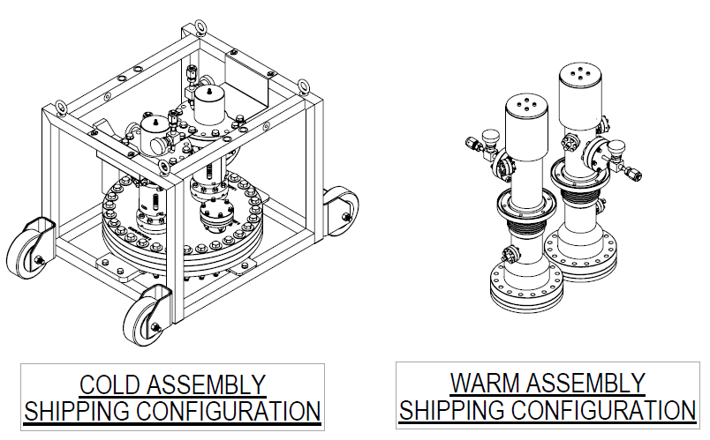
Fundamental Power Coupler (FPC) Procurement
Shipping configuration
Warm ends and cold ends arrive in separate shipping cases
Components are to be cleaned (Class 10), double bagged, nitrogen purged
Interconnecting hardware also included with each shipment

Slide 6
Fundamental Power Coupler (FPC) Procurement
Parts in Circulation (as originally planned)
Coupler cold end shipping frame and processing stand
Shipping cases
Original plan is to have 16 sets in circulation for each vendor (32 total)
Parts in circulation to be returned to vendor ASAP
Late returns will result in production delay at vendor
Additional parts in circulation (new scope, not in original plan)
Coupler cold end top hats and bellows restraints
Warm end ceramic protection, CF100 base, valve, and bellows restraint
Return of these parts early creates storage, labor, and handling issues
Difficult to store couplers with these components removed
More risk of damage to unprotected components such as ceramics and Cu plating
Top hats and bellows restraints must remain on coupler during production
Additional PIC components have ordered by SLAC for a long term solution
We are currently working through alternative storage and handling solutions

Slide 7
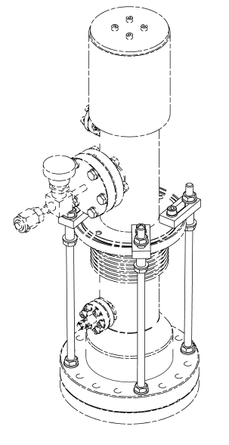
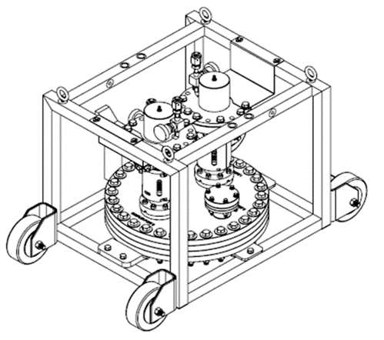
Parts in circulation

Slide 8
Planned Lifecycle of the FPCs at FNAL
Receipt of coupler shipping cases at FNAL
Incoming quality assurance checks
Storage of components until ready for use
Transport of the qualified components to production
Assembly onto cavity (cold ends) or cryomodule (warm ends)

Slide 9
Receipt of coupler shipping cases at FNAL
Delivery truck arrives IB4, skid with cases placed on floor
Remove bands and inspect cases for damage
Warm end cases will be sent to ICB
Colds end cases will be sent to MP9
Open cases and inspect for damage to internal components
Collect documents (hard copies)

Slide 10
FPC Acceptance Criteria
Acceptance Criteria Strategy
LCLSII-4.5-ES-0055-R2 is the governing Engineering Specification Document (ESD)
There is no RF qualification, couplers are not RF processed
Bake out with RGA recorded at vendor, documentation provided to SLAC for approval prior to shipment
Any deviations from the ESD during manufacturing (discrepancy reports) are reported to SLAC for acceptance or rejection
SLAC to OK shipment from vendor after receipt and analysis of data and documentation for each coupler pair
All vendor reports and data is received and stored by SLAC, accessible to partner labs if desired
Partner labs complete final incoming QC

Slide 11
Incoming quality checks, cold ends
Cold ends
Check the accuracy of the shipping documents provided
Work will be done by our cleanroom group, 1 lead and 4 technicians
Work will alternate between string assembly and incoming QC, assembly is priority
New Class 10 coupler workstation WS0 added for coupler cold end incoming inspection and installation onto cavities
Bring into MP9 Class 10 clean room per incoming inspection traveler (Vector)
Clean exterior surfaces, blow with pressurized N2 until acceptable particle counts
Visual inspection of exterior
Connect to pumping station, leak check and RGA scan of waveguide box
For internal surfaces, visual inspection, particle count at time of assembly to cavity
Discrepancies are reported to SLAC for resolution with vendor (DR)

Slide 12
Incoming quality checks, warm ends
Incoming QC at FNAL (as planned)
Warm ends
Work on warm ends is done by cryomodule assembly group, 2 leads, 5 technicians
2 technicians are currently trained for warm coupler work, more will be trained
QC when removed from double bags, and prior to installation at WS5
Inspection is part of warm coupler assembly portion of traveler for WS5
Visual inspection of exterior surfaces and sealing surfaces
Visual inspection of internal surfaces, at time of assembly at WS5
Work will be done in portable cleanrooms (2 in ICB)
Discrepancies are reported to SLAC for resolution with vendor (DR)
Vector, incoming inspection traveler (cold ends)

Slide 13
Storage of FPC components until ready for use
Store ready for use after incoming QC (as planned)
Warm end and cold ends will be stored separately
Cold ends to be stored under vacuum, inside MP9 clean room
Warm ends stored in desiccator cabinet under nitrogen purge, to prevent oxidation
Hardware to be stored in kits
There are storage issues due to mismatch of FPC delivery and installation onto cryomodules at partner labs:
Manufacturers are scheduled to deliver all couplers by as early as March 2017
Cryomodule production is not expected to be complete until May 2018
Parts in circulation (PIC) concept requires quick return of shipping cases and cold end stands, and couplers will have to be stored

Slide 14
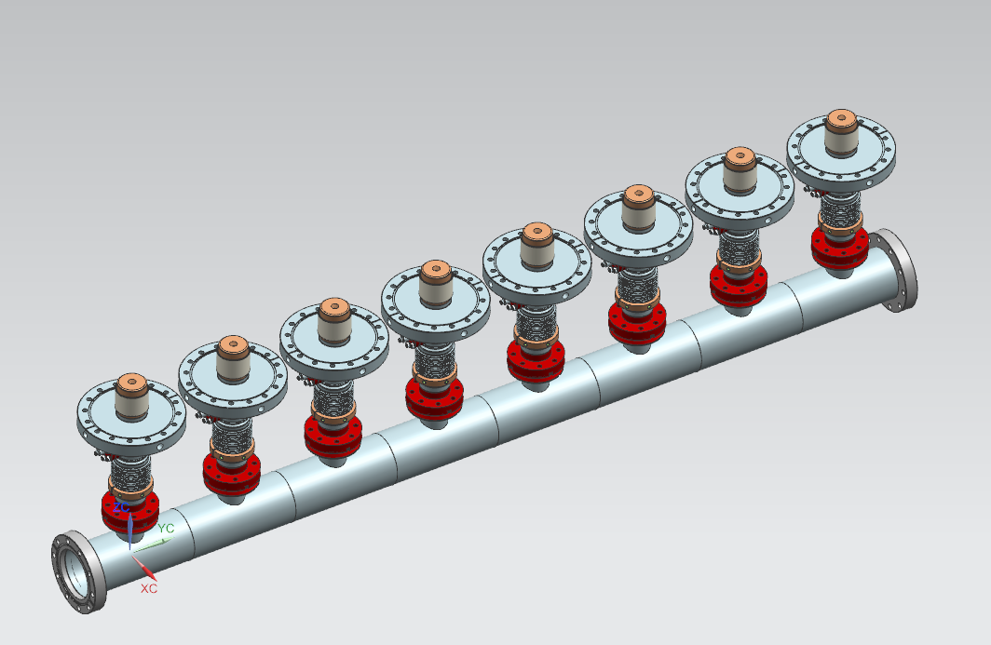
Storage, cold ends
Based on latest delivery and production schedules:
Estimated up to 90-100 cold ends will be in storage in MP9 clean room
Duration in storage could be as long as 1 year
It is desired that the cold ends should be stored under vacuum
Vacuum storage manifolds will be required for storage inside the clean room
At the end of coupler production, some coupler cold ends could be stored as shipped on the stands
A BCR has been approved for the purchase of 10 storage manifolds (80 coupler capacity)

Slide 15
Storage, warm ends
Based on latest delivery and production schedules:
Estimated up to 110-120 coupler warm ends will be in storage
Duration in storage could be as long as 1 year
Warm ends should be stored under nitrogen purge desiccator to prevent oxidation
There is one available cabinet in MP9, this cabinet can hold up to 32 warm ends
In order to provide adequate storage, 4 cabinets will be required to store 120 warm ends
3 additional cabinets are in the process of being ordered
A BCR has been approved for the purchase of 3 additional desiccator cabinets to be located in ICB

Slide 16
Summary
FPC Procurement
Deliveries
28 coupler pairs have been delivered to FNAL
Expect regular deliveries, order completed by March 2017
There will be enough couplers to meet production schedule
Parts in circulation issues
Currently the biggest challenge of the procurement
Long term solution to order additional PIC components in place by SLAC
We are working through the short term PIC and will adapt as needed
Planned Lifecycle of FPCs at FNAL
Receipt
Procedures are in place for product flow
FPC Acceptance Criteria
Acceptance criteria is clear, as defined by the ESD LCLS-II-4.5-ES-0055-R2
Primary responsibility of partner labs is to assure couplers arrive undamaged from the vendor and assure the couplers can be cleaned properly for assembly onto the cryomodule
Incoming QC
Procedures and travelers are in place to document incoming QC
Infrastructure in place to accommodate incoming QC work (WS0 and cleanrooms)
Discrepancy reports (DR) will be generated and reported to SLAC for resolution if needed
Storage
Long term storage solution for cold ends is in place, manifold design is complete, in procurement process
Short term storage solution being worked out for cold ends until manifolds are delivered
Long term storage for warm ends is in place, 3 desiccators are in procurement process
We currently have short term storage capacity for warm ends

Slide 17
The End
Thanks! Any Questions?

