Slide 1
Incoming Inspection, Qualification, QA/QC
F. Marhauser, K. Davis
1.3 GHz Cryomodule Production Readiness Review
13-14 September, 2016

Slide 2
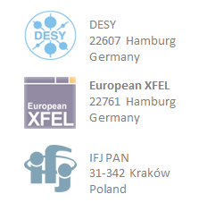
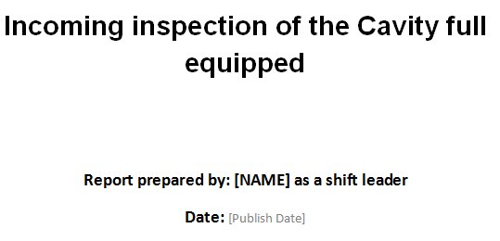
QC / Inspection Travelers
Receipt inspections are in place at both laboratories
Electronic data management system (EDMS) at FNAL and JLab:
FNAL uses Vector
JLab uses Pansophy
Partner laboratories have been and are still in communication to bring consistency to what data are and need to be covered in the database for proper QC
Basis of incoming inspection traveler was XFEL/DESY document (18 pages)

Slide 3
QC / Inspection Travelers
Cavity incoming receipt inspection has been split in 3 travelers at JLab:
Dressed Cavity Inventory Traveler
LCLS-II Cavity RF Incoming Inspection Traveler
Incoming Visual and CMM Inspection of Dressed LCLS-II Production Cavities
Revisions might be required based on experience with first articles

Slide 4
Dressed Cavity Inventory Traveler
The inventory traveler accounts for the integrity of the shipment:
Check package for damages
Check and record status of tilt- and shock watch indicators
Read and upload electronic data of accelerometer
Check existence of tuner hardware (separate or assembled to split ring)
Check existence of documentation binder (Hold Point certificates)

Slide 5
Cavity RF Incoming Inspection Traveler
The RF incoming inspection traveler checks the integrity of the cavity by means of the fundamental passband mode frequencies:
Check whether the accelerating mode pi-mode frequency is within the specified range at room temperature
Measure all 9 modes of the fundamental passband with cavity under vacuum using Vector Network Analyzer
Store and upload the data
SOTR will analyze the data by comparing with the RF result measured by the vendor sunder the same conditions → impact on field flatness can be assessed
Check the electrical integrity of all RF antennas (check whether pins are loose

Slide 6
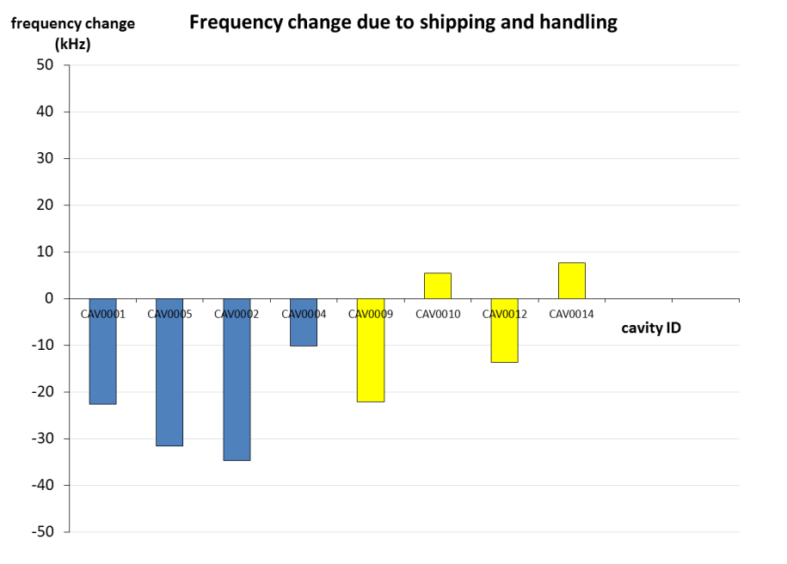
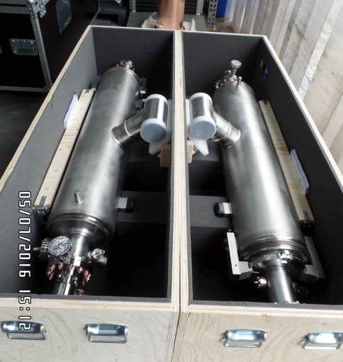
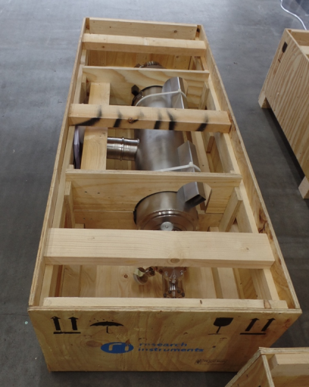
Cavity RF Incoming Inspection Traveler
RI shipped first 16 cavities in 2 shipping crate designs to test suitability for oversea shipment (note that vendors are responsible for all shipping affairs incl. crates)
Wooden crates were chosen to avoid circulation of empty boxes back to Europe
Minimize costs, boxes can be recycled/discarded
None of the cavities received at JLab were deformed
Frequency shift from before to after shipment acceptable
FNAL and JLab mutually agreed to choose 1st design (lighter, but more costly) but gave feedback to RI to further improve shock absorption → feedback also given to ZANON
1st design
2nd design
Cavities received at JLab
1st design
2nd design

Slide 7
Incoming Visual and CMM Inspection of Dressed LCLS-II Production Cavities
The incoming Visual and CMM Inspection traveler covers all steps required to visually and dimensionally accept incoming cavities
The goals of this inspection covers:
Visual inspections of the dressed LCLS-II cavity (some checks require torque wrench and caliper)
CMM inspections (restricted to accessible components on the exterior)

Slide 8
Incoming Visual and CMM Inspection of Dressed LCLS-II Production Cavities
The traveler currently contains 51 inspection steps
Serial numbers are recorded for various components (cavity, He tank, conical disc, right angle valve, beam tube flanges, high-Q fixed antenna)
Visual inspections covers external components such as 2-phase Helium pipe, conical discs, weld joints, He tank brackets and clamping pin, temporary protection shields for Helium tank bellows unit and He fill lines, damages to Helium bellows after removal of shielding, presence of protection caps, presence of filling line adapters, right angle valve, burst disc, tuner split ring and hardware and bellows restraint brackets, proper number of bolts, screws, nuts, washers on all flanges, bellows restraint brackets and split rings, check of proper torque values on all sealing flanges, number of He inlet ports of beam tube flanges, orientation of right angle valve, proper closure of right angle valve (caliper used), presence and damage to RF feedthroughs (HOMs, pick-up, high-Q antenna, i.e. check damage of inner conductors), damages to HOM coupler housings,
CMM check includes distance of cavity center to center line of 2-phase header pipe, parallelism of the 2-phase TEE, perpendicularity of main coupler to He lugs, distance between He vessel lugs, angle of He vessel lug surface to center plane of 2-phase header pipe

Slide 9
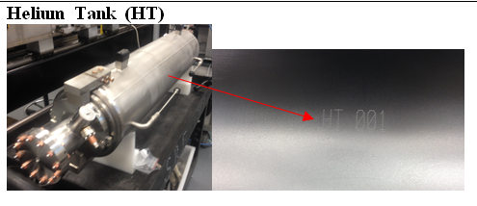
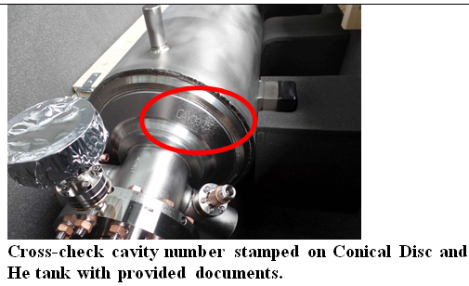
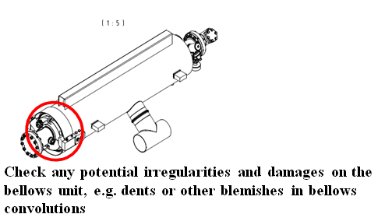
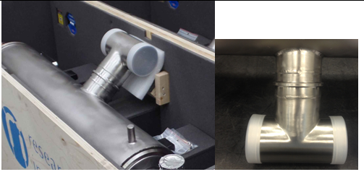
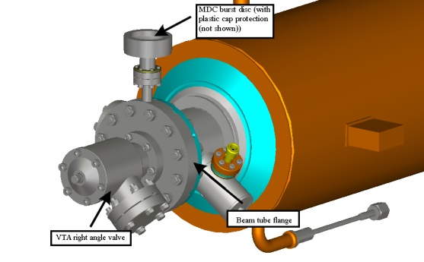
Incoming Visual and CMM Inspection of Dressed LCLS-II Production Cavities
New photos are being incorporated when becoming available replacing obsolete XFEL photos and sketches

Slide 10
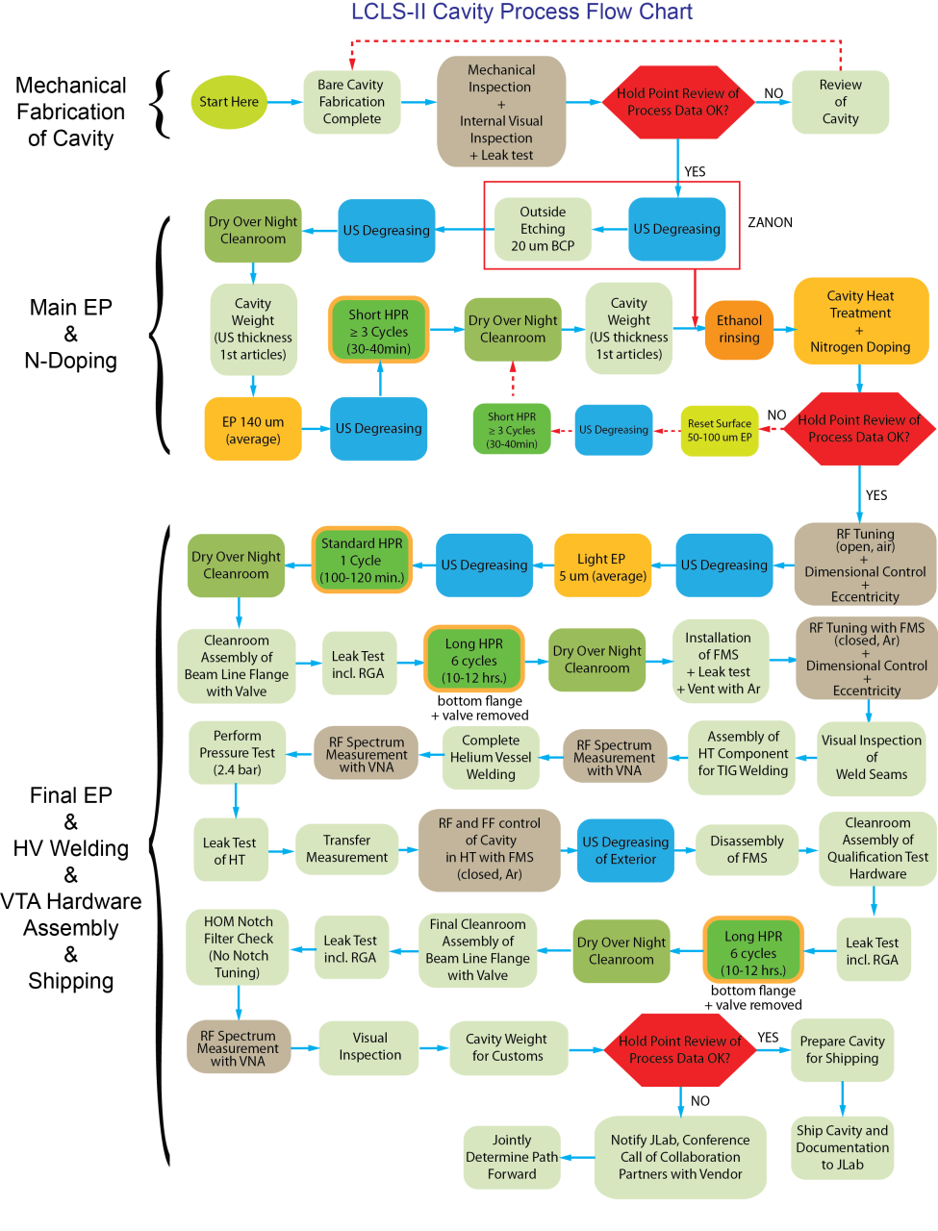
Quality Assurance and Control
Vendor change requests partially accepted
Ethanol rinsing is introduced after bulk EP
Weight of fully dressed cavity must be recorded for customs documentation/release
Added
HPR rinse times follow XFEL recipe (mitigation of field emission)
We have weekly meetings for more than 1 year with both RI and EZ to talk about production and technical issues
We now provide feedback from receipt inspections and VTA testing
Added

Slide 11
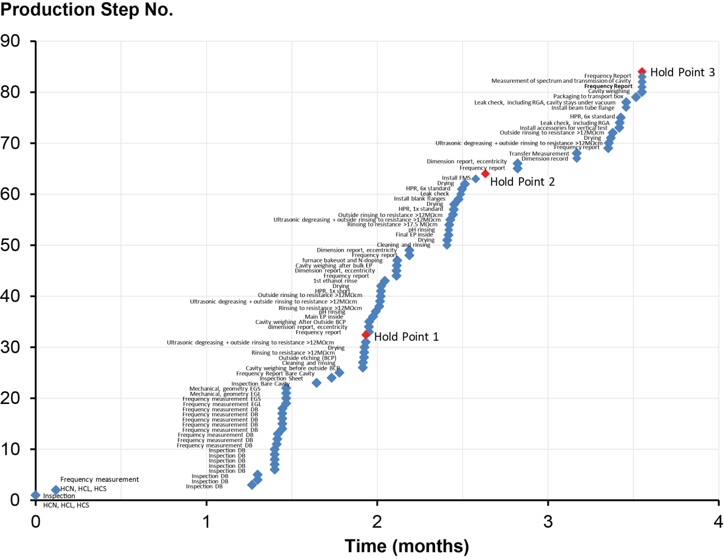
Hold Point Data Review
Vendors deliver QC documents for all main production steps reviewed at the 3 Hold Points

Slide 12
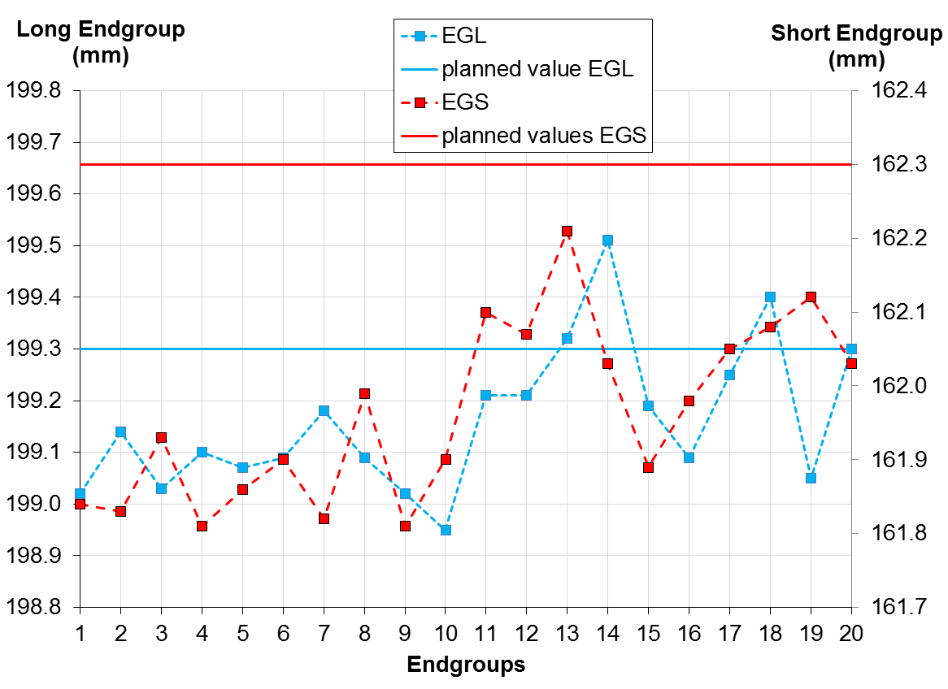
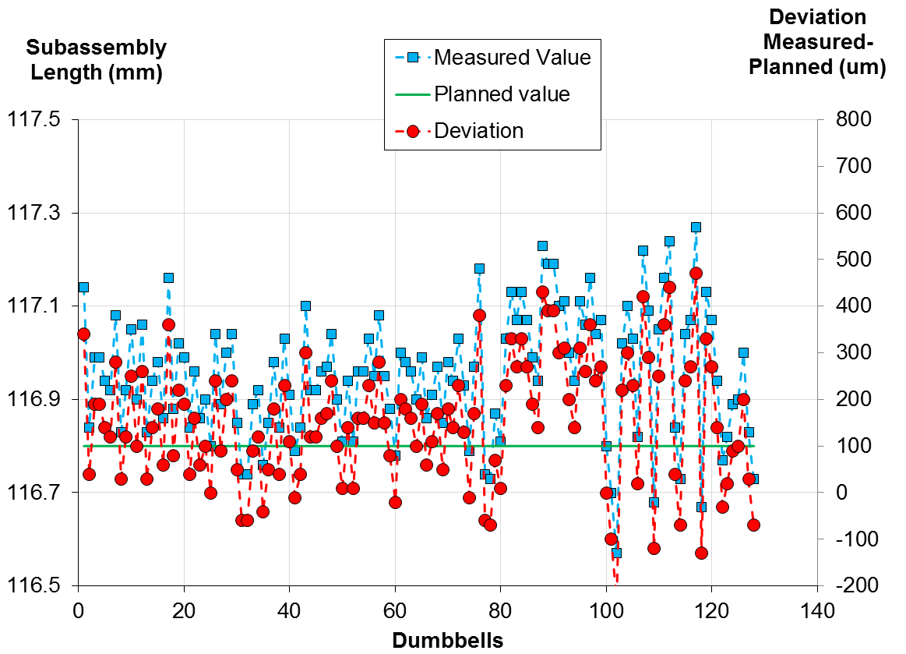
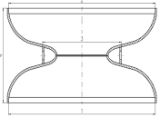
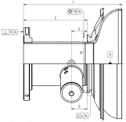
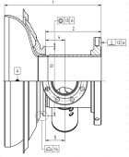
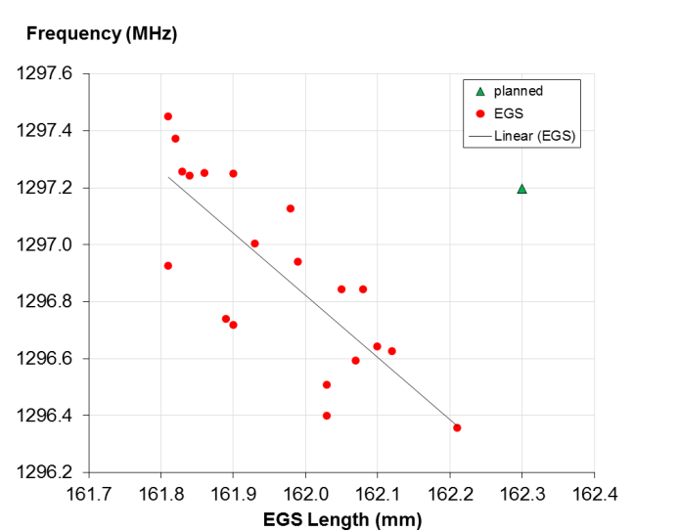
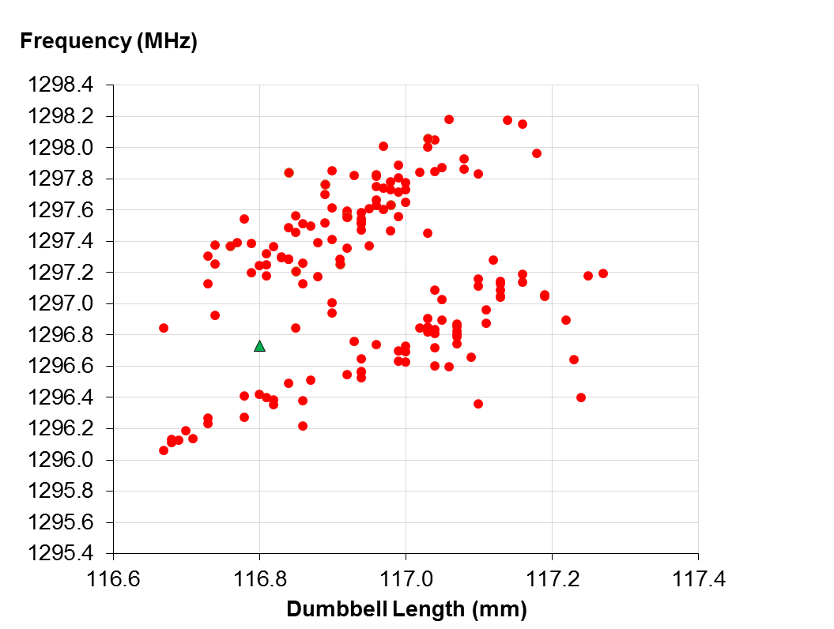
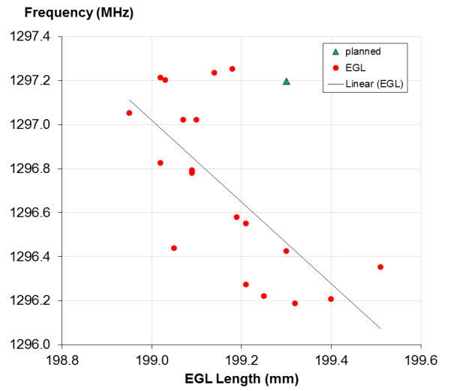
Hold Point Data 1 – Mechanical Fabrication

Slide 13
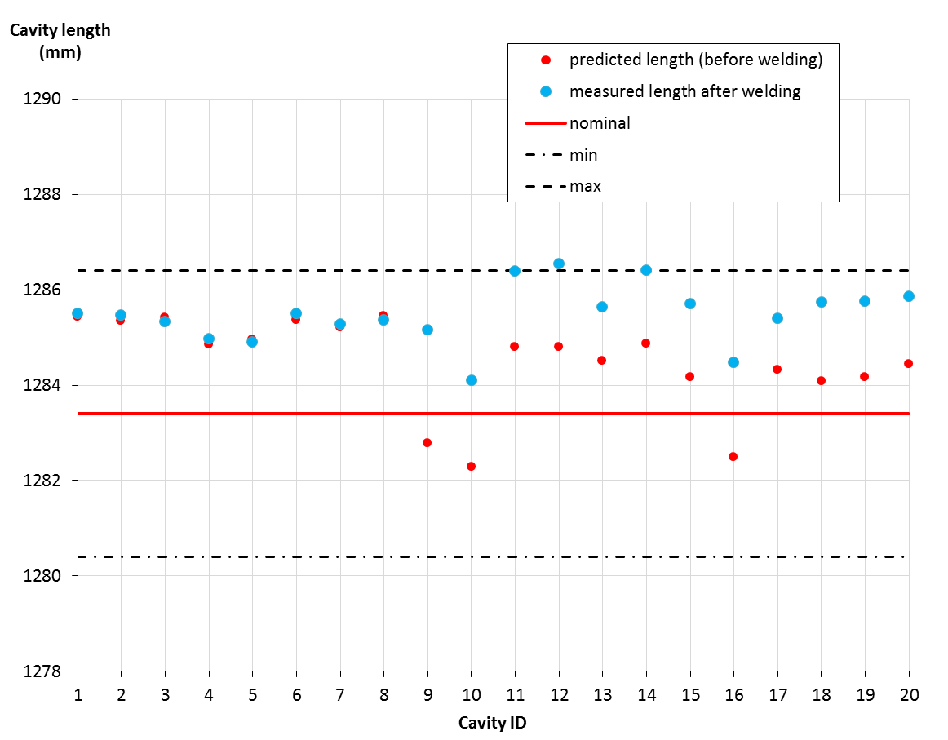
Hold Point Data 1 – Mechanical Fabrication

Slide 14
Hold Point Data 1 – Mechanical Fabrication
Cavity half cell composition
Serial No. | EGS | DB |  | DB |  | DB |  | DB |  | DB |  | DB |  | DB |  | DB |  | EGL
CAV0001 | T10266 | T10146 | T10368 | T10635 | T11008 | T10387 | T11155 | T10160 | T10357 | T10499 | T11052 | T10662 | T11058 | T10150 | T11157 | T10506 | T11056 | T10569
CAV0002 | T10430 | T10425 | T10714 | T10355 | T10612 | T10640 | T11092 | T10707 | T11189 | T10486 | T10526 | T10373 | T10541 | T10443 | T10656 | T10184 | T10450 | T10032
CAV0003 | T10437 | T10189 | T10413 | T10228 | T10458 | T10712 | T11149 | T10599 | T11147 | T10672 | T11059 | T10224 | T10426 | T10359 | T10555 | T10358 | T10388 | T10291
CAV0004 | T10246 | T10145 | T11050 | T10374 | T10720 | T10671 | T11191 | T10360 | T10598 | T10308 | T10367 | T10665 | T11197 | T10077 | T10414 | T10493 | T10501 | T10281
CAV0005 | T10457 | T10488 | T10726 | T10438 | T10514 | T10079 | T10411 | T10375 | T10495 | T10773 | T11160 | T10191 | T11005 | T10348 | T10732 | T10177 | T10999 | T10628
CAV0006 | T10260 | T10608 | T11001 | T10455 | T10771 | T10610 | T11012 | T10504 | T10995 | T10448 | T10654 | T10500 | T11352 | T10099 | T10362 | T10502 | T11101 | T10899
CAV0007 | T10420 | T10489 | T10636 | T10365 | T10670 | T10372 | T10527 | T10069 | T10307 | T10226 | T10449 | T10363 | T10709 | T10116 | T10338 | T10507 | T11162 | T10898
CAV0008 | T10262 | T10062 | T10484 | T10553 | T11152 | T10427 | T10515 | T10085 | T11089 | T10436 | T10638 | T10595 | T11187 | T10091 | T10491 | T10371 | T10519 | T10317
CAV0009 | T10257 | T10096 | T10370 | T10485 | T10545 | T10415 | T10520 | T10377 | T11208 | T10383 | T11190 | T10361 | T10646 | T10340 | T10605 | T10439 | T10642 | T11112
CAV0010 | T10410 | T10081 | T10172 | T10038 | T10175 | T10068 | T10302 | T10196 | T10522 | T10064 | T10607 | T10090 | T10660 | T10083 | T10716 | T10094 | T10597 | T10616
CAV0011 | T10275 | T10772 | T10985 | T10084 | T10440 | T10023 | T10304 | T10021 | T10998 | T10098 | T10339 | T10461 | T10774 | T10652 | T11049 | T10073 | T10259 | T10132
CAV0012 | T10271 | T10066 | T10364 | T10037 | T11323 | T10009 | T10269 | T10092 | T11164 | T10667 | T11002 | T10147 | T10994 | T10174 | T11188 | T10462 | T10643 | T10300
CAV0013 | T11009 | T10022 | T11156 | T10058 | T11151 | T10724 | T11148 | T10554 | T11011 | T10188 | T11051 | T10342 | T10609 | T10346 | T10647 | T10093 | T11013 | T10323
CAV0014 | T11097 | T10655 | T11010 | T10552 | T11158 | T10199 | T10487 | T10169 | T11087 | T10176 | T10337 | T10117 | T10382 | T10195 | T10497 | T10017 | T10442 | T10848
CAV0015 | T10309 | T10167 | T11098 | T10645 | T11166 | T10719 | T10993 | T10155 | T10380 | T10020 | T10310 | T10024 | T10494 | T10551 | T11006 | T10089 | T10496 | T10280
CAV0016 | T10252 | T10144 | T10183 | T10376 | T10717 | T10118 | T10713 | T10018 | T10596 | T10097 | T10639 | T10385 | T10711 | T10516 | T10710 | T10087 | T10603 | T10618
CAV0017 | T10244 | T10498 | T11161 | T10095 | T11349 | T10540 | T11000 | T10492 | T10708 | T10661 | T11060 | T10723 | T11090 | T10173 | T11055 | T10444 | T10531 | T10287
CAV0018 | T10242 | T10143 | T11125 | T11704 | T11778 | T11402 | T11924 | T11712 | T11745 | T11448 | T11801 | T11616 | T11948 | T11467 | T11813 | T11557 | T11675 | T10034
CAV0019 | T10267 | T10225 | T11054 | T11723 | T11726 | T11392 | T11660 | T11601 | T11837 | T11484 | T11766 | T11403 | T11684 | T11564 | T11847 | T11476 | T11902 | T10055
CAV0020 | T10270 | T11418 | T11873 | T10178 | T10617 | T11443 | T11769 | T11510 | T11762 | T11477 | T11676 | T11396 | T11661 | T11455 | T11756 | T11705 | T11866 | T10838

Slide 15
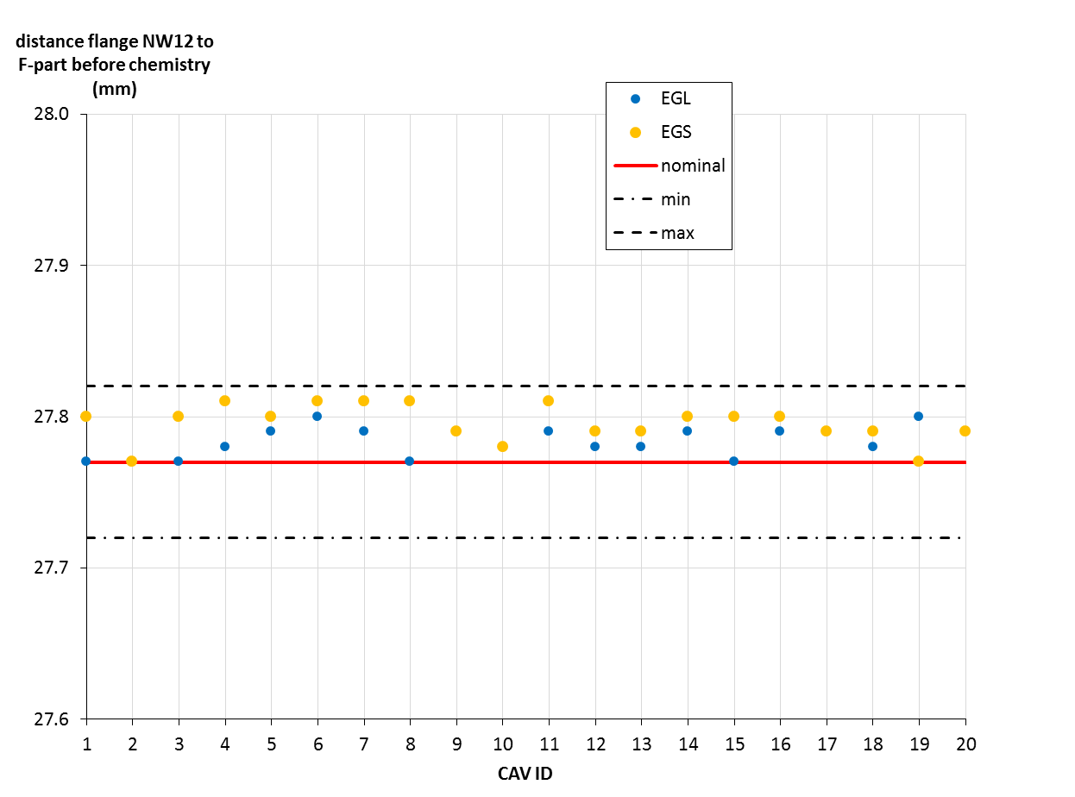
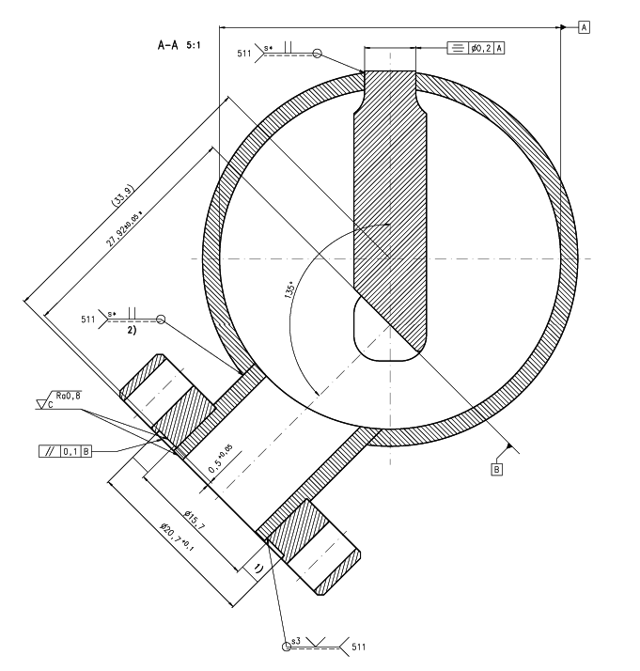
Hold Point Data 1 – Mechanical Fabrication
before chemistry

Slide 16
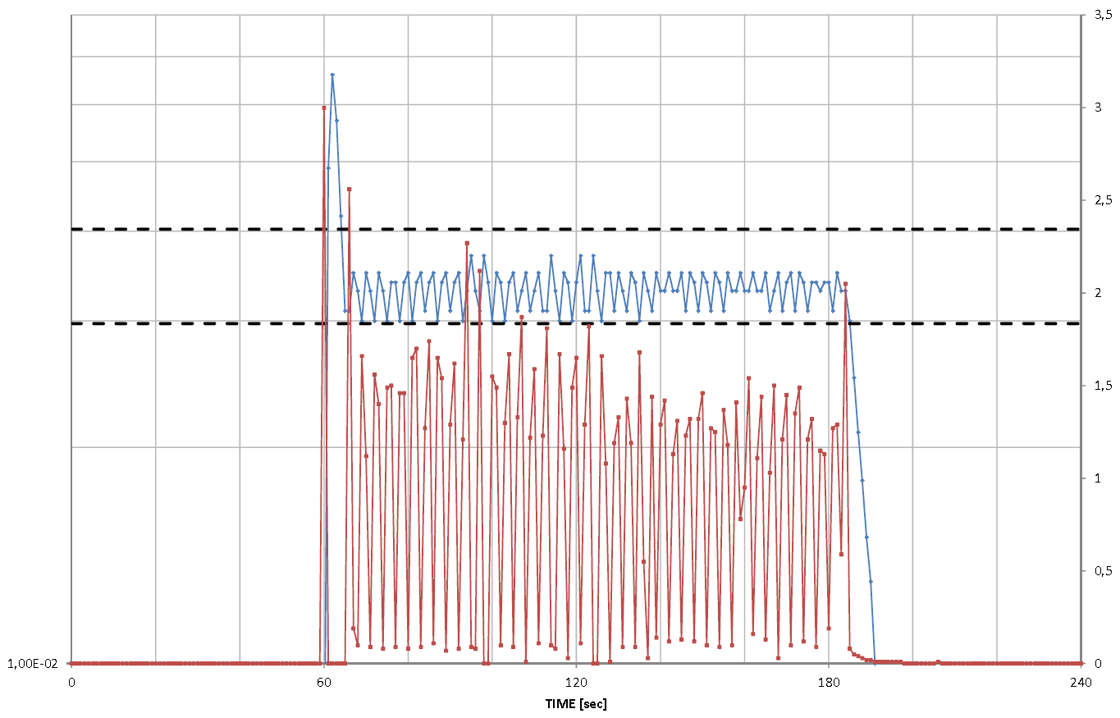
Hold Point Data 2 – After N-Doping
N-Doping of multiple cavities in furnace (so far 2 cavities at a time in furnace)
N-Pressure (mbar)
mass flow (l/sec)
Temperature (deg. C)
N-Pressure (mbar)
8e-2
3.5
7e-2
6e-2
2 minutes N-doping
3
+/- 15 % pressure limits
5e-2
4e-2
2.5
2 minutes N-doping
2
3e-2
6 min. at 800 deg. C
1.5
2e-2
1
0.5
1e-2
0
CAV0001 & CAV0002
26 mTorr = 0.0347 mbar
CAV0200 & CAV0201

Slide 17
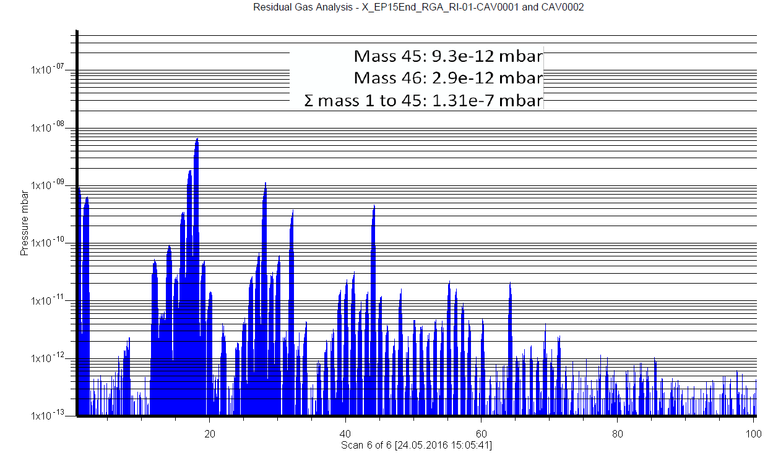
Hold Point Data 2 – After N-Doping
Residual Gas Analysis
Partial pressure for any mass > 45 should be at least 300x smaller than sum of peaks of partial pressures up to mass 45 (reference)
Pressure (mbar)
Pressure (mbar)
RGA_end
Reference = 1.49e-7 mbar
RGA_end
Reference = 1.31e-7 mbar
300 x smaller than reference
300 x smaller than reference
1000 x smaller than reference
1000 x smaller than reference
AMU
AMU
CAV0200 & CAV0201
CAV0001 & CAV0002

Slide 18
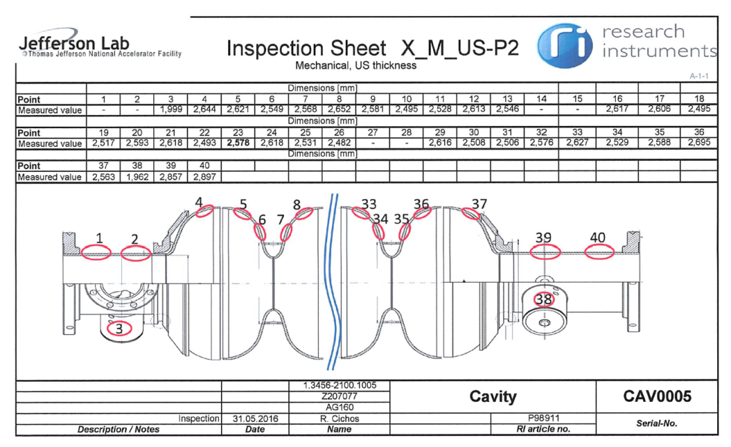
Hold Point Data 2 – Before and After bulk EP (1st Articles)
Wall thickness measurements before and after bulk EP
New compared to XFEL recipe, but so far limited to 1st articles only
Reason is to understand
1) Actual removal at equators given that EP is controlled by removal by weight/integrated current
2) Differential removal from equator to iris/beam tubes
3) Gain insight into process volatilities, e.g. variable removal along cavity cells

Slide 19
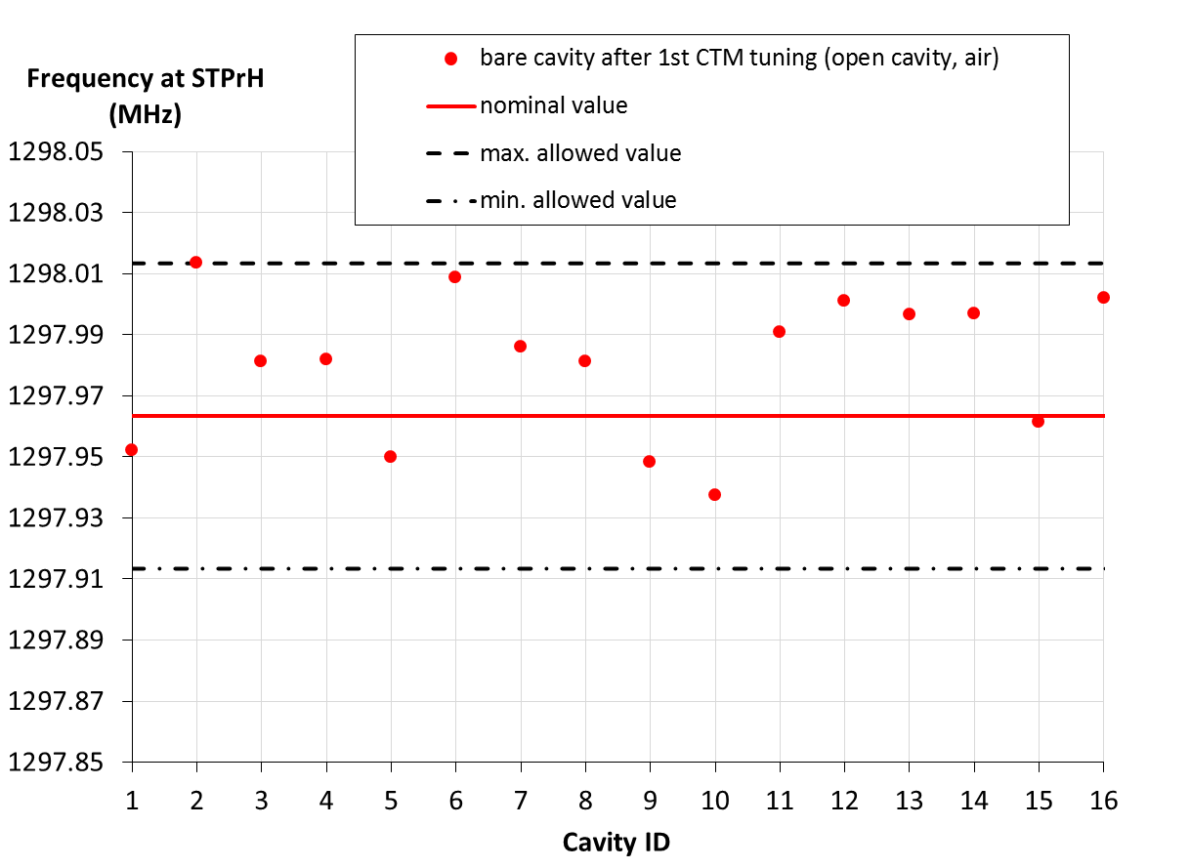
Hold Point Data 3 – After Completion of Fully Dressed Cavity
Cavity frequency of bare cavity after 1st bench tuning (after bulk EP/N-doping)

Slide 20
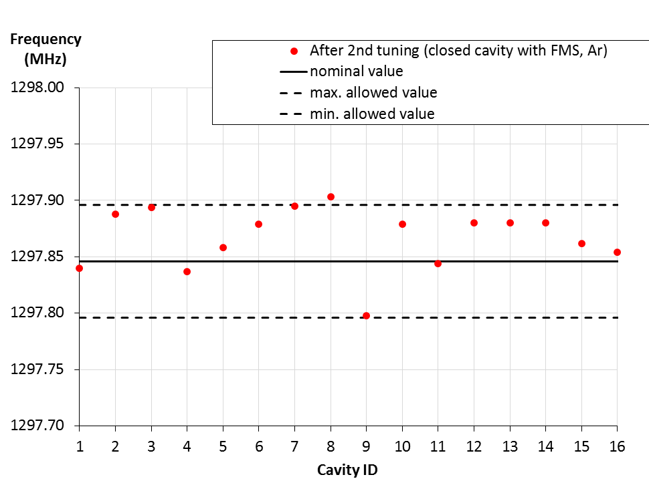
Hold Point Data 3 – After Completion of Fully Dressed Cavity
Cavity frequency of bare cavity after 2nd bench tuning (after final EP)

Slide 21
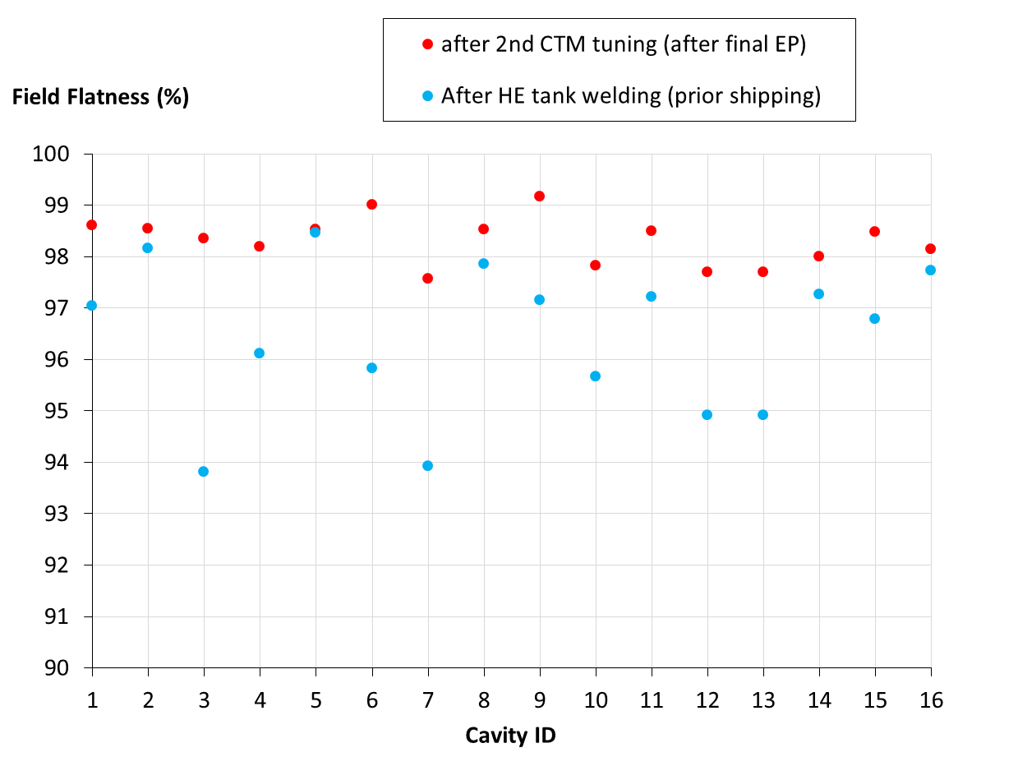
Hold Point Data 3 – After Completion of Fully Dressed Cavity
Field Flatness – Requirement ≥ 90% after completion (98% after 2nd tuning)

Slide 22
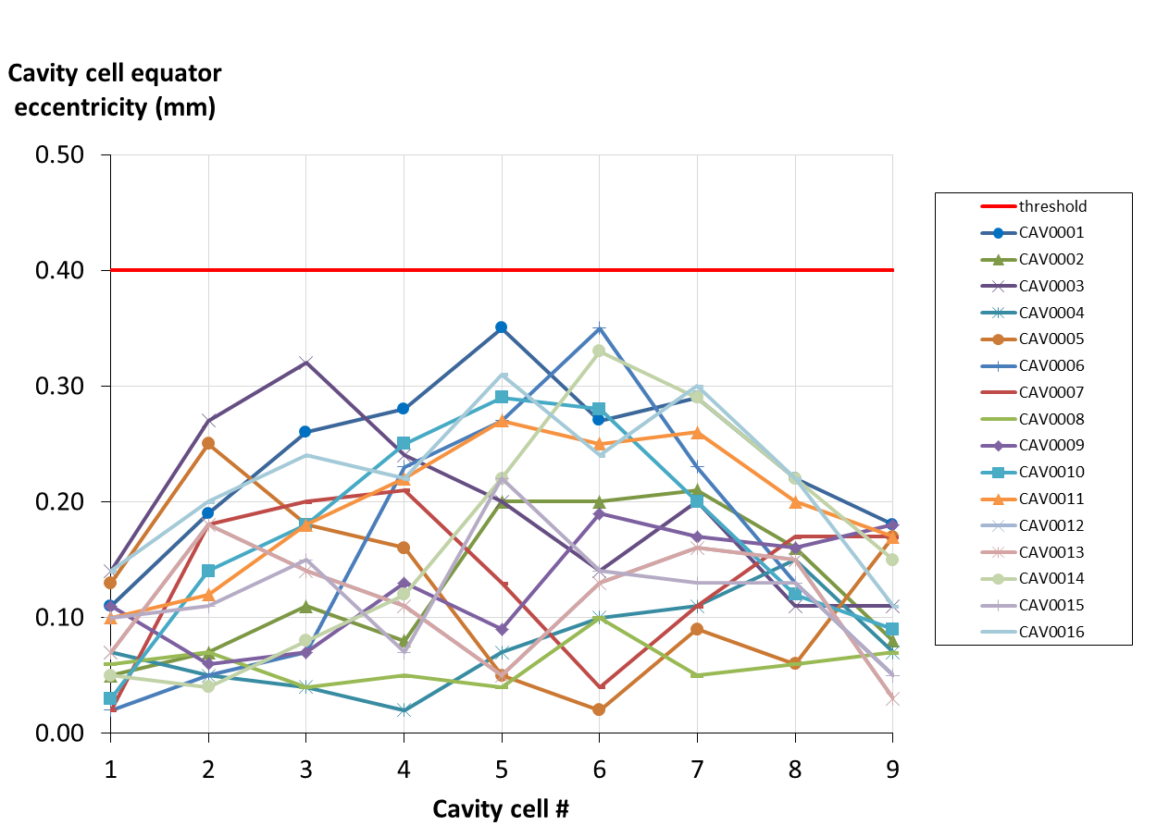
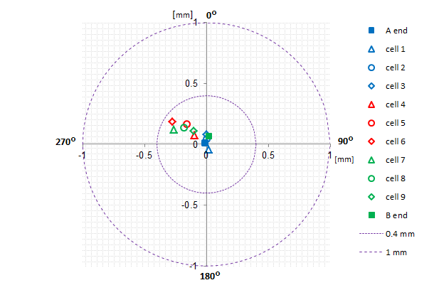
Hold Point Data 3 – After Completion of Fully Dressed Cavity
Eccentricity of cells

Slide 23
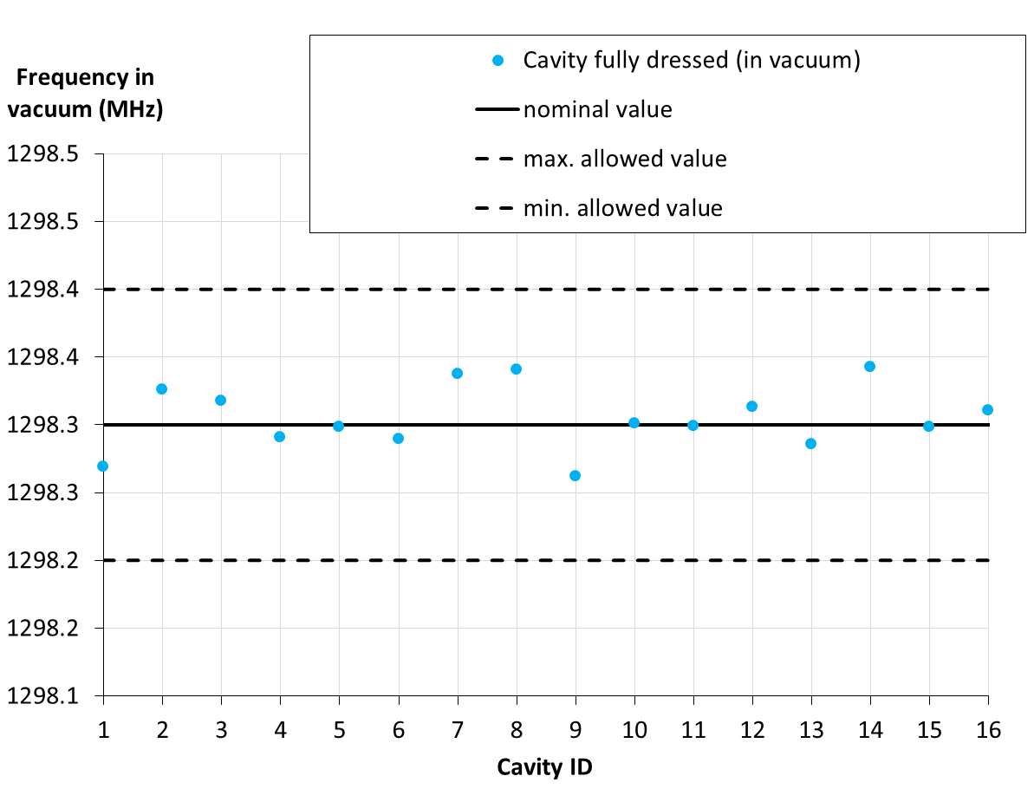
Hold Point Data 3 – After Completion of Fully Dressed Cavity
Frequency in vacuum after helium tank welding (before shipment)

Slide 24
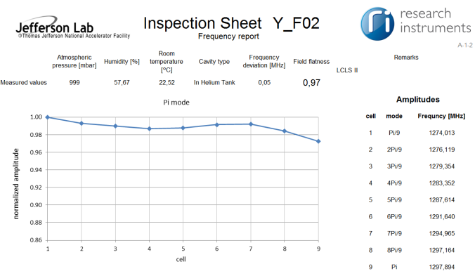
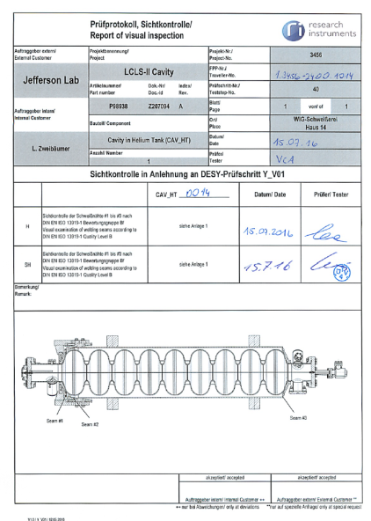
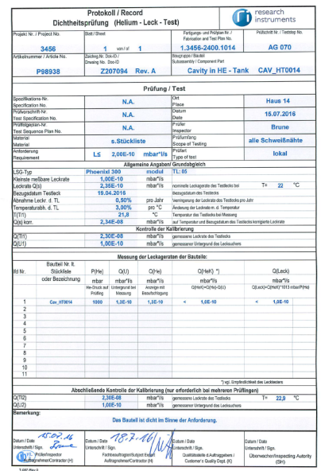
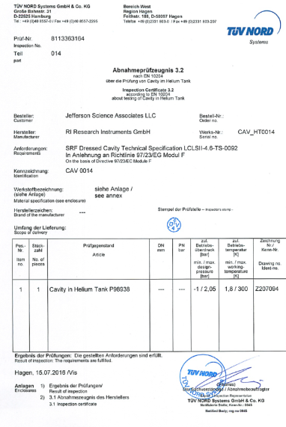
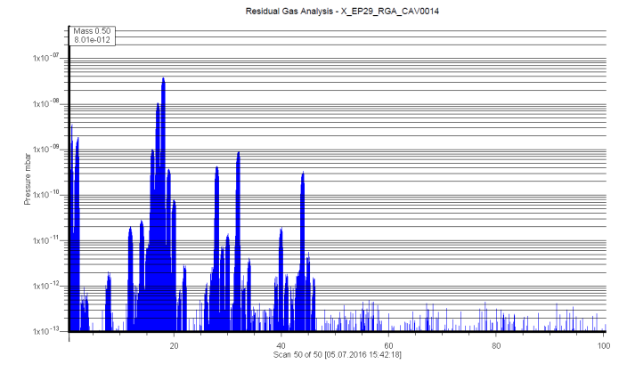
Hold Point Data 3 – After Completion of Fully Dressed Cavity
Includes e.g. Helium leak checks, RGA spectra (before after final HPR), HPR details, drying time, US degreasing to spec'd rinsing resistance, dimensional and frequency reports (field flatness, passband modes), cavity cell eccentricity measurement, transfer measurements, pressure test and report of visual inspection of welding seams (TPI), cavity weighing

Slide 25
QC Hold Point Status per 8/17/2016
Hold Point 1
Bare cavity after mechanical fabrication
Cavity # | Hold Point 1 release | Hold Point 2 release | Hold Point 3 release
1 | YES | YES | YES
2 | YES | YES | YES
3 | YES | YES | YES
4 | YES | YES | YES
5 | YES | YES | YES
6 | YES | YES | YES
7 | YES | YES | YES
8 | YES | YES | YES
9 | YES | YES | YES
10 | YES | YES | YES
11 | YES | YES | YES
12 | YES | YES | YES
13 | YES | YES | YES
14 | YES | YES | YES
15 | YES | YES | YES
16 | YES | YES | YES
17 | YES | No data received yet | No data received yet
18 | YES | No data received yet | No data received yet
19 | YES | No data received yet | No data received yet
20 | YES | No data received yet | No data received yet
Hold Point 2
Bare cavity after main EP and N-doping
Hold Point 3
Fully dressed cavity after post- processing just before shipping

Slide 26
QC Hold Point Status per 8/25/2016
Hold Point 1
Bare cavity after mechanical fabrication
Cavity # | Hold Point 1 release | Hold Point 2 release | Hold Point 3 release
1 | YES | YES | No data received yet
2 | YES | YES | No data received yet
3 | YES | YES | No data received yet
4 | YES | YES | No data received yet
5 | YES | YES | No data received yet
6 | YES | YES | No data received yet
7 | YES | YES | No data received yet
8 | YES | YES | No data received yet
9 | YES | No data received yet | No data received yet
10 | YES | No data received yet | No data received yet
11 | YES | No data received yet | No data received yet
12 | YES | No data received yet | No data received yet
13 | YES | No data received yet | No data received yet
14 | YES | No data received yet | No data received yet
15 | YES | No data received yet | No data received yet
16 | YES | No data received yet | No data received yet
Hold Point 2
Bare cavity after main EP and N-doping
Hold Point 3
Fully dressed cavity after post- processing just before shipping

Slide 27
Jefferson Lab Vertical Test Area
Eight Vertical Dewars
Radiation Shielding (6/8)
Magnetic shielding and compensation coils (7/8)
Over 4400 vertical cavity tests since 1995
LHe supply 150L/hr steady state (450 L/Hr short-term)
Recent upgrade projects:
PLC-based cryo controls
Digital LLRF systems
1300 MHz RF Power Amps

Slide 28
LCLSII Production Cavity Vertical Acceptance Testing
Day 1: - External cleaning and pass into Cleanroom
- Mount the cavity to vertical test stand
- Establish test stand vacuum and open cavity isolation valve (actively pumped during RF test)
Day 2: - Leak check
- Transfer to Vertical Staging Area (VSA)
- Mount temperature sensors and magnetic sensors (as required)
- Cool 4K (p.m. fully automated)
Day 3: - Cool 2K (Automated, but with operator monitoring)
- HOM survey using VNA, Matlab curve fitting software
- High Power RF test
- Warm up
Day 4: - Warm up
Day 5: - Remove cavity from dewar (a.m.), next cavity loads (p.m.)

Slide 29
LCLSII Production Cavity Vertical Acceptance Testing
Work flow & throughput
Goal: qualify eight cavities every 5 weeks
Schedule: Test 2 to 3 cavities per week, 30% fail/rework
Schedule risk mitigation –
Two dewars are qualified for LCLSII 9-cell testing (D7 & D8). We could investigate using D3 and D4 (275 cm vs 336 cm).
D7 and D8 can each support two tests per week (3 days per test cycle, warmups can occur over weekends and unattended).
Cryo plant is shared between cryomodule test and vertical test
Cryomodule cooldowns are scheduled for weekends
Careful cryo coordination between CMTF and VTA is required
Availability of cryo plant could be mitigated by testing at other labs

Slide 30
Cavity Delivery Schedule
Schedule for delivery of 133 Cavities
First eight production cavities (RI) at Jlab
Eight more scheduled during Sept at Jlab (EZ).
4 cavities per week Oct 16 through mid-Feb 17.
8 cavities per week mid-Feb 17 through mid-Apr 17.
4 cavities per week May 17 through June 17
Assemble one string (8 cavities) every 5 weeks
Qualified cavities not needed for the next string assembly will be valved out under vacuum, bagged and stored outside the cleanroom in their original shipping containers
Parts in Circulation Plan
50% of cavity total PIC allotted based on 5 wk/CM
PIC returned to vendor after string assembly

Slide 31
VTA Performance Summary for JLab’s Production Cavities (Status 9/10/2016)
Cav. SN | Initial FE onset (MV/m) | Q₀ at 2K at 16 MV/m | Final E_{max} (MV/m) | Final Q₀ at E_{max} | Final radiation max | Comment
0005 | No FE | 2.2e10 | 16.4 | 2.2e10 | 0.001 mR/h | Quench Limited
0002 | No FE | 2.6e10 | 24.2 | 2.6e10 | 0.006 mR/h | Post degauss of HV Admin Limited
0001 | No FE | 2.3e10 | 24.1 | 1.7e10 | 0.001 mR/h | Admin Limited
0004 | No FE | 2.5e10 | 21.0 | 2.5e10 | 0.004 mR/h | Cable BD limited 21 MV/m
0009 | No FE | 2.7e10 | 17.1 | 2.7e10 | 0.001 mR/h | Quench limit 17.1 MV/m
0012 | No FE | 2.7e10 | 22.1 | 2.7e10 | 0.001mR/h | Cable BD limited 22.1 MV/m
0010 | No FE | 3.0e10 NbTi flange | 23.0 | 2.1e10 | 983 mR/h | Radiation limited, plan to re-rinse, retest 9/16
0014 | No FE | 2.7e10 | 24.0 | 2.7e10 | 0.001 mR/h | Admin limited
Average |  | 2.5e10 SS only | 20.8 | 2.4e10 SS only |  | Stainless Steel flange averages
Acceptance criteria:
Min. E_{acc} = 19 MV/m
Field emission onset
> 17.5 MV/m
Q₀ = 2.5e10 @ 16 MV/m
(with SS flange hardware,
equals ~2.7e10 without flange losses)
Fully Qualified, no NCRs
NCR: Use As Is, no rework planned
NCR open,
rework/retest planned

