Slide 1
Incoming inspection, Qualification, QA/QC LCLSII FPC at JLAB
Mircea Stirbet
LCLS-II CM Production Readiness Review
13 – 14 September, 2016

Slide 2
Outline
LCLSII FPC Configuration
Work at JLAB on LCLSII PFC
Resources allocated for LCLSII FPC at JLAB
LCLSII travelers and procedures
Cold FPC incoming inspection and storage
Warm FPC incoming inspection and storage
FPC qualification for string / cavity assembly
LCLSII FPC preparation and RF power tests on HTB
String cold coupler assembly
Cryo-module warm coupler assembly
Actual LCLSII FPC status at JLAB
FPC delivery schedule
Conclusions

Slide 3
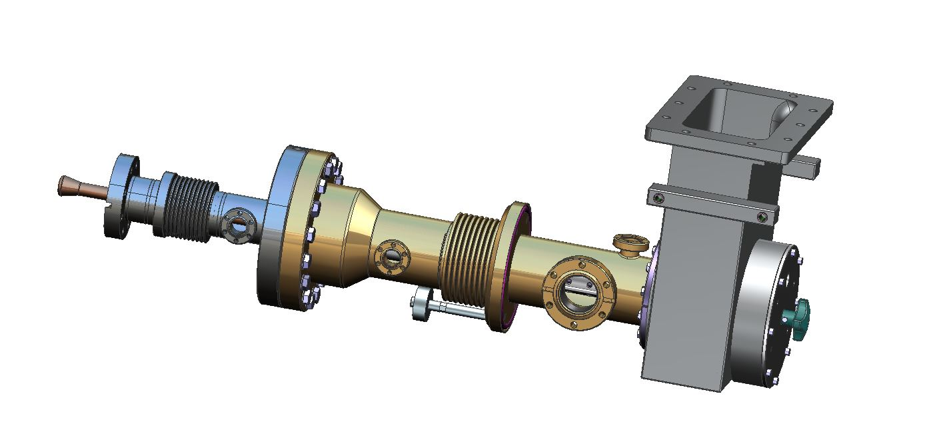
LCLSII FPC Configuration
LCLSII FPC Waveguide
LCLSII FPC Cold Part
FPC Instrumentation:
5 and 50K heat sinks
temperature sensors
Electron probes
Arc detectors in the warm part
Arc detector on FPC waveguide
One ionic pump for 8 warm couplers
One vacuum gauge for 8 warm couplers
LCLSII FPC Warm Part
LCLSII FPC manual antenna actuator

Slide 4
LCLSII FPC Configuration cont.
FPC waveguide
FPC warm part (including the pushrod and FPC manual antenna actuator)
FPC cold part (including cold bellows protection, 5 and 50K heat sinks, “Berry” bolts)
FPC parts vacuum related: vacuum lines, T junction, bellows, vacuum valves, ionic pump and vacuum gauge
FPC “orphan” parts: FPC super-insulation, FPC waveguide brackets, hardware

Slide 5
Resources allocated for LCLSII FPC at JLAB
Space/Infrastructure: inside and /or outside clean room
Tools and instrumentation for incoming inspection (vacuum pumping system with slow pumping down and controlled bleeding up capabilities, particulate counter, dry, filtered, particulate free nitrogen supply and ionized nitrogen gun, clean room tools, clean room stands and wired carts, clean room desiccators).
Man power – from Cavity Assy Group and CM Assy Group. Work on couplers needs at least one full time trained clean room technician for work related with cold parts and another full time technician for work on warm parts of the couplers. Partial time of other JLAB staff members are required for activities (FPC receiving / shipment , chem. technicians, procurement).
Training – revised procedures, lessons learned, HTB experience, pCM string experience.

Slide 6
Work at JLAB on LCLSII PFC
Starts in SRF Institute storage area: receiving FPC pairs, FPC waveguides, other parts related with FPC assembly on cryo-module.
Chem area: preparation of test stands with cold parts for clean room admission.
Clean room (for cold parts) incoming inspection, cold coupler long term storage, cold coupler preparation for and assembly on cavity, preparation for shipment of FPC test stands and other PIC.
Outside clean room (for warm parts): incoming inspection , warm part long term storage, warm part coupler preparation for installation on cryo-module preparation for shipment of warm PIC.
Ends also in SRF Institute storage area: PIC shipment back to vendors to keep LCLSII FPC production going on for the next 6 months.

Slide 7
LCLSII FPC travelers and procedures
Dedicated FPC receiving travelers used to record the vendor, data of arrival, status of shipment crates, completeness of shipment package list. One receiving traveler is used for FPC waveguides, and other receiving traveler is used for FPC pairs.
This information is also used when preparing PIC shipping back to vendors.
Cold FPC incoming inspection traveler and associated procedure.
Procedure for Warm FPC assembly on cryo-module. In LCLSII CM traveler, 16 steps for each of the 8 assembled couplers are recorded.

Slide 8
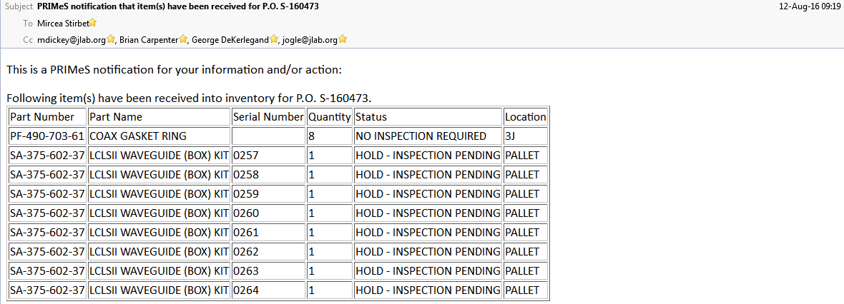
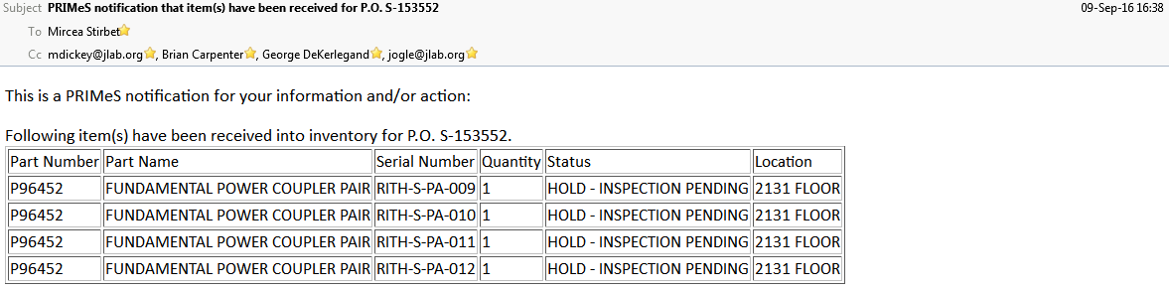
Receiving LCLSII FPC parts at JLAB

Slide 9
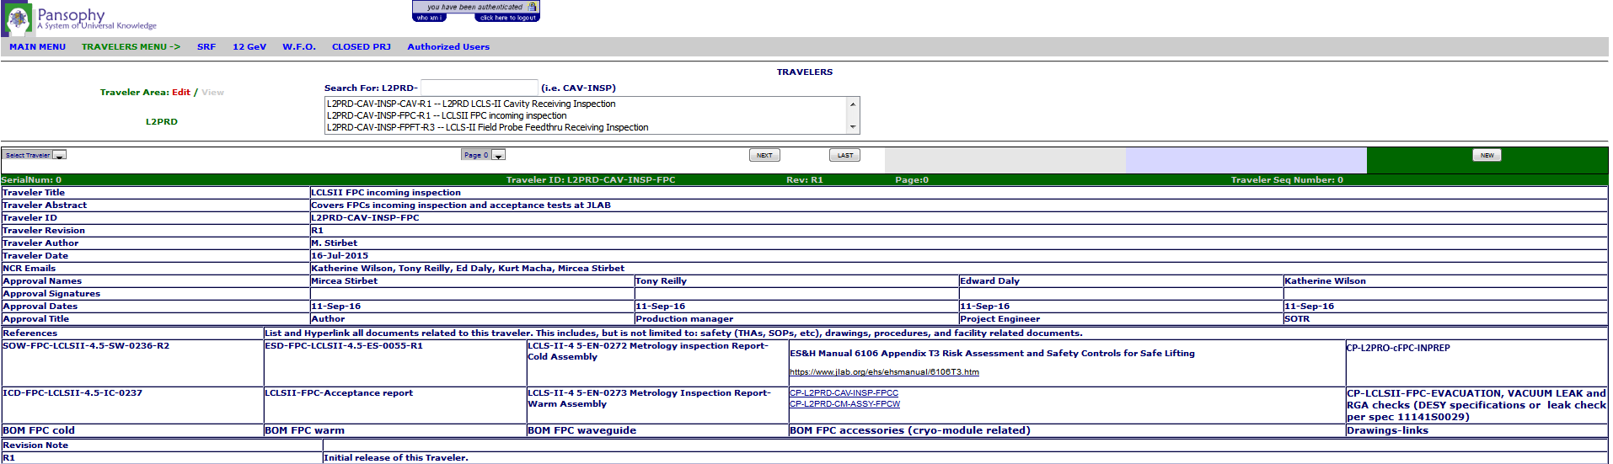
Travelers and procedures for LCLSII FPC at JLAB

Slide 10
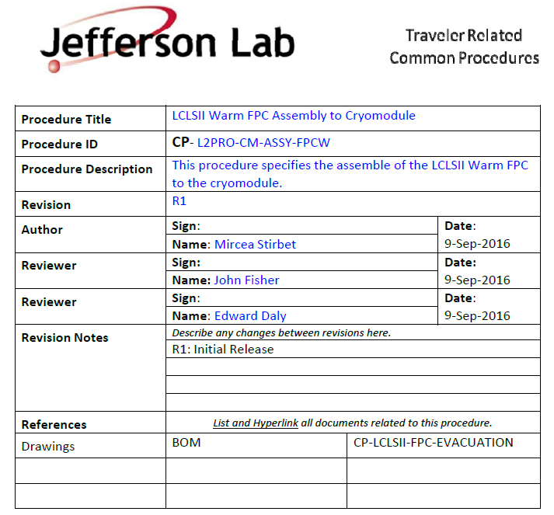
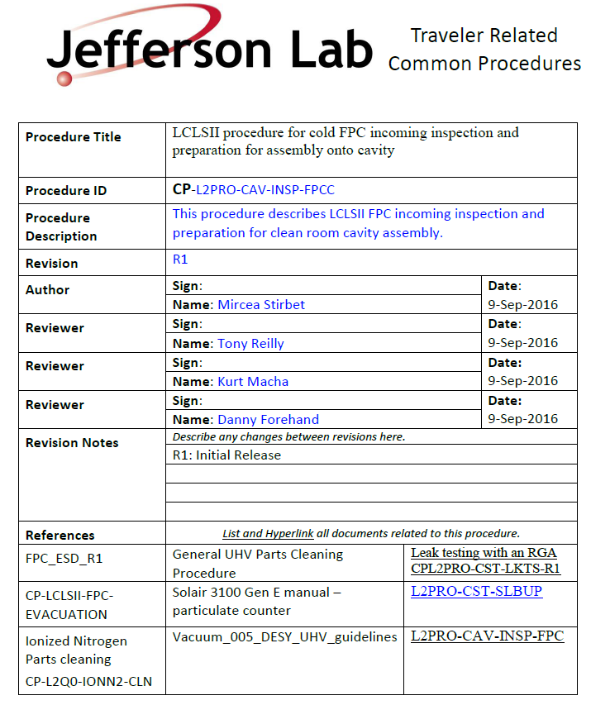
Travelers and procedures for LCLSII FPC at JLAB

Slide 11
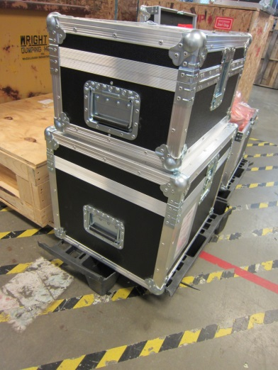
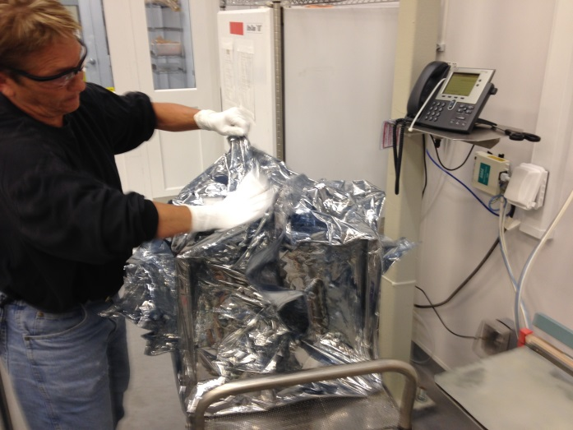
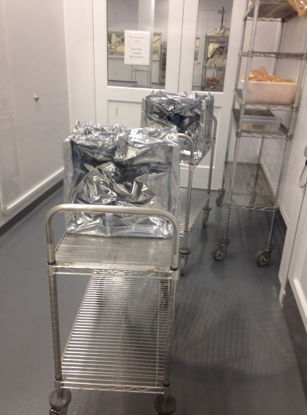
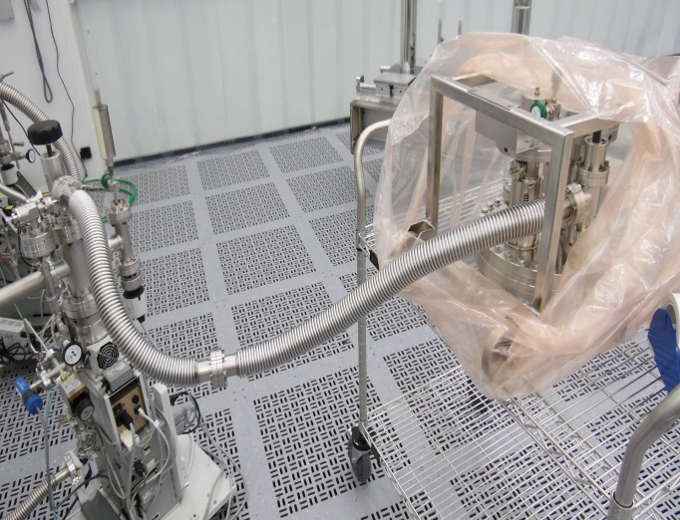
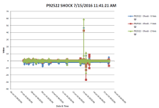
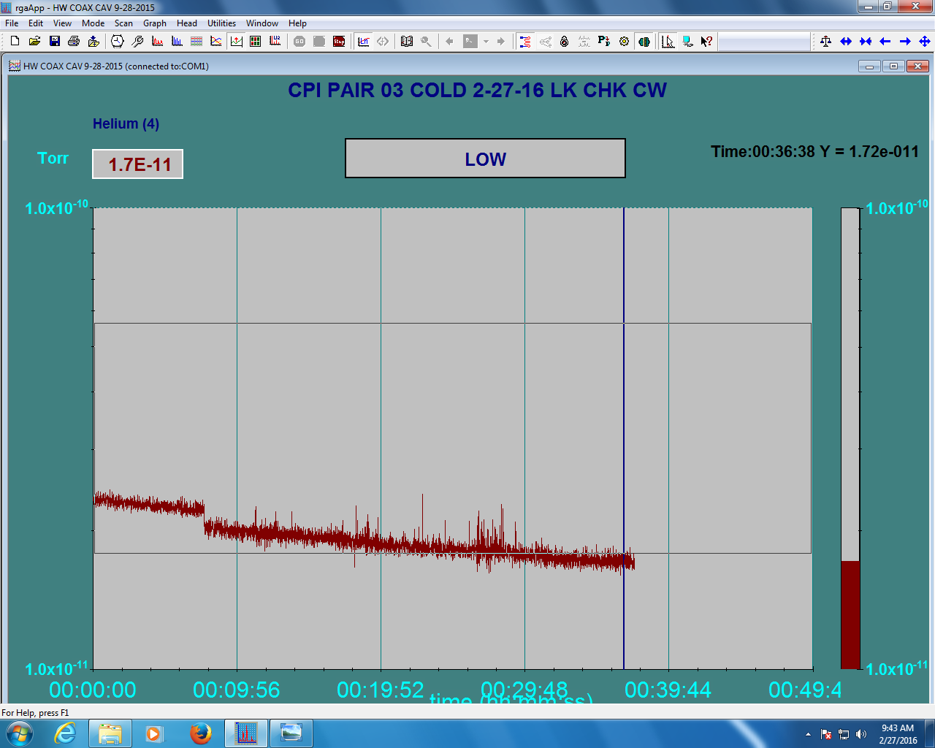
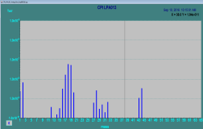
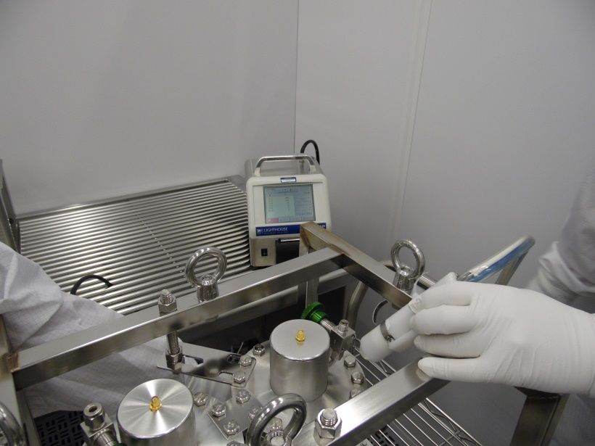
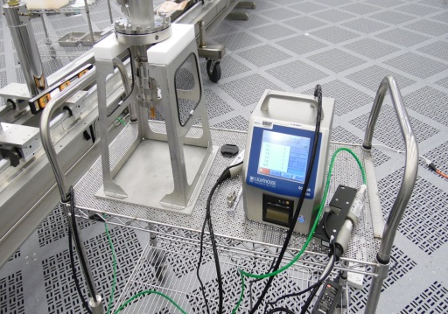
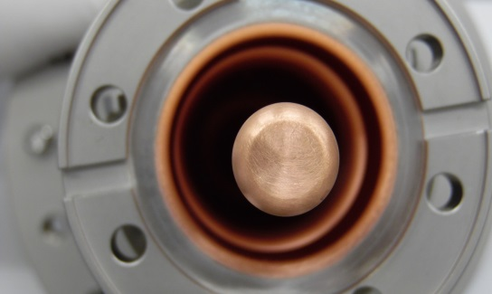
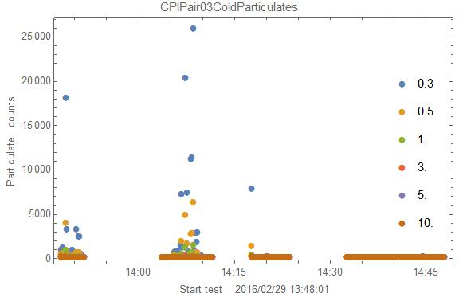
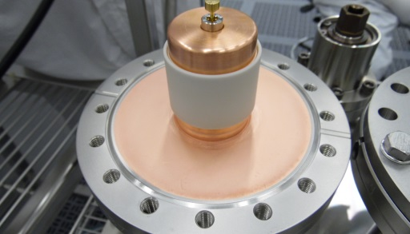
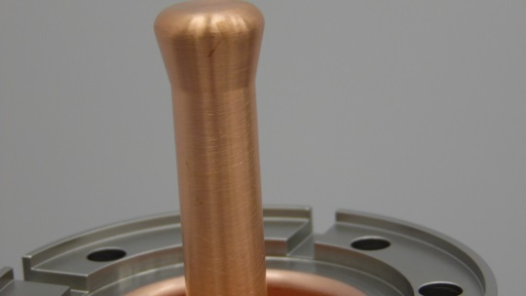
LCLSII FPC cold parts incoming inspection
Vacuum leak checks
Time to perform incoming inspection is about one working day per cold coupler
Particulate counts, RF contacts, ceramics, copper plating vacuum sealing surfaces

Slide 12
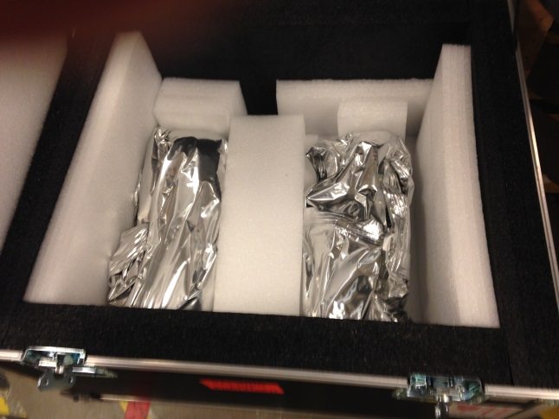
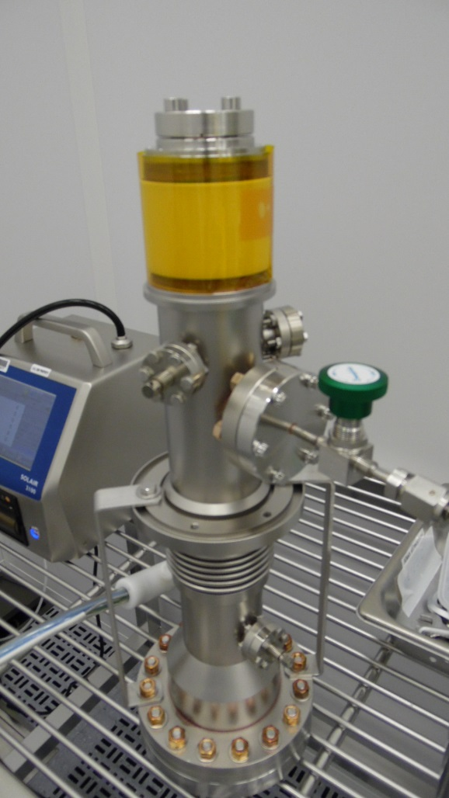
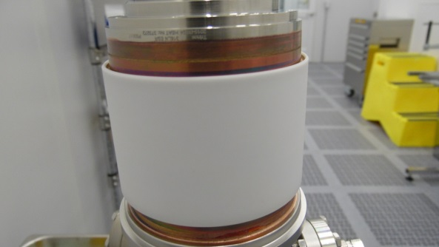
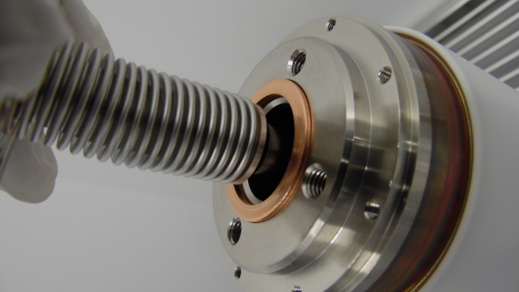
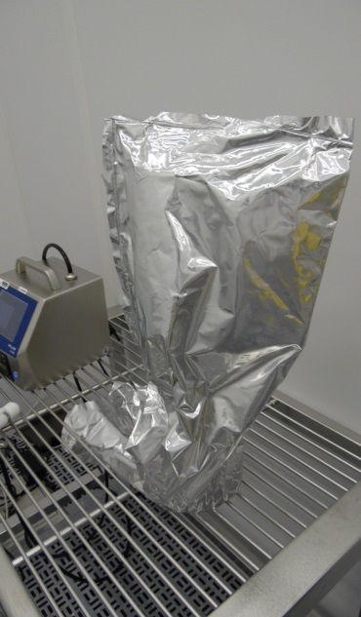
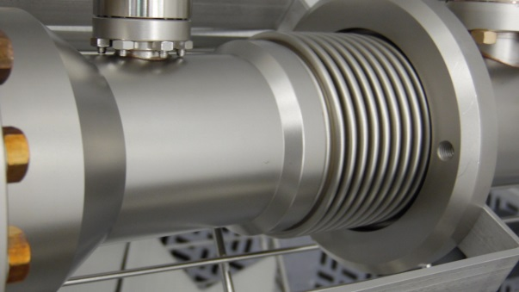
LCLSII FPC warm parts incoming inspection
Warm ceramic , bellows integrity, vacuum sealing surfaces, copper plating
Time to perform incoming inspection is about half working day per warm coupler

Slide 13
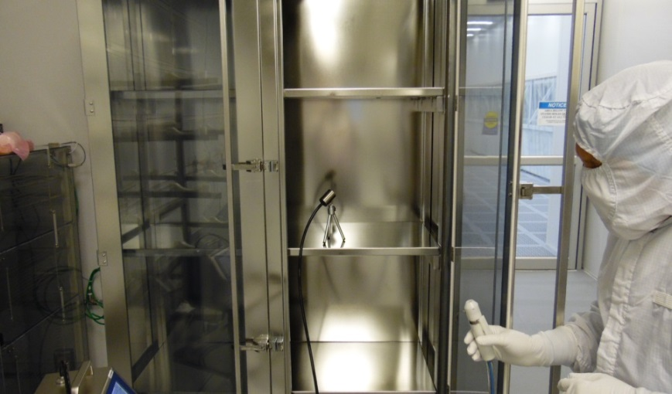
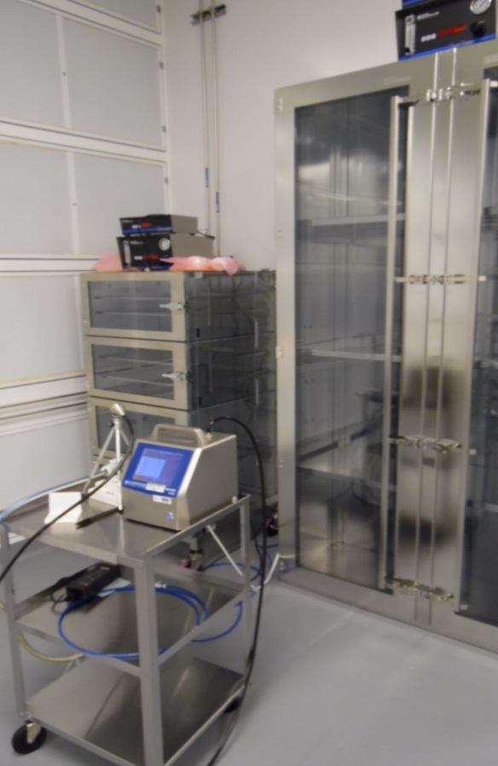
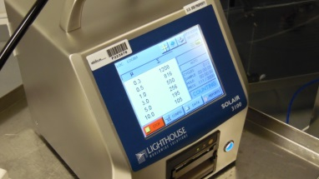
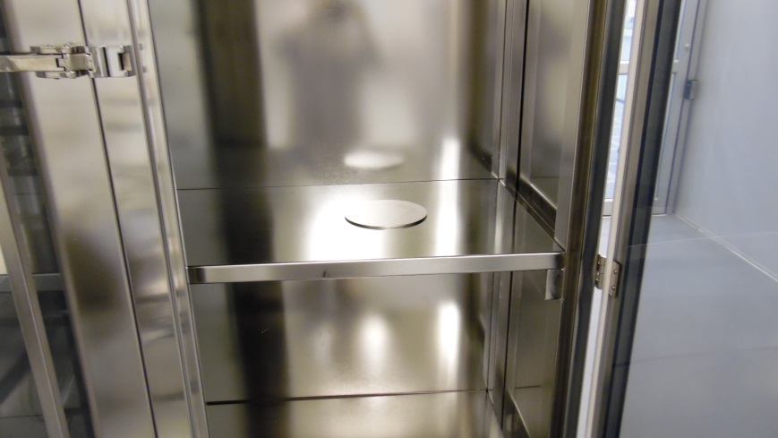
LCLSII FPC storage at JLAB – cold parts
Initial, inside static measurements 9 – 20 counts.
Inside dynamic (with N2 spray) 1200- 3000 counts. Action: cleaning cabinet (will be tough with particulate count acceptance tests before cold parts long term storage).
Final: surface contamination sample test ZERO particulate counts after 7 days of storage.

Slide 14
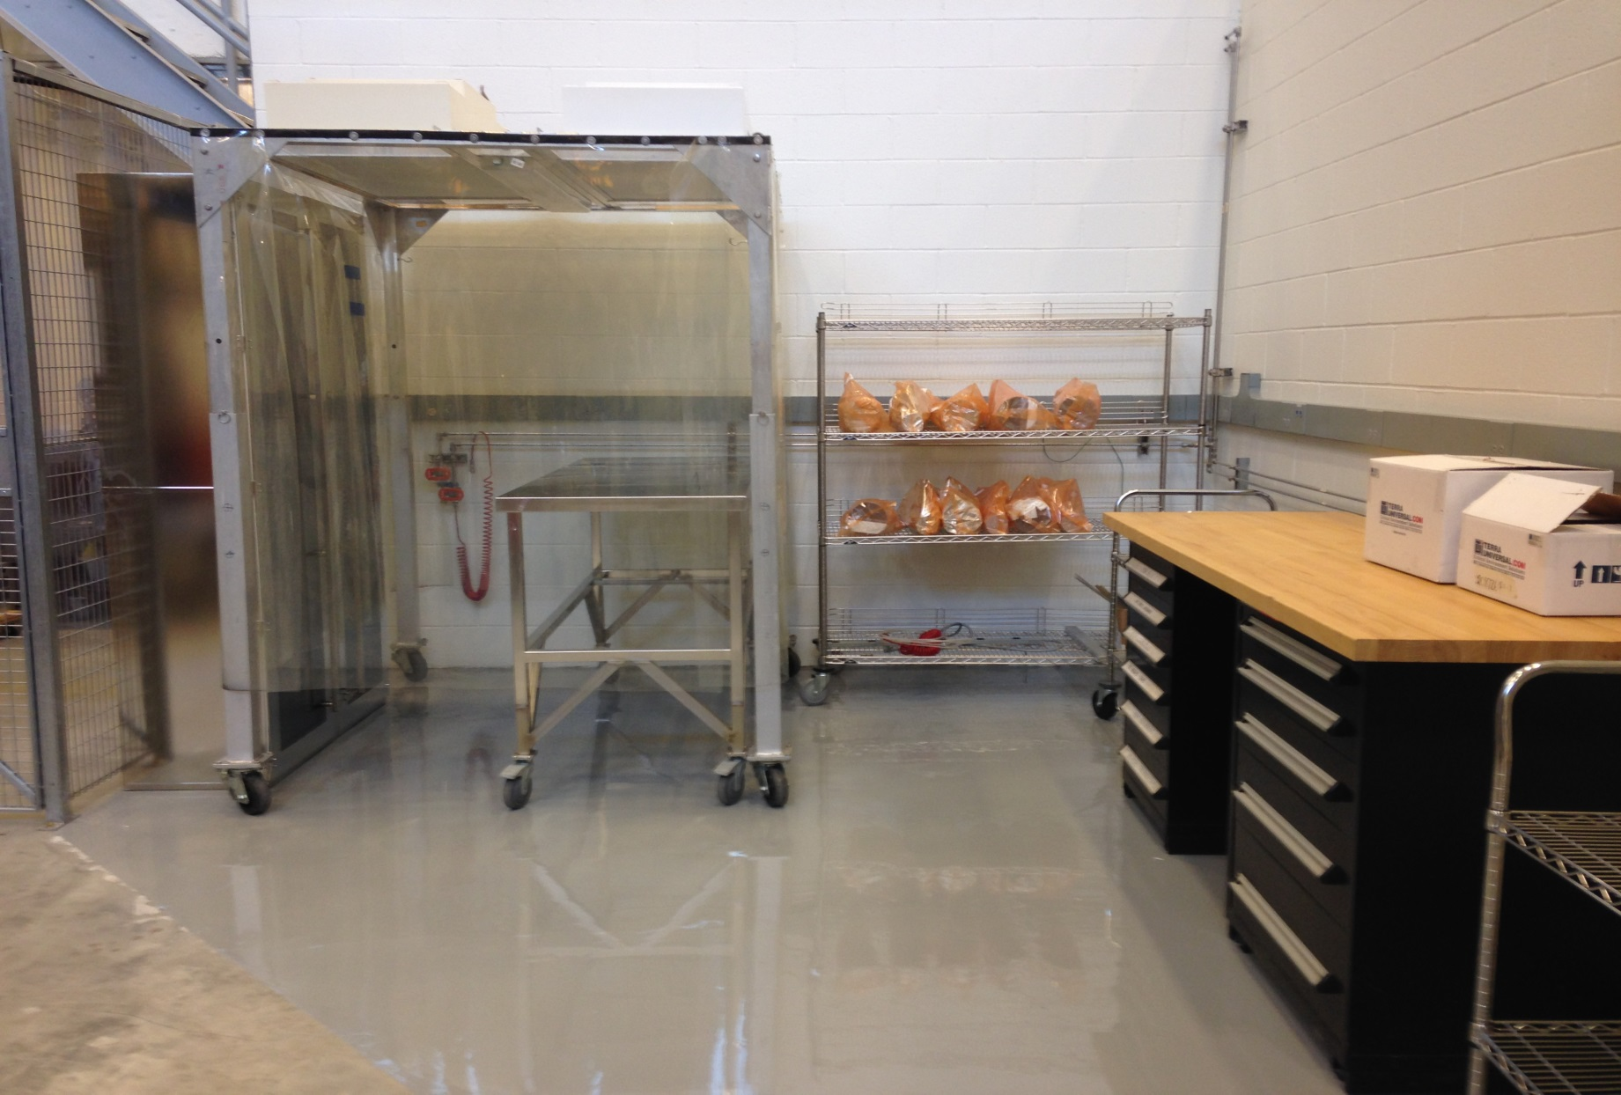
LCLSII FPC storage at JLAB – warm parts

Slide 15
FPC qualification for string / cavity assembly
No RF qualification tests are done at JLAB on couplers delivered by vendors.
In March 2016, two couplers delivered by each vendors (CPI and RITH) successfully passed RF qualification tests on room temperature test stand at Triumf.
The LCLSII couplers have qualification tests done at vendors. Before FPC shipment by the vendors, QA documentation is submitted to SLAC and approval and final destination (PL) is granted.
At JLAB, the LCLSII couplers are considered to be accepted for long term storage and subsequent cavity assembly, if they pass incoming inspection qualification tests.
For string assembly, qualification of cold couplers will be related visual inspection of copper plating and particulate counts on internal and external surfaces: N2 scrubbing in dedicated fixture and particulate counts after taking the cold FPC out from the storage cabinet. We’ll make sure the internal and external particulate counts will not affect the expected cavity performance (Target: LCLSII cavities are expected to be field emission free during commissioning / machine operation).

Slide 16
FPC qualification for string / cavity assembly cont
Remove cold FPC from the storage cabinet and check copper plating after long term storage.
Assemble cold bellows protections and cold ceramic protection cup
N2 scrubbing in each coupler dedicated fixture and check particulate counts after long term storage.
Ensure the internal and external particulate counts will not affect the expected cavity performance (field emission free during commissioning/ machine operation).
Remove warm FPC part form the N2 storage cabinet and check copper plating quality after long term storage (PICs).
Assemble bellows protection and warm ceramic cup, place the warm coupler in plastic bags under nitrogen.
Move the warm coupler form the storage area to CM assembly area.
The waveguides, received with full QA done by the vendor, are stored as kits and will be assessed during final steps of FPC assembly on CM.

Slide 17
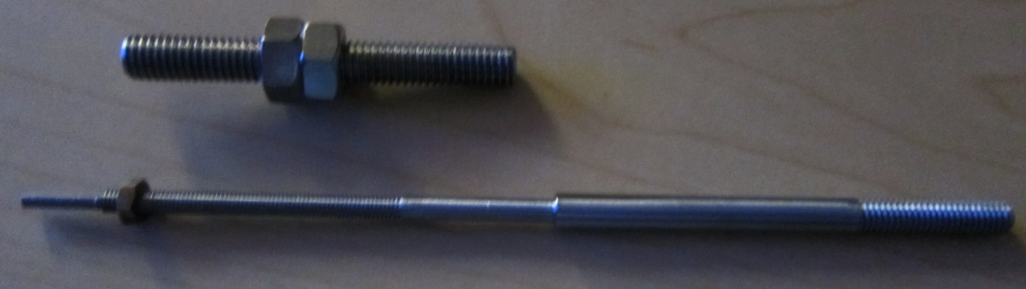
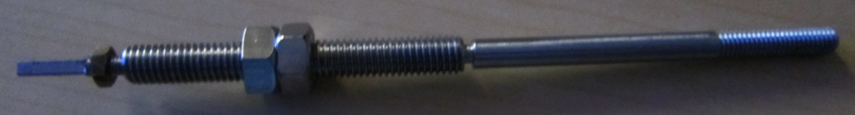
Cryo-module warm coupler assembly
Conceptual design Ed Daly, Kurt Macha (JLAB) and Stephane Berry (CEA Saclay France): making use of “Berry” bolts allows keeping the LCLSII string under vacuum (minimize risk of particulate contamination) after vacuum leak check performed in the clean room.

Slide 18
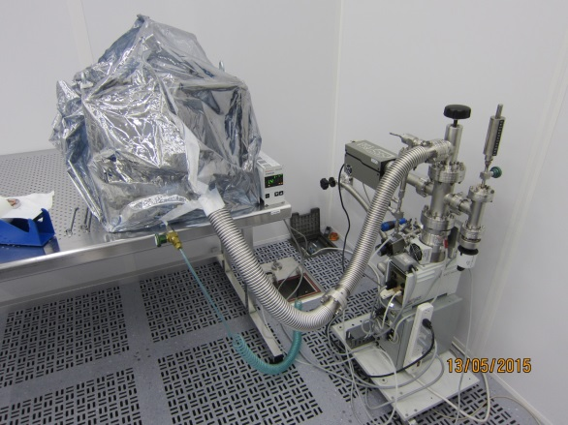
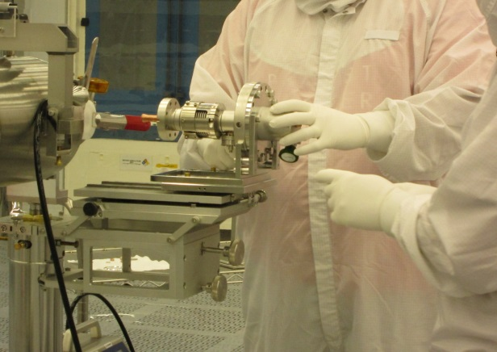
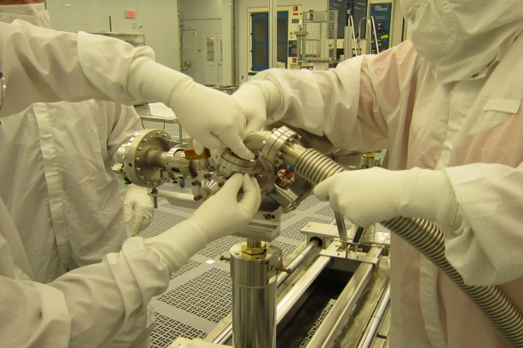
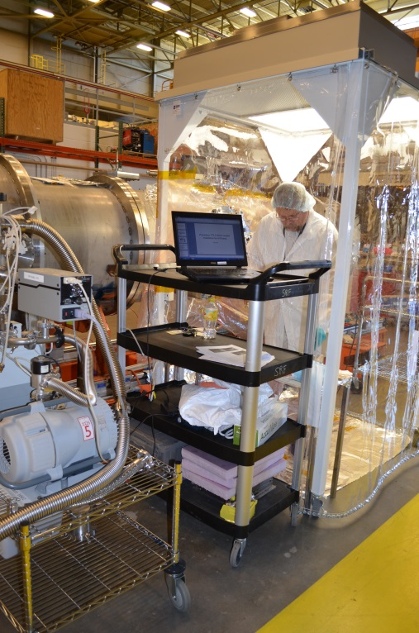
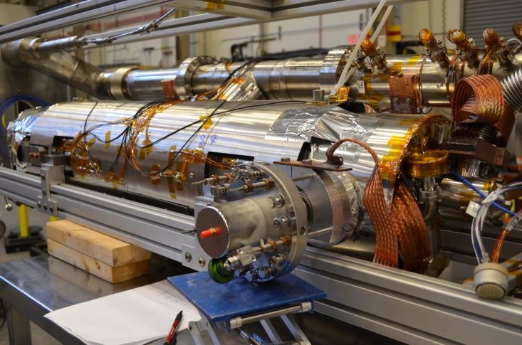
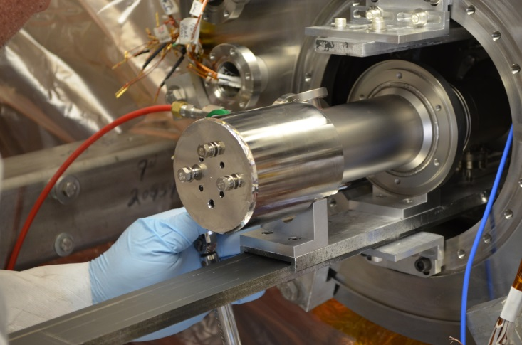
LCLSII FPC during RF power tests on HTB at JLAB

Slide 19
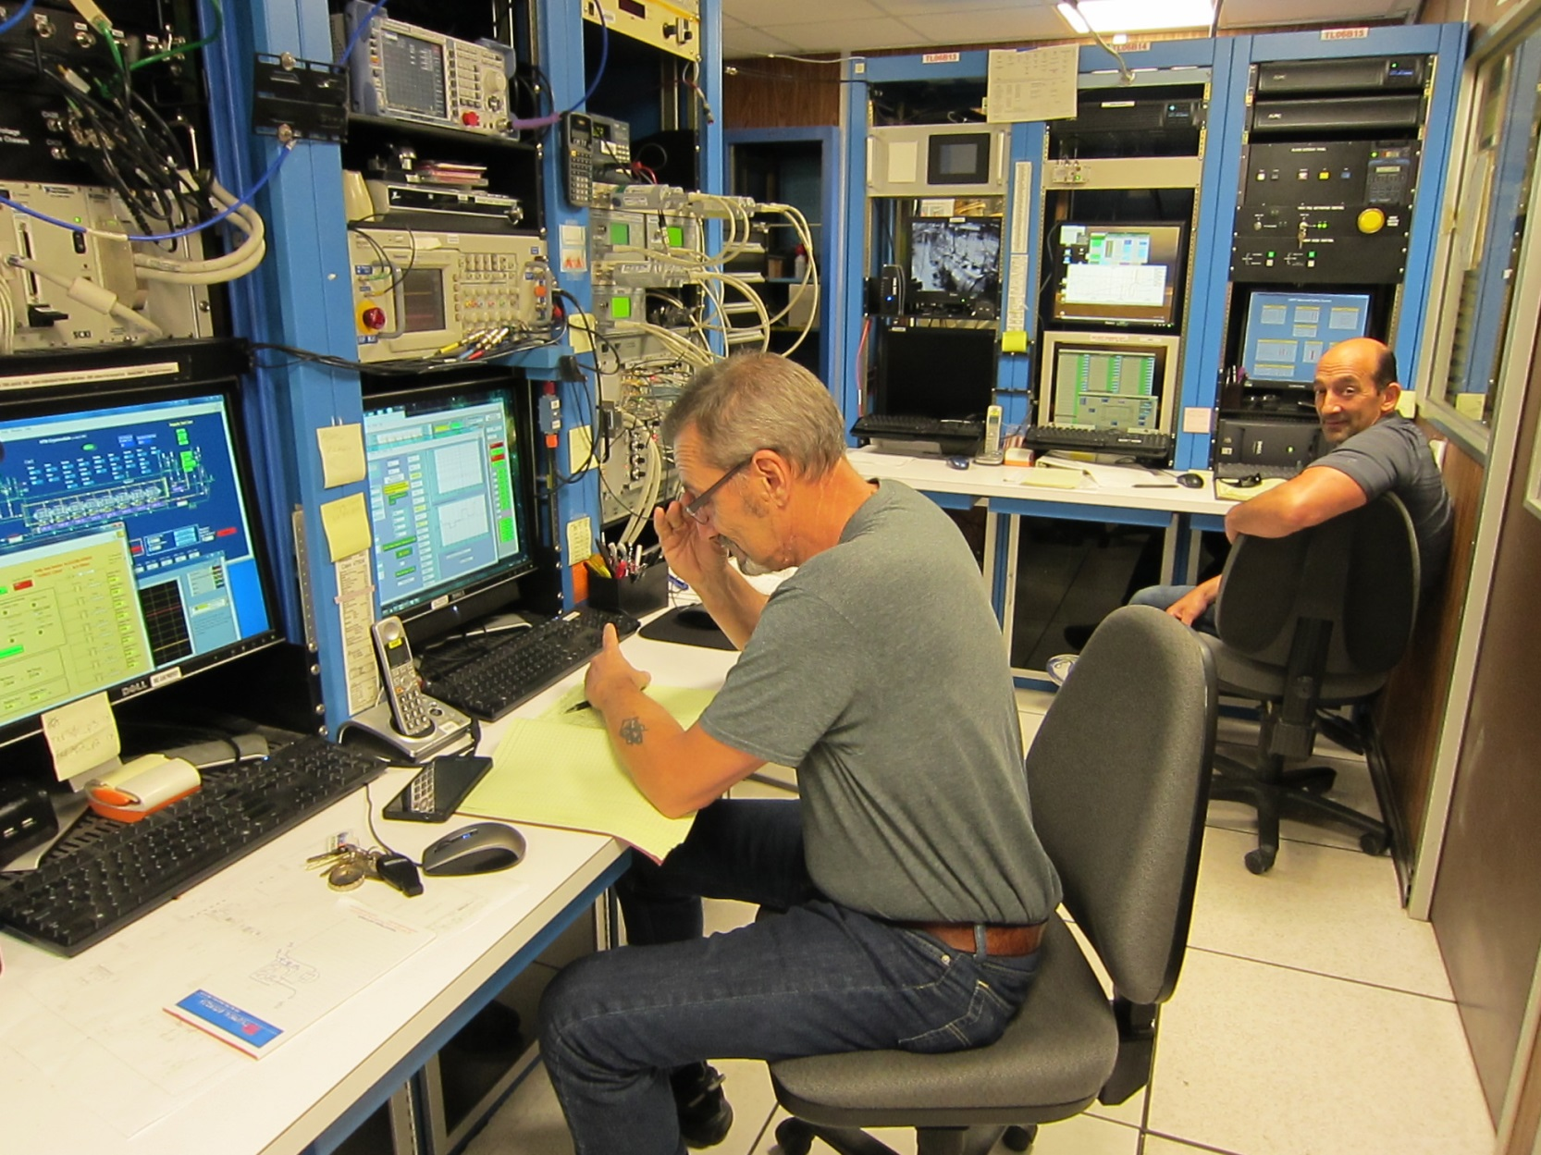
LCLSII FPC RF power tests on HTB

Slide 20
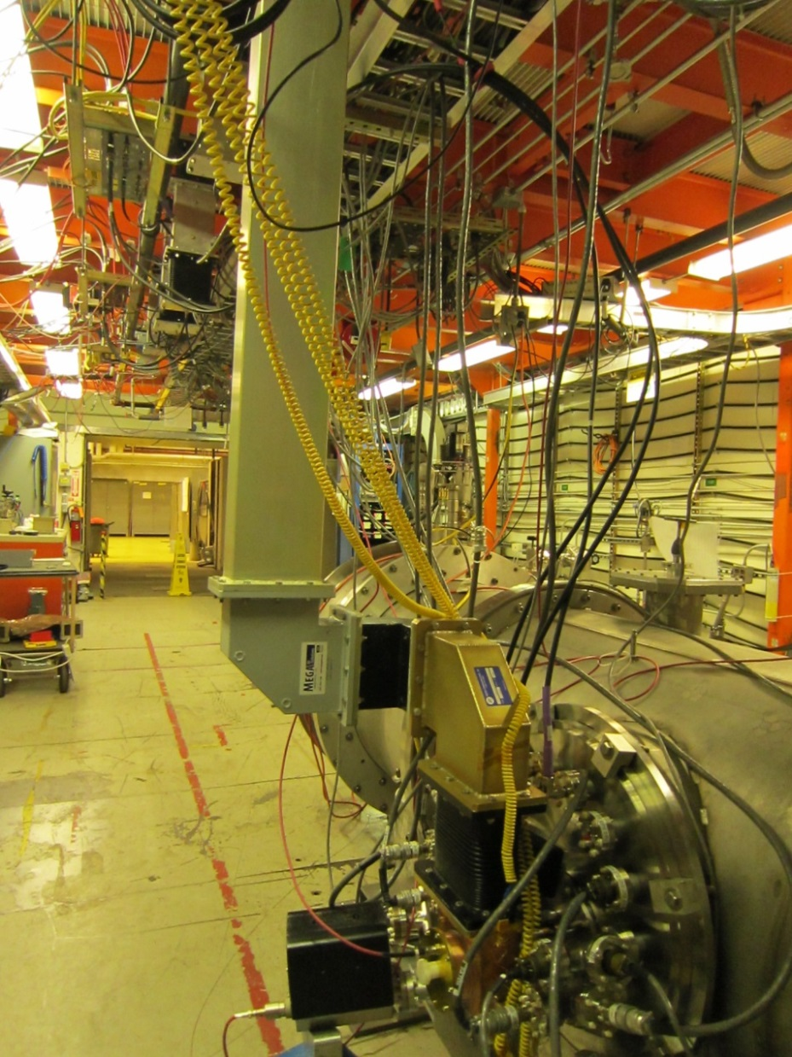
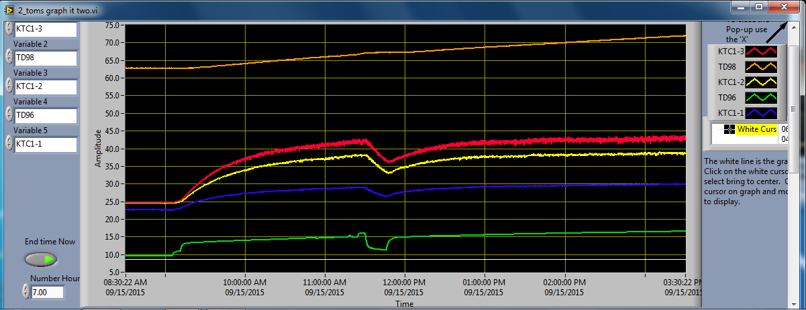
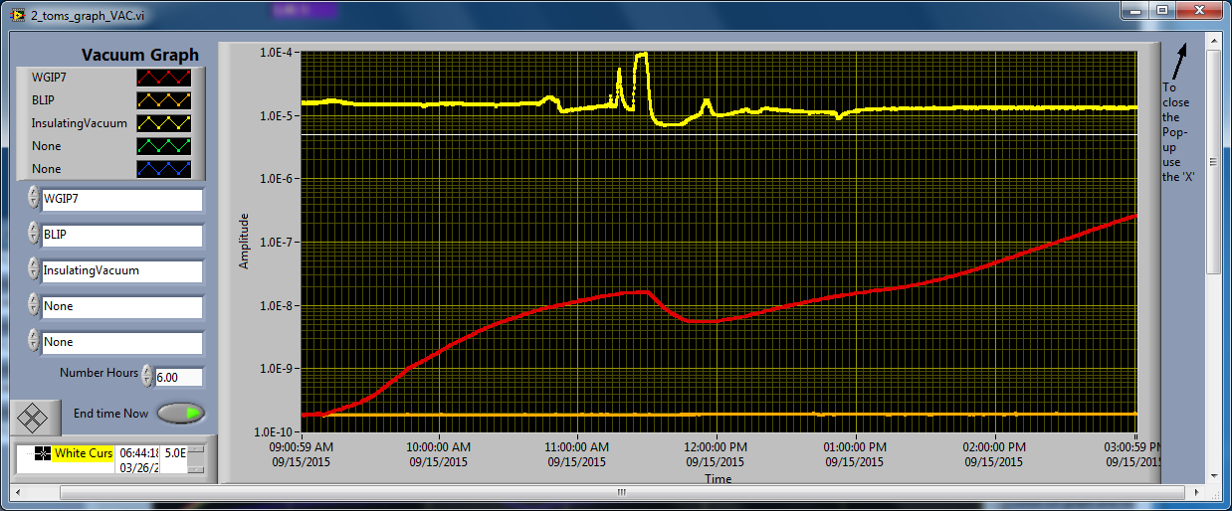
LCLSII FPC response during RF power tests on HTB
Experience with cold assembly resulting in FE-free RF power tests.
Concern with thermal performance and vacuum response
<45C
Temperatures FPC warm after 3 hours at 12 MV/m
2 10-7 mbar!!!
Vacuum FPC warm after 3 hours at 12 MV/m

Slide 21
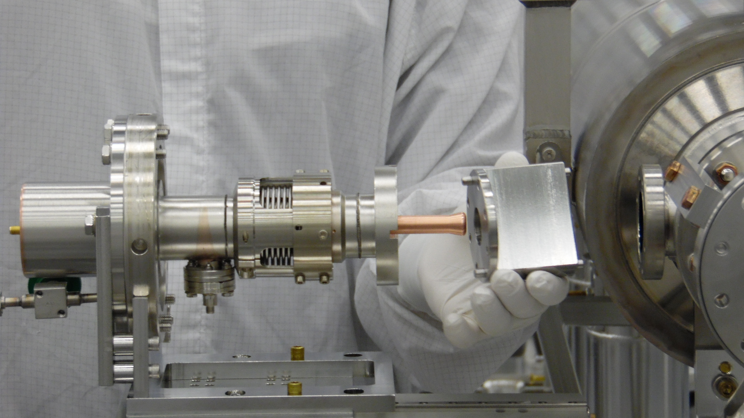
String cold coupler assembly

Slide 22
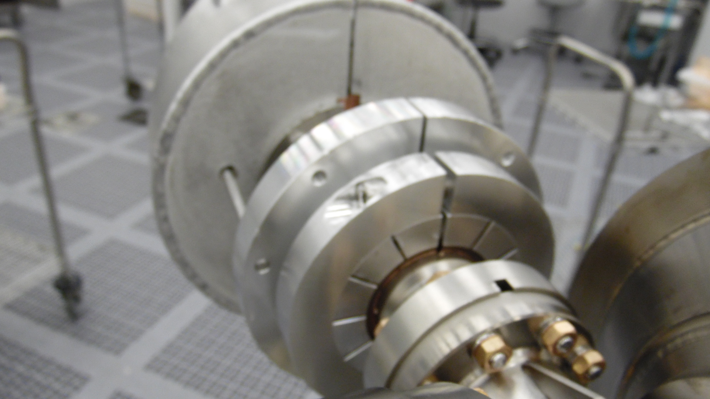
String cold coupler assemble

Slide 23
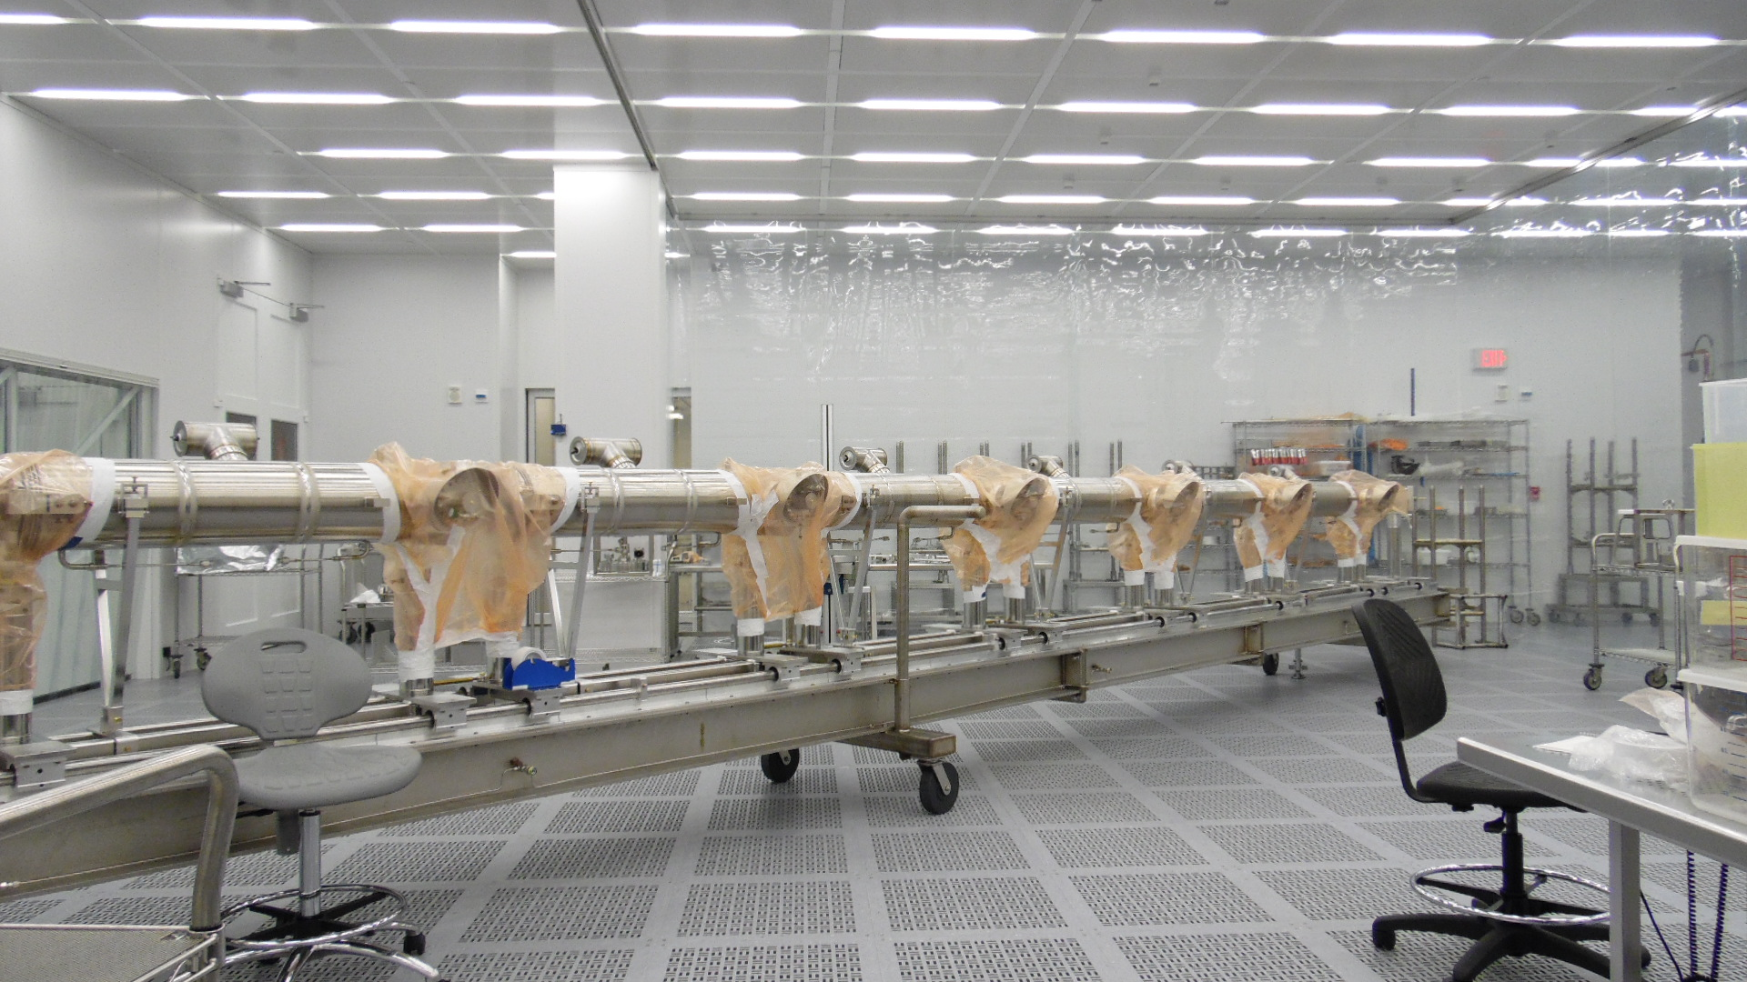
Cryo-module warm coupler assemble

Slide 24
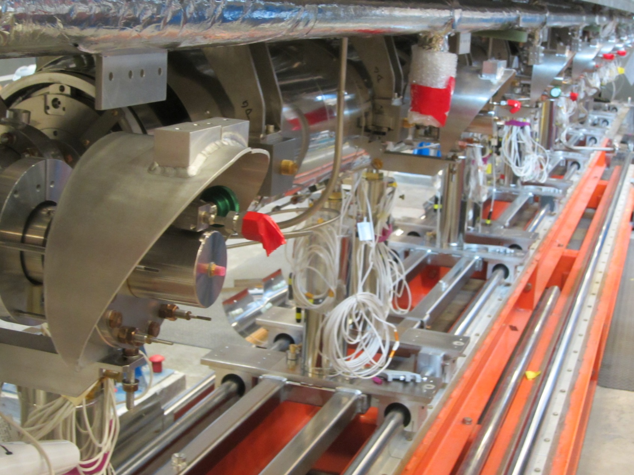
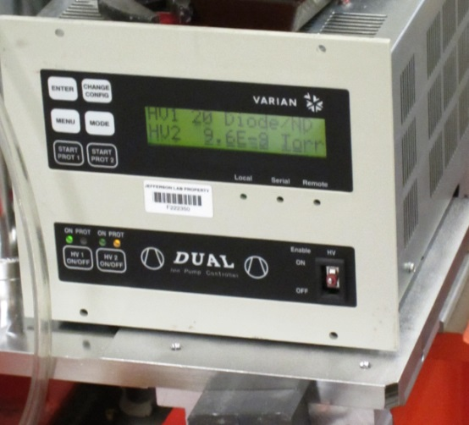
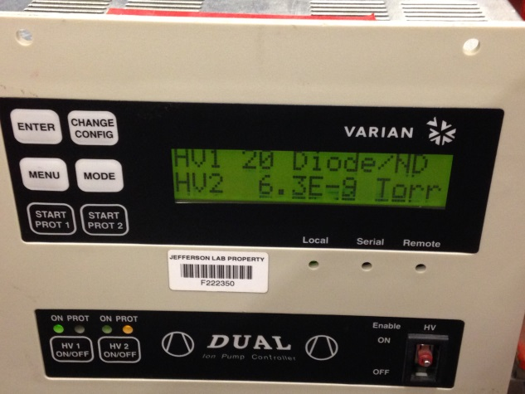
JLAB LCLSII pCM – couplers outside clean room
RT pCM vacuum 5 July 2016
RT pCM vacuum 7 Sep 2016

Slide 25
FPC Delivery Schedule
- At JLAB, we can sustain Incoming inspection for one coupler per day (cold and warm parts).
- Expect alternative delivery of 2 - 3 pairs of couplers per week, for the next six months.
- To sustain this activity, both vendors are supposed to deliver state of the art Fundamental Power Couplers, satisfying all requirements as specified in LCLSII ESD. All Non Conformance Reports are solved with SLAC agreement.

Slide 26
Actual LCLSII FPC status at JLAB
 | Total
FPC cold parts | 12 RITH + 16 CPI
FPC warm parts | 12 RITH + 16 CPI
FPC waveguides (kits) | 72
Berry bolts (pcs) | 64
50K and 5 K heat stations | 0 (Backup solution)
The first LCLSII production cryo-module with be equipped with 8 CPI delivered couplers. All other couplers (cold and warm parts) with incoming inspection done and NCRs cleared, will be stored under nitrogen in SS desiccators.

Slide 27
Conclusions
JLAB has the infrastructure, man-power and know how to fulfill FPC work requested by the LCLSII project.

Slide 28
Many thanks
Reviewers and PRR attendants of this LCLSII PRR.
W-D Moeller and D. Kostin from DESY for very useful discussions / procedures related with XFEL couplers
K. Premo from FERMI for procedures / advice for warm coupler installation
K. Fant and all SLAC FPC team for procurement of LCLSII couplers
Vendors: Communication Power Industries (CPI) form US and Research Instruments (RI - Germany) and Thales (TH – France) for state of the art FPC deliveries for the LCLSII project.
Special thanks to Sir James for designing different FPC tooling.

Slide 29

For you all

Slide 30
Warm FPC restrain during Berry bolts removal
Remove cold ceramic protection cup
Assemble the warm FPC to the cold CF100 flange
Assemble the inner conductor to the cold ceramic RF contact then torque hollow bolt. Follow the two persons rule.
Install the push-rod and plastic link.
Protect ceramic with a metallic cup.
Replace lower slide with a link between FPC insulation flange and FPC port.
Remove / replace “Berry” bolts with Nitronic M8 bolts.
Torque CF100 flange.
Remove Nitrogen purge and connect the pumping system to the warm FPC pumping port.
Vacuum leak check the CF100 flange.
Bleed up warm coupler with filtered Nitrogen.
Remove pumping system and instrumentation (eprobe and sapphire window).
Pass over the insulating vacuum flange and Viton gasket.
Restrain the warm coupler (in HTB case we restrained the warm ceramic).
Remove link installed at pct.6 and upper slide.
Assembly the insulating vacuum flange on FPC port.
Replace instrumentation , reconnect the pumping port and perform vacuum leak check on warm coupler.

Slide 31
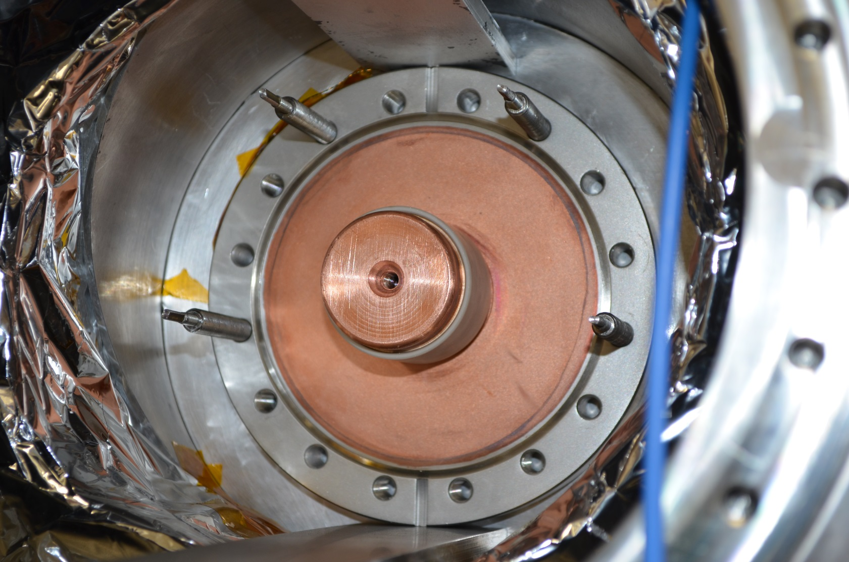
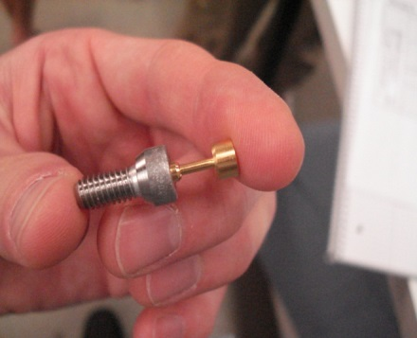
Warm FPC restrain during Berry bolts removal
Remove the bolts holding the protective ceramic cup.
By hand, unscrew the spring-loaded RF connector from the cold antenna end.

Slide 32


Warm FPC restrain during Berry bolts removal

Slide 33

Warm FPC restrain during Berry bolts removal
Disassembly protection cup
Protect ceramic with a Mylar sleeve
Look into the back of the warm ceramic and verify the orientation of the slit in the inner conductor
Insert push-rod into inner conductor
Turn push-rod with 90 degree for bayonet connection to the inner conductor.
Tighten conflat flange.

Slide 34

Warm FPC restrain during Berry bolts removal

Slide 35

Warm FPC restrain during Berry bolts removal

Slide 36

Warm FPC restrain tool used during Berry bolts removal

