Slide 1
LCLS-II Cryomodules Production Model at FNAL
Tug Arkan
LCLS-II CMs Production Readiness Review
September 13-14, 2016

Slide 2
Outline
Production Strategy
Fermilab Cryomodule Assembly Facility (CAF) infrastructure
Detailed CM Assembly Workflow at CAF
Production Throughput
Travelers and Part kits
Manpower
Summary

Slide 3
Planned LCLS-II Production CMs Workflow at Fermilab
Receive dressed, ready to be tested in VTS (vertical test stand) cavities from the vendors (Beamline under vacuum)
Incoming Inspection at IB4.
Test cavities in VTS at IB1
Qualified Cavities go to CAF-MP9 cleanroom for cold end coupler assembly (WS0). Non qualified cavities will be re-processed (HPR, light EP etc.) and re-tested.
One cavity out of every sixteen will be tested in horizontal test stand (HTS) . Other cavities still stay in the cleanroom and ready to be assembled into a cavity string.
8 qualified cavities, Magnet Spool Tube, BPM, Gate Valves, Interconnecting Bellows: Cavity String Assembly at CAF-MP9 Cleanroom (WS1)
Cold Mass Assembly at CAF-MP9 (WS2)
Cold Mass Assembly at CAF-ICB (WS3 & WS4)
Final Assembly and QC checks (WS5) and prep for transport to CMTS at CAF-ICB (WS6)
Cryomodule Test at CMTS
Transport the module back to CAF-ICB (WS6)
Prepare and Ship Module to SLAC

Slide 4
Supply Chain for Production CMs assembly at Fermilab
Dressed cavities (RI and Zanon) delivered ready to be tested (Alex Melnychuk talk)
Fundamental power couplers (CPI and RI/Thales) delivered ready to be assembled at WS0 and WS5 (Ken Premo talk)
Gate valves (VAT) cleaned to Class 100 standard at the vendor
BPM cleaned to Class 10 standard at DESY
BPM electrical feedthroughs (Solcera)
Copper plated beamline components (fabricated in U.S industrial vendor, plated at SLAC for initial Production CMs, will be plated at Nomura plating in Japan for remainder Production CMs
Cavity String Assembly Hardware (JT industries) and Seals (Wepek)
Cold Mass Upper assembly (WXCX, China)
Cold Mass peripherals from various U.S. vendors
Split Magnet (Milhous) delivered ready to be tested
Instrumentation (U.S and International vendors)
Vacuum Vessel (WXCX, China)
Vacuum vessel peripherals from various U.S. vendors
(Jamie Blowers talk)
Full or batch delivery Supply Chain Manager working with SOTRs & TD QMD for qualified parts storage in TD inventory system Parts are kitted & delivered to work stations Sort, magnetic hygiene QC, clean and use

Slide 5
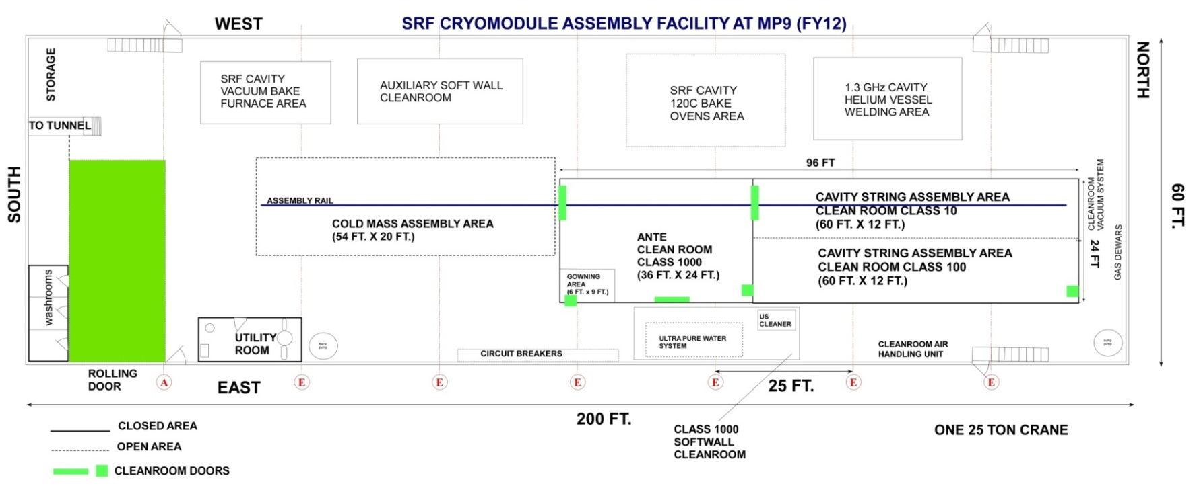
CAF-MP9 during LCLS-II Production
WS2
WS1
WS0

Slide 6
CAF-ICB during LCLS-II Production
Sick CM
repair area
WS5
WS3
WS4
WS6

Slide 7
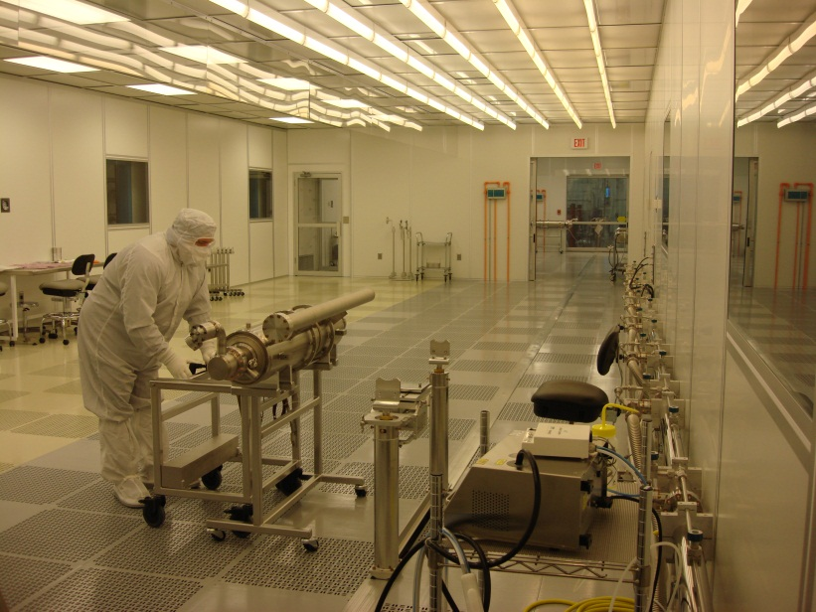
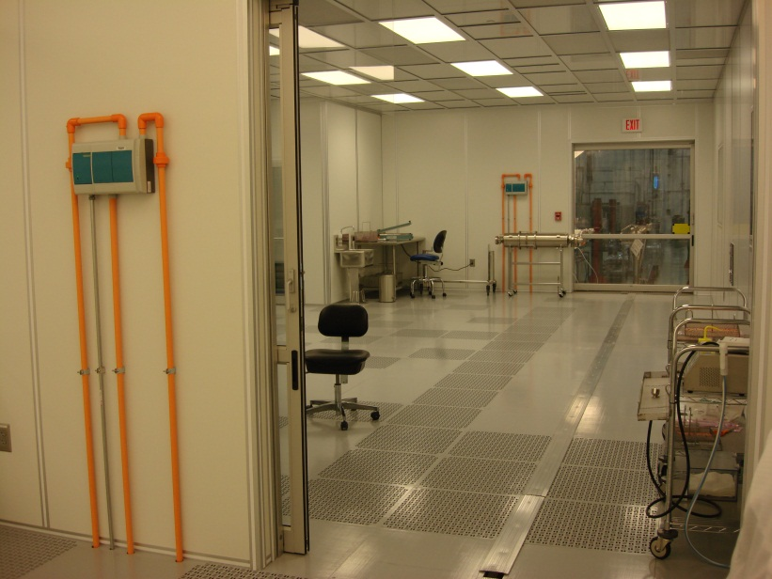
CAF-MP9 Clean Room
Cavity String Assembly Clean Room (WS0 & WS1)
A ~250 square-meter clean room:
Class 1000 ante clean room area
Class 100 sluice area
Class 10 assembly area
Class 100 staging/storage area
Class 100
Class 10
Class 1000
Rail
Sluice Class 100

Slide 8
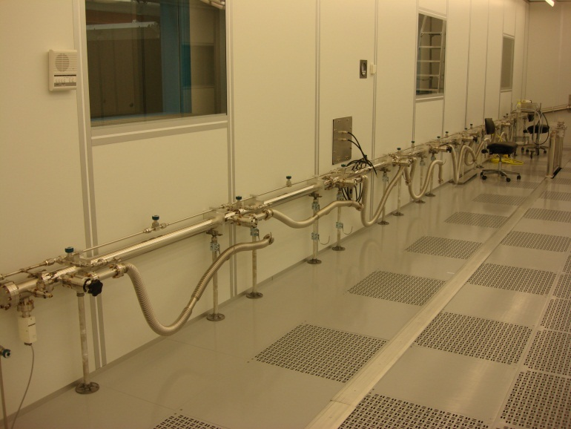
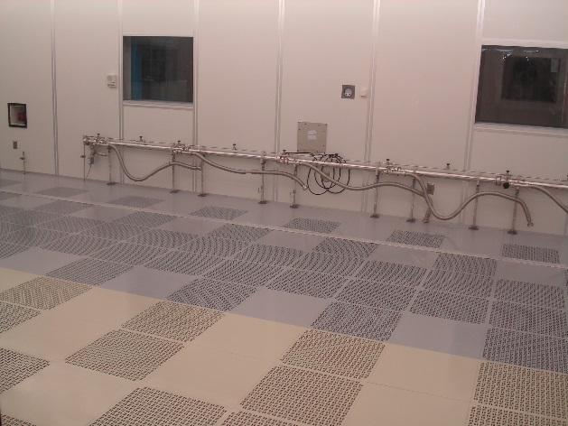
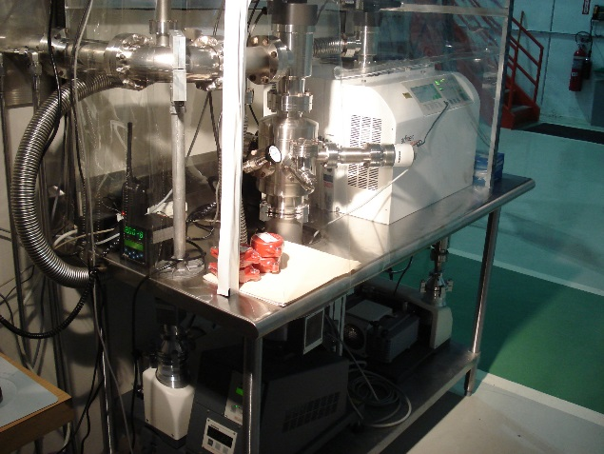
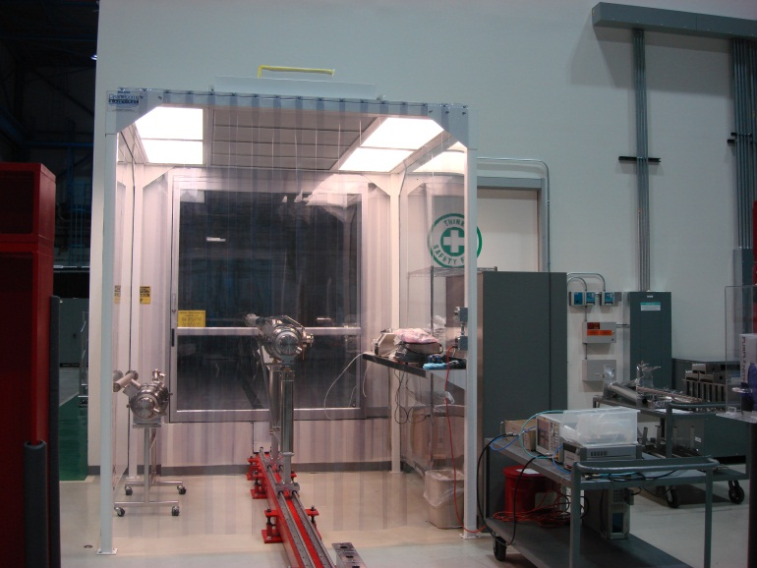
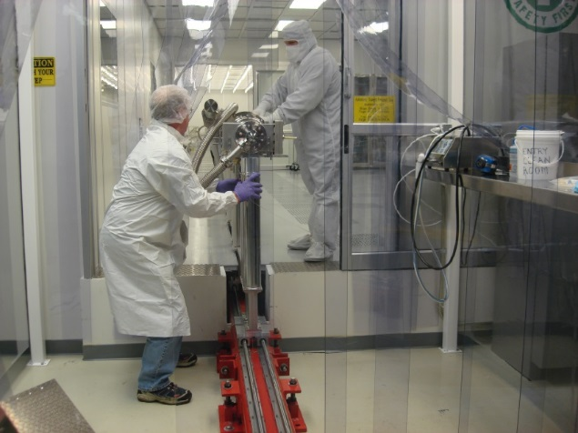
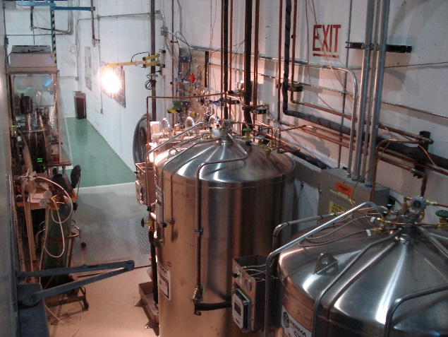
Cleanroom Infrastructure
Vacuum / Gas Manifold
8 stations for pumping, purging and backfilling
Particle Free UHV Pumps System
Cavity Support Fix Rail System
Boiled-off LN2 gas dewars and gas delivery panels
Class 1000 softwall cleanroom for dry cleaning before entry to ante cleanroom

Slide 9
Quality Assurance for CAF infrastructure
Cleanrooms
Cleanroom vitals (pressure, temperature, relative humidity) are monitored through Metasys digital system under the responsibility of Fermilab Facilities Engineering (FESS) Division. When alarm situation, CAF cleanroom team and I receive e-mails, text messages.
Cleanroom Air handling unit (belts, outside filters), dehumidifier are maintained by FESS
Daily check of the fan filter units (FFU) through computerized monitoring system
Daily cleaning of the rooms
Annual deep cleaning (remove raised floor panels)
Auxiliary systems preventive maintenance [PM] (pumping systems, backfill/purge systems). DI water plant is a rented system and maintained by the vendor
Annual calibration of particle counters, replacement of filters on the blow guns e
Spare parts (FFU, pumps, leak detectors, particle counters) were purchased to minimize the down time
Production Floor:
Assembly fixtures and tools PM is responsibility of the CAF assembly group
Welding machines reside at CAF. Operated and maintained by the Weld shop
Calibration of torque wrenches, calibration of oxygen monitors, calibration of helium calibrated leaks for leak detectors

Slide 10
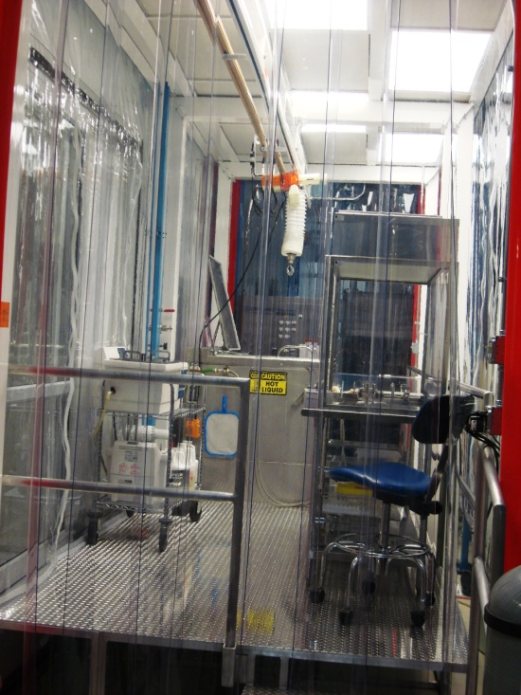
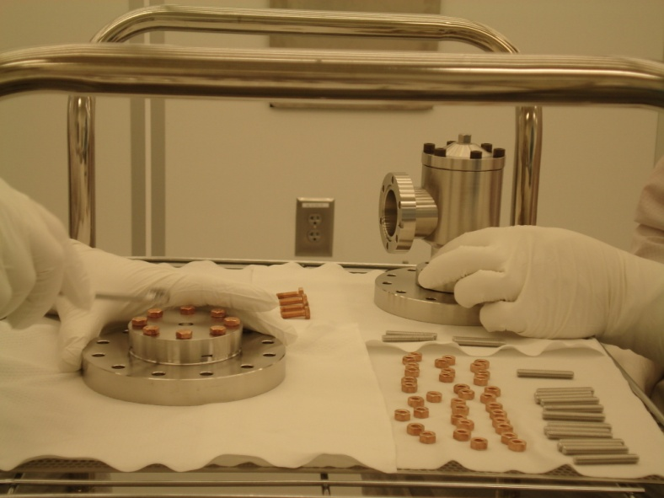
Parts / Fixtures / Hardware Entrance to Cleanroom Preparation
Magnetic Hygiene Quality Control for every part, hardware, fixtures, tools that will be used in the cleanroom for assembly prior cleaning
Class 1000 softwall cleanroom
Class 10 Hood
Assembly hardware:
Wash in the ultrasonic bath
Dry under Class100 hood
Move into the Class 1000 ante clean room
Blow clean with ionized nitrogen while monitoring the particle count in the sluice area (Class 100)
Transport into the Class 10 assembly area
US cleaners
Electro-polished, rolled thread 316L stainless steel studs; silicon bronze nuts

Slide 11
Durations
Actual Duration (AD) for pCM assembly: Durations (per work stations) shown in the pCM talk including first time assembly learning time + waiting time due to missing parts, not fitting parts, magnetic hygiene issue investigation etc.
Optimized Touch Labor Duration (OTLD) for Production CMs: Durations after learning curve is completed and no waiting time
Planned Touch Labor Duration (PTLD) for Production CMs assembly: Target goal duration to achieve the peak rate production throughput

Slide 12
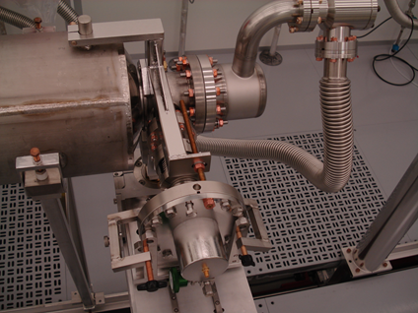
Cold End Coupler Assembly (WS0)
Leak check, RGA the dressed qualified cavity (received with beamline under vacuum)
Assemble pump/backfill/purge flex hose to the cavity
Backfill the cavity
Leak check the coupler pair in the processing stand as delivered
Backfill
Remove a cold end coupler from the stand
Assemble cold end coupler to the cavity using particle free flange assembly (PFFA) procedures.
Pump down, leak check, RGA
AD (pCM): 8 days
OTLD (Production): 8 days
PTLD (Production): 5 days (2 assemblies per day) + 1 day spare

Slide 13
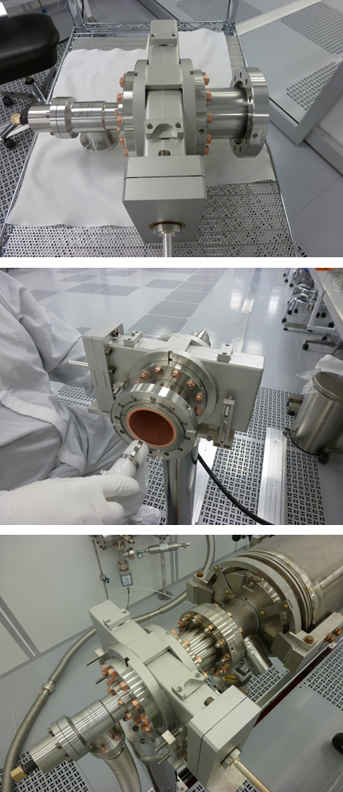
String Assembly-I (WS1)
Align 8 cavities for string assembly: 0.5 day
Gate Valve (GV1) to Cavity #1 Assembly: 1 day
Check the particle free cleanliness of the GV and clean as needed
Sub-assembly of the GV peripherals
Installation to the support post and vacuum hose assembly
Alignment to the cavity beam line flange
Assemble the gate valve to the cavity

Slide 14
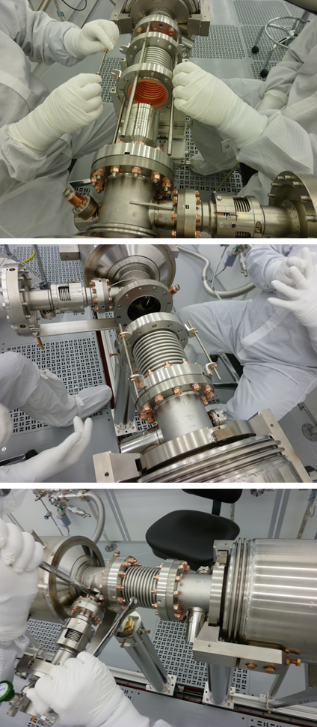
String Assembly-II (WS1)
Cavity to Cavity Assembly with the interconnect bellows:
Assemble flex hose to the cavity. Pump down and Leak check. Backfill
Align the interconnect bellows to the cavity field probe end beampipe flange
Assemble with PFFA
Align the bellows to the cavity coupler end beampipe flange
Assemble with PFFA
1 day per interconnecting bellows,
8 cavities, 7 bellows total = 7 days

Slide 15
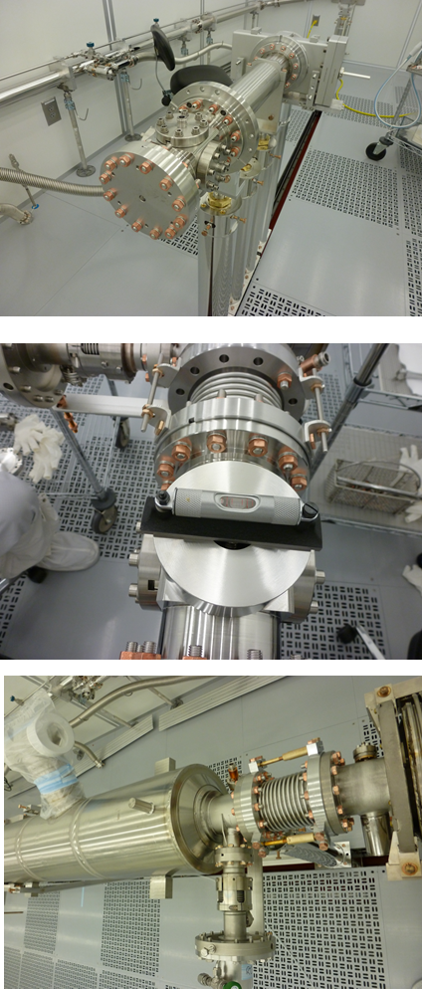
String Assembly-III (WS1)
BPM+Magnet Spool Tube+GV2 assembly and leak check (1 day)
BPM/Magnet package subassembly to the 8 cavity string (0.5 day)
Pump down fully assembled cavity string, bag the bellows, leak check. Backfill (1 day)
Roll out of the cleanroom to WS2
AD (pCM): 16 days
OTLD (Production): 11 days
PTLD (Production): 11 days

Slide 16
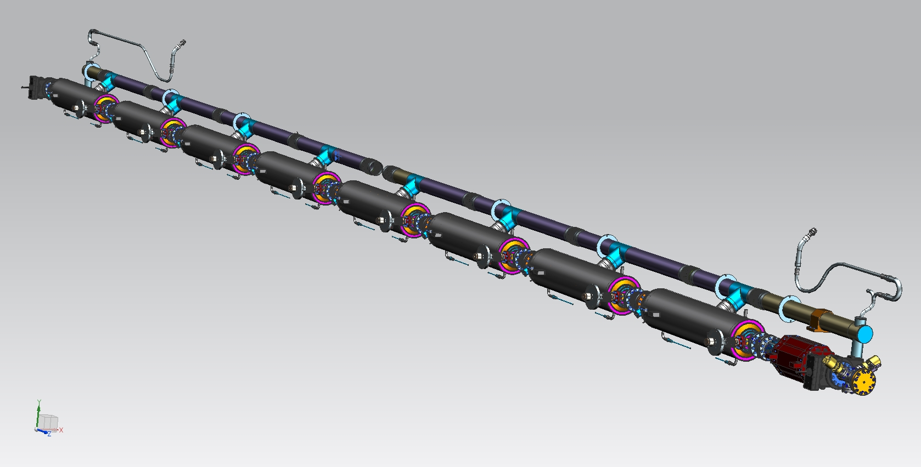
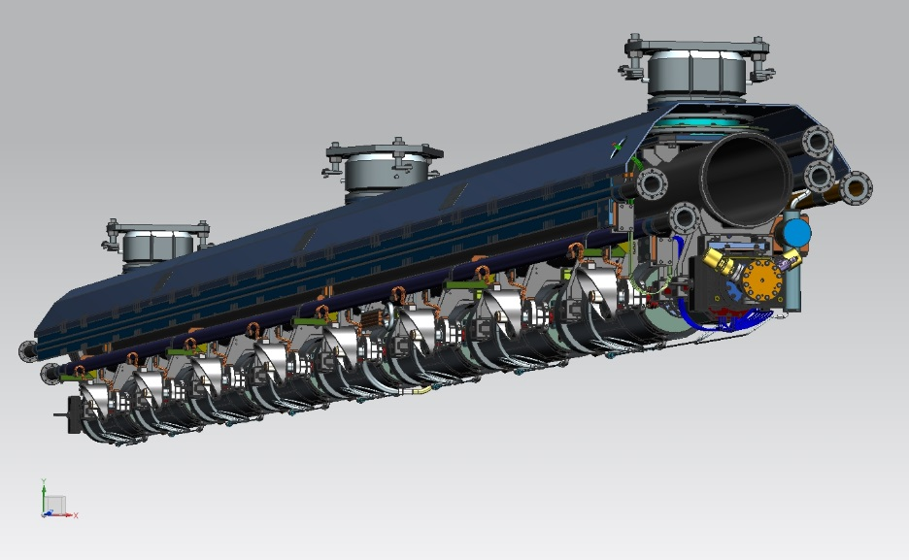
Cold Mass Assembly Phase-I at CAF-MP9 (WS2)
Tasks outside of the clean room before the string was lifted off the cleanroom posts to Cold Mass Upper assembly:
Split Magnet installation (1 day)
2-phase circuit pipes cutting to length & peripherals welding with orbital cutting and welding machines (3 days)
Instrumentation (sensors, heaters etc.) installation (3 days)
Cavity magnetic shields installation (2 days)
Cavity helium vessel insulation installation (0.5 day)
Cavity helium vessel lugs to needle bearings and housings installation (1 day)
GHRP to 2-phase pipe welding (0.5 day)
Cool down line to cavity helium vessels welding (1 day)
Various leak checks of the helium circuit (1 day)
Various electrical checks (1 day)
Various RF checks & HOM notch frequency tuning (2 days)

Slide 17
Durations at WS2
AD (pCM): 36 days
OTLD (Production): 16 days
PTLD (Production): 10 days:
Parallel assembly tasks will be done to reduce the duration from OTLD to PTLD.
This 10 days duration is critical to achieve because the next CM cavity string assembly at WS1 cannot start until the cleanroom post fixtures are freed up of the cavity string for the current CM cold mass assembly phase-I at WS2 (infrastructure limitation due to fix rail system at CAF-MP9)

Slide 18
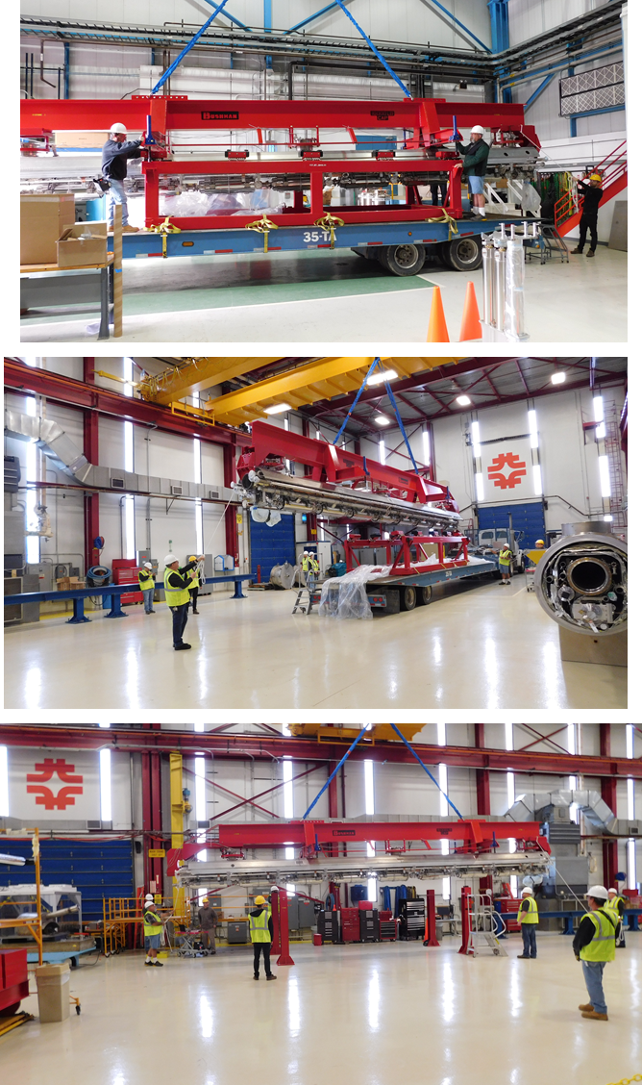
Cold Mass Transport
After the cavity string was picked up off the rail and partially assembled to cold mass upper, the cold mass assembly was transported to CAF-ICB (~2 km from CAF-MP9)
There are a written procedure and a job hazard analysis
A lead engineer supervises this transport. Accelerators and geophones are used to collect data during the transport
AD (pCM): 1 day
OTLD (Production): 0.5 day
PTLD (Production): 0.5 day

Slide 19
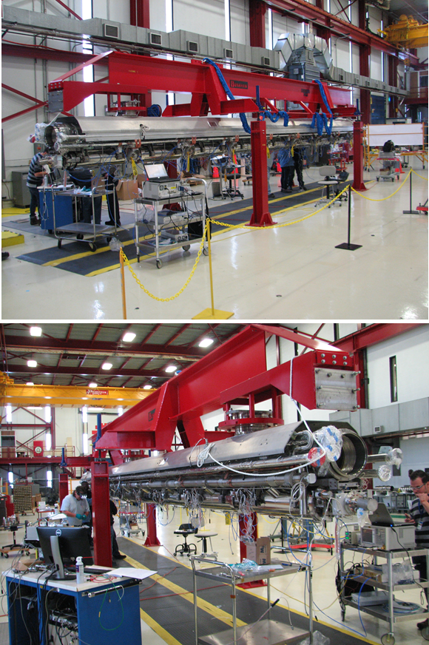
Cold Mass Assembly Phase-II at CAF-ICB (WS3)
Assembly Tasks: (Phase-II)
Align cavities axial position in Z (laser tracker) (1 day)
Magnet and current leads thermal intercepts installation (3 days)
Align cavity string to cold mass (laser tracker) (2 days)
Remove helium vessel safety brackets & Assemble end lever tuner system (2 days)
Complete thermal intercepts assembly (HOM connectors, tuner motor etc.) (2 days)
RF cables installation (1 day)
Complete the end caps magnetic shielding assembly (1 day)
Complete the harnessing of the instrumentation wires & RF cables (2 days)
Thermal intercepts installation for RF cables (1 day)
Electrical & RF Checks (1 day)

Slide 20
Durations at WS3
AD (pCM): 42 days
OTLD (Production): 16 days
PTLD (Production): 11 days:
Parallel assembly tasks will be done to reduce the duration from ATLD to PTLD.

Slide 21
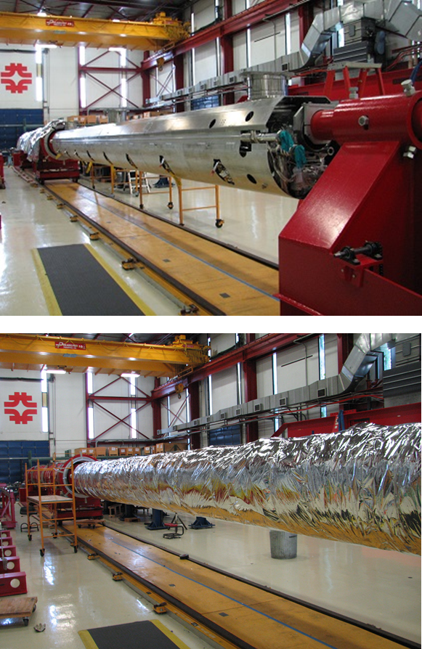
Vacuum Vessel Assembly at CAF-ICB (WS4)
Assembly tasks: (Phase-II cont.)
Install and weld lower 50K aluminum shields (1 day)
30 layers of MLI as pre-made blankets (1 day)
Electrical & RF checks (2 daya)
Slide vacuum vessel onto the cold mass (0.5 day)
Assemble cold mass supports (0.5 day)
Align cold mass to the vacuum vessel and transfer to external fiducials (laser tracker) (2 days)

Slide 22
Durations at WS4
AD (pCM): 11 days
OTLD (Production): 7 days
PTLD (Production): 7 days

Slide 23
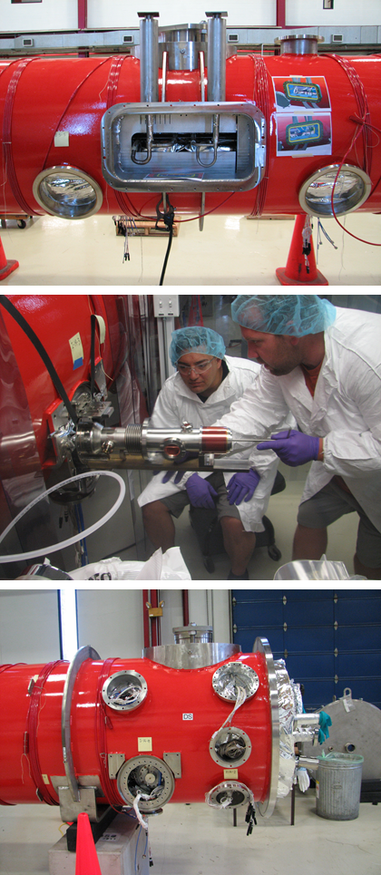
Final Assembly Phase-III (WS5)
Weld JT/Cooldown valves (0.5 day)
Leak check (2 days)
X-ray (0.5 day, weekend)
Pressure tests (0.5 day weekend)
Install warm part of the fundamental power couplers and leak check (8 days)
Install FPC waveguides and tuner motors (2 days)
Route & terminate instrumentations wires and RF cables to the feedthrough flanges (3 days)
Install coupler pumping lines, pumps & leak check, leave under vacuum (2 days)
Leak check beamline vacuum, leave under vacuum (1 day)
Pump down and leak check insulating vacuum (5 days)

Slide 24
Durations at WS5
AD (pCM): 39 days
OTLD (Production): 23.5 days
PTLD (Production): 15 days:
Parallel assembly tasks will be done to reduce the duration from OTLD to PTLD.

Slide 25
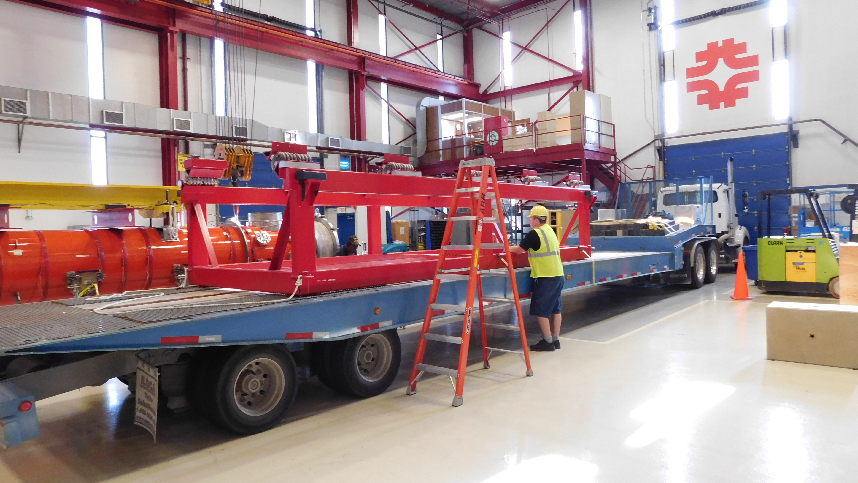
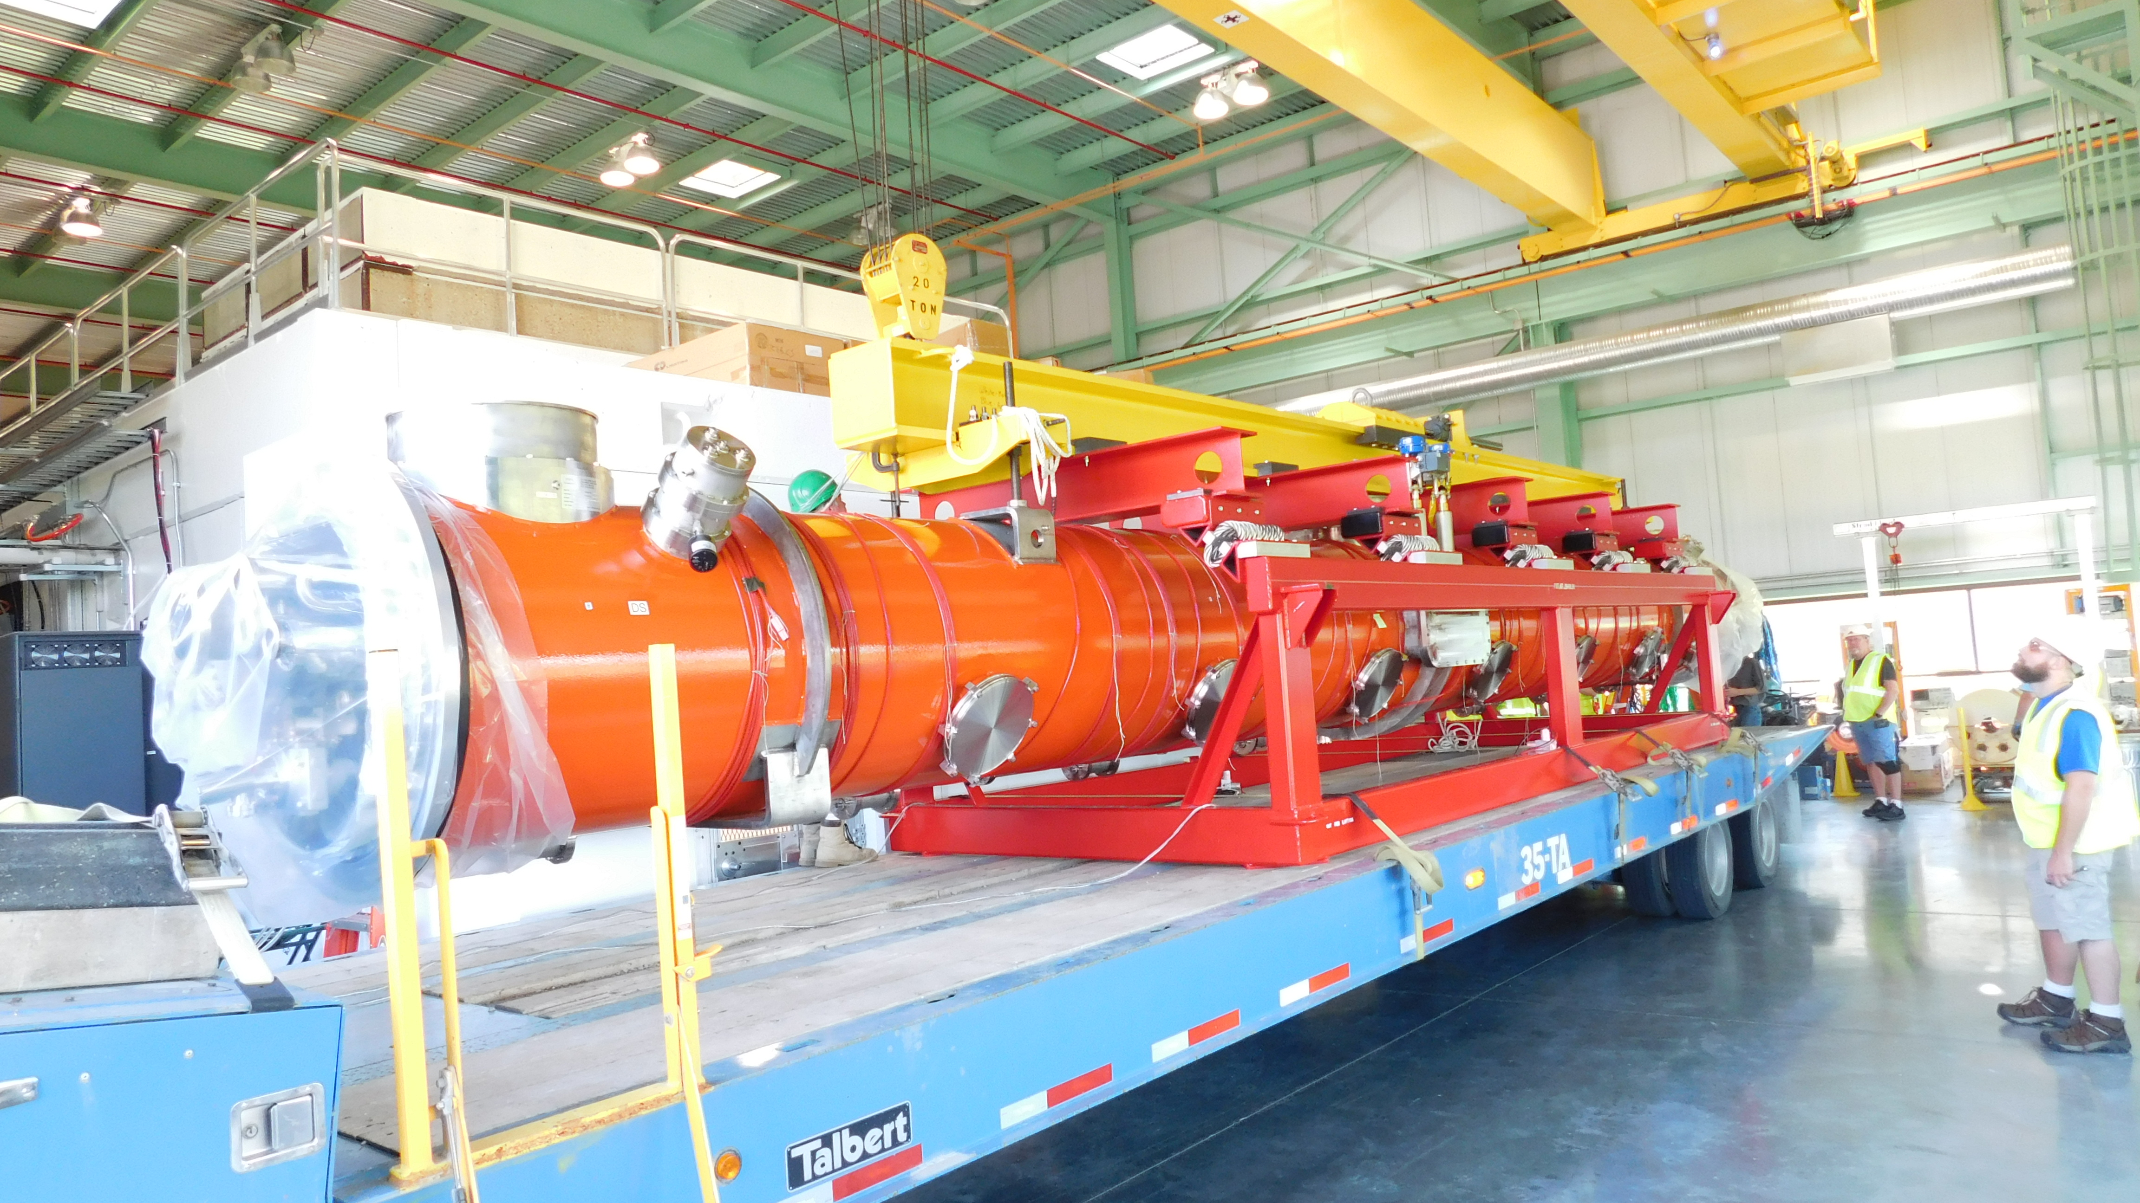
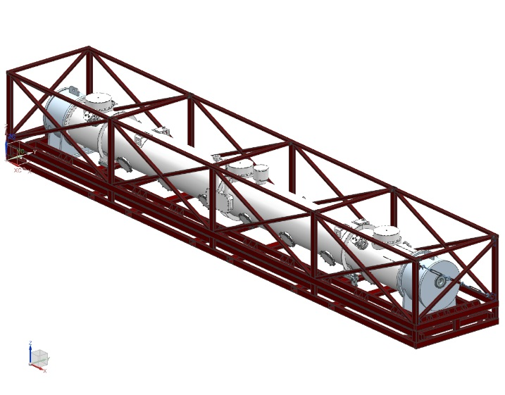
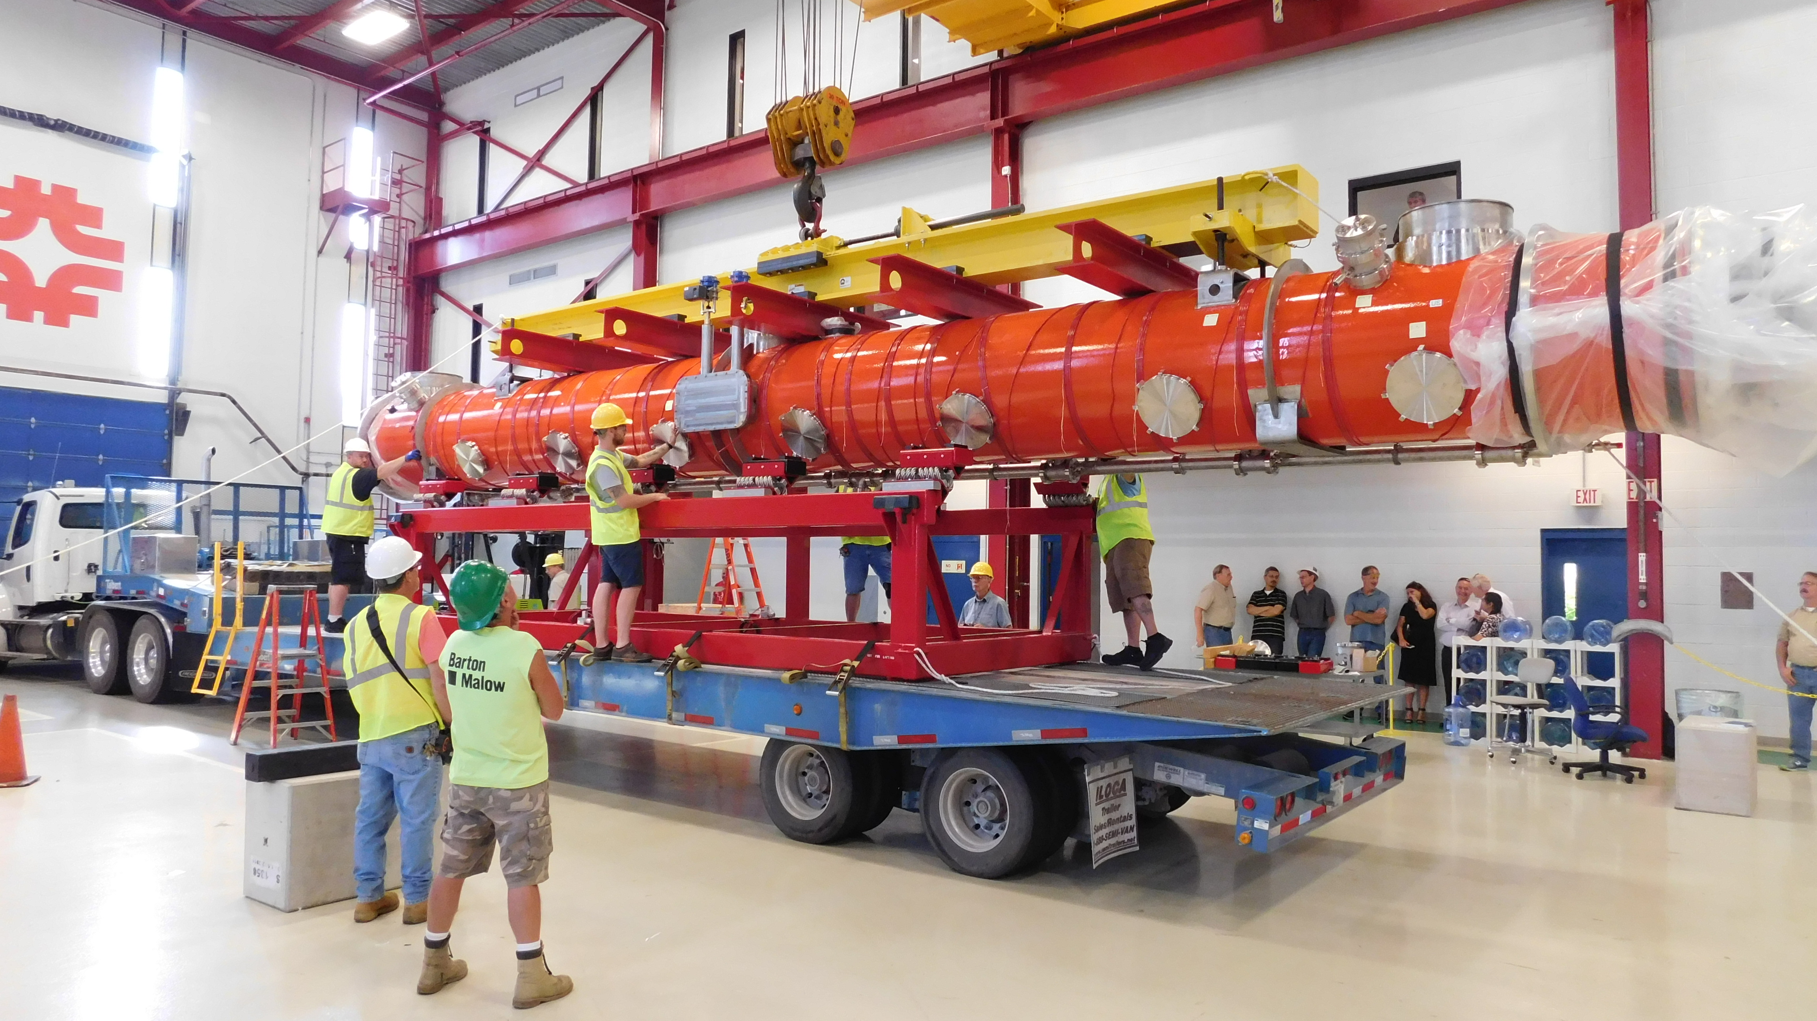
Cryomodule Prep & Transport to CMTS (WS6)
LCLS-II module shipping fixture is requested to be available for CM transport at Fermilab
LCLS-II fully assembled CM barely fits into the ILC CM transport frame. We managed to transport pCM with partial disassembly of the transport frame and some modifications of the lifting fixture
AD (pCM): 2 days
OTLD (Production): 1 day
PTLD (Production): 1 day

Slide 26
Production Throughput Goal (based on the PTLD)
WS0: Cold End Coupler Assembly - 5 days
WS1: Cavity String Assembly – 11 days
WS2: Cold Mass Assembly Phase I – 10 days
WS3: Cold Mass Assembly Phase II – 11 days
WS4: Vacuum Vessel Assembly – 7 days
WS5: Final Cryomodule Assembly – 15 days
WS6: Prep & Transport – 1 day
3 weeks in the cleanroom
9 weeks on the production floor
Total PTLD for assembly: 60 working days (12 weeks)

Slide 27
pCM to Production CMs
pCM assembly total AD is ~24 weeks
Production CMs:
CM02~CM04 (ramp-up) assembly total PTLD: 14~16 weeks per module. CM assembly in pseudo-parallel mode to get ready for peak rate production
CM05~CM16 (peak rate) assembly total PTLD: 12 weeks per module. 3 CMs assembled in parallel with the required throughput of 1 CM every 5 weeks

Slide 28
Module Assembly Weekly Workflow (peak rate)
Module #n
Module #n+1
Module #n+2
Cleanroom Assembly:
Start: Week #1
Complete: Week #3
Cleanroom Assembly:
Start: Week #6
Complete: Week #8
Cleanroom Assembly:
Start: Week #11
Complete: Week #13
WS1 cannot start until WS2 of the previous CM is completed
WS1 cannot start until WS2 of the previous CM is completed
Cold Mass Assembly:
Start: Week #4
Complete: Week #12
Cold Mass Assembly:
Start: Week #9
Complete: Week #17
Cold Mass Assembly:
Start: Week #14
Complete: Week #22
5 weeks throughput
5 weeks throughput

Slide 29
Throughput check with MS Project
CM(n+1) cavity string assembly at WS1 cannot start until CM(n) cold mass assembly phase-I at WS2 is completed: CAF Infrastructure limitation due to fix assembly rail system extending from cleanroom WS1 to WS2
3 CMs assembled in parallel: CM(n+2) in the cleanroom at WS0, CM(n+1) at WS2, CM(n) at WS4
CM(n+2) cold mass assembly phase-I at WS2 starts when CM(n) final assembly phase-III at WS5 is completed
1 cleanroom team, 2 cold mass assembly teams are needed

Slide 30
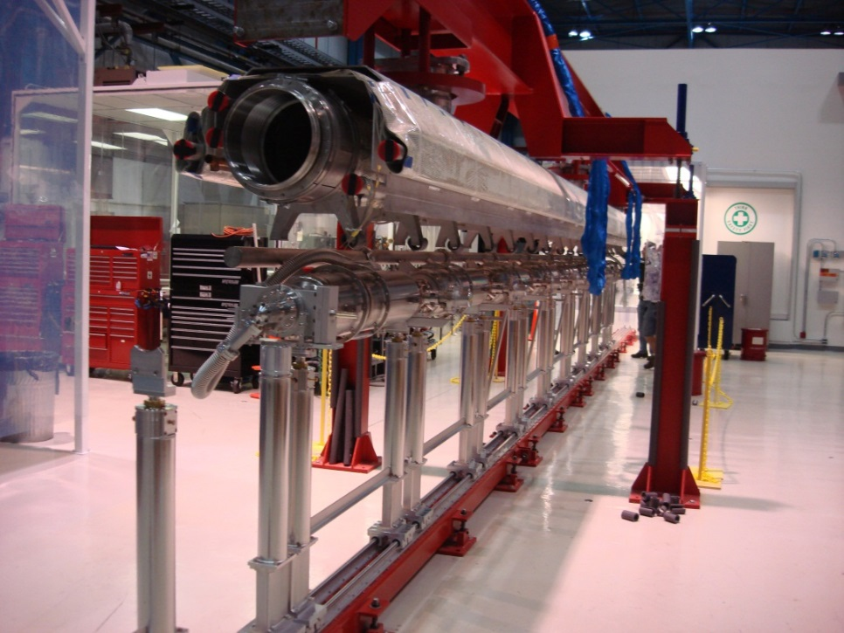
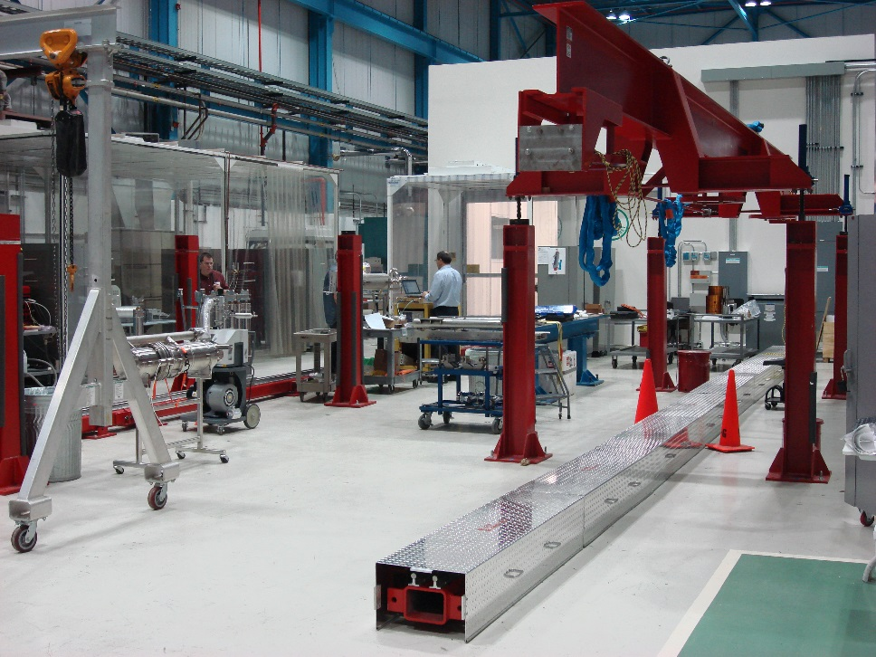
Throughput Risk Mitigation
Spreader bar fixture is used to support, lower and raise the cold mass upper at WS2. Fixed rail system extends from the cleanroom to WS2 which supports the cleanroom assembly post fixtures that roll on the rail.
A second rail system is setup at WS2. If production peak-rate throughput cannot be achieved, the cavity string rolled out from WS1 can be immediately moved to the second rails at WS2 to free up cleanroom assembly posts fixture that can be rolled back into the WS1 for next cavity string assembly (need to procure some additional cleanroom assembly post fixtures to have a full second set)

Slide 31
Throughput after risk mitigation implemented
WS0: Cold End Coupler Assembly
WS1: Cavity String Assembly
WS2: Cold Mass Assembly Phase I
WS3: Cold Mass Assembly Phase II
WS4: Vacuum Vessel Assembly
WS5: Final Cryomodule Assembly
Up to 5 weeks in the cleanroom
Up to 5 weeks at each work stations
Total duration for assembly: ~25 weeks per CM
CM02-CM04 (ramp-up) assembly duration: 14~16 weeks per module. CM assembly in pseudo-parallel mode to get ready for peak rate production
CM05-CM16 (peak rate) assembly duration: High Likely <25 weeks per module. Up to 5 CMs assembled in parallel with the required throughput of 1 CM every 5 weeks

Slide 32
CM Assembly Travelers
464176 LCLS-II Cold End Coupler Assembly Traveler - WS0 (RFCG)
https://vector-offsite.fnal.gov/Tools/TravelerWriter/TravelerWriterPreviewDocument.asp?qsSpecificationID=1518&qsRevisionID=3
464179 LCLS-II 1.3 GHz Cavity String Assembly Traveler - WS1 (RFCG)
https://vector-offsite.fnal.gov/Tools/TravelerWriter/TravelerWriterPreviewDocument.asp?qsSpecificationID=1521&qsRevisionID=3
464229 LCLS-II Cryomodule Cold Mass Assembly Part-1 - WS2 (RFCG)
https://vector-offsite.fnal.gov/Tools/TravelerWriter/TravelerWriterPreviewDocument.asp?qsSpecificationID=1571&qsRevisionID=3
464252 LCLS-II Cryomodule Cold Mass Assembly Part-2 - WS3 (RFCG)
https://vector-offsite.fnal.gov/Tools/TravelerWriter/TravelerWriterPreviewDocument.asp?qsSpecificationID=1594&qsRevisionID=3
464253 LCLS-II Cryomodule Vacuum Vessel Assembly - WS4 (RFCG)
https://vector-offsite.fnal.gov/Tools/TravelerWriter/TravelerWriterPreviewDocument.asp?qsSpecificationID=1595&qsRevisionID=3
464254 LCLS-II Cryomodule Final Assembly - WS5 (RFCG)
https://vector-offsite.fnal.gov/Tools/TravelerWriter/TravelerWriterPreviewDocument.asp?qsSpecificationID=1596&qsRevisionID=3

Slide 33
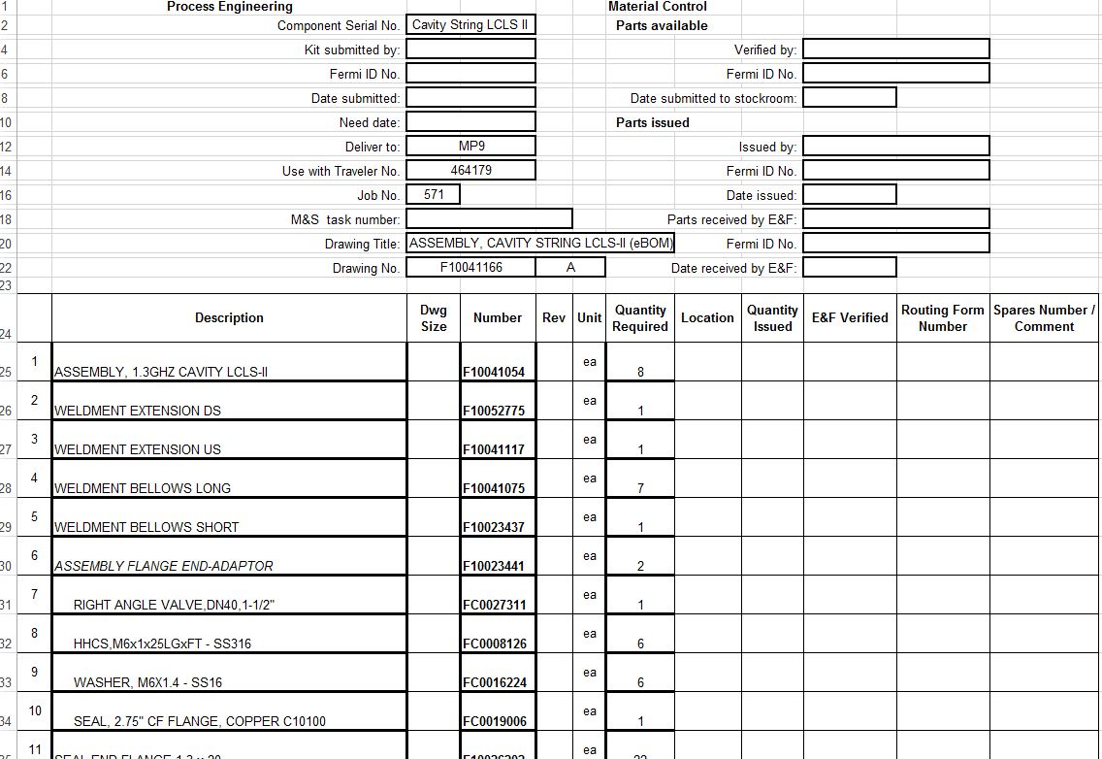
Parts Kit Lists (MBOM)
Parts kit lists were created
Lists are included in each work station assembly traveler (Section 4)
Parts/hardware will be stored at Technical Division (TD) Storage Areas and will be organized by the TD inventory management systems
When a kit is requested by the production floor, LCLS-II supply chain manager will ensure that the parts/hardware are kitted as specified and the kit is delivered to the specific work station
Excerpt from the cavity string assembly at WS1 parts kit list

Slide 34
CAF Mechanical Techs & Staffing Schedule
CAF core mechanical technician group is small but well trained and experienced.
We hired contract mechanical technicians before and during pCM assembly.
We need to hire additional contract technicians (during ramp-up CMs assembly) to achieve the peak-rate production throughput

Slide 35
Planned mechanical technicians touch labor workforce
WS0 and WS1 in the cleanroom:
1 cleanroom assembly team: 5 mechanical techs +1 lead supervisor = 6 total
PTLD is 3 weeks
WS2 through WS6 on the production floor:
2 cold mass assembly teams: 2 x (4+1) mechanical techs + 1 lead supervisor = 11 total
PTLD is 9 weeks
We currently plan to work one 8-hrs shift. If schedule slips, we might plan to work additional shifts (split or second). This will probably require to add additional manpower

Slide 36
LCLS-II Cryomodule Production Team
Eng. Support
-E. Borissov
-Y. Orlov
-J. Kaluzny
-Y. He
-V. Roger
-J. Theilacker
Supply Chain Manager
(J. Rife)
Lead
(T. Arkan)
S
uppo
r
t
(K. Premo), deputy lead
Fundamental Power Coupler
(C. Grimm), deputy lead
Welding
Process Eng
(J. Szal)
QA/QC
(T. Beale)
Machine & Weld Shops
Components Storage
(l. Peters)
Cavity String Assembly @ MP9 [WS0, WS1]
(B. Smith)
Cold Mass Assembly
@MP9 & ICB [WS2 ~WS5]
(G. Smith)
Alignment
(V. Bocean)
Tuner
(Y. Pischalnikov)
RF
(T. Khabiboulline)
Instrumentation
(D. Orris)
Crew Chief
J. Yun
J. Wittenkeller
P. Berruti
F. Lewis
M. Battistoni
Technician
Magnet/ Current Leads
(A. Makarov)
Ryan Thiede
M. Awida
P. Dubiel
Technician
M. Chlebek
Jared Gaza (C)
D. Eddy
Andrew Penhollow (C)
Electrical Tech (C)
L. Bonilla
Electrical Tech (C)
Alexey Akimov (C)
James Focht (C)
Ryan Treece (C)
Magnetic Hygiene
(S. Chandrasekan)
Thermal Intercepts
(J. Kaluzny)
Technician (C)
Technician (C)
Technician (C)
Technician (C)
Technician (C)

Slide 37
Summary
CAF infrastructure is a proven, fully operational facility to assemble 1.3GHz and 3.9GHz cryomodules. We have successfully assembled LCLS-II pCM.
Each work station infrastructure is ready for the LCLS-II Production CMs assembly.
We will hire additional contract mechanical technicians for the CAF group during the assembly of the ramp-up rate CMs (CM02~CM04).
Assembly travelers/procedures document were used during pCM assembly. Discrepancy reports, sticky notes triggered traveler revisions. Revised travelers + Parts kit lists (MBOM) are ready for Production CMs assembly.
We are ready to start the LCLS-II Production CMs assembly

