Slide 1
JLab CM Production Plan
R. Legg
On Behalf of JLAB Team
14-SEP-2015

Slide 2
Outline
Scope of Work for Cryomodule Assembly
Plan / Schedule for multiple assembly lines required for Cryomodule production
Staffing for Production
Supply Chains
Work Control Documents for Assembly Task

Slide 3
Scope by WBS Element
  1.04.06.01 PL Management and Integration - JLAB Cryomodule Management, Integration & QA
  1.04.06.05 Engineering and Design including Design Verification - Tuner Accelerated Life Testing, Microphonics Studies, Shipping Test
  1.04.06.06 Prototype 1.3 GHz Cryomodule - Procurements, Cavity Preparation and Test, Cavity String Assembly, Assembly, CM Testing
  1.04.06.07 1.3 GHz Cryomodule Procurements – Cavities, HOM & FP Feedthroughs, Parts In Circulation (PICs), Cavity String Bellows, Gate Valves, Cavity Tuners, HOM Absorbers
  1.04.06.08 1.3 GHz Cavity Preparation and Test – 17 + 1 spare
  1.04.06.09 1.3 GHz Cavity String Assembly – 17 + 1 spare
  1.04.06.10 1.3 GHz Cryomodule Assembly – 17 + 1 spare
  1.04.06.11 1.3 GHz Cryomodule Test - 17 + 1 spare
  1.04.06.15 Infrastructure – Design, Cleanroom Fixtures, CM Assembly Fixtures, CMTF including HPRF and LLRF, Shipping Fixtures
  1.04.06.20 Installation Support and Shipping - Shipping 18 CMs + 1 spare and support for installation and commissioning 3 CMs

Slide 4
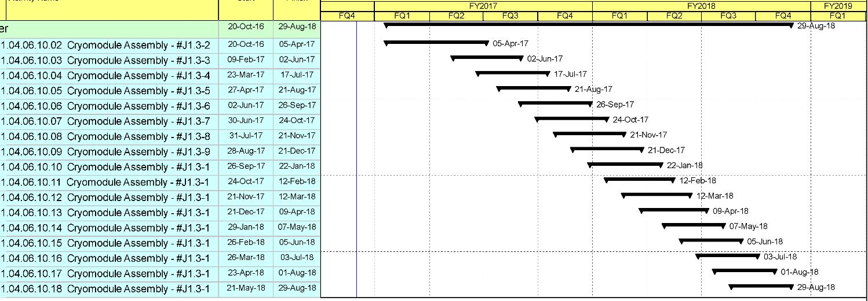
JLab LCLS II Production Schedule

Slide 5
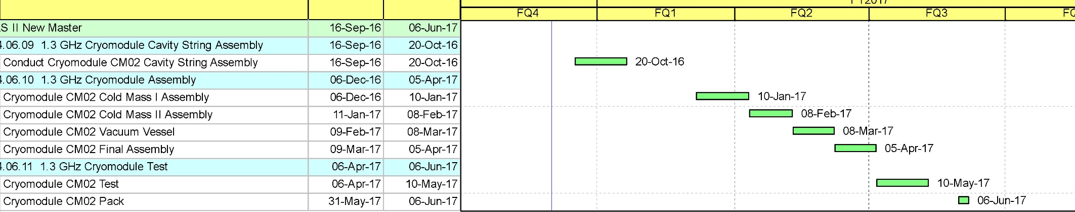
Typical LCLS II CM Assembly Schedule
Each task is about 4 weeks
There are five distinct tasks and test, with multiple work stations associated with CM I & II Assembly

Slide 6
Jlab Cryomodule Assembly – 7 Major Tasks
  Cavity Preparation and Test – VTA area
  Cavity String Assembly – Clean Room
  Cold Mass Assembly I – Cryomodule Rails
  Cold Mass Assembly II – Cryomodule Rails Existing
  Vacuum Tank Assembly
  Final Assembly
  Test

Slide 7
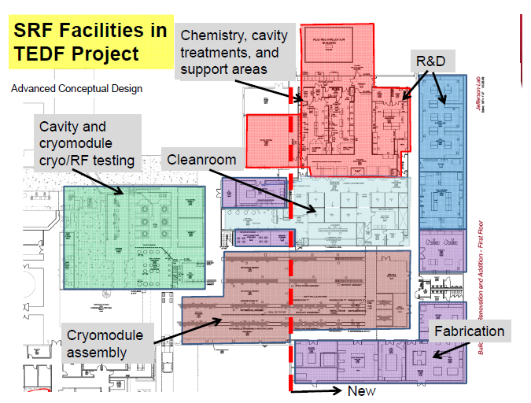
SRF Facilities at JLab
Located in Annex –
Receiving
Inspection
Inventory
Start
Offsite considered for additional storage
CMM/RF Checks
Ship

Slide 8
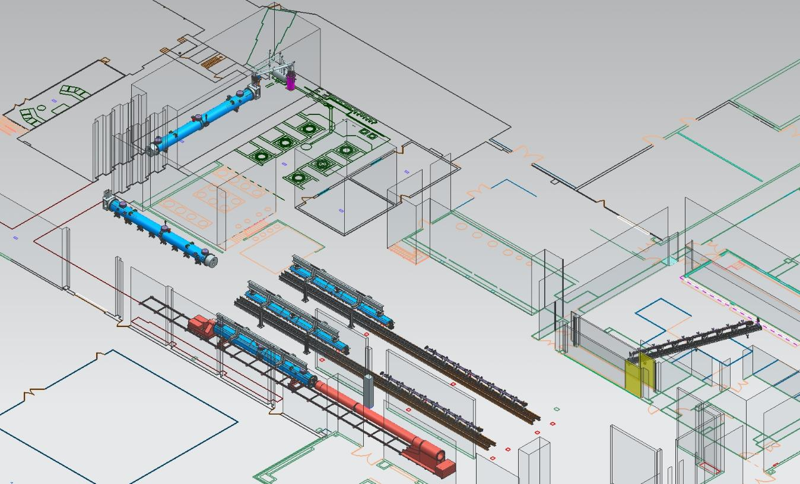
JLab Layout for LCLS-II CM Production
CM Testing
Phase II CM Assembly (2X)
Clean Room String Assembly
Phase I CM Assembly (2X)
Final Assembly / Prep for Testing
Vacuum Vessel Installation

Slide 9
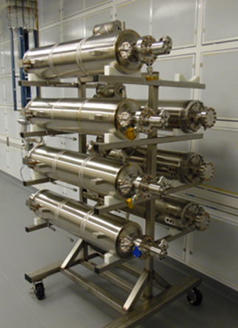
Qualified Cavities Staged for String Assembly
Cavities return to clean room post VTA test via crane lift to VAA
Cavities will be isolated, left under vacuum and installed on the clean room storage rack.
The Backtech equipped with the two arm tooling will be used for transfer.

Slide 10
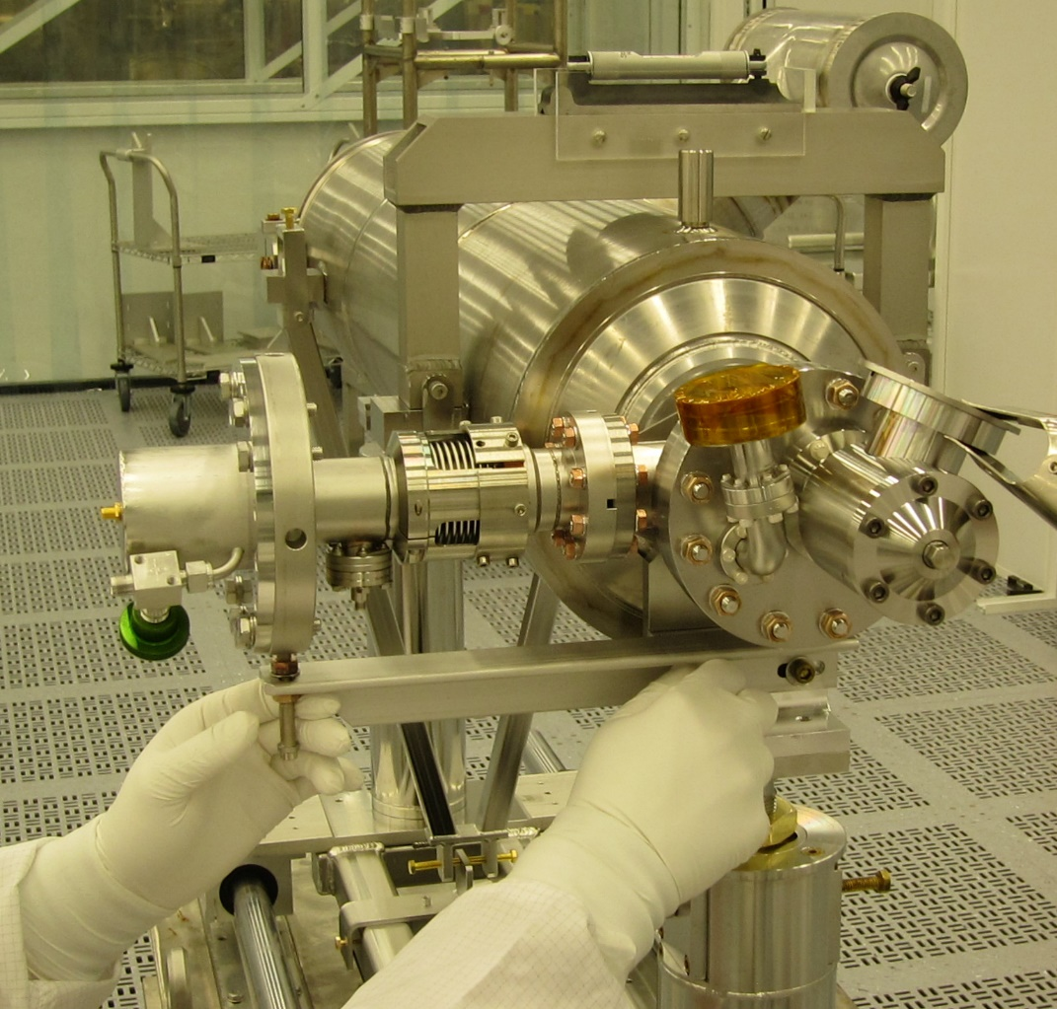
Cavity String Assembly in Clean Room
Component assembly tooling same as FNAL
“Lollipop” supports for each cavity and BPM subassembly
Lollipops mounted to mobile rail system
Use mobile rail system rather than rail-in-floor used at DESY, CEA/Saclay and FNAL
Transfer to CM assembly rails for cold mass assembly
Cold Coupler Assembly on AES033

Slide 11
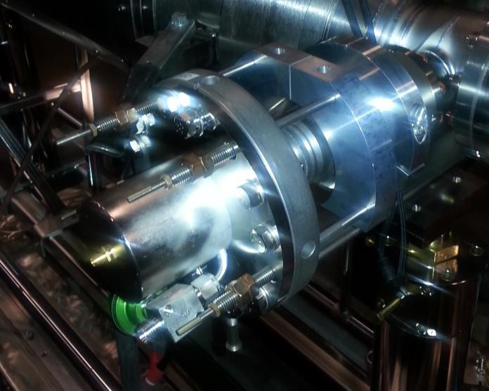
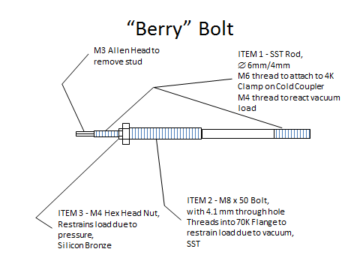
JLab Cavity String Assembly – Berry Bolts
Restraint that enables pump down and keep cavity string under vacuum using “Berry” Bolts
Installed inside of clean room during string assembly phase

Slide 12
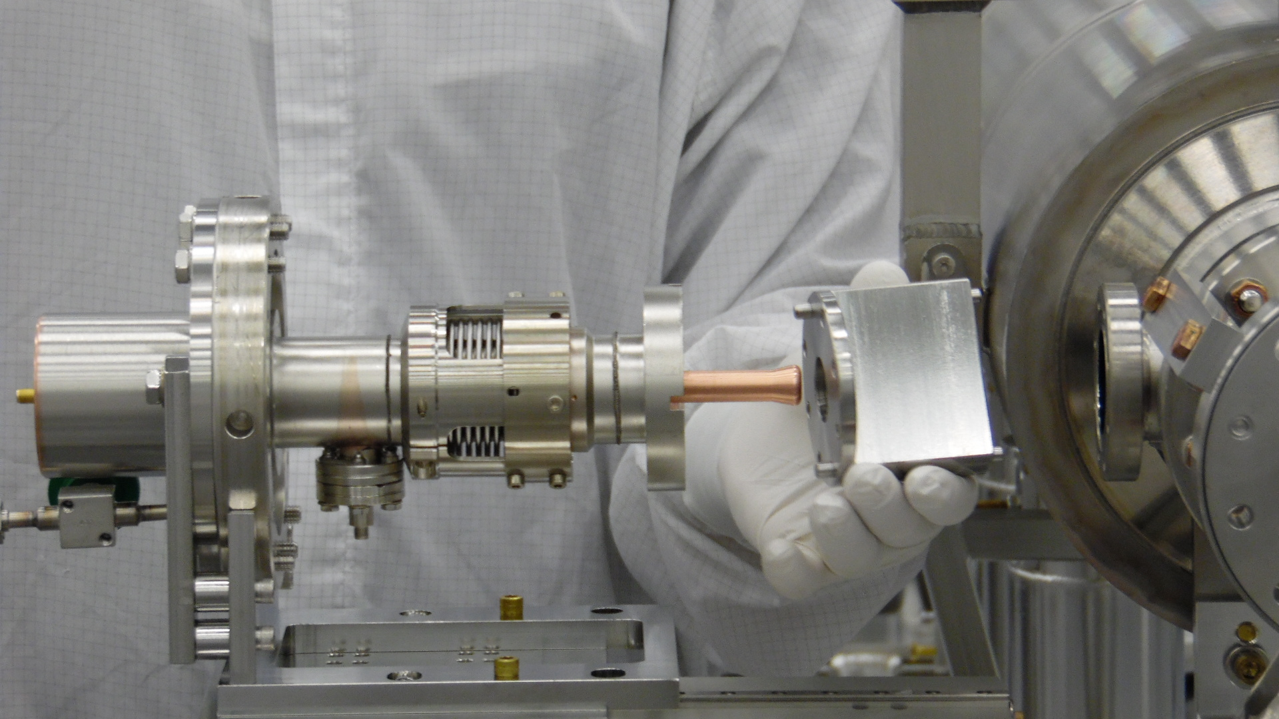
String cold coupler assembly – tooling ready

Slide 13
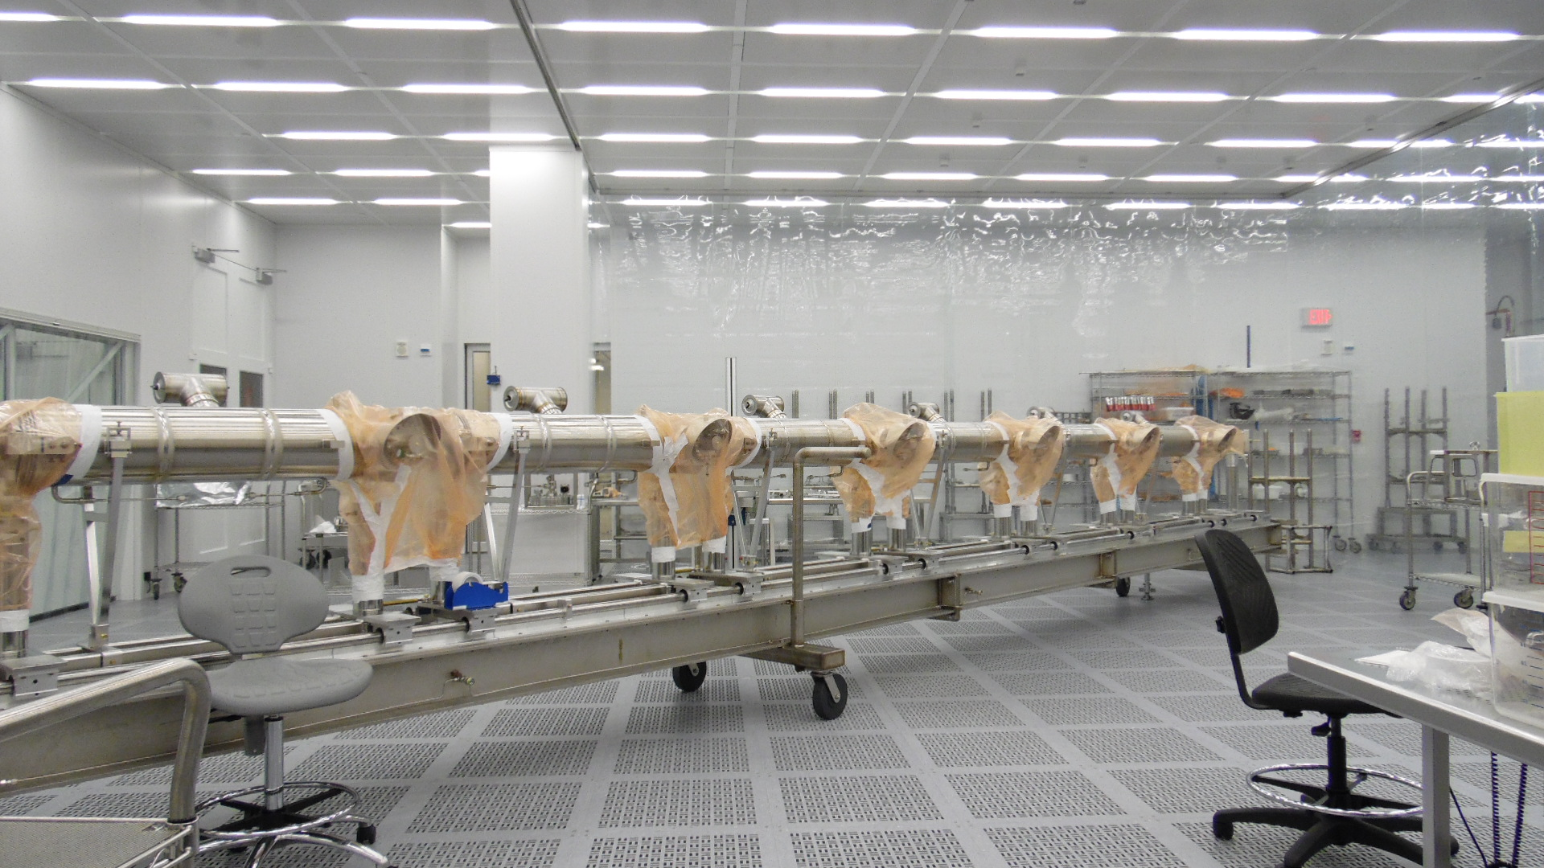
Cavity coupler installation

Slide 14
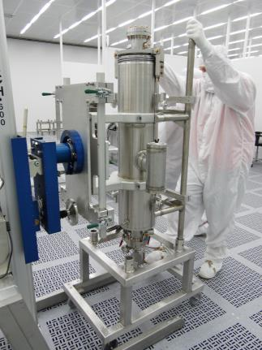
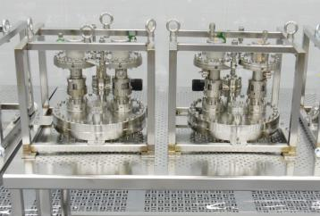
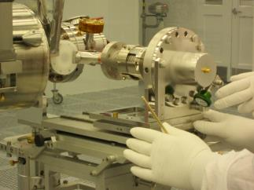
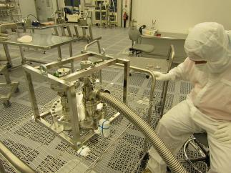
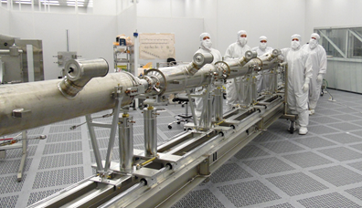
WS1 - pCM String Assembly Completed in May 2016

Slide 15
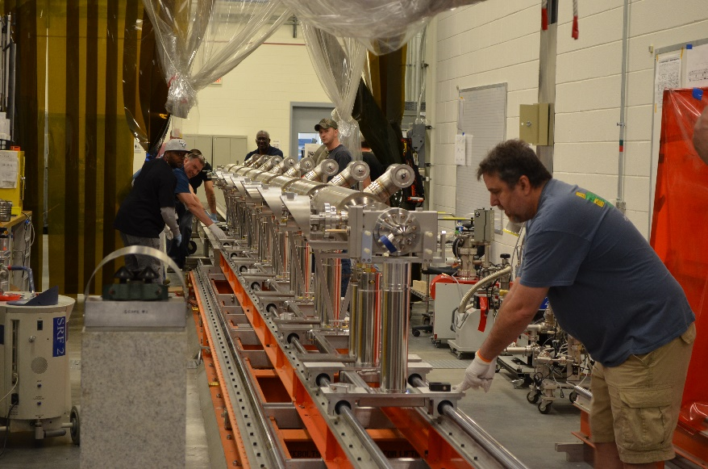
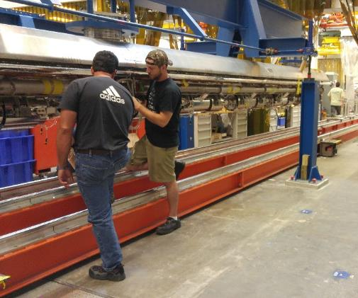
Cryomodule Assembly
Use two-rail system for cold mass assembly I (CMA I)
Use rail system to move cold mass from CMA I to CMA II
  Rails located under and in between 4-post systems
Use bridge crane to move cold mass from CMA II to cantilever system for installation into vacuum vessel
Use bridge crane to move from VV assembly to stands for final assembly
Use bridge crane to transfer from stands to roll carts to move into test cave

Slide 16
Cryomodule Cold Mass Assembly
  CMA II Primary Task
  Put the cold mass on the 4 support spreader bar fixture
  Align cavity string to GRHP to 0.1 mm (laser tracker)
  Complete the interconnect magnetic shielding assembly
  Complete the coupler heat shields intercepts assembly
  Complete cooling straps assembly to the cavities HOM
  Complete the harnessing of the instrumentation wires & RF cables
  Various electrical checks
  Weld the magnet current leads to the magnet instrumentation box
  Various leak checks of the helium circuit
  CMA I Primary Task
  2-phase helium pipes & bellows welding
  Cavity magnetic shields installation
  Tuner system installation
  Cavity insulation installation
  Temperature sensors instrumentation and RF cables installation
  Cavity helium vessel lugs needle bearings and housings installation
  Various leak checks / pressure tests of the helium circuit
  Various electrical and RF checks

Slide 17
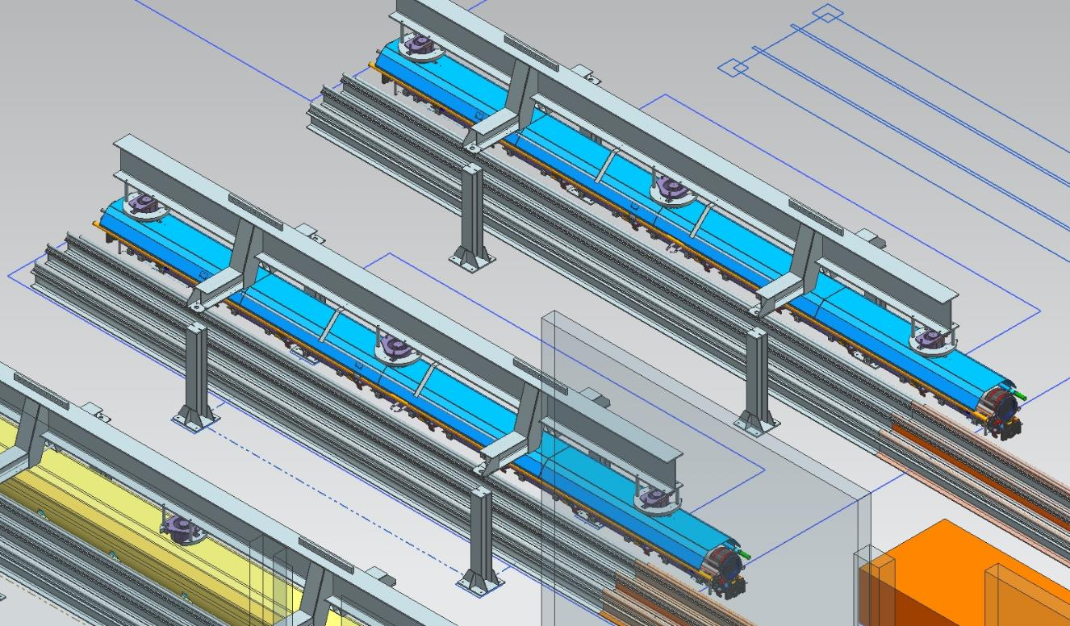
LCLS-II Cold Mass Assembly II
Existing JLab Rail Systems
“Four-Post” Fixture
Cold Mass Assy (10 kips)

Slide 18
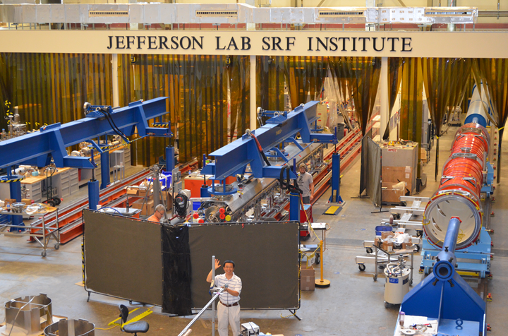
LCLS-II Cold Mass Spreader Bar Installed

Slide 19
Vacuum Vessel and Final Assembly
Vacuum Vessel Primary Tasks
  Install and weld 50K shields
  Lay and wrap 30 layers of MLI
  Trim insulations around main couplers, magnet and cold mass support posts
  Slide vacuum vessel onto the cold mass
  Align cold mass to the vacuum vessel (laser tracker)
Final Assembly Primary Tasks
  Weld JT/Cooldown valves
  X-ray of final welds
  Install warm part of the main power couplers + RF Waveguides
  Route & terminate instrumentations wires and RF cables to the feedthrough flanges on the vacuum vessel
  Install warm end coupler vacuum/pumping lines
  Pump down and leak check warm end coupler vacuum
  Pump down and leak check beamline vacuum
  Pump down and leak check insulating vacuum
  Install End Cans and Prep for CM Test

Slide 20
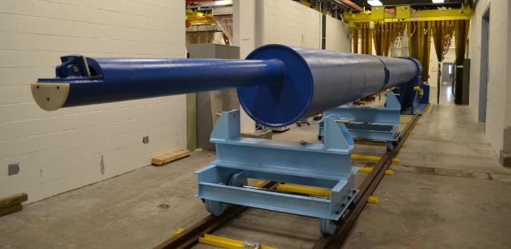
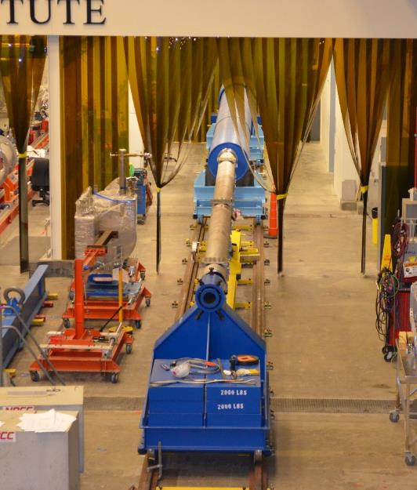
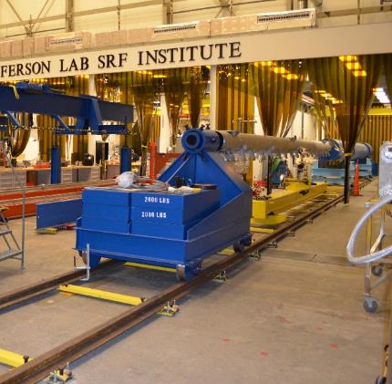
JLab Cantilever System

Slide 21
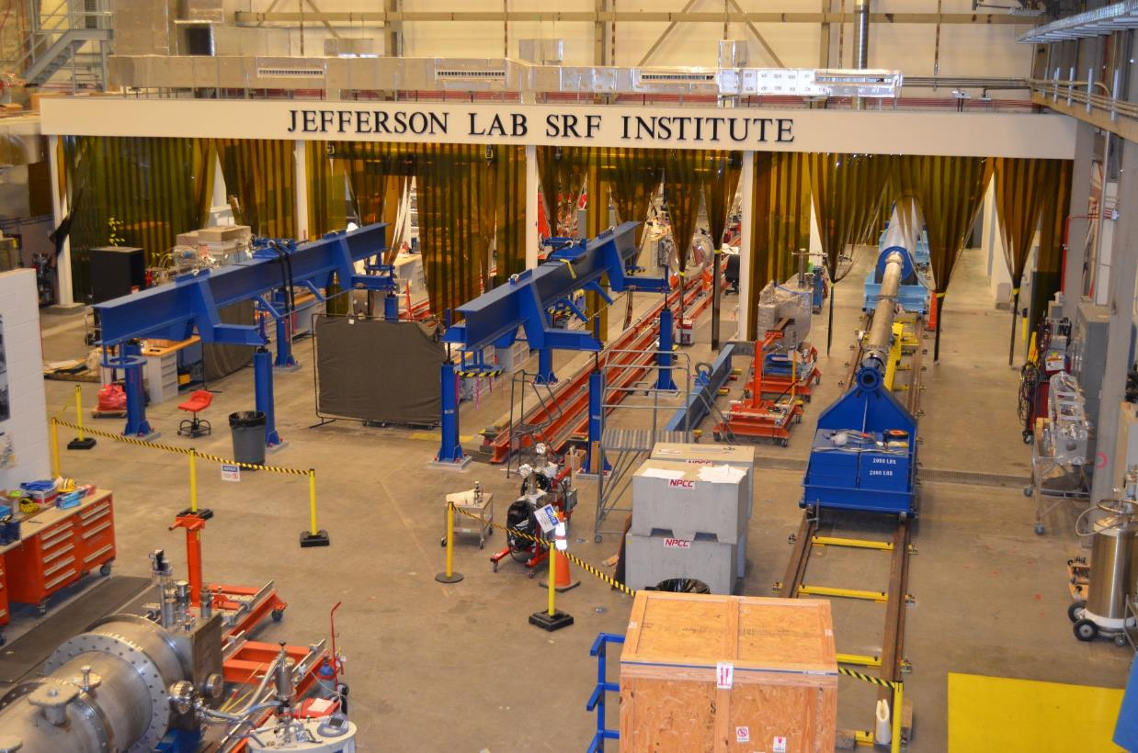
LCLS II Cryomodule Assembly

Slide 22
Magnetic Hygiene Program
Substitute materials with lower permeability
Check that parts are materials they are supposed to be
Measure magnetic fields on individual parts and demagnetize if needed
Set a spec, 10 G on contact, as the maximum for tooling used and follow it.
  Measure tools before use and exchange or demagnetize if needed
Measure and map vacuum vessel magnetic field.
  Demagnetize using coils wound on vacuum vessel according to procedure
  Verify performance of demagnetization procedure
Measure magnetometers at hold points through out the assembly process
Demagnetize finished cryomodule
  Use magnetometer measurements to verify demagnetization procedure

Slide 23
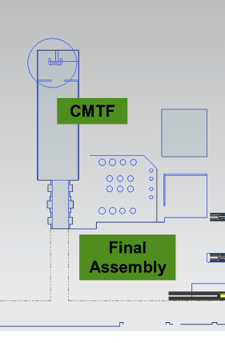
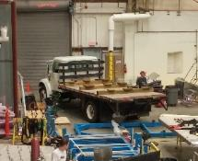
Prep for Shipping
Prep for shipping
  Warm up CM. Bleed up insulating vacuum
  Remove Faraday Cups and BL pipes with End Cans
  Install final Beamlines
  Install blank shipping caps
  Attach lifting fixture to CM
  Bring shipping cradle on truck bed in North West roll up door
  Lift CM to shipping cradle and remove lifting fixture
  Prepare CM /cradle for shipping
Prep for shipping
Crane lift to cradle on truck

Slide 24
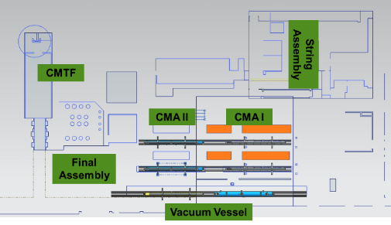
Staying on Track
Facilities and tooling support having 7 cryomodules in production at full ramp
  (1) in String Assembly
  (2) in Cold Mass Assembly I
  (2) in Cold Mass Assembly II
  (1) in Vacuum Vessel (cantilever)
  (1) in Final Assembly
Built in redundancy at Cold Mass Assembly
  One Rail/4-Post system is minimal required, having two enables mitigating schedule impacts and resulting “standing army” effect
Use of mobile rails and additional stands allows for CM to be set aside at worse case
Staffing strategy is to have one Lead SME with ~ 3 technicians per work station (6 stations)
  Cross trained to allow for transfer of resources to load

Slide 25
Planned Production Rate
Vertical Testing of Bare/Dressed Cavities
  Capacity - 4 cavities per week reserved for LCLS II
  Planned qualification rate – 2 cavities per week (C100 actual)
Cavity String
  Capacity – 2 strings ~ 5 weeks
  Planned Rate – 1 per ~ 4 weeks
Cold Mass and CM Assembly Tools
  Capacity – 2 CM per month for LCLS II
  Planned rate – 1 CM per ~ 5 weeks (SNS actual)
Cryomodule Testing Facility (CMTF)
  Capacity & planned rate – 1 CM per 5 weeks

Slide 26
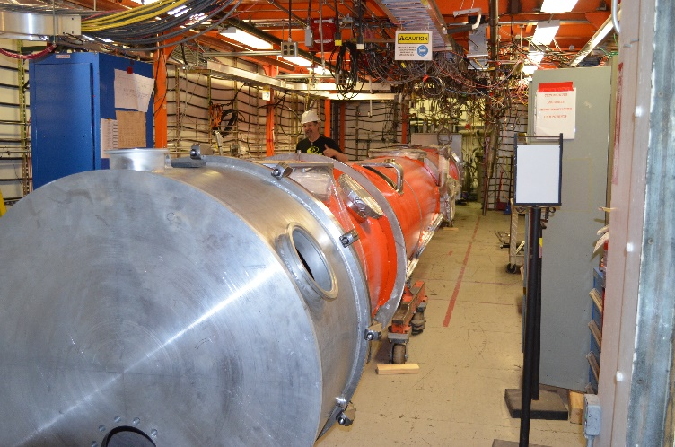
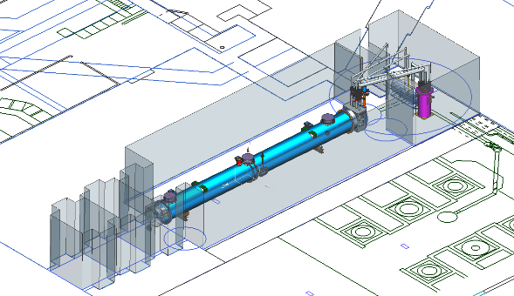
JLAB CMTF: Production Rate Limiter
Test cycle planned to be ~ 5 weeks
HPRF to test single or all eight cavities together
TBD system for testing SC magnet
Magnetic shielding encloses testing volume reducing external fields to less than 50 mG
Cryogenic capacity for testing individual cavities in CW mode
End Caps – specific for LCLS-II CM testing
  Interface to CM piping and existing junction box using u-tubes

Slide 27
ISM & Safety
Safety is integrated into all tasks in Cryomodule Assembly
Supervisors specify training for staff
Embedded Safety wardens in areas
OSPs will specify training required for tasks; e.g.
Demagnetization of LCLS II Vacuum Vessel Prior to Assembly requires SAF 104, SAF603A, and review of the OSP
TATLs (Task Assessment Test Lab) are Work Control Documents used for communicating work within Test Lab

Slide 28
Potential Risks to Schedule
Magnetic hygiene; we have seen issues with high remnant field on pCM, which we mitigated by in situ degaussing while monitoring the embedded magnetometers. Limited magnetometers on production CMs.
FNAL has developed a time/current program which has produced good results which might be used without internal metrology. Alternately, some metrology might be added to baseline.
If there is a problem found during cooldown or testing, the module must be set aside until assembly run is complete since cantilever fixture is a “choke point” for the assembly process and is also required for disassembly.
The use of mobile rails allows the module to be set aside easily. Once defect is understood, the assembly schedule might be adjusted to put resources on preparing the module in need of repair to be removed from the vacuum vessel. Removal of the vacuum vessel using the cantilever fixture, could be timed between two CMs assembly.

Slide 29
JLab Org Chart
Lab Director
H. Montgomery
Support
CPO
Senior Technical Lead
Administrative
C. Fragapane
ESH&Q
B. Rainey
Systems Integration
S. Smith
Procurement
M. Laney
QA
J. Leung
A. Lung
J. Preble
Deputy TBD
PMO
K.Krug
E. Evans
P. Kessler
Cryogenics
RF Controls & LLRF
SRF (Cryomodules)
High Q0
Accelerator Physics
D. Arenius
M. Bevins
C. Hovater
E. Daly
K. Wilson
C. Reece
G. Krafft
Accelerator Division
Engineering Division
CFO
CPO
As of 1 June 2016

Slide 30
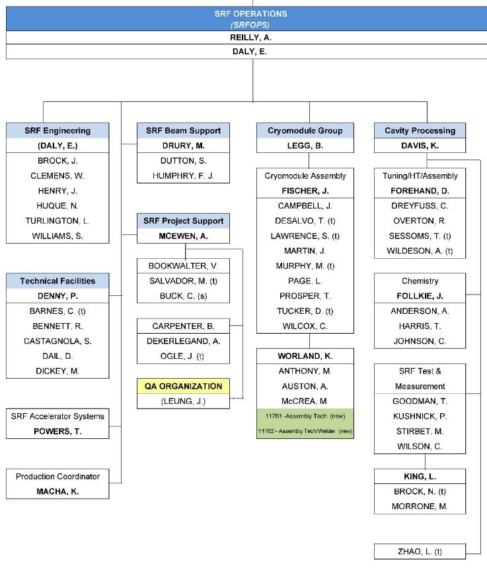
Cryomodule Assembly Team
Alignment Group
Chris Curtis
Jim Dahlburg
Kelly Tremblay
https://www.jlab.org/accel/office/org_chart.pdf
Engineering Department Staff (matrixed/assigned to SRF Engineering)
K. Wilson G. Cheng
H. K. Park T. Hiatt

Slide 31
Hands on Cryomodule Assemblers
Additional hands on support provided by the Chemistry and Technical Facilities groups.
CM Assembly
Cleanroom Assembly
Instrumentation
Welders

Slide 32
Staffing Ramp
Balancing other work at JLAB to avoid standing army issues; e.g. Lull in LCLS schedule in November is taken up by C50-13 work.

Slide 33
JLab LCLS II Cryomodule Labor
Basis of estimate was 12 GeV - Adjusted for known scope differences
    For example LCLS II cavities will be “test ready”
Labor refined from visits to CEA Saclay and information provided by Saclay
  Cavity string and cryomodule assembly labor were reduced
Average over 17 CMs
Activity | Person Hours per CM
Cavity Prep and Test | 2150
String Assembly | 720
Cryomodule Assembly | 4640
Cryomodule Test | 913
Pack and Ship | 242
Assembled, Tested and Shipped | 8665
= 5360
Cryomodule Labor Ramp Profile (hours/CM)
Early Production | Mid Production | Full Production
CM02-CM06 | CM07-CM-10 | CM11-CM18
6374 | 5144 | 4857

Slide 34
1.3 GHz Production CM Procurement Status
Vast majority of production procurements awarded

Slide 35
Off-Site Storage and Inspection
Space required to stage, inspect and store LCLS II cryomodule components
Estimated space to stage and store components is 8500 square feet
  Conditioned space, Lighting, Racks
Estimated space for receipt inspections is 1500 square feet
  A dedicated environmentally controlled room will be needed
Total estimated space needed to support LCLS II is about 10,000 square feet

Slide 36
Blue-Crab off-site storage
Demag. and Insp. of VV
Parts Storage
Loading/ Unloading Area
Inventory and Inspection Office

Slide 37
Cryomodule Travelers
RECVing traveler (inventory) 32 done / 32 total
INSP/PROC/ASSY travelers 31 done / 34 total
Procedures 40 done/ 46 total
RECV TRAVELERS (Does the part have a serial number?) |  | INSP TRAVELERS (Will the part be inspected?) |  | CHEM/PROC TRAVELERS |  | ASSY TRAVELERS
CRYOMODULE (CM) |  | CRYOMODULE (CM) |  |  |  | CRYOMODULE (CM)
L2PRD-CM-RECV |  | N/A |  |  |  | L2PRO-CM-ASSY-FRST | FISCHER
L2PRD-CM-RECV-BP2PH | CHENG | L2PRD-CM-INSP-BP2PH | CHENG |  |  | L2PRO-CM-ASSY-SCND | FISCHER
L2PRD-CM-RECV-DCXCU |  |  |  |  |  | L2PRO-CM-ASSY-VV | FISCHER
L2PRD-CM-RECV-DCXSD |  |  |  |  |  | L2PRO-CM-ASSY-FINL | FISCHER
L2PRD-CM-RECV-DDTSD
L2PRD-CM-RECV-DDTCU
L2PRD-CM-RECV-FT06P
L2PRD-CM-RECV-IP75SD
L2PRD-CM-RECV-MCCLA | CHENG | L2PRD-CM-INSP-MCCLA | CHENG |  |  | MISSING ? UNKNOWN
L2PRD-CM-RECV-UCMASS | CHENG | L2PRD-CM-INSP-UCMASS | CHENG |  |  | N/A
L2PRD-CM-RECV-C12P |  |  |  |  |  | NOT YET RELEASED / RECEIVED
L2PRD-CM-RECV-IP75SD |  |  |  |  |  | COMPLETED / IN PRODUCTION
L2PRD-CM-RECV-P2PH
L2PRD-CM-RECV-VV

Slide 38
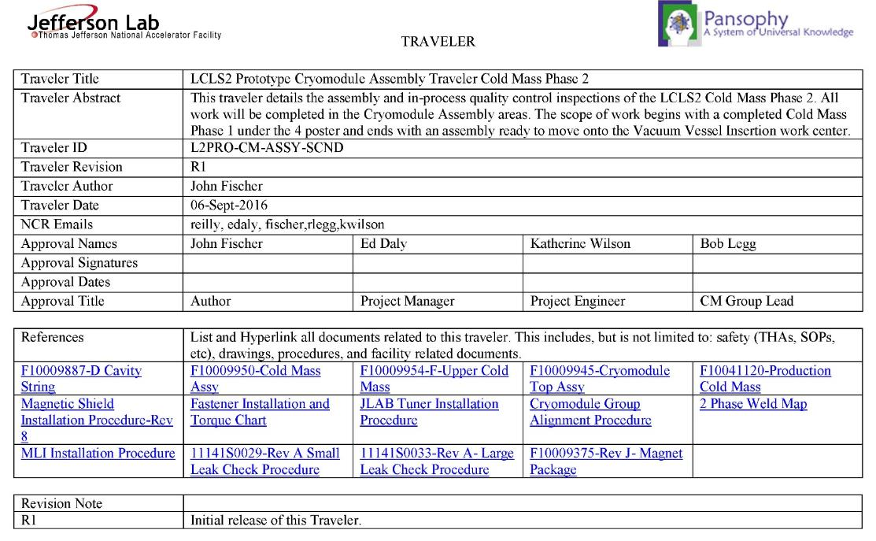
Documentation
Travelers provide day to day task planning for the work. They provide links to the drawings, procedures and documentation which is expected from the task.

Slide 39
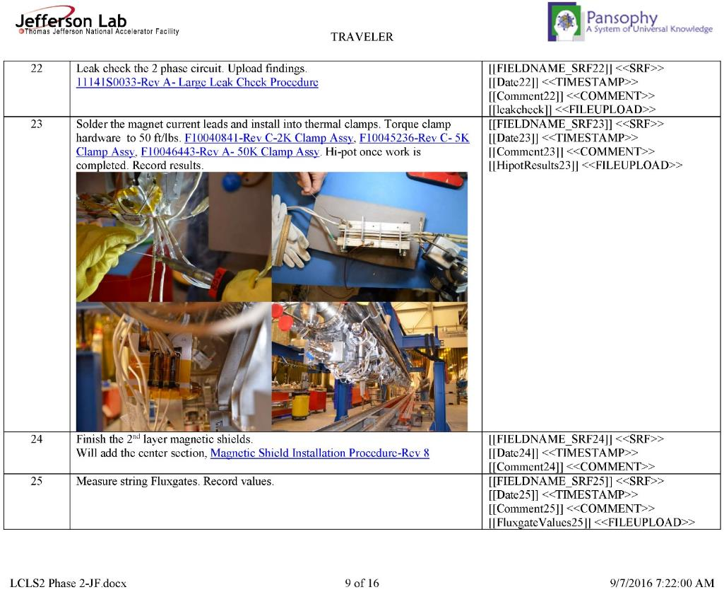
Documentation
Perform external procedure and upload documentation from task
Links to drawings to make task clear. Pictures always help.
Magnetic hygiene measurement and record in traveler

Slide 40
CM Production Preparations at JLab
Adapt existing infrastructure and facilities to accommodate LCLS-II components, sub-assemblies, final assembly and testing
Define processes required for component handling, assembly and testing
Develop staffing plan and hire and train necessary staff to perform processes
Develop work control documents using SRF QA Tools used for 12 GeV 100 MV CW cryomodules (aka C100) production and SNS production

Slide 41
Production Readiness
  Tooling and Infrastructure for assembly is in use
    Two parallel CM rails and four posters in place, cantilever in place as third work station for CM assembly
  Preparing for production assembly efforts
    Receipt inspection efforts have commenced
    Assembly procedures in progress; Phase 1 complete.
    Traveler system in place including reporting
    Staff is ramping up
  Currently completing CM Testing Facility
  Production procurements are progressing well
    All contracts placed; vendors have begun deliveries
JLAB is ready to start Cryomodule Production.

Slide 42
Back Up Slides

Slide 43
JLab Facilities Improvements:
Clean Room Modifications Completed
General
100% ULPA coverage
Laminar flow, 100% perforated RMF, side wall return
Bulk headed HPR and other process tools
LCLS II
Dedicated, segregated area for string assembly
  About 1800 sq.ft. (majority of open clean room area)
  Clean room curtains used for segregation
  Compartments for cavity staging, component staging, coupler prep and parts blow down
Adjacent to roll-up air lock door for string roll-out
Configuration specific to JLab

Slide 44
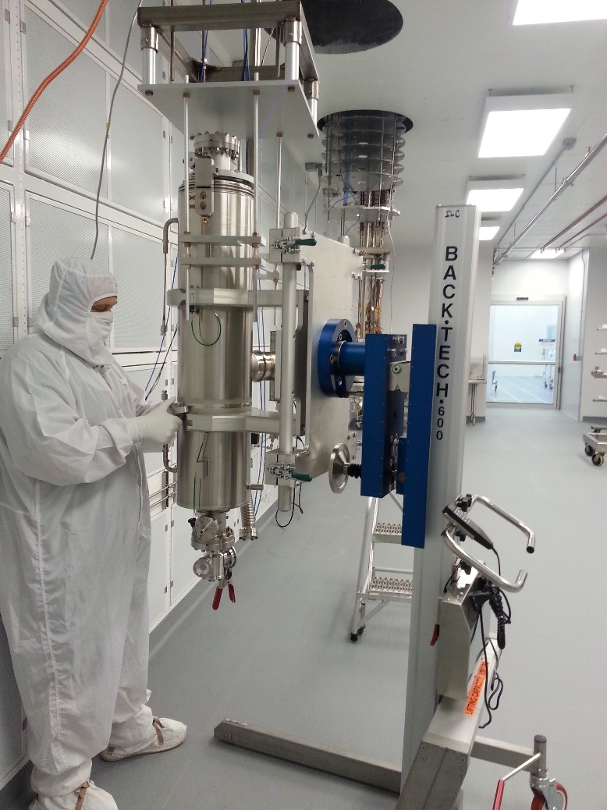
JLab Cavity Vertical Test
Vertical qualification testing
  Continuous pumping during vertical test – standard at Jlab
  Dedicated dewars (7&8) for LCLS II
    Low magnetic field, controlled with compensation coils
    4 dedicated test inserts (identical configuration) equipped with pump systems
    Additional dewars with compensation coils available as needed

Slide 45

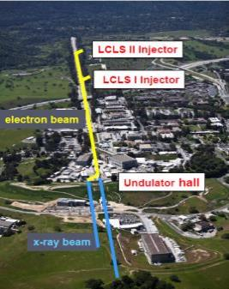

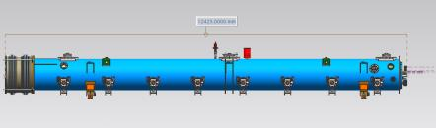
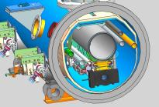
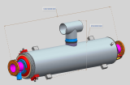
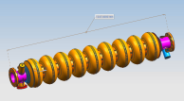
LCLS-II Cavity/Cryomodule Process at JLab
Supplier
Partners
JLAB SRF Facility
Receiving in SRF Inventory
Mechanical Inspection CMM
 | Component | FNAL | JLAB | SLAC
Cavity String | Niobium (Prototype) - existing cavities | NA
 | Niobium (Production) | X
 | Cavities (Prototype) - existing cavities | NA
 | Helium Vessels (Prototype) | X
 | Cavities w/Helium Vessels -VTS Ready (Production) |  | X
 | Cavity Feedthroughs |  | X
 | Cavity Flanges & Assoc. Hardware/Seals (VTS & HTS compatible) |  | X
 | Fundamental Power Coupler (FPC) |  |  | X
 | Cavity String Interconnecting Bellows |  | X
 | Cavity String Assembly Hardware & Seals | X
 | SC Magnet Assembly | X
 | Beam Position Monitor (BPM) | X
 | Gate Valves |  | X
 | Beamline Vac. Monitoring Manifold & Gauge | X
Cryomodule | Two-phase Pipe Bellows | X
 | Tuner, actuator, piezos (Prototype) | X
 | Tuner , actuator, piezos (Production) |  | X
 | Magnetic Shielding | X
 | GRHP Sub-assembly | X
 | Vacuum Vessel | X
 | Coupler Pumping Lines & Pumps (ion+TSP) + vacuum gauges | X
 | Instrumentation | X
 | Liquid Level Probes & JT Valve | X
 | Beamline Interconnect Parts including Aluminum Heat Shields | X
 | HOM Absorber |  | X
 | Shipping Frames & End Caps + Shock Log Devices |  | X
 | X = Lead Lab per SLAC LCLSII-4.1-PM-0229-R0 (June2014)
Cavity /Helium Vessel Prep. & Test
VTA RF Test in liquid Helium @ 2 K
Cavity String Assembly & Leak Test
Assemble Cavity String -Class 100 Clean Room
Courtesy Chi-Chang Kao, SLAC
Cryomodule Assembly
Instrumentation & Wiring
Tuners, MLI– Multi Layer Insulation,
Cryogenic Circuits , magnetic shielding, alignment
Super Insulation Cabling & Shield
Vacuum Vessel & Final Alignment
Install Cryogenic Supply Interfaces
  Horizontal Test Preparation
  Pressure Test & Leak Check (vacuum)
Commissioning at SLAC
Install Cryomodules in Accelerator, cool to 2 K
Weld & certify leak tight , pressure test
check Controls,
Gradient & Dynamic Heat Load - Q_{o}
Cryomodule Test in “Test Cave”
Cryomodule integrity @ 2 K
Tuners - Range, Hysteresis, & Resolution/ Sensitivity
Cavities for Gradient & Dynamic Heat Load Q_{o}
LCLS-II 1.3 GHz Cryomodule
Cryomodule shipping to SLAC
JLAB support for installation of first 3 Cryomodule

Slide 46
Strategy – One Design, Two Production Lines
  Designs for Prototype and Production CMs (aim to satisfy PR and CM FRS)
  Identical Prototypes - utilize as much existing hardware as possible to reduce schedule risk and reduce overall cost while achieving the same performance as the production CMs
  Identical Production Designs - utilize as much of the DESY/XFEL design as practically possible to reduce schedule risk and reduce overall cost
    FNAL produces 16 CMs; JLab produces 17 CMs
  Identical Parts Received at Partner Labs
    Well-developed drawing packages, clear requirements and specifications
    Concurrent reviews within LCLS-II project
    Procurement activities – lead technical contacts at Jlab/FNAL/SLAC work together during all phases
  Identical Tooling Interfaces
    Interfaces between CM hardware and tooling are identical
      Avoid adding custom features to CM
    Adapt non-CM hardware interfaces to Lab-specific tooling
  Equivalent Processes yielding Equivalent Performance
    Recognize that some tools are different at each lab (e.g. HPR, vertical testing systems, vacuum leak checking equipment, etc.)
    Monitor key process variables in consistent fashion (e.g. samples to verify etch rates)

Slide 47
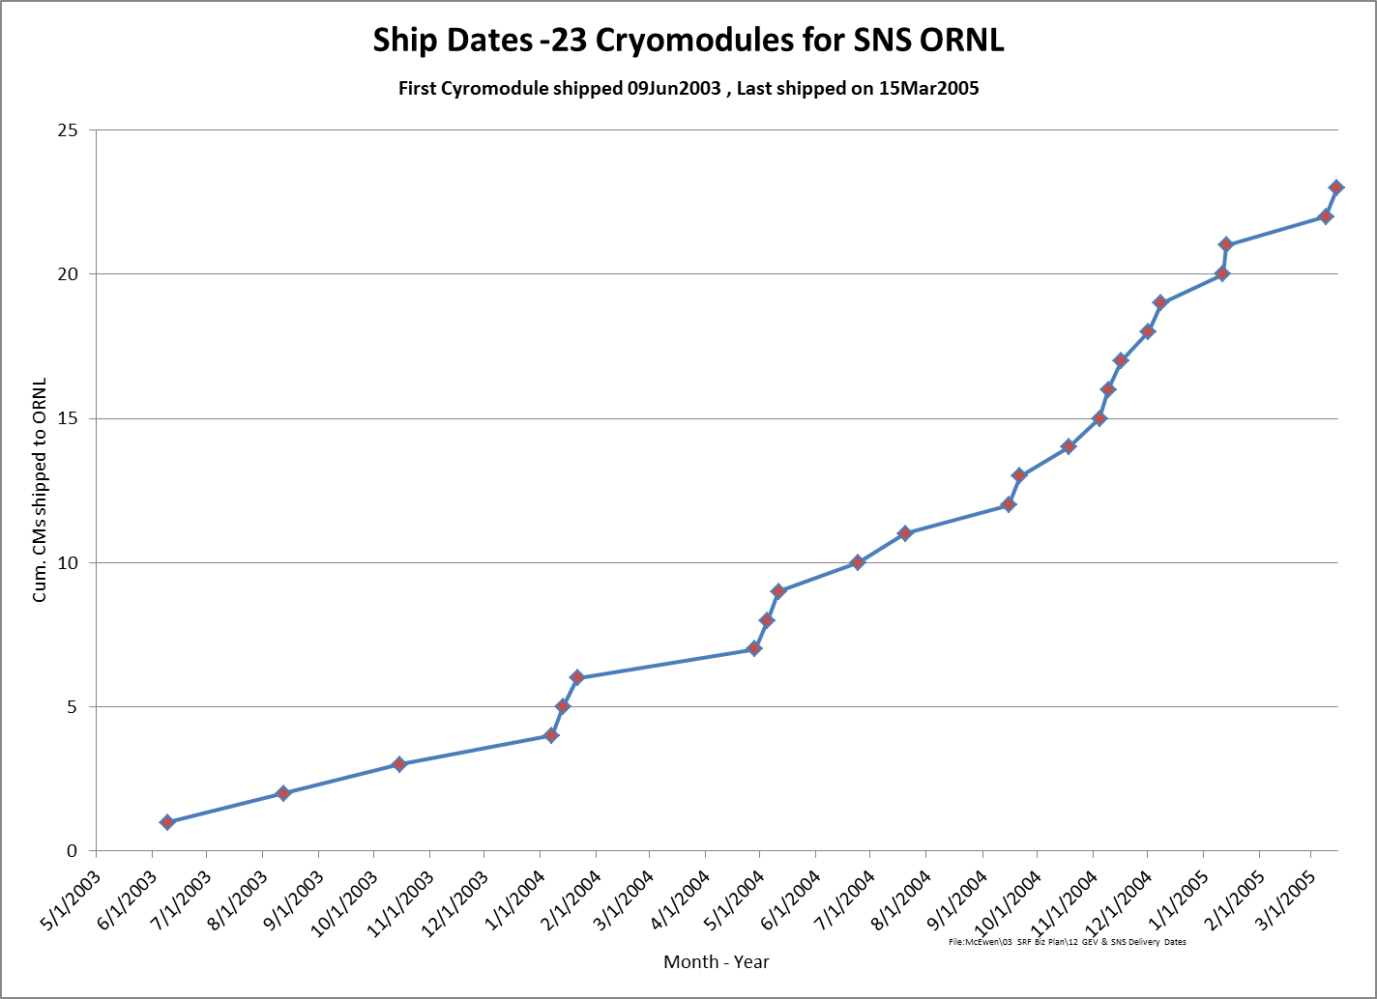
SNS: Average Rate of 1 CM per Month
CEBAF: 2 CM per Month at Peak

Slide 48
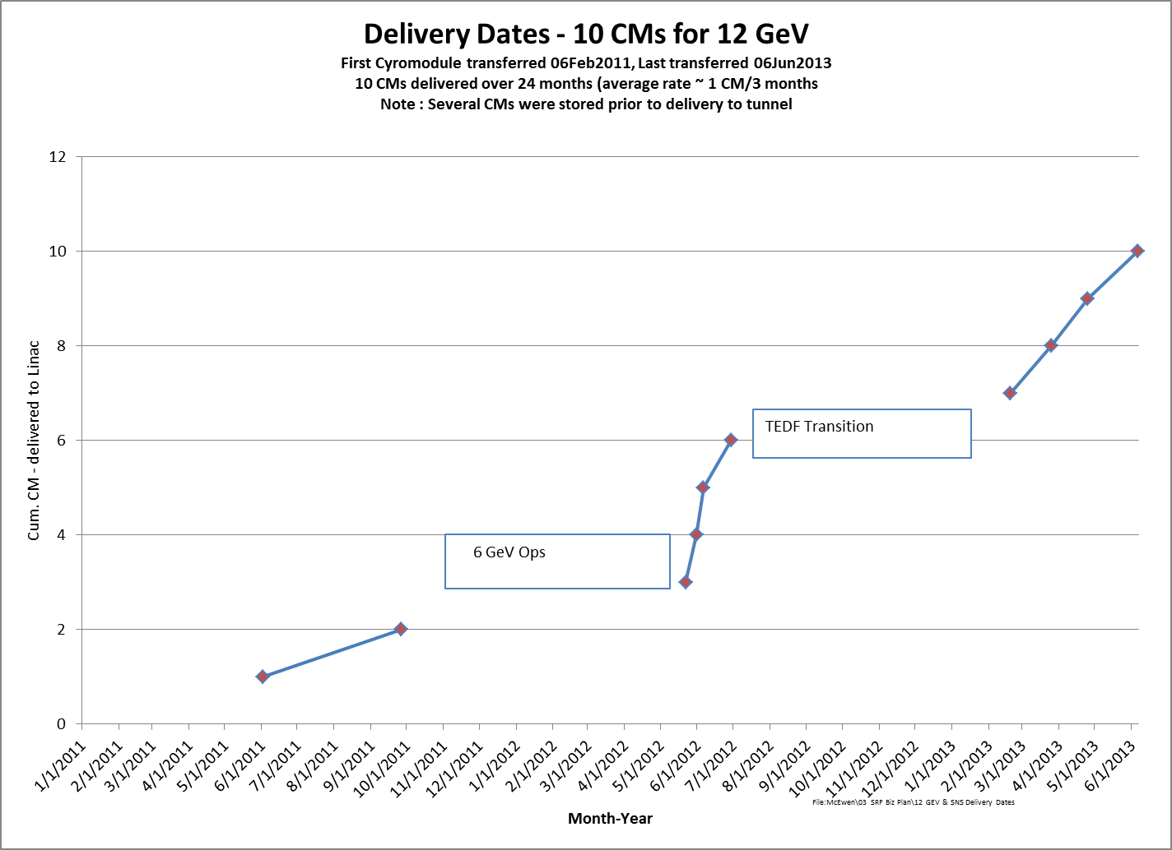
Rate of ~ 1 CM every 5-6 weeks

Slide 49
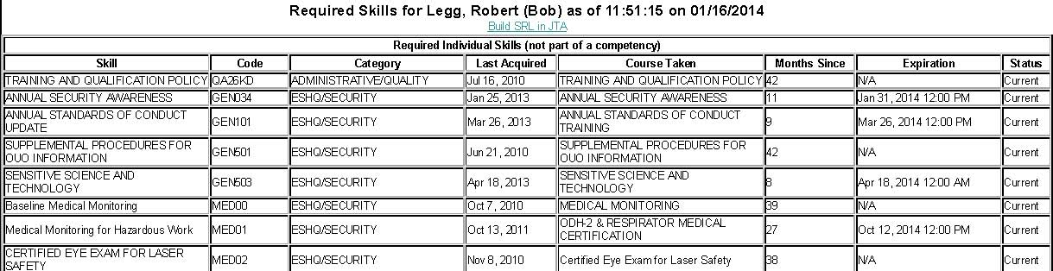
Staff Training – LMS & SRL
Training & Qualification Policy
Purpose | This policy establishes expectations for the Jefferson Lab training and qualification program. This program is established and implemented to satisfy the requirements of DOE O 414.1D, 10 CFR 851, ES&H Manual and the Jefferson Lab Quality Assurance Program Description.
Scope | This policy applies lab-wide. It ensures that all personnel are proficient commensurate with the scope, complexity and nature of their work assignments. The training and qualification program provides for development, maintenance and documentation of this needed competence.

Slide 50
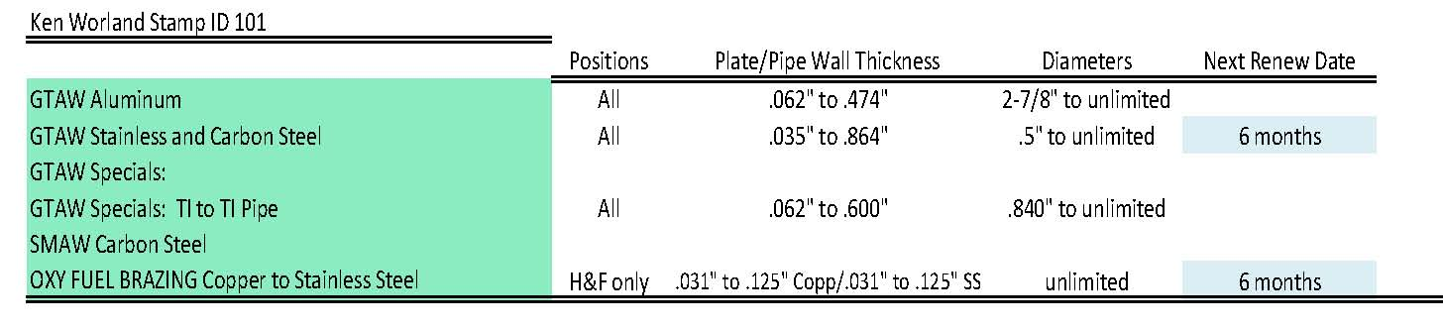
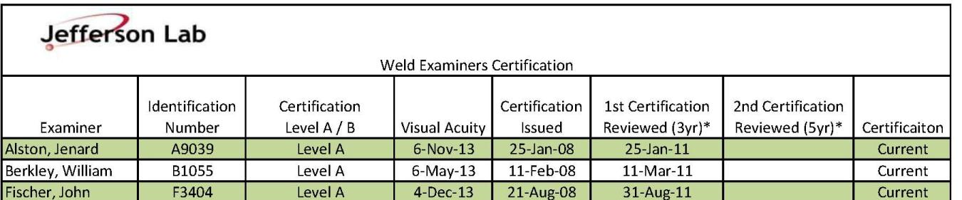
Staff Training – Welding and brazing
Qualification for welding and brazing are awarded by completing tests and are kept in special section of Docushare.
Similar qualification for weld examiners.

Slide 51
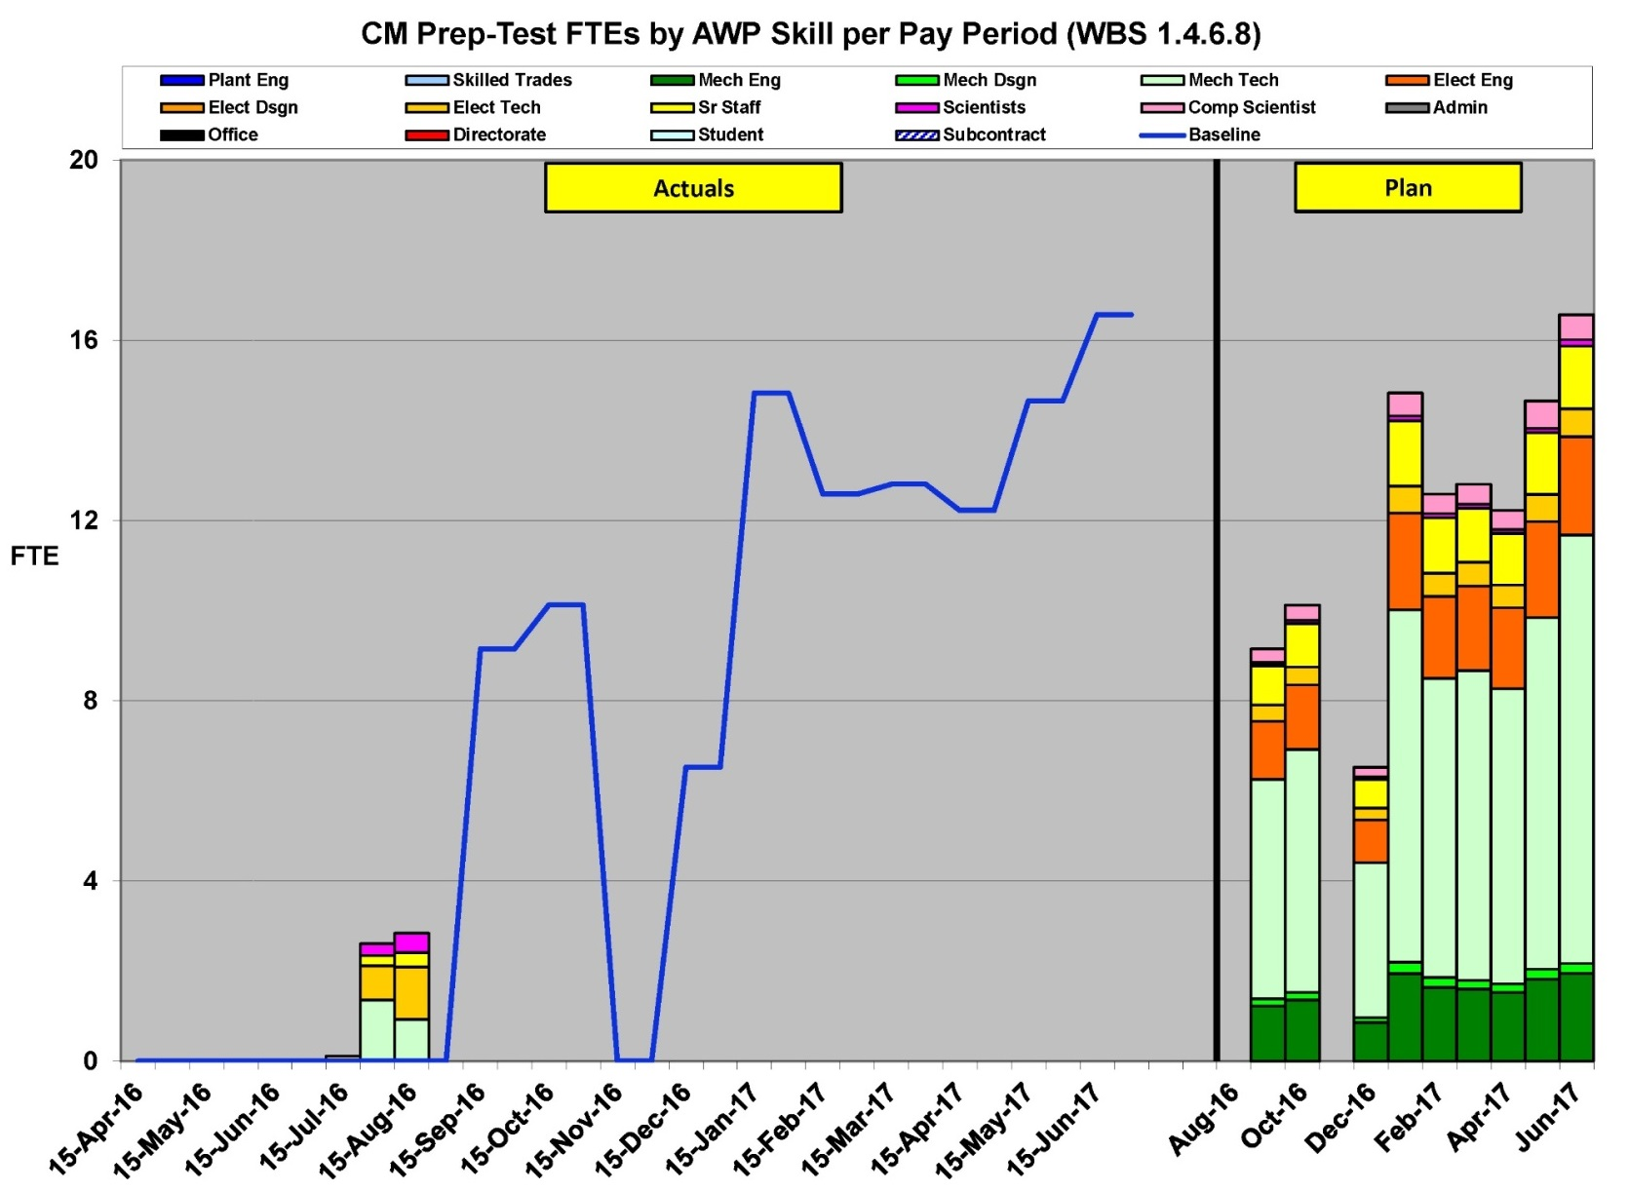
Cavity Qualification and VTA Labor

Slide 52
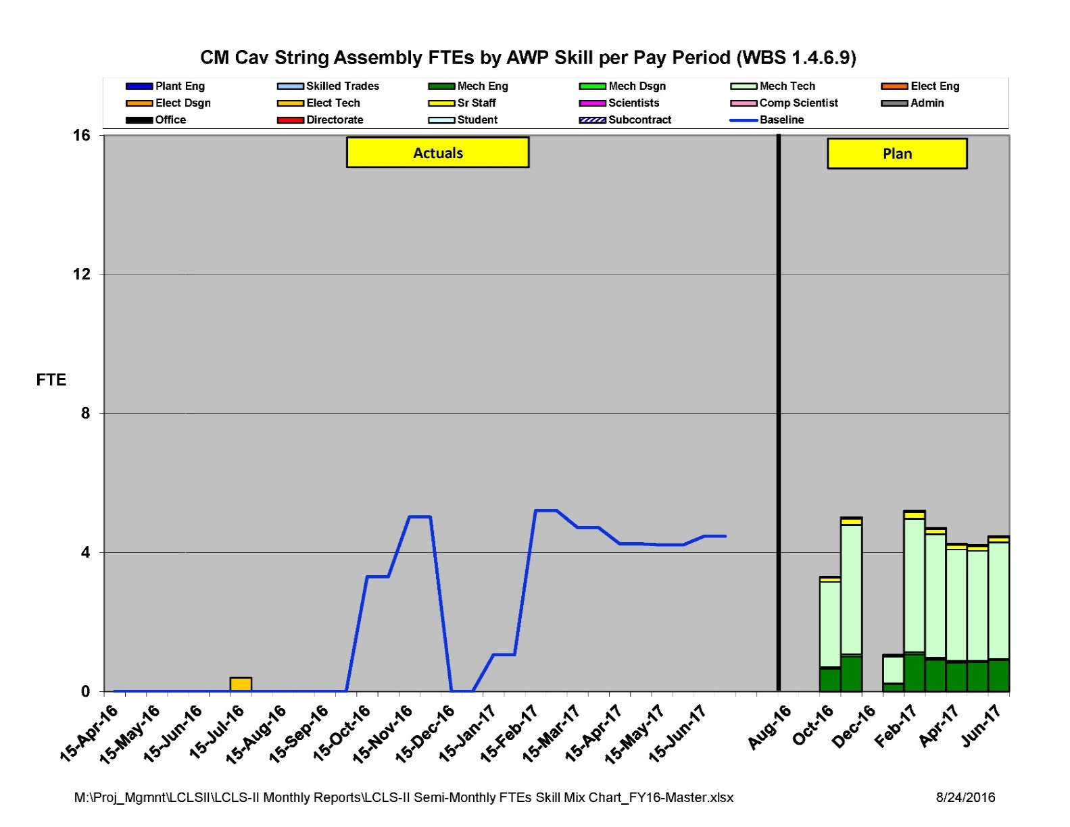
String Assembly Labor

Slide 53
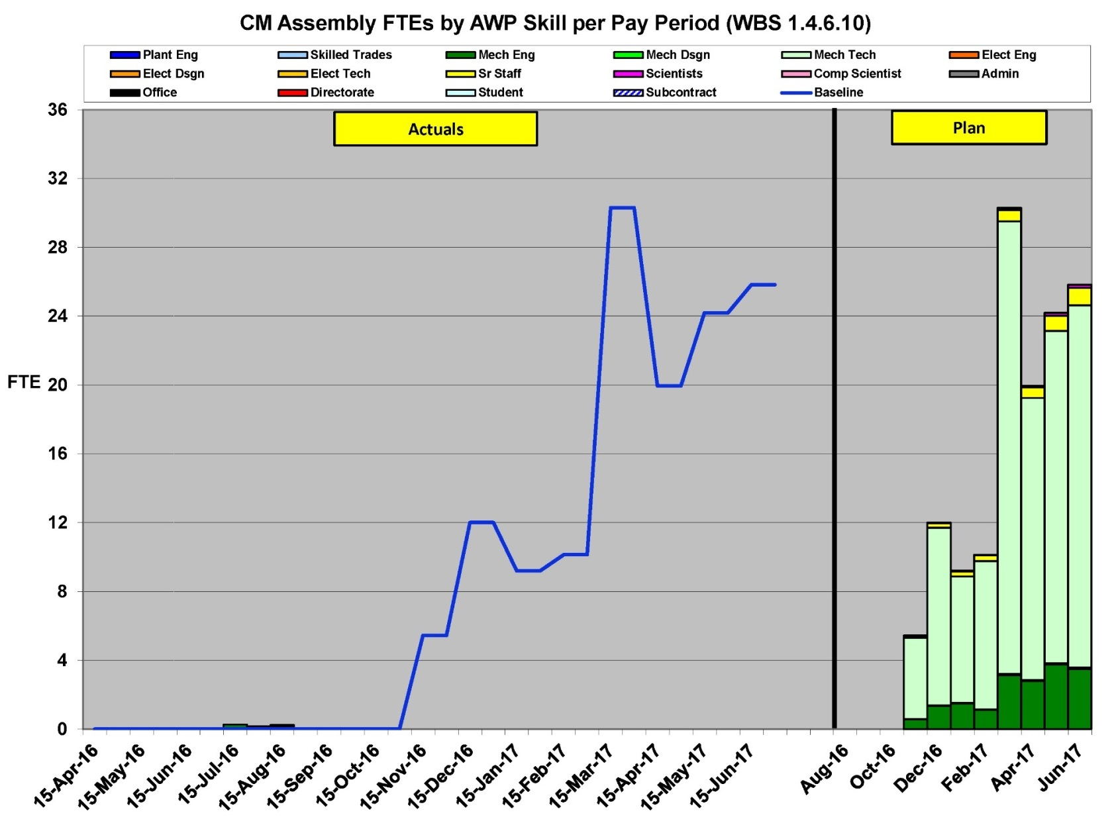
Cryomodule Assembly Labor

Slide 54
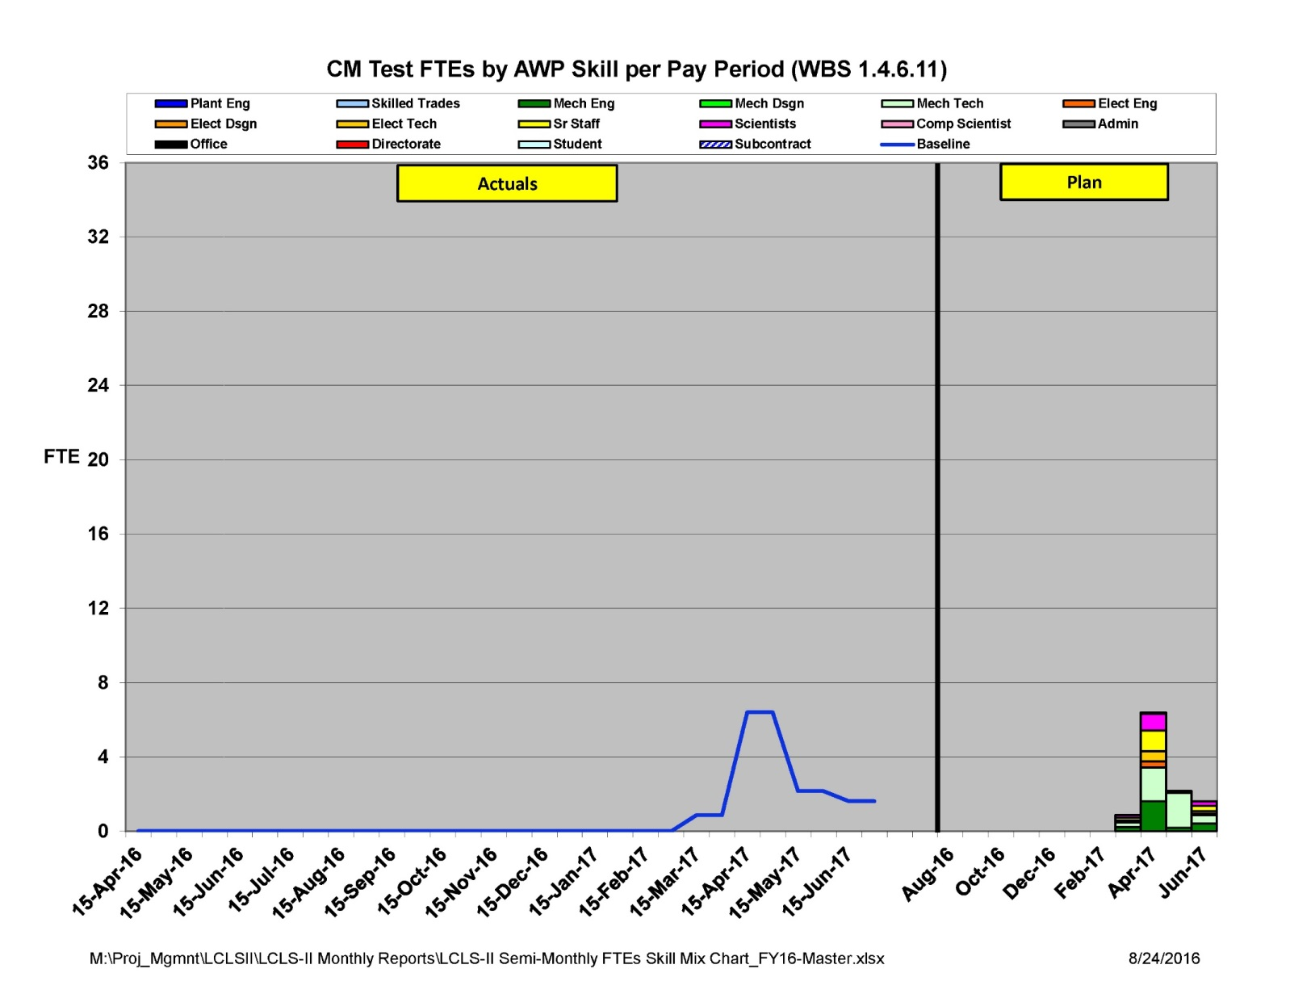
Test Labor

Slide 55
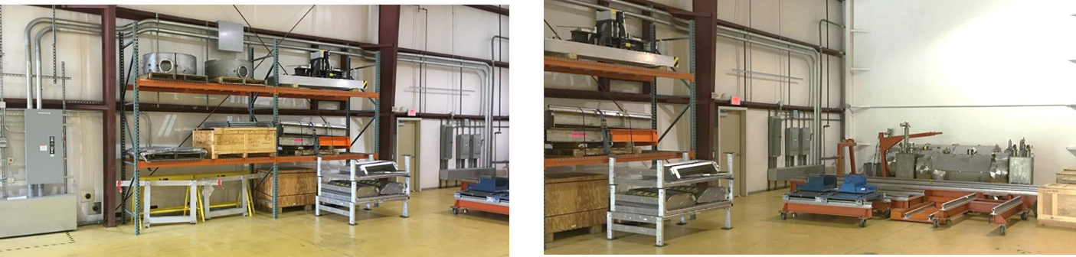
Blue Crab Warehouse

Slide 56
Documentation
Description

Slide 57
Documentation
Drawings referenced by the tasks in the traveler.

Slide 58
Documentation
Procedures describing the work in detail contained in the tasks in the traveler.

Slide 59
Documentation
Mandatory documentation for DOE pressure systems.

