Slide 1
JLAB Prototype CM Test Plan
Mike Drury representing the JLAB CMTF Team
LCLS-II 1.3 GHz Cryomodule Production Readiness Review
13-14 September, 2016

Slide 2
Outline
CMTF Capabilities
LCLS II Upgrades and Status
Test Plans
Schedule

Slide 3
Cryomodule Test Facility
The Cryomodule Test Facility (CMTF) at Jefferson Lab has carried out at least 40 successful cryomodule tests.
These include various CEBAF designs from C20 to C100 as well as SNS cryomodules and several HTB tests for CEBAF and LCLS II.
Can be quickly reconfigured to test any of the current CEBAF designs as well as the LCLS design.
The CMTF currently consists of:
Dedicated shielded cave with Personnel Safety System (PSS)
Radiation shielding – 4.5 ft thick concrete walls and 3 ft. concrete roof.
Magnetic shielding – magnetic fields in the vicinity of the cryomodule of 50 mG or less.
Close loop 2K helium refrigerator shared with the Vertical Test Area (VTA)
Primary circuit supply up to 7-8 g/s 2.8 Bar 4K supply for cool-down, steady state ~2-3 g/s
50 K shield circuit, several g/s (not a limit to operations)
2 channels of High Power RF, 12 kW each, 2 Klystrons operating in pairs deliver 12 kW per channel at 1497 MHz.
Control Room
Currently VXI / VME / GPIB based data acquisition and controls
Three Windows PC’s running Labview for control and data acquisition
Faster RF data acquisition and control
Slower process data acquisition (liquid level, He pressure, temperatures)
Microphonics, tuner control and characterization

Slide 4
Cryomodule Test Facility
Instrumentation includes:
Six channels RF Power Measurement
Ten Channels Portable GM tubes
Gamma / Neutron Probes (owned by Safety Group)
Several Network Analyzers
Spectrum Analyzers
Variety of Scopes, Waveform Generators, etc…
Temp Diodes, Thermocouples, Vacuum gauges, Pressure Transducers, Cameras, etc…

Slide 5
Upgrades for LCLS II – LLRF and Data Acquisition
Addition of eight digital Field Control Chassis
Based on C100 design- modified for CMTF operation and for 1.3 GHz
New interlock chassis
New temperature measurement scheme
New resonance control chassis – cavity tuners
Moving away from VME / VXI based hardware to PC104 / IOC / epics
CMTF Network infrastructure upgraded to support this approach
LabView will be used as top level interface to epics / Channel Access and to talk to other GPIB based instruments.
Labview handling datalogging

Slide 6
Upgrade Hardware Status
Field Control Chassis – ready to be installed now
Interlock Chassis – ready to install Oct 10
Resonance Control Chassis – ready to install now
Temperature measurement – cernox sensor readback solution needs to be defined; comparing custom and off-the-shelf solutions
Any new instrumentation cables – install in September

Slide 7
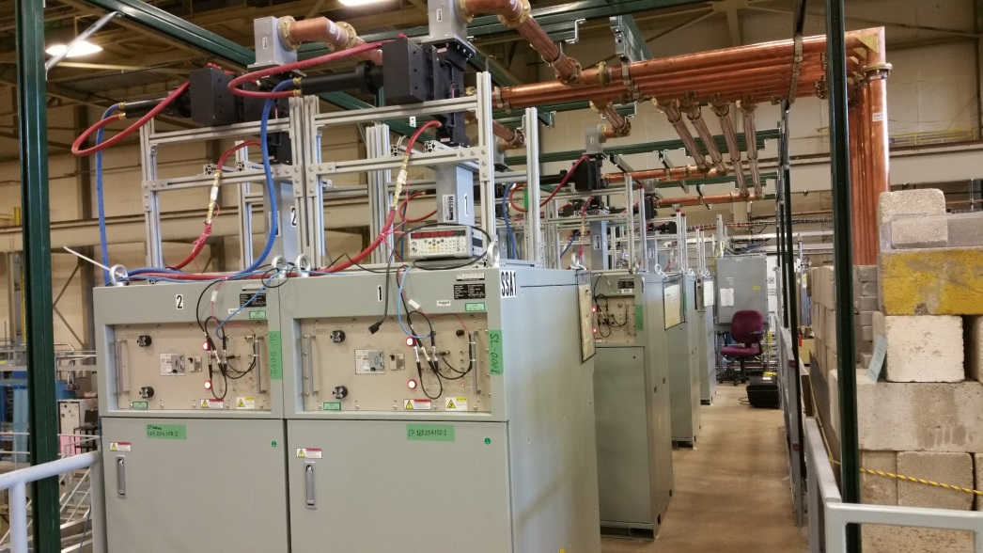
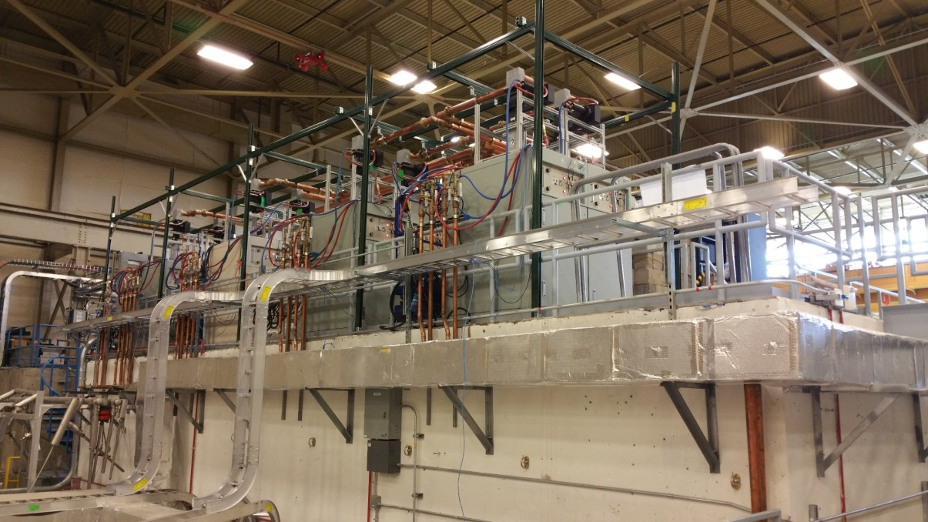
Upgrades for LCLS II-HPRF
Addition of Eight 1.3 GHz, 3.8 kW Solid State Amplifiers
New 1.3 GHz RF network
Units are installed and operational
Integrated into Personnel Safety System
RF Distribution Network Completed
Additional Heliax Cable to be installed in September

Slide 8
Upgrades for LCLS II - Shielding
Shielding enhancements required for several reasons:
Length of the LCLS II cryomodule positions last cavity at the edge of the CMTF concrete walls
Concrete blocks added above the outer door to enhance an area with weaker shielding
Experience with the C100 cryomodules identified weaknesses in the CMTF shielding - specifically the roof and south wall (bordering the VTA)
Increased shielding around the fan-stack
Other mitigations include the posting of Radiologically Controlled Areas (RCA’s) on the CMTF roof and in the VTA once LCLS II testing begins.
New mitigations are called out in the CMTF OSP.

Slide 9
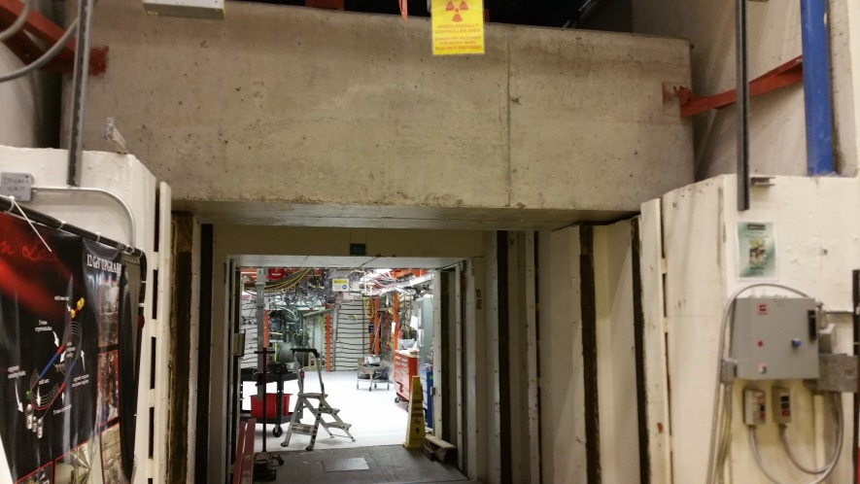
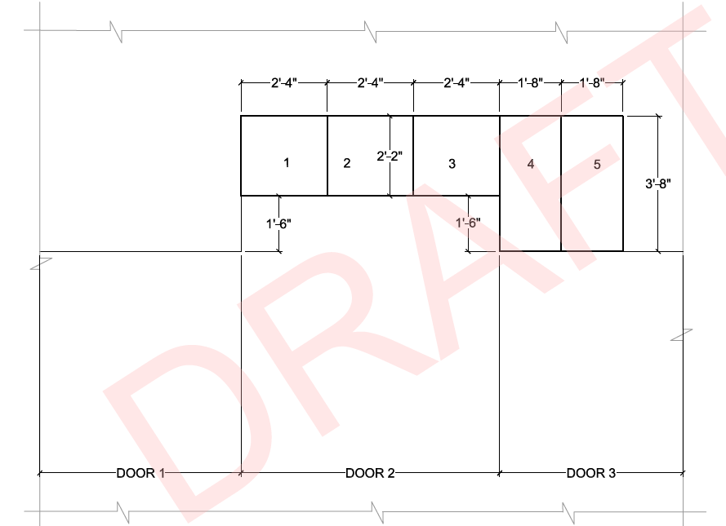
Upgrades for LCLS II-Shielding
Additional shielding blocks have been installed above the roll up doors to compensate for greater length of LCLS II

Slide 10
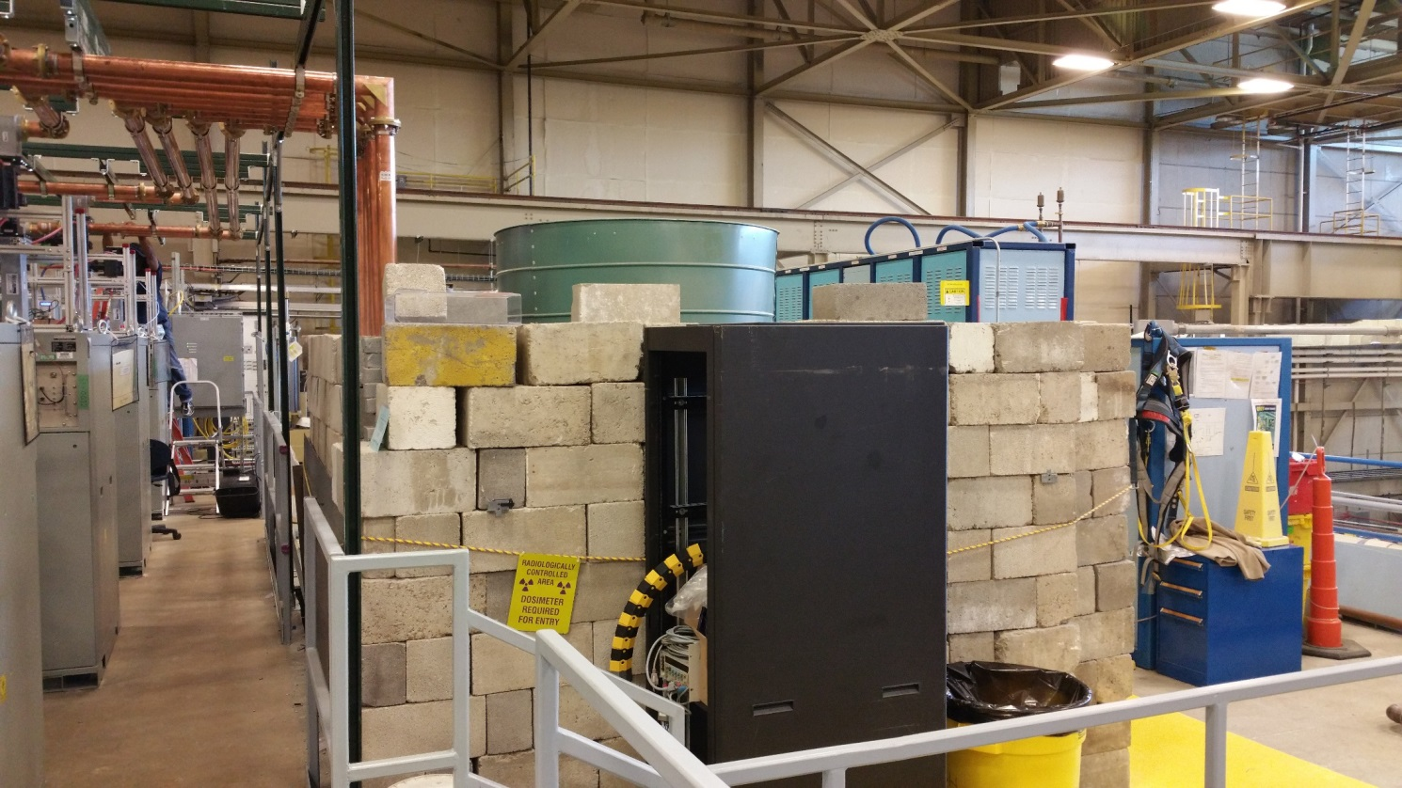
Upgrades for LCLS II-Shielding
Enhanced shielding (extra lead bricks) around fan-stack on mezzanine
To be completed in September

Slide 11
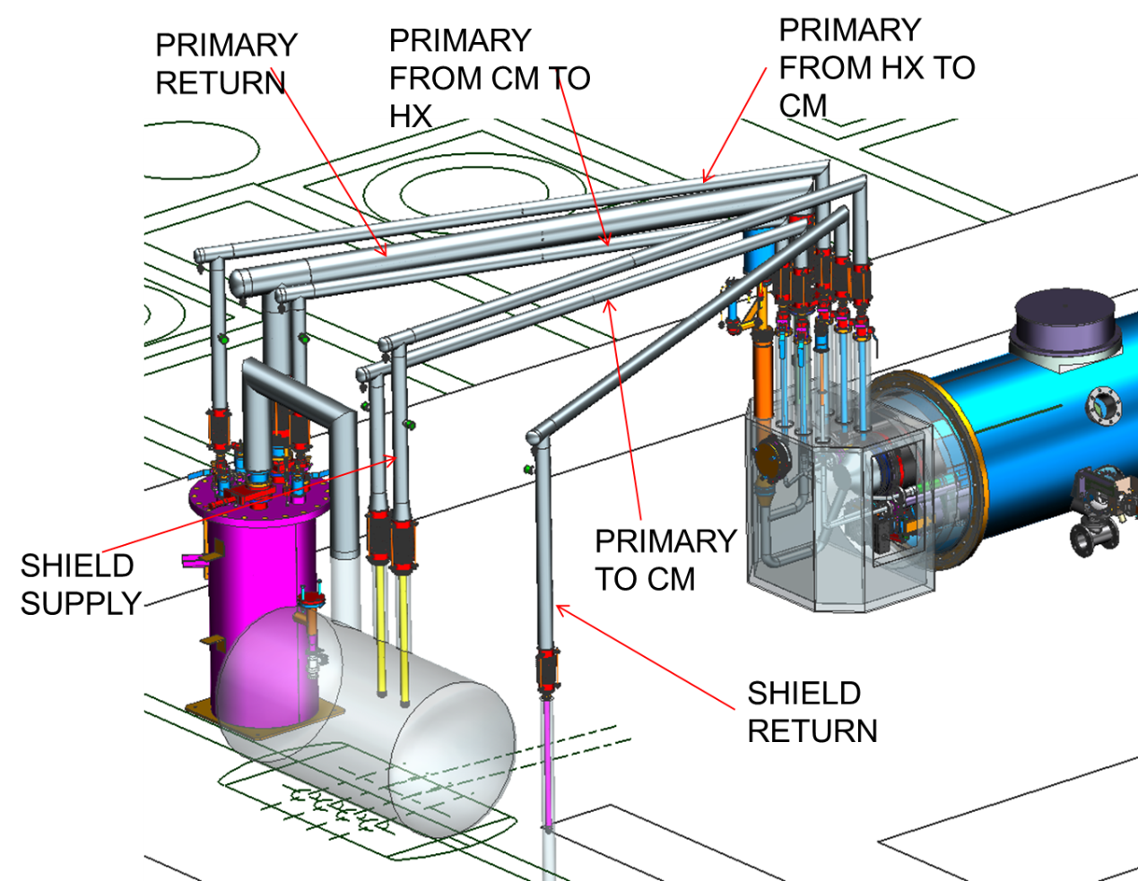
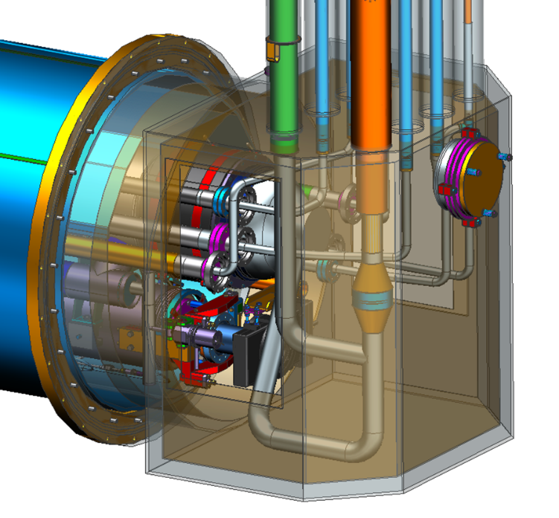
Upgrades for LCLS II – End Cans
End Cans (2 sets to support CM production rate) Design complete, in house fabrication complete for prototype cryomodule testing
Connects CM to CTF valve box via u-tubes
Interfaces for valves, LL and diodes to monitor and control helium flow/inventory
Provides reliefs for primary circuit, shield circuit and insulating vacuum space

Slide 12
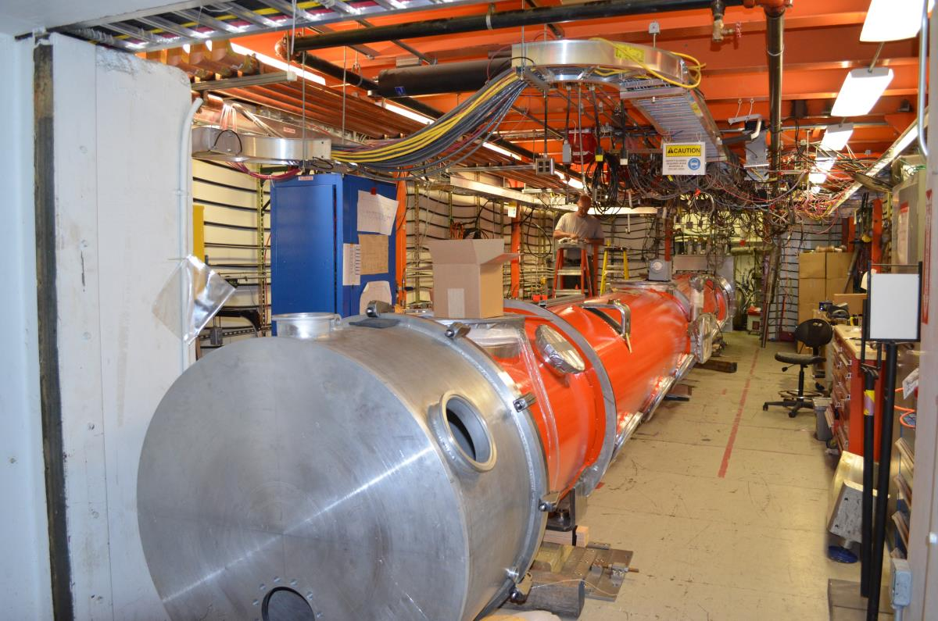
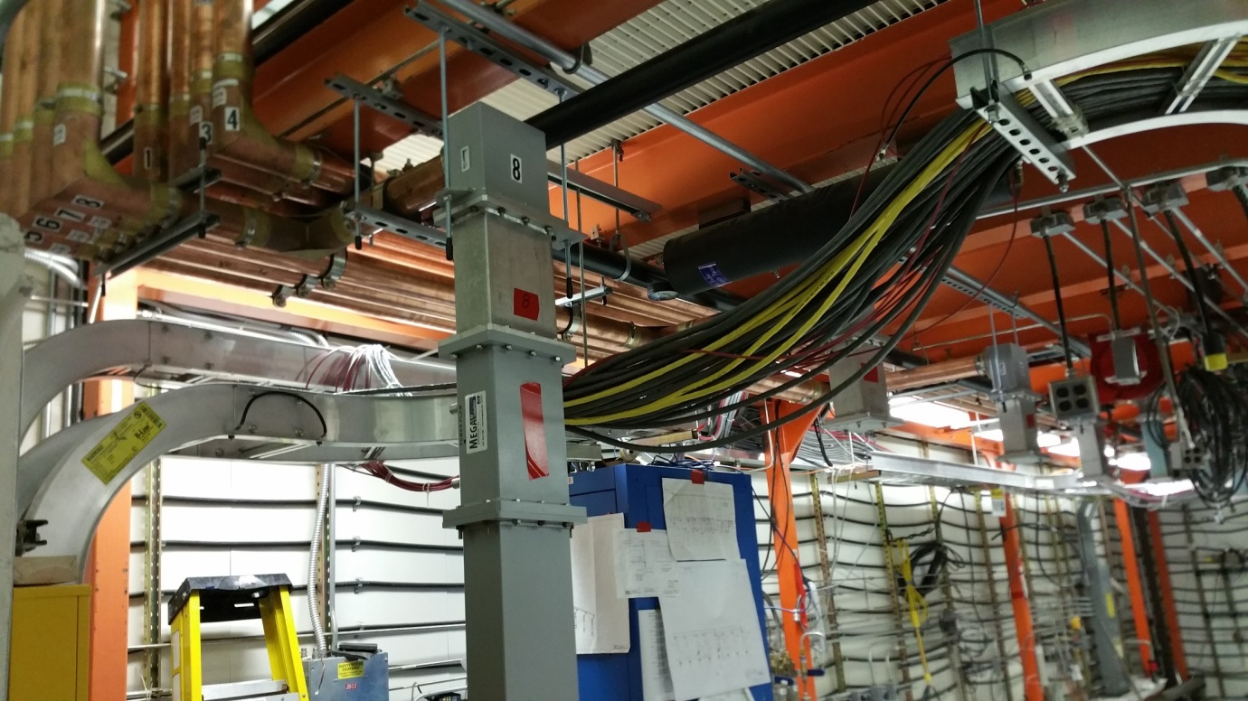
CM Test Facility – Checking CM Position
CM positioning exercise
Measurements for u-tube fabrication
Final placement of waveguide drops to FPC’s

Slide 13
Schedule Concerns
Interlock Chassis – ready to install Oct 10
A bit too close to the start of testing
Check out, software integration, etc. needs to happen quickly
Temperature measurement – TBD for Cernox readback
Late change in plans for temperature monitoring hardware
Not yet a problem but needs to be sorted out
Cryomodule Testing ongoing during reconfiguration
Just completed C50 Acceptance Test
C100 style quarter cryomodule testing about to begin

Slide 14
ISM & Safety- CMTF
Safety is integrated into all work performed in the CMTF
OSP – recently updated to cover LCLS II concerns
TOSP’s as necessary to cover off – normal work
Ex. Early Testing of SSA’s
OSP and TOSP’s call out specific training
Task Hazard Analyses – awareness of hazards
All procedures and travelers call out hazards and required training
ATLis for communicating work within Test Lab

Slide 15
ISM & Testing – High Power Checklist
Complete RF Cable Calibrations
Inspect all Waveguide flange connections
Inspect all RF cable connections
Check placement of GM tubes
Machine Protection Interlock Check
RadCon Checks
Shielding configuration (inspections up-to-date)
CARMs in proper location and calibrations valid
EDM display screens correct and CARMs online
Radiological postings correct
Environmental dosimetry in place.
Personal Safety System Functional Check

Slide 16
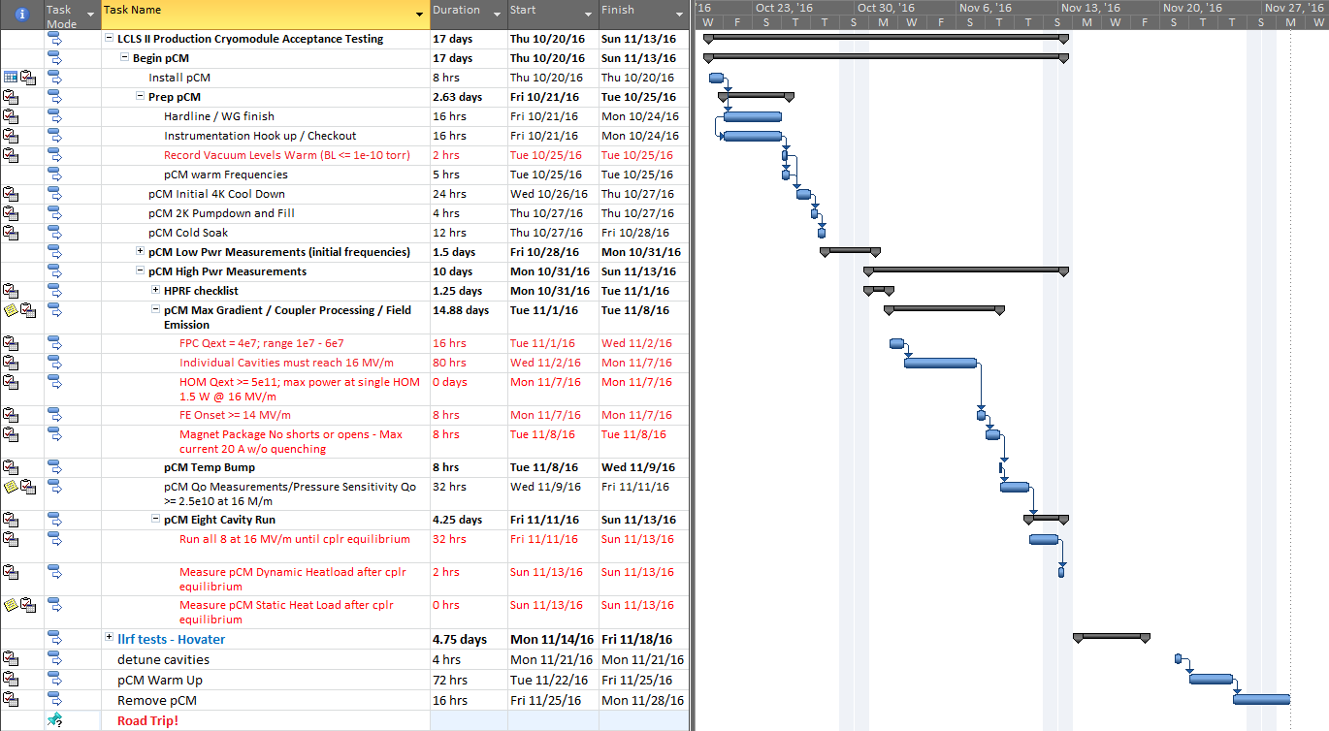
pCM Testing – Total Duration is ?
2 shift / day
7 day / week

Slide 17
pCM Testing - Schedule
Assumes transfer of CM to CMTF on 10/20/16
Time estimated is generous – does not account for surprises and / or problems.
Includes~ 4 days for LCLS II llrf testing
Review of test results as we go – may add more time but is necessary
A “No Surprises” test completes end of November.
Likely that testing pushes into December

Slide 18
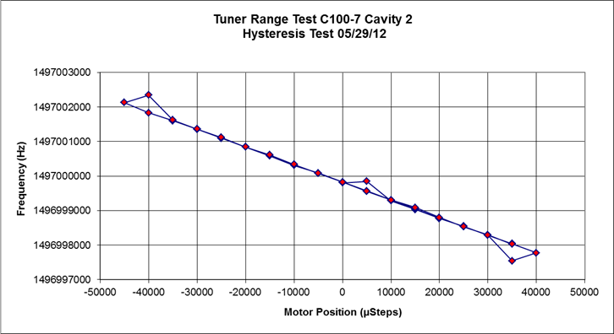
pCM Testing Highlights
Low power Tests (<1 W)
Frequencies
Tuners Mechanical and Piezo
BPM checks

Slide 19
pCM Testing Highlights
High Power Tests / Minimum Acceptable Performance
Max Gradient / Coupler Processing / Field Emission
FPC Qext = 4e7; range 1e7 - 6e7
Average Cavity gradient >= 15.4 MV/m
Total Voltage >=
HOM Qext >= 5e11; max power at single HOM 1.5 W @ 16 MV/m
FE Onset >= 14 MV/m / Dark current < 10 nA
Magnet Package No shorts or opens - Max current 20 A w/o quenching
Qo Measurements - Qo >= 2.5e10 at 16 M/m

Slide 20
pCM Testing Highlights
Eight Cavity Run
Run all 8 cavities at max operating gradients
Requirement total Voltage ≥ 128 MV
run until couplers reach thermal equilibrium
Attempt to measure heat loads
~100 W needed for CW operations (16 MV/m, 2.7x10^10)
Concern: This test will challenge the CTF refrigerator and perhaps compromise the VTA testing schedule

Slide 21
Testing - Refrigerator concerns
Currently, Primary circuit can supply up to 7-8 g/s at 4K for cool-down
LCLS II cool down 8-10 g/s maximum
New hardware installation tentatively planned in early 2017
Cold compressors replace aging expansion engines
New hardware should help mitigate CM cool down concerns and Eight Cavity Run concerns

Slide 22
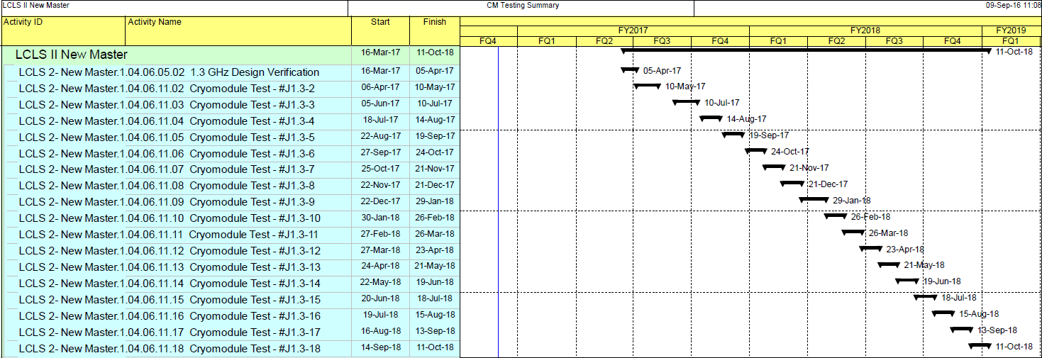
CM Testing – Production Schedule
This is a challenging schedule
Can be met on average
Fewer problems = faster turn around

Slide 23
Summary
Most hardware ready for use in CMTF
Some concern that all LLRF and Data Acquisition hardware will be available by pCM install date.
Production Testing Schedule is challenging but not impossible
Eight Cavity Testing requirement will be a challenge for the refrigerator

Slide 24
Back Up

Slide 25
LCLS II Uses Well-Established JLab ISM program
15 work Observations were conducted,
ESH professionals, Division Safety Officer, and Accelerator Division staff and management.
All safe for all observations
ISM – Integrated Safety Management applies for all work.
Presenters will address their specific areas (VTA, Assembly, Testing)
Example - Shoulder injury experienced by a technician while loosing a bolt on a LCLSII cavity flange.
Immediate actions to modify work procedures, larger wrench
Follow up in depth investigation by Division Safety Officer
All corrective actions are either complete or on-schedule for completion.

