Slide 1
Fermilab pCM test results
E. Harms, G. Wu
LCLS-II 1.3 GHz Cryomodule Production Readiness Review
13-14 September, 2016

Slide 2
Outline
pCM Test plan and basis
Installation & Test chronology
pCM results to date
Magnetic Field Management
Cavity performance measurement
Acceptance Criteria and production readiness
Next steps
Documentation, especially Traveler
Summary

Slide 3
Test plan
Detailed plan includes
Prep for Delivery
Installation
Warm Checkout & Cold Test Preparation
Cooldown
Cold Testing
Extended Tests
Up to 6 Periods of Fast Cooldown Studies
Slow Cooldown
Warm Up
Removal
Multi-prong development
Past experiences
Working group
Testing workshop
Minimum Acceptance criteria
Minimum Acceptance criteria addressed in appropriate testing steps

Slide 4
Acceptance criteria

Slide 5
Installation & Test chronology
Installation
begun in July, ~6 weeks duration
Warm checkout
begun late in installation
Off resonance conditioning
Cavities 1-5: 25 to 26 August
Cavity 8: 12 to 13 September
Demagnetization
27 August
Magnet/supply
testing since 29 August
50 K cooldown
27 to 29 August
‘Fast’ cooldown to 4 K
30 August
2 K cooldown
ongoing since 30 August
ORC
permission for cold, full power operation received 9 September
Cold testing
in progress

Slide 6
pCM results/Acceptance criteria
Criteria | Design Validation | Workstation | Status
Cavity beamline vacuum Cold (2K) 1x10⁻¹⁰ Torr Warm (RT) 1x10⁻⁸ Torr | Vacuum pumping and leak determination | WS 1 – CR Assembly | Warm = 2.5 X10⁻⁹ Cold = 4X10⁻¹⁰ Coupler = 5.5X10⁻⁹ Insulating vacuum = 5X10⁻⁷ (previously identified leaks)
Center Frequency 1.300000 GHz +/- 20kHz | Cavity Fabrication Target frequency |  | All cavities tuned to close to 1.3 GHz
Tuner range –slow 450 kHZ, fast 0-500 Hz | Tuner Design | WS3 – CMA I | All slow tuners tested to at least 64 kHz, most ~300 kHz
Notes:
Elvin

Slide 7
pCM results/Acceptance criteria
Criteria | Design Validation | Workstation | Status
The magnet package is verified electrically to be without shorts or opens and can be operated at a current of at least 20 A without quenching | Magnet Installation | WS3 – CMA II | Electrical checkout good, 20A tests imminent
Nominal FPC Qext = 4E7 with range verified from 1E7 to 6E7 | FPC/CM design verification | WS3 – CMA II | to be determined
Notes:
Elvin

Slide 8
pCM results/Acceptance criteria
Criteria | Design Validation | Workstation | Status
Individual cavities reach at least 16 MV/m | Overall Design and Assembly Validation | WS 1 – CR Assembly | to be tested
Field emission onset ≥ 14 MV/m for each cavity individually | Particle Free Assembly | WS 1 – CR Assembly | to be tested
HOM Qext ≥ 5 x 10¹¹, maximum power measured out of a single HOM is 1.5 W at nominal gradient of 16 MV/m with the forward power set to 2.5 kW for at least 10 hours or until the FPC window temperature reaches equilibrium | HOM notch tuning | WS2 – CMA I | to be tested
Notes:
Elvin

Slide 9
pCM results/Acceptance criteria
Criteria | Design Validation | Workstation | Status
The BPM shall be verified electrically to be without shorts or opens, with cross-talk between electrodes ≤ -30dB. The difference in S-parameter (S21) between electrodes is < 1dB over a frequency range of 0.5 to 2.5 GHz. | BPM design and assembly | WS 1 – CR Assembly | testing in progress
Average CM Q₀ ≥ 2.5x10¹⁰ at 16 MV/m as measured after at least 10 hours c.w. operation or until the FPC window temperature reaches equilibrium | Magnetic Hygiene and Shielding | WS 2/3 – CMA I/II | to be tested, partially validated
Notes:
Elvin

Slide 10
pCM results/Acceptance Criteria
Measure total static heat load on the CM with all cavities operating at 16 MV/m and document for comparison with the LCLS-II Cryogenic Heat Load table developed by Tom Peterson. A summary of these values is listed below for reference assuming a Q₀ = 2.5e¹⁰ and all 8 cavities are operating. |  |  | WS2-5 – Final Assembly
Dynamic 2K = 92 W | Dynamic 5K = 8 W | Dynamic 45K = 92 W
Static 2K = 7 W | Static 5K = 17 W | Static 45K = 123 W
Total 2K = 99 W | Total 5K = 25 W | Total 45K = 215 W
To be tested
Notes:
Genfa

Slide 11
Magnetic field management
Demagnetization (results)
Active cancellation (results)
Fast cool down (in progress)
Notes:
Genfa

Slide 12
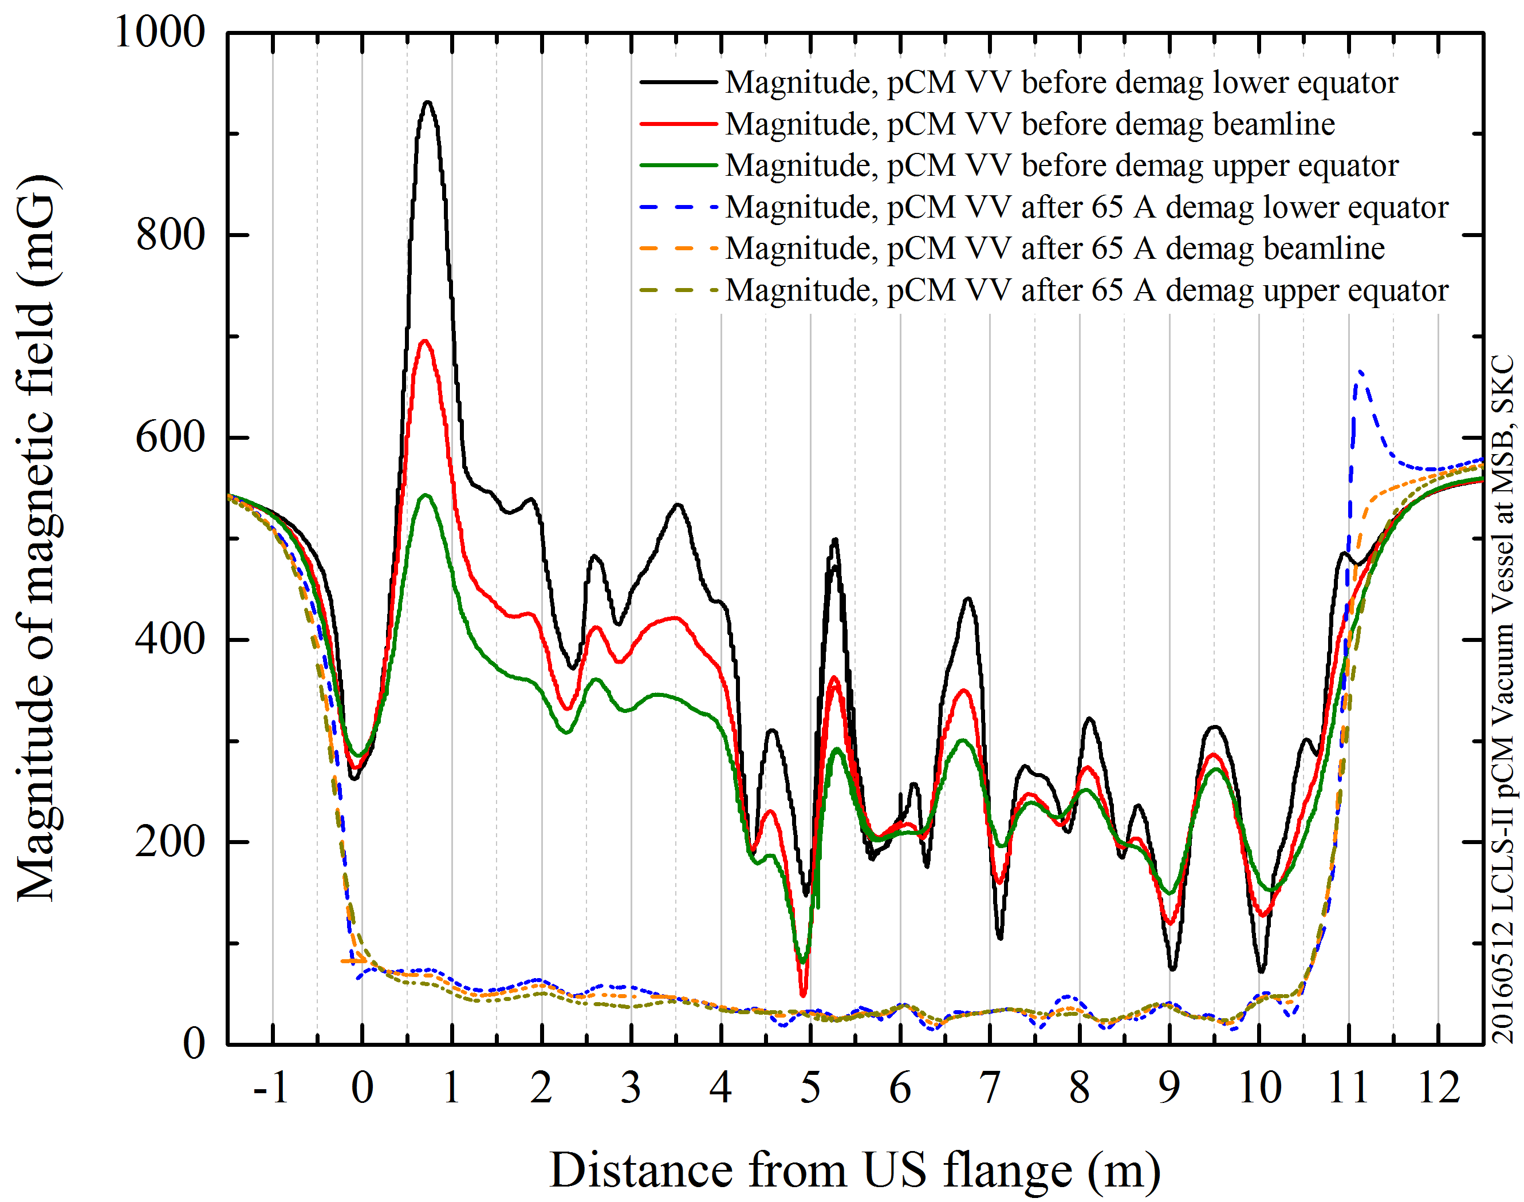
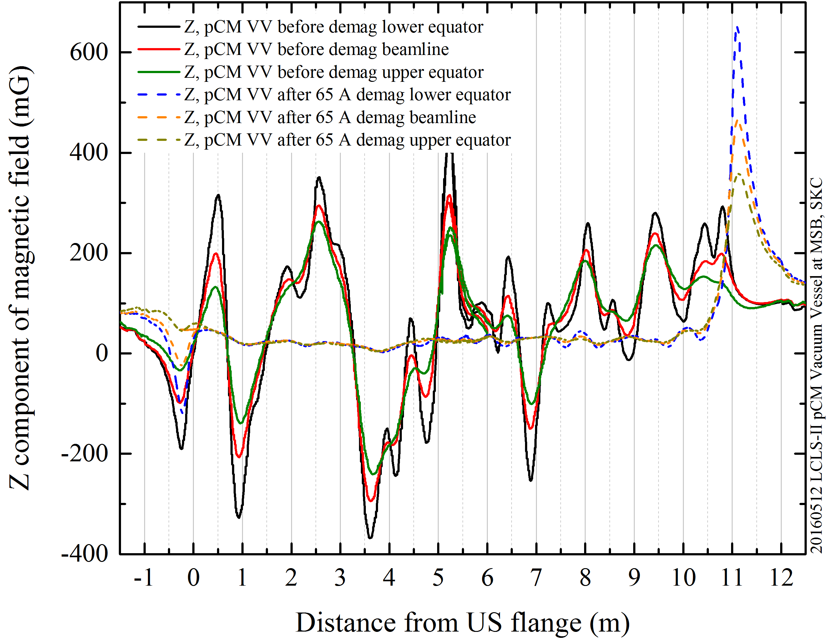
Vacuum vessel magnetic field management
Vessels come with high, non-uniform residual magnetic fields
Demagnetization reduces magnitude by a factor of 10
Increases magnetic shielding efficiency of vessel
B_{z} > 300 mG
↓
<50 mG & uniform
B_{avg} > 500 mG
↓
<50 mG & uniform
S. Chandrasekaran and colleagues
Notes:
Genfa

Slide 13
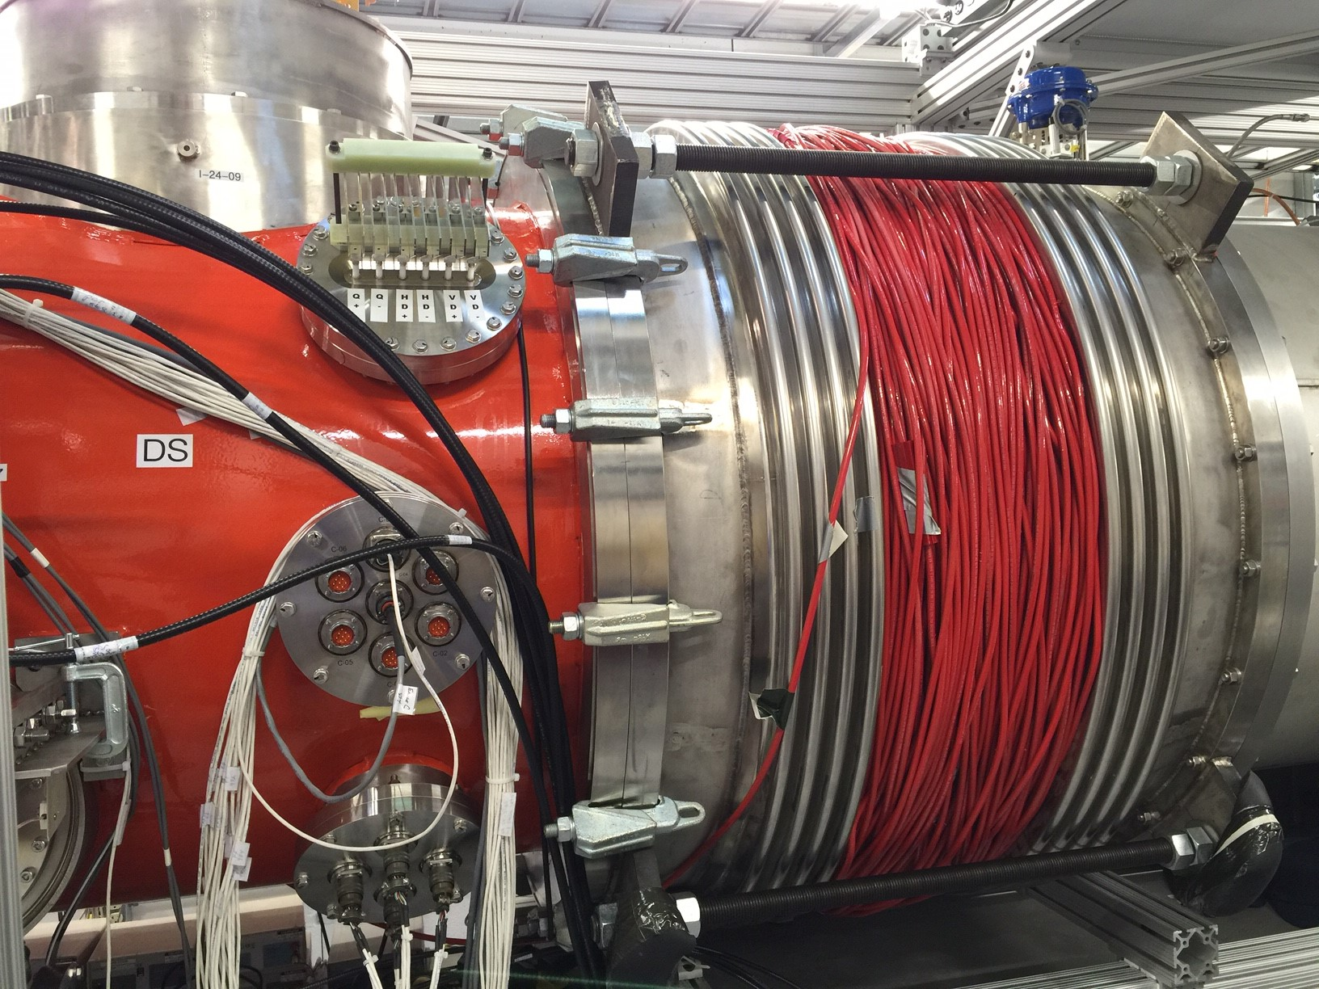
Magnetic field management ( Cryomodule Demagnetization )
S. Chandrasekaran and colleagues
Notes:
Genfa

Slide 14
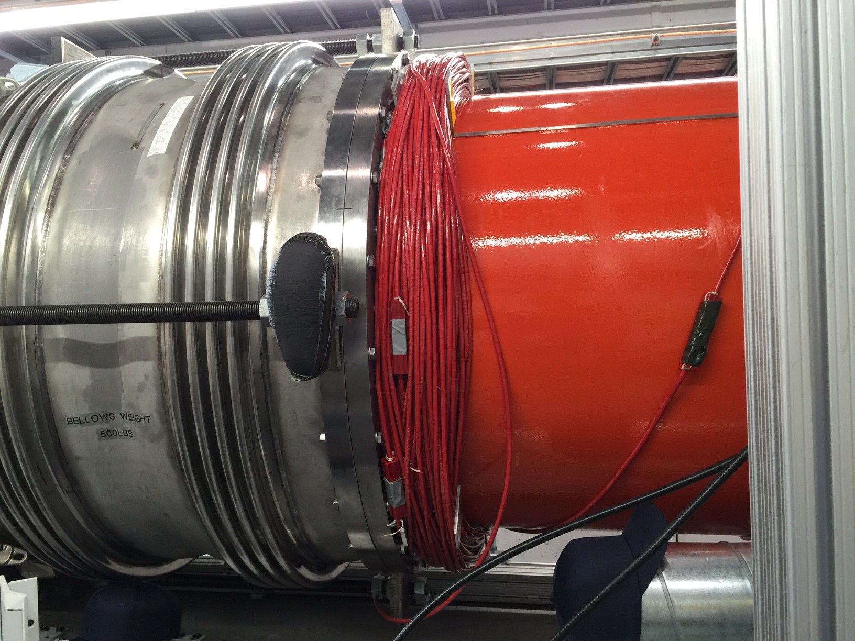
Magnetic field management ( Demagnetization )
S. Chandrasekaran and colleagues
Notes:
Genfa

Slide 15
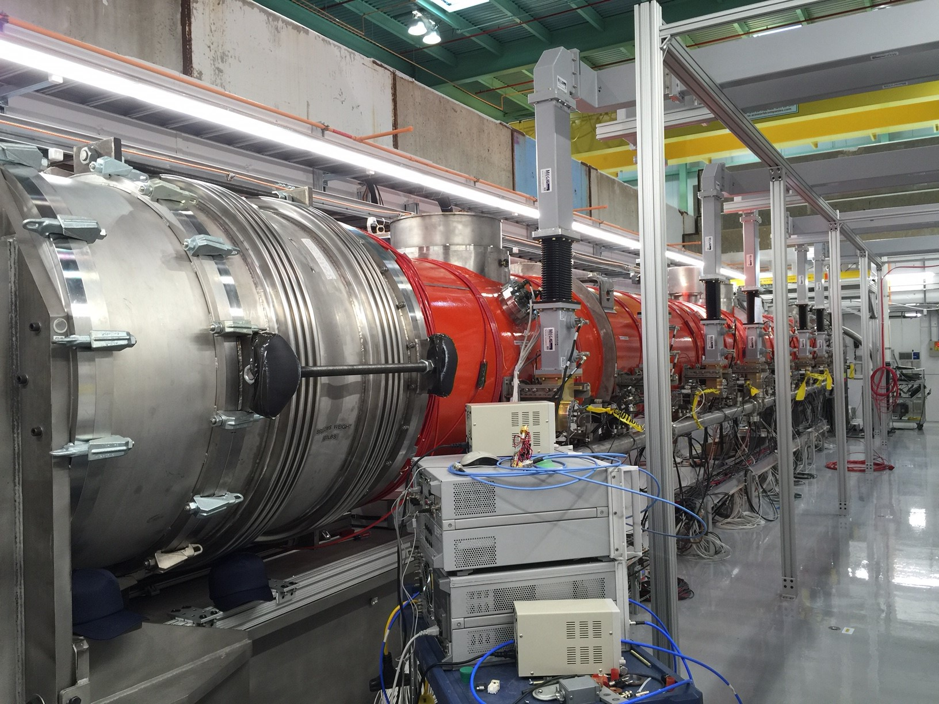
Magnetic field management ( Demagnetization )
S. Chandrasekaran and colleagues
Notes:
Genfa

Slide 16
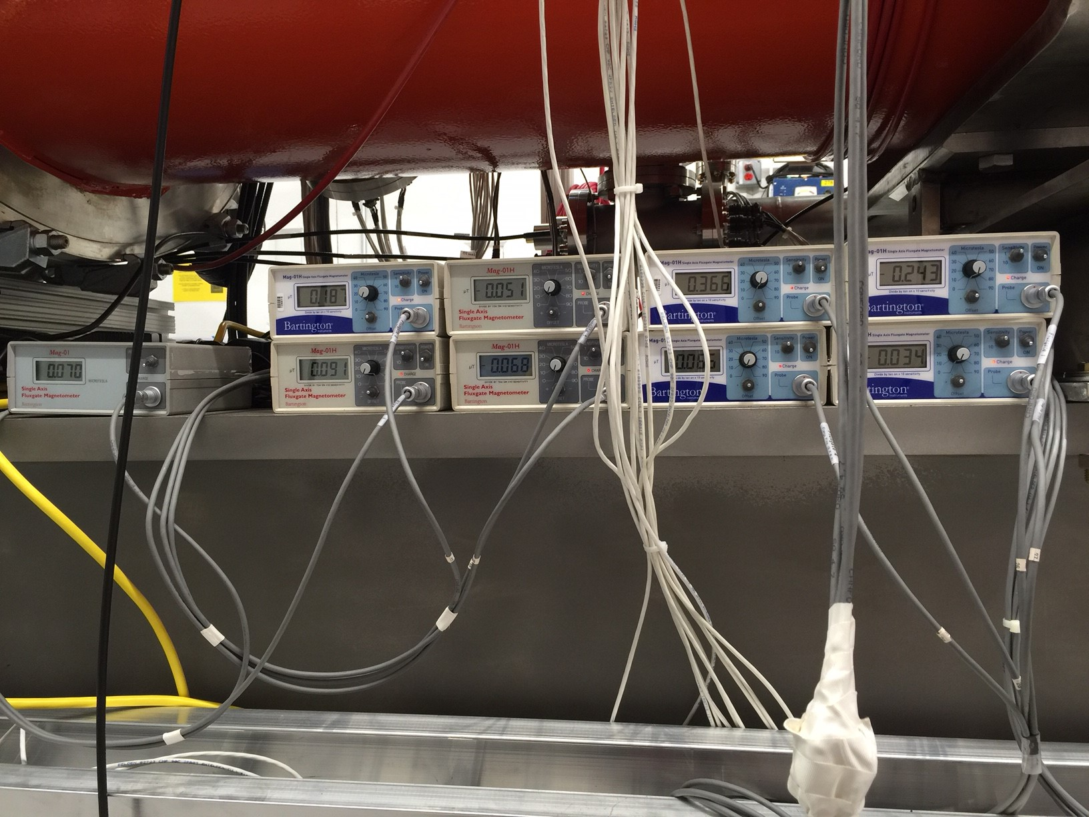
Magnetic field management (Active Coil Cancellation)
S. Chandrasekaran and colleagues
Notes:
Genfa

Slide 17
Magnetic field management (Active Coil Cancellation)
All internal fluxgate sensors reads <1.5 mG in Fermilab pCM
If magnetic shields have consistent high permeability as in pCM, cryomodule will have very low remnant field.
Active coil cancellation will depend on the ambient fields at final installed location.
7 production cryomodules and 2 prototype cryomodules will be available to implement the active cancellation.
Notes:
Genfa

Slide 18
Magnetic field management (Flux expulsion)
Several fast and slow cool down cycles are planned for extended studies.
Cool down procedure will be finalized for production cryomodule testing.
Fast cool down is needed due to the limited diagnostics (no internal fluxgate sensors in production cryomodule.)
Notes:
Genfa

Slide 19
Magnetic field management
Magnetic shield design is successfully validated
Magnetic hygiene is successfully implemented
Demagnetization is successful and will be standard in production
Notes:
Genfa

Slide 20
Cavity Performance Measurement - Calibration
RF calibration
Forward power at SSA output before the circulator
Minimize the directional coupler signal deviation due to reflected power
Calibration using calorimetric load
Transmitted power and HOM power
Network analyzer
Qext1
Fast oscilloscope for decay time
RF power decay
Heatload
Massflow vs. known heater power
Notes:
Genfa

Slide 21
Cavity Performance Measurement - Gradient
Method A – Forward Power (Production method)
Measure FPC Qext and forward power
$E_{acc}=\frac{1}{L}\sqrt{4P_{for}Q_{ext1}(\frac{R}{Q})}$
Method B – Transmitted Power
Measure transmitted power and field probe Qt (using VTS/HTS Qt
$E_{acc}=\frac{1}{L}\sqrt{P_{t}Q_{t}(\frac{R}{Q})}$
Notes:
Genfa

Slide 22
Cavity Performance Measurement - Heatload
Method A – Mass flow change
Measure mass flow delta to extrapolate heat load
Method B – Measure compensation heater (production method)
Maintain constant mass flow
Measure RF compensation heater power
Notes:
Genfa

Slide 23
pCM cryomodule test result
Cavity | VTS/HTS Eacc | VTS Q0@16MV/m | pCM gradient | pCM FE onset | pCM Q0
TB9AES021 | 23 | 3.08e10
TB9AES019 | 19.5 | 2.82e10
TB9AES026 | 21.4 | 2.57e10
TB9AES024 | 22.4 | 2.95e10
TB9AES028 | 28.4 | 2.81e10
TB9AES016 | 18 | 2.75e10
TB9AES022 | 21.2 | 2.77e10
TB9AES027 | 22.5 | 2.75e10
Total Voltage | pCM dynamic heatload | pCM total heatload
Notes:
Genfa

Slide 24
pCM cryomodule test result – HOM/FP
Cavity | HOM1 Qext | HOM2 Qext | Field Probe Qext | Note
TB9AES021
TB9AES019
TB9AES026
TB9AES024
TB9AES028
TB9AES016
TB9AES022
TB9AES027
Notes:
Genfa

Slide 25
Achievements to date
Installation – went about as well as it could
Good leak check; pre-existing insulating vacuum vessel leaks verified
cold connections (including the line B Indium seal) checked out and verified cold
Cryo
Plant and compressors very reliable
Control loops being established
Cooldown to 4 K went as expected and met requirements including magnetic flux
Fast cooldown went well and met requirements (30 g/s and could have been more)
Investigating control stability of CM on 0.5% slope
Operating at 2K with cold compressors will require dedicated time
Magnetic system checks on track
Notes:
Elvin

Slide 26
Achievements to date
RF system perform as advertised
All SSA’s operated and calibrated with loads at end of waveguide network
Most calibrations completed and verified
Tuners
All SSA’s operated at 200 Watts cw into each cavity; All Tuners exercised to get close to resonance
Thermal shorting looks very good – ΔT ~3 K during extended operation
Heaters operated including control loops – all good
LLRF
Fermilab single cavity version routinely used – frequency lock demonstrated
8-cavity system undergoing final checks
SLAC/LCLS-II hardware here and being installed
Final checkout of the test stand with the CM in place
Instrumentation, timing, data logging, interlocks all in operation and interfaced via Controls system
Notes:
Elvin

Slide 27
Next steps
Move cavities exactly to resonance
Bring up power to 1500 Watts
preliminary gradient check (pending final calibrations)
field emission/dark current
Complete minimum acceptance checks
Notes:
Elvin

Slide 28
Documentation - Traveler
Imperative to document pCM installation & testing activities as completely as possible
assure consistency
check against acceptance criteria
as complete a record of performance as practical for LCLS-II operation
Use available tools (and some new ones)
Electronic Log
Reports
Travelers
Controls system archival system
High capacity/high speed data collection

Slide 29
Test Traveler Contents
Same platform as for other activities – Vector
Contents based on
Minimum acceptance criteria
Installation activities flow
Test plan developed by joint working group last year
Reviewed and refined by expected users
In use, reviewed at least weekly
Further revisions based on experience
Use as is for pCM

Slide 30
Test Traveler Contents
RFCG 464255, LCLS-II Cryomodule Testing at CMTF
https://vector-onsite.fnal.gov/GenerateTravelerRequest.asp?qsDocID=18229
Ongoing refinement
Next version released for First Production CM

Slide 31
Summary
pCM is on test stand and mostly cooled down
Magnetic field management is validated/successful
Warm testing complete/successful
Cold tests in progress – so far good, cavity performance remaining
2 K operation is a learning experience
Initiating a testing program + comissioning a new facility
Suite of documentation tools, especially Traveler in use

Slide 32
Charge
1 Technical Scope and Schedule (FNAL and JLab)
a. Is the scope of work defined properly? yes
b. Is the schedule reasonable to achieve the defined scope? to be determined
c. Are there opportunities for schedule advancement or schedule recovery in cases of cryomodule rework or repairs?
d. Are the prototype test-results, as available, consistent with initial acceptance criteria? yes, but….
4 ES&H and Work Planning and Control (FNAL and JLab)
a. Is there evidence of work planning and control pocesses in day-to-day procedures? yes
b. Have all safety risks been identified and ranked? yes
c. Is there evidence of appropriate hazard mitigation plans? yes
6 Production Management (FNAL and JLab)
d. Have lessons learned and traveler documentation from Eu-XFEL, Fermilab CM02, and JLab 12 GeV Upgrade been incorporated into the assembly procedures and component/system check-out planning?
e. Are all travelers and assembly procedures updated and available? yes
f. Is there an agreed upon plan in place to collect and deliver all relevant inspection, assembly and testing data to SLAC for each cryomodule? handoff agreement being developed

Slide 33
Thank you for your attention – Questions?

