Slide 1
SBND / NP04 Cold Cables & Feedthroughs for the Cold Electronics
Bo Yu
Brookhaven National Lab
Oct. 13, 2016

Slide 2
Outline
Requirements
Overall cable routing schemes
Feedthrough port design
Signal feedthrough flange design
Cable routing from the APA to the feedthrough
Summary
Charge Questions:
Does the conceptual design for the CE systems meet the requirements?
Are justifications for each of the specific technical design choices sufficiently documented?

Slide 3
Requirements
Signal Feedthroughs (SBND docdb 1158)
MAWP must ≥ cryostat MAWP (350 mbarg)
A proof test at 4x cryostat MAWP (1400 mbarg) to establish the feedthrough MAWP
Maintain a leak rate < 10⁻⁹ mbar·liter/sec under all thermal conditions*
Implement a purge port (minimum ¼” tubing) on the feedthrough flange
Avoid moisture condensation
Cables
Use PTFE based cable for best LAr purity compatibility
Must be halogen free for use at CERN
Maintain signal integrity/voltage stability at room temperature for up to 25m in length (more in backup slides)
Cable Routing
All electrical connections (power and signal) from an APA shall lead to a single feedthrough.
APA Power line return leads and any shields shall be connected to the common plane of the cold FE module at one end and to the flange of the feedthrough at the other end. This shall be the only connection of the APA frame to the cryostat.
Feedthrough Port
Exert no mechanical stress to the crossing tube in the insulation space
*Upon special situations, the SBND Technical Coordinator will consider granting an exception to this leak tightness requirement on a case-by-case basis.

Slide 4
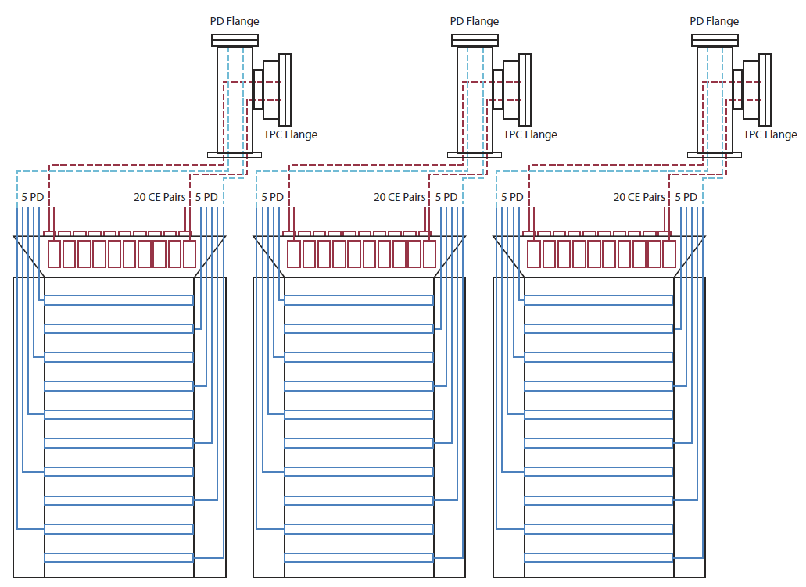
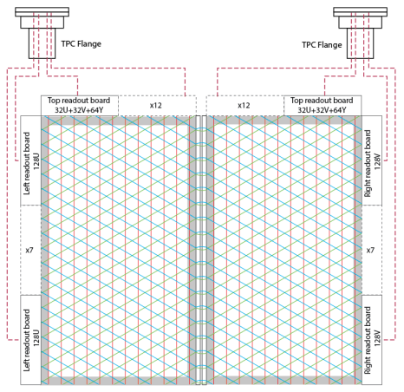
NP04 and SBND APA Cable Routing Scheme
NP04
SBND
4m
6m
7m
5m

Slide 5
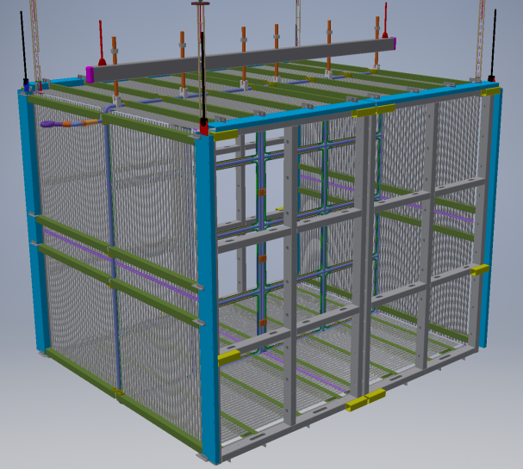
The SBND TPC
4 APAs, 11k readout channels
TPC readout feedthrough ports: 4, one on each top corner of the TPC
On each FT port:
22 sets of data and power cables
8 bias cables
Data cable:
3M mini SAS (twinax 8 pair + 8 sideband wires, 30 awg)
Power cable:
16x 22 awg wires in twisted pairs
Bias cable:
RG316 with SHV connectors
TPC cable length: equal length @ 6m
4m
4m
5m

Slide 6
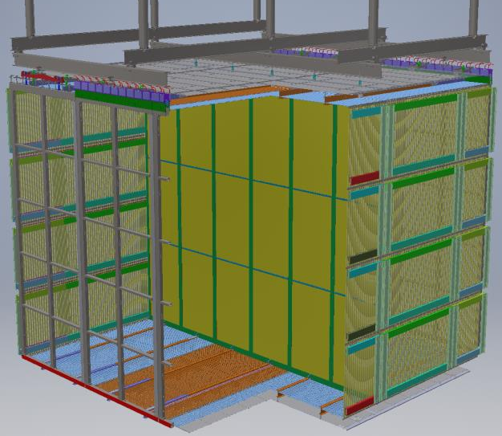
ProtoDUNE SP TPC
6 APAs, 15k readout channels
TPC readout feedthrough ports: 6, one per APA
On each FT port:
20 sets of data and power cables from CE
10 PD cables
8 bias cables
Data cable:
Samtec twinax, 26 awg, 12 pairs
Power cable:
18x 20 awg wires in twisted pairs
Bias cable:
RG316 with SHV connectors
PD cable:
Cat 6
TPC cable length: equal length @ 7m
Field cage modules with ground plane
APAs
CPAs
End wall field cage modules
6m
Field cage modules
7m
7.2m

Slide 7
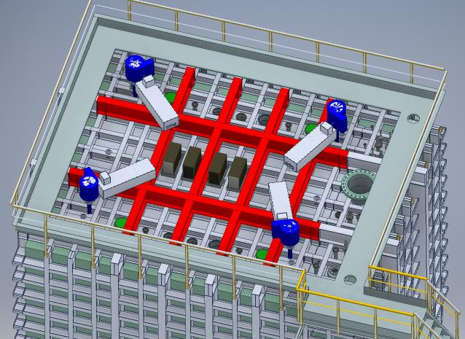
SBND Cryostat Top Arrangement
PMT feedthrough ports
CE feedthrough ports
Light guide feedthrough ports

Slide 8
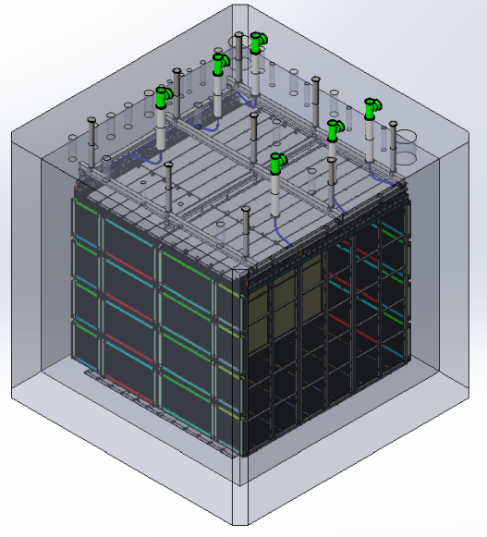
NP04 Cryostat Top Arrangement
Both CE and PD cables from each APA share a feedthrough port
Beam

Slide 9
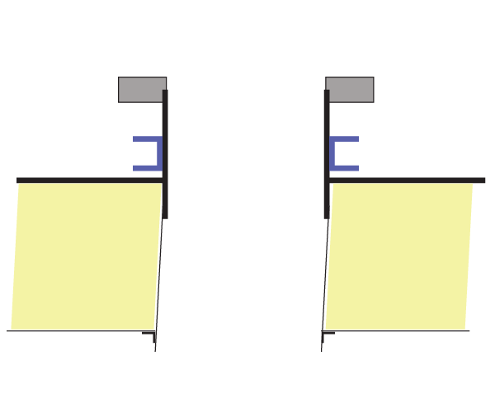
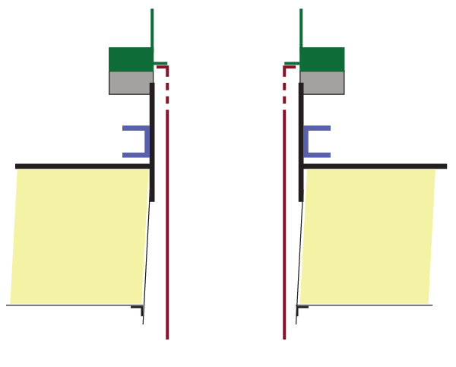
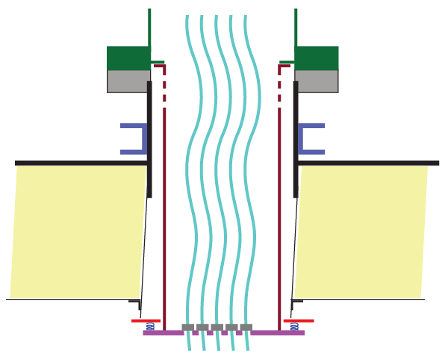
Feedthrough Port Design Concept
GTT/CERN will provide the feedthrough ports in the form of DN250 CF flanges on the top of the cryostat. The precise dimensions of these ports have not been finalized by CERN.
Purging gas flow
Spool piece / tee supplied by experiment
DN250 CF flange
supplied by CERN
Inner support tube
Structural support
By blocking most of the openings at the bottom of this chimney, a small amount of gas argon purging will result in high velocity flow through the gaps at the bottom of the chimney, preventing the outgassing of the warm cables from diffusing back into the cryostat.
10mm SS top plate
Crossing tube (~1mm)
Foam insulation
The bottom portion of the crossing tube is very thin therefore we must avoid transferring load to it.
Ceiling membrane
Sealing ring
Bottom plate with strain relieved cables

Slide 10
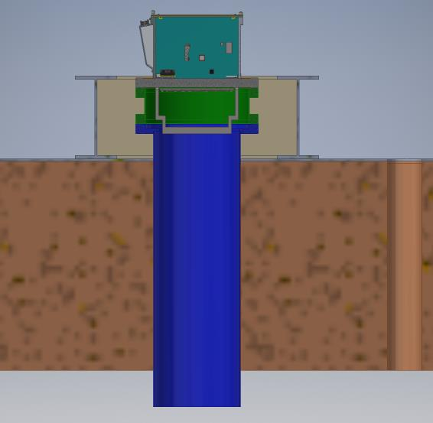
SBND Signal Feedthrough Port
Signal flange and warm interface crate (supplied by protoDUNE)
14” spool piece (supplied by ProtoDUNE)
Signal feedthrough flange must stay below the lower I-beams in order to get out of the TPC assembly building (DAB)
Lower I-beams
CF flange (supplied with cryostat)
10mm SS top plate
60cm insulation
Ceiling membrane
Crossing tube (~1mm thick)

Slide 11
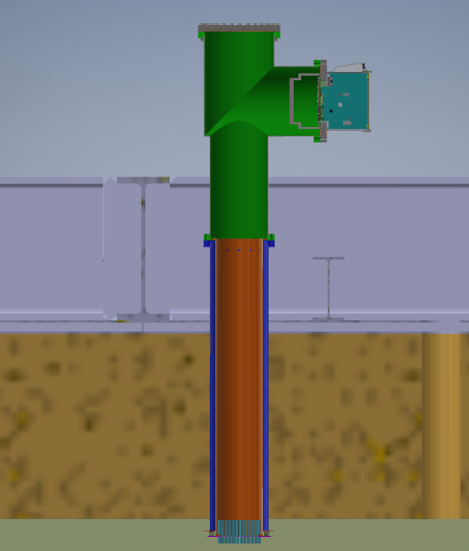
NP04 Signal Feedthrough Port
PD cable feedthrough
Signal flange and warm interface crate (supplied by CE)
Tee (supplied by CE)
Both CE and PD cables pass through the same port. In the DUNE FD, we have twice as many cables. So a 4 way cross will be used: two CE flanges and one PD flange.
DN250 CF flange (supplied with cryostat)
Cryostat warm structure
10mm SS top plate
60cm insulation
Ceiling membrane

Slide 12
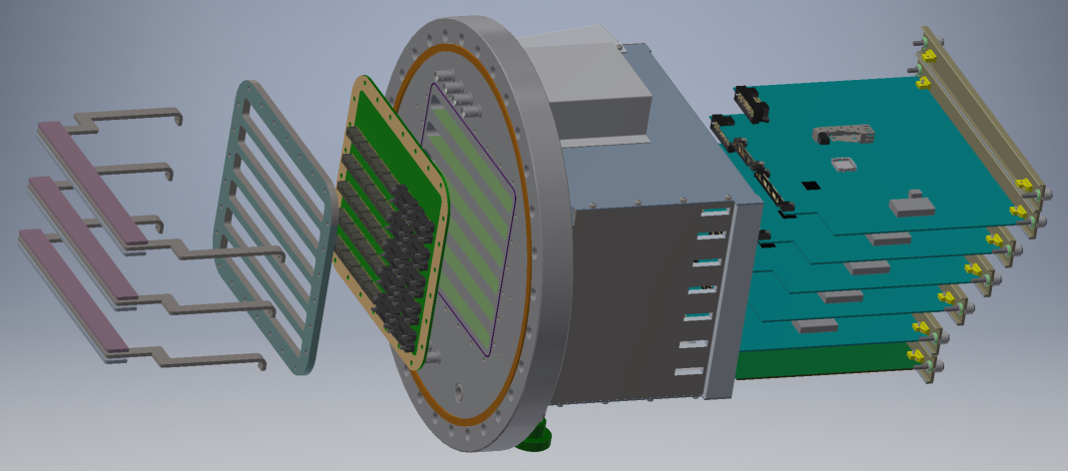
Exploded View of the Flange and Warm Interface Boards
8x SHV Connectors
Power & Timing Backplane (PTB)
Compression Plate
Cable strain relief bars
Warm Interface Boards (WIB), 5x for ProtoDUNE,
6x for SBND
14” CF flange
Warm electronics Crate
Power & Timing Card (PTC)
Flange PCB
(DUNE version)
Purging Port
Indium wire seal

Slide 13
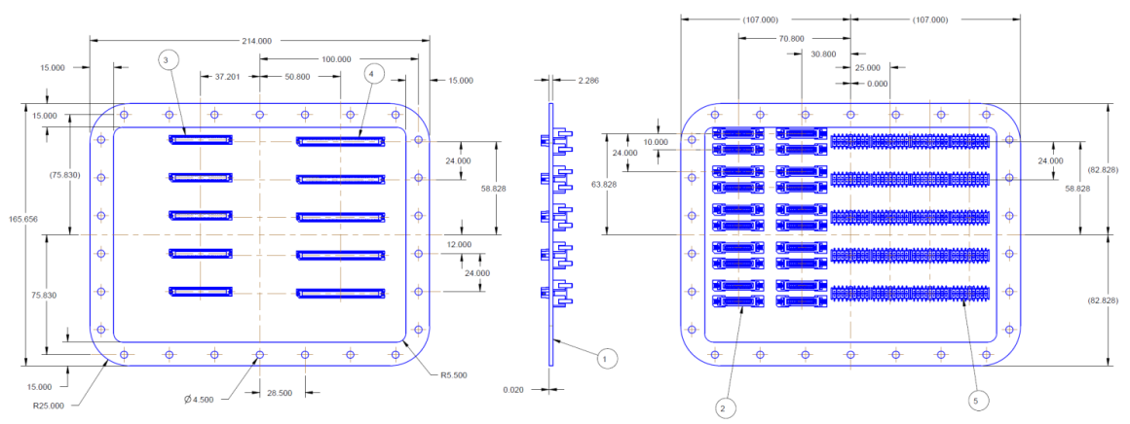
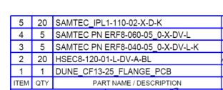
Layout of the Flange PCB
Air Side
Argon Side

Slide 14
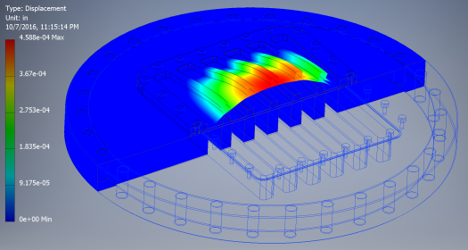
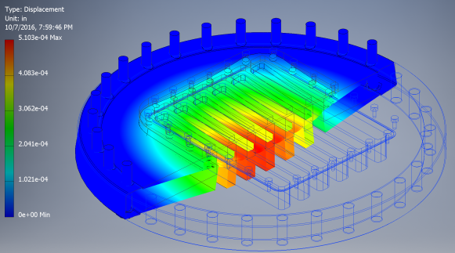
Deflection Under Pressure
Cryostat design pressure range: 950 – 1350 mbar
5 psi from inside cryostat: ~13μm max deflection
Max stress: ~ 2000 psi
1 psi from outside cryostat: ~12μm
Max stress: ~ 900 psi

Slide 15
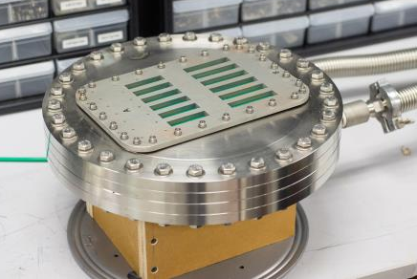
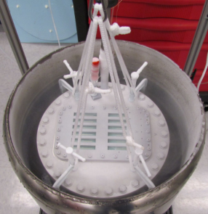
Leak Test of a Prototype Flange
Cryostat design pressure range: 950 – 1350 mbar (-0.7 – 5.1 psig)
A special chamber was built to perform helium leak check of the signal flange under those two pressure extremes.
Both indium wire and spring energized metal seals were tested, including cold tests with indium seal.
The leak rate of the metal O-ring is 10⁻⁴ mbar.l/s
The leak rate of the indium wire seal is 1.6x10⁻⁹ mbar.l/s
We expect lower leak rate with
hard plated gold surfaces on the flange PCB.

Slide 16
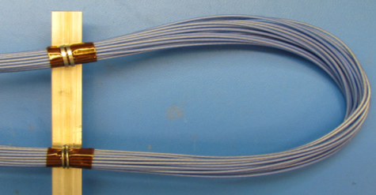
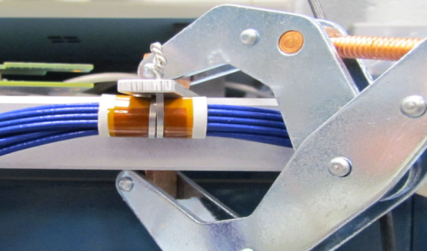
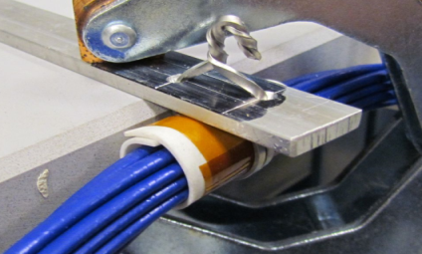
Cable Strain Relief
Examples of tests to hold cables against slippage (all Teflon jacketed cables)
Lock wires, commercial hose clamps, custom clamps
The cable clamps will be different between the DUNE and SBND versions of the cables

Slide 17
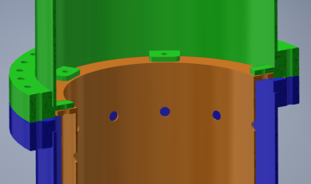
A Load Bearing Chimney Design
Assumptions:
CERN provide DN250 CF flanges above the cryostat top plate
The crossing tube may have some angular tolerance wrt. the CF flange (~2cm clearance needed)
No load on the crossing tube
TPC feedthrough tee
Crossing tube with DN250 flange (CERN)
Inner tube
Cold cables
Sealing ring
The inner tube is a perforated SS tube ~ 8” OD. It has a thin flange on the top which is screwed into a few welded mounting tabs on the large tee.
Cover plate

Slide 18
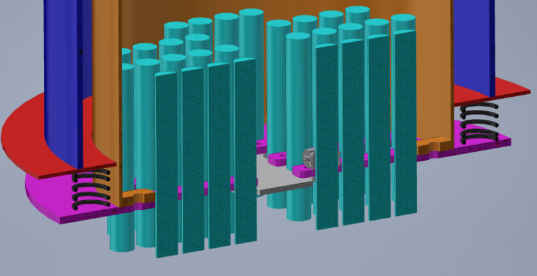
Details of the Bottom of the Port
The bottom cover plate has many slots to capture the cable bundles (use hose clamps as stops on each cable). It has a large opening in the middle to ease the threading of cables. This opening is blocked by a plate (gray) when all cables are in place.
The inner tube has a few tabs on the inside bottom edge to hold a bottom cover plate (magenta). A sealing ring (red) is pushed up to the bottom opening of the crossing tube by compression springs. Except for a small axial force from this sealing ring, no other load is applied to the crossing tube.
The number of cables in ProtoDUNE is about half of what’s shown here.

Slide 19
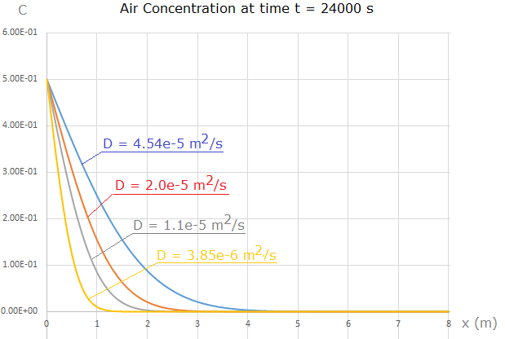
Argon Gas Purging Rate
LArTPC docdb 1983
This study is a justification of the gas argon piston purge method used to efficiently remove air from inside the cryostat. It seems to equally applicable to gas purging inside the feedthrough chimneys.
The model: a vertical tube, filled with air on top and argon on bottom, separated by a thin film at x = 0. The tube is large enough, so that we don’t have to consider its boundary. At time t = 0, the film is removed. We calculate the air concentration for t > 0 and x > 0 (x direction pointing downward).
D = 4.54x10⁻⁵ m²/s ---- our calculated value;
D = 2.0x10⁻⁵ m²/s ---- experimentally measured value;
D = 1.1x10⁻⁵ m²/s ---- scaled to 200 K from experiment value;
D = 0.395x10⁻⁵ m²/s ---- scaled to 100 K from experiment value.
Diffusion coefficient (m²/s) | Front 100 ppm position (m) | Front 100 ppm velocity (m/s)
4.54e-5 | 5.49 | 0.114e-3
2.0e-5 | 3.64 | 0.759e-4
1.1e-5 | 2.70 | 0.563e-4
0.385e-5 | 0.608 | 0.127e-4
We need mm/s scale argon purging velocity in the bottom of the FT chimney.
100ppm to 1ppb is a factor of 1.6 higher velocity

Slide 20
Gas Flow in the Chimney
Assumptions:
250mm ID cross section, 490cm²
Gas velocity: 1mm/s @ 87K at the bottom
GAr density @ 87K: 5.8mg/cc
Mass flow: 490*0.1*5.8=0.28 g/s
GAr heat capacity: 0.52 kJ/kg/K
Heat flow: 0.28 * 0.52 *(293-87) = 30 Watt
The flow velocity at the bottom plate is much higher due to the restricted openings
As the gas warms up, its volume increase and so is the flow velocity; partially compensating for the higher diffusion constant
Additional baffles can be added in the inner tube to make the high flow velocity path longer; tricky to do so for the outer tube due to unknown alignment.

Slide 21
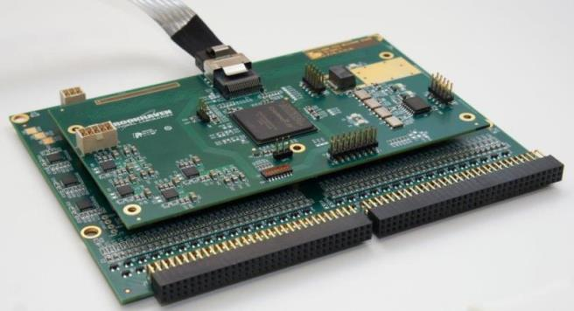
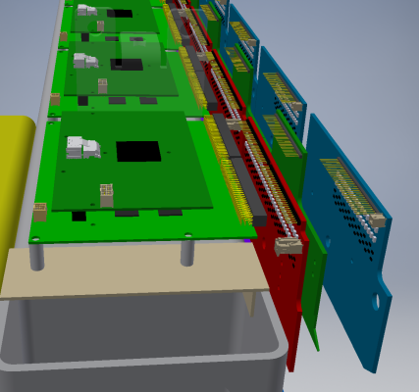
SBND Cold Electronics Boards and APA Connection (top bank)
FEMB Power
Data Cable
FPGA power
FPGA board
Connectors to the geometry boards
Mounting holes to APA Frame
FEM board
SBND geometry board stack and cold electronics board stack

Slide 22
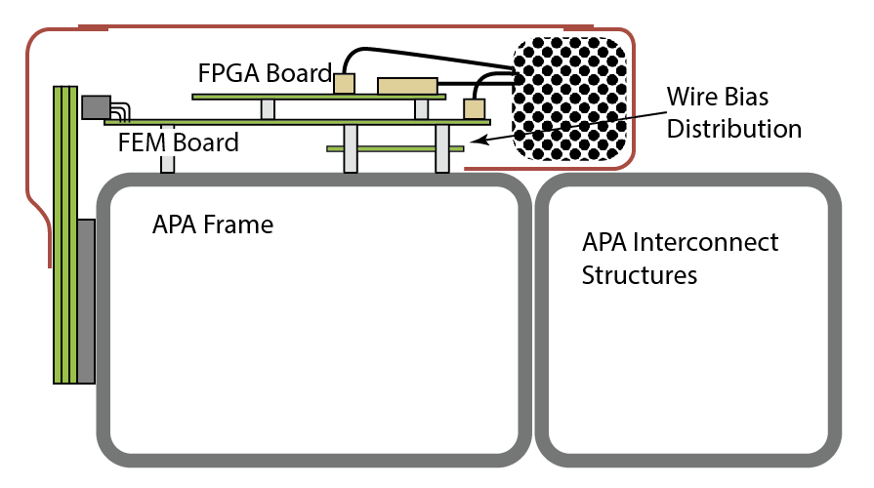
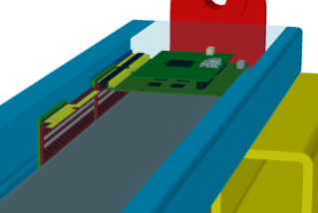
SBND Cable Routing along the APAs
3 faraday cages are installed over the cold electronics boards.
The top one has the outer cover perforated to allow gas escape.
The side ones have solid covers to direct the gas up.
Cables are routed inside the enclosure and exit at the top two corners of the APAs.
FEM boards are grounded to the APA frame through their mounting hardware (screws and standoffs): ~ 2 per 10cm along the three APA sides.
Data
ASIC power
FPGA power
Cable bundle
A full scale mockup of the cable routing is underway

Slide 23
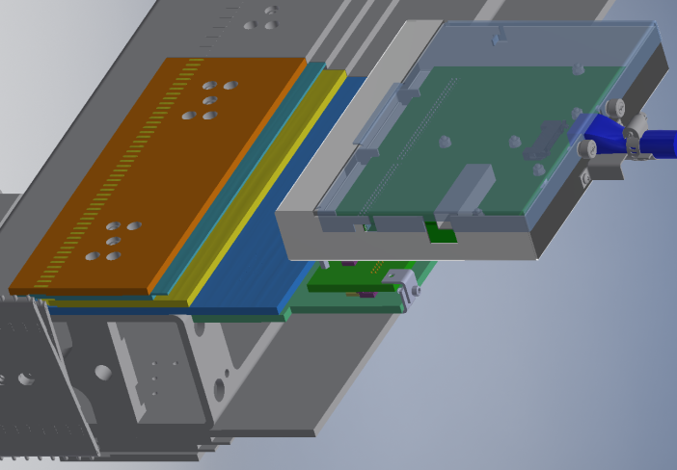
NP04 CE to APA Connection
DUNE CE module
APA frame
CE Box
Cold cable
(data & power)
Wire bonding boards
(4 layers)
FEMB &
FPGA Board
Intermediate connector board
CR board
(bias distribution)

Slide 24
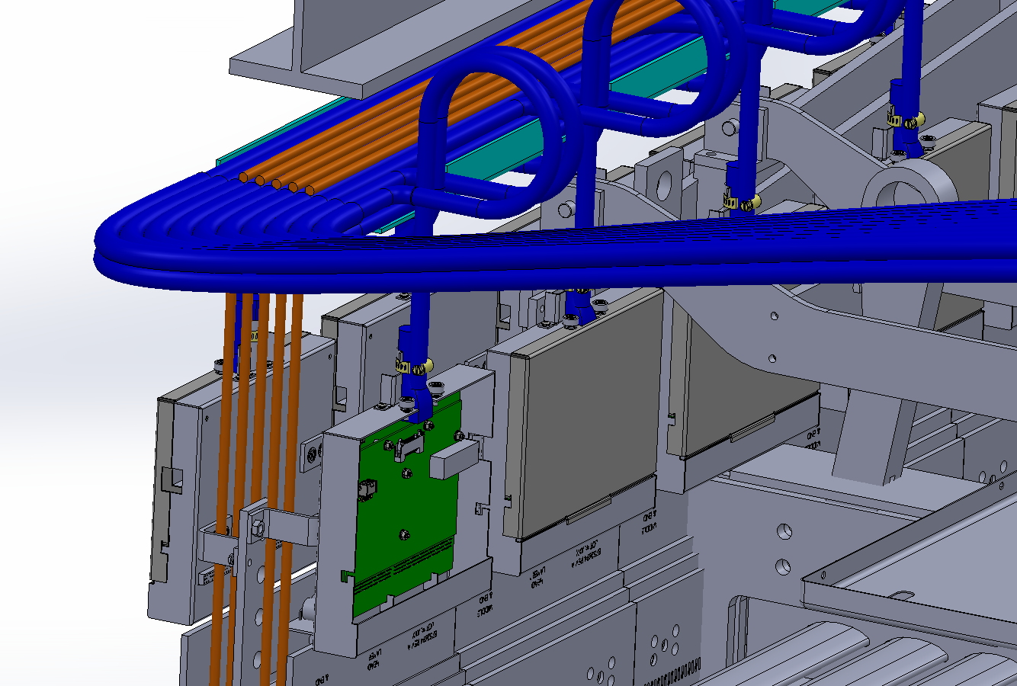
Concept of a Cable Tray Attached to an APA
A cable tray is planned on the APA between the cold electronics modules and the APA mounting rail to hold and direct the cables toward the feedthrough port.
Since the CE boxed are distributed over a 2.3m width but with cables of equal length, we have to store excess cables of various lengths somewhere.
We are working with the APA and integration teams to determine if all excess cables can be fit on this cable tray.
The weight of CE cables and boxes is about 65kg per feedthrough.
APA mounting rail
PD cables
CE Modules

Slide 25
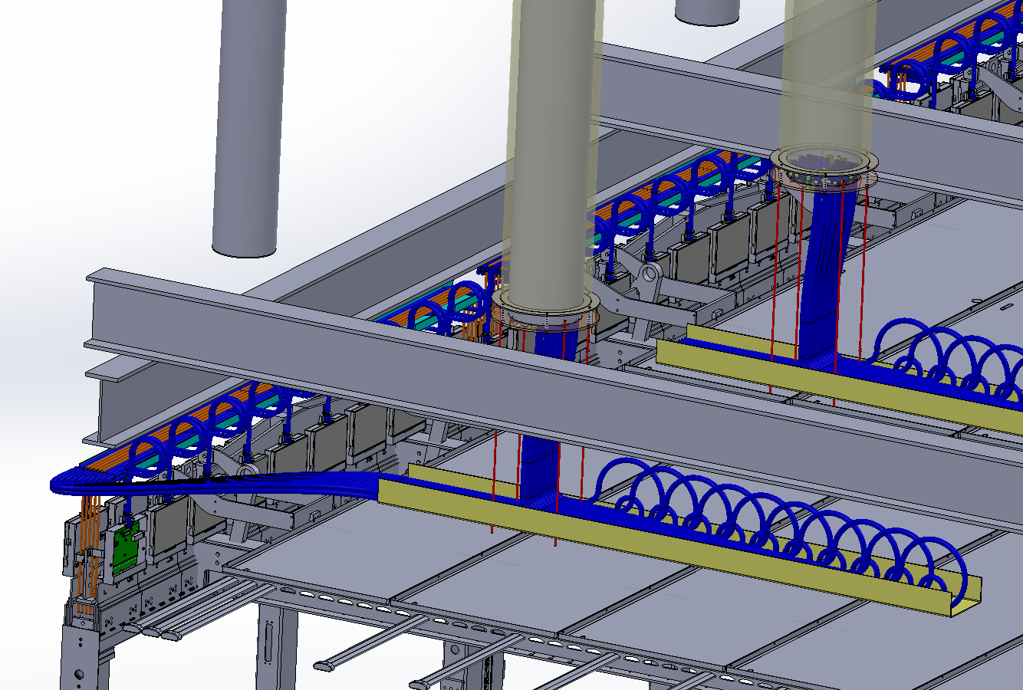
Concept of a Cable Tray under the Chimney
Since the CE boxed are distributed over a 2.3m width but with cables of equal length, we have to store excess cables of various lengths inside the cryostat. One concept is to store them on a tray under each chimney.

Slide 26
Summary
A common CE signal feedthrough design has been developed for both DUNE and SBND. It is based on a multi-layer printed circuit board with blind vias and all surface mount components. Indium wire seal is used between the PCB and a 14” CF flange to make it leak tight and ensure good electrical contact (grounding). Minor differences exist between the two versions due to data cable connector choices. Second round of prototyping is underway.
A low outgassing feedthrough chimney design concept is being developed and its detailed design awaits final design of the cryostat port. This concept uses minimal purging of the boil-off argon to sweep the impurities from the cables out of the cryostat. This concept should benefit both NP04 and SBND with tailored implementation details.
The installation of the DUNE cold electronics boards is distinctively different from that of the SBND. The DUNE scheme is meant to ease large scale assembly, testing and installation with limited access.
Cable routing scheme inside the cryostat for NP04 is evolving in connection with the development of the TPC installation process. The SBND design remains conceptual, but will be fleshed out soon.
Use of PTFE based cables in NP04/DUNE needs to be resolved.

Slide 27
Backup Slides

Slide 28
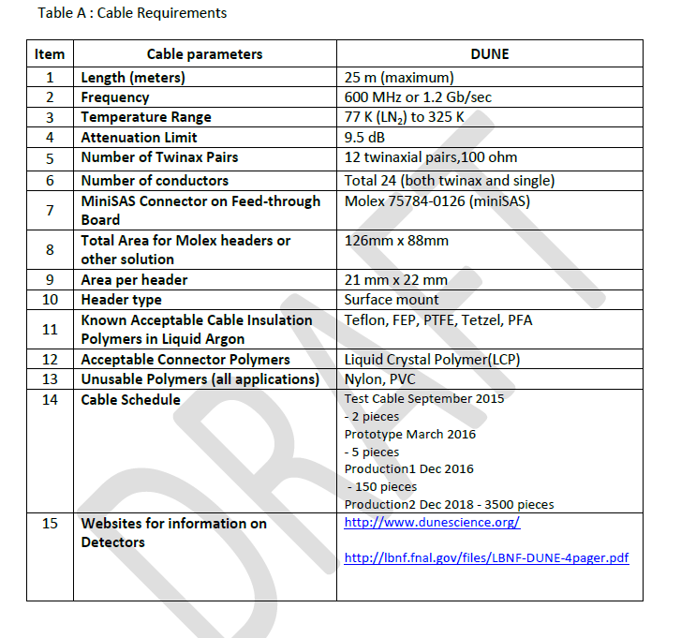
DUNE Cold Cable Specification
Cold cable development for DUNE has been progressing with SBND in parallel for the past few months
Shown is a draft specification matrix for DUNE
For SBND the maximum cable length is about 7 meters which allowed a cable gauge of 30 in a 3M cable with a miniSAS connector
In DUNE the maximum length is 18-25 meters which requires a different solution
Some of the companies which have provided cable, connectors or other information to date are:
3M
Gore
Amphenol
Glenair
Hitachi
Huber+Suhner
Samtec
ANTA

Slide 29
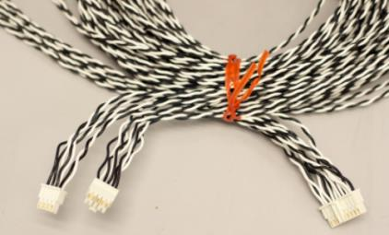
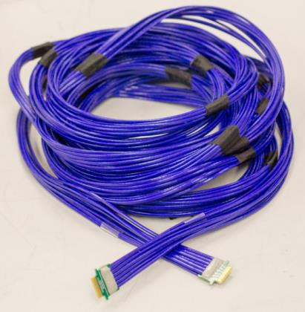
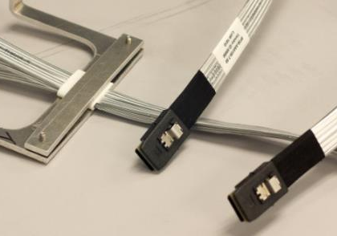
Cables
Power cable
DUNE
ProtoDUNE data cable
SBND data cable

Slide 30
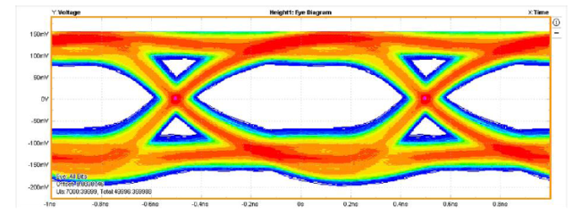
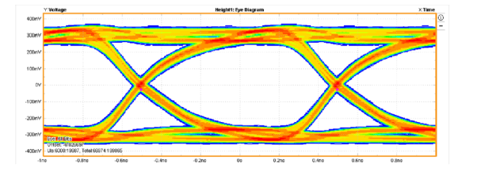
Gore Cable @ 25m
24 AWG
Used in the 35ton TPC @ 25m
High cost
Room Temperature, 25m
Eye Height 150 mV
Eye Width 757 ps
Jitter 243 ps
Liquid Nitrogen Temperature, Eye Height 484 mV
Eye Width 872 ps

Slide 31
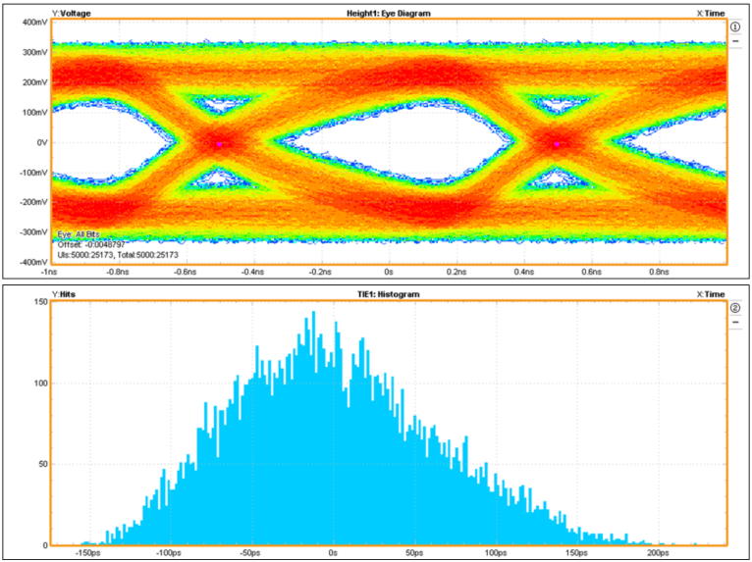
Samtec 26 AWG Cable
1.3GHz
Room Temperature
18m long
@ 25m length, need equalizers on the WIBs

Slide 32
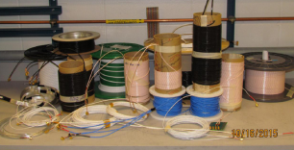
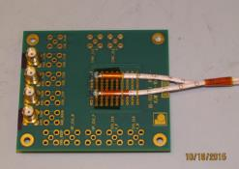
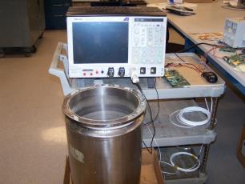
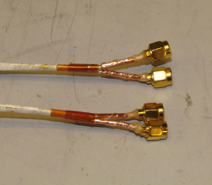
Cold Cable Setup, Samples and Terminations
25 meter test samples
Terminations
Eye Diagram Test Setup

Slide 33
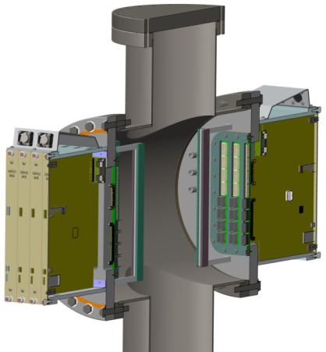
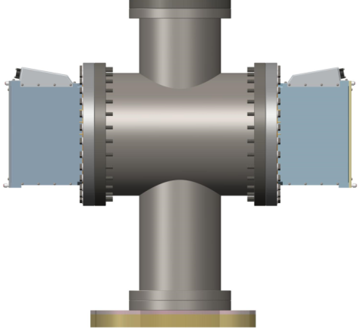
DUNE Version of the Flanges/Crates

Slide 34
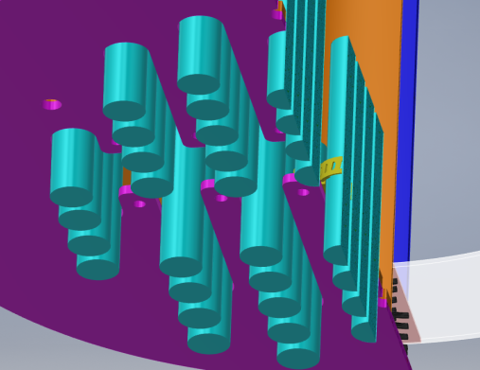
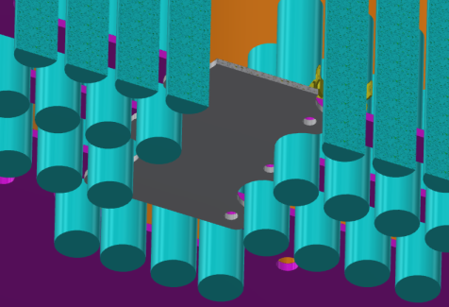
The bottom cover plate has many slots to capture the cable bundles (use hose clamps as stops on each cable). It has a large opening in the middle to ease the threading of cables. This opening is blocked by a plate (gray) when all cables are in place.
The cables can be pre-installed onto the bottom cover plate in the clean room.

