Slide 1
SBND Warm Electronics Design and
Integration Test with DAQ System
Jack Fried
Cold Electronics Review
October 13, 2016

Slide 2
Outline
SBND System Overview
SBND Warm Interface Electronics
  Warm Interface Board (WIB)
  Power & Timing Card (PTC)
  Power & Timing Backplane (PTB)
  Magic Blue Box (MBB)
    Used for Timing and Control Fan-out
Nevis Integration Test
Summary

Slide 3
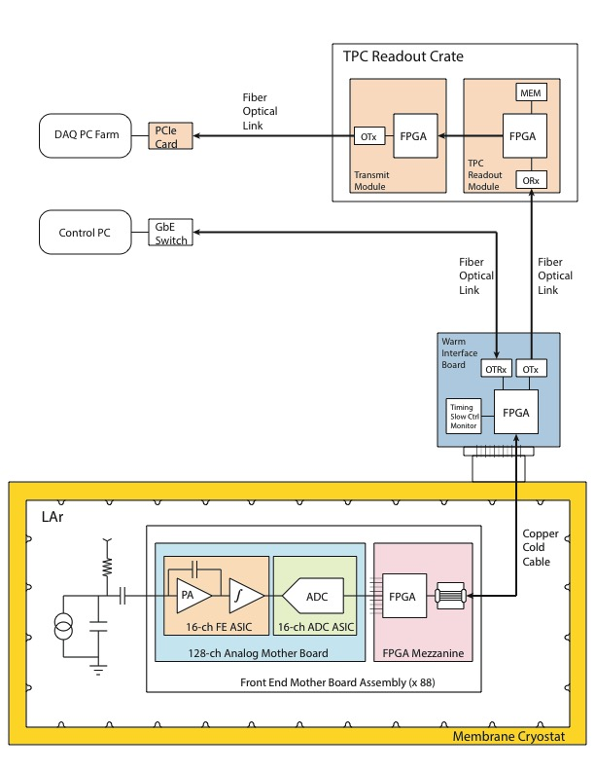
SBND TPC Electronics
TPC Readout Electronics
Back End Electronics
Front End Electronics System
  704 FE ASICs/704 ADC ASICs/88 Cold FPGAs
  88 Front End Mother Board assemblies
  4 sets of cold cable bundles, 4 sets of signal feed-throughs
  ~22 warm interface boards
Front End Electronics
Warm Interface Electronics
Signal Feed-through
Cold Cable
Cold Electronics
Cold Electronics Review

Slide 4
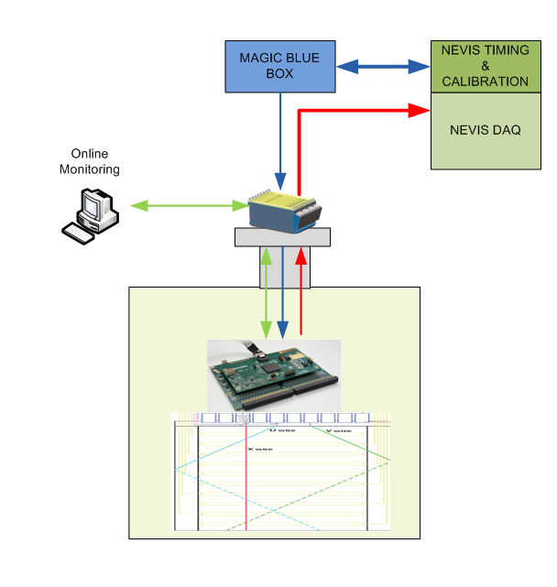
SBND Communication and Control Paths
SBND uses three paths for communication and control
  High speed Data
    Unidirectional data sent from FEMB->WIB->(Nevis DAQ)
      ADC Data
  Slow control
    GigE Link WIB <-> Online monitoring system
    I2c Link FEMB <-> WIB
    Used to control and monitor all system electronics
      Program ASIC SPIs
      Monitor Board voltages & currents
      System debugging (real time ASIC DATA)
      FEMB & WIB register control
  Timing & Synchronous Control
    A unidirectional path from Nevis DAQ -> MBB-> WIB -> FEMB
      System clock fan-out
      ADC sampling clock
      Synchronous commands such as calibration pulse and time stamp reset
Timing
&
Synchronous control
High speed Data
Slow Control

Slide 5


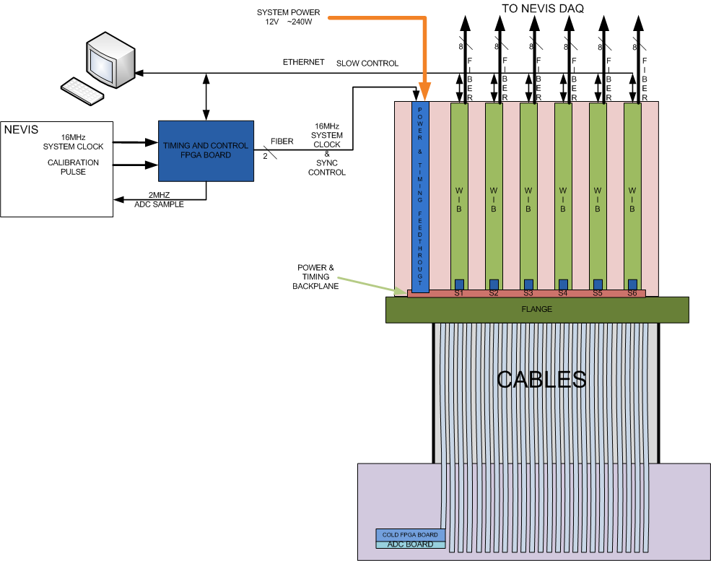
SBND Warm Interface Electronics
Warm Electronics Crate
(WEC)
MBB (Magic Blue Box)
Warm interface board electronics will be installed on top of the cryostat flange
  Receive data from cold electronics through cold cables
  Send data to Nevis electronics over fiber optical links
  Interface to slow control system using fiber GIG-E
  Manage power, timing and control to cold electronics
Each Warm Electronics Crate (WEC) contains the following
  Six Warm Interface Boards (WIB)
    Each WIB will control up to four 128-ch FEMBs
  One Power and Timing back plane (PTB)
  One Power and Timing Card (PTC)
WEC is a faraday cage with only optical signals going in and out other than the main power
Total up to 3072 channels per WEC, SBND uses 2816 channels

Slide 6
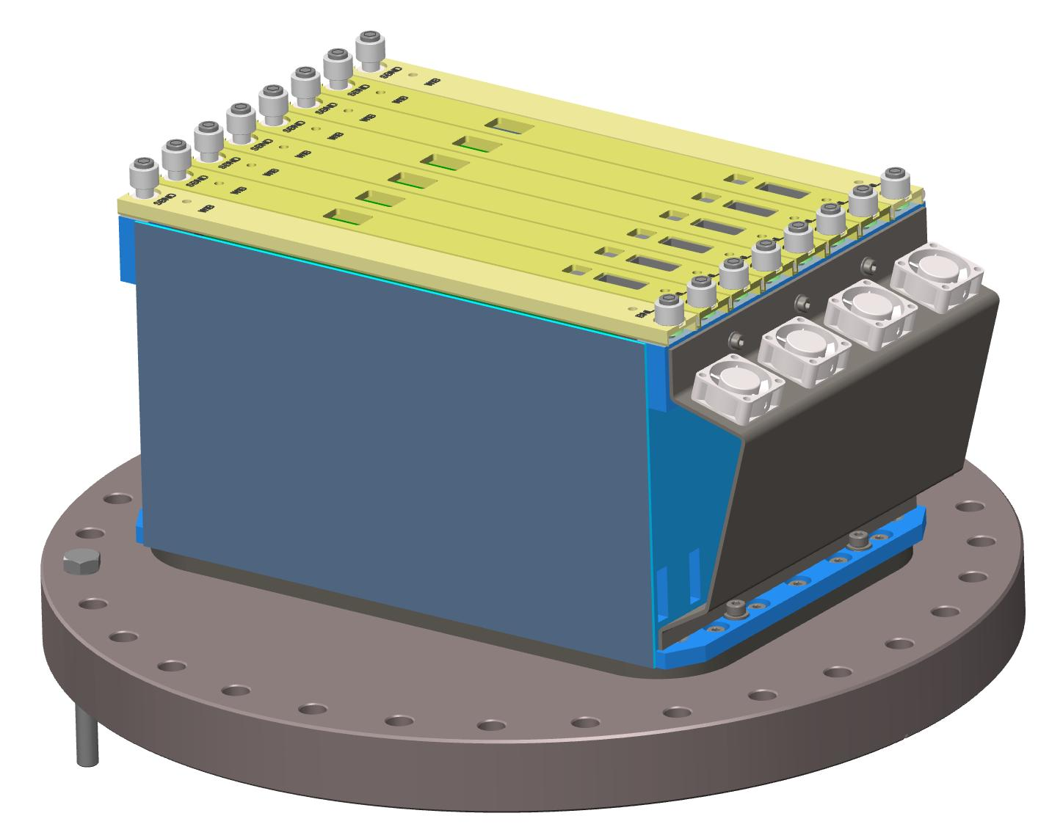
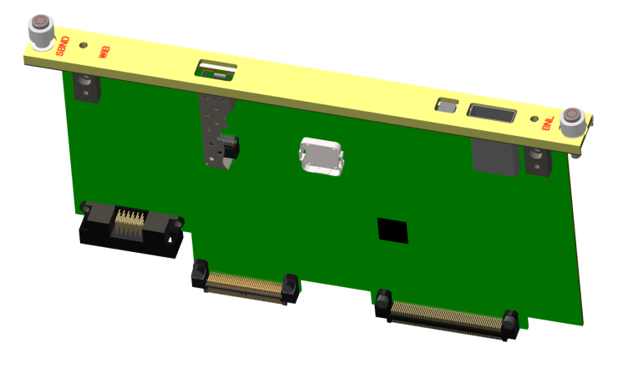
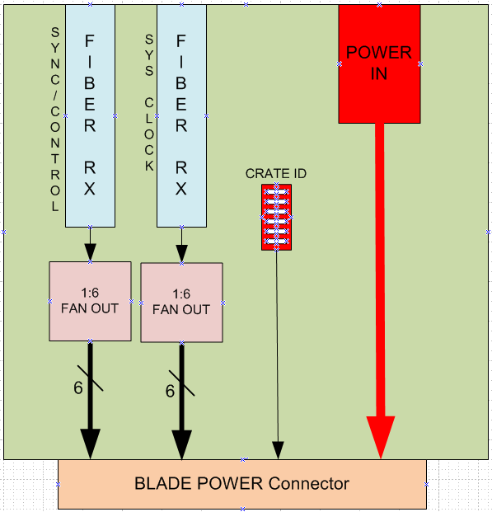
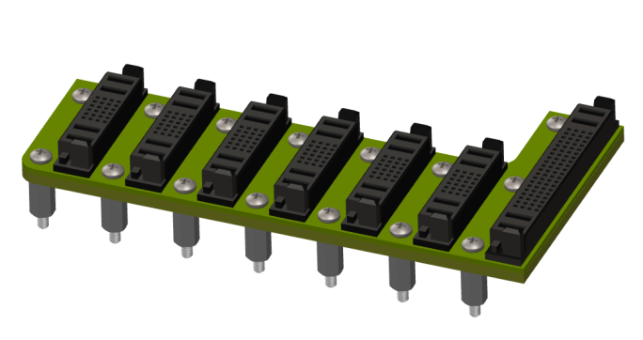
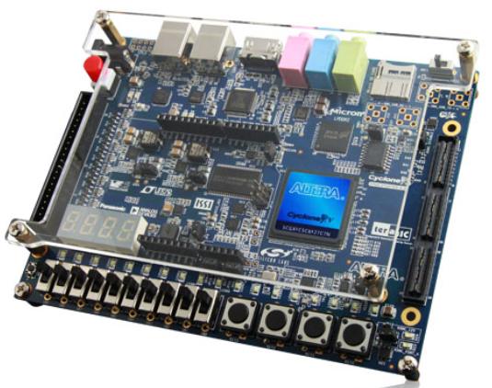
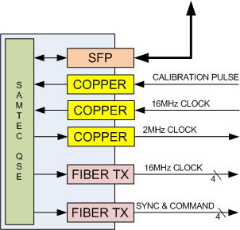
SBND Warm Electronic Components
WIB
WEC
WEC
PTB
PTC
MBB

Slide 7
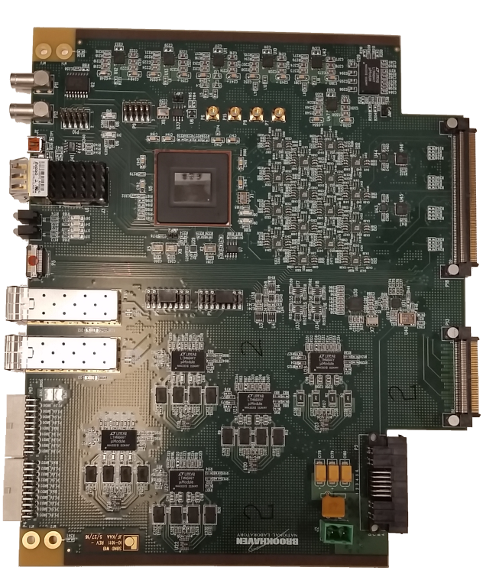
SBND WIB
FEMB JTAG
SFP
GigE
EXT Calibration
FEMB
Quad
DC/DC
P-POD
12V Input
Arria v FPGA
Cable Equalizers
FEMB POWER & DATA

Slide 8


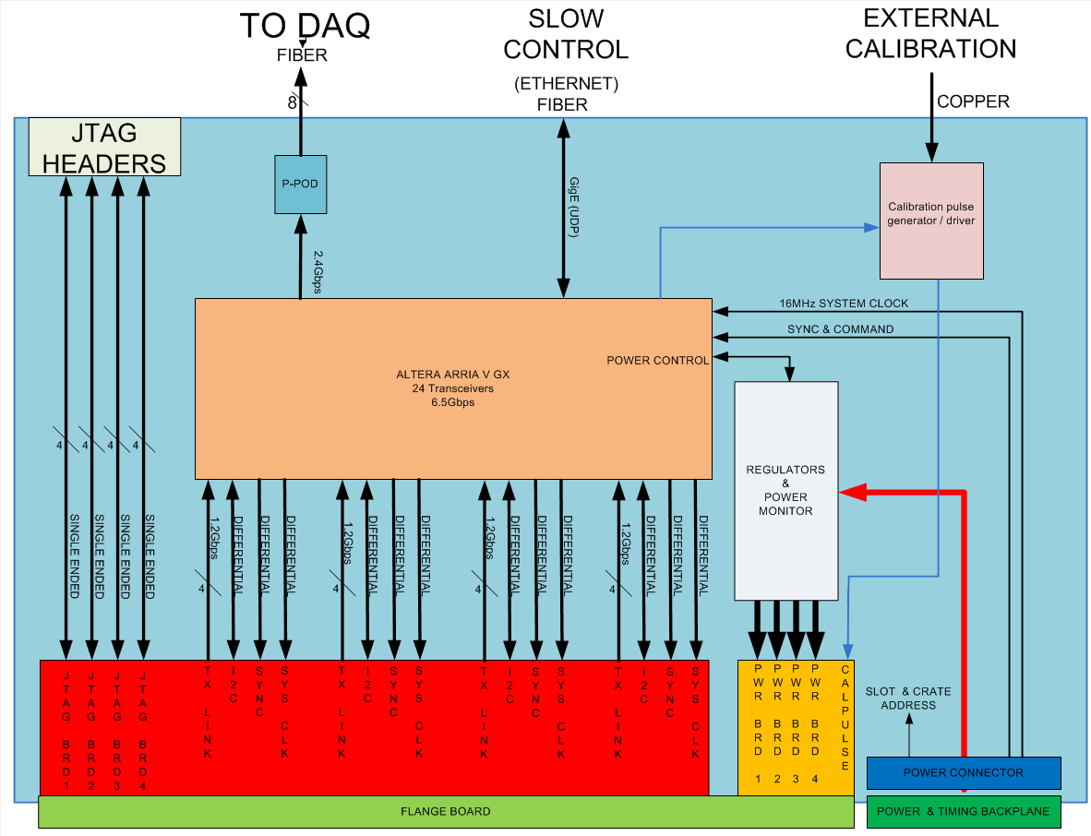

Warm Interface Electronics
(WIB)
Online Monitoring
Interfaces to 4 FEMBs, signals for each FEMB include
  Four 1.28Gbps receiver links
  I²C link (Differential LVDS)
  16MHz system clock (Differential LVDS)
  SYNC/CONTROL (Differential LVDS)
  FPGA JTAG signals (single ended)
Sends eight 2.125Gbps links to the Nevis DAQ electronics
Communicates to online monitoring through a fiber Gigabit Ethernet link using UDP
  IP address is generated by slot and crate address
Each FEMB has can be controlled independently over Ethernet

Slide 9
Warm Interface Electronics
(WIB)
Receive the system system clock + Sync/Cntrl from Magic Blue Box (MBB) system which will be distributed to the FEBs
  The WIB can generate the system clock and sync/control internally for system testing
Built in calibration pulse generator which can be triggered by the Sync/Cntrl link from the (MBB) or from online monitoring
  External calibration can be accomplished by an input on the front panel of the WIB
  Calibration pulse distribution is for risk mitigation only
System clock
+
Sync/Cntrl
PTB
PTC
MBB

Slide 10
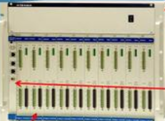
Warm Interface Electronics
(WIB)
Power is delivered through Power Timing backplane (PTB)
  There are 5 DC/DC converters for each FEMB for a total of 20 per WIB
    Each FEMB requires 1.5V, 2.5V 2.8V, 3.6V and 5V
  Each DC/DC converter has voltage and current monitoring and can deliver up to 4A
  Each DC/DC converter can be individually enabled or disabled through slow control
Alternate power path available from front panel connector
Wiener MPOD
PTB
PTC

Slide 11
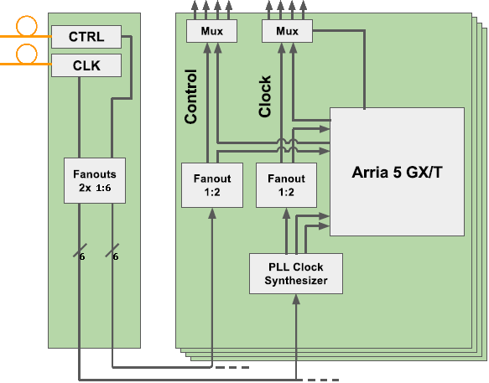
SBND Warm Electronics
Timing & Control
To FEMB
Nevis -> MBB -> PTC->WIB
  16MHz system clock
  Sync/Cntrl
On WIB
  System clock go through PLL synthesizer and generates 100MHz clock which is fanned out to the FEMB’s and FPGA
  Sync/Cntrol fanned out to FEMB’s
  Clock & Sync/Cntrl source selectable FPGA or external
From
MBB
PTC
6 WIB’s

Slide 12
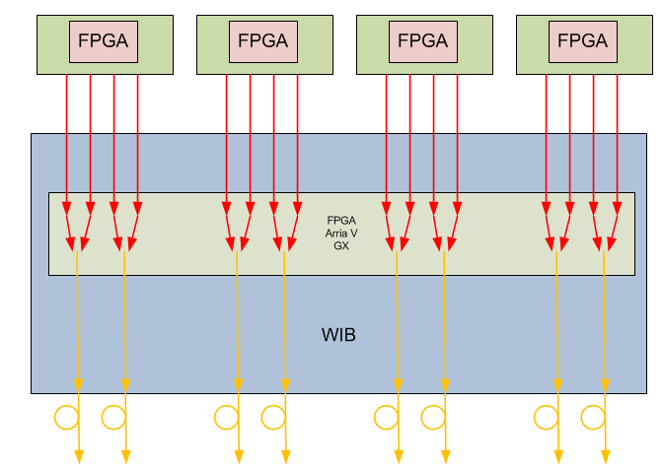
SBND Data Path
FEMB
  Four 1.28Gbps links
  Payload per link 1.16Gbps
WIB
  Strip header from FEMB payload and multiplex 2 links into 1
  Output link 2.125Gpbs
  Payload per link 1.92Gbps
FEMB
FEMB
FEMB
FEMB
16 Links @
1.28Gbps
Payload
(1.16Gbps)
8 Links @
2.125Gbps
payload
(1.92Gbps)

Slide 13
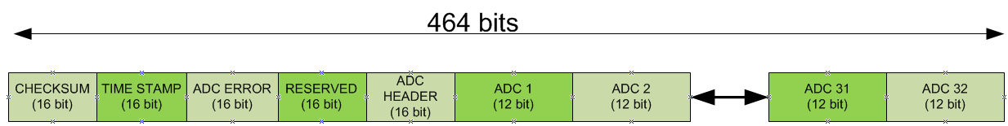
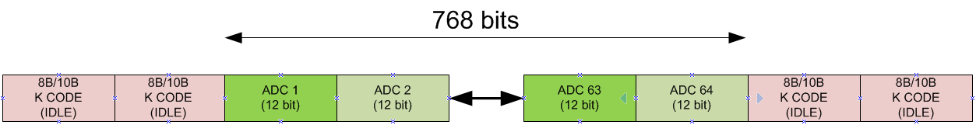
High Speed Signal Details
HIGH SPEED WIB RX DATA (FROM COLD FPGA TO WIB)
(16bit (Checksum) + (16bit (Timestamp) + 16bit (ADC ERROR) + 16bit (Reserved) + 16bit (ADC Header) + (12bit(ADC) * 32 (Channels)) * 2MHz * 1.25 (8B/10B encoding) = 1.16Gbps
Link Speed = 1.28Gbps
HIGH SPEED TX DATA PER LINK( FROM WIB to NEVIS DAQ)
(12bit(ADC) * 64 (Channels)) * 2MHz * 1.25 (8B/10B encoding) = 1.92Gbps
Link Speed = 2.125Gbps
TOTAL DATA RATE
WIB = 8(Links) * 1.92Gbps = 15.36Gbps WEC = 6(WIBs) * 15.36Gbps = 92.16Gbps

Slide 14
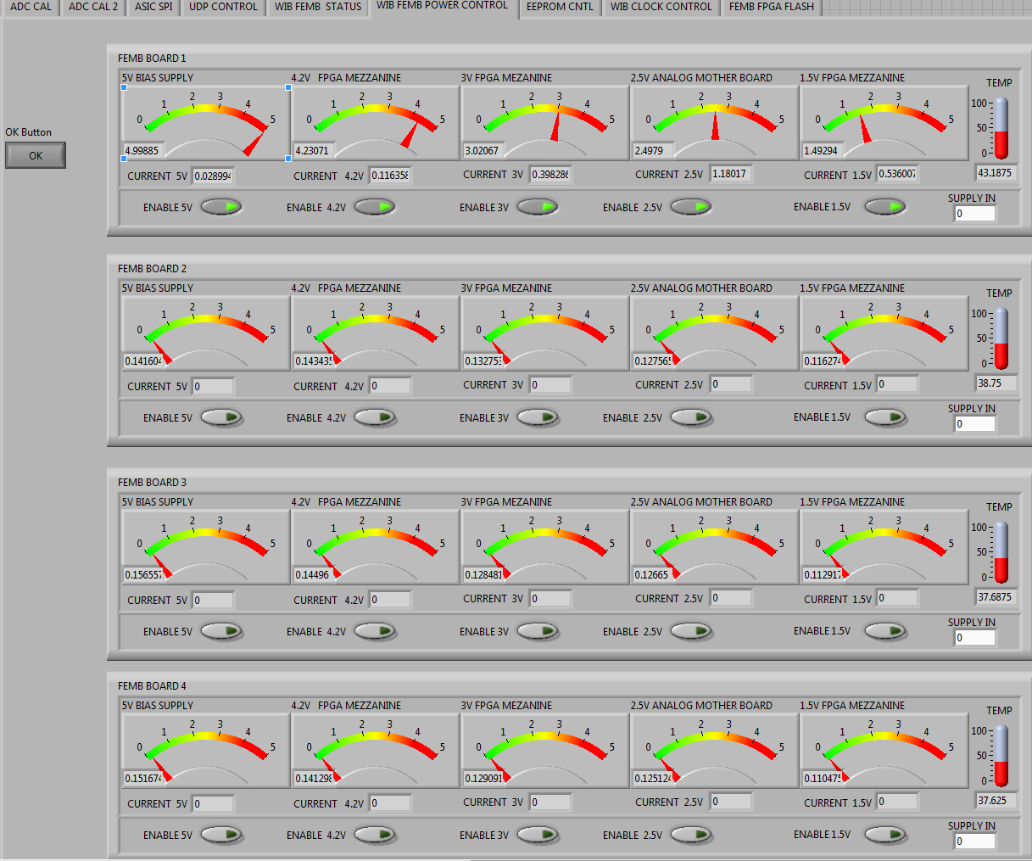
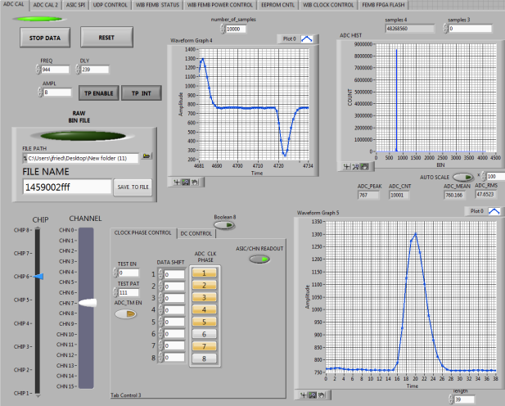
Warm Interface Board (WIB)
Online Monitoring / Debugging Features
Monitor and control FEMB voltages and currents
  Can set alert triggers to be sent to online monitoring
Can monitor FEMB ASIC data sent over high speed link
  Can set alert triggers to be sent to online monitoring ( Such as ADC thersholds)
Read and write FEMB registers
  WIB works as a UDP to I2C translator
Program and verify FEMB FPGA flash memory
Store default settings on on-board flash device
Can select to use on-board or system clock
Can generate internal or external calibration pulse
Peek at high speed data link in real time over slow control
  Can monitor one ASICs worth of data (16 channels)
Can generate high speed test data sent to DAQ
  PRBS test pattern
  Counter
  Channel , Crate , Slot address encoded to aid in mapping
Utilize all engineering development tools used at BNL
  Can plug a laptop containing BNL tools into the Ethernet switch or directly into a WIB
  Can be used simultaneously with DAQ system
  Will simplify debugging of entire system
Power Monitor & Control
Real-time channel data

Slide 15
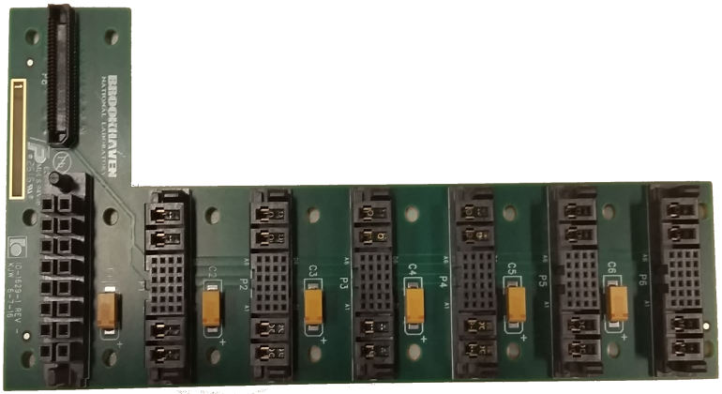
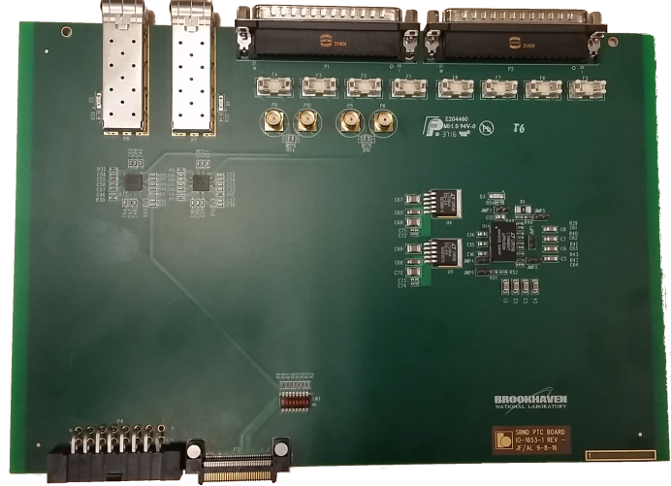
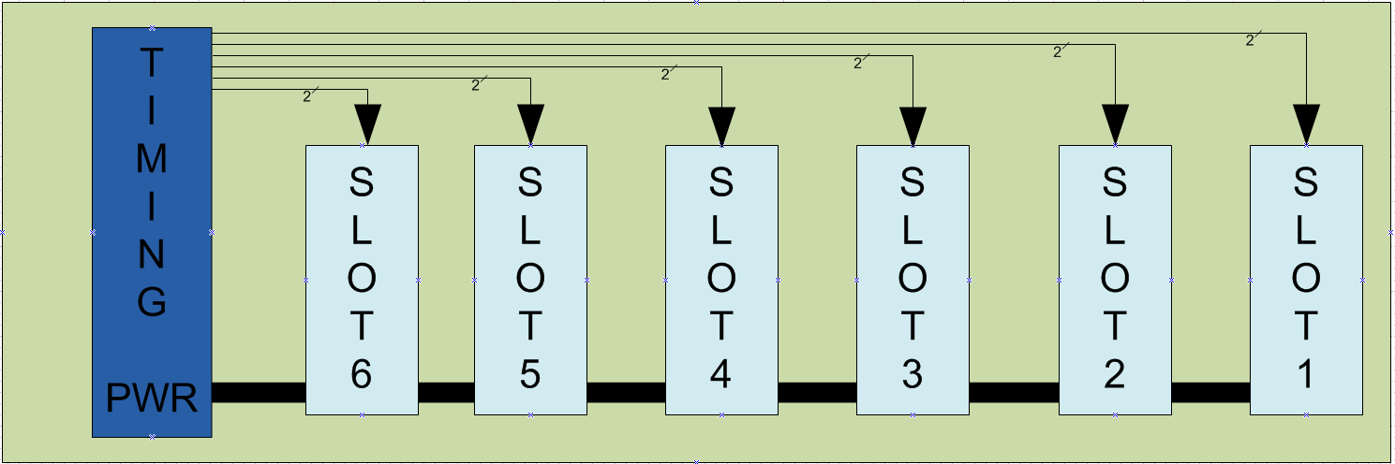
Power & Timing Backplane (PTB)
Power & Timing Card (PTC)
PTB distributes system clock and Sync/Cntrl signals to each WIB
  Each signal is a point to point connection and is individually terminated on the WIB
PTB each slot has a unique slot address
  Used to generate GIG-E IP address on WIB
PTC dip switch allows for selection of crate address which is bused to each WIB
PTC two fiber optic receivers used for 16MHz system clock and Sync/Cntrl signals from MBB
  The PTC fansout the received signals through a 1:6 clock driver delivering point to point signals to each WIB
PTB
PTC

Slide 16
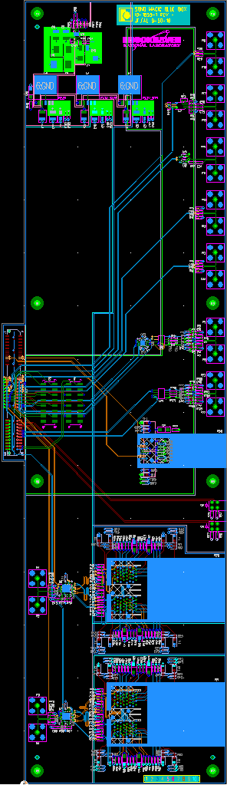
Magic Blue Box
(MBB)
  MBB Electronics
    MBB Design utilizes an Altera Cyclone V evaluation board
      Simplified MBB design
    Connections to the Nevis DAQ
      16MHz system clock from Nevis DAQ (copper)
      2MHz ADC sampling clock goes to Nevis DAQ (copper)
      Calibration signal from Nevis DAQ synced to the 2MHz clock (copper)
      5 Spare copper input signals
      5 Spare copper output signals
    Connections to the Warm Electronics Crate (WEC)
      Four 16MHz system clocks one to each WEC (fiber)
      Four Sync/Cntrl signals one to each WEC (fiber)
    Slow control
      One SFP module GIG-E which goes to online monitoring
2MHz ADC
sampling clock
Calibration signal
16MHz clock input
One GigE link
Fiber or RJ45
Four sync/control
fibers
Four 16MHz system clock
fibers

Slide 17
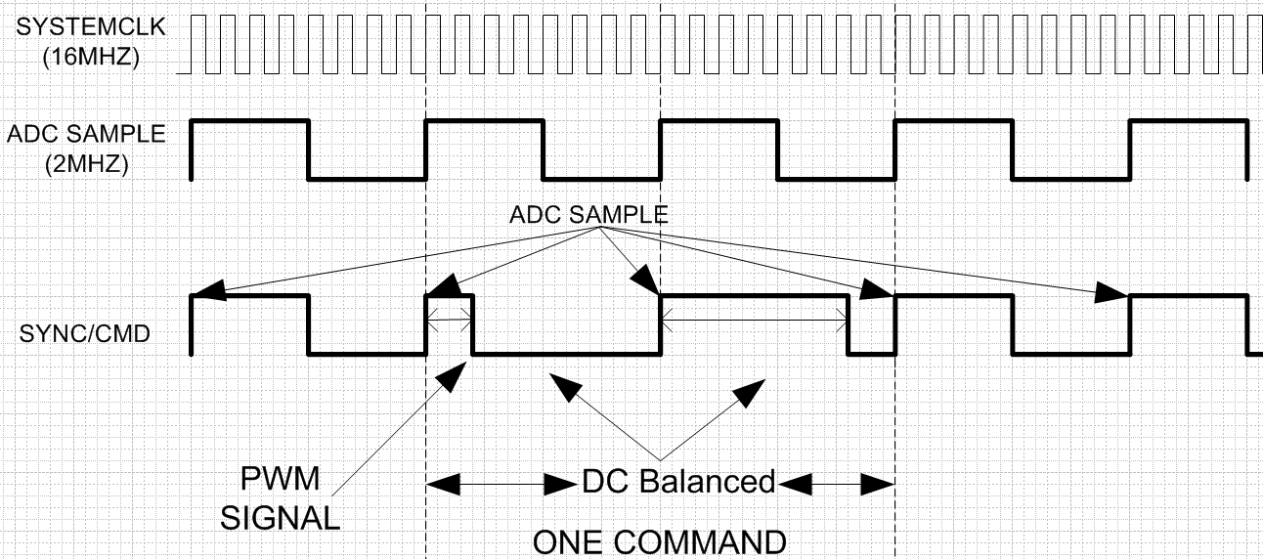
Magic Blue Box
(MBB)
  MBB Features
    Gigabit Ethernet communication to DAQ for SBND system control
    Distributes 16MHz system clock to each WEC
    Generates 2MHz ADC sampling clock from 16MHz system clock
      Sent to NEVIS DAQ
    Sends Sync/Cntrl signal to each WEC
      2MHz Clock
      DC balanced pulse width modulated signal to encode synchronous commands
      can encode up to seven synchronous commands
Command Executed
System synchronous commands
    Calibration pulse
    Time stamp reset
    System rest
    System enable/disable
    -----TBD-----

Slide 18
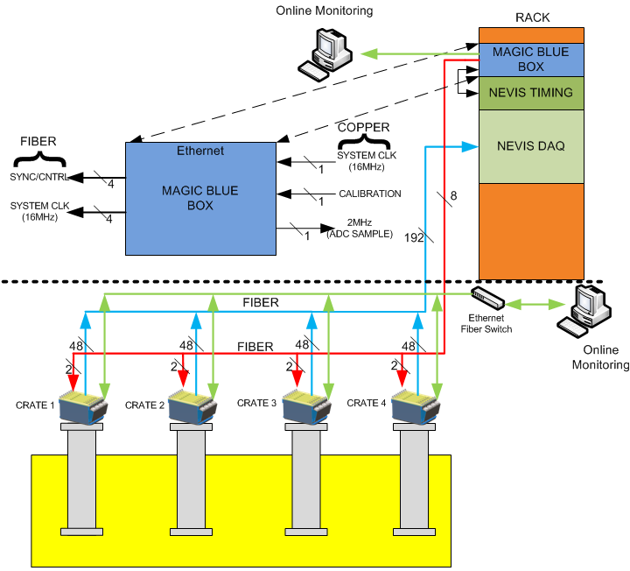
SBND TPC Data , Clock & Calibration Signals
DAQ
  WIB -> Nevis DAQ RACK
    192 Fibers
System Clock
  Nevis timing to MBB
    Copper
  MBB (DAQ RACK) -> PTC
    Four Fibers
Sync/Cntrl
  MBB (DAQ RACK) -> PTC
    Four fibers
Ethernet
  To online monitoring
  Six per WEC 24 total
    WIB <-> switch
    Fiber
  One MBB
    Fiber or copper
Calibration
  Nevis timing to MBB
    Copper
  MBB (DAQ RACK) -> PTC
    Encoded on SYNC/CNTRL

Slide 19
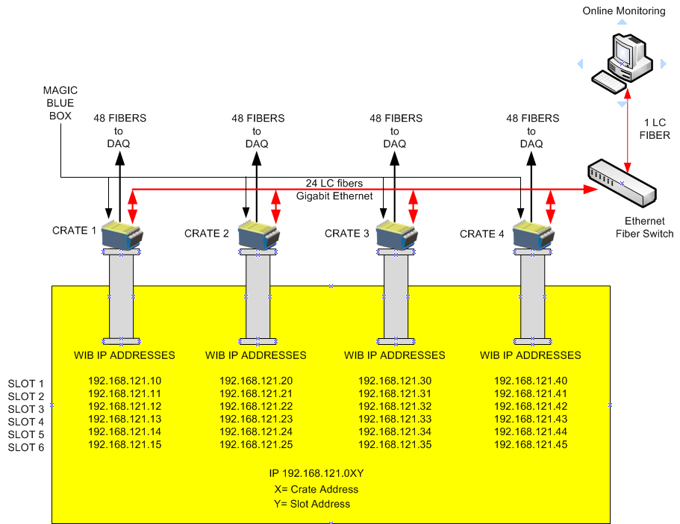
SBND WIB Address Map
192.168.120.001

Slide 20
ETHERNET PACKET FORMATION
(UDP)
DEVICE IP 192.168.1XX.0YY (192.168.121.1) = FEMB
  XX = Crate ID
  YY = WIB Slot ID
DEVICE MAC: AABBCCDDXXYY (AABBCCDDEE00 ) = FEMB
  XX = Crate ID
  YY = PTB Slot ID
SYSTEM KEY = 0xDEADBEEF
WIB ETHERNET PORTS
  32000 write port -- Used to write registers
  32001 read request port -- Used to read registers
  32002 response port -- Used in respond to a read request
  32003 high speed data port -- Used to receive alert & high speed data
FEMB COMUNNICATION Z = FEMB 1-4
  32Z00 write port -- Used to write registers
  32Z01 read request port -- Used to read registers
  32Z02 response port -- Used in respond to a read request

Slide 21
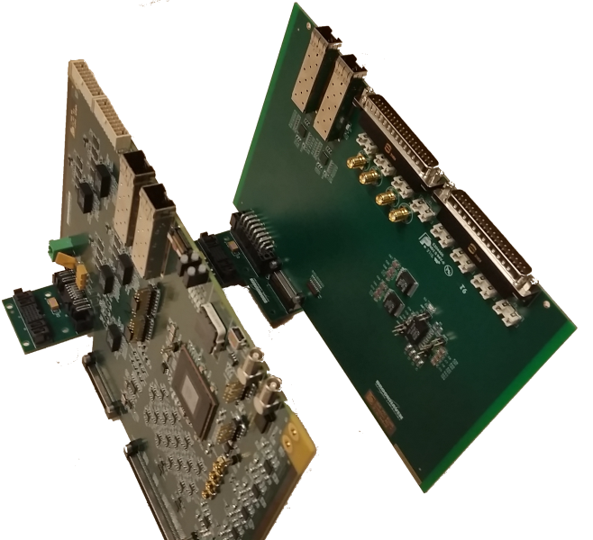
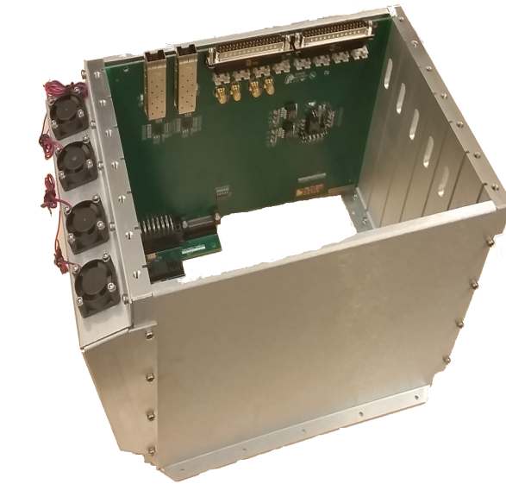
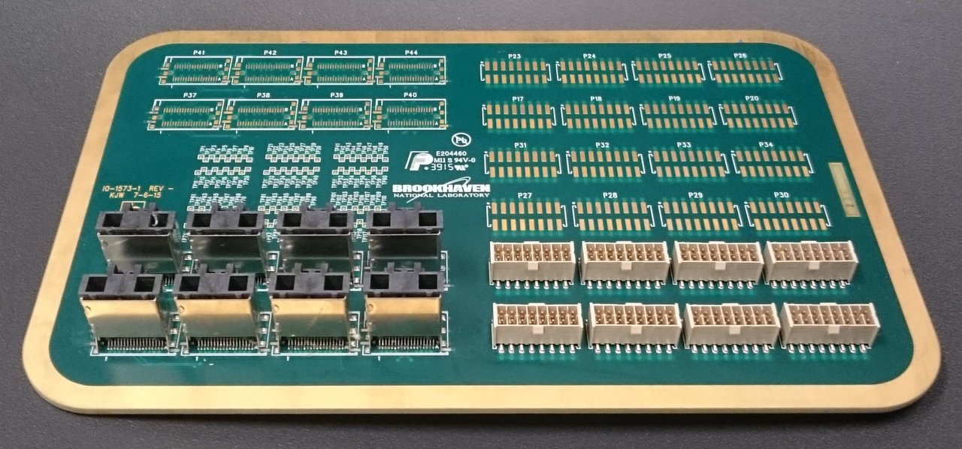
SBND Warm Electronic Components
WIB
WEC
MBB
SBND FLANGE
(prototype)
SBND PTC
PTB

Slide 22
BNL-Nevis Integration Test
BNL & Nevis had an integration test at Nevis Labs on September 22
  Goal
    Test optical link between BNL's Warm Interface Board (WIB) and Nevis's Front End Module (FEM).

Slide 23
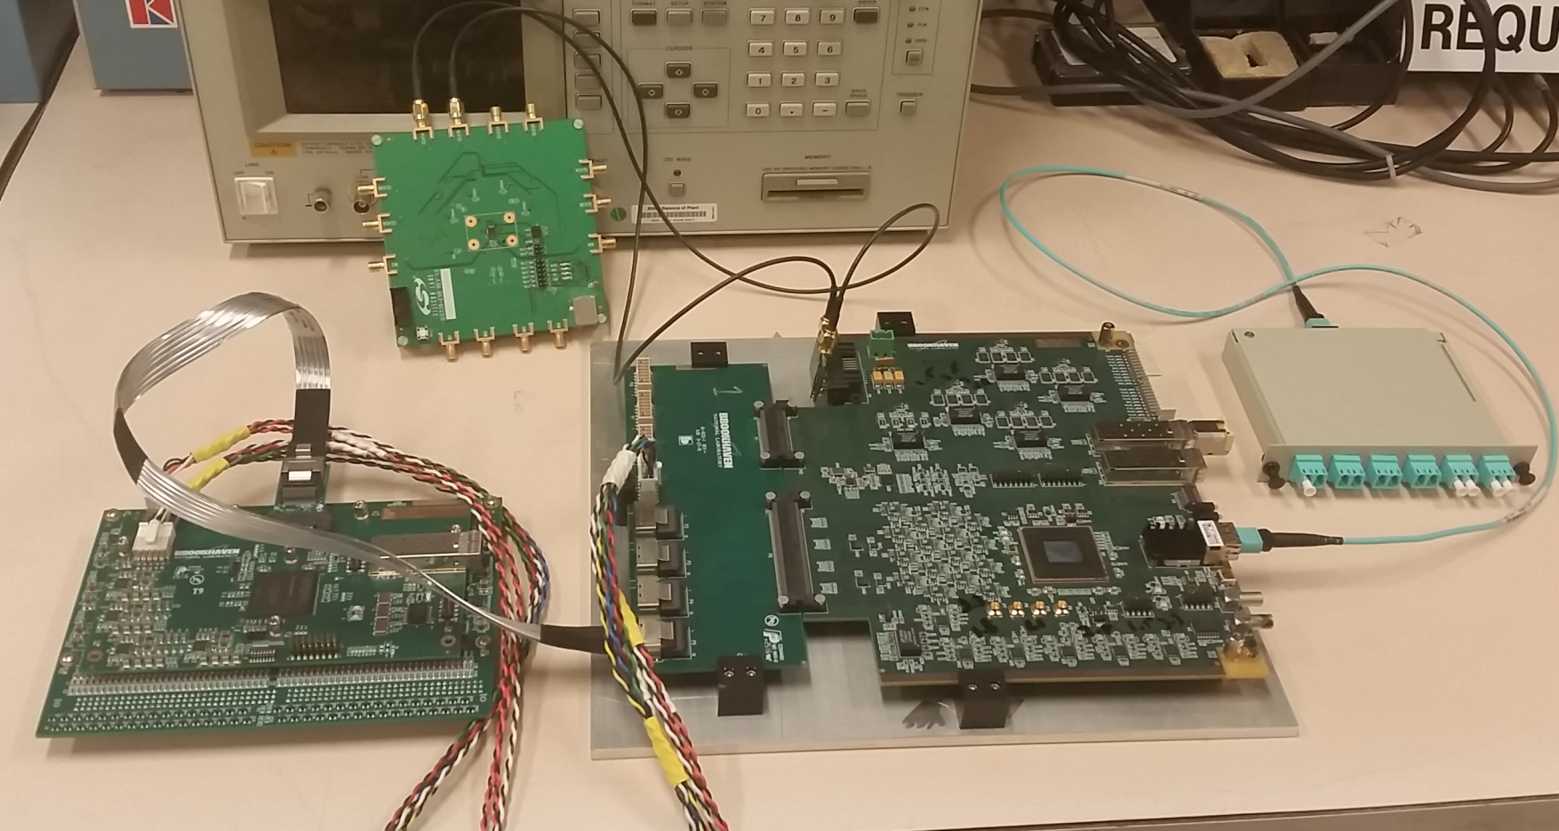
BNL-Nevis Integration Test
BNL Hardware
SILABS SI5338 EVAL
DC to DC
FEMB POWER
FEMB POWER
12V POWER
SFP SOCKET
FIBER
BREAKOUT
P-POD
FEMB
DATA CABLE
SBND WIB TEST ADAPTER

Slide 24
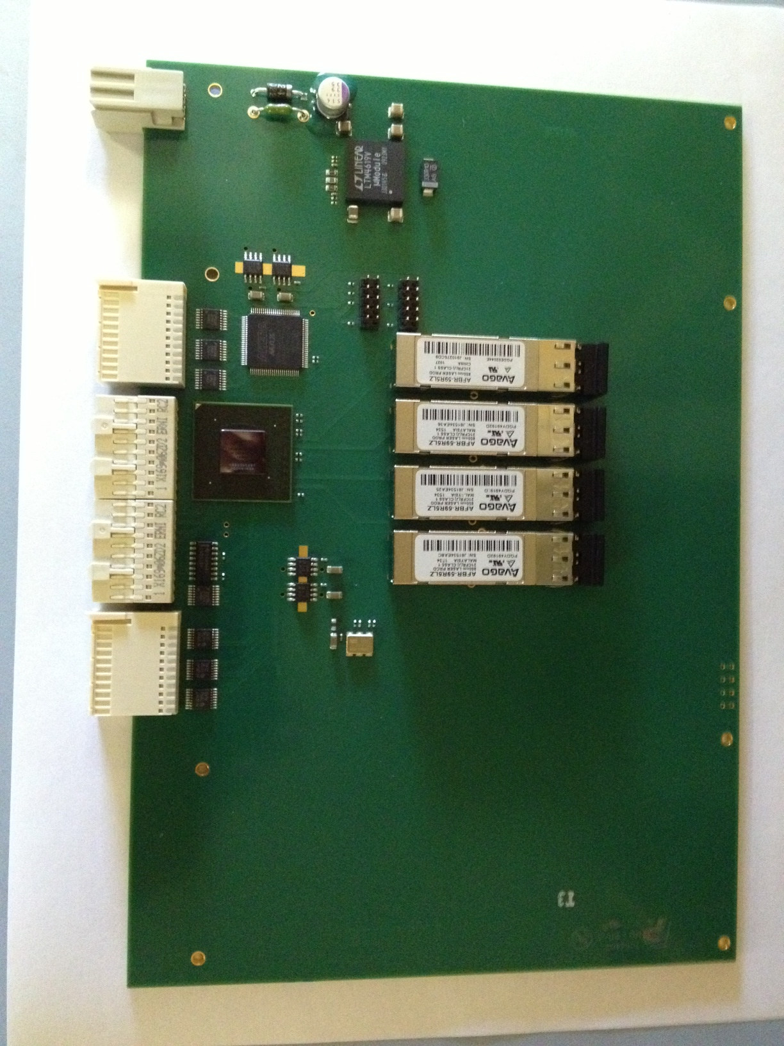
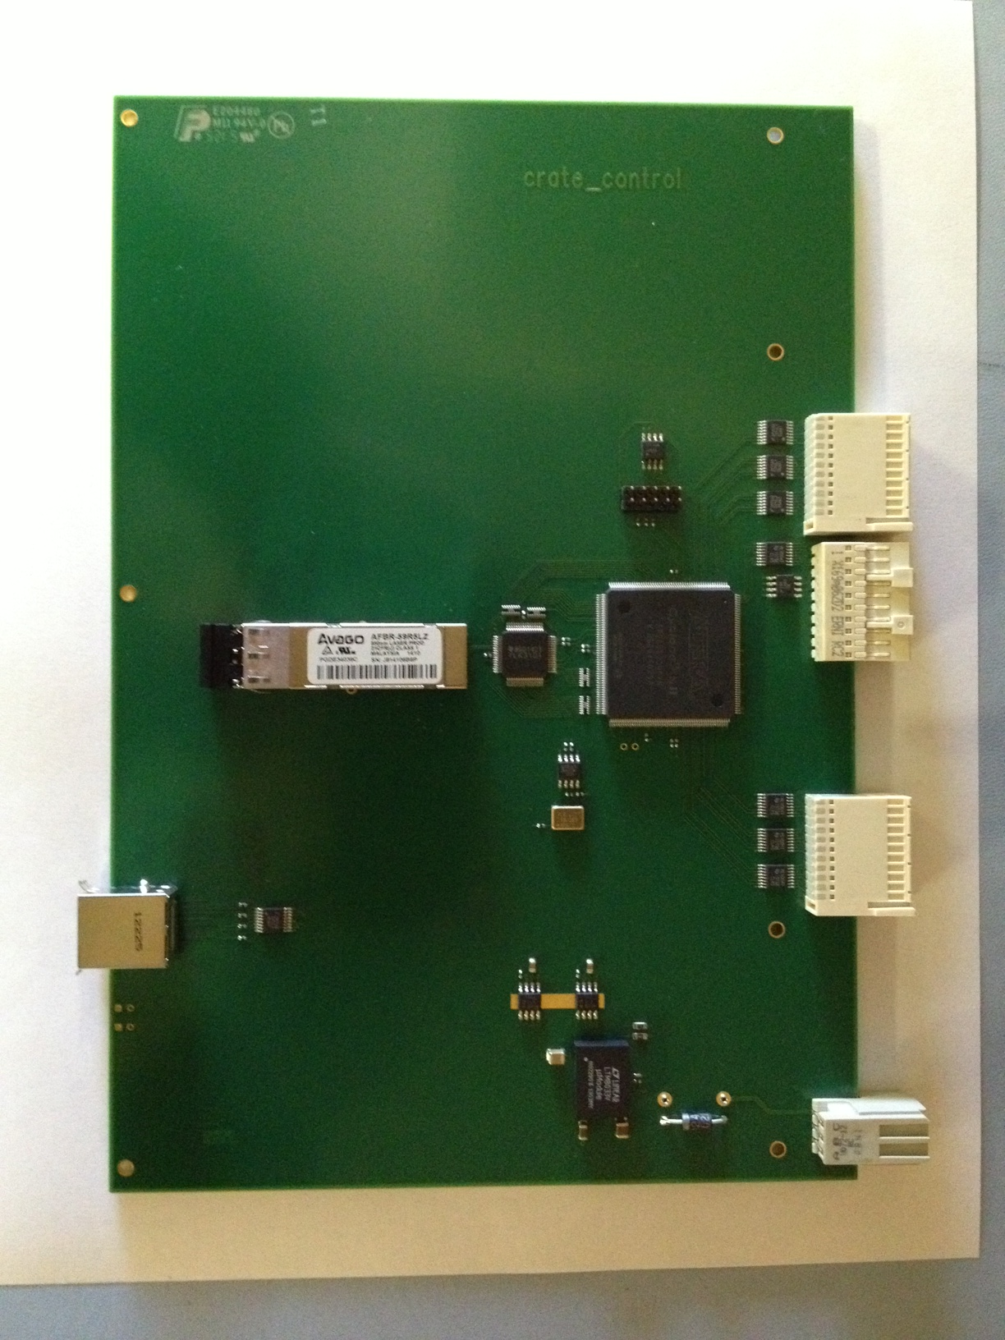
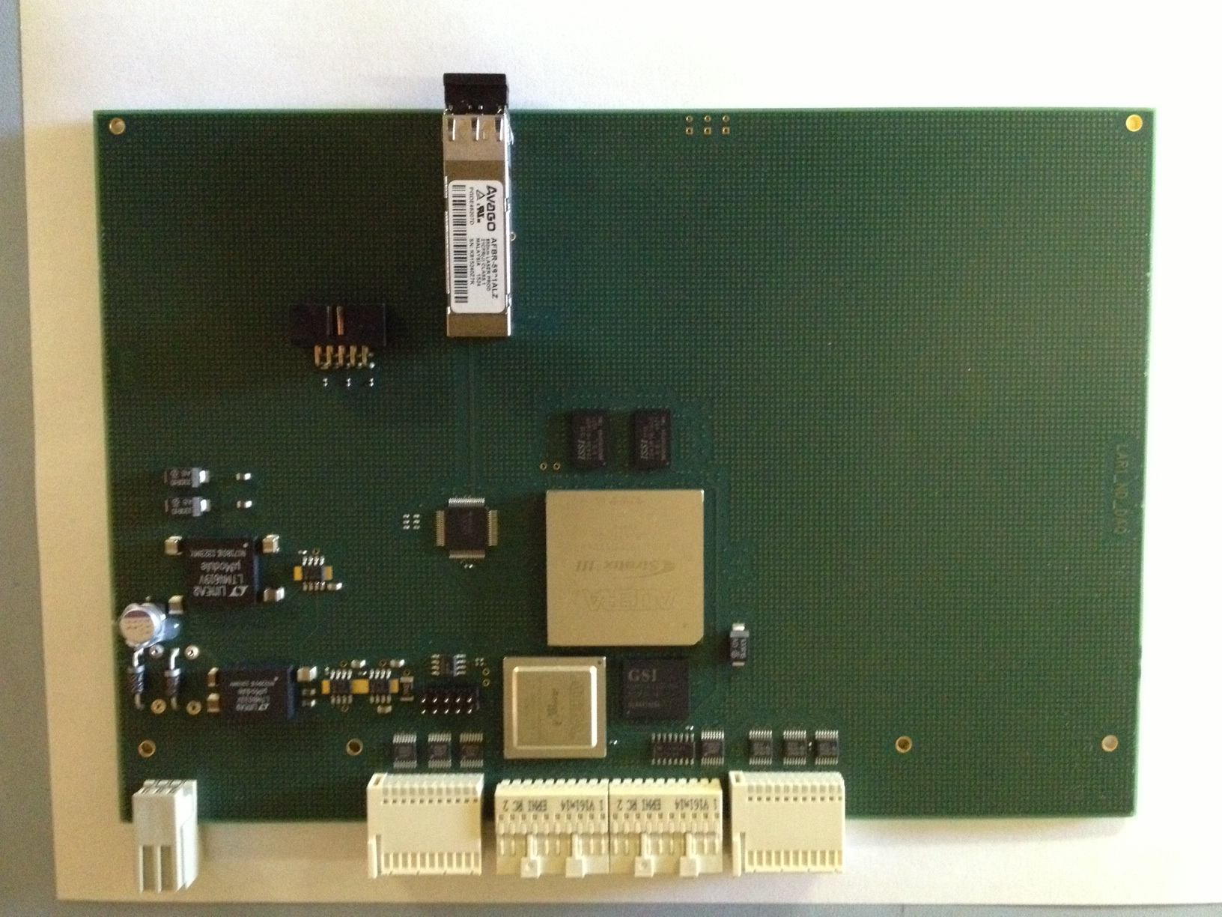
Front End Module
BNL-Nevis Integration Test
Nevis Hardware
XMIT transmitter module.
New Format 6U 160mm deep
Crate Controller.
Deserialiser
New Optical Receiver
New Format 6U 160mm deep

Slide 25
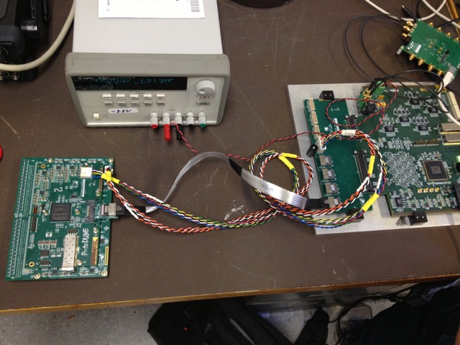
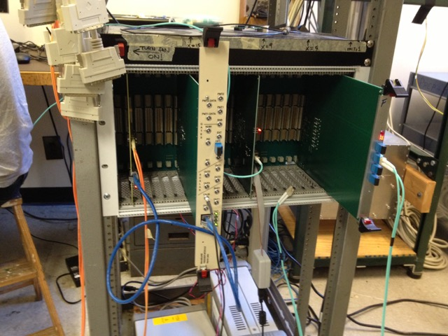
Setup
FEMB
ASIC’s
WIB
Optical
Copper
BNL
Nevis
Magic Blue Box (MBB) not available.
Used SiLabs SI5338 eval board to emulate MBB + PTC. Fed (16 MHz) directly to WIB
Clock
Crate
Controller
Trigger
FEM
Slow readout through controller (no XMIT used)
DAQ PC
PCIe
card
Trigger sent only to controller:
Asynchronous readout of WIB

Slide 26
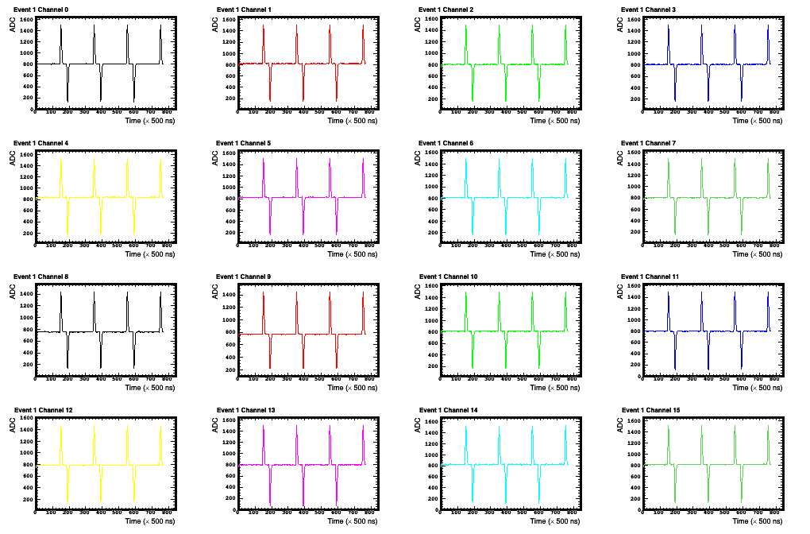
Calibration pulse generated in BNL's ASIC chip 1
(16 channels) read out by Nevis FEM

Slide 27

Success!

Slide 28
Summary
The development of SBND warm electronics is making good progress
  WIB Prototype testing is underway
  MBB is out for fabrication
  SBND & ProtoDUNE Flange is out for fabrication
BNL<->Nevis Integration test
  September integration test completed successfully but without MBB & PTC
  November integration test planed to include MBB & PTC

Slide 29
BACK UP

Slide 30
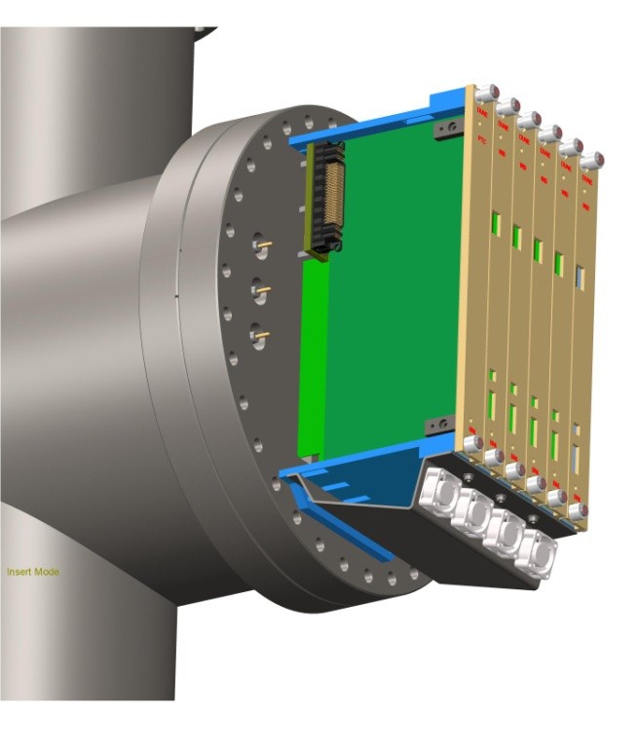
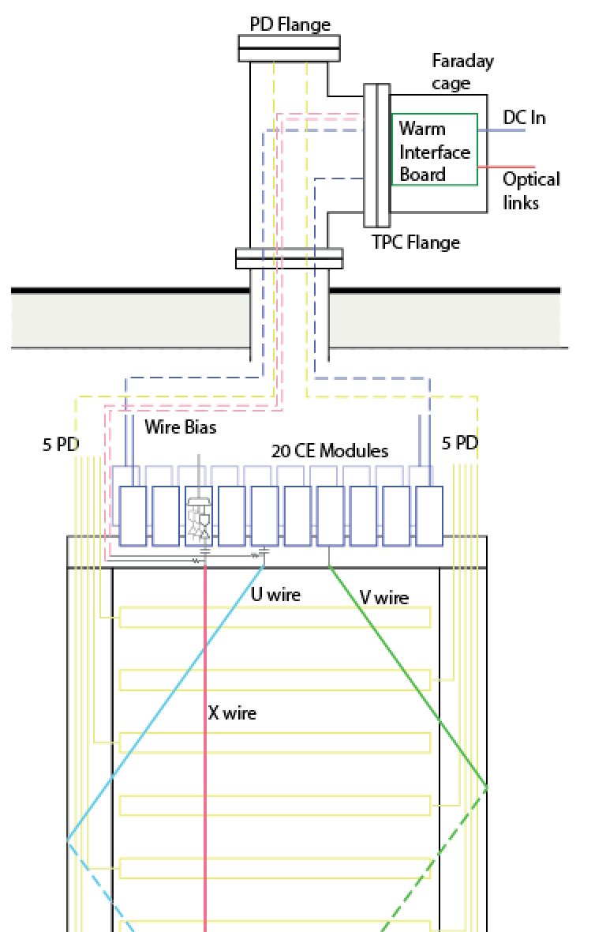
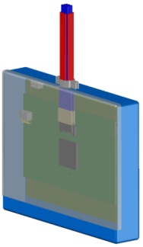
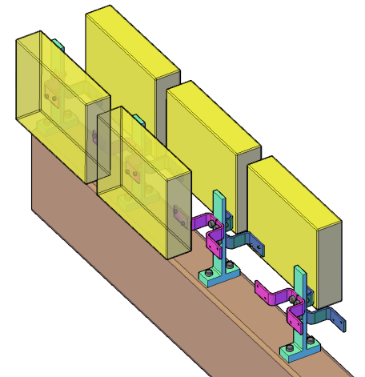
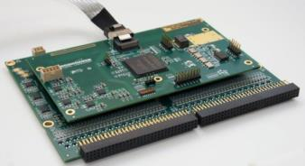
APA with Integrated Warm Electronics
Warm electronics module and its attachment to the APA frame

Slide 31
SBND WIB MODIFICATIONS/FIXES
Replace poly fuse “F1” with 5A fuse holder “0031.7701.11”
Replace 5V FEMB bias “U28” DC to DC with lower power solution
Add cable drivers / receiver to lemos on front panel
Use TPS3847 voltage monitor for WIB local DC to DC ”U29” to fix startup issues
Add I2C level shifter “TCA9406” to ALL LT2991 power monitors “U19-U23”
Front panel power inputs should go through sense resistors for power monitoring
Remove AC coupling from U31 “C272-C277”
Modifiy ERF8 connector “P18” to allow for unidirectional LVDS
  JTAG signals rearranged to allow for an extra differential pair
Add 12V power input at front panel (if there is room)
Replace SI5338 PLL “U31” with SI5345 PLL
  Fix clock termination “R53” wrong side of AC coupling
Added voltage monitoring feature for WIB local power
  Two LT2991 added
Add mounting holes. ( for bench testing)

Slide 32
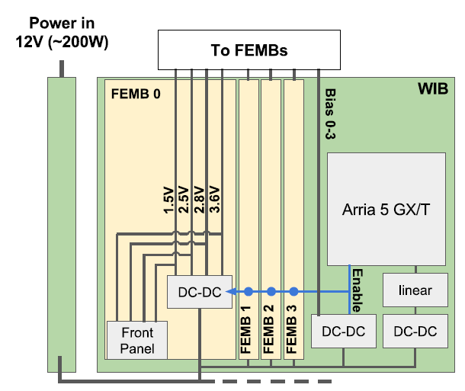
WIB Power
Power for cold:
  Each FEMB requires 1.5V, 2.5V, 2.8V, 3.6V and bias
  Primary power path:
    External 12V distributed through PTC, backplane
    Each WIB uses LTM4644 quad DC/DC converters to generate required voltages
  Alternate power path:
    Front panel connector receives regulated cold power directly

Slide 33
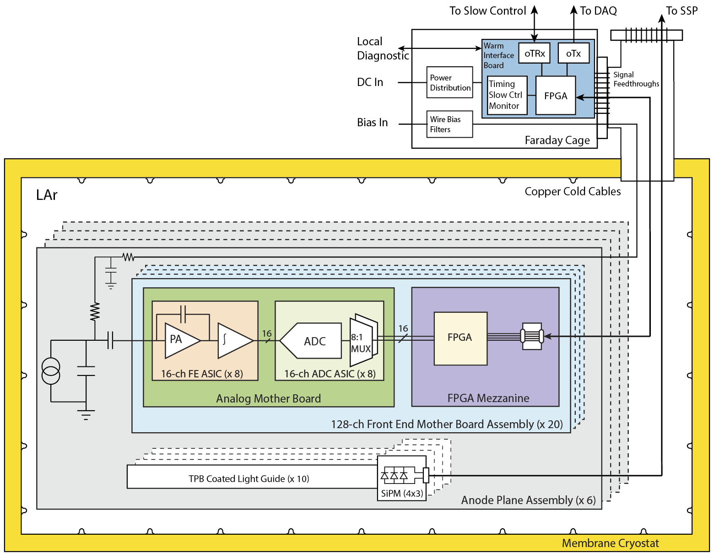
Cold Electronics Communication
  SPI interface
  ADC data / synchronization
  FPGA mezzanine IO
  System readout
    To DAQ and real time monitor
  Analog Motherboard
  FPGA Mezzanine

Slide 34
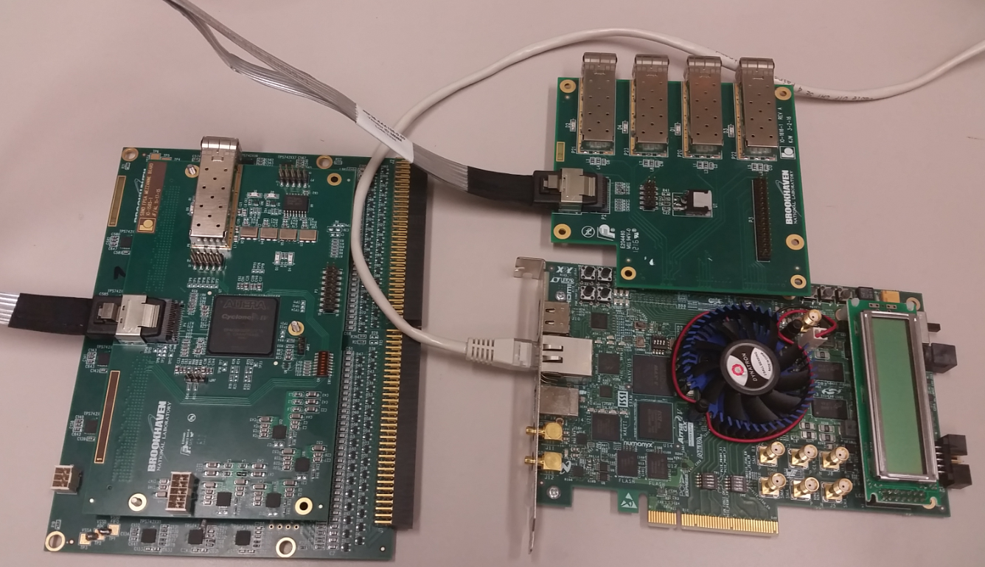
WIB Emulator + FEMB
I²C Link +
High Speed Data
FEMB Test Adapter
Board
Altera Cyclone V
Eval Board

Slide 35
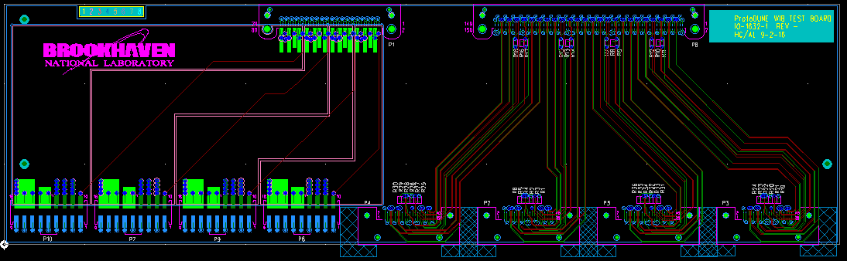
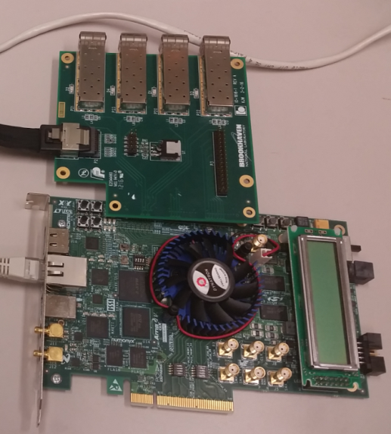
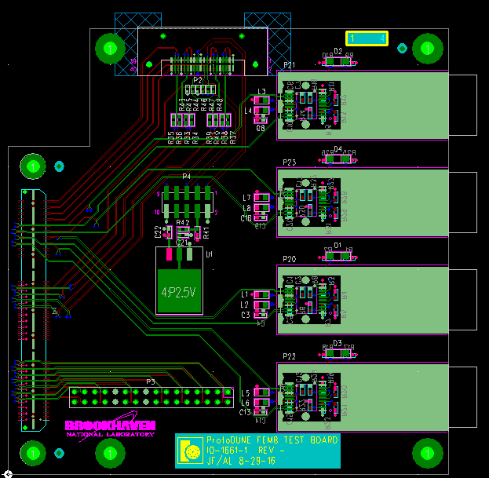
ProtoDUNE WIB Adapter
SBND WIB Emulator
ProtoDUNE WIB Emulator

