Slide 1
Lessons (to be) learned from MicroBooNE, 35 ton → the path forward
Veljko Radeka, BNL
CE Review, Oct 12-14, 2016

Slide 2
Outline
Waveform recording in LAr TPCs: A brief introduction
MicroBooNE, first tests of FE ASIC in LArIAT, ARGONTUBE,
35 ton. Big problems, lots of negative publicity; what is real what is not? Do we have a better picture now?
Integral approach to pDUNE and SBND. What to expect?
What is ahead in CE? Further development.

Slide 3
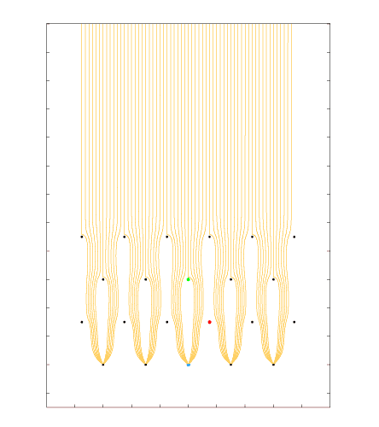
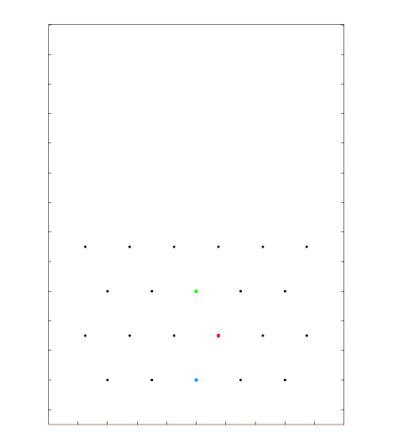
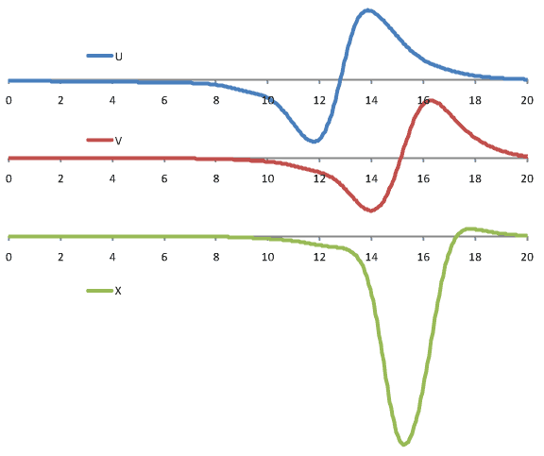
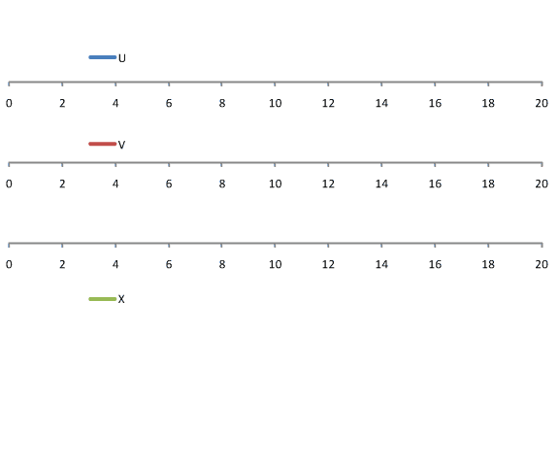
Signal Formation: Induced Signals from a Track Segment
3 mm wire spacing; drift velocity ~ 1.6 mm/µs
[µs]
LBNE style wire arrangement: 3 instrumented wire planes + 1 grid plane;
Raw current waveforms convolved with a 0.5µs gaussian (~1/2 drift length) to mimic diffusion

Slide 4
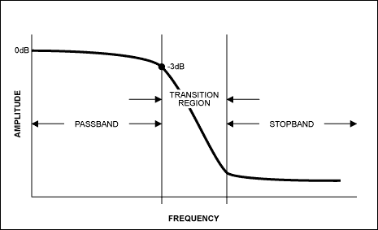
An anti-aliasing filter is a filter used before a signal sampler (ADC) to restrict (f_{3db}) bandwidth of a signal to approximately or completely satisfy the sampling theorem over the band of interest. Since the theorem states that “unambiguous reconstruction of the signal from its samples is possible when the power of frequencies above the Nyquist frequency is zero”, a real anti-aliasing filter trades off between the bandwidth and aliasing. A realizable anti-aliasing filter will typically either permit some aliasing to occur or else attenuate some in-band frequencies close to the Nyquist limit. For this reason, most practical systems sample higher than required to ensure that all frequencies of interest can be reconstructed, a practice called oversampling (adapted from Wiki)
Sampling System Definitions
M=(f_{N}/f_{NR}= f_{S}/4f_{3db}
The transition region is determined by the type and order of the anti-aliasing filter.
The Nyquist frequency is defined as f_{N}= f_{S}/2
The Nyquist rate is defined for practical purposes as
f_{NR}=2f_{3db}
(The Nyquist rate is sometimes identified with Nyquist frequency which is not strictly correct; the choice of 3dB for the bandwith, while commonly used, is arbitrary. )
f_{3dB}
f_{NR}=2f_{3db}
f_{S}

Slide 5
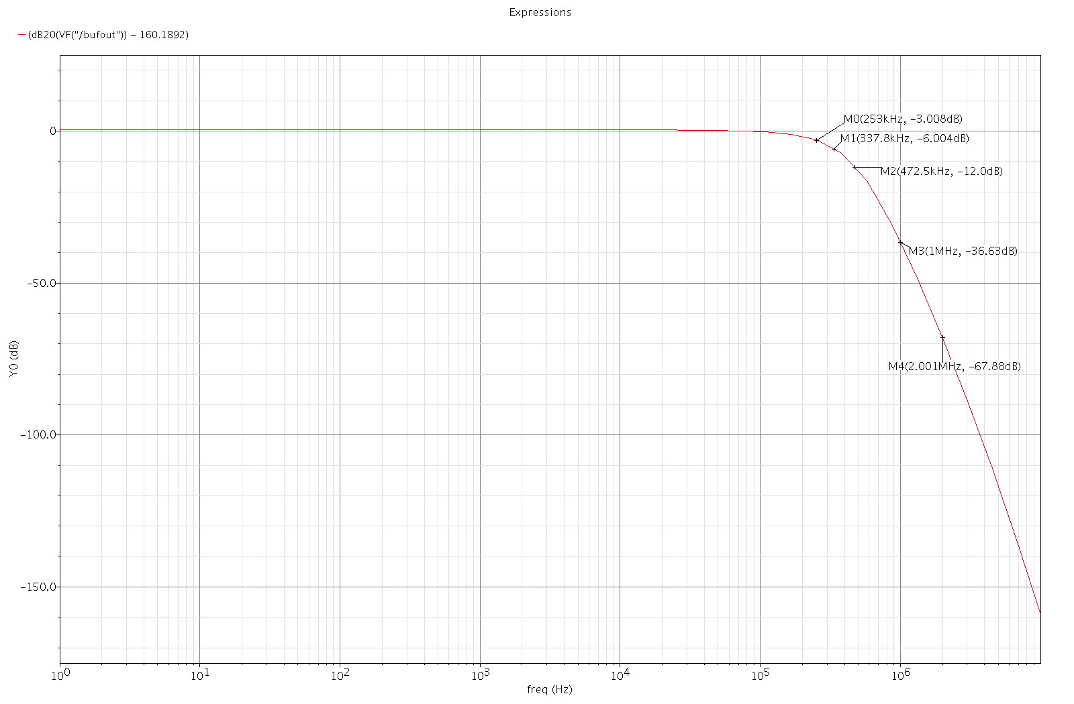
LAr ASIC Anti-aliasing filter: bandwidth, Nyquist rate, sampling frequency
Oversampling: M=f_{N}/f_{NR}= f_{S}/4f_{3db} = Nyquist frequency/Nyquist rate
-3dB at 253kHz
-36dB at 1MHz
300K
77K
1 μs
Sampling 2MS/s

Slide 6
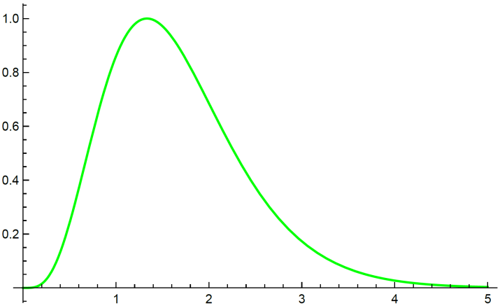
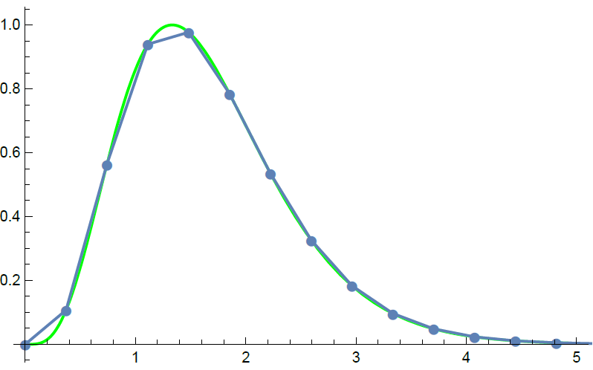
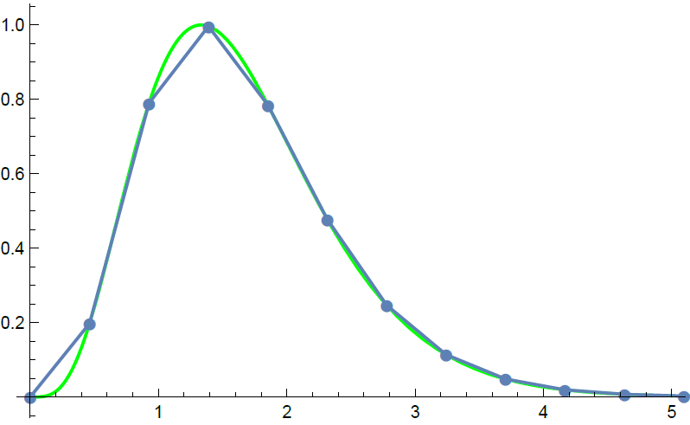
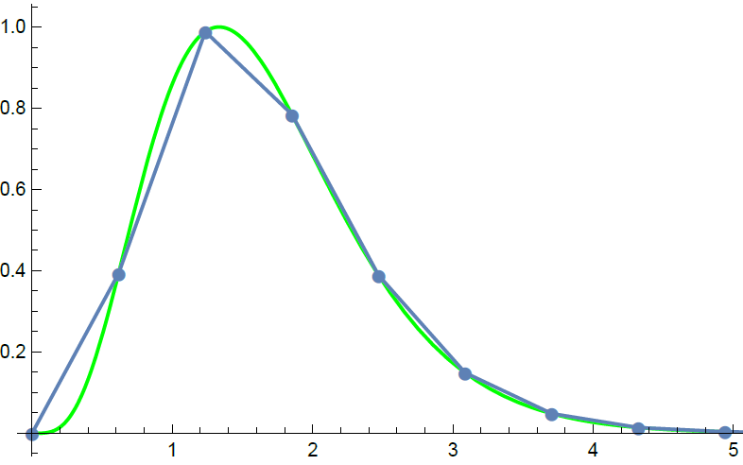
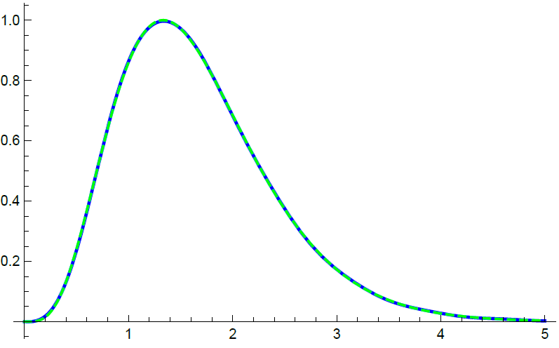
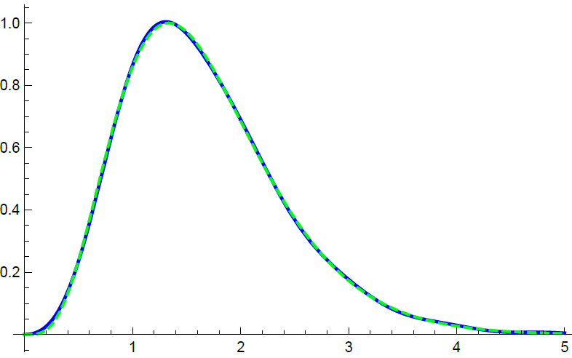
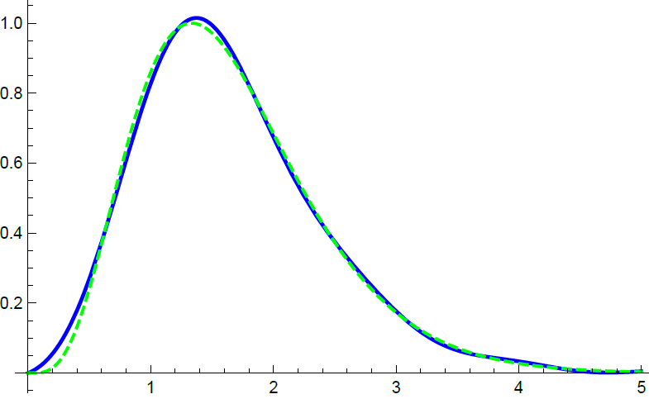
Sampling, Waveform Reconstruction and Charge (area) Measurement of (induced) current i(t)=qδ(t) , from the samples
M=f_{S}/f_{NR}= f_{S}/4f_{3db} = sampling frequency/(4 x bandwidth)
= charge(area) error
Waveform interpolating function = sinx/x used with each sample to reconstruct the waveforms (bottom row)
t_{p}
S_{i}
M=2.5
M=2
M=1.5

Slide 7
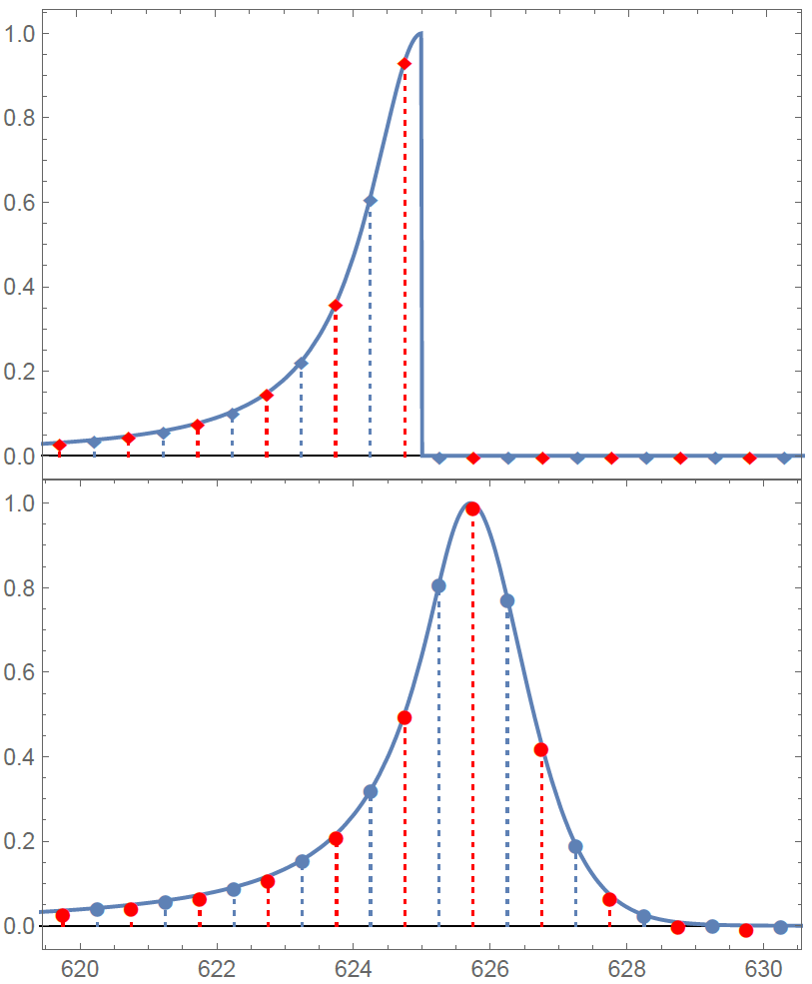
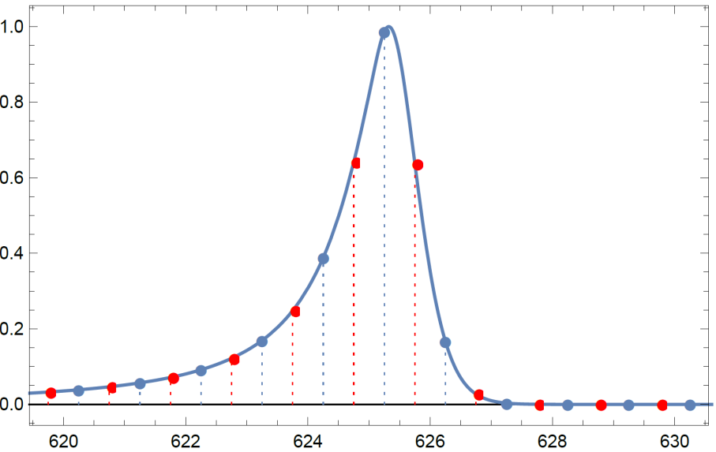
Accuracy of charge information in the samples vs oversampling
Oversampling M=f_{S}/f_{N}= f_{S}/2f_{3db} = sampling frequency/Nyquist frequency
= charge(area) error
Induced current for point charge
The sampling frequency is 2MS/s for both t_{p}=0.5μs and t_{p}=1μs (1MS/s for every other sample at t_{p}=1μs). The Nyquist rate is ~500 kHz at 1 μs peaking time and ~1MHz at 0.5 μs.
The sum of samples area error is less than ~0.1% in all cases, and less than ~0.03% for M=2 (t_{p}=1μs and 2MS/s).
i_{in}(t)
t_{p}=1μs
M=2
M=1
t_{p}=0.5μs
M=1
0.5µs

Slide 9
Relative Signal Pulse Height Between 3 Wire Types
Normalized to the total net charge passing through the wire cell.

Slide 10
Noise (ENC) in LArASIC vs temperature and peaking time of the anti-aliasing filter
White series noise which is dominant at short peaking times decreases the most with temperature.
The remaining noise is dominated by 1/f noise, which is independent of the peaking time.

Slide 11
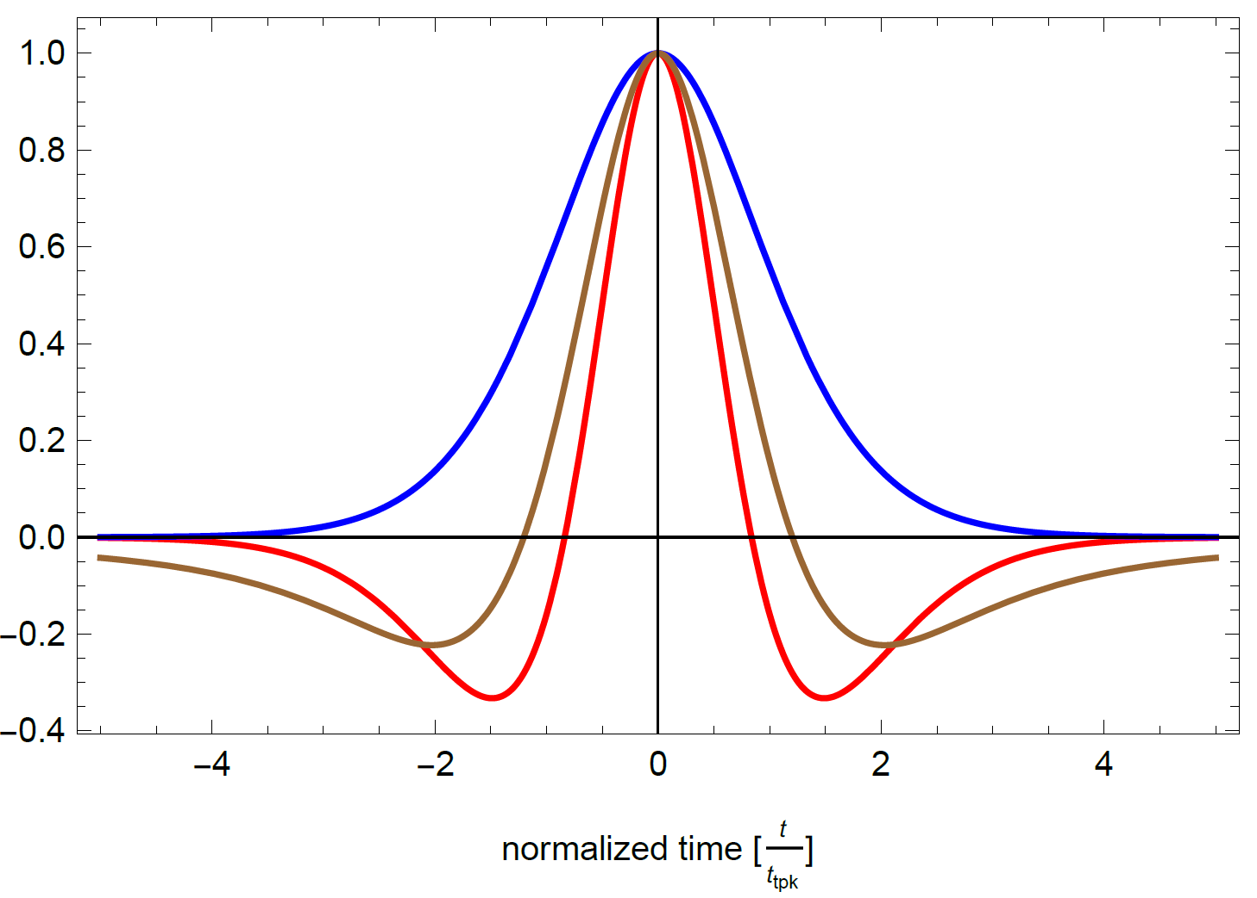
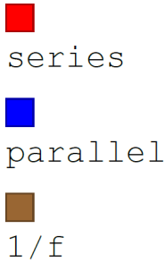
Autocorrelation function for anti-aliasing filter (normalized to peaking time) calculated for the three basic noise components at the sensor node:
“series white” “series 1/f” “parallel white”

Slide 12
Discussion
Is the anti-aliasing filter a separate circuit block? No. It is comprised of the entire analog part of the readout chain, from the TPC electrode (strip) to the ADC, in this case the LAr FE ASIC (the sample-and-hold in the ADC is fast enough to have negligible effect on the weighting function).
How is the transfer function/impulse response optimized? The goal is twofold: a) to reproduce the induced/collected TPC current waveform as accurately as possible to enable waveform shape discrimination, and b) to obtain the charge (waveform area) enabling good energy resolution. These requirements are somewhat contradictory: a) requires a narrow (short) impulse response near the Nyquist sampling criterion (M=1), while b) requires area accuracy, which improves with the oversampling ratio. The peaking time is programmable in the ASIC. Higher oversampling (M>~4) provides additional (superfluous) samples, which could be used to correct for ADC imperfections, taking advantage of the noise correlation.
Can the “electronics response” (anti-aliasing filter) be deconvolved? No. Once the high frequencies have been attenuated by a high order filter they cannot be restored, without the noise becoming dominant. Likewise, broadening of the induced current due to diffusion cannot be removed.

Slide 13
Outline
Waveform recording in LAr TPCs: A brief introduction
MicroBooNE, first tests of FE ASIC in LArIAT, ARGONTUBE, …
35 ton. Big problems, lots of negative publicity; what is real what is not? Do we have a better picture now?
Integral approach to pDUNE and SBND. What to expect?
What is ahead in CE? Further development.

Slide 14
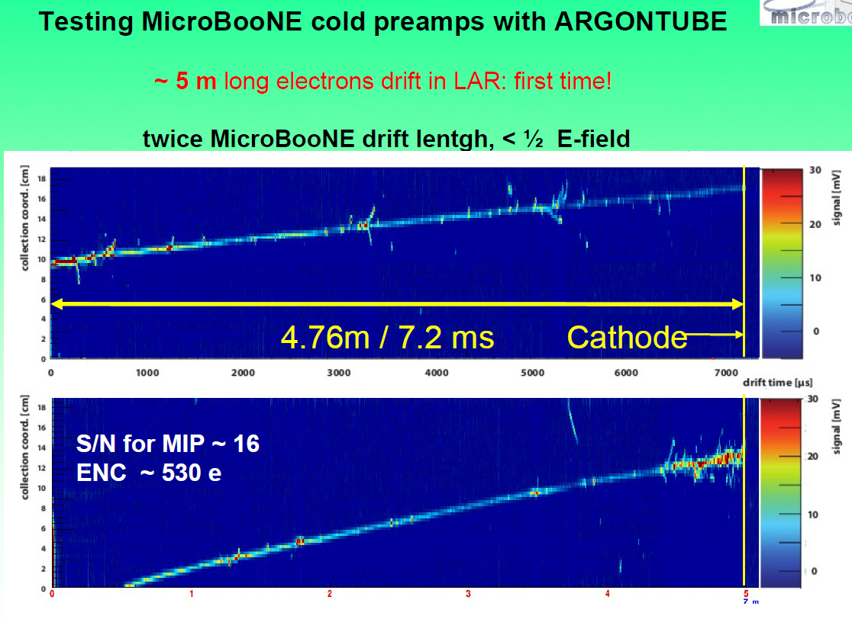
Τ~3.5ms
τ_{e}≈ 3.5 ms
From: Igor Kreslo, Bern, also at FEE 2014

Slide 15
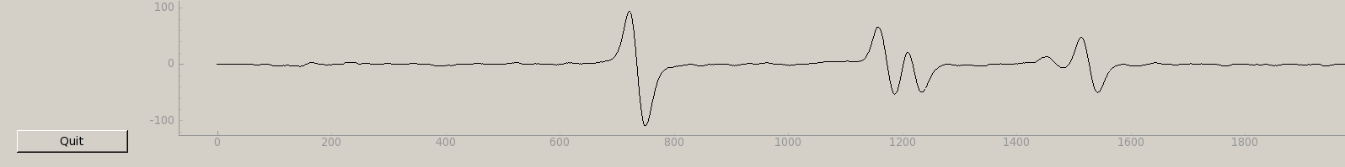
Successful application of BNL FE-ASIC in LArIAT
LArIAT deployed 30 BNL FE-ASIC (V4*) chips to readout 480 wires
All 480 channels have been working in LAr for 1.5 years.
Signals for a 5mm long mip track yields ~100 ADC counts on the collections plane, with a pedestal RMS of 1.4 counts (S/N~70)
Induction plane wire display
100
2 mip
1 mip signals
ADC
Counts
0
-100
10μs
Grounding & shielding adequate to avoid coherent noise.
LArIAT is providing essential information to calibrate LArTPC physics
ASIC serial corruption and reset issues addressed by BNL in V5
Incomplete Pole-Zero cancelation identified by MSU (BNL confirmed)

Slide 16
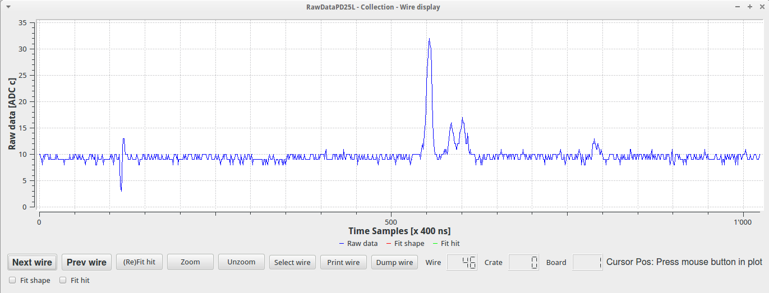
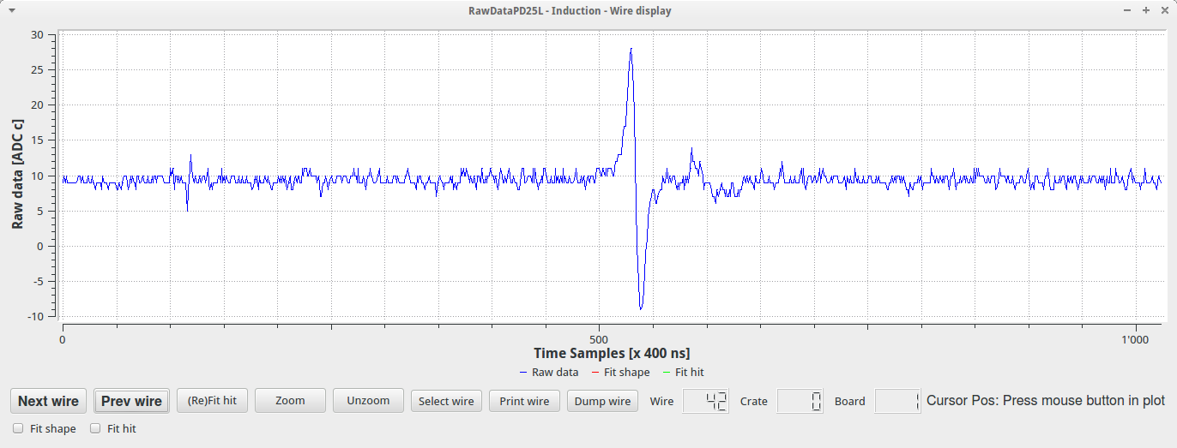
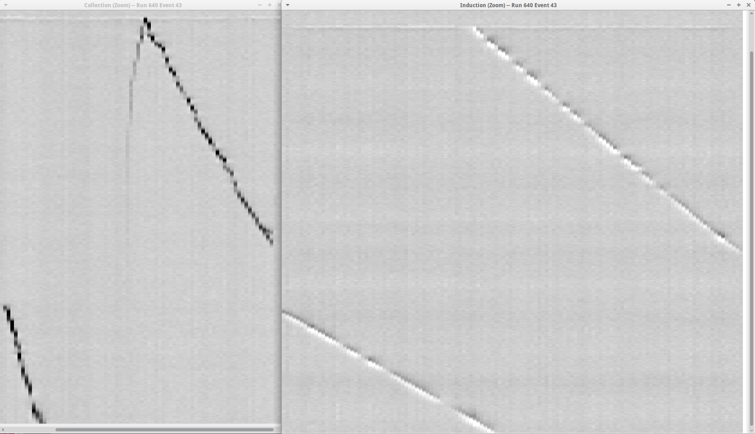
Analog FE ASIC in ICARUS 50l TPC
ICARUS 50l TPC
  Warm integration test in the week of March 30th at CERN (2015)
  Cold data taking in the week of April 20th at CERN:
    The signals were observed and the tracks reconstructed on the first day of cooling down!
col
ind

Slide 17
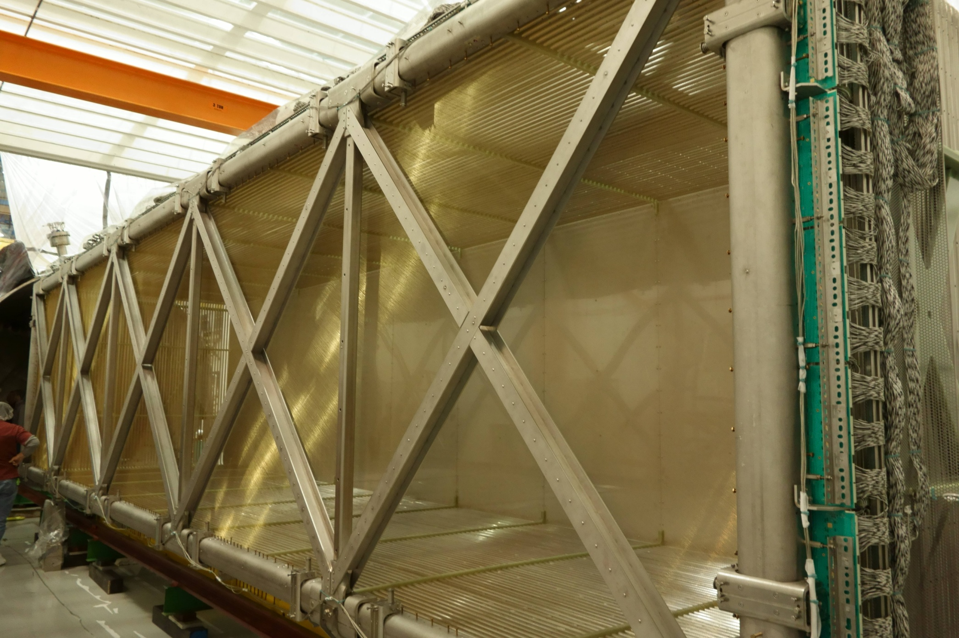
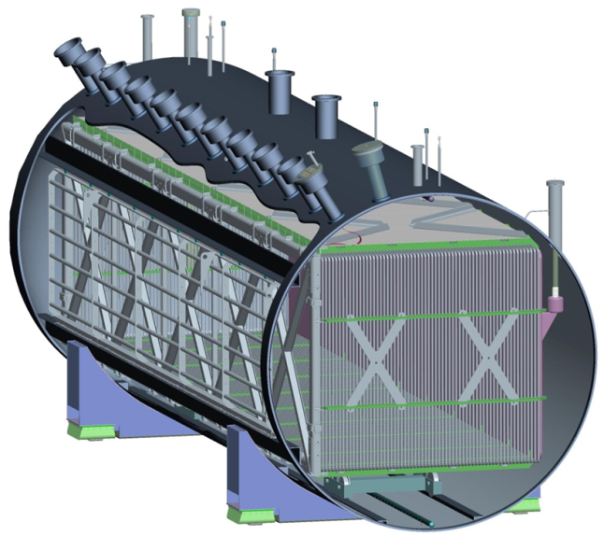
MicroBooNE electrode structure
8192 sense wires:
3456 collection (y-plane)
2368 each induction (u, v- planes)

Slide 18
Excess Noise “Phenomena” in MicroBooNE
1. “noisy wires after applying the wire bias” - wires in contact
2. “chirping noise” - FE ASIC saturation due to wire motion
3. “zig-zag noise” - “pickup” burst noise
4. “10-30 kHz noise” - low voltage regulator noise
“drift HV noise” - cathode→anode HV supply ripple
Details in Workshop Documentation: VR_CE noise overview_082616
Commissioning experience: It took ~one year to understand and remove/reduce the excess noise effects, to be left with the remaining FE ASIC noise.

Slide 19
Summary of Excess Noise
1. “noisy wires after applying the wire bias” - wires in contact:
50-70 wires (mostly u), the number varies in time as the contact is intermittent. Once the wire loses contact, the FE response returns to normal.
2. “chirping noise” - FE ASIC saturation due to wire motion:
Virtually eliminated (<20 wires) by proper ASIC bias setting (500 pA)
3. “zig-zag noise” - “pickup” burst noise:
Switching noise source outside the cryostat, pointing to PMT HV supply system. Negligible effect on signal/track reconstruction.
“10-30 kHz noise” - low voltage regulator noise:
Affects all wires. Substantially reduced by lower noise regulators installed.
“drift HV noise” - cathode→anode HV supply ripple:
Affects all u-wires, 1/3 amplitude on all v-wires; negligible on y-wires. Reduced to negligible level by a better filter (2nd “bean pot”) in HV line.
(Both 4. and 5. had to be removed by software in the data processing over the last year, prior to hardware corrections.)

Slide 20
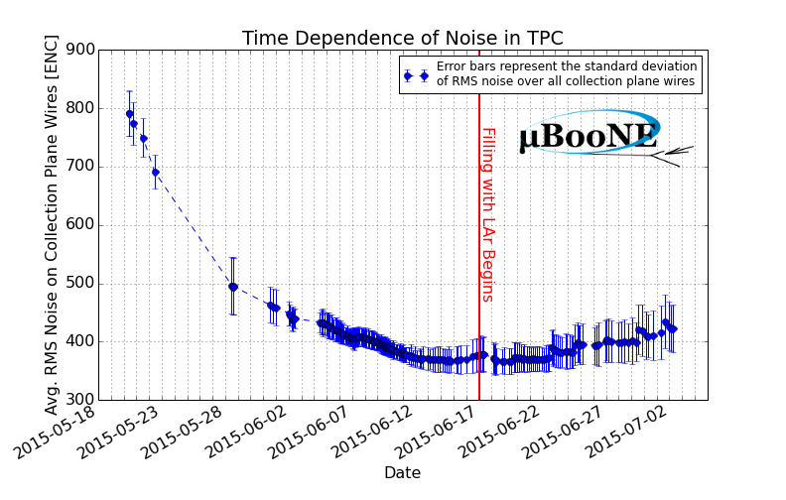
Commissioning: Cool with gaseous argon, then fill with liquid argon … measure noise on the collection plane …
Design value
Gas cool-down
LAr filling

Slide 21
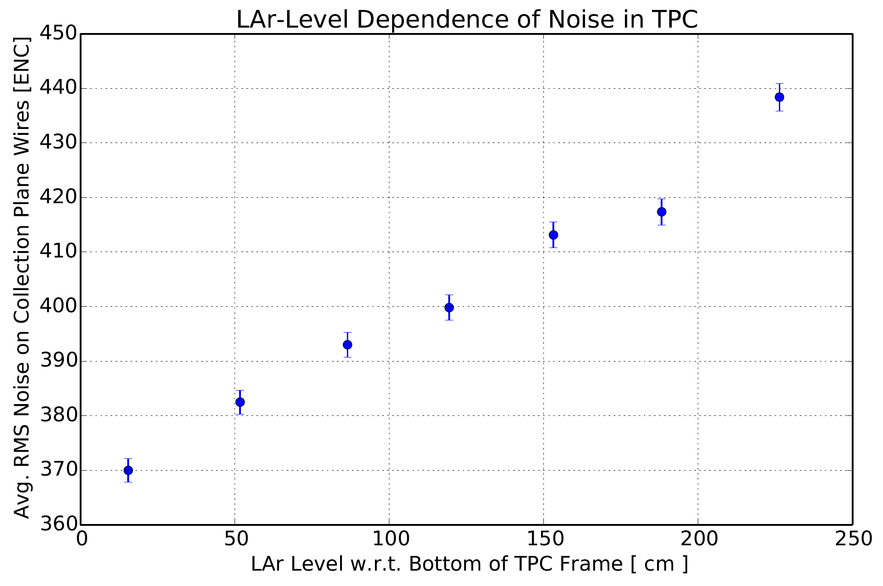
MicroBooNE Noise Measurement (1)
MB Tech Note 1001

Slide 22
The noise looks good – Overall performance in the experiment?
“Anomalous channels”:
- Touching Wires (Noisy or Dead): ~400
-"Dead" ASICs: ~320 channels
-Wire Carrier Boards Not Plugged In: 96 channels
- Saturating ("Chirping“) Channels due to wire motion: ~20
-Total: ~840 ; This number has remained very steady in time after August 2015, with fluctuations around the mean due to start-up after power cycling and outages.
M. Mooney: “Since we have 8256 channels, that means roughly 10% of our detector readout is not usable. However, even with these dead channels, 97% of the TPC volume sees at least two planes that are functioning normally (enough for 3D reconstruction). So I would say MicroBooNE is not significantly impacted by dead/noisy channels.”
The gain and peaking time of the functioning 90% channels have been remarkably stable, with stable dispersion at the 5% level.

Slide 23
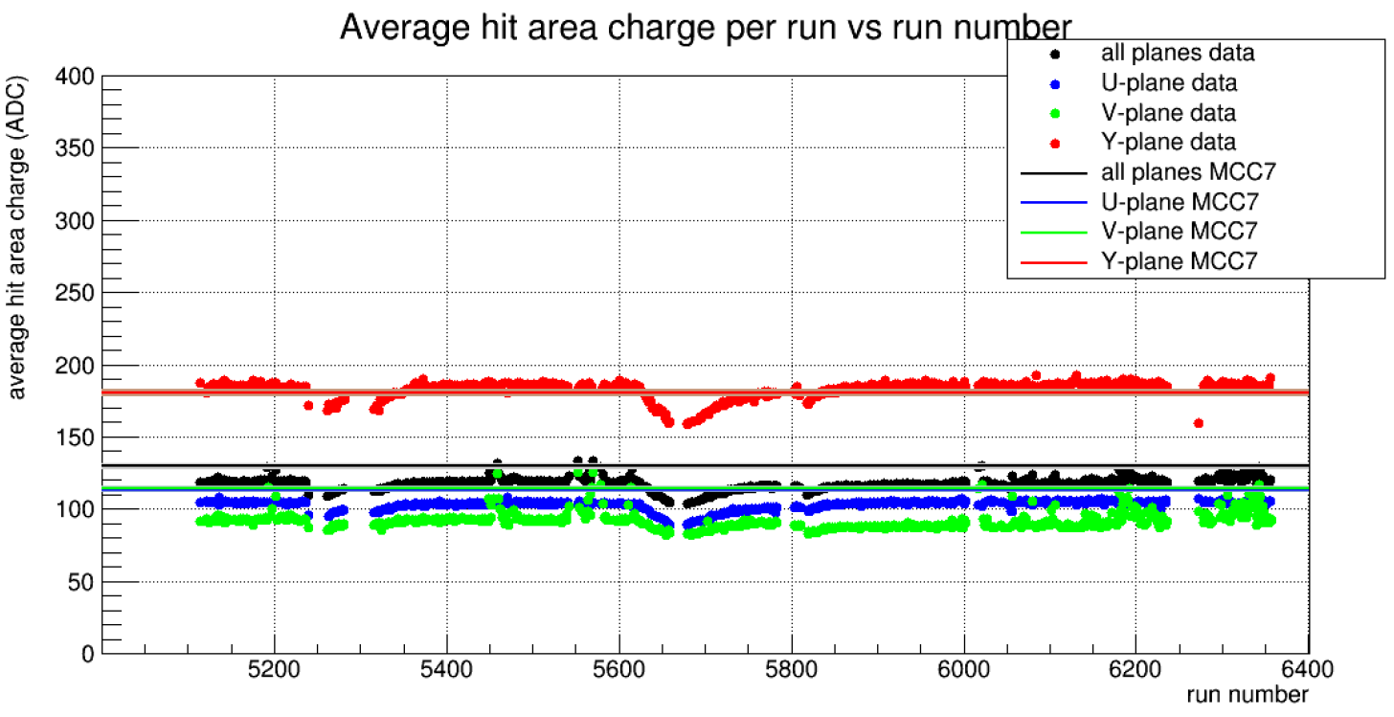
MB long term stability of average MIP response, incl. argon purity variations
MICROBOONE-NOTE-1013-INT

Slide 24
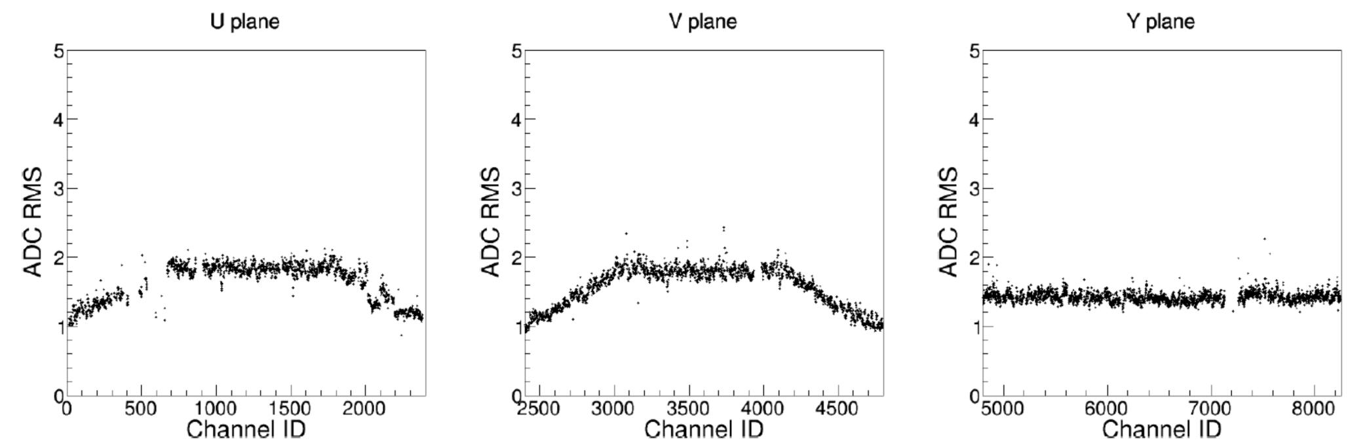
MicroBooNE residual noise level after removal of excess noise
Calibration: 1 ADC count ~ 198 e
Wire length dependence is clearly seen

Slide 25
Outline
Waveform recording in LAr TPCs: A brief introduction
MicroBooNE, first tests of FE ASIC in LArIAT, ARGONTUBE, …
35 ton. Big problems (“High State Noise”), lots of negative publicity; what is real what is not? Do we have a better picture now?
Integral approach to pDUNE and SBND. What to expect?
What is ahead in CE? Further development.

Slide 26
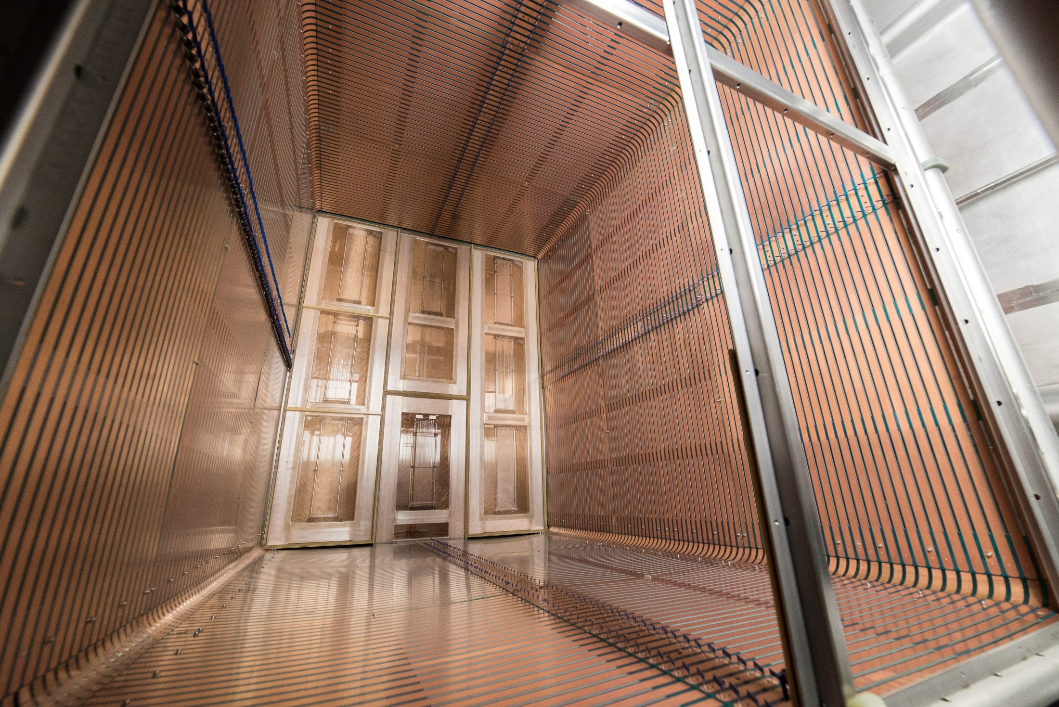
35 ton APAs and Field Cage

Slide 27
BNL Cold Electronics Team “nostra culpa”: Shortcomings of APA electronics
  Low voltage regulator (LVR) supplying Vdd=1.8 V to FE ASICs
    Excessive low frequency noise (~11kHz) from LVR. The FE ASIC which has been developed to achieve very low noise requires also very low noise from LVR. This requires proper filtering on FEMB.
  ADC ASIC
    Differential nonlinearity (DNL) is shown as stuck bins every 64 ADC counts in data.
  FE ASIC
    Remnant startup issue causes 5 ASICs (~4%) nonoperational during cooldown.
    This was also shown in MicroBooNE, being already addressed in new FE ASIC submissions.
  QA/QC
    Production test was not complete and detailed enough to catch subtle design issues. Time pressure and lack of manpower played a role in that.
    While all of the above must be (and is being) corrected for protoDUNE and beyond, these shortcomings would not have precluded cosmic data collection by the TPC.

Slide 28
What worked:
  Readout functionality. All FEMBs performed data collection, also in the High Noise State (HNS).
  APA1 has been working well with the lowest noise and not entering into (HNS) by itself (without the power turned on to all APAs, in particular to APA3).
  All cold FPGAs (16) in 35 ton have functioned as expected. This is a first and a milestone in R&D on cold electronics. FPGAs’ functioning did not affect the noise.
  With software filter for low frequency LVR noise, ENC is ~twice the MicroBooNE noise.
  Noise increase with bias, drift HV and PD turned ON was significant.

Slide 29
35 ton noise in “normal” state (no HNS)
- Some observations:
Wide range of ENC among the APAs under normal cosmic data taking conditions (slide 7). APA1 the lowest.
Non-readout TPC system noise contributions are very significant and most apparent at the lowest noise locations, increasing ENC from 750 e to 1070 e, and from 1380 e to 1950 e, for collection and induction wires respectively.
Induction wire ENC ~ 1380 e~ twice the collection wire ENC ~ 750 e, at lowest ENC values, is higher than accounted for by different wire capacitances. Induction wires are more exposed to pick-up noise.
The lowest noise values are also most uniform (slide 36). Note: All FE ASICs showed a very small ENC dispersion (<5% RMS) in the pre-assembly tests (all ASICs had been tested). Large differences in APAs’ noise cannot be explained by dispersion in FE ASIC noise.

Slide 30
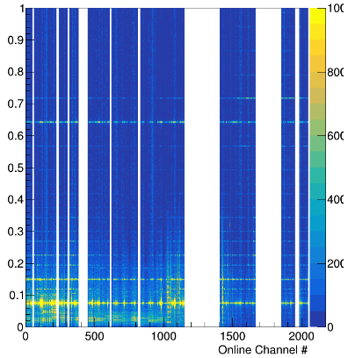
7. High noise state (HNS): ENC~ 4 fC=25,000 e
Intense spectral lines present in all “good” channels

Slide 31
    High noise state (HNS): Are FE ASICs oscillating?
The magnitude of HNS in all channels: ENC ~4 fC~ 25,000 e. At the ASIC input, on ~100 pF sense wire, the “noise on the wire” would be 40 µV rms, and at the input to the ADC, 56 mV rms. This is still a fraction of the ASIC dynamic range of 1.6 V. The HNS, while very high for noise, is still in the linear region and in the lower part of the dynamic range.
HNS frequency spectrum shows a number of different frequencies, which for a periodic waveform indicates a nonlinearity (or switching) somewhere in the system.
APA1 with ~400+ working channels shows ENC as low as ~750 e, which could not be the case if an oscillation were present.
Linear systems do not generate harmonics.
The answer: There is no evidence and no basis for FE ASIC oscillation.

Slide 32
High noise state (HNS): Is it inside or outside the cryostat?
Two observations reported sensing the presence of HNS: a) spectrum analyzer connected to the bias terminal for APA screen grid; and b) photo detector readout. An analysis of the signal magnitudes and attenuation involved shows the following:
a) Spectrum analyzer readings could not show if there is any signal on the APA grid. This is due to the filter networks in the grid bias lines inside the cryostat, which would attenuate any large noise signals from the sense wires down to picovolt level, at the frequencies observed, which is orders of magnitude below the sensitivity and noise of the spectrum analyzer.
b) Photo detector electronics could not show if there is any signal on the APA grid. Assuming the worst case of the high noise state, ~4 fC on each of the 2000 sense wires, coherent on all wires, and assuming one-to-one coupling to the grid (which is not the case), the grid noise voltage would be of the order of less than 100 microvolts. SiPM cables have specified common mode rejection of 60 db, which would bring the HNS signal on the wires (even with good coupling) far below the sensitivity of photo detector electronics.
This indicates that whatever the spectrum analyzer and photo detector electronics might have "seen“ (such as, TPC data collection activity!) they could not have received from inside the cryostat, and it was outside. The TPC readout data show HNS, which means that HNS involves the entire system, both inside and outside, in particular the power supply and power distribution system with its cables and interconnections.

Slide 33
  35 ton: Some fateful decisions were made , or just slipped through without careful consideration:
1. Shielding and grounding guidelines were violated in two critical points, long respected in other experiments (e.g., NA-48 and ATLAS) and very carefully implemented in MicroBooNE:
  Ground isolation between the cryostat and the building was not planned in the very beginning, and it was accepted that the cryostat ended up connected directly to the building ground (the cryostat was intended for purity tests initially).
  The decision to design an open feed-through with potted flange board, and the way it was implemented, precluded realization of an integral Faraday Cage.
  No single document on all the wiring and connections in the cryostat has been made available. Recently, after almost one year, two power supply wiring problems, which affected the performance, have been found (at the supply and in the flange board).
    2. Decision to abandon warm interface electronics, and RCE/DAQ to interface to cold FPGA directly. This has increased latency which made diagnostics more cumbersome.

Slide 34
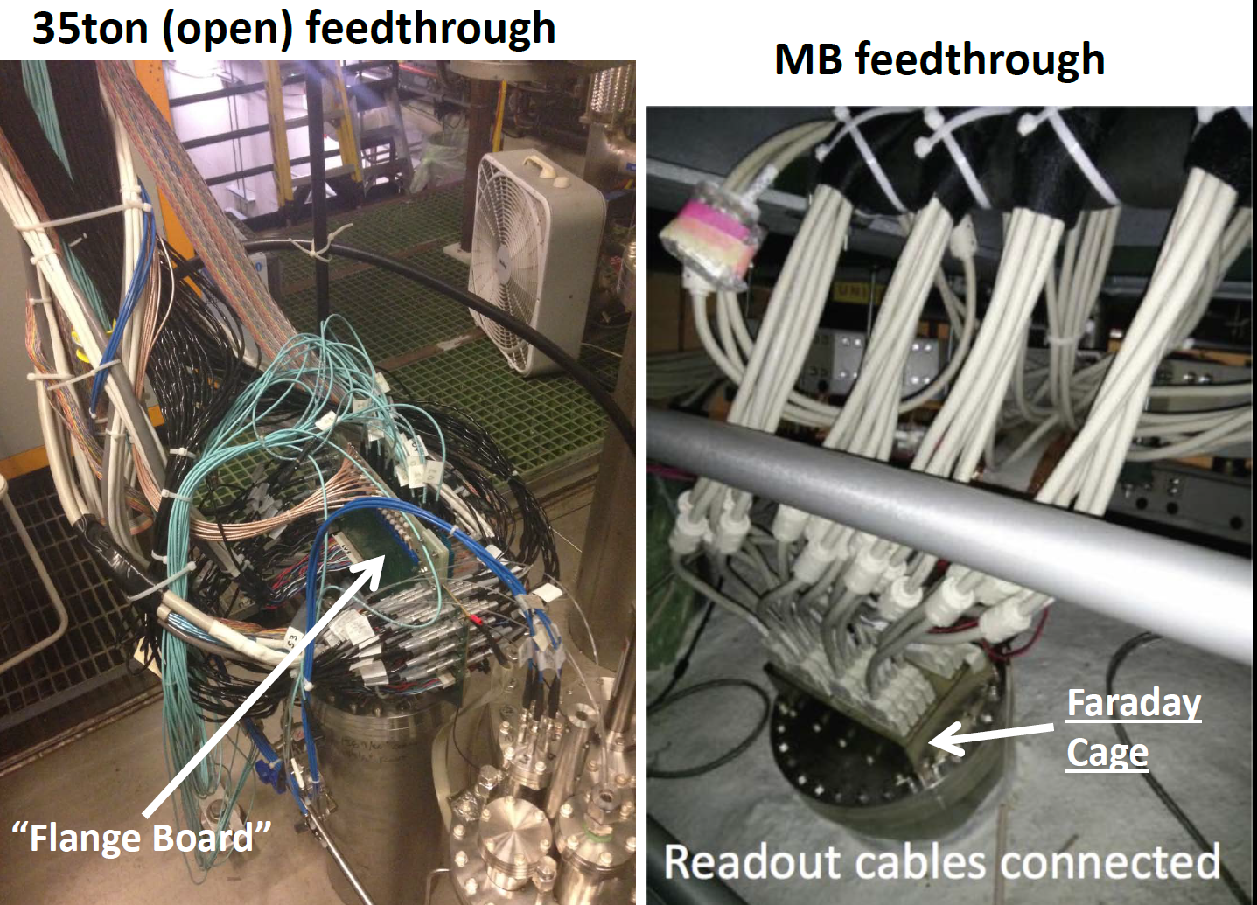
No Faraday cage

Slide 35
Lessons (to be) learned from 35 ton:
One on leadership and one technical
A cohesive team with inspiring leadership should come above and ahead of the necessary (micro?)management structure.
The TPC APA+cold readout+Faraday Cage-Feedthrough with Warm Interface and Local Diagnostics should be treated as an integrated whole and managed as such.

Slide 36
Outline
Waveform recording in LAr TPCs: A brief introduction
MicroBooNE, first tests of FE ASIC in LArIAT, ARGONTUBE,
35 ton. Big problems (“High noise state”), lots of negative publicity; what is real what is not? Do we have a better picture now?
Integral approach to pDUNE and SBND.
What is ahead in CE? Further development.

Slide 37
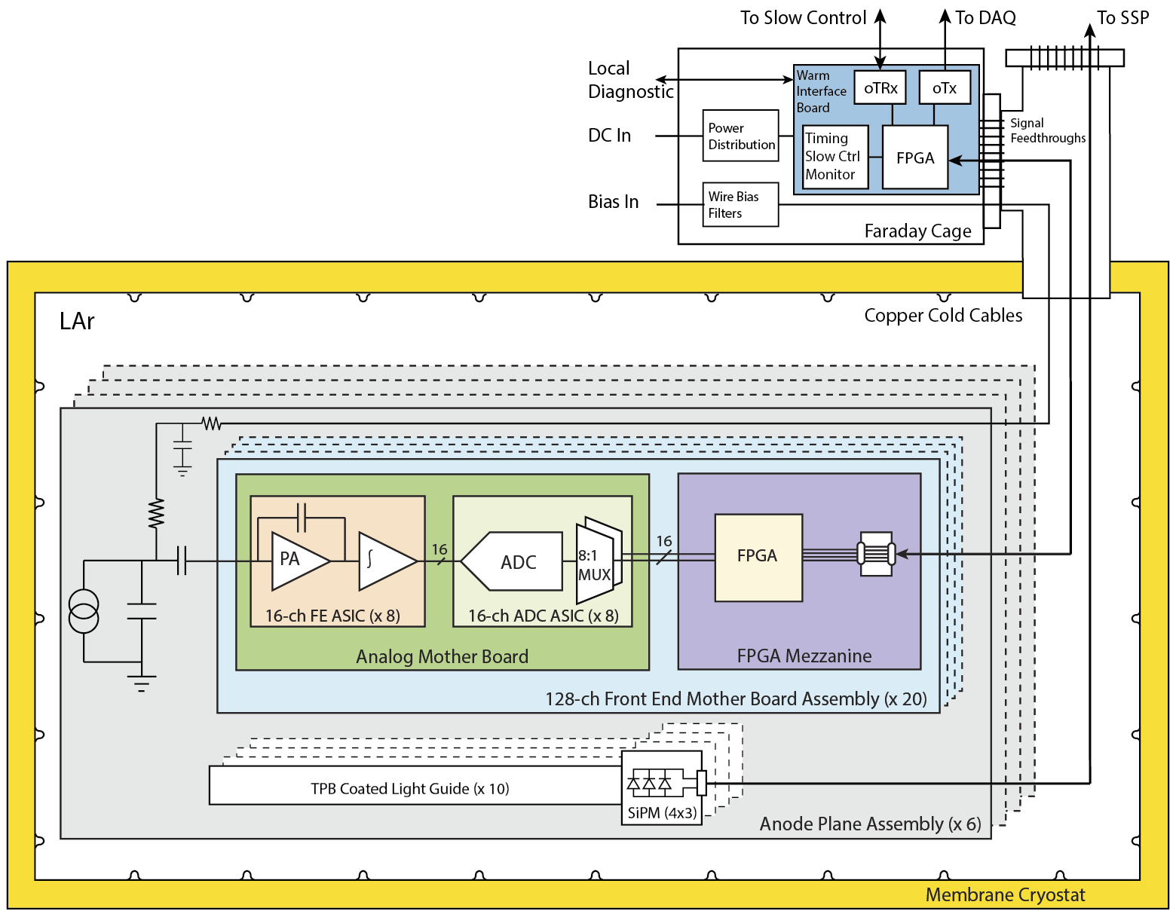
Cryostat+feedthrough→Faraday Cage
On the APAs, there are 3 types of circuits: cold electronics, photon detectors, bias and filter networks

Slide 38
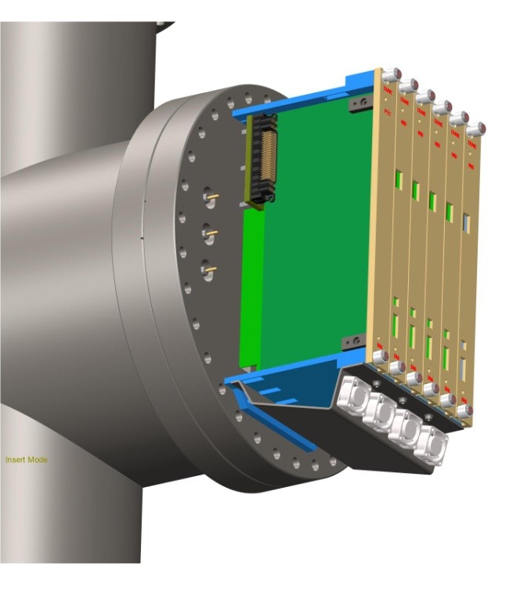
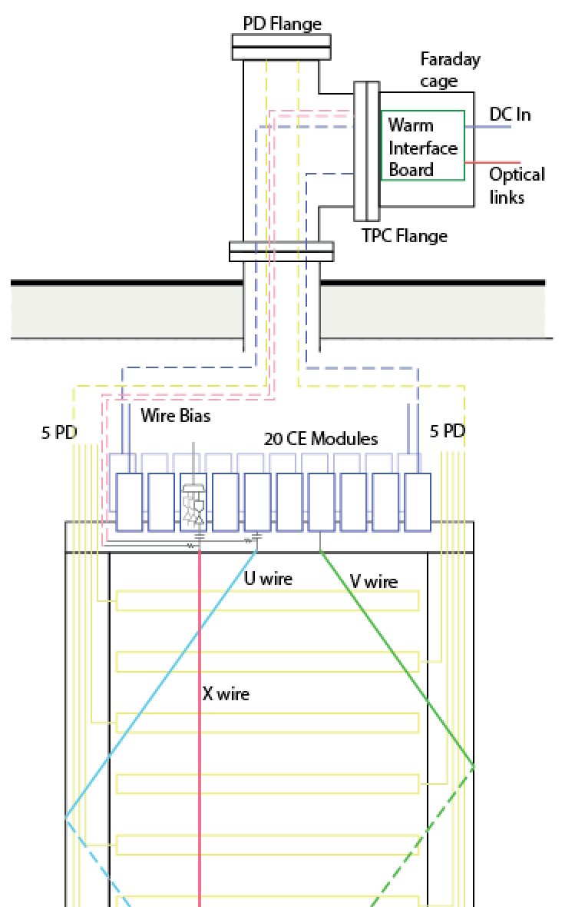
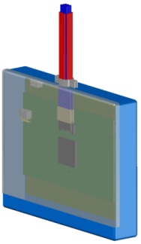
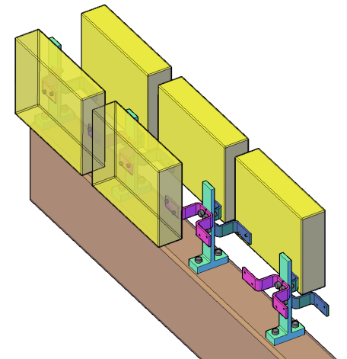
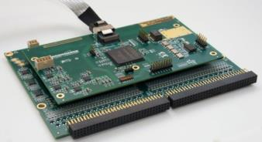
APA with Integrated Cold Electronics
Cold electronics module and its attachment to the APA frame

Slide 39
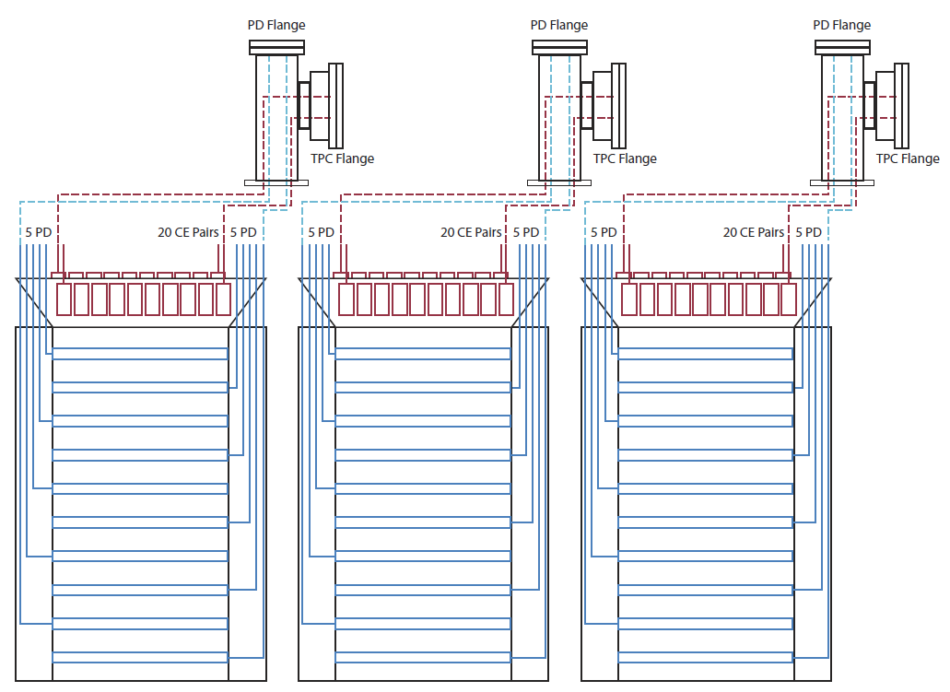
ProtoDUNE APA Cable Routing Plan

Slide 40
Outline
Waveform recording in LAr TPCs: A brief introduction
MicroBooNE, first tests of FE ASIC in LArIAT, ARGONTUBE,
35 ton. Big problems (“High noise state”), lots of negative publicity; what is real what is not? Do we have a better picture now?
Integral approach to pDUNE and SBND.
What is ahead in CE? Further development.

Slide 41
CE continuing R&D
FE ASIC: resolve remaining issues, a) start-up after power cycling, b) protection on configuration inputs, c) pole-zero cancellaton for longer signals;
ADC: stuck code!!! – approach in stages
Distinguish improvements and R&D in three phases, under time/schedule pressure for 1) protoDUNE, 2) SBND and 3) longer term developments for DUNE (e.g., CMOS process changes; consider different dynamic range approaches, e.g., dual range instead of single 12 bit range).

Slide 42
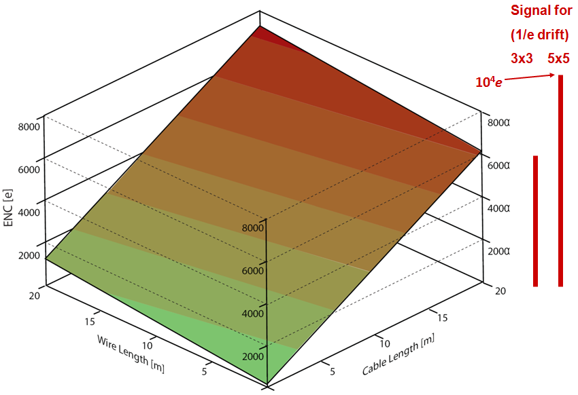
Noise (ENC) vs TPC Sense Wire and Signal Cable Length for CMOS at 300K and 89K MIP Signal for 3x3 and 5x5 mm Sense Wire Spacing
DUNE with warm electronics (300K)
ENC~6x10^3 e rms
CMOS at 77K: ENC< 10³ e rms
MicroBooNE
ENC~400 e rms
42

Slide 43
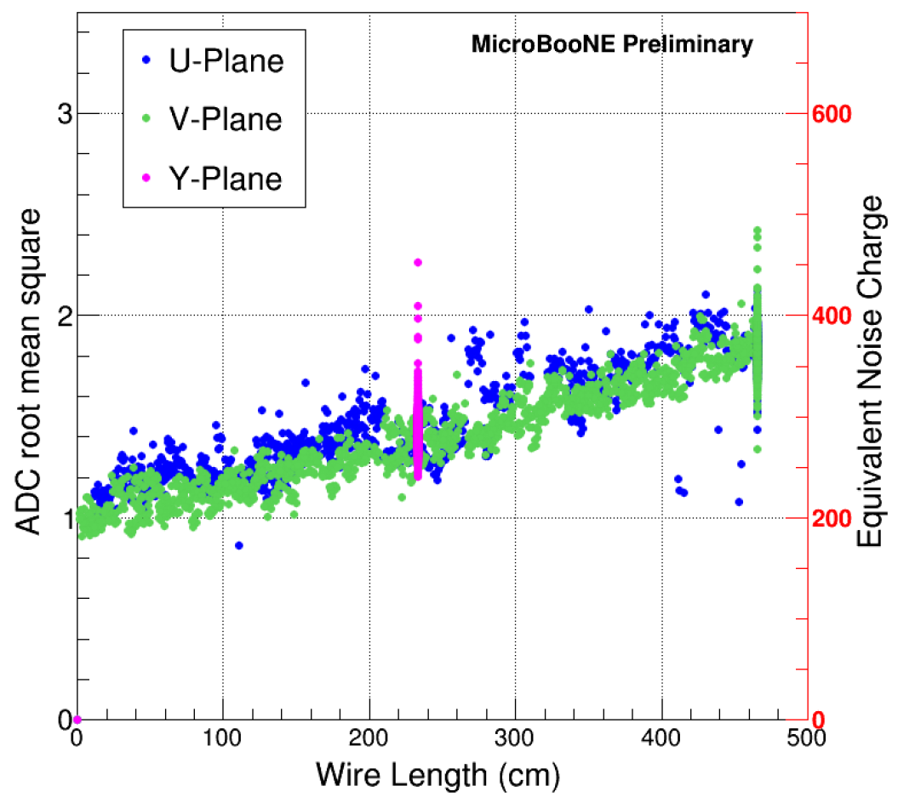
ENC projection from MB to protoDUNE
500
MB note: Noise Filtering
750

Slide 44
Summary
To have a chance at achieving a good performance, a) the integral design concept of APA+CE+Feedthrough with Warm Interface and b) strict isolation and grounding rules will have to be followed.
protoDUNE will have longer sense wires; noise projections from MicroBooNE should be viewed with caution.
Achieving ENC~600-800 e rms appears to be an achievable goal.
All of the above requires a solid team work …

Slide 45
Appendix

Slide 46
Comments on the LBNC recommendations (2)
  - Investigate the options (including the identification of possible design teams) for implementing a cryogenic front end design as a fully differential device (to improve the power supply rejection ratio) using the same interface as the present CE front end chip - within the next three months.
A simple analysis shows that following this recommendation would be detrimental to the noise and power dissipation performance of the ASIC and the entire detector:
The present single ended design is based on a single transistor, which is the dominant noise source in the ASIC, as it should be. This transistor is optimized in size to the sense wire capacitance for wires from ~2 to ~5 meters. The transistor has to be very large, it occupies ~25% of the ASIC area and consumes ~70% of the ASIC power. A differential input would require an additional identical transistor, which would add noise equal to that of the first transistor, and require equal power. The result: The noise ~ sqrt of two higher, power dissipation ~ 2 times higher. If we introduce a constraint on the power dissipation, to remain the same, the current in each transistor will be halved and the noise from each transistor will increase. The result: equal power, twice as much noise. Do we want all our detectors to be limited to ~1200 electrons rms, instead of 600?! Even If we remove any power limitation, differential input could not reach the noise of the single ended stage in this case, because the basic parameters of that stage have been optimized for minimum noise. A realistic differential amplifier, with the necessary auxilliary circuits, will take even more power and have higher noise than the idealized case above. For the 10 kton detector this may take ~ 2 kW more dissipated in LAr.
The approach we have to follow, is to suppress (to filter) the regulator noise.

Slide 47
ENC vs power in the ASIC input cascode

Slide 48
ProtoDUNE electrical connections within the cryostat The Commandments:
APA frame shall be connected to the COMMON of all FE ASICs.
All electrical connections (power and signal) from an APA shall lead to a single feedthrough.
APAs shall be insulated from each other.
The COMMON of the FE ASIC and of the rest of cold readout shall be connected to the common plane/enclosure of the cold FE module.
APA Power line return leads and any shields shall be connected to the common plane of the cold FE module at one end and to the flange of the feedthrough at the other end. This shall be the only connection of the APA frame to the cryostat.
APA mechanical suspension from the frame to the cryostat shall be insulated.
The last stage of the sense wire and grid bias filters shall be connected to the frame (i.e., ASICs common).

