Slide 1
ProtoDUNE/SBND Grounding and
Voltage Distribution Plans
Linda Bagby
ProtoDUNE/SBND CE Design Review
12 October 2016

Slide 2
Purpose
This talk addresses Charge Item 6.
Is the grounding and shielding plan for the detectors and its impact on the CE systems understood and adequate?

Slide 3
Overview
Premise of Design
Grounding Points
Key Isolation Features
AC Distribution
SBND Ufer ground
Isolation Bandwidth
Grounding Concept Graphic
DC LV ASIC Power Distribution
Summary

Slide 4
Premise
ProtoDUNE and SBND utilize extremely sensitive electronics to measure the charge from the TPC wires.
To achieve extremely low noise levels (ENC < 650 e⁻), such that the low level TPC signals may be captured, it is vital that building utility noise sources are minimized and the front end ASIC preamp ground is stable.
To achieve this low noise signal ground, we utilize an adapted AC power ‘isolation’ technique successfully implemented on the DZero, Atlas, and MicroBooNE experiments.

Slide 5
ProtoDUNE/SBND Grounding Points
Since both of the experiments utilize a membrane type containment vessel enclosing the TPC detector and the same cold electronics, the Grounding Points are the same for both of the experiments.
ProtoDUNE Grounding Points: DUNE DocDB# 879
  http://docs.dunescience.org:8080/cgi-bin/ShowDocument?docid=879
TPC_APA_Electrical_Connections: DUNE DocDB# 1244
  http://docs.dunescience.org:8080/cgi-bin/ShowDocument?docid=1244
SBND Grounding Points: SBN DocDB# 1077
  http://sbn-docdb.fnal.gov:8080/cgi-bin/ShowDocument?docid=1077

Slide 6
Key Isolation Features
A grounding scheme which isolates the detector and local detector electronics racks from all other electrical systems.
Safety ground between the Building Ground and Detector Ground are connected via a saturable inductor.
A double shielded ‘isolation’ transformer provides power to detector electronics.
Dielectric breaks on all cryogenic piping entering the cryostat
The APA frame is connected to the circuit common of all FE ASICs.
For ProtoDUNE: All electrical connections (power and signal) from an APA shall lead to a single feedthrough.
The circuit common of the FE ASIC and the rest of the cold readout are connected to the common plane/enclosure of the cold FE module.
The APA Power line return leads, and any shields, are connected to the common plane of the cold FE module at one end and to the flange of the feedthrough at the other end. This is the sole connection of the APA frame to the membrane cryostat.

Slide 7
ProtoDUNE AC Distribution Scheme

Slide 8
SBND AC Distribution Schematic
http://sbn-docdb.fnal.gov:8080/cgi-bin/ShowDocument?docid=284

Slide 9
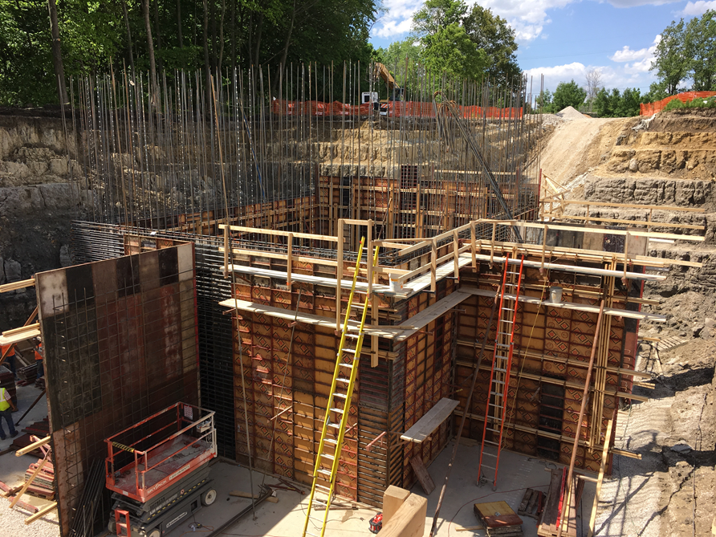
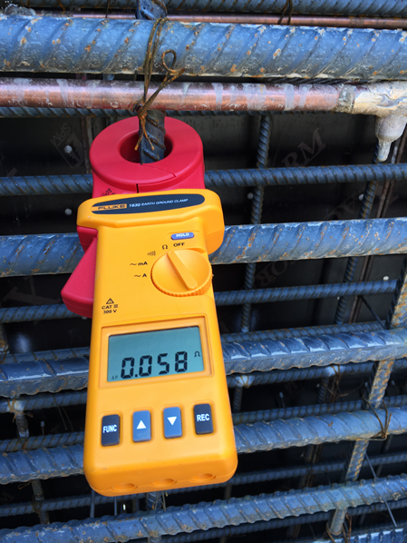
SBND Building Ground
To establish a solid building ground, an Ufer ground was constructed within the Near Detector building. Measurements have been taken with a Fluke 1630 Earth Ground clamp throughout the construction. The latest resistivity measurement of the Ufer ground structure is < .3 Ohms.

Slide 10
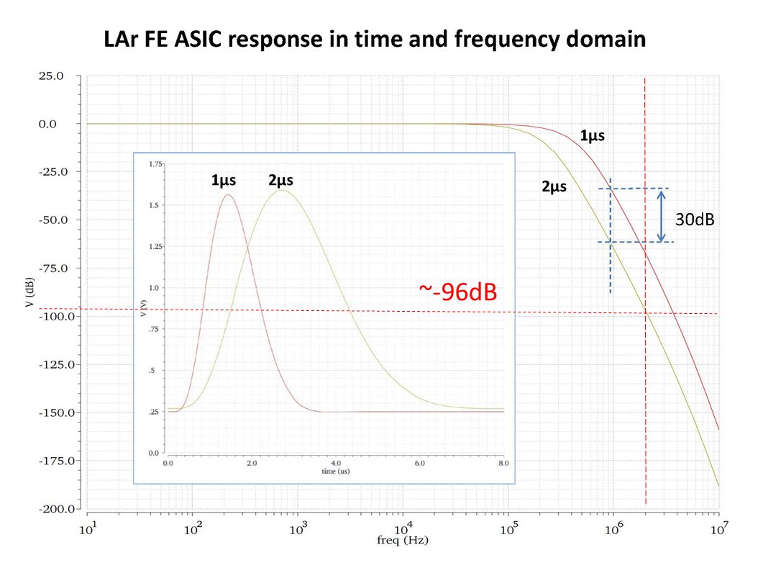
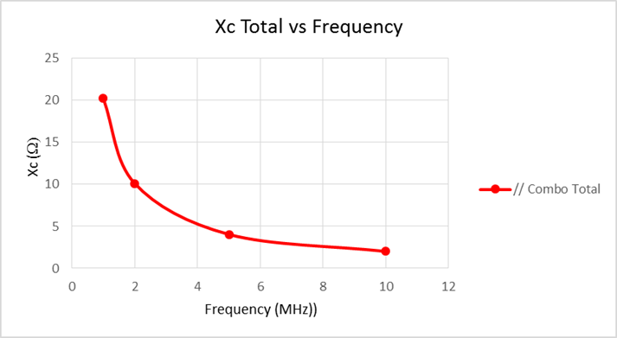
Expected Isolation Bandwidth
DC isolation between the detector and the building is relatively easy to achieve. AC isolation is more difficult. An analysis was conducted to determine the spacing thickness between the detector I-beam structure and the building concrete to achieve 10 Ohms at 2 MHz capacitive reactance.
http://sbn-docdb.fnal.gov:8080/cgi-bin/ShowDocument?docid=1077
Response with 2” G-10 Garolite

Slide 11
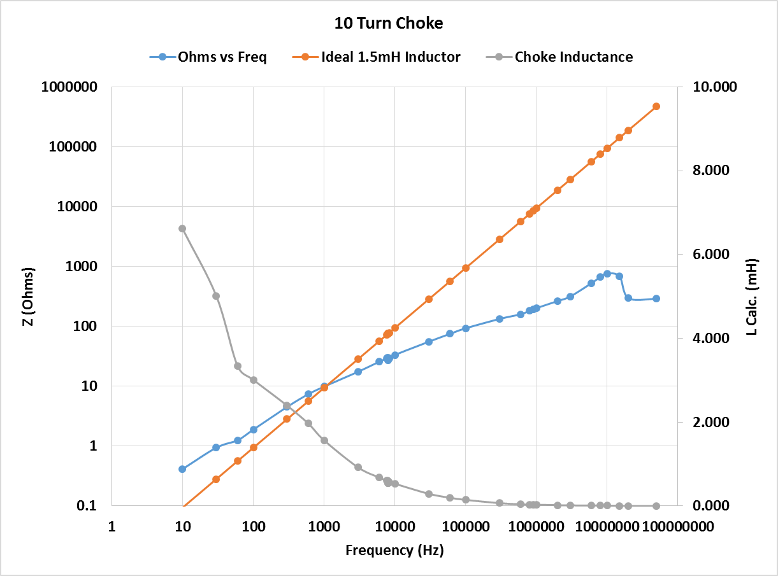
Saturable Inductor Response
A study was done by Dave Huffman to determine the response of the 10-turn saturable inductor.

Slide 12
ProtoDUNE Grounding Concept Graphic

Slide 13
ProtoDUNE Grounding Concept Graphic

Slide 14
ProtoDUNE Grounding Concept Graphic
~1.6” spacer of elastomeric and G10

Slide 15
ProtoDUNE Grounding Concept Graphic

Slide 16
SBND Grounding Concept Graphic

Slide 17
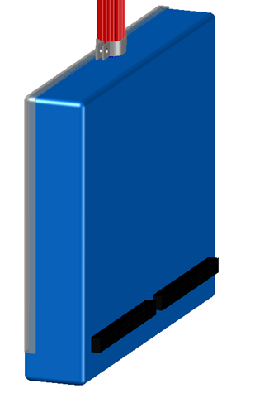
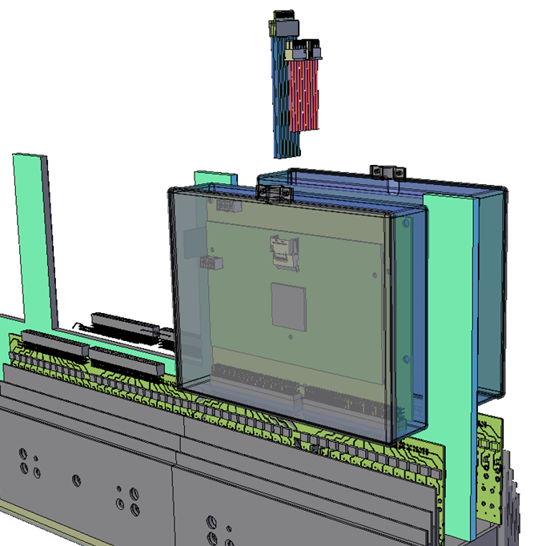
ProtoDUNE/SBND Voltage Distribution Grounding Connections
The signal ground of the FE ASIC is connected to the Detector Ground via the power returns in the warm electronics crate mounted on the top of the detector.
+12V source must be floating from the supply chassis
Supply returns are connected at ground plane of PTC card
PTC card ground plane is connected to crate backplane
Crate backplane ground plane is connected to crate housing
Crate housing bolted to Feedthrough
Feedthrough welded to membrane
APA frame isolated from membrane
CE boards mounted to APA frame inside cold faraday box.

Slide 18
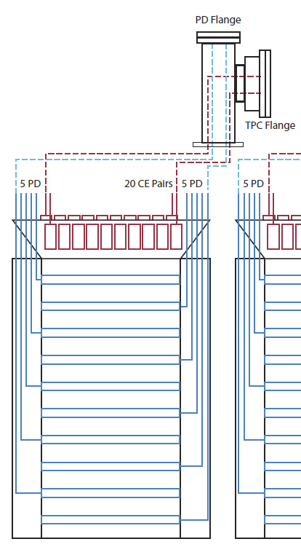
ProtoDUNE SP APA Cable Routing Concept for PD
The PD cables for each APA are routed to a dedicated Feedthrough flange.
10 PD cables per APA frame
Dedicated PD Flange port
PD frame conductively connected to APA frame-no floating metal
Shielded twisted pair cables used for signal
Provisions for a variety of reference terminations are built into the design

Slide 19
ProtoDUNE Voltage Distribution Requirements
Provide +12V/20A of DC voltage to each WIB crate mounted on top of 6 TPC feedthrough ports, 5 WIBs/FT.
Provide +12V/1A of DC power to PTC card, housed within the WIB crate, one per feedthrough.
External Interlock capability.
Ethernet network capable with integration into Slow Controls monitoring system.
Over current/over voltage protection.
Power control (granularity needs to be defined; crate or WIB level).
Ripple: <2mVpp @ 20MHz.
Readback resolution: 100mV/100mA
Voltage ramp rate 1-500V/s.

Slide 20
SBND Voltage Distribution Requirements
Provide +12V/24A of DC voltage to each WIB crate mounted on top of 4 TPC feedthrough ports, 6 WIBs/FT.
Provide +12V/1A of DC power to PTC card, housed within the WIB crate, one per feedthrough.
External Interlock capability.
Ethernet network capable with integration into Slow Controls monitoring system.
Over current/over voltage protection.
Power control (granularity needs to be defined; crate or WIB level).
Ripple: <2mVpp @ 20MHz.
Readback resolution: 100mV/100mA
Voltage ramp rate 1-500V/s.

Slide 21
ProtoDUNE/SBND Voltage Distribution Connections
Power, Timing, and Control card
Two 37-pin D connector interfaces on front panel of PTC card.
Sense fusing built into card.
Investigating MPOD solution.
Once power supply is identified, will be able to continue with interface engineering.

Slide 22
Summary
Charge Item 6:
Is the grounding and shielding plan for the detectors and its impact on the CE systems understood and adequate?
For both experiments:
  Grounding Points finished
  Grounding Concept graphics finished.
  DC LV ASIC Power in progress.
ProtoDUNE:
  Isolated AC Power concept design finished.
SBND:
  Isolated AC Power design finished.

Slide 23
Back Up Slides

Slide 24
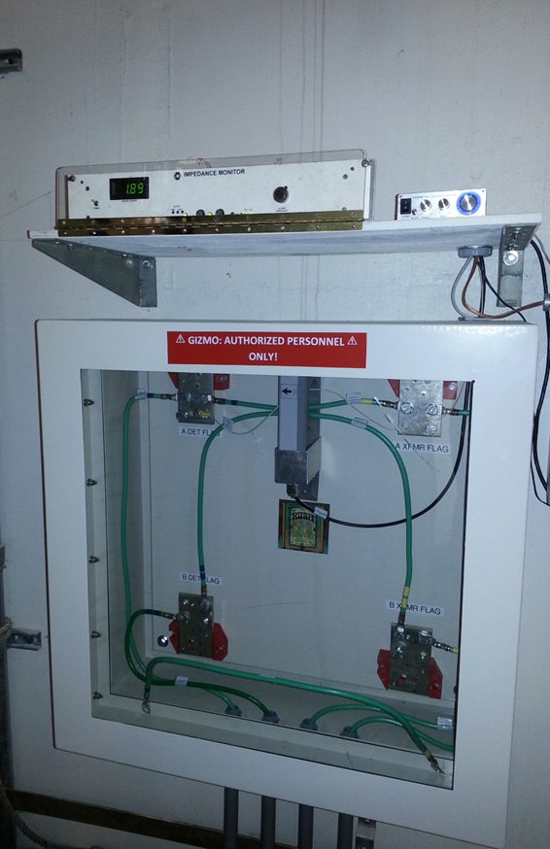
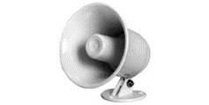
GIZMO: Ground Current Impedance MOnitor
Successfully implemented on MicroBooNE.
Part of the AC Distribution scheme.
Consists of 4 components
  Monitor chassis
  Amplifier
  Current transformer
  Speaker
Provides a stimulus current
Imbalance in return current signifies a short between grounds.
Runs 24/7 at MicroBooNE without affecting data.
http://docs.dunescience.org:8080/cgi-bin/ShowDocument?docid=1805
http://sbn-docdb.fnal.gov:8080/cgi-bin/ShowDocument?docid=1322

Slide 25
GIZMO Upgrade Design Features
Mike Utes has begun the upgrade design work on the Impedance Monitor for ProtoDUNE and SBND. Based on operational experience at MicroBooNE and 35-ton, the following upgrades will be implemented:
Frequency locking amplifier
C, L, and R front panel digital display
Variable frequency stimulus

