Slide 1
SBND/ProtoDUNE Single Phase System Interfaces
T. Shaw, L. Bagby
ProtoDUNE/SBND CE Electronics Review
13 October 2016

Slide 2
Purpose
This talk addresses Charge Question 5.
Are the CE interfaces to other detector subsystems including TPC, DAQ, and cryostat well defined and documented?

Slide 3
SBND/ ProtoDUNE SP System Interfaces
Cryostat
  Warm Interface crate
DAQ
  SBND: Nevis Electronics
  ProtoDUNE: RCE (Reconfigurable Cluster Element)/Felix
TPC – APA wires and Frame
  How FE card attaches to APA frame
  Wire Bias supply to APA
Racks and Power Supplies

Slide 4
Cryostat: SBND Interface - 3D model

Slide 5
Cryostat: SBND Interface - prototypes
PTC/PTB/WIB

Slide 6
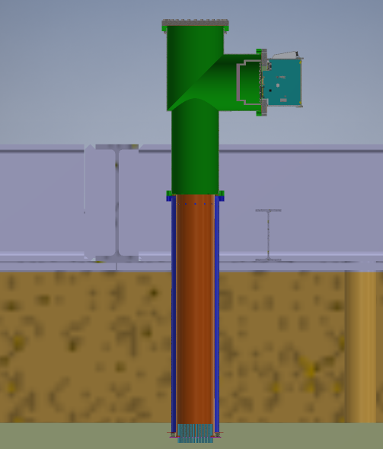
Cryostat Interface: ProtoDUNE SP Electronics
PD
Flange
ProtoDUNE cold electronics to cryostat interface takes place at the cold feedthrough
Almost identical to SBND
Grounding details explained earlier in previous grounding talk (L. Bagby)

Slide 7
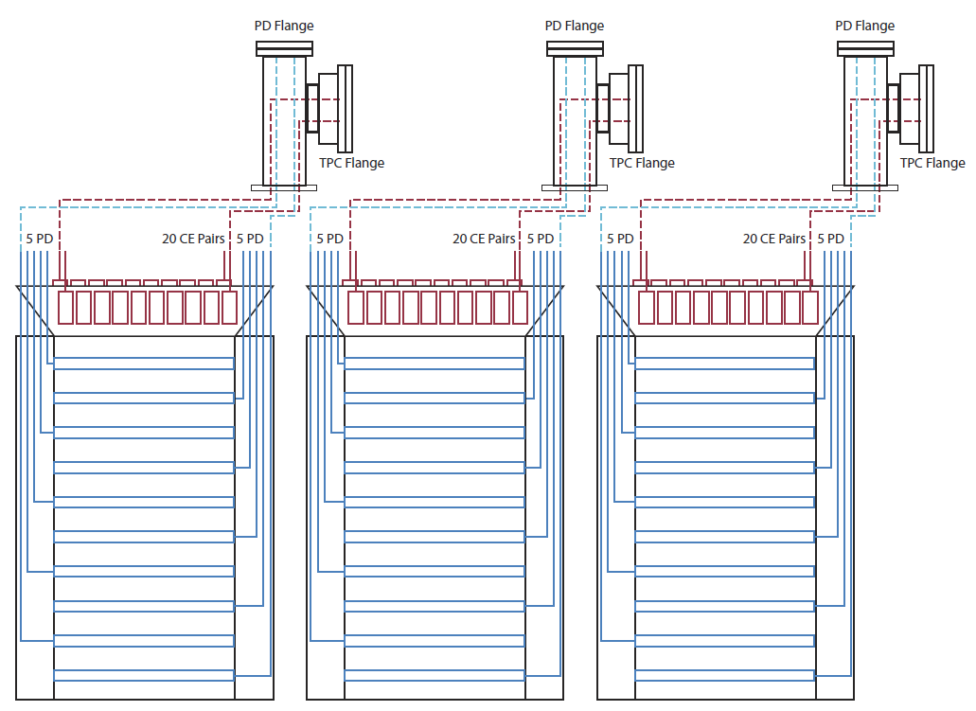
ProtoDUNE SP APA Cable Routing Concept
Photon Detector system will read out ganged SiPMs from paddles inserted into APA slots.
Note that cable paths share the same feedthrough, but different Flange.
PD readout design will allow for grounding of cable shields at Flange consistent with grounding and shielding plan.

Slide 8
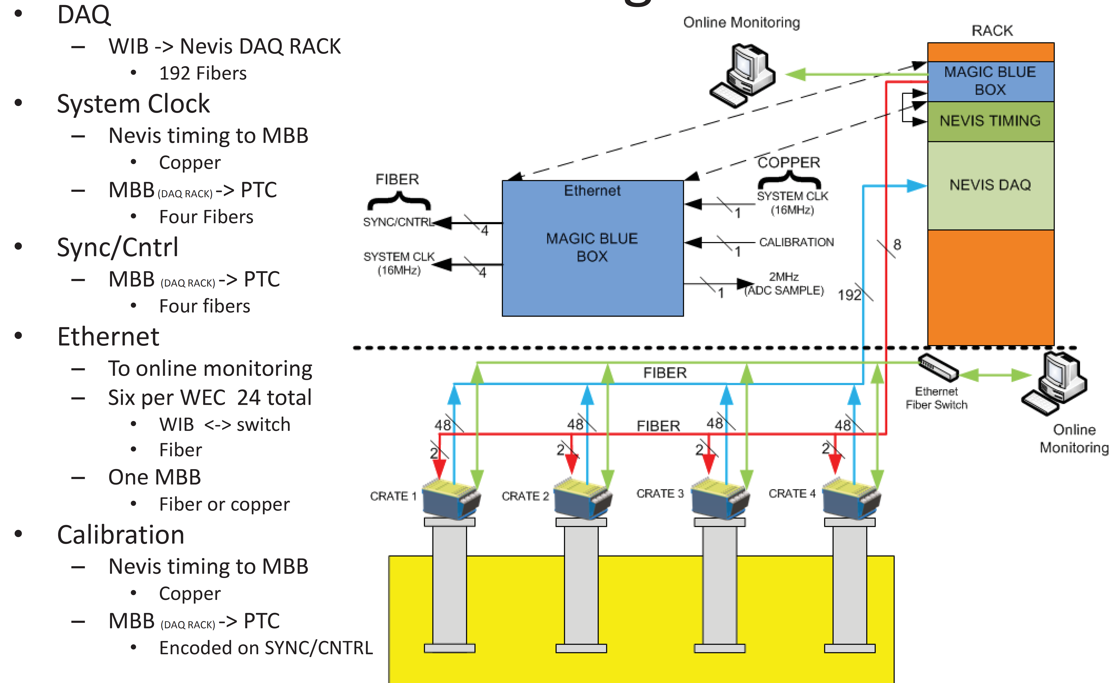
DAQ Interface: SBND
Data and
Timing/Control
Fibers

Slide 9
DAQ Interface: ProtoDUNE SP Electronics
DAQ
Interfaces

Slide 10
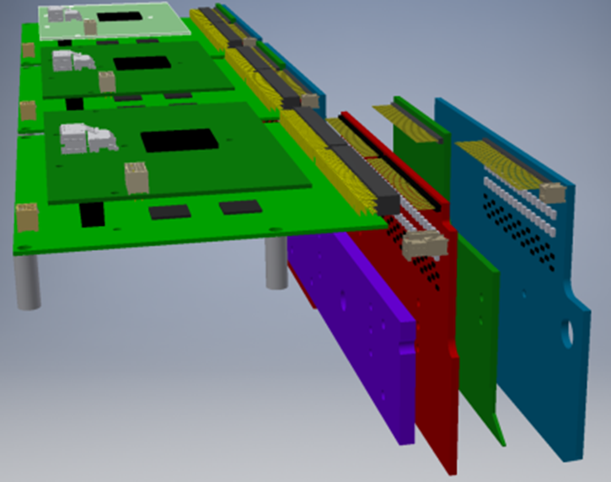
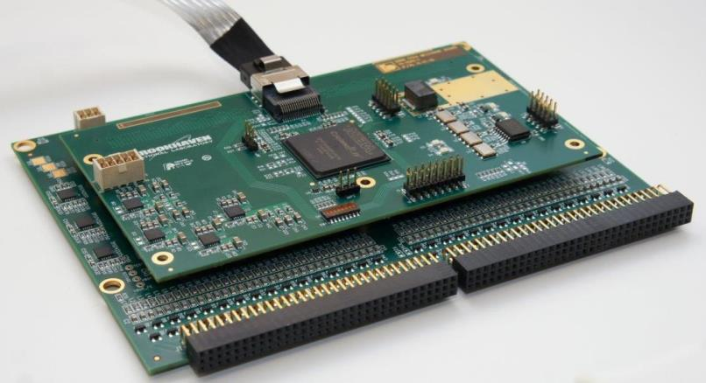
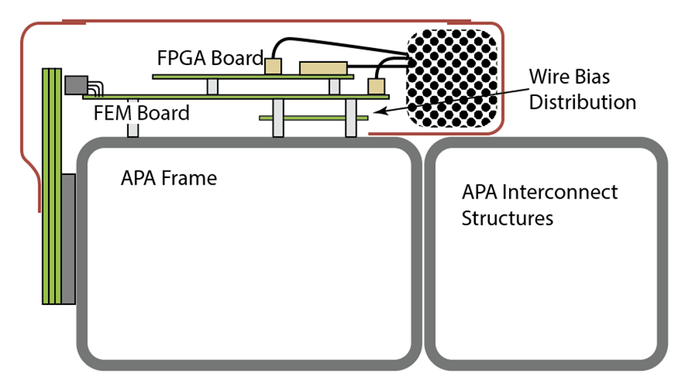
TPC – APA Wire Interface - SBND
SBND CE and Geometry board stack
3 Faraday cages over CE
Room for cabling inside the enclosure
FE card ground connected to APA frame via screws and standoffs.

Slide 11
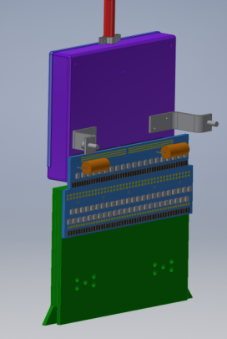
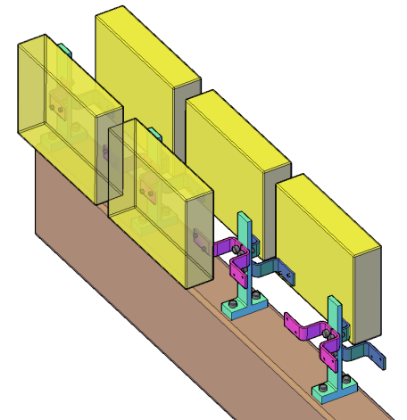
TPC – APA Wire Interface : ProtoDUNE SP Electronics
Cold Electronics interface to TPC occurs at the locations that the FE card cold boxes are plugged into the APA wire boards.
The implemented interface will provide a low impedance ground connection between the APA frame and the cold electronics board set.
COLD
FE
ProtoDUNE SP wire board stack and cold electronics box

Slide 12
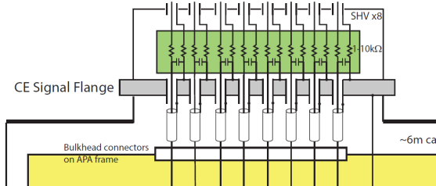
TPC – APA Wire Bias Interface
The Cold Electronics Warm Box and feedthrough flange also provide for the pass through of the wire bias lines.
8 SHV connectors are on the CE feedthrough flange.
The cables (RG316) need to be terminated on the APA top end on a patch panel, with single ended wires reaching various connection points around the APA.

Slide 13
Racks and Power Supplies
DC Power for CE
and PD

Slide 14
Conclusion
Charge question 5
Are the CE interfaces to other detector subsystems including TPC, DAQ, and cryostat well defined and documented?
All interfaces are well understood
Prototypes are being produced
Final design details will be documented over the next few months

Slide 15
BACKUP

Slide 17
ProtoDUNE Grounding Concept Graphic

Slide 18
ProtoDUNE

Slide 19
ProtoDUNE
COLD
FE

