Slide 1
DUNE Science Requiremetns for the ProtoDUNE-SP Detector Support
Jim Stewart - BNL
Detector Support Structure Design Review
November 2016

Slide 2
The DUNE Experiment
ν

Slide 3
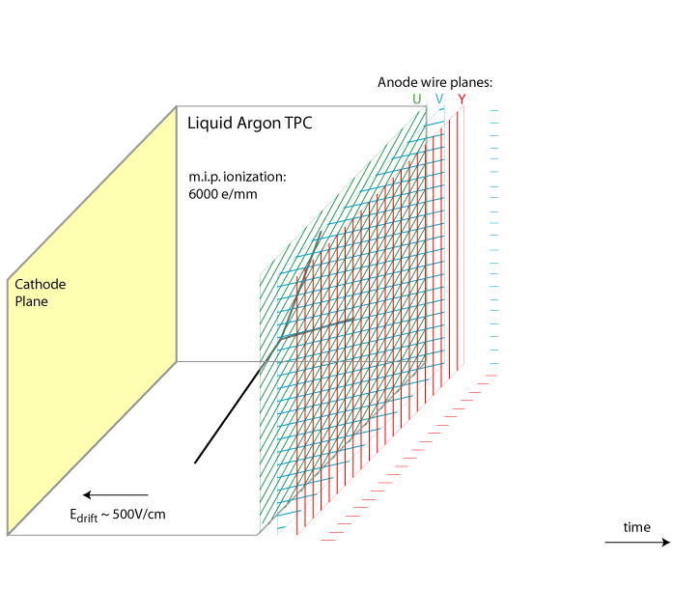
Time Projection Chamber (TPC) Operation
MIP dE/dx = 2.2 MeV/cm
→ ~ 1fC/mm @ 500 V/cm
~1 MeV/wire
x
180 kV
3.6m → 2 ms
TPC design is modular.

Slide 4
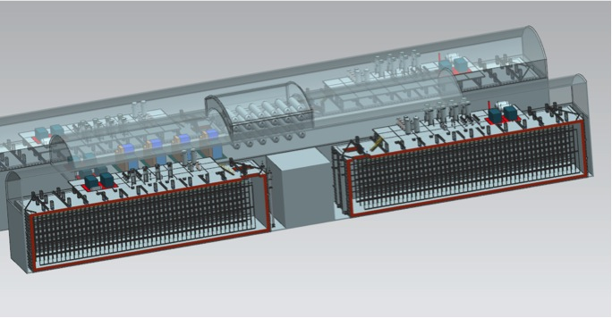
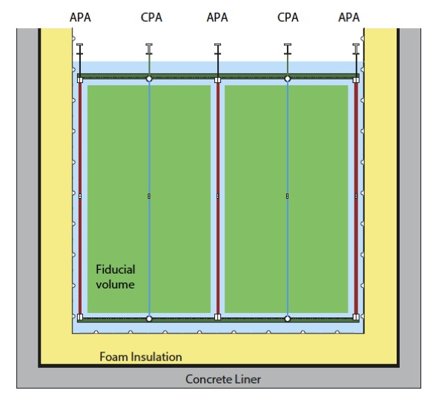
Single-Phase10 kt Detector Configuration
Liquid Argon Time projection chamber with both charge and optical readout.
58 m
62 m
LAr Detector Module Characteristics
17.1/13.8/11.6 kt Total/Active/Fiducial mass
3 Anode Plane Assemblies (APA) wide (wire planes)
  Cold electronics 384,000 channels
Cathode planes (CPA) at 180kV
  3.6 m max drift length
Photon detection for event interaction time determination for underground physics
14.4 m
12 m
3.6 m
Steel Cryostat

Slide 5
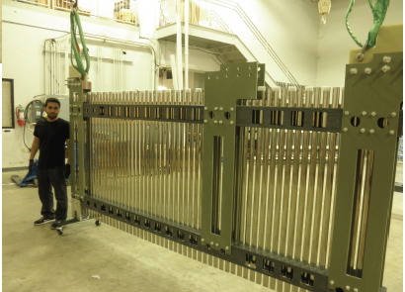
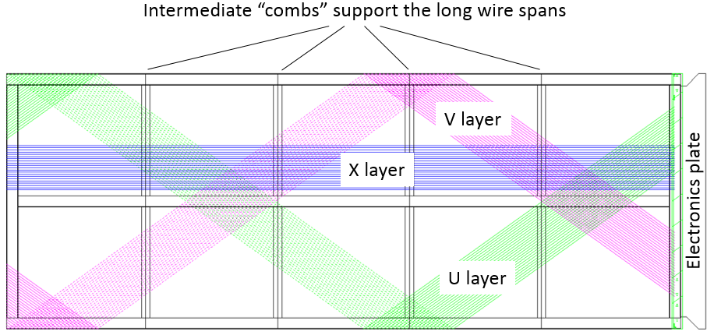
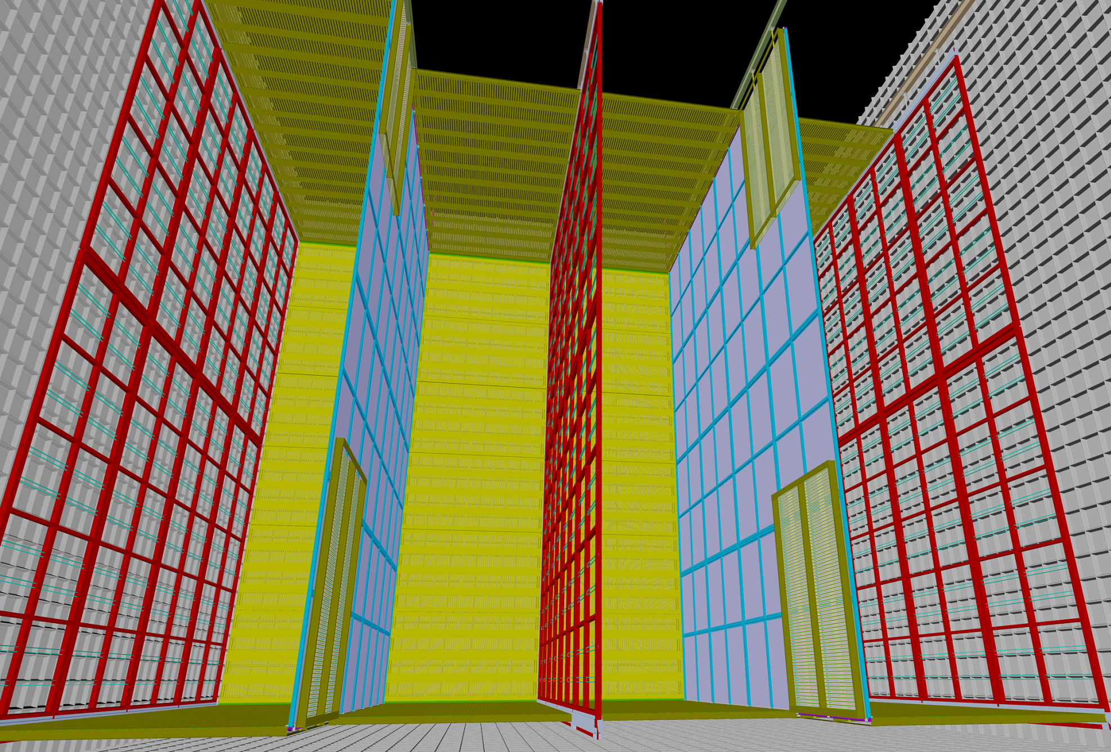
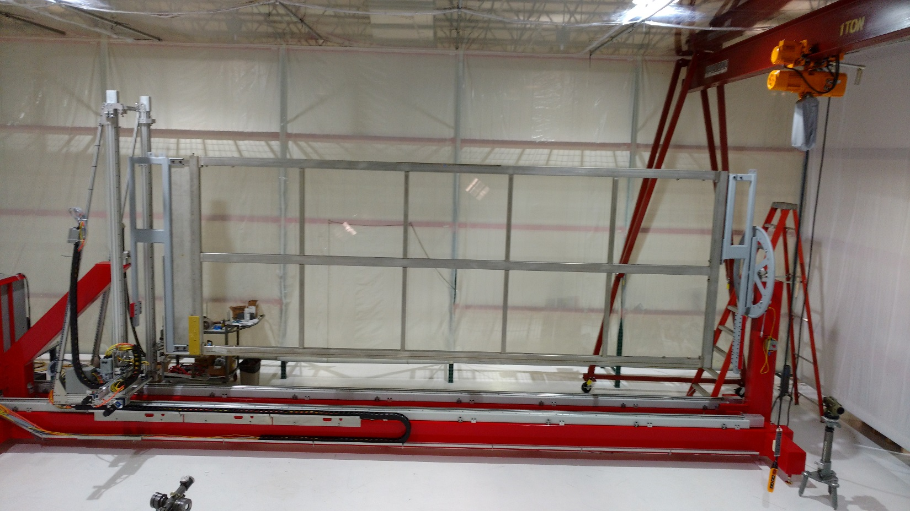
2.3 m
Modular APAs - 2.3m by 6m
  width limited by Ross shaft, and shipping
  Length limited by wire capacitance and noise
Cathode and field cage geometry fixed by APA and 3.6m drift → HV limitations and purity
6 m
End wall Field Cage Panel
Field Cage
Membrane cryostat
12 m
APAs
CPAs
APAs
APAs
Field Cage

Slide 6
ProtoDUNE Goals
Engineering validation of the full-scale DUNE detector components.
  Test the full scale detector elements under realistic (but high rate) conditions.
  Use as close to final detector components as possible.
Develop the construction and quality control process.
Validate the interfaces between the detector elements and identify any revisions needed in final design.
Validate the detector operation using cosmic rays.
Study the detector response to known charged particles.
Improve the detector reconstruction and response model
Validate the Monte Carlo Model accuracy
Engineering validation
Performance
validation

Slide 7
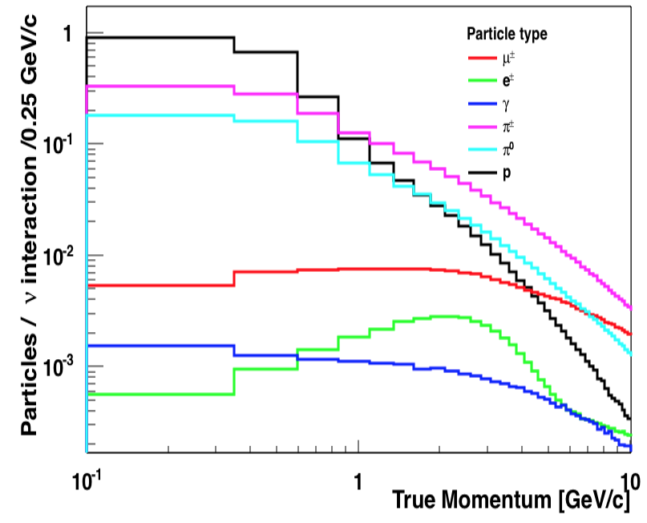
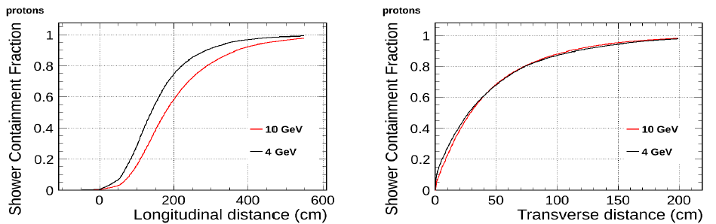
Desired ProtoDUNE-SP Data
Particles produced in neutrino interactions at DUNE
ProtoDUNE needs to be capable of measuring low energy pion, kaon, and electron showers well.
The vertex reconstruction is critical for PID.
Maximum hadronic shower size is 2m radius and 6m deep.
A 3APA deep (6.9m) by two drift cell wide (7.2m) provides optimal coverage
Largest complex event topology is from hadronic showers

Slide 8
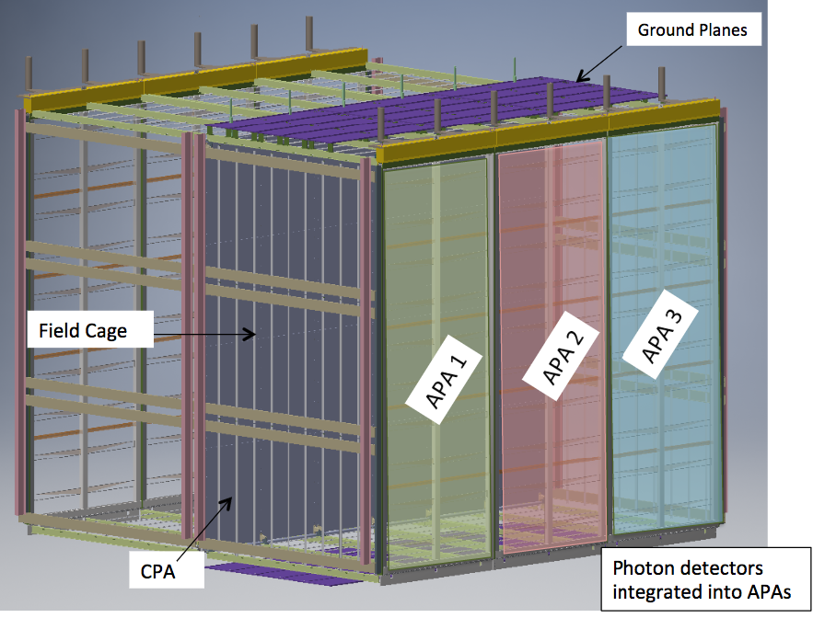
ProtoDUNE-SP configuration
6 APA
6 CPA panels
6 top FC panels
6 bottom FC
End wall FC
180kV HV
Desire to reconfigure to 2.5m drift for future runs to reduce space charge effects (few CM distortions).
The DSS dimensions are defined by the requirement to support the TPC.

Slide 9
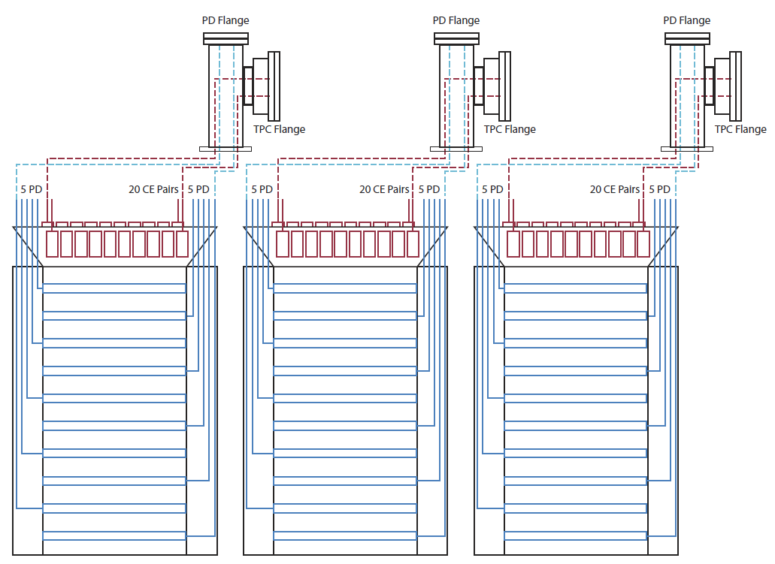
Grounding
The single-phase TPC has no gain prior to charge collection so low noise design is critical.
Proper grounding and shielding are vital.
The detector support structure must be electrically isolated from the APA and electronics.
The DSS must be electrically connected to the membrane at the penetrations..

Slide 10
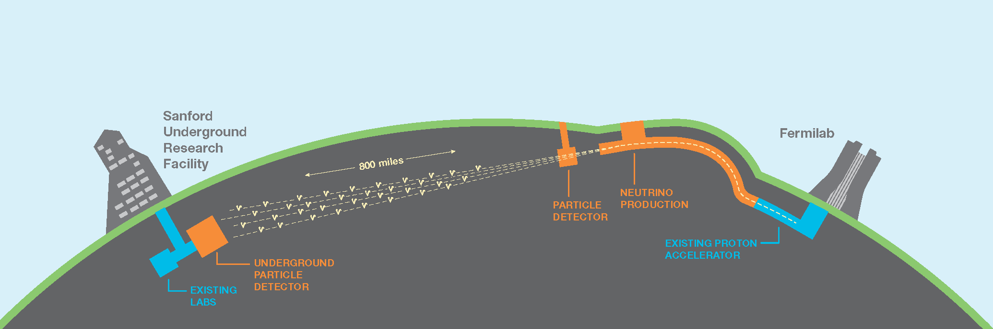
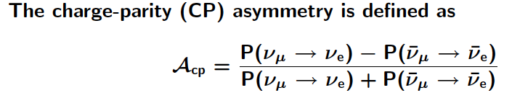
Detector Mechanical Tolerances
1300 km
No absolute position accuracy required!
  At 1300km the flux varies <1% over 1km
FD
ND
ν
  Requirements on the detector position are driven by engineering considerations and the cryostat interface.
Detector volume needs to be known better than the 1% level.
  DUNE will measure asymmetries so the volume is needed to normalize the data sets.
  Detector motion under cooldown needs to be understood to insure the 1% precision in defining the fiducial volume.

Slide 11
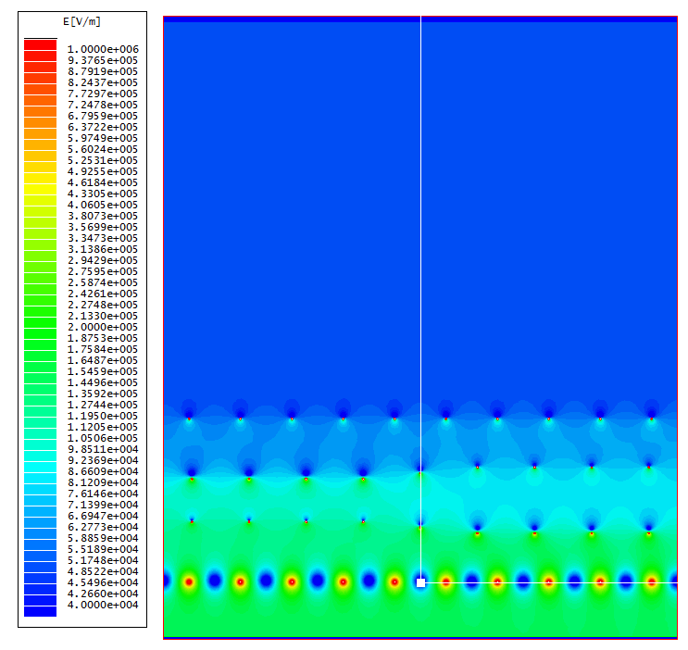
APA plane mechanical distortions
LBNE DOCDB 7370
The induction planes must fulfill the transparency condition at > 99%.
  Needed for both calorimetry and tracking.
This defines the APA flatness specification.
Field calculations show 0.5 mm wire displacement OK.
APA distortion studies show that this corresponds to a +/-5mm tolerance on flatness.
The detector support cannot distort the APA beyond the +/- 5 mm limit.
Nominal wire plane spacing: 3/16”
G & X wire pitch: 4.5mm
U & V wire pitch: 5mm
G and X planes remain at nominal position
U & V each moves 0.5mm closer at the left (U-V gap reduced by 1mm), 0.5mm farther at the right (U-V gap increase by 1mm).
Bo Yu

Slide 12
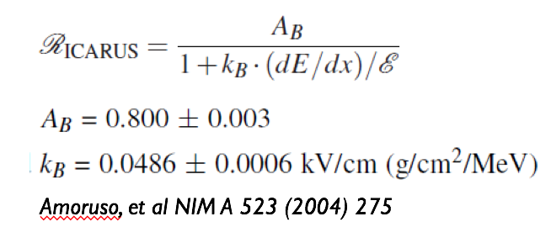
Impact of Mechanical Distortions on calorimetry
If the wire planes are off by 1 cm, the drift distance will be changed by 1 cm over 3.6 m. The will change the nominal drift field 500 V/cm by 0.3%.
The recombination (quenching) effect depends on electric field. Using the Birks correction:
Changing the electric field by 0.3% will change the recombination factor by 0.05% for a MIP particle (2.1 MeV/cm) and by 0.15% for a HIP particle (10 MeV/cm). The changes are negligible for calorimetry reconstruction.
Distortions of several cm would be permitted based on calorimetry
Stewart | Detector Support Structure Review

Slide 13
Impact on dE/dx from mechanical distortions
3.6 m
2.3 m
Suppose the drift volume becomes a trapezoid instead of a rectangle due to distortion and the drift distance on one side is 1 cm longer than on the other side, the electric field is different by 0.3% between the two sides.
For a track near the cathode that is parallel to the wire planes, the reconstructed track would appear to have a smaller angle w.r.t the wire planes. The maximum change to dE/dx would be .01/2.3 = 0.4% due to this distortion. This is negligible for particle ID.
Stewart | Detector Support Structure Review

Slide 14
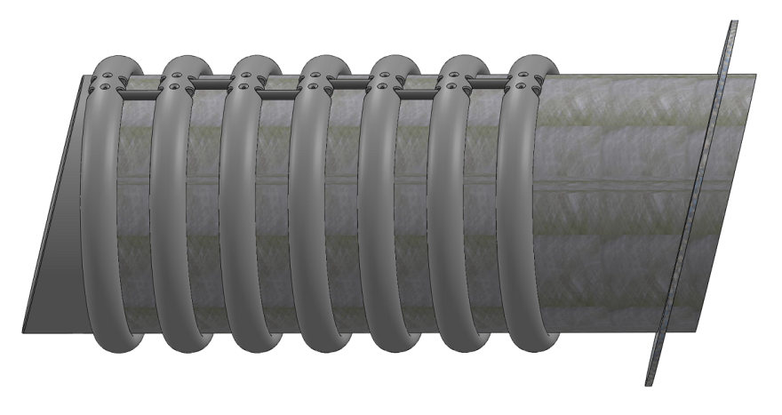
Material Budget in the ProtoDUNE-SP Beam
Required Particles:
  Hadrons starting 1 GeV/c , electrons from 0.5 GeV/c
  Energy uncertainty <=1%
  Minimize electron showering, for e/γ discrimination test
  Avoid large scatterings, for “good” particle identification and checks of angular resolution/reconstruction
Dead materials are an issue, especially if the composition/ thickness is not well defined.
Reminder: without plug,
  all electrons would shower before the active volume,
  >=50% hadrons would interact in the passive layer
  1GeV un-collided protons would loose 36% of their energy
Beam Plug

Slide 15
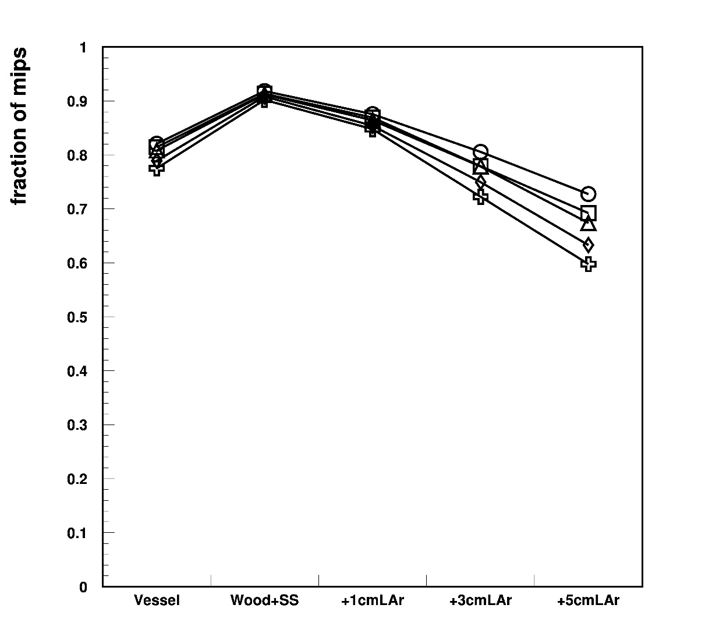
Effect of materials on electrons
Fraction of electrons that are still “minimum ionizing particles” after dead layers in various configurations ➔ study e/γ discrimination
Different symbols: e⁻ initial momentum, within 0.2-2 GeV/c
Beam window: 90% survive
5cm LAr: only 60-70 % survive as mip
Also 3 cm is problematic
Can tolerate ≈1 cm IF PRECISELY KNOWN
0.2
0.4
0.5
1.0
2.0
Only beam window
Beam window plus a few cms inactive Lar ( 1,3,5 cm)
All cryo layers

Slide 16
Hadrons, and summary
For protons at 1GeV/c, every cm of inactive LAr adds 1.5% energy loss. ➔ few cms can be afforded IF PRECISELY KNOWN (better than 1-2 mm )
For pions at 1 GeV/c, absolute energy loss is relatively less important, however
  angular deflection becomes large, 20mrad rms for 5cm inac. LAr
  Spread in energy loss 0.5% at 5 cm inactive LA
  Also for pions safe limit is few cm, need knowledge
Combining electron and hadron requirements, acceptable Lar inactive layer is or the order of 1cm.
Needed good knowledge of the actual thickness

Slide 17
Contamination
The electron lifetime needs to be longer than 3ms.
  All materials in the cryostat need to be tested for electronegative impurities.
  Materials in the gas ullage are especially important.
  All materials need to be tested in the FNAL material test stand.
As the outgassing rate grows exponentially with temperature all penetrations to the warm structure must be purged to prevent contaminates from entering the ullage space.

Slide 18
Summary
The detector support dimensions are defined by the TPC dimensions based on the desired test beam data set.
  The gap between the beam entry window and the beam plug should be on the order of ~1cm.
The detector will be constructed from full-scale DUNE detector components.
The DSS needs to be able to accommodate a shift from 3.6 to 2.5 m drift distance.
The requirements from contamination and grounding are clear.
The DSS must not appreciably distort the APA frames.
Mechanical distortions of the TPC at the few cm level will not appreciably impact detector performance.

