Slide 1

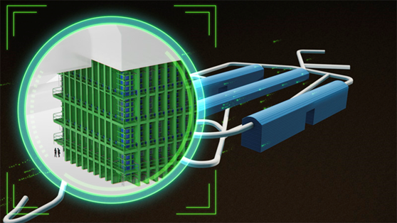
Field Cage for protoDUNE
Rahul Sharma
Brookhaven national laboratory

Slide 2
Contents
Main Slides
  Top/Bottom FC Design
  Top/Bottom FC Construction
  Top/Bottom Module Crating and Shipping
  End Wall FC Design
  End Wall FC Construction
  End Wall FC Panel Crating and Shipping
  Material Properties
  Structural Analysis
  Thermal Considerations
  Risks and Mitigation
  Conclusions
Backup Slides
  Stress Analysis worst cases details
  Ash River Installation Delivery
  Clean Room for the assembly of protoDUNE panels
  Shipment to CERN
  Acceptance at CERN

Slide 3
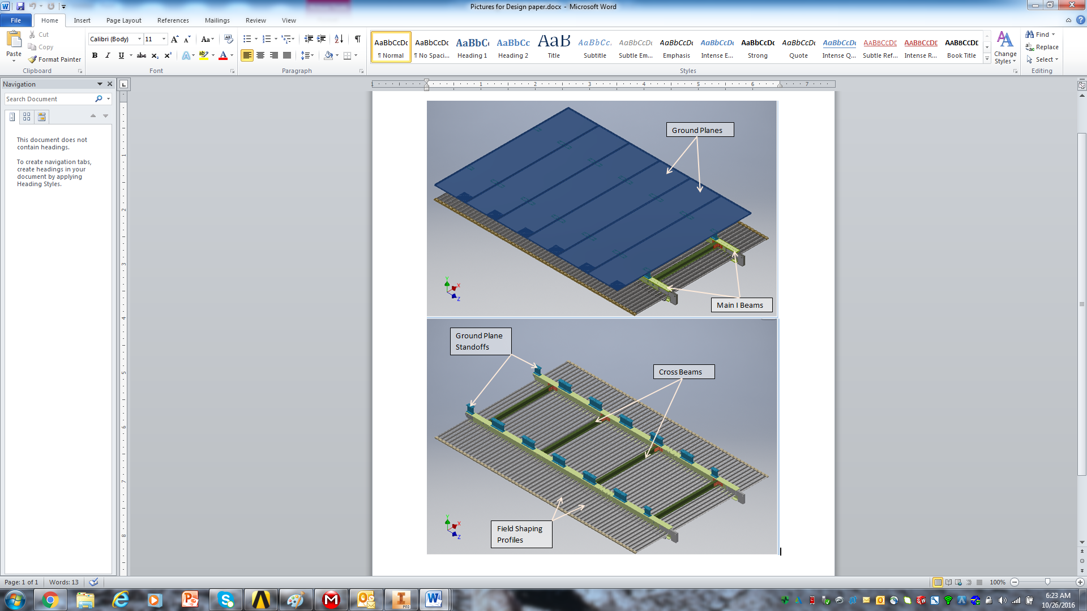
Top/Bottom FC Design
Top/Bottom FC Design:
Size : 3.5m x 2.3m
Material used for building Structure is FRP
Field shaping profiles and ground planes are made of stainless steel
Ground Planes are mounted at a fixed distance of approximately 20cm away from the top of the field shaping profiles

Slide 4
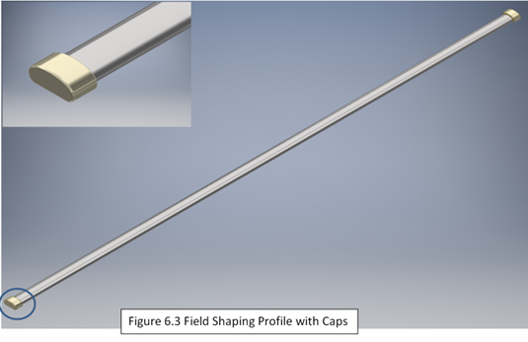
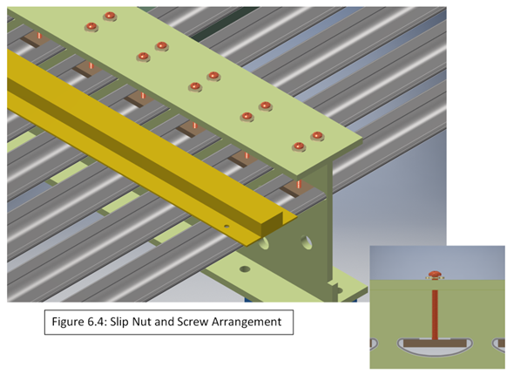
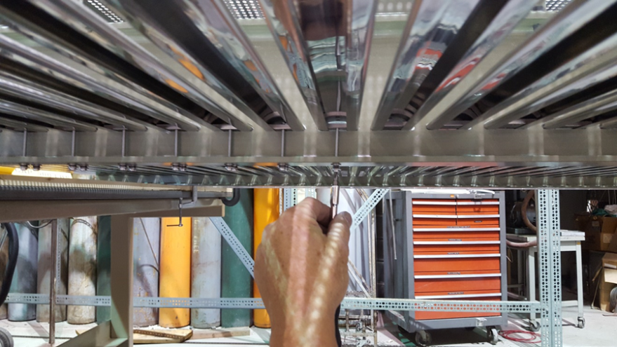
Top/Bottom FC Construction
The field shaping metal profiles as shown in Figure 6.3 are constrained using custom slip nut and screw arrangement as shown in Figure 6.4. These profiles are only constrained on the first main I-beam and are allowed to move freely in the slots of the second main I-beam

Slide 5
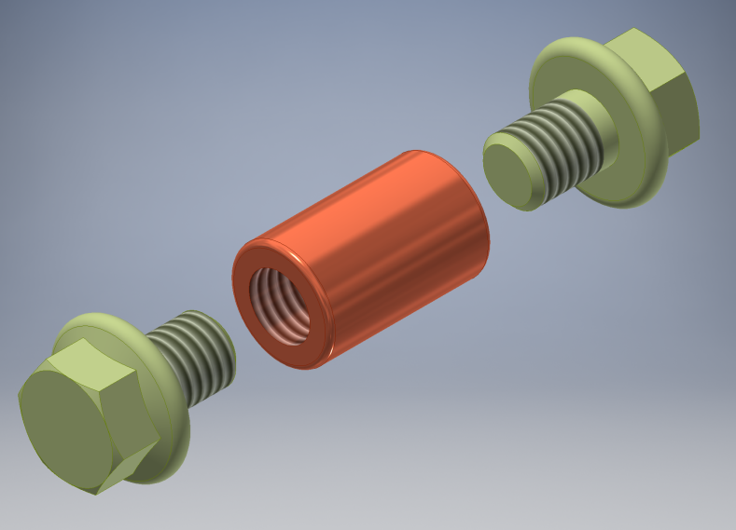
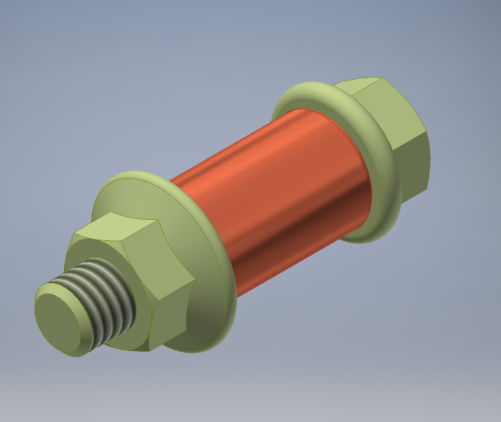
G10 Shear Pin Design
G10 Pins with FRP fasteners are used wherever conductive fasteners could not be used.
The design comprises of the pin with 15.875mm (5/8 in) diameter loose fit (.25mm clearance) in the mating parts and flange head FRP bolts (3/8 -16”) or bolt and nut arrangement to capture the pin in the hole.
Testing done on the pins shows very promising results as published in the design paper.

Slide 6
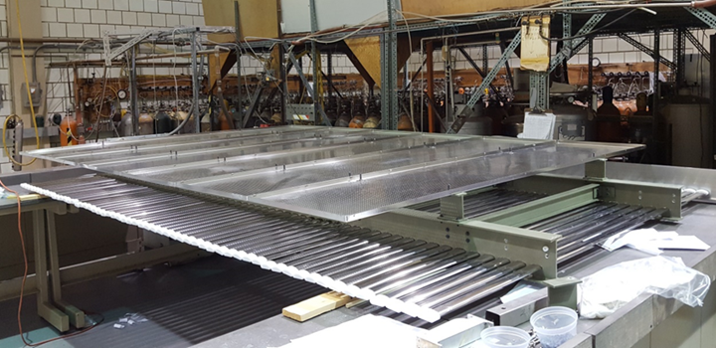
Top/Bottom FC Construction

Slide 7
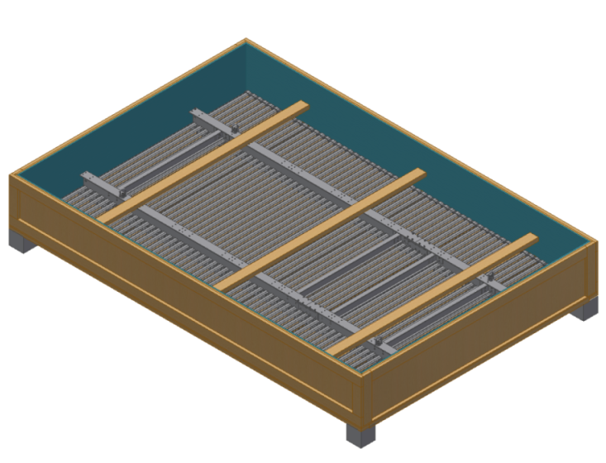
Crating and Shipping
Shipping crate design features:
Fork Liftable
Pictures show crating and shipping for modules for Ash River Mockup. FC modules lay horizontal inside these crates.
protoDUNE top/bottom FC crates will have FC panels in vertical orientation (Flipped up on one side).
The panels will be crated at Stony Brook University and then shipped to Ash River for mockup installation and to CERN for protoDUNE.

Slide 8
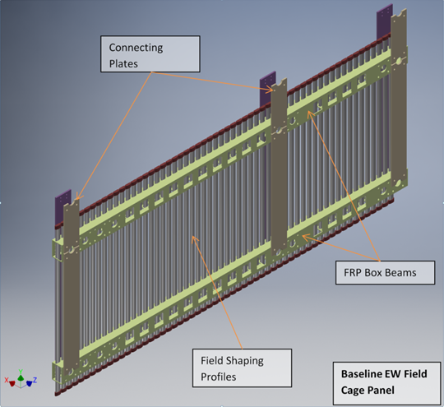
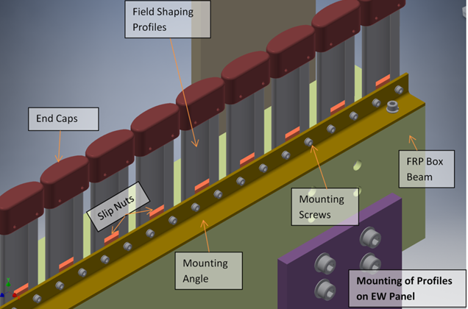
End Wall FC Design
Structural Components (Box beams, Angles etc.) are made of FRP.
Size: 3.5m x 1.5m
Field Shaping Profiles and locking nuts for profiles are made of Stainless Steel.

Slide 9
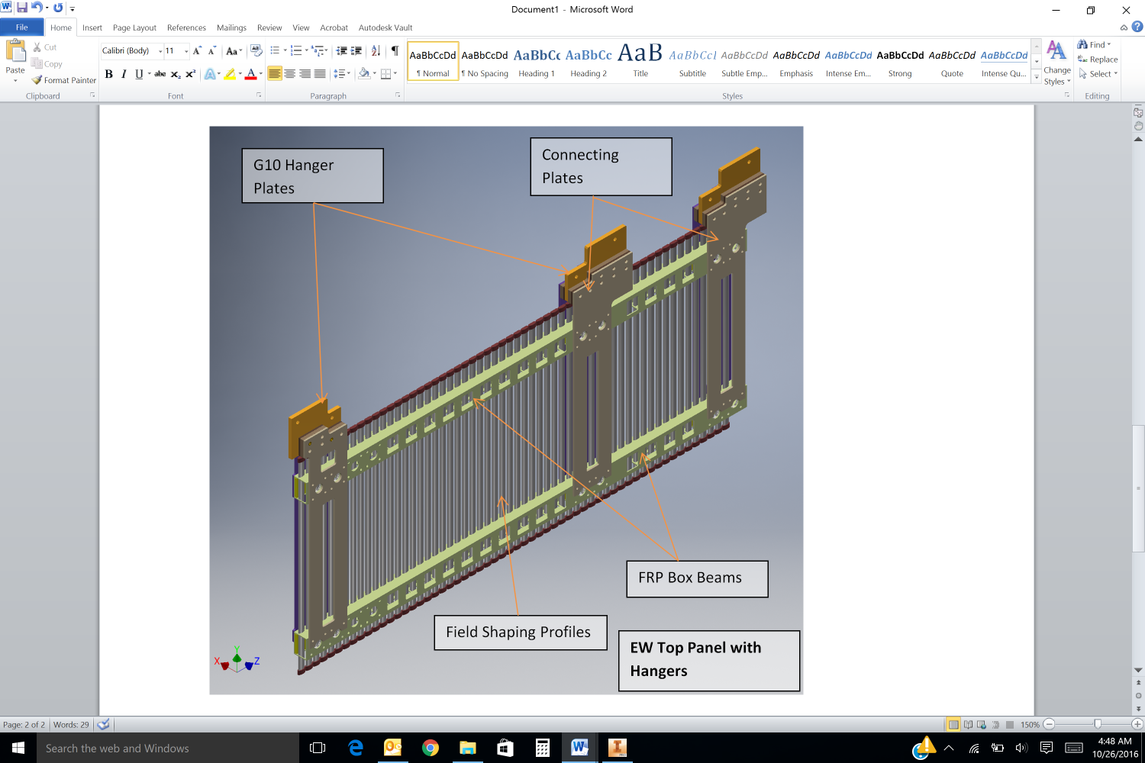
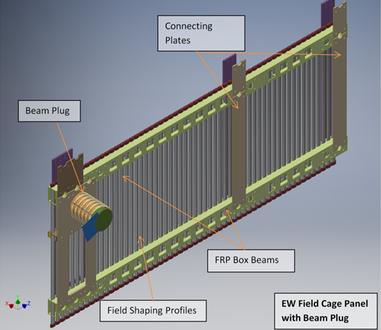
End Wall Panels

Slide 10
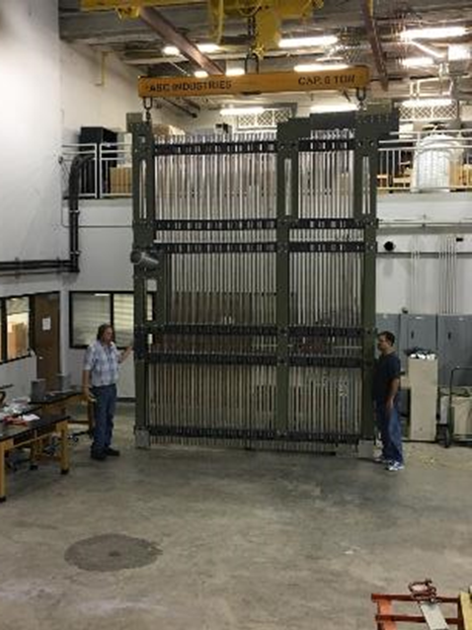
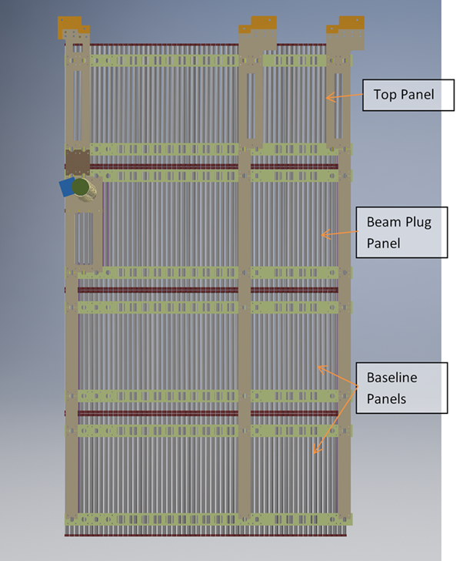
End Wall Assembly
6.2m
3.5m

Slide 11
Crating and Shipping
Shipping crate design features:
Fork Liftable
All 4 panels will be shipped together in 0ne crate for each end wall.
The panels will be crated at Louisiana State University and then shipped to Ash River for mockup installation and to CERN for protoDUNE.

Slide 12
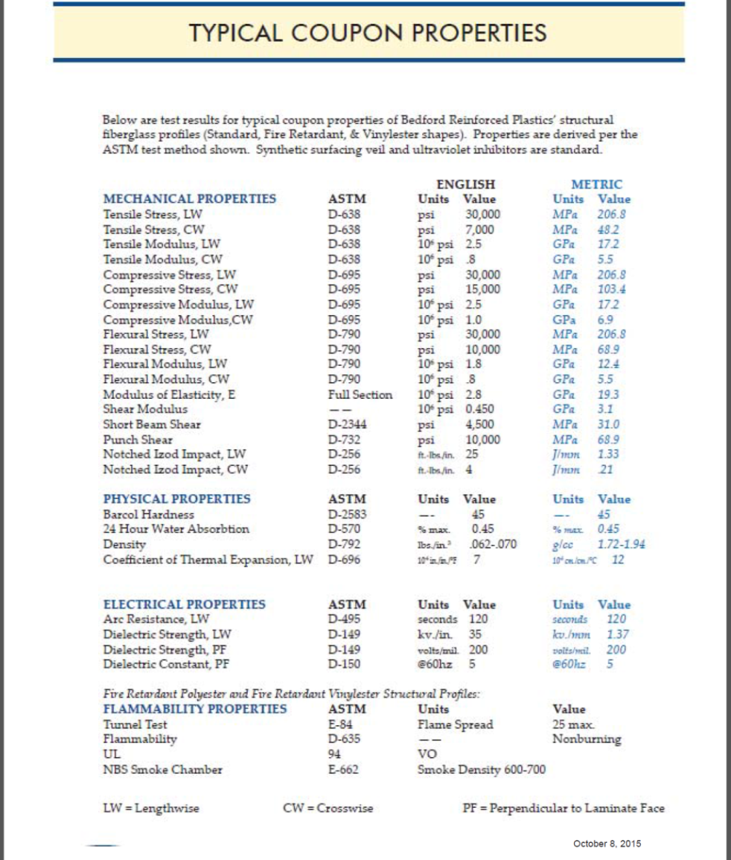
Material Properties
All material properties were take from the design guides provided by manufacturers of the materials. Please refer to the following documents:
Bedford Reinforced plastics design guide document for all FRP and beams/sheet properties.
Mcmaster/Atlas material properties for G10 pins
Accurate Plastics Inc. Data Sheet for G10 plates.

Slide 13
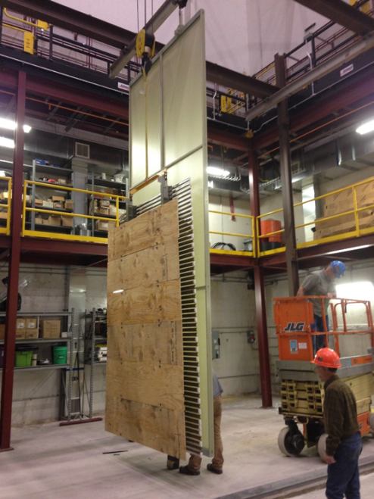
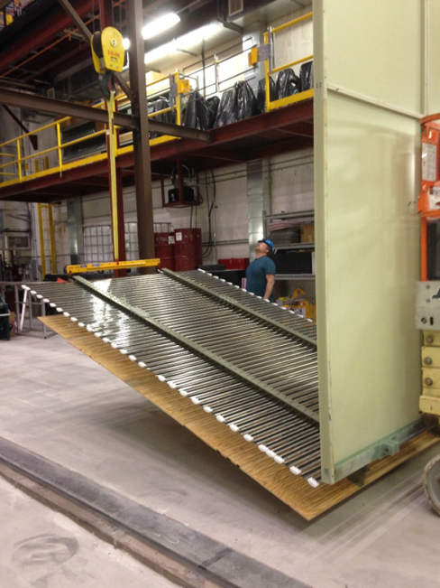
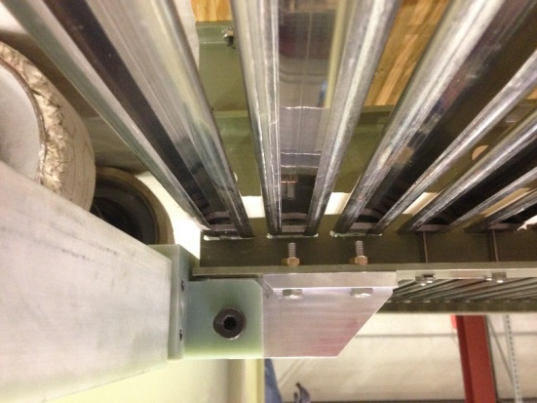
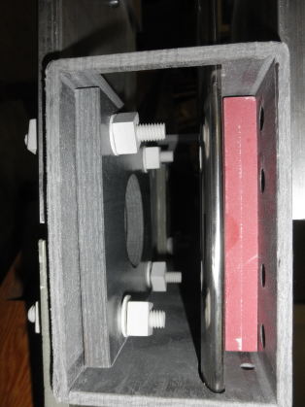
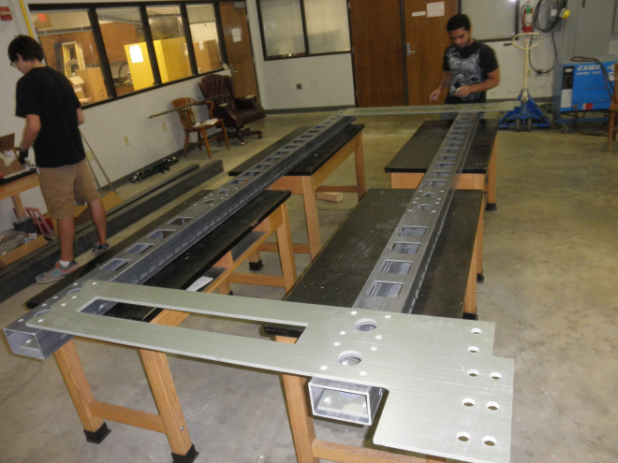
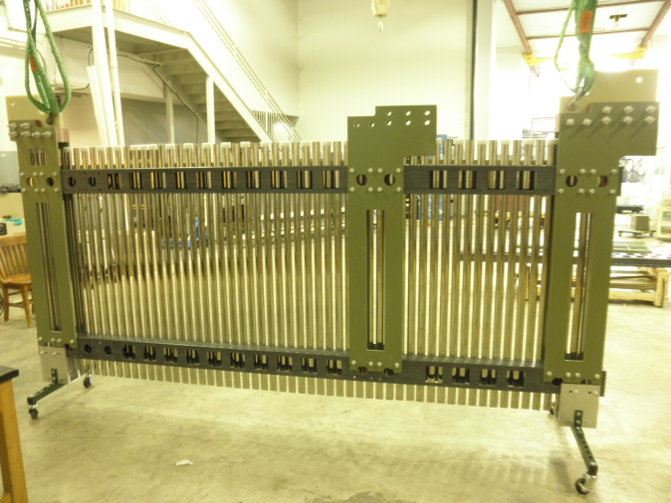
FC Structures and loading

Slide 14
List of Structural Analyses for FC Panels
Assuming worst case loading at 3.5m drift distance for top/bottom panels, stress analyses were performed for 11 load cases:
  Panel laying horizontal (Both Top and Bottom)
  Panel hanging vertical from CPA
  Bottom panel with legs with weight of 1 person (100kg) at 2 different positions
  Panel at various different angles during handling and installation (0, +/-30,+/- 45 and +/-60 degrees)
End Wall Analyses for protoDUNE stress analysis was run on 13 different load cases (Assuming beam plug end wall is under worst loading conditions and hence high stresses):
  Top Panel with Hangers with 1 beam plug panel and 2 baseline panels hanging from it.
  EW Panel at various different angles during handling and installation (0, +/-30,+/- 45 and +/-60 degrees)
End Wall Analysis for DUNE (for 3.5m drift distance)
  Top Panel with hangers with 7 baseline panels hanging from it

Slide 15
Structural Analysis
Most of the components were found to have very low stress values during field cage analysis.
Out of 21 load cases and looking at stress results of all components for all load cases, there were just a few components in a couple of load cases where stresses were found to exceed and the factor of safety requirement of 3.75 were not met:
  FRP beams when top/bottom FC is on hinge
  End Wall box beam for the top panel for beam plug end wall (FOS = 3.42)
  End Wall Box beam during one of the handling cases during assembly (FOS =1.87)
  FRP beam for DUNE End Wall (FOS=2.75)
  G10 pin for DUNE End Wall (FOS =3.57)
With a few minor design changes these high stresses could be mitigated:
All the other components in various different load cases meet the factor of safety requirement of 3.75

Slide 16
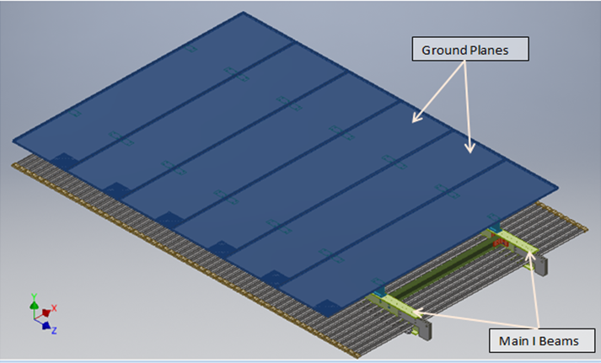
Thermal Considerations
Going from room temperature to liquid argon temperature differential shrinkage between SS and FRP is of the order of 1mm per meter because of that following components had to be carefully designed to allow for differential shrinkage:
Box beam/I-beam and Field shaping profiles connections:
  For both Top/Bottom and End wall FC panels, field shaping profiles are only locked at one of the beams to allow for differential shrinkage.
To hold the Field shaping profiles onto the top/bottom beams, a stack of belleville washers sandwiched between two flat washers is used.
  Since the epoxy is suppose to shrink a lot more than SS, 6 belleville washers provide a compressed spring will 1.5mm flexibility.
  Vendor is not giving out details of the material or properties of epoxy as it is proprietary information.
  Plan to cold test sections of FRP pieces to find the contraction at cryogenic temperatures.

Slide 17
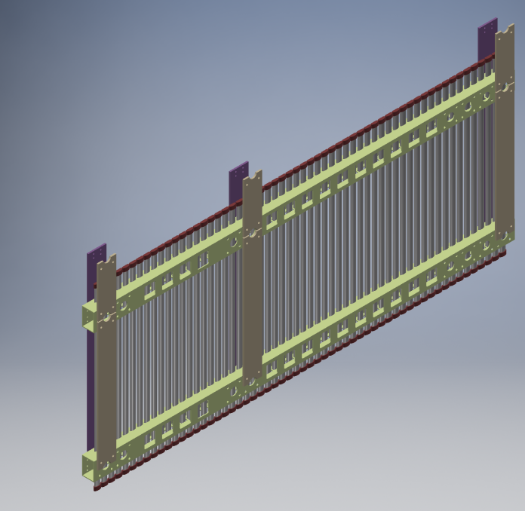
Thermal Considerations
To hold field shaping profiles onto the box beams using the FRP angle, a spring washer and flat washer is used.
Ground planes for Top/Bottom:
  CTEs of FRP and SS are very close to each other.
  Over the length of 3.5m the differential thermal contraction between stainless steel and FRP beams could be upto 3mm.
  Over the width of ground plane (about 2.3m). The differential contraction will be about 2mm.
  Earlier design of ground plane had oversized holes 10mm in diameter. Ground planes holes have been changed to 6mm diameter. Need to open the ground plane holes to have oversized holes at certain places.
A stack of two M10 belleville washers is used to connect the inner FRP vertical support pieces.

Slide 18
Mechanical Risks and Mitigation
Risk#1 FC mechanical structure not having enough strength.
Mitigation: FC mechanical structure is being analyzed for all load conditions to make sure there is enough factor of safety for all components.
Risk#2 Shear Pins or fastening method not adequate.
Mitigation: Testing shear pins and fasteners as mentioned in all orientations as shown in the test plan document.
Risk#3: Structure distorting under cryogenic conditions
Mitigation: Testing of full structure under liquid nitrogen.
Risk#4: Problem with assembly or installation of modules.
Mitigation: Practice assembly on mockup modules at LSU and Stony Brook. Make design changes to make assembly process easy. Ash River Installation exercise to practice installation. Required changes will be made to make installation easy.

Slide 19
Conclusions
Analysis of FC Panels show the structure is good to hold the loads in all assembly, handling and installation scenarios except for a few cases as explained.
Minor changes to the design will be made to raise the factor of safety of all components above 3.75 in all loading scenarios.
If needed, minor changes will also be made to the design based on input from trail assembly at ash river

Slide 20
Charge Questions
Does the FC mechanical design meet the requirements? Are the requirements/justifications sufficiently complete and clear?
  Yes. Please refer to design paper for the requirements of FC mechanical design.
Are FC mechanical risks captured and is there a plan for managing and mitigating these risks?
  Yes. As shown on slide 18.
Does the design lead to a reasonable production schedule, including QA, transport, installation and commissioning?
  Yes. Assembly will manufacturing of parts/assembly/testing will take about 5 months including contingency. If pre production design review happens by end of January, We will deliver everything by end of June.
Does the documentation of the FC mechanical design provide sufficiently comprehensive analysis and justification for the FC design adopted?
  Yes, Please check the design paper for all the analysis.

Slide 21
Charge Questions
Are all FC mechanical interfaces to other detector components (APA, detector support system and beam plug) and cryostat documented, clearly identified and complete? Does the TPC integrated 3D model adequately represent the mechanical interfaces to the FC and between adjacent FC?
  Most of the interfaces have complete design. Some interfaces that need some work is: beam plug interface, APA latch, end wall constraining to APA/CPA details. TPC integrated model may lack detail for these interfaces.
Are the FC mechanical 3D model, top level assembly drawings, detail/part drawings and the material and process specifications sufficiently complete to demonstrate that the design can be constructed and installed?
  Yes. All the drawings/models are available on docdb and box accounts that are used to exchange the files among TPC collaborators. Fully integrated models are available on CERN EDMS.
Are operation conditions (loads and temperature) listed, understood and comprehensive?
  Yes. Please refer design document FC analysis and Thermal considerations section.
Are the teams sufficiently resourced to deliver on time?
  Yes. We have 2 groups: LSU and SBU that have technical know how to build FC panels after pre production review.

Slide 22
Field Cage for protoDUNE
(Backup Slides)
Rahul Sharma
Brookhaven national laboratory

Slide 23
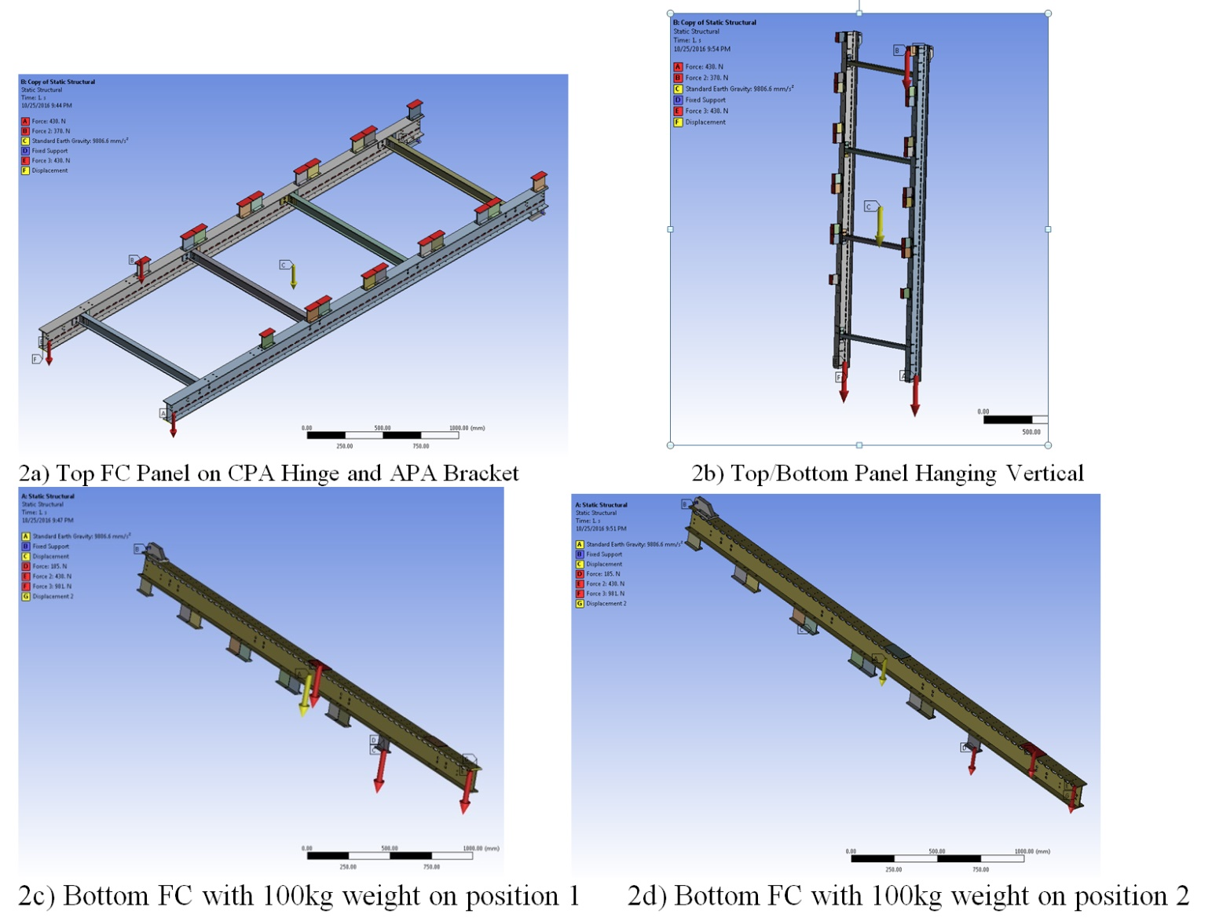
Top/Bottom Panel loading cases

Slide 24
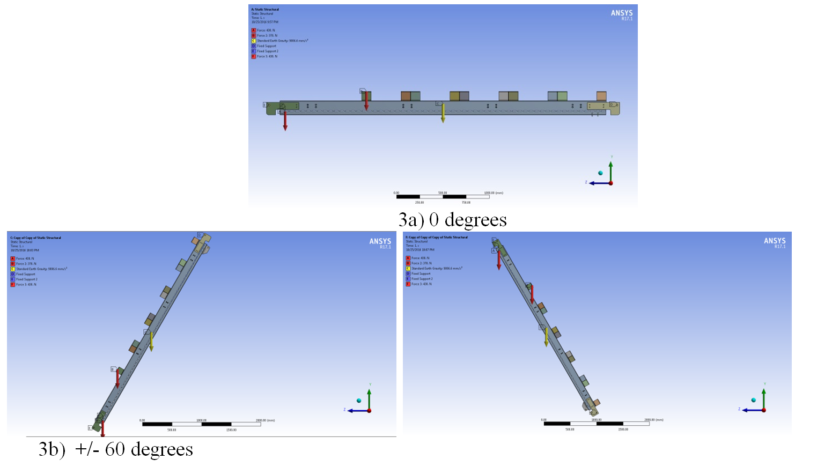
Top/Bottom Panel loading cases

Slide 25
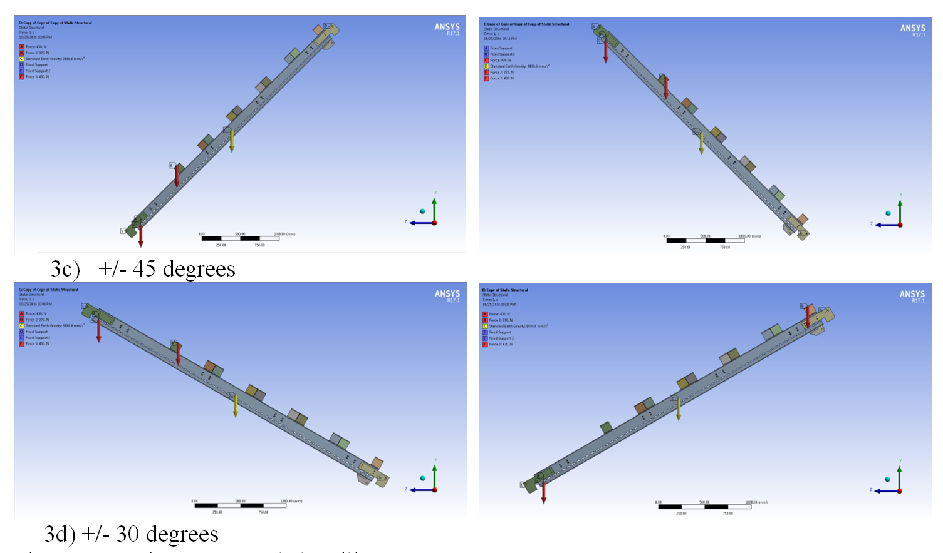
Top/Bottom Panel loading cases

Slide 26
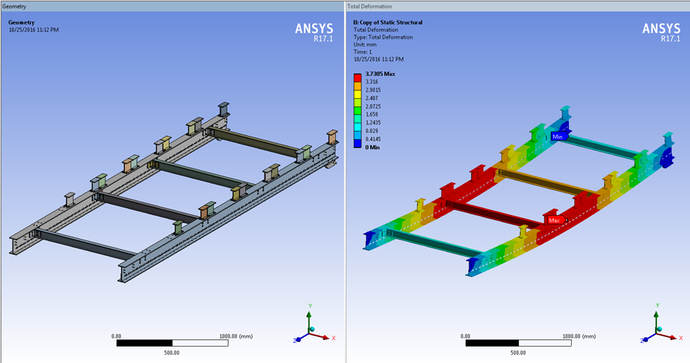
Structural Analysis (Worst Case)
Maximum Deflection :3.7mm

Slide 27
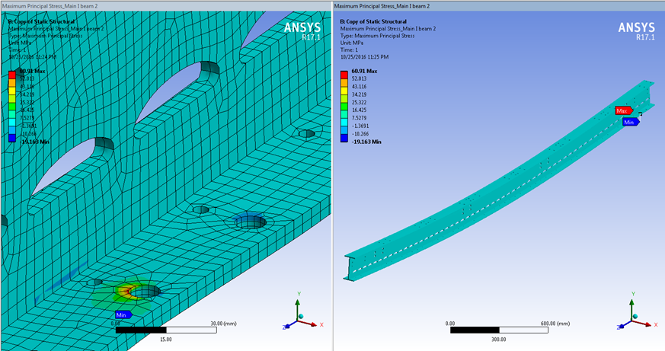
Worst case stress for top/bottom FC analysis at CPA hinge
Component | Maximum Principal Stress (MPa) | Max Normal Stress _{X}(MPa) | Max Normal Stress _{y}(MPa) | Max Normal Stress _{z}(MPa) | Factor of Safety
I Beam | 60.91 (At constraint) < 15MPa (Everywhere Else) | 36.1 | 24.5 | 59.0 | FOS (x) = 1.33 FOS (y) = 1.96 FOS (z) = 3.55
In all other load cases the I beam meets the factor of safety requirement of 3.75
All other components for top/bottom FC meet the factor of safety requirement of 3.75 as well. Please refer to design paper for detailed stress analysis results for all load cases.

Slide 28
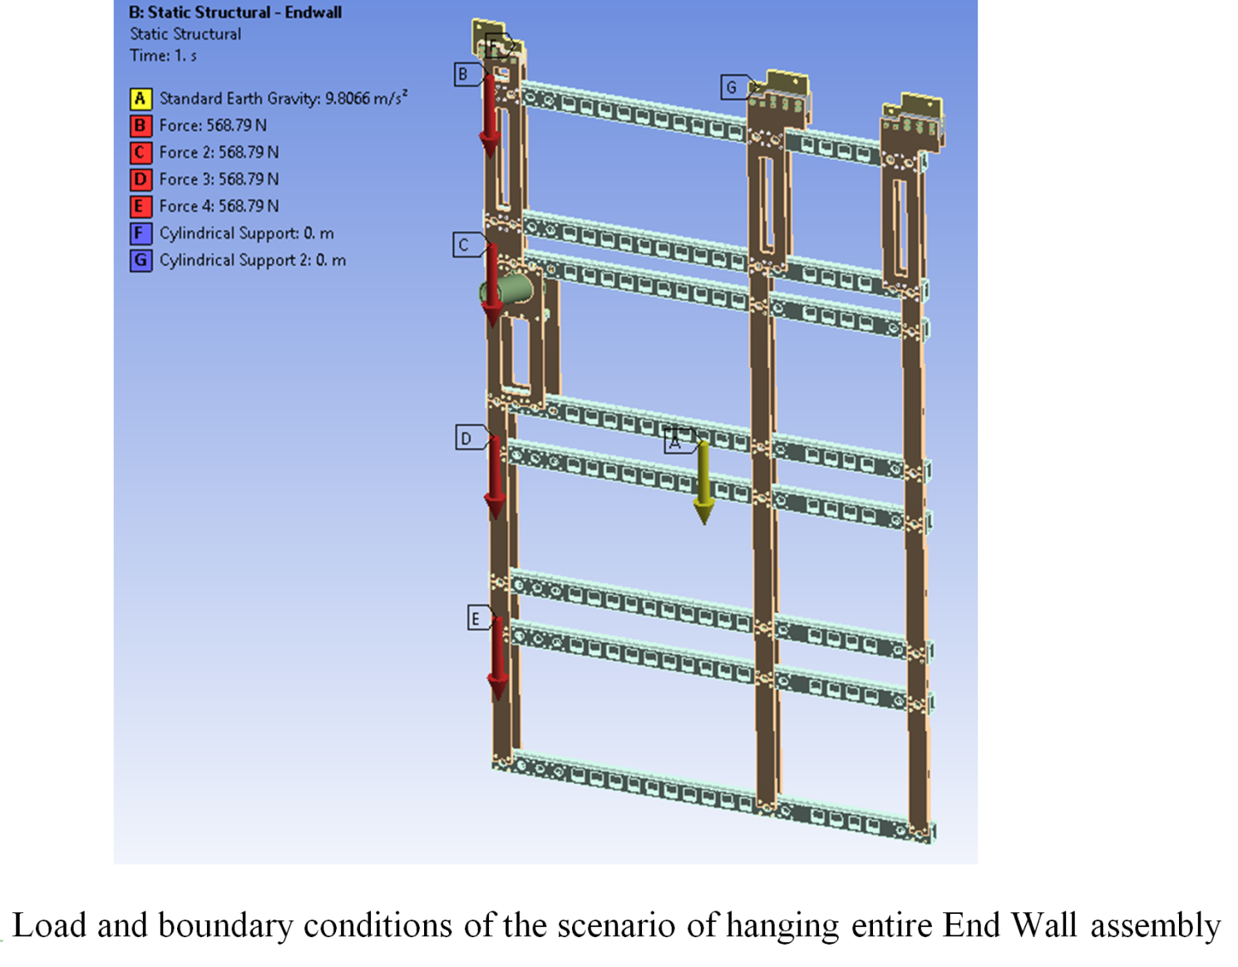
End Wall protoDUNE loading cases

Slide 29
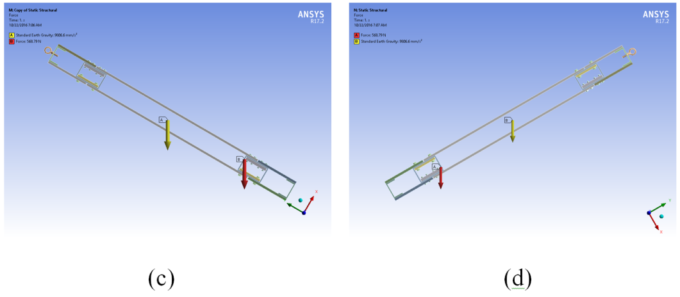
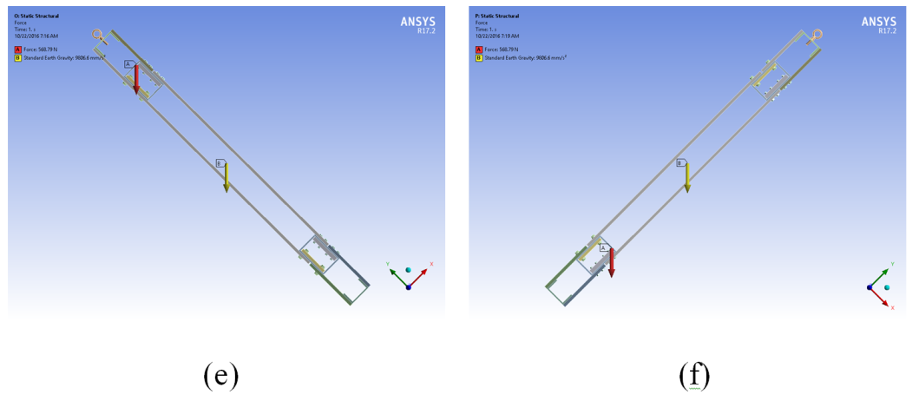
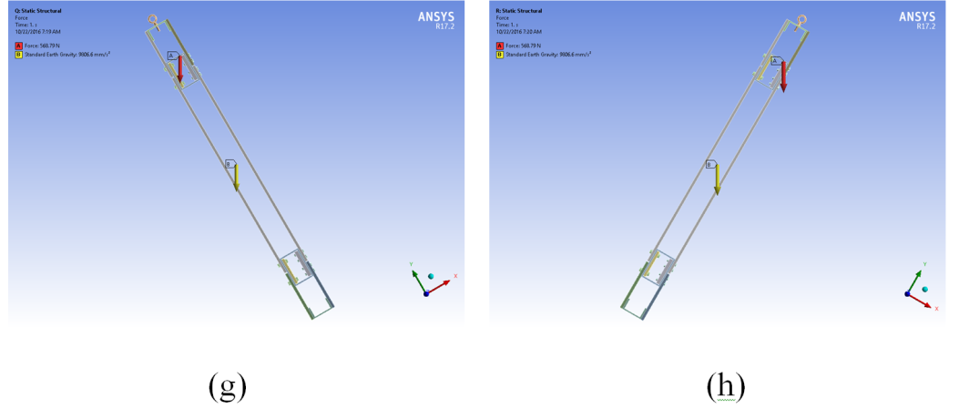
End Wall FC loading cases
Stress analysis was performed for eight different tilt angles the end wall panel may see during handling and installation. a) 0 degrees b) -0 degrees c) 30 degrees d) -30 degrees e) 45 degrees f) -45 degrees g) 60 degrees h) -60 degrees

Slide 30
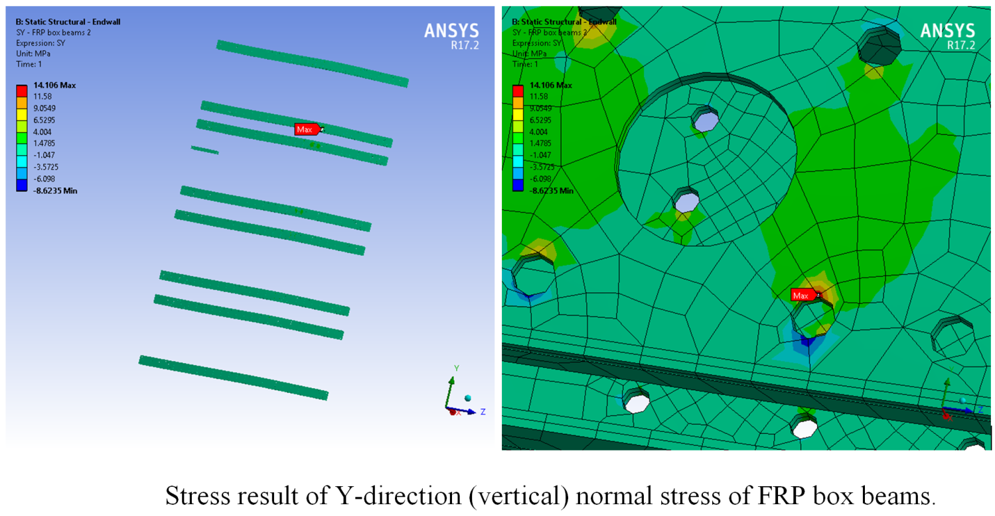
Worst case stresses for EW Panel FRP beam
FRP Box Beams | 2.4 m drift distance |  | 3.5 m drift distance |  | Strength limit (MPa) | Safety Factor
 | Lifting | Hanging | Lifting | Hanging
Max Principal Stress (MPa) | 16.024 | 15.824 | 12.801 | 12.83
Max Normal Stress _{X}(MPa) | 7.2618 | 6.5482 | 5.5261 | 5.7702 | 48.2 | 6.64
Max Normal Stress _{Y}(MPa) | 14.106 | 13.942 | 10.841 | 10.773 | 48.2 | 3.42
Max Normal Stress _{Z}(MPa) | 14.783 | 14.603 | 11.265 | 11.269 | 206.8 | 13.99

Slide 31
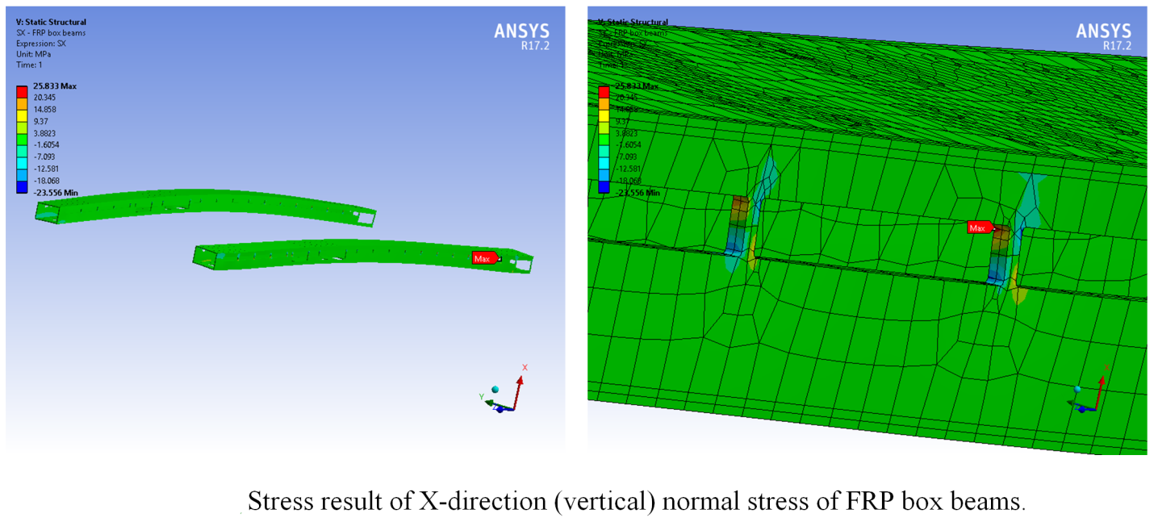
Worst case stresses for EW Panel FRP beam
FRP Box Beams | Max Equivalent Stress (MPa) | Max Principal Stress (MPa) | Max Normal Stress _{X}(MPa) | Max Normal Stress _{Y}(MPa) | Max Normal Stress _{Z}(MPa)
-0 degree | 29.769 | 25.721 | 24.29 | 3.7507 | 17.757
+0 degree | 29.36 | 26.659 | 25.833 | 4.9768 | 19.54
-30 degree | 27.226 | 23.277 | 21.989 | 3.5669 | 16.283
+30 degree | 24.956 | 22.77 | 22.05 | 3.8667 | 15.336
-45 degree | 23.093 | 19.604 | 18.524 | 3.4292 | 13.836
+45 degree | 20.096 | 18.403 | 17.811 | 3.0497 | 11.873
-60 degree | 17.388 | 14.595 | 13.796 | 3.1106 | 10.446
+60 degree | 13.867 | 12.781 | 12.358 | 2.1207 | 8.0202
Strength Limit (MPa) |  |  | 48.2 | 48.2 | 206.8
Safety Factor |  |  | 1.87 | 9.68 | 10.58

Slide 32
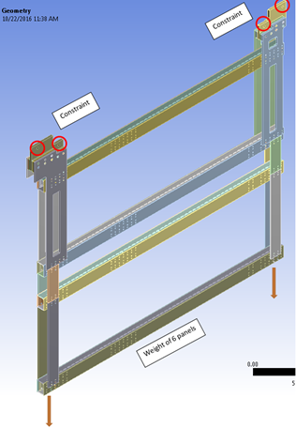
End Wall DUNE loading case
Design of End Wall for DUNE differs from End Wall for protoDUNE:
There will be a total of 8 panels in DUNE End Wall.
The drift distance will be decided and there will be no need to change the drift distance for DUNE. Hence, no structure is required in the middle for facilitating drift distance change.
The Top panel with hangers for DUNE with one baseline panel hanging from it was imported into ANSYS and weight of 6 baseline panels was applied to the model.

Slide 33
Worst case stresses

Slide 34
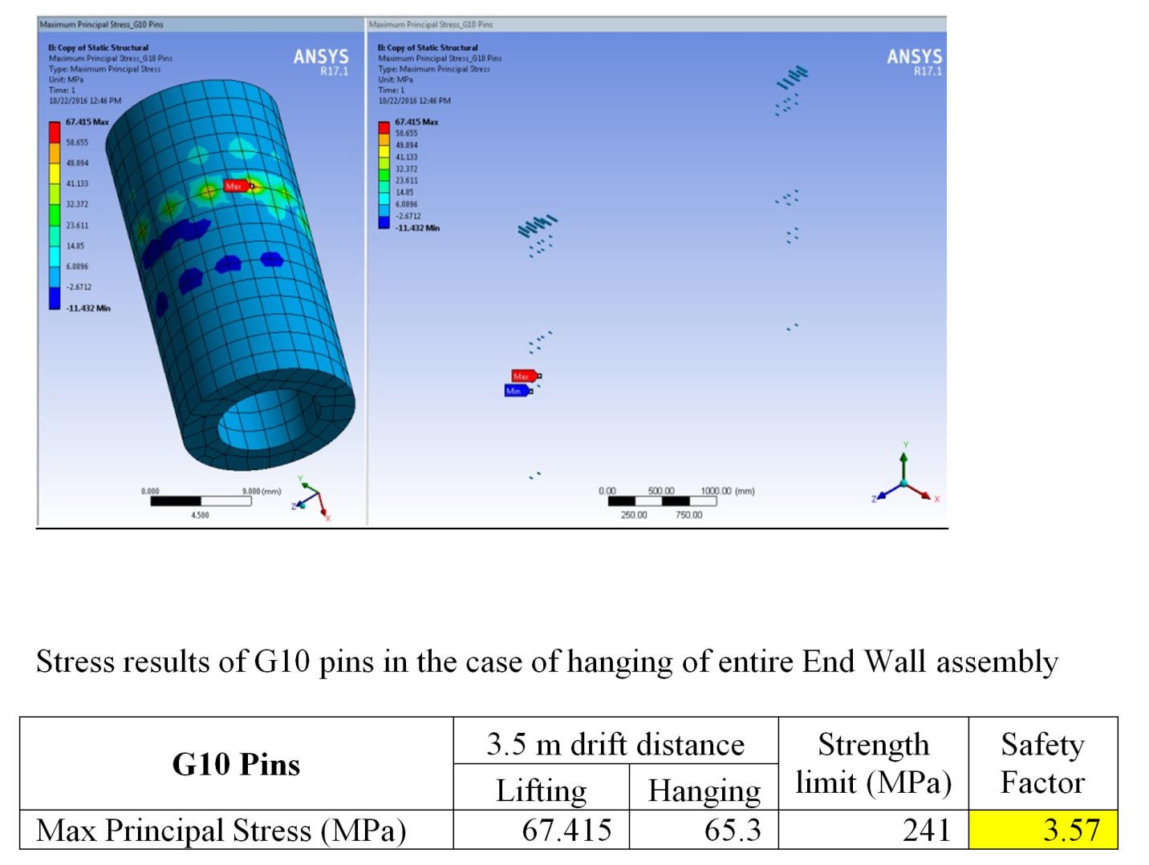
Worst case stresses

Slide 35
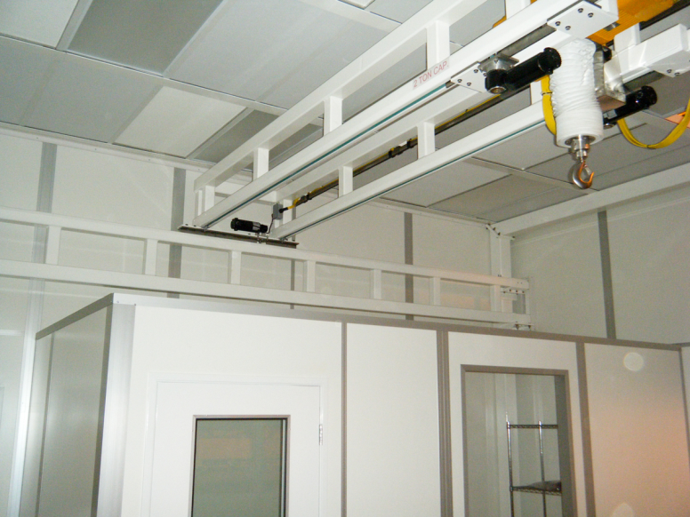
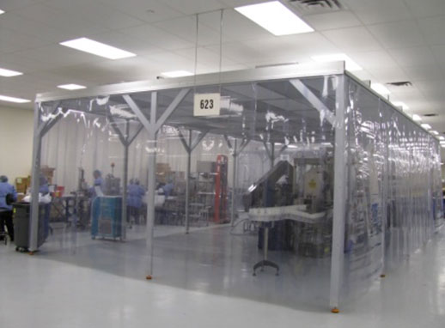
Clean Room for Assembly
Temporary clean enclosure:
A temporary clean enclosure can be constructed in respective facilities (SBU and LSU) for the construction of field cage modules.
The enclosure will be constructed from unistrut and transparent vinyl sheeting.
All the components will be cleaned before bringing in the cleanroom.
No machining/abrasive cleaning operation will occur inside the clean enclosure.
Shoe covers and gloves will be required to work before entry inside the cleanroom.

Slide 36
Ash River Installation Delivery
4 Top/Bottom Panels:
  2Panels with latest design (No splice joint and latest modifications)
  2 panels older version with stainless hardware just for mockup - Delivered
4 Endwall Panels - Delivered
  Top panel with hangers
  Panel with beam plug mockup.
  2 Regular End wall panels.
All panels are fully populated with field shaping profiles but the end caps may not be on all of them.

Slide 37
Shipment to CERN
Weights – Shipping boxes/crates will weigh between 250kg (for top/bottom) to 750kg (for end wall). Weight for Top and bottom panels after they are assembled with ground plane is 200kg.
FC Panel – FC Panels will be assembled in a clean environment and will be bagged before putting inside the shipping box.
Handling Instructions – A document with handling instructions will be provided to CERN beforehand. FC should be handled in accordance with that document at all times.
Traveler document – It will include data from testing that was done after the assembly and was approved. It’ll be included in each shipping box with individual panels. These documents will also be uploaded on EDMS or docdb as required by the project.
Special tools/components – Any special tools required for testing/assembly will be coordinated with CERN. If any tool/equipment required can’t be made available at CERN then it’ll be shipped from US.

Slide 38
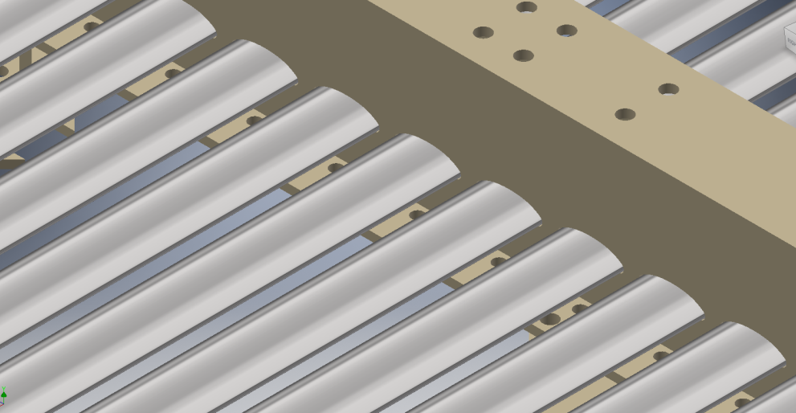
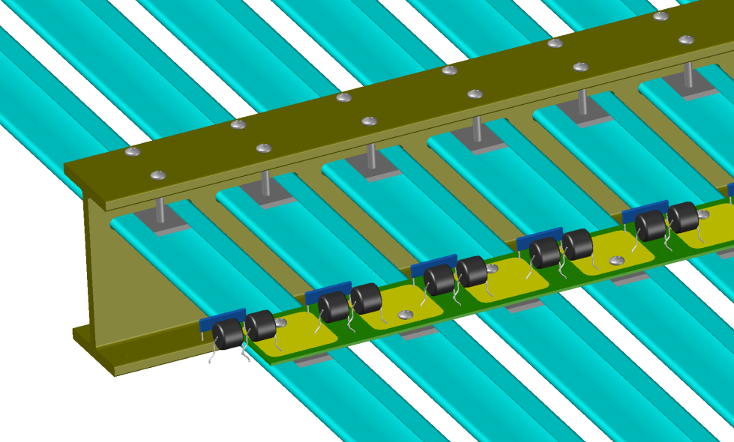
Acceptance at CERN
Visual Inspection of all the components will be performed. All profile surfaces will be inspected and in case of any dents and scratches the profiles will be replaced.
All the screw connections will be checked using a calibrated torque screw driver. These screws will be tightened to a low torque spec and can become loose due to vibrations during shipping. Retightening of screws may be required.

Slide 39
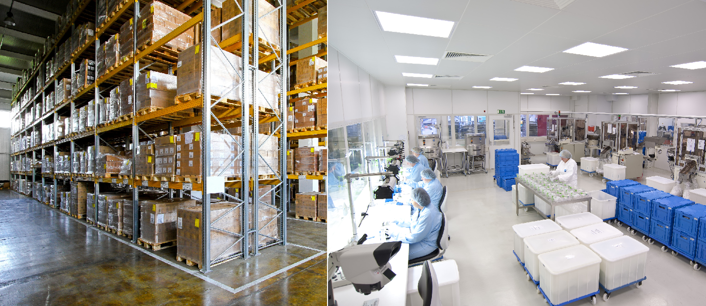
Acceptance at CERN
Depending upon where FC panels are stored, they may have to be bagged again and stored in the shipping boxes until installation.
Warehouse
Clean Room

