Slide 1
ProtoDUNE – Installation
CPA/FC/HV Review
Dan Wenman, Bill Miller
CPA/FC/HV Review
November 9, 2016

Slide 2
Outline
Introduction
  Overview of the plan
  Trial Assembly
Installation
  Cleanroom set up at CERN
  Overview
  Installation details
    South Drift
    North Drift

Slide 3
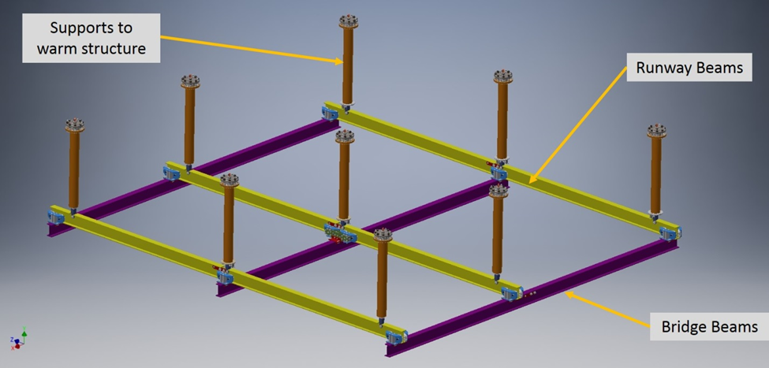
DSS delivers modular TPC subassemblies
The DSS rail system is mounted in the ceiling of the Cryostat
APAs, CPAs(with FCs), and EWs supported on trolleys and loaded onto bridge beams
The bridge beam translates modules to their final position
Allows for assembling the TPC in a tight space (and reconfiguring to 2.5m gap later)
Minimizes lifting in the cryostat

Slide 4
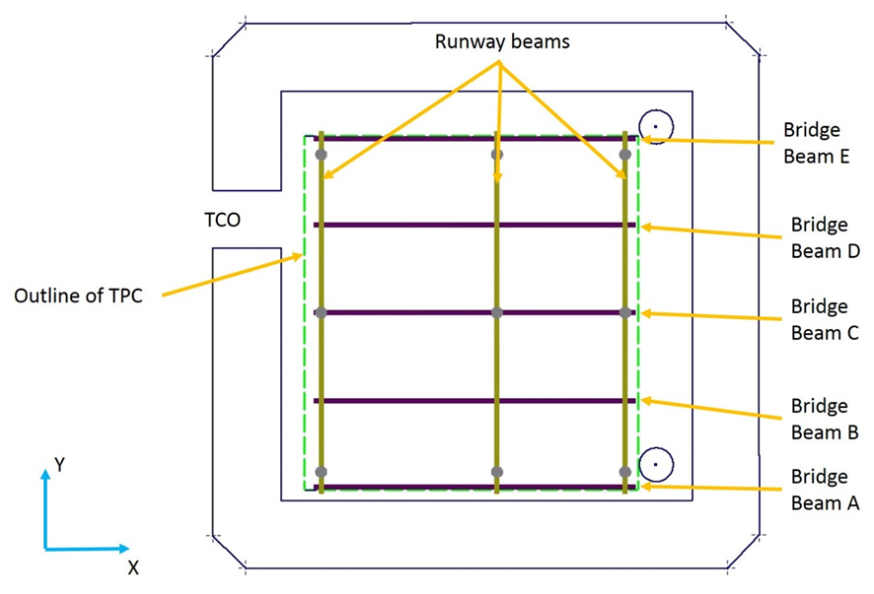
Overview
South Drift
  APAs delivered on Beam A
  EWs delivered on Beam B
  CPAs with FCs delivered on Beam C
  EW load transfer
  South Drift FCs are deployed
North Drift
  APAs stored on Beam E
  EWs stored on Beam D
  TCO is closed
  EW (TCO) is delivered
  APAs positioned
  EW (TCO) load transfer
  Last EW is delivered and transferred
  North Drift FCs are deployed
North
Top View of the cryostat

Slide 5
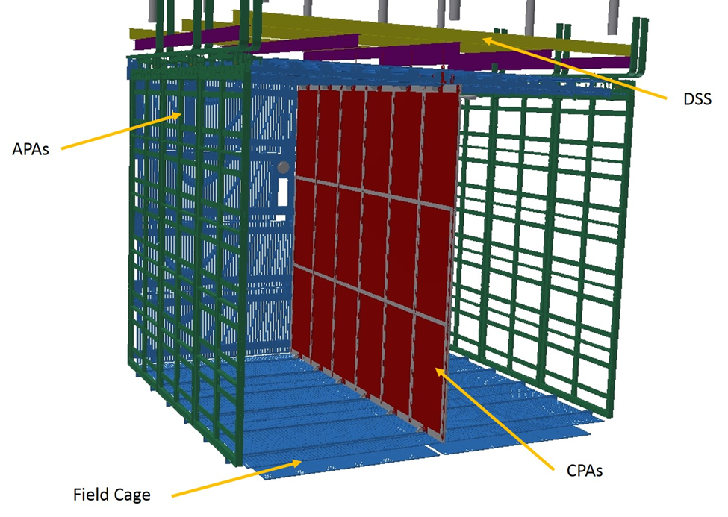
Access requirements
Modular TPC subassemblies minimize the work that needs to be done at height in the cryostat
Access to the top of the TPC is needed for fixing APAs and CPAs, APA cabling, FC deployment and final FC connections.
Access equipment will be provided by CERN
Endwalls (EW)

Slide 6
Trial Assembly at Ash River
The mechanical trial assembly is underway at the NOvA Far Detector Lab in Ash River Minnesota
Detailed Procedure and Hazard Analysis documents are being written as the assembly process is being fine tuned.
Changes to installation tooling and fixtures and access required will be made during this process
The baseline plan is to assemble the CPA plane in the cleanroom adjacent to the cryostat. A second option of assembling under the building crane and then transferring to the cleanroom is being considered.
CPA and Field cage being assembled.

Slide 7
Clean Room
APAs, End Wall and CPA/FC assembly happens in the cleanroom where you have easy access via scissor lift

Slide 8
Clean Room Rail System
SAS
A rail system is used to move TPC components, delivered through the SAS (Sanitary Access) roof, through the cleanroom

Slide 9
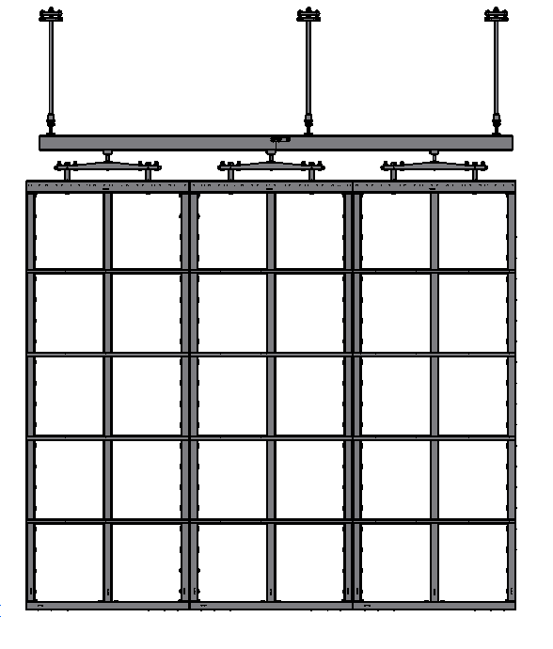
South Drift APAs
An APA first has it’s Photon Detectors installed, then it’s cold electronics and cables are installed.
It then spends a minimum of 1 week in the cold box where it is given a complete system test
Cables are bundled above each APA on a temporary cable tray and it is rolled through the TCO and loaded on Beam A
Once all 3 APAs are loaded, Beam A is translated into final position
Delivery trolleys not shown

Slide 10
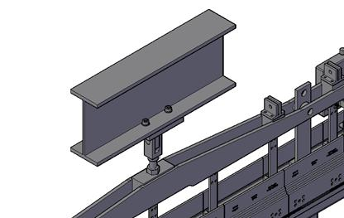
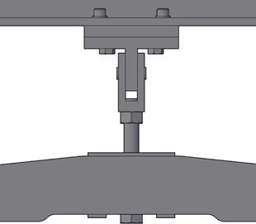
APA support
Trolley location
Nut Plate
Pivot Bracket
APA support
The APA is delivered on two trolleys to its mount point
The single permanent connection is made by connecting the mounting bracket to a nut plate
The load is transferred by adjusting the APA support

Slide 11
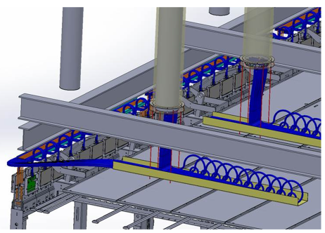
APA cabling
Once the APA has been mounted to Bridge Beam A the cables are removed from the temporary APA cable tray
The cable bundle is then routed to the strain relief and up the feed-thru
Cabling (FC and GP would not be present during cabling)

Slide 12
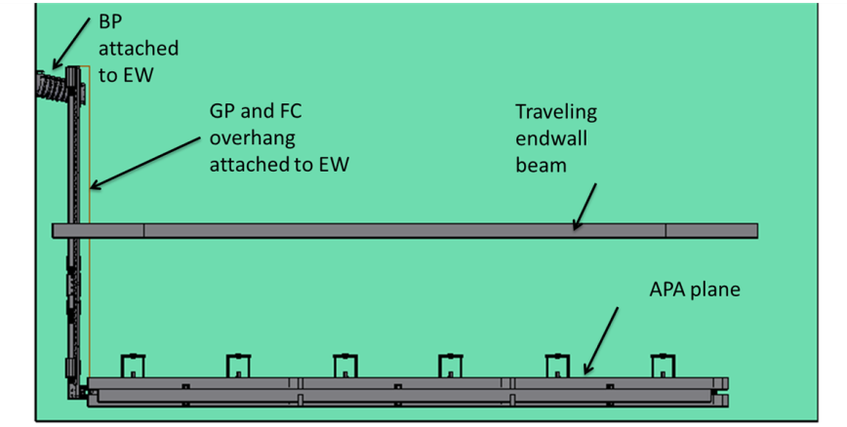
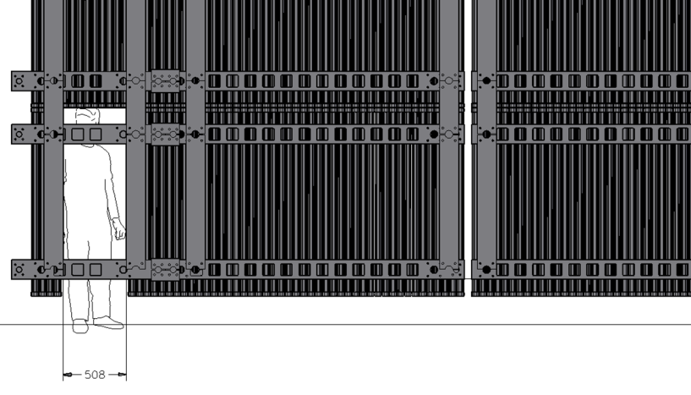
South Drift EWs
Beam plug is pre-mounted to the “west” EW
Some profiles are omitted in the “east” EW to provide access/doorway

Slide 13
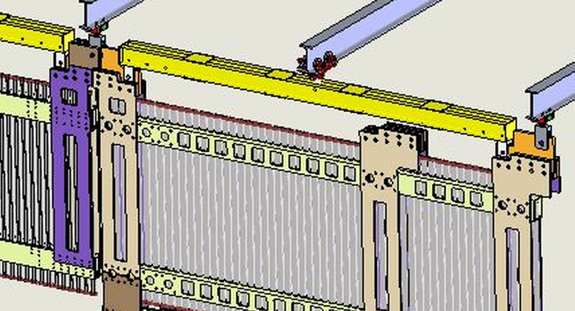
Delivering the EW’s
Trolley
Beam B
Low profile beam
Shared support
The end wall is delivered on beam B.
After the CPA is positioned, its load is transferred to 2 permanent support points on each end.
The north drift EW shares the support point with the south drift.

Slide 14
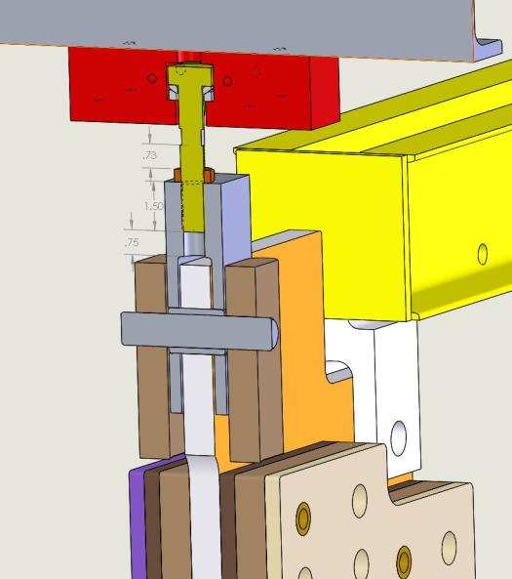
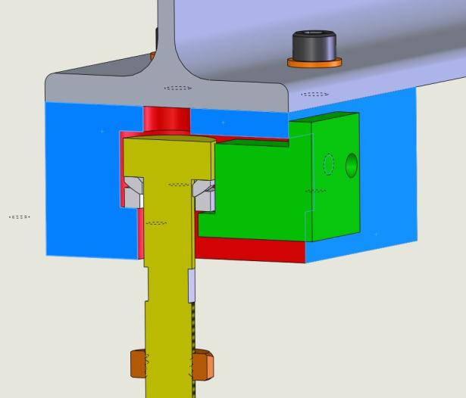
Mounting the EW’s
EW support
Supporting clevis
Spherical washers
sleeve
pin
Flats
EW support
EW support with spherical joint
Shared EW connection
The south drift EW is connected to the supporting clevis using a sleeve
The EW support is then adjusted to pickup the load.
When the north drift EW is delivered it is connected to the same clevis with a pin

Slide 15
CPA Assembly
A CPA plane arrives at CERN in 3 modules that must be bolted and pinned together on a flat table.
As many module-to-module electrical connections, HV cables and field shaping strips are installed as possible
A pair of CPA planes are hung on the rail system and joined together
Four FC units are mounted to the CPA assembly

Slide 16
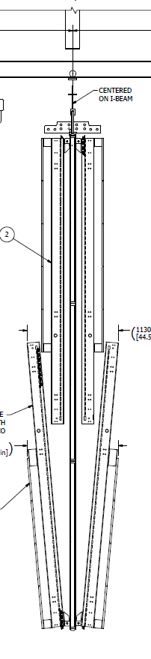
CPA and FC
Once the CPA with FC assembly is completed it is rolled thru the TCO and loaded in its final position on Beam C
Three pairs may be rolled into final position as unit to allow for electrical connections to be made and tested via scissor lift
Some profiles on the APA end are omitted to allow for lowering of the FC.
Some ground plane and latch hardware will have to be installed after passing through the TCO
Fourth GP is omitted
Edge view of CPA with FC’s

Slide 17
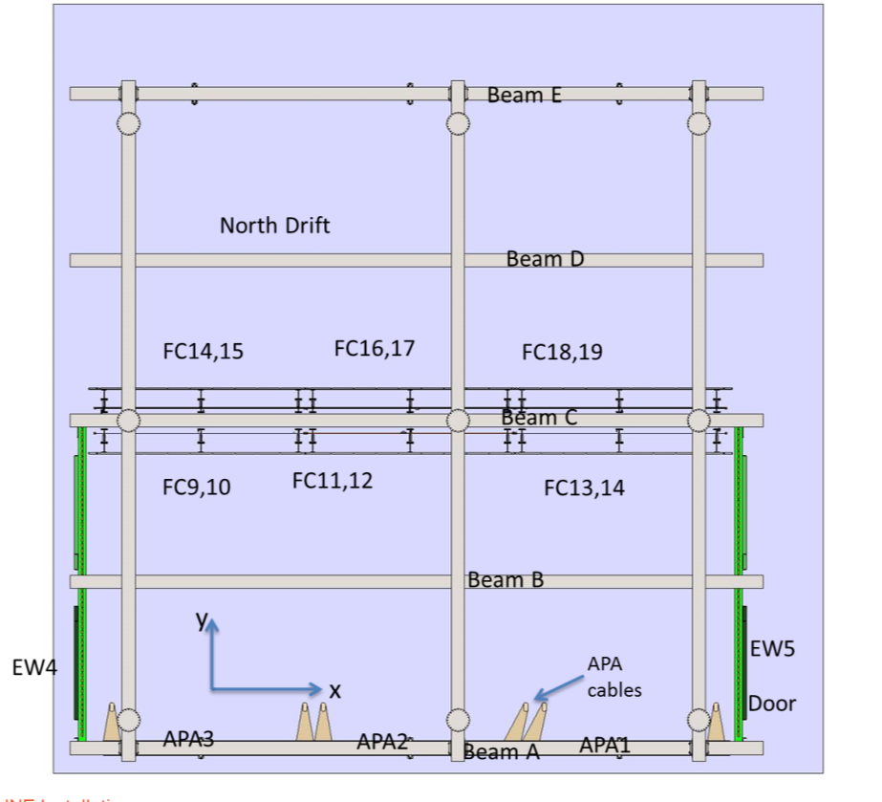
CPA and FC
Beam C is translated into final position

Slide 18
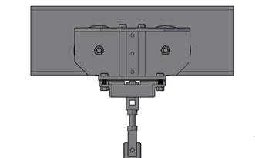
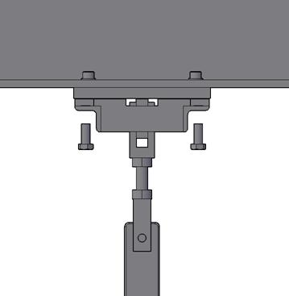
CPA load is transferred to Beam C
Trolley removed for clarity
Nut plate
Angle –part of trolley
Pivot/mount bracket
CPA support
The CPA is delivered on one trolley that is connected to the its single support point
The pivot mount bracket is in the load path between the trolley and the CPA support.
There is clearance between the nut plate and the pivot mount
Bolting the pivot mount to the nut plate lifts the CPA and takes the load off the trolley.
The trolley halves could be removed at this time if desired.

Slide 19
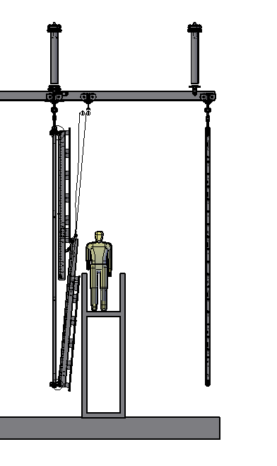
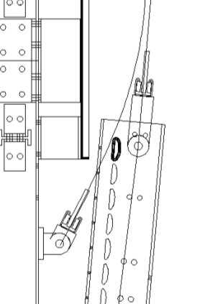
Preparing to lower FC
FCs are deployed starting on the beam plug side, alternating bottom then top.
Two sets of lifting hardware is used. One is connected to the bottom FC and one to the top.

Slide 20
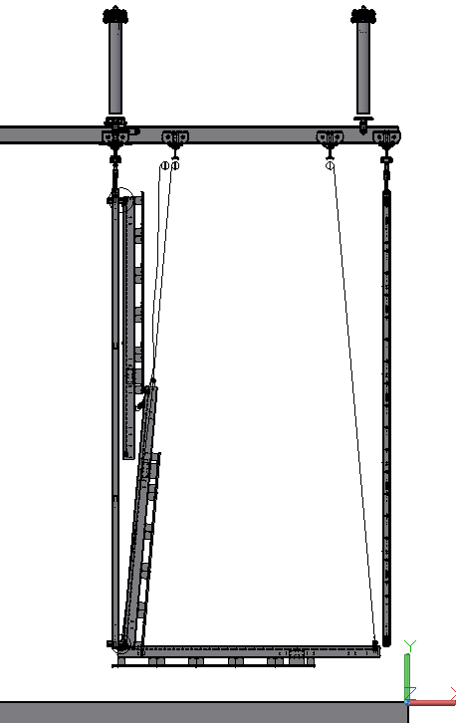
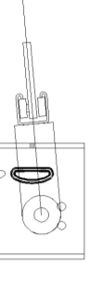
Lowering the FC
The bottom FC is lowered and automatically latched.
Lifting gear is removed from the bottom FC with access from the top of the FC
Profile would be omitted for lowering

Slide 21
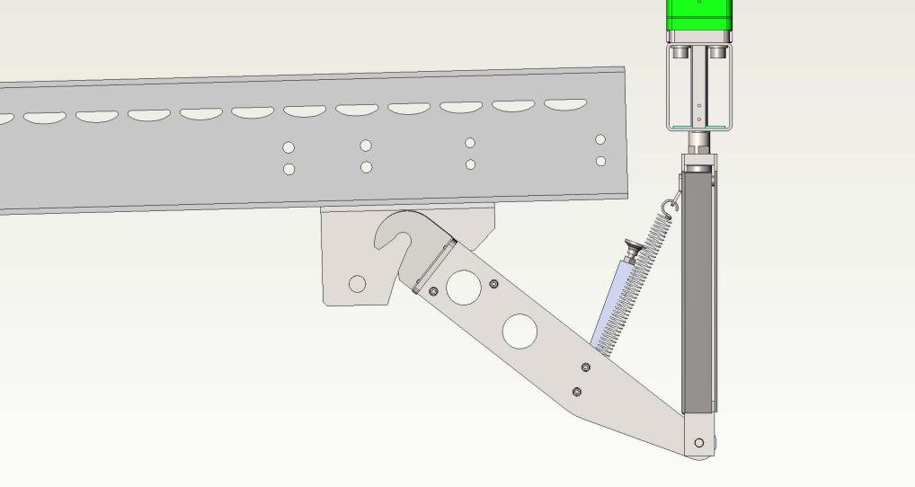
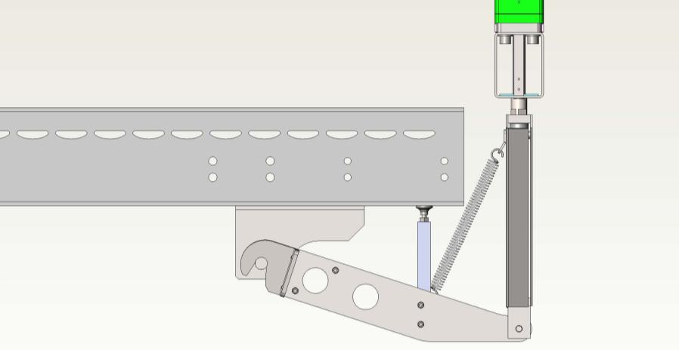
Automatic bottom latch
Initial engagement
Fully engaged

Slide 22
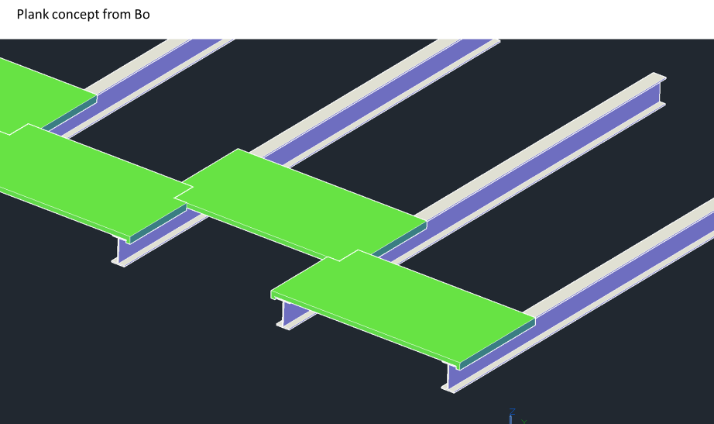
Planks for access to the field cage
Planks provide temporary surface for access
FC beams are supported from below on feet
Planks for access

Slide 23
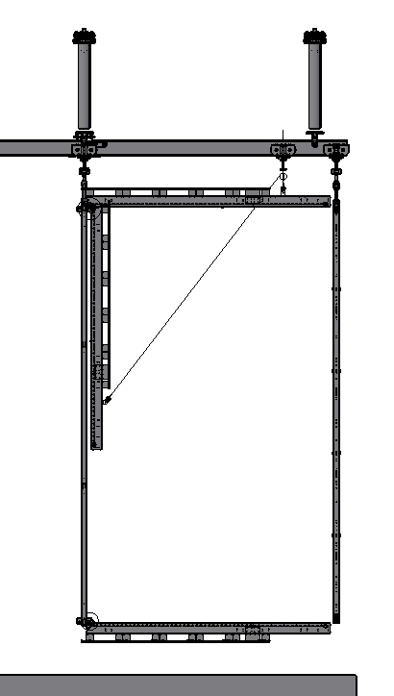
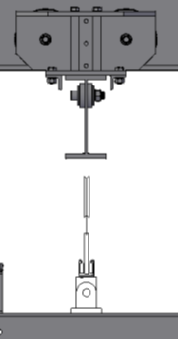
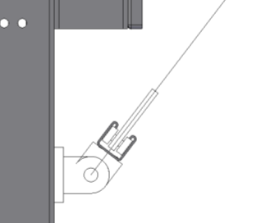
Lifting the top FC
The top FC is lifted into position, manually latched
Repeat for the 2nd pair and 3rd pair of FC
  Note: After the lifting gear is connected on the third pair of FCs, the access equipment is disassembled and removed through the access door and from above the EW
Half length profiles are installed and spliced to fill in the EW doorway.

Slide 24
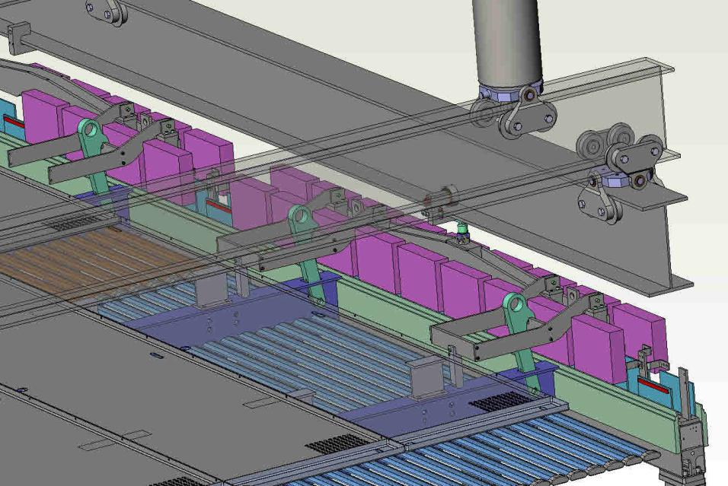
Top Latch
Latch brace reacts latching forces
After FC is lifted slightly higher than final position and the latch is manually engaged.
304 SS latch striker assembly. Mounts to the top of the APA support hanger.
Mechanical stop constrains rotation

Slide 25
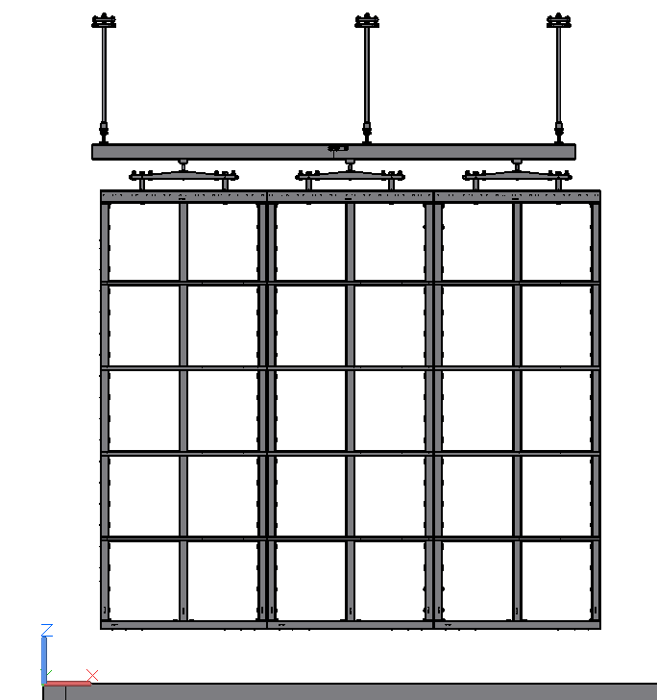
North Drift APAs
APAs are loaded on to Beam E in storage position (300mmfurther “east” on beam)
Beam E is translated into final position
APA cables are routed
300 mm
APA storage location

Slide 26
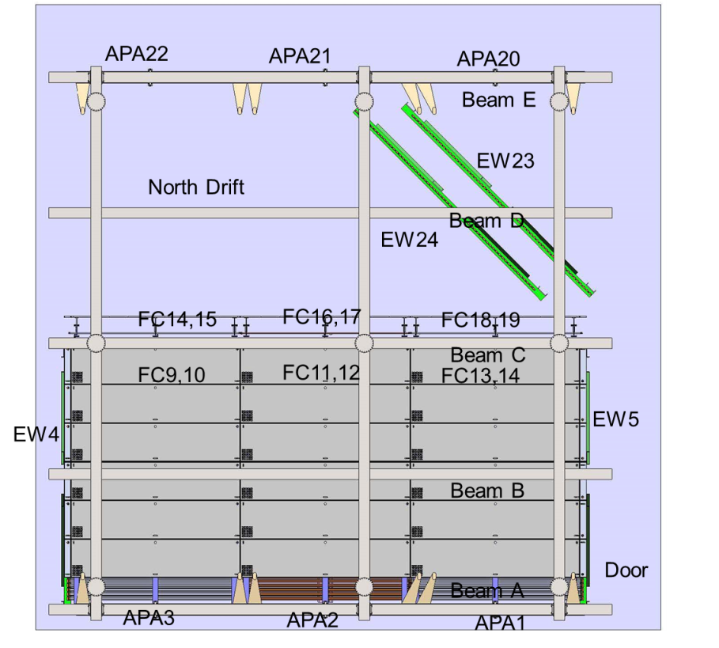
North Drift EWs – Step1
North Drift EWs are loaded onto Beam B
Some profiles are missing in the “east” EW to provide access/doorway
EWs are delivered to the storage position
EW maybe positioned to protect the APA plane
TCO is closed

Slide 27
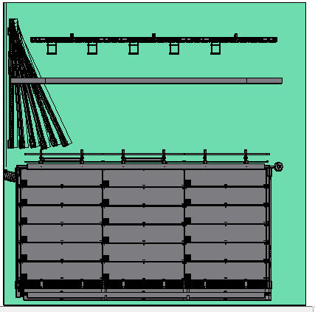
North Drift APAs & EWs – Step 2
EW on the TCO side is moved into final position
North Drift APAs are moved into final position
APAs load is transferred to the single support.
EW load is transferred to Beams C and E
The second EW is delivered and connected
APA plane is shifted east ~300 mm. Cables routed to the feedthroughs must allow for this.
APA plane
Beam D
Figure needs update

Slide 28
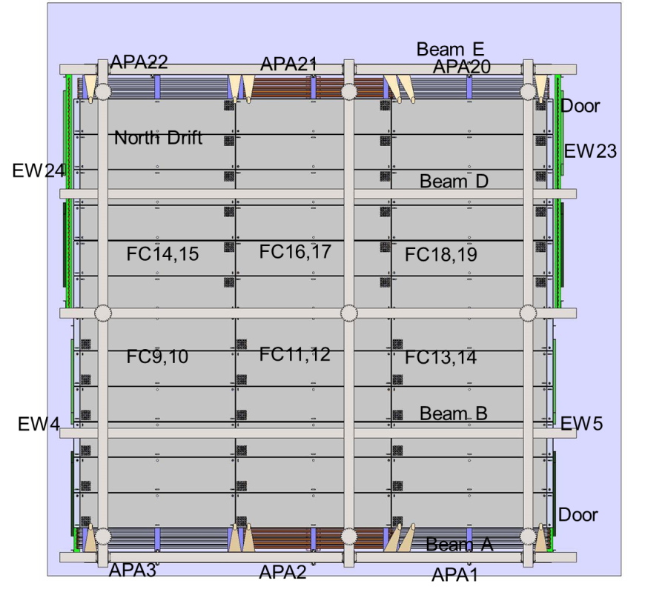
North Drift FC deployment
Steps are the same as the North drift

Slide 29
Back up slides

Slide 30
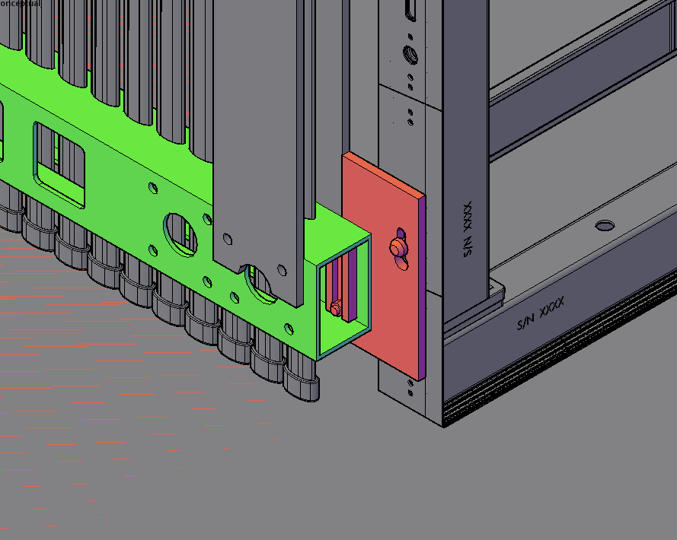

Slide 31
