Slide 1
Few Remarks on Impact of Impurities in WA105
Thorsten Lux

Slide 2
Introduction
Motivation: The discussion about the impurities focused a short attenuation length for primary scintillation light but in fact the impurities might have impact on the detector performance beyond S1 attenuation.
2 important questions to be answered:
What is the nature of the impurities? Which type of elements/molecules? Which quantity of each type of impurity?
What is the effect on the charge readout? (To my knowledge ArDM Run I does not run with charge readout)

Slide 3
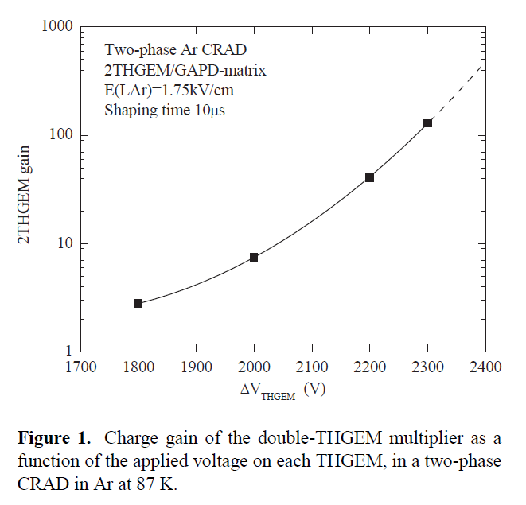
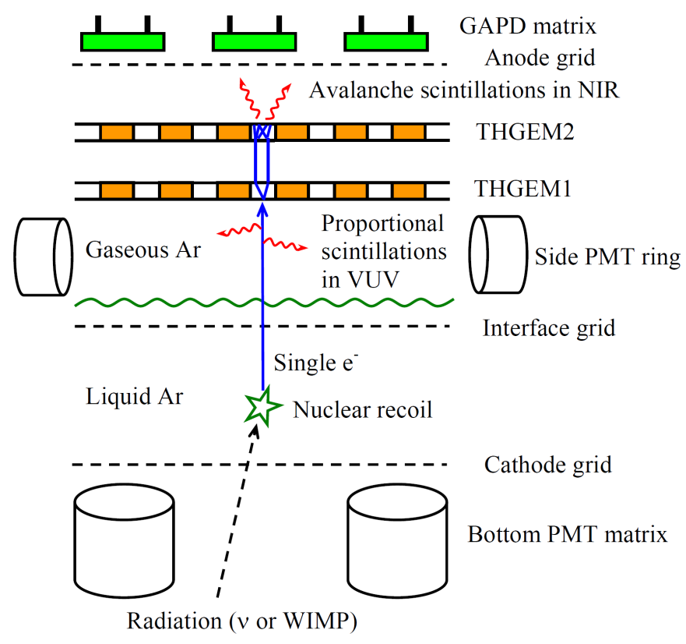
Impact on Gas Gain
fraction of the impurities will end up in gas phase
Russian group presented DP results with impurities at MPGD 2015
other groups reported even higher gains with THGEMs
significant increase of gas gain seem to be possible
But this means also more ions drifting back from LEM!
electrons
GAr
ions
?
LAr

Slide 4
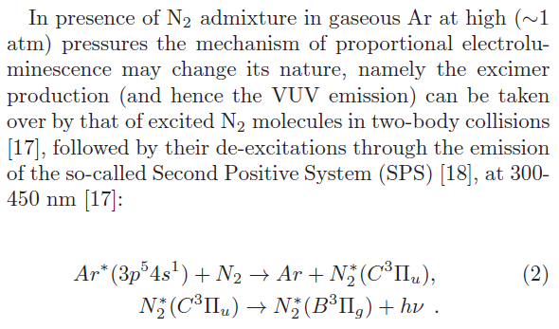
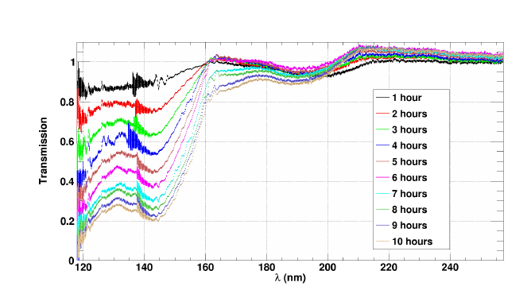
Impact on S2 Signal
studied also impact on S2 signal
much higher S2 yield as expected from literature
higher charge gain goes with higher S2 gain
real problem: impurity might change wavelength e.g. N2 impurity shifts light to 300 – 450 nm
shifted wavelength depends on type of impurity
Ar highly transparent above 160 nm
=> S1/S2 separation might in fact get worse
T. Takahashi et al., NIM 205 (1983) 591:

Slide 5
Impact on Attachment
The statement in Technical Board Meeting a month ago was:
The purification system removes efficiently electronegative impurities so that this will not be a problem!
The problem is that rate of attachment does not depend only on amount of electronegative impurities but also on the gas composition as a whole!
E.g. attachment process to O2:
e + O2 -> O2⁻ * (instable exited ion)
O2^{-*} + X -> O2- + X (stable ion)
X: atom/molecule in the gas

Slide 6
Impact on Attachment
The rate A of this process can be described by a simple factorization:
P(X),P(O2): partial pressures of the different gas components
C(X,O2): attachment coefficient
C(X,O2) depends strongly on the type of element/molecule e.g. C(Ar/Xe, O2) = 0 but large for CO2, iC4H10, H20, …
Thumb rule: The more complex it is/the more vibration and rotation energy levels it has, the higher is its attachment coefficient!
Depending on the type of impurity, the attachment rate is different even for the same amount of electronegative gases as O2!
Having a large S1 attenuation should worry us also in respect of charge attachment!

Slide 7
Summary
The short light attenuation length observed in ArDM Run I might indicate impact on the WA105 performance going beyond the light attenuation:
significant increase of maximal gas gain seem to be possible!
But this means also more ions drifting back from LEM!
S1/S2 separation might in fact get worse due to S2 wavelength shifting!
Depending on the type of impurity, the attachment rate is different even for the same amount of electronegative gases as O2!
The answers to the following questions might help us:
What is the nature of the impurities? Which type of elements/molecules? Which quantity of each type of impurity?
What is the effect on the charge readout? (To my knowledge ArDM Run I does not run with charge readout)
Thinking that we could solve the light attenuation problem simply by increasing the photo detection efficiency might be too simplistic!

