Slide 1
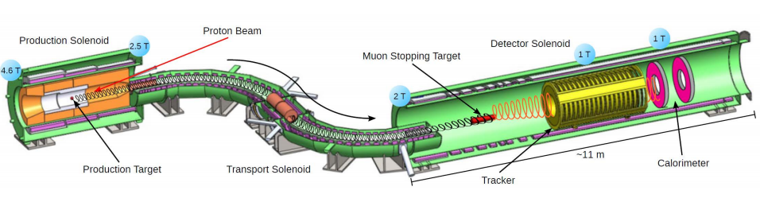
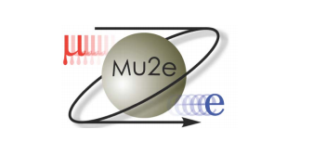
The Mu2e Experiment
Dan Ambrose
University of Minnesota
June 8, 2017

Slide 2
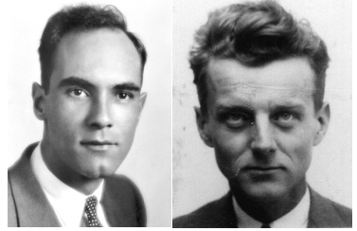
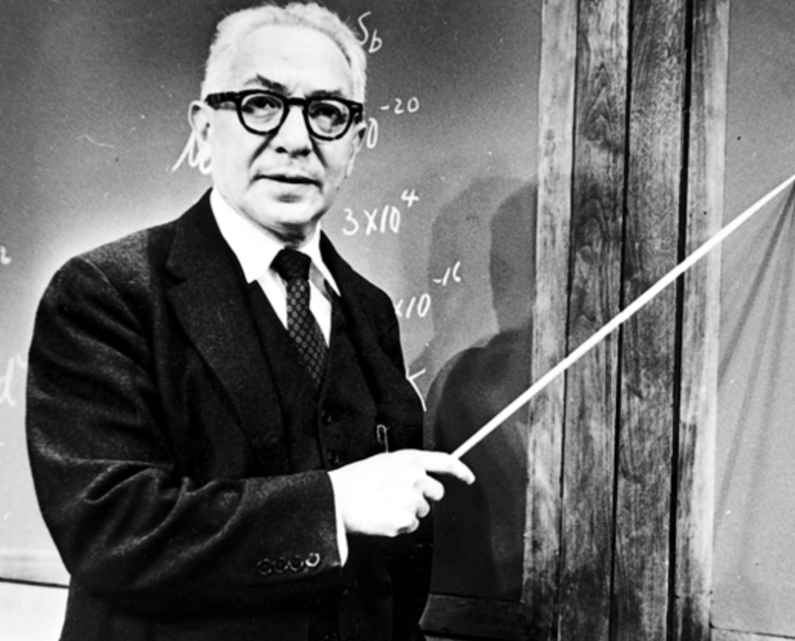
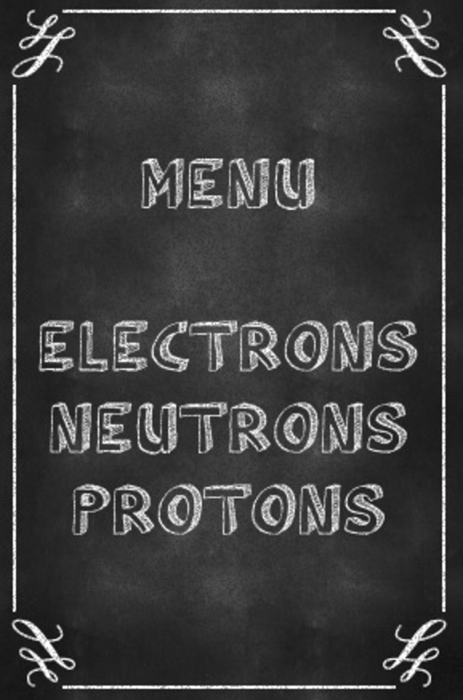
What’s up with the Muon?
1936: Anderson and Neddermeyer discover the muon surprising almost everyone with a second generation of matter.
Many mysteries still surrounded the muon:
Anomalous magnetic dipole moment deviation from theory > 3σ
Quarks mix and Neutrinos mix. Shouldn’t we expect charged Leptons to mix?
Mu2e Collaboration, November 2013

Slide 3
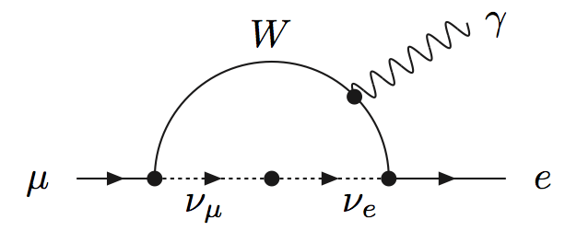
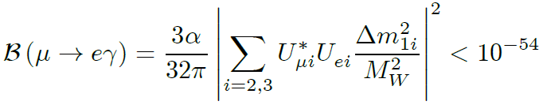
Charge Lepton Flavor Violation (CLFV)
With neutrino mass, we know that lepton flavor is not conserved.
The SM CLFV process would be :
*Physically unobservable
Any observation of CLFV must be new physics!

Slide 4
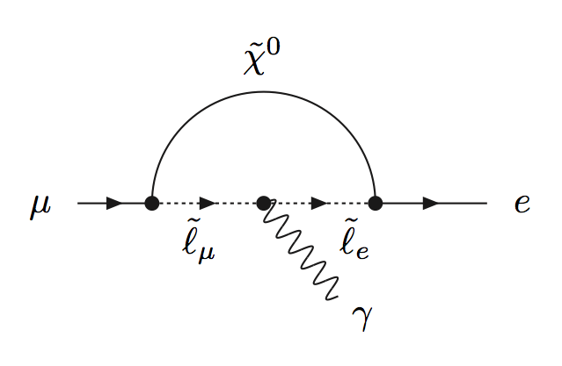
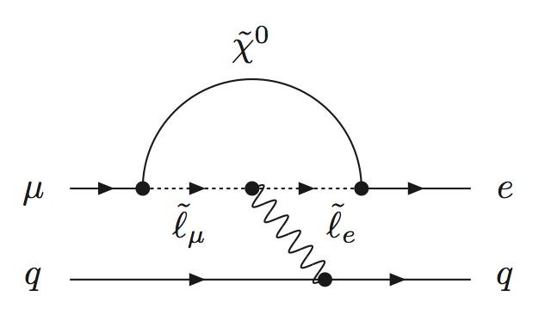


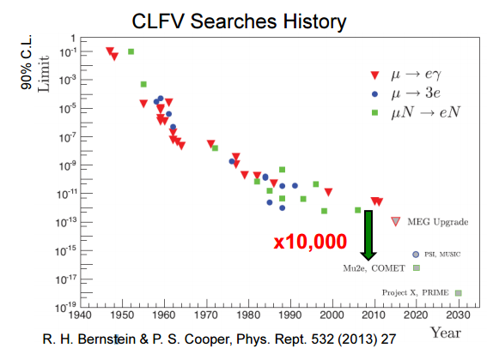




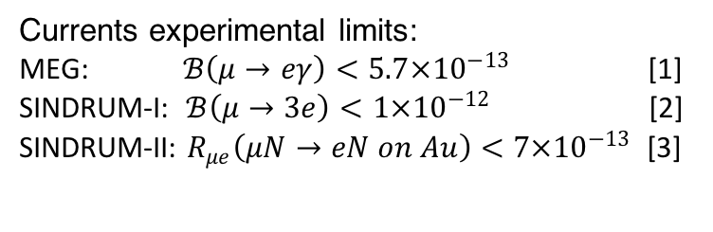
Searching for CLFV
$$μ→eγ$$
$$μ→eee$$
$$μN→eN$$
$$\overline{e}$$
Currents experimental limits:
MEG: $ℬ\left(μ→eγ\right)<5.7×{10}^{−13}$ [1]
SINDRUM-I: $ℬ\left(μ→3e\right)<1×{10}^{−12}$ [2]
SINDRUM-II: $R_{μe}\left(μN→eN on Au\right)<7×{10}^{−13}$ [3]
Mu2e will increase precision by an incredible 4 orders of magnitude.
Fully operational Mu2e would be able to beat the current world best measurement with 1 hour of data.
[1]PRL 110, 201801 (2013)
  [2]Nucl. Phys., B 299, 1 (1988)
[3]EPJ C 47, 337 (2006)

Slide 5
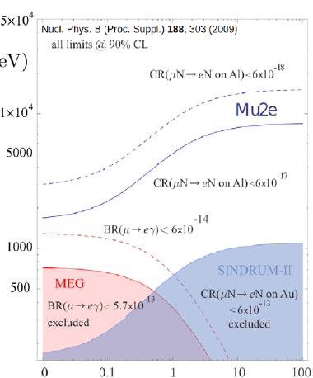
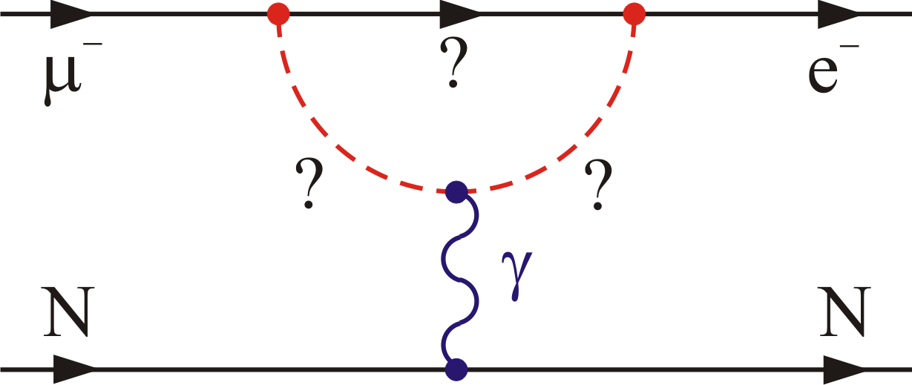
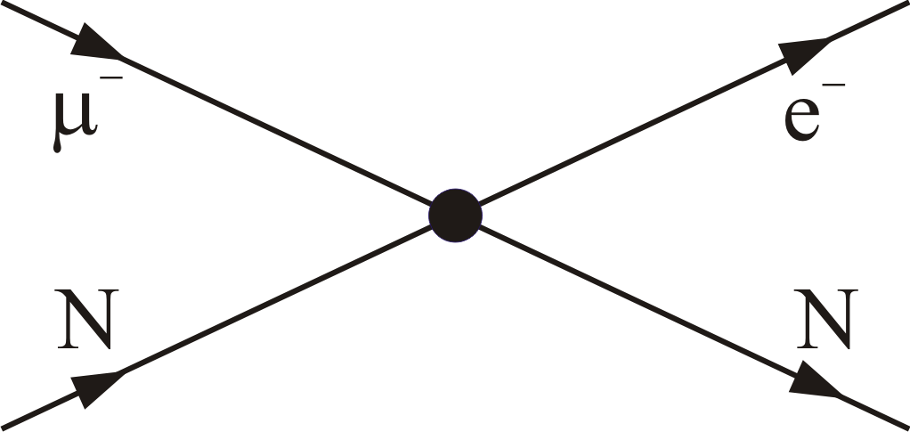
Sensitivity to High Mass Scales
Loops dominate for κ << 1
Contact terms dominate for κ >> 1
Λ (TeV)
μ→eγ
μ→eγ
μN→eN
μN→eN
μ→eee
μ→eee
Mu2e Collaboration, November 2013
κ

Slide 6
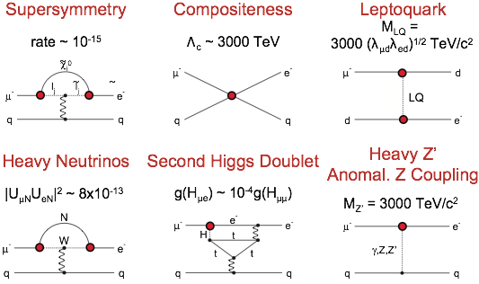

Sensitive to many models
Mu2e will probe:
Rate > 10⁻¹⁷
$Λ_{c}$between 2000 to 7000 TeV
Estimates from Flavour Physics of Leptons and Dipole Moments, Eur.Phys.J.C57:13-182,2008

Slide 7
Mu2e’s Concept
Generate a beam of low momentum muons (μ⁻)
Stop the muons in an Aluminum target
The stopped muons are trapped in orbit around the nucleus
Look for events consistent with μN→eN
We measure :
Numerator:
  Muon to electron conversion in the presence of a nucleolus
Denominator:
  Nuclear captures of muonic Al atoms
Mu2e Collaboration, November 2013

Slide 8
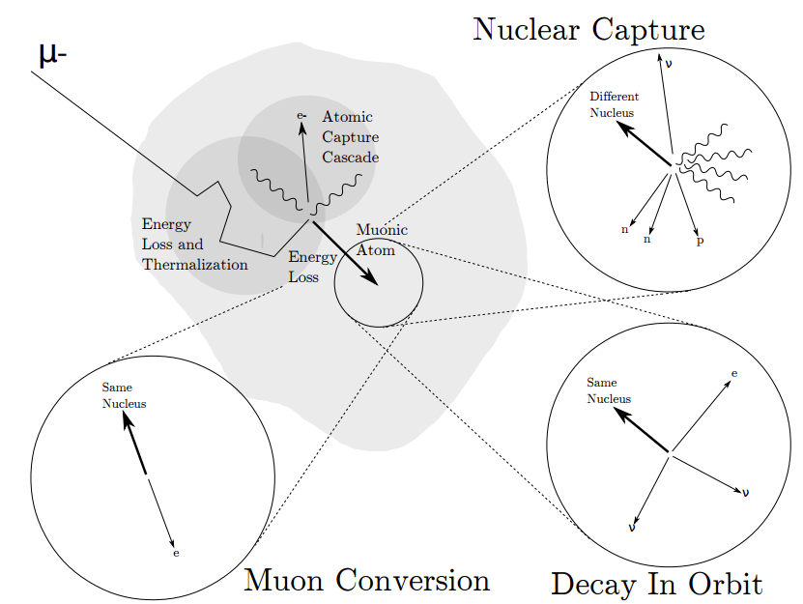

Creating and Decaying Muonic Atom
61%
<7x10⁻¹³
39%
Mu2e Collaboration, November 2013
*Image from talk by Kevin Lynch
Decay in Orbit(DIO)

Slide 9
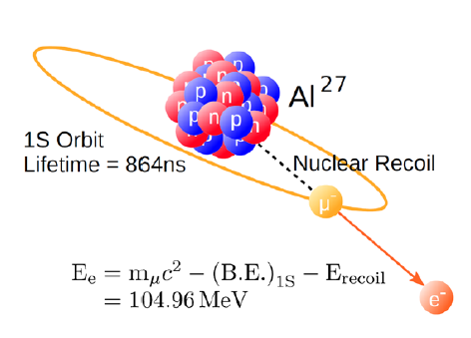
Experimental Signature
When captured by a nucleus, a muon will have an enhanced probability of exchanging a virtual particle with the nucleus.
This reaction recoils against the entire nucleus, producing a mono-energetic electron carrying most of the muon rest energy.
Mu2e Collaboration, November 2013

Slide 10
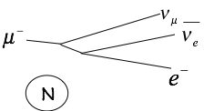
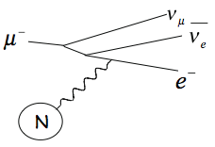
Comparing DIO to conversion electrons
Free muon decay
M_{μ}
DIO shape
DIO tail
M_{μ} / 2
M_{μ}
Reconstructed Momentum (MeV)

Slide 11
Experimental effects on
DIO to conversion electrons
Tail of DIO falls as (E_{Endpoint} – E_{e})⁵
Separation of ~few 100 keV for R_{μe} = 10⁻¹⁶
Experimental effects
Czarnecki, Tormo, Marciano
Phys.Rev. D84 (2011) 013006

Slide 12
How do we measure 2.4×10⁻¹⁷ ?
Stop 10¹⁸ Muons in Aluminum stopping target
Momentum resolution σ < 180 keV/c
Reduce expected background to less than half an event over full run period.
Tall tasks, but the accelerator and Mu2e have been designed to accomplish this.

Slide 13
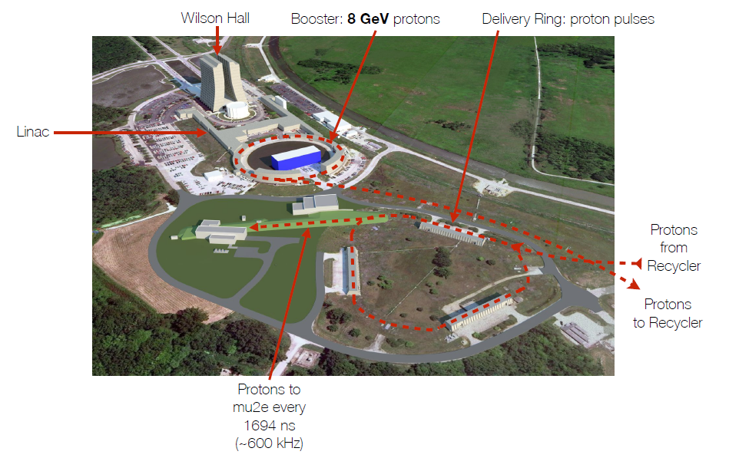
Proton’s Path
3.6x10²⁰ total protons on target
3.1x10⁷ protons per bunch
Share the beam with NOvA and g-2

Slide 14
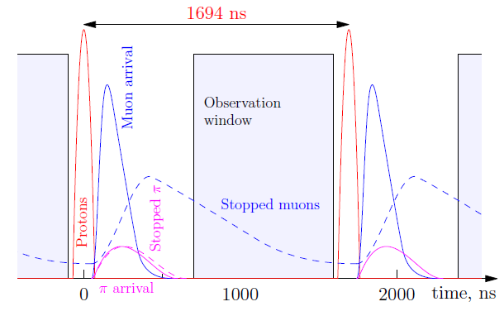
Beam Time
~20,000 muons per bunch
10¹⁰ muons per second
Almost all protons, unstopped muons, stopped and unstopped pions will be through the detector before observation window.
Mu2e Collaboration, November 2013

Slide 15
The Mu2e Experiment
Production Solenoid
Detector Solenoid
Transport Solenoid
25 m
3 main components: Production Solenoid (PS), Transport Solenoid (TS), and Detector Solenoid (DS)
Experimental setup contained within vacuum space
Gradient magnetic field (4.6 T → 1 T) moves charged particles downstream
Step 1:
  8 GeV proton beam hits tungsten target and produces Pions in PS
  Pions decaying into muons are pushed downstream towards TS
Step 2:
  TS selects particles based on charge and momentum
  TS collimators eliminate backgrounds
Step 3:
  Muons are captured in Aluminum target foils
  Conversion electron trajectories measured and validated in tracker and calorimeter

Slide 16
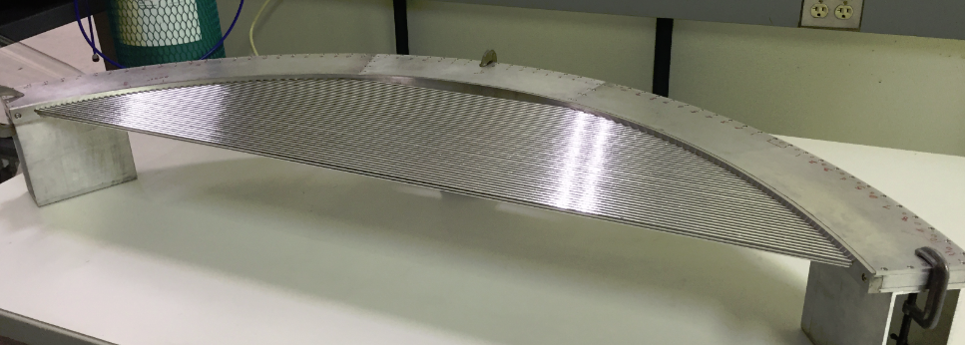
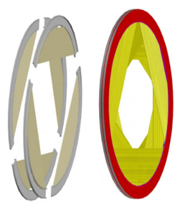
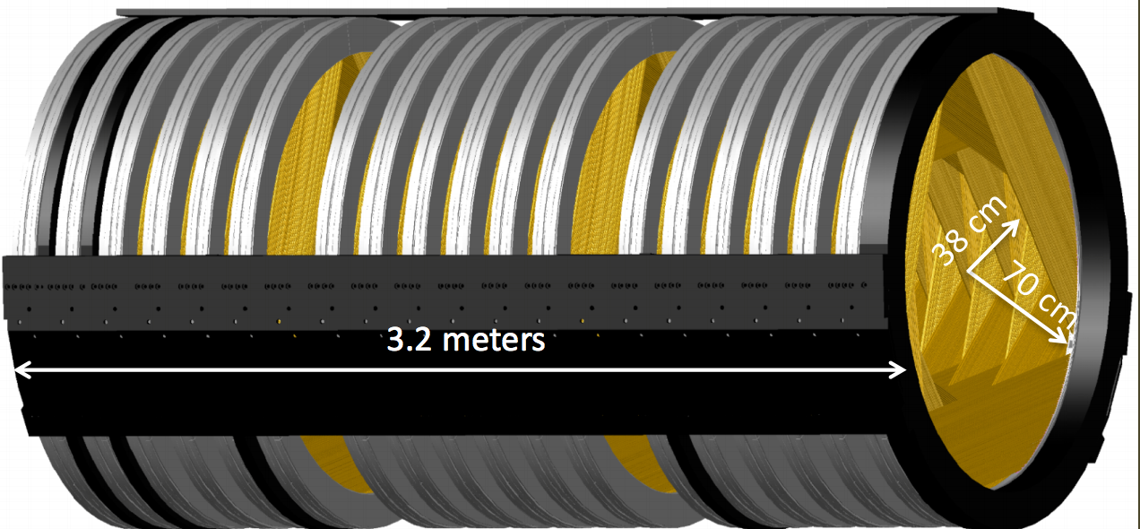
Low Mass Tracker Design
Excellent momentum resolution better than 180 KeV/c
15 micron thick Mylar straws provide for a very low mass detector
Mu2e Collaboration, November 2013

Slide 17
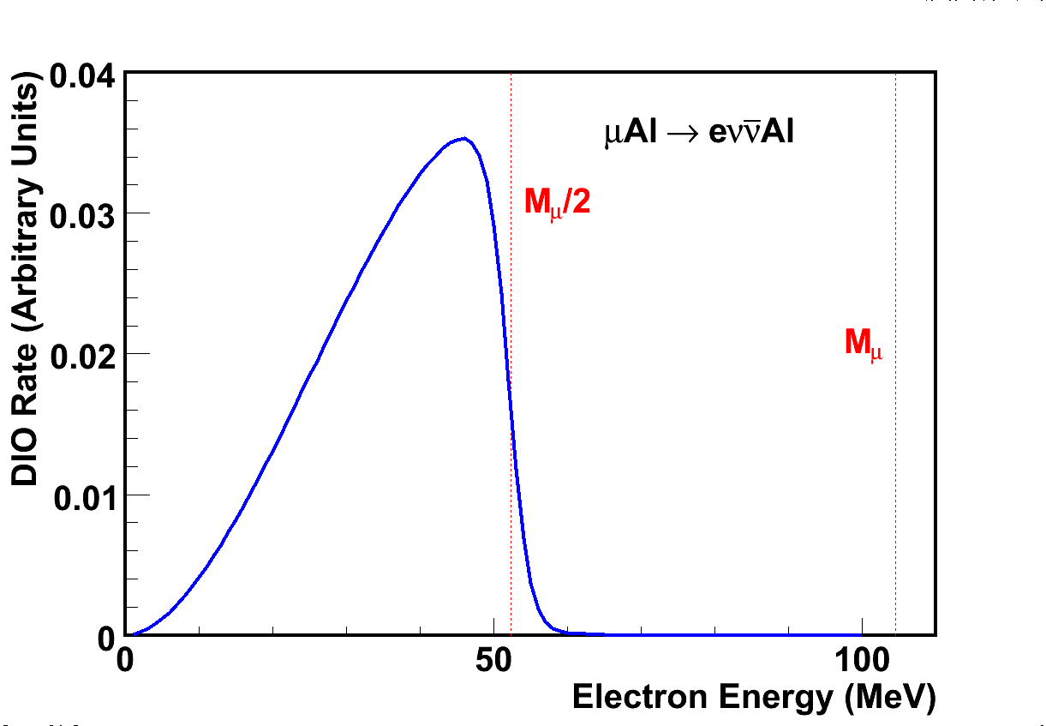
There’s a hole in your detectors
No hits in detector
Some hits in detector.
Tracks not reconstructable.
Beam’s-eye view of Tracker
Reconstructable tracks
Momentum resolution σ < 180 keV/c
Mu2e Collaboration, November 2013

Slide 18
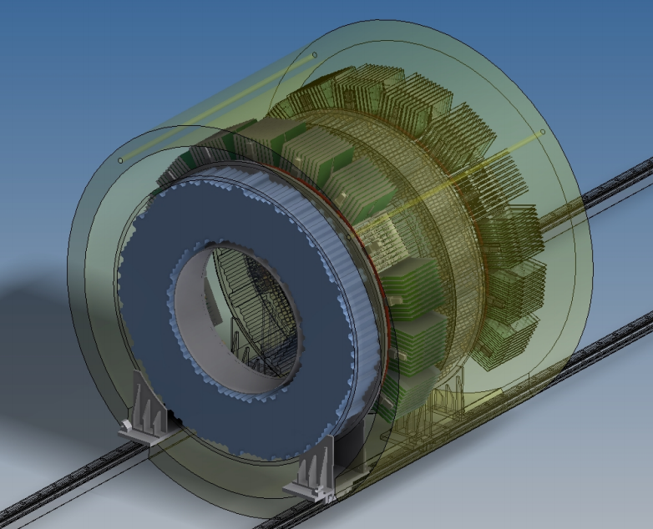
Calorimeter
Will employ 2 disks ( radius = 37-66 cm)
~1400 CsI crystals with square cross-section – ~3 cm diameter, ~20 cm long (10 X0)
Two photo-sensors/crystal on back (MPPCs)
Mu2e Collaboration, November 2013

Slide 19
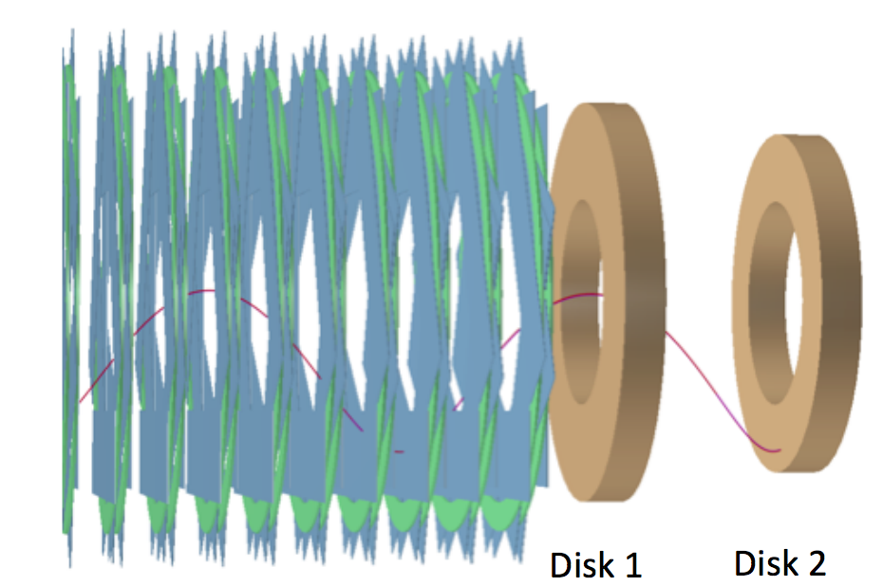
Calorimeter
Radiation hard, good time (110 ps) and energy (5%) resolution
Provides precise timing, PID, seed for tracking and triggering
Muon rejection factor of 200 with 96% electron efficiency
Mu2e Collaboration, November 2013

Slide 20
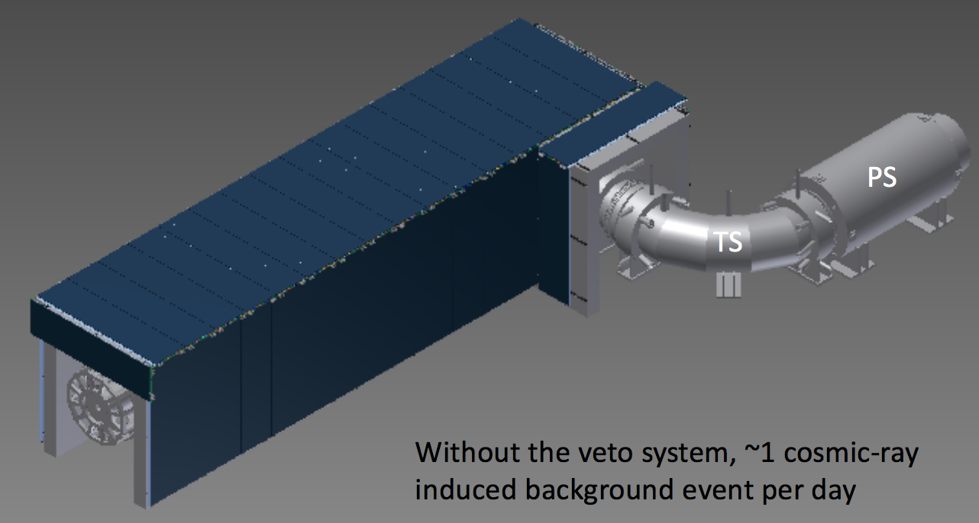
Cosmic Ray Veto (CRV)
The CRV covers all of DS and half of TS
Without CRV, expect ~1 cosmic-ray-induced background event per day (99.99% net efficiency)
Mu2e Collaboration, November 2013

Slide 21
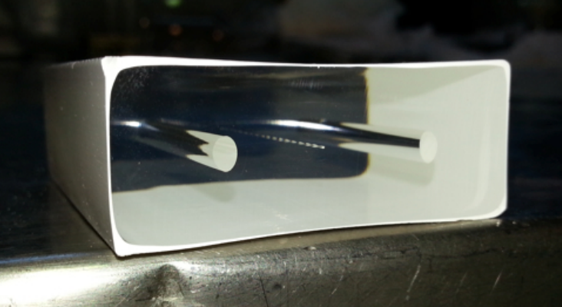
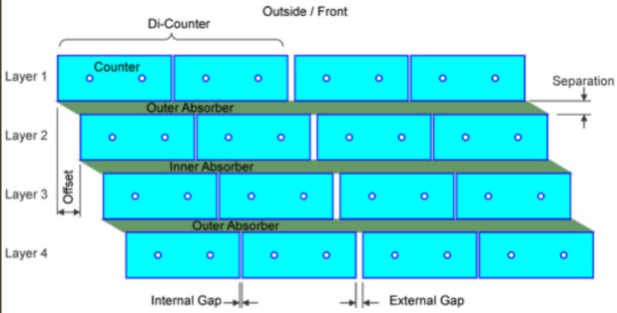
CRV scintillator strips
The CRV consists of 4 overlapping layers of scintillator strips with wavelength shifter and aluminum absorber
Each bar is 5 x 2 x ~450 cm³
Each bar has 2 wavelength shifting fibers which are read-out at both ends with SiPM
Have achieved e > 99.4% (per layer) in test beam
Mu2e Collaboration, November 2013

Slide 22
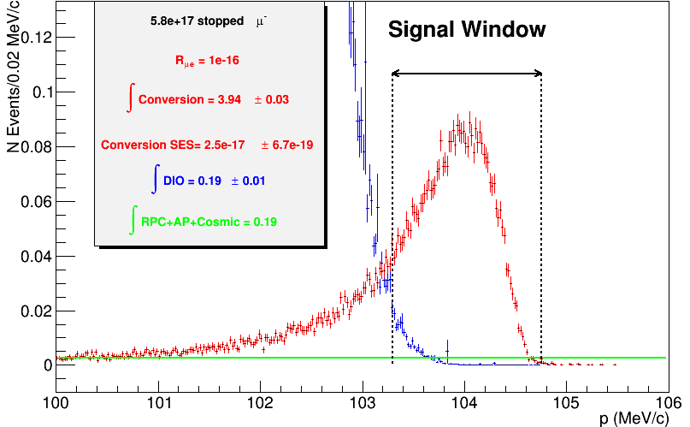
Reconstruction Simulation
Stopped μ: 6 × 10¹⁷
For R = 10⁻¹⁶
N_{μe} = 3.94 ± 0.03
N_{DIO} = 0.20 ± 0.09
N_{Other} = 0.16
SES = 2.9 × 10⁻¹⁷
SES (Goal) = 2.4 x 10⁻¹⁷
Errors are stat only
Mu2e Collaboration, November 2013
Reconstructed e⁻ Momentum

Slide 23
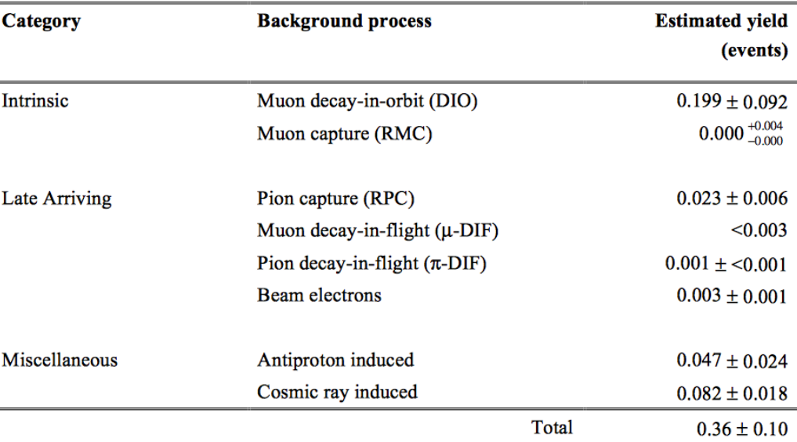
Estimated background yields
*
+
Mu2e Collaboration, November 2013
*Assuming 6x10¹⁷ stopped muons in 6x10⁷ sec of beam time
+Assuming an proton beam extinction of 10⁻¹⁰, a cosmic ray veto inefficiency of 10⁻⁴, PID muon-rejection of 200.

Slide 24
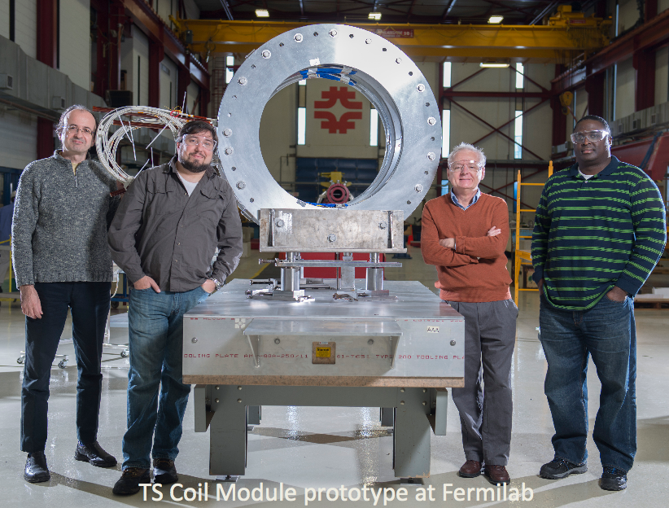
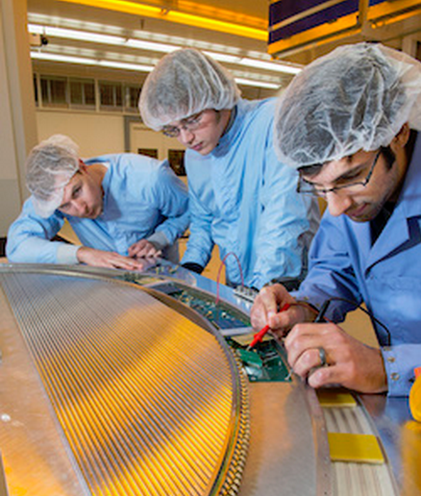
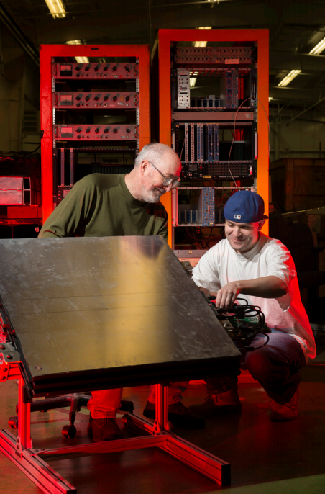
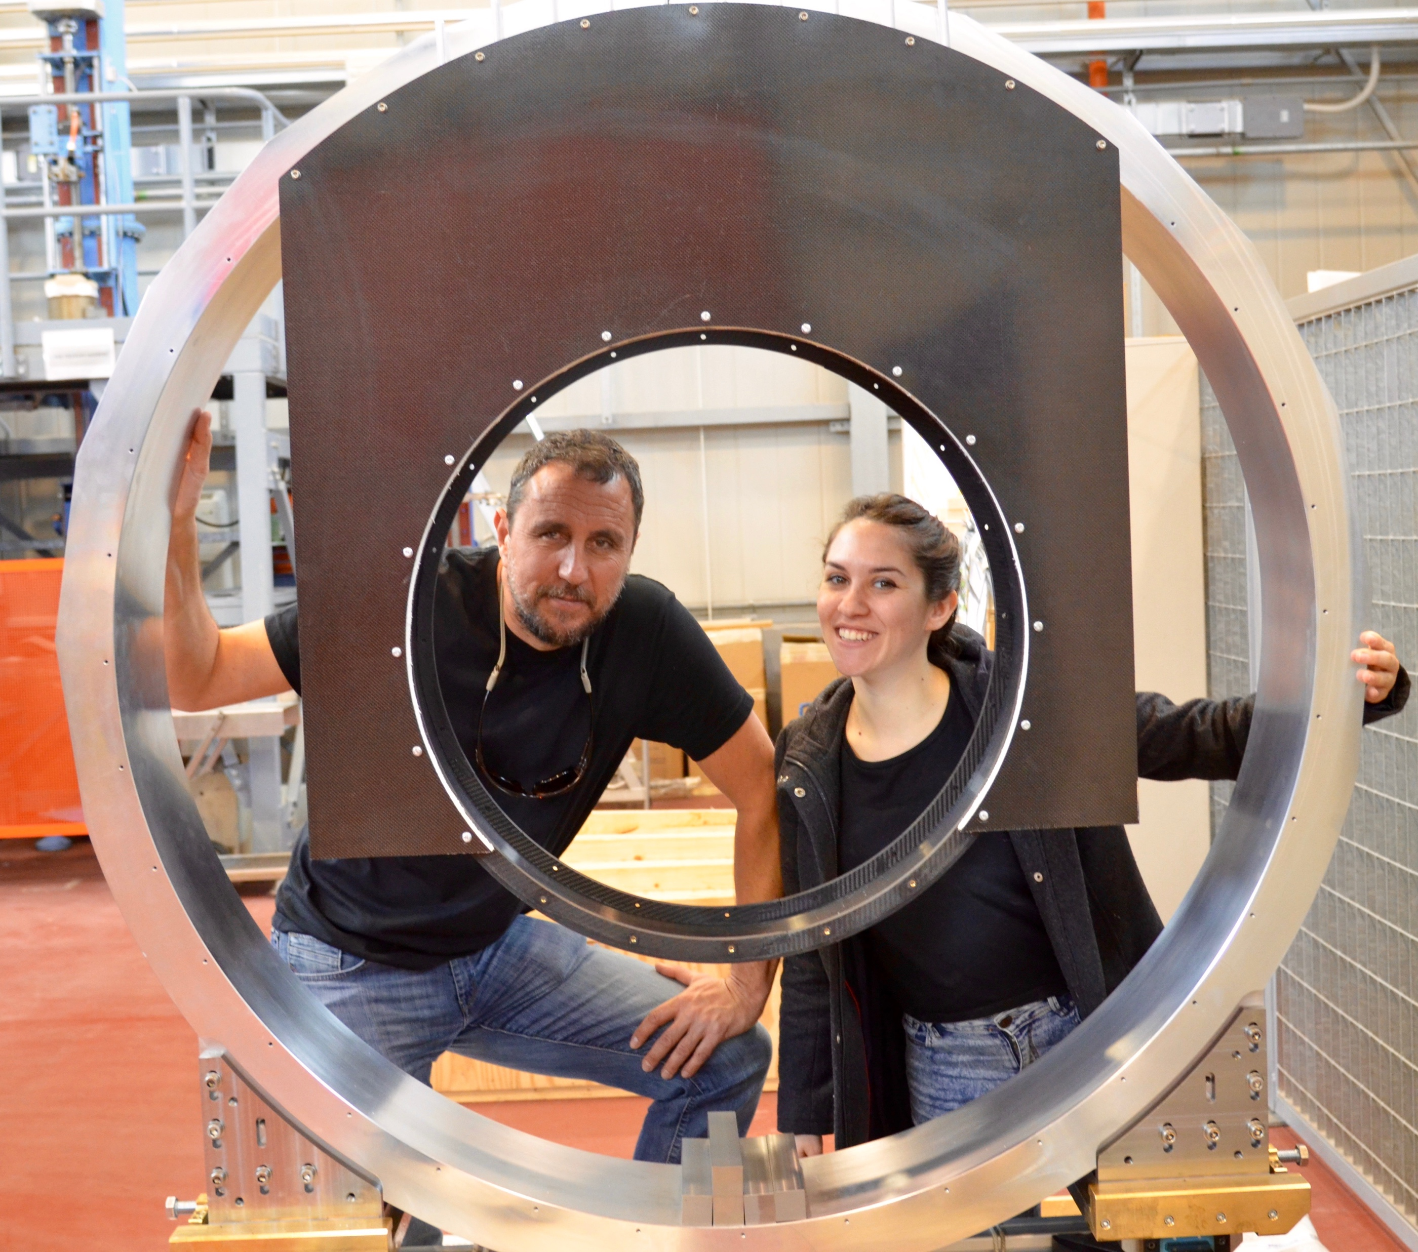
R&D and Prototype testing
Tracker Prototype, Fermilab
CRV Prototype, Fermilab
Calorimeter Prototype INFL

Slide 25
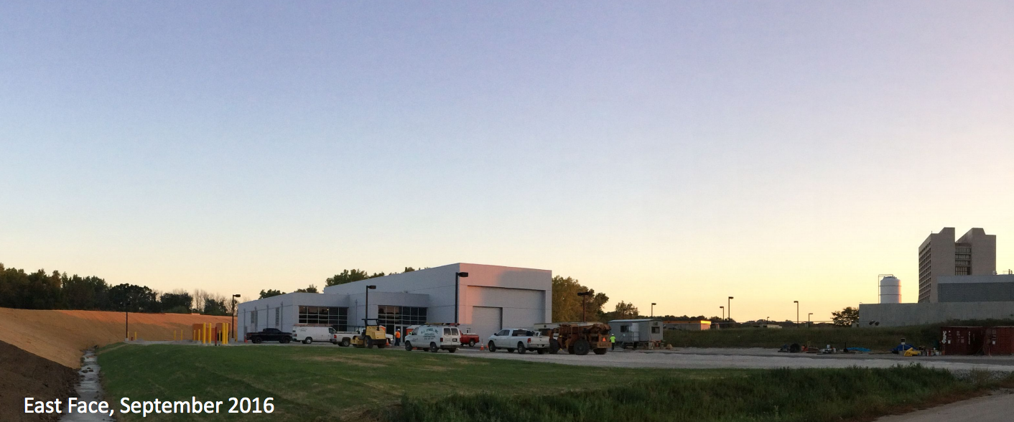
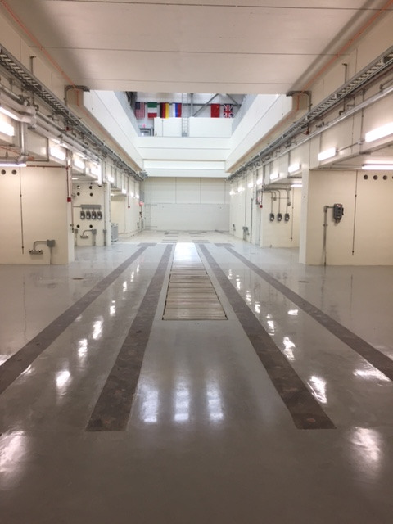
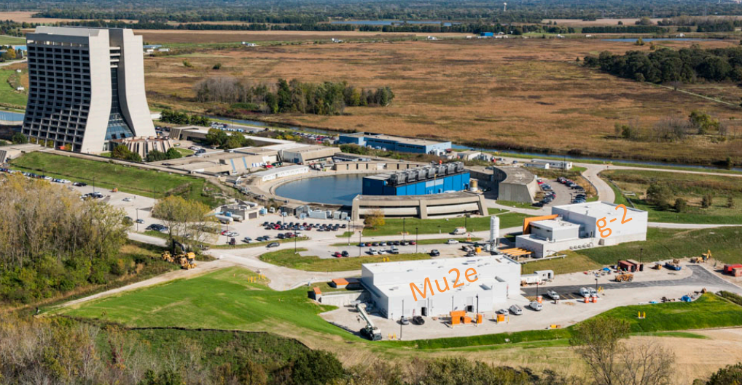
New Building Completed 2017
Mu2e Collaboration, November 2013

Slide 26
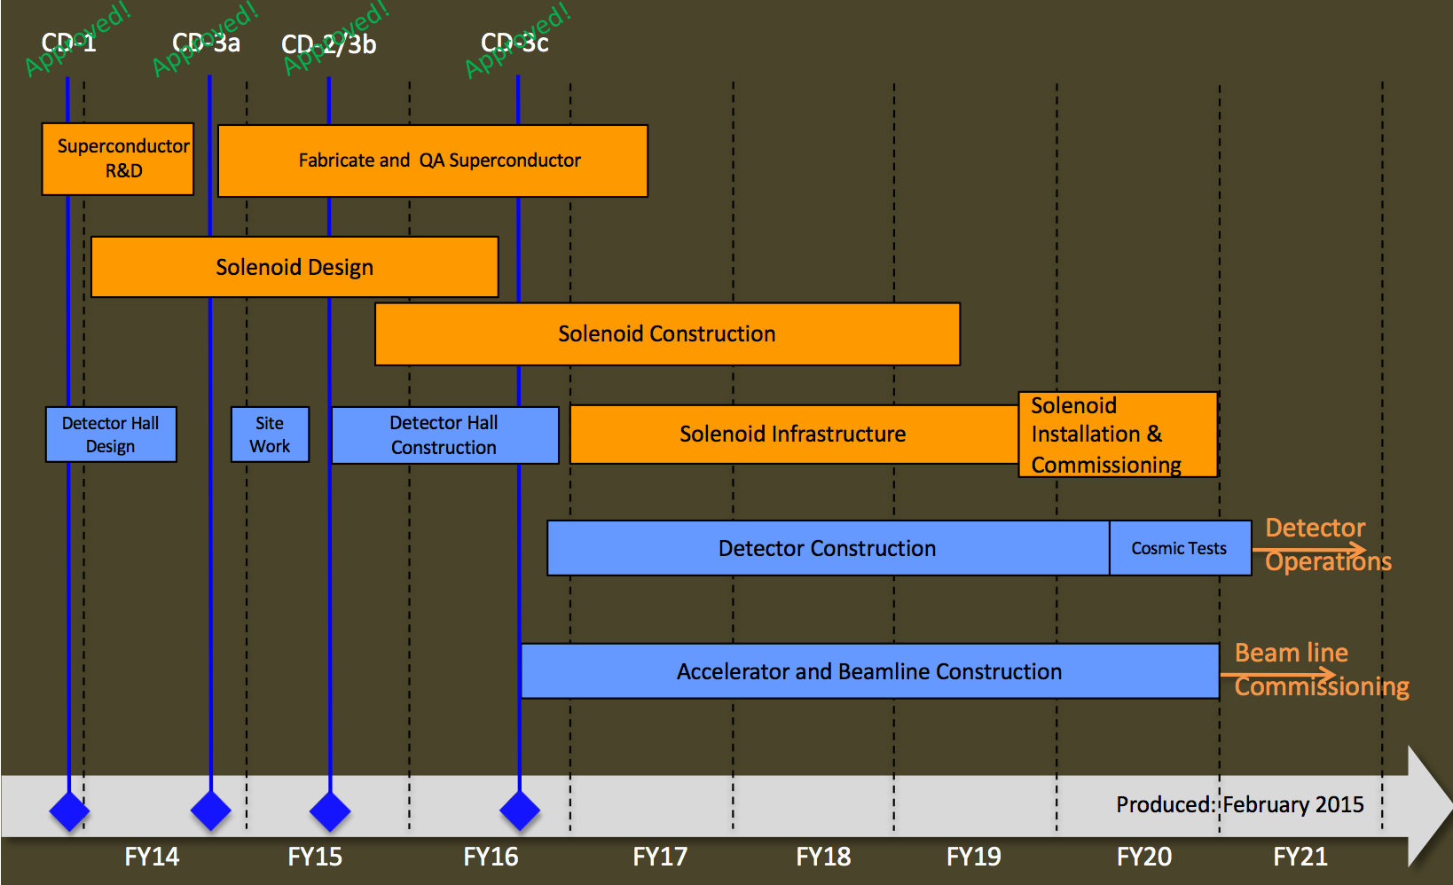
Schedule
Mu2e is on schedule. We expect to be commissioning in 2020.
Critical path is Solenoid Construction and Commissioning
Mu2e Collaboration, November 2013

Slide 27
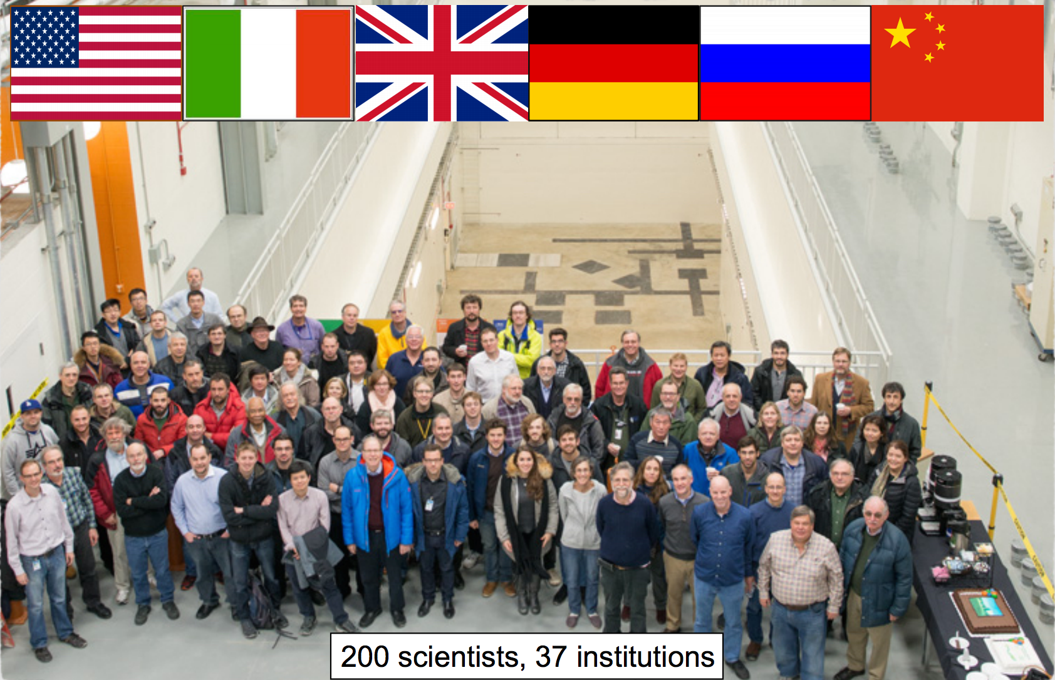
The Mu2e Collaboration
Mu2e Building Opening, Feb 2017

Slide 28
Summary
There is a lot of excitement about theoretical model discrimination afforded with a 4 orders of magnitude improvement on muon conversion sensitivity.
The Mu2e project has a design which will allow for a single event sensitivity of 2.4×10⁻¹⁷.
The experimental design is mature and on schedule for commissioning in 2020 and taking production data starting in 2021.
For more detailed information ask or check out our :
Technical Design Report : http://arXiv.org/abs/1501.05241
Experiment website : http://mu2e.fnal.gov

Slide 29
Thank you

Slide 30
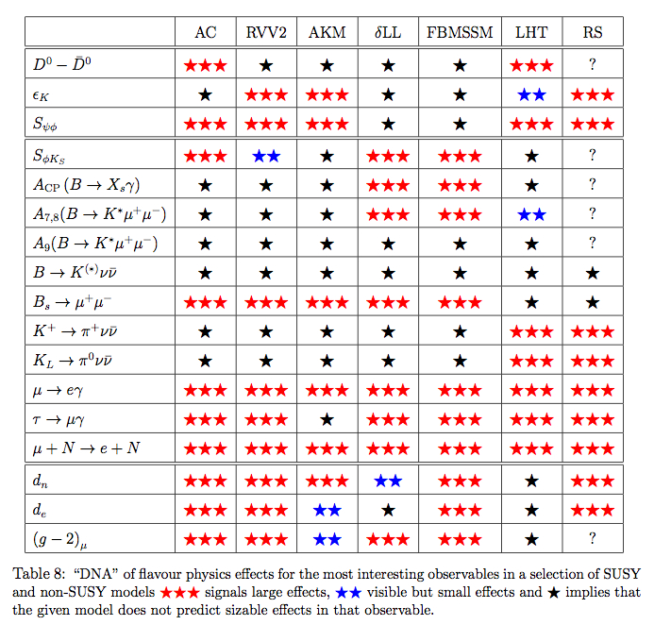
Sensitive to many models
W. Altmannshofer, A.J.Buras, S.Gori, P.Paradisi, D.M.Straub
arXiv:0909.1333[hep-ph]

