Slide 1
Short Baseline Neutrino Program
Anne Schukraft (FNAL)
for the SBND, MicroBooNE and ICARUS collaborations
Fermilab Users Meeting 2017

Slide 2
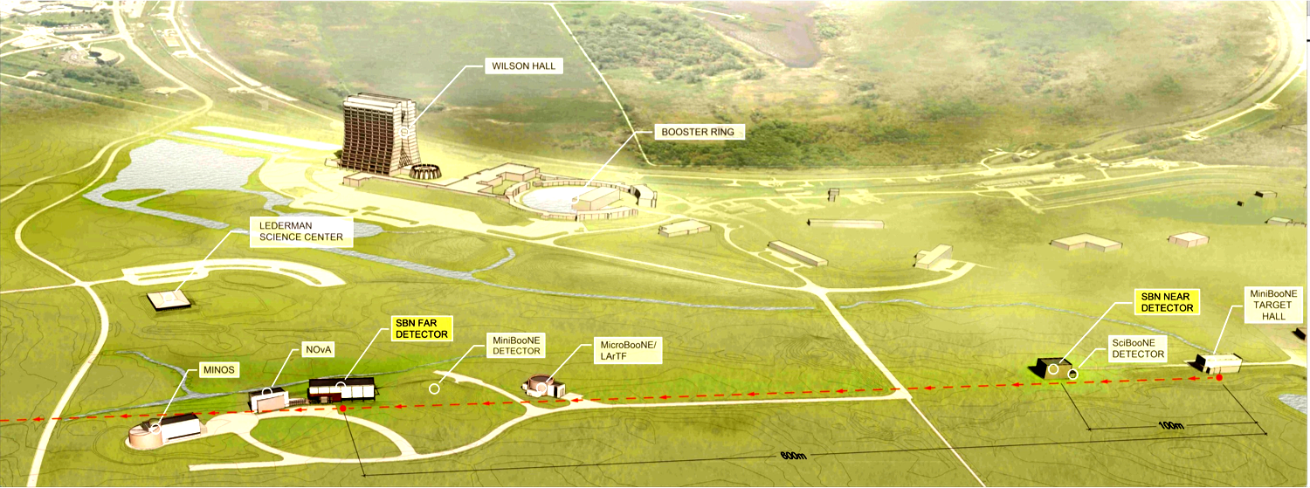
One program – three detectors
SBN Near Detector
NuMI neutrino beam
SBN
Far Detector
MicroBooNE
Detector | Distance from BNB target | Active LAr mass
SBND (near) | 110 m | 112 ton
MicroBooNE | 470 m | 87 ton
ICARUS (far) | 600 m | 476 ton
Booster Neutrino Beam (BNB)
All detectors are liquid-argon time projection chambers (LArTPC)
Sitting on-axis in the BNB
Receiving off-axis NuMI beam

Slide 3
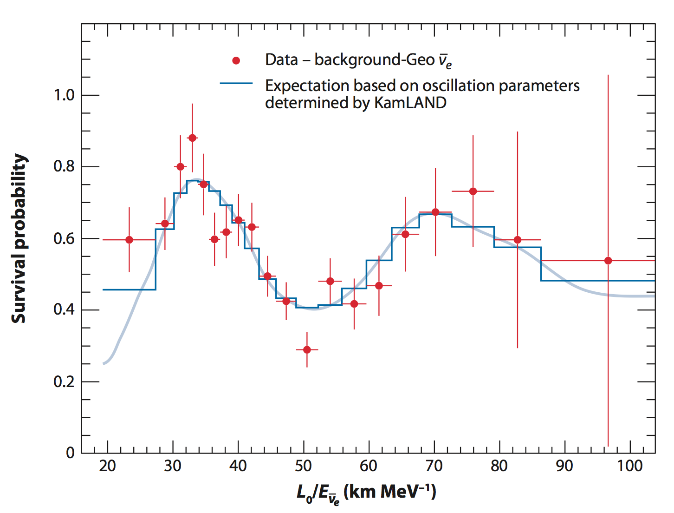
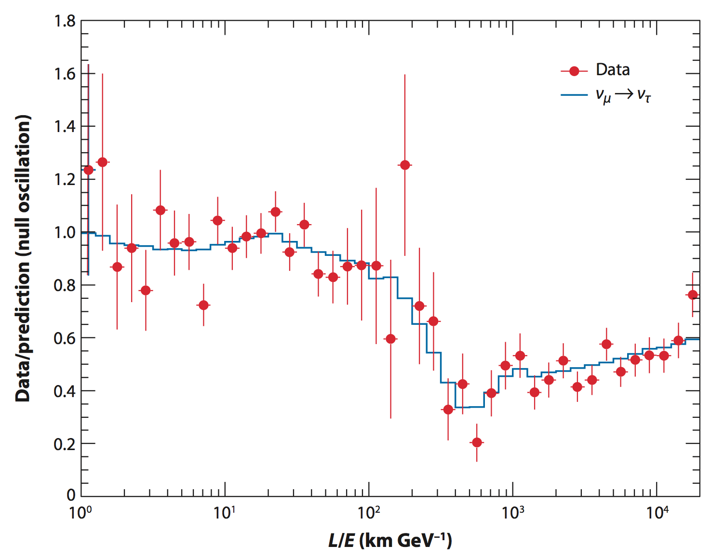
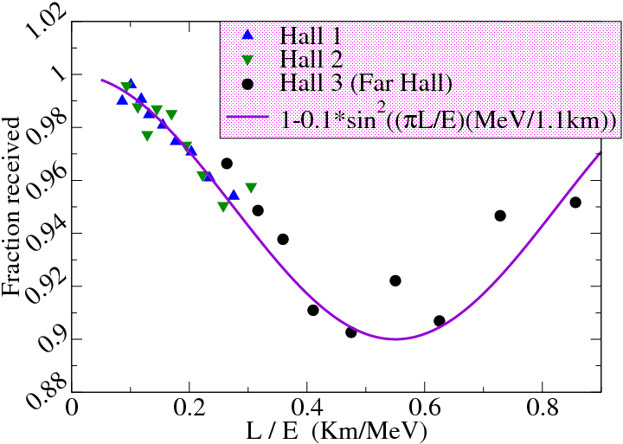
Physics motivation:
Oscillations beyond the three flavor mixing model?
“solar mixing”
“atmospheric mixing”
Super-K
Daya Bay
KAMLAND
Standard model three-flavor oscillations are observed on the scale of
L/E $>\sim$ km / MeV

Slide 4
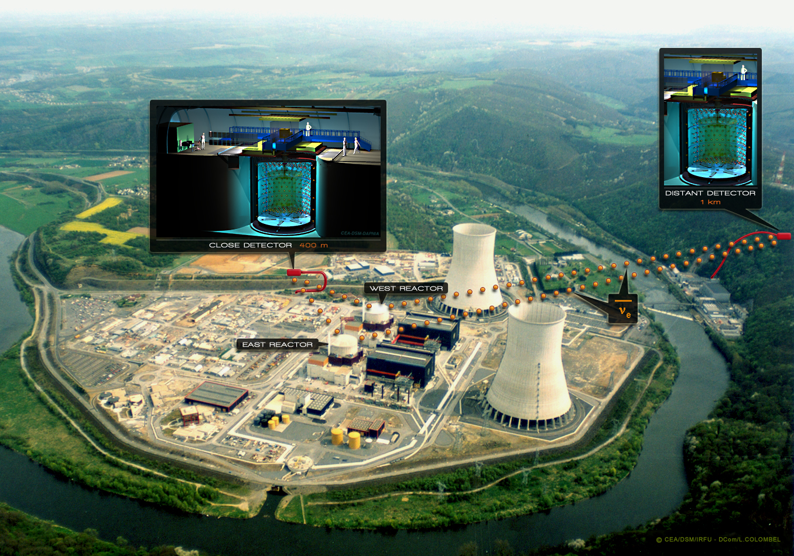
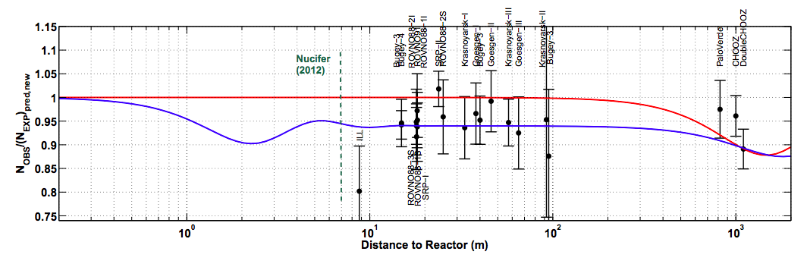
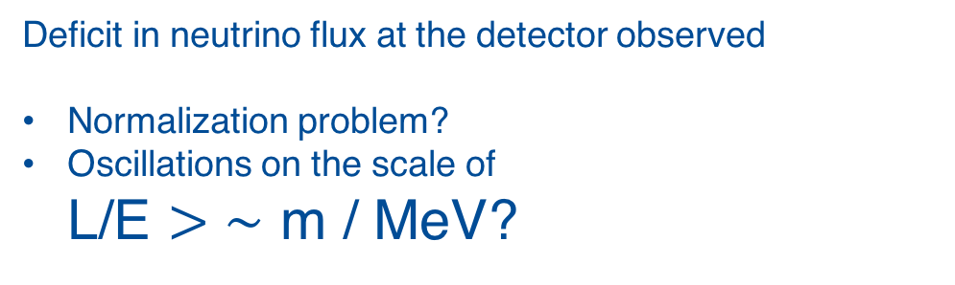
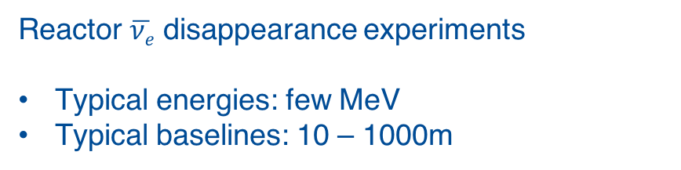
Physics motivation: The reactor neutrino anomaly
arXiv:1204.5379 [hep-ph]
3 flavor neutrino mixing
3 + 1 mixing scenario
Deficit in neutrino flux at the detector observed
Normalization problem?
Oscillations on the scale of
L/E $>\sim$ m / MeV?
Reactor $\overline{νe}$ disappearance experiments
Typical energies: few MeV
Typical baselines: 10 – 1000m

Slide 5
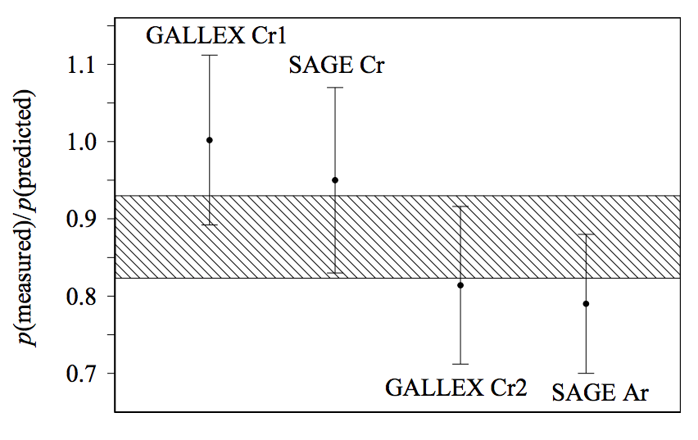
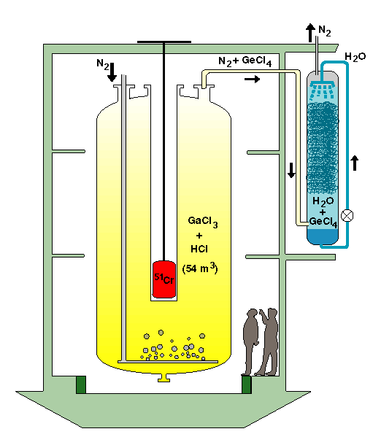
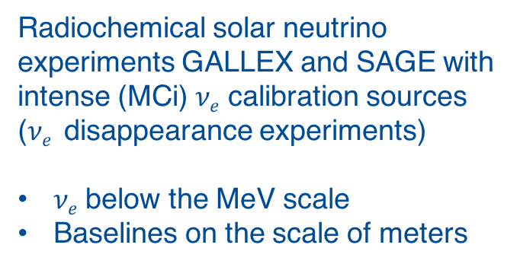
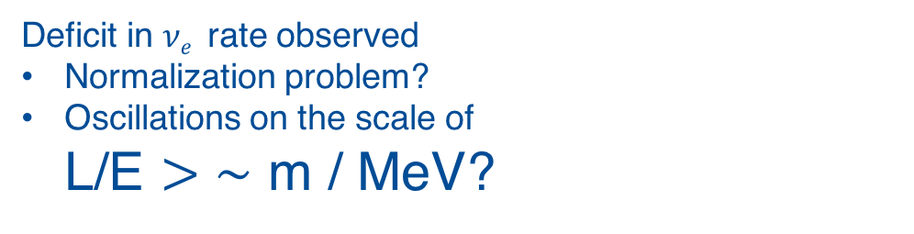
Physics motivation: Radioactive source experiments
Radiochemical solar neutrino experiments GALLEX and SAGE with intense (MCi) $νe$ calibration sources ($νe$ disappearance experiments)
$νe$ below the MeV scale
Baselines on the scale of meters
Phys. Rev. C73,
045805 (2006)
Deficit in $νe$ rate observed
Normalization problem?
Oscillations on the scale of
L/E $>\sim$ m / MeV?

Slide 6
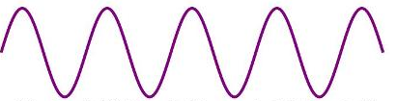
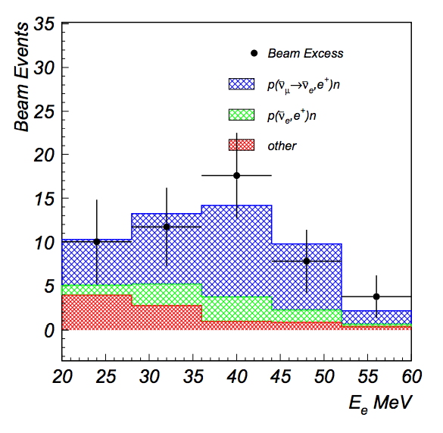
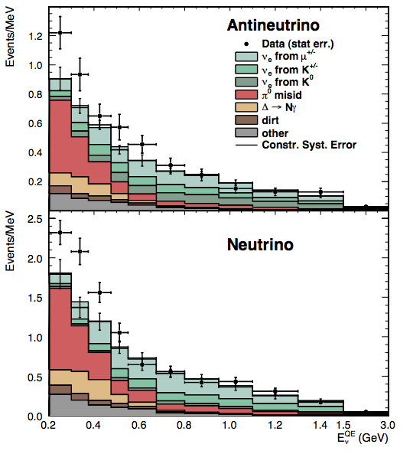










Physics motivation: The MiniBooNE and LSND results
Anomalies observed in $νe$ appearance experiments
LSND
MiniBooNE
$$\overline{νμ}$$
$$\overline{νe}$$
$$νμ$$
$$νe$$
e⁻
e⁺
Baseline
L = 30m
Baseline
L = 540 m
p
n
E_{ν} ~ 800 MeV
E_{ν} = 20 – 55 MeV
p
n
$$\overline{νe}$$
e⁺
$$\overline{νμ}$$
p
n
$\overline{νμ}$ $→$ $\overline{νe}$ signal?
Intrinsic $\overline{νe}$ background
Other background
$$νe$$
See also talk by A. Fava yesterday

Slide 7
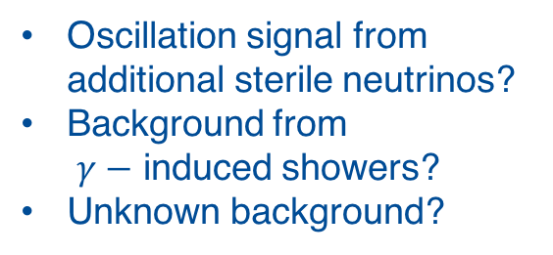
Physics motivation: The MiniBooNE and LSND results
LSND
MiniBooNE
Excess of electromagnetic events on a scale of
L / E ~ m / MeV
Oscillation signal from additional sterile neutrinos?
Unknown background?
Oscillation signal from additional sterile neutrinos?
Background from
$γ−$ induced showers?
Unknown background?
$\overline{νμ}$ $→$ $\overline{νe}$ signal?
Intrinsic $\overline{νe}$ background
Other background
$$νe$$
See also talk by A. Fava yesterday

Slide 8
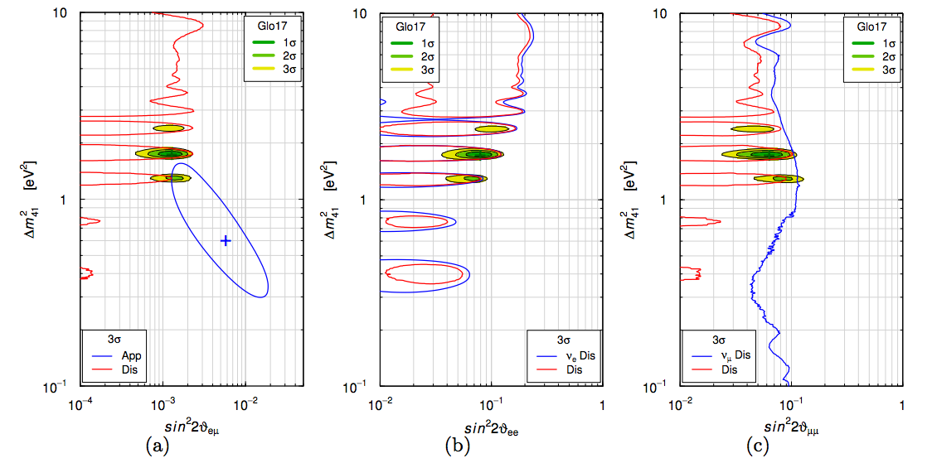
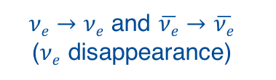
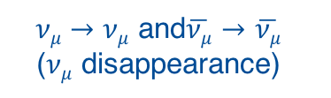
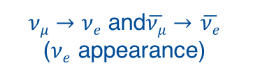
Status of sterile neutrino global fits
$νμ→νe$ and$\overline{νμ}→$ $\overline{νe}$
($νe$ appearance)
$νe→νe$ and $\overline{νe}→$ $\overline{νe}$
($νe$ disappearance)
$νμ→νμ$ and$\overline{νμ}→$ $\overline{νμ}$
($νμ$ disappearance)
S. Gariazzo, C. Giunti,
M. Laveder, Y.F. Li, arXiv:1703.00860

Slide 9
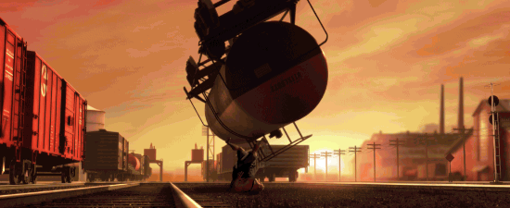
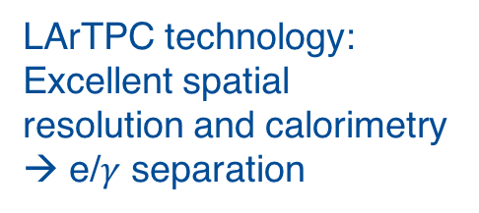
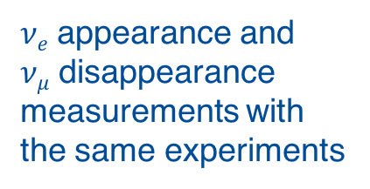
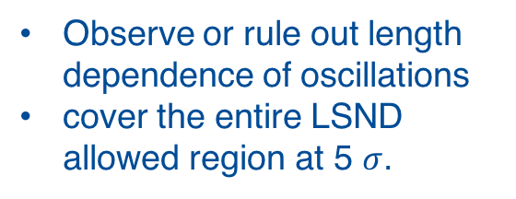
Mission of the SBN program:
Resolving the low-energy excess question
The strengths of the SBN program:
1.
2.
3.
Same beamline as MiniBooNE but measurements at different baselines
LArTPC technology:
Excellent spatial resolution and calorimetry → e/$γ$ separation
$νe$ appearance and
$νμ$ disappearance measurements with the same experiments
The mission of the SBN program:
MicroBooNE?
Phase A
MicroBooNE only
Phase B
SBND+MicroBooNE+ICARUS
Resolve the nature of the low-energy EM event excess
Observe or rule out length dependence of oscillations
cover the entire LSND allowed region at 5 $σ$.

Slide 10
Principle of LArTPC
Cathode
Anode
Large volume filled with liquid-argon
Strong electric field
E

Slide 11
Principle of LArTPC
ν
Neutrinos interact within the liquid argon volume
Scintillation light production
E

Slide 12
Principle of LArTPC
Ionization e⁻
ν
Production of ionization electrons

Slide 13
Principle of LArTPC
Drift
Anode
ν
Electrons drift towards anode plane
E

Slide 14
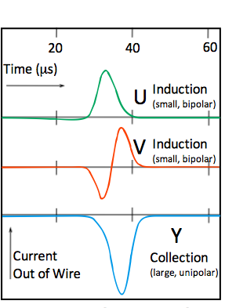
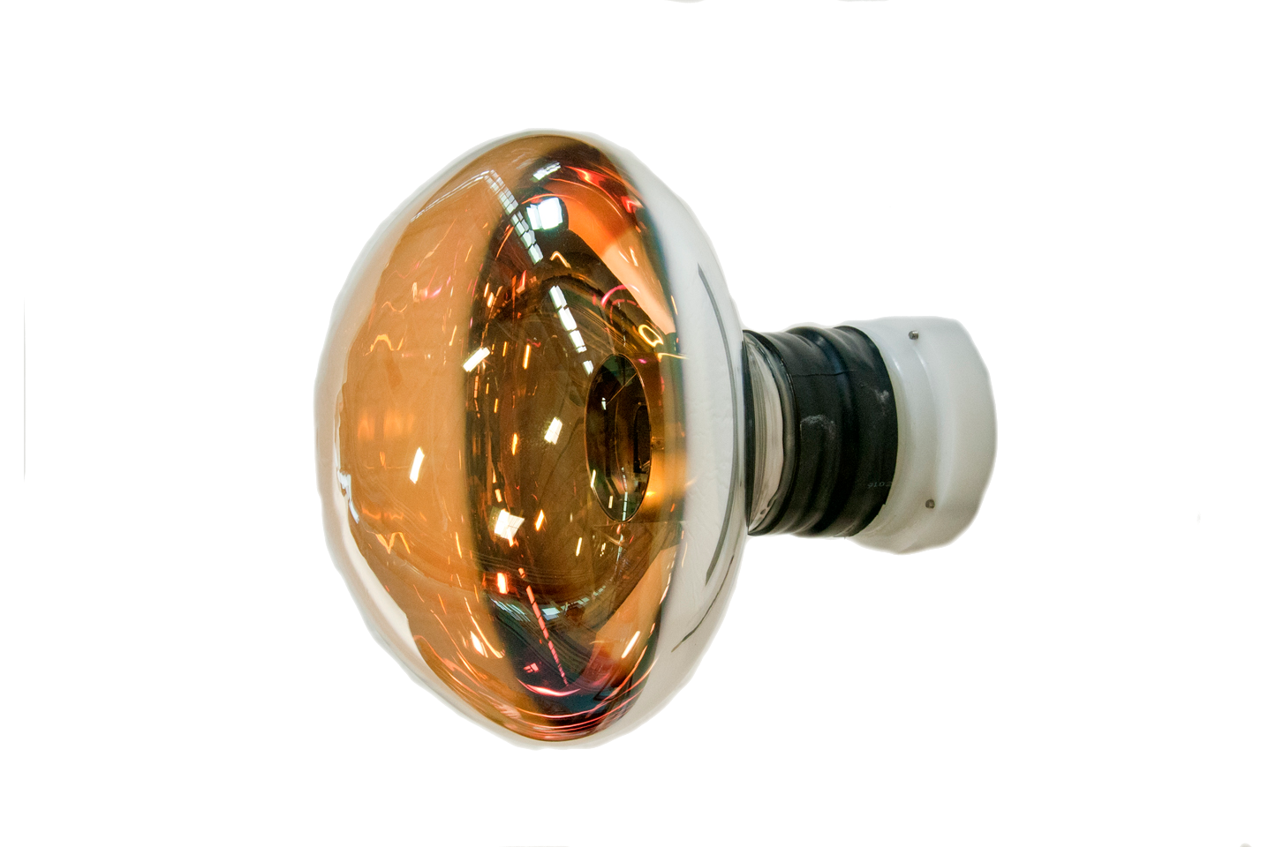
Principle of LArTPC
Readout on wire planes
Scintillation light captured by PMTs
Anode
U
V
Y
Anode
ν
E

Slide 15
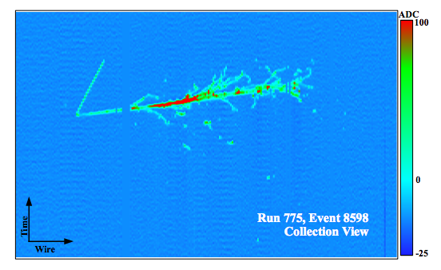
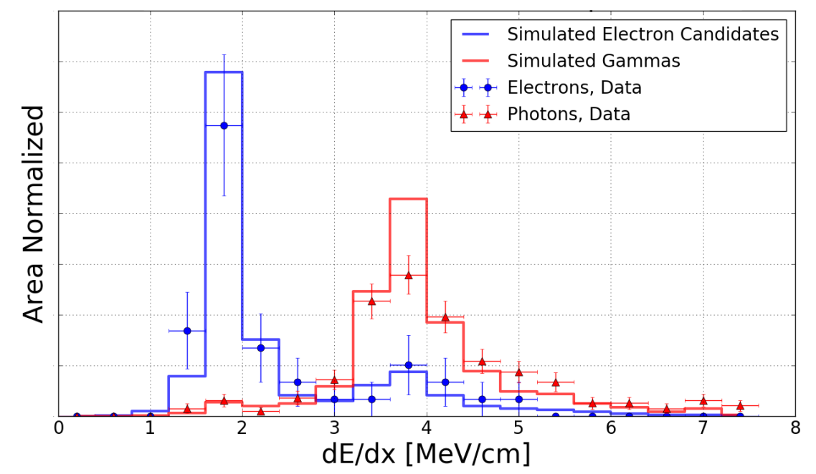
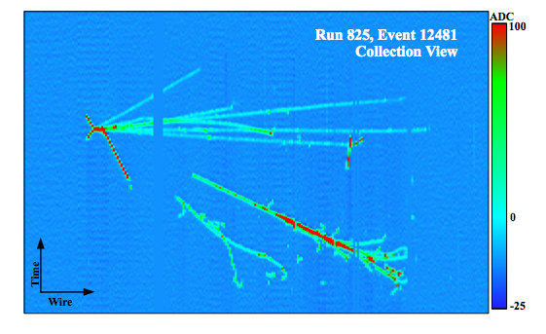

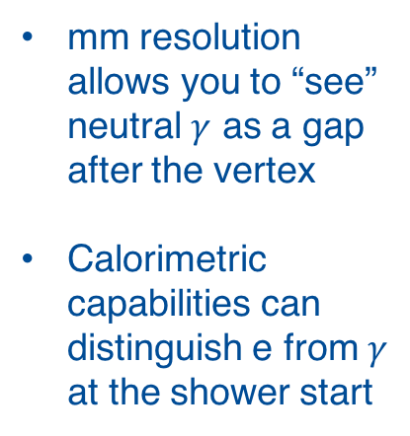

e / $γ$ separation in LArTPCs
ArgoNeuT
electron candidate
Technique well demonstrated by ArgoNeuT:
ArgoNeuT collaboration; Phys. Rev. D 95, 072005 (2017)
mm resolution allows you to “see” neutral $γ$ as a gap after the vertex
Calorimetric capabilities can distinguish e from $γ$ at the shower start
ArgoNeuT
$π0$ candidate
e⁺
e⁻
el. shower
el. shower
$$γ$$
e⁻

Slide 16
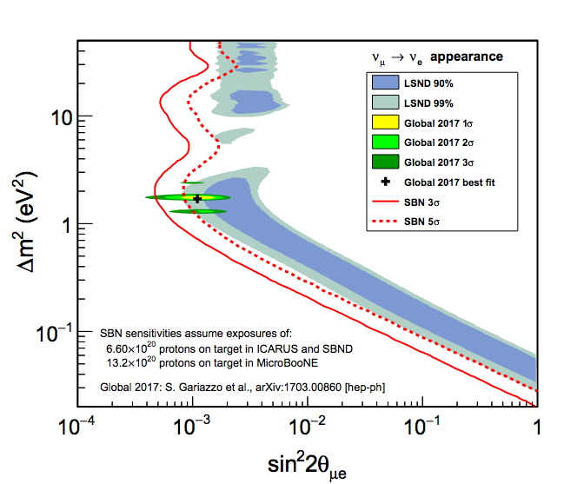
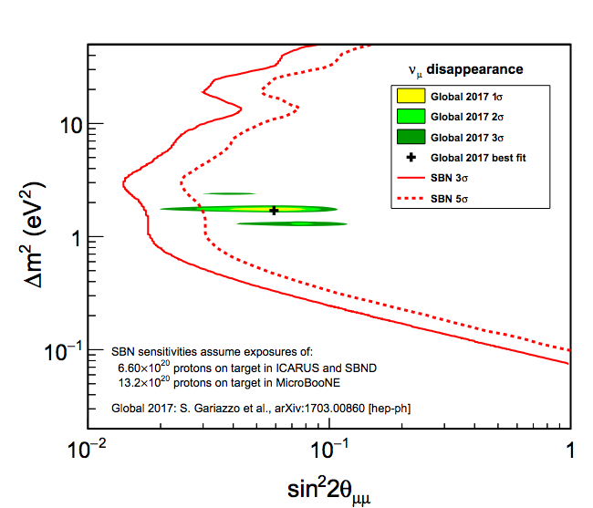


Sensitivities of the SBN program
$νe$ appearance
$νμ$ disappearance
Appearance and disappearance measurements with the same detectors!
SBN is sensitive to the entire range of interest.
arXiv:1503.01520

Slide 17
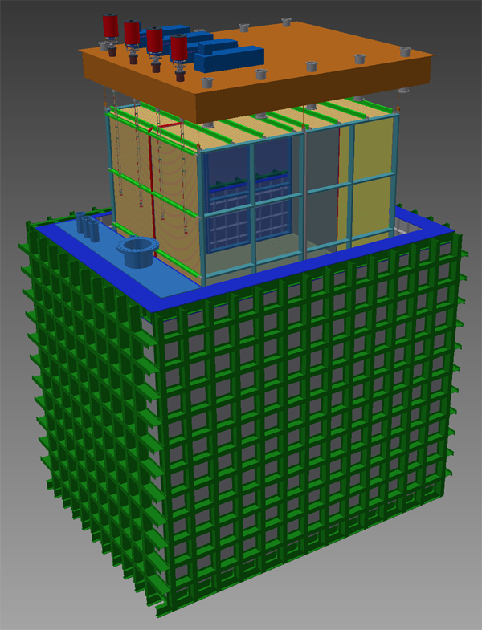
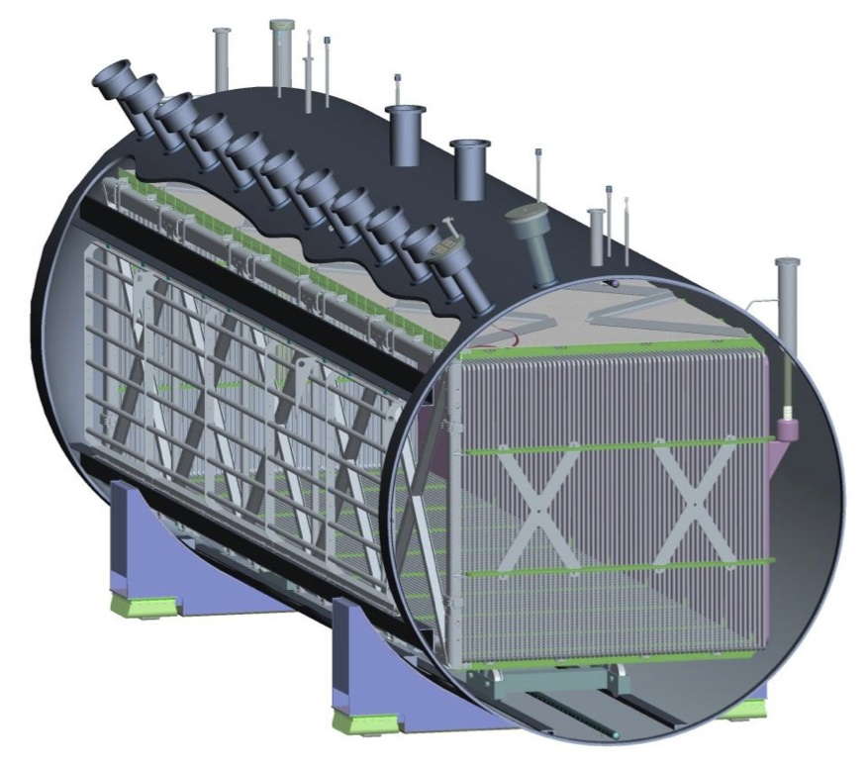
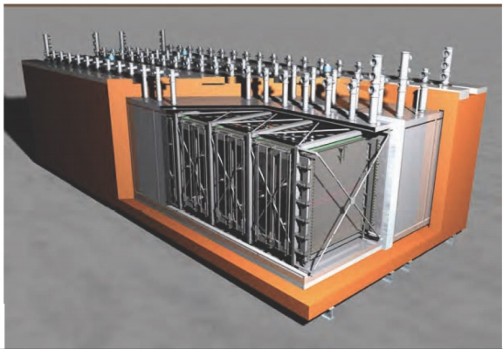
SBN schedule
Not all activities shown
TPC Design and Fabrication / PMT Procurement
TPC Assembly
SBND
TPC Electronics Design, Fabrication, Delivery
Cryostat and Cryogenics Design, Fabrication, Delivery
Detector Installation
Building Construction
Cryo Installation
Cryo install.
LAr Filling & Commissioning
MicroBooNE
Operate
ICARUS
Warm Vessel
Cold Vessel
Readout Electronics
ICARUS TPC 1 & Cold Vessel
TPC 2
Cryogenics Design, Fabrication, Delivery
Warm Vessel Design & Fabric.
Cryogenics
Building Construction
Lar Fill Commission
Operate
2Q 2016
3Q 2016
4Q 2016
1Q 2017
2Q 2017
3Q 2017
4Q 2017
1Q 2018
2Q 2018
3Q 2018
4Q 2018
1Q 2019
2Q 2019

Slide 18
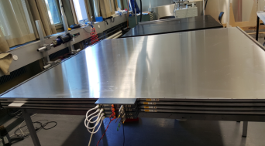
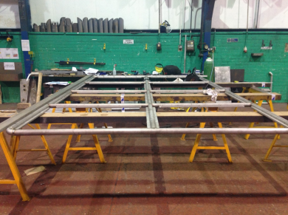
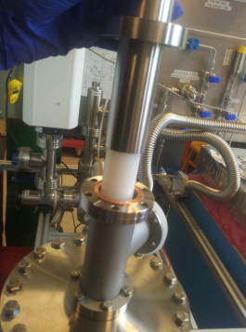
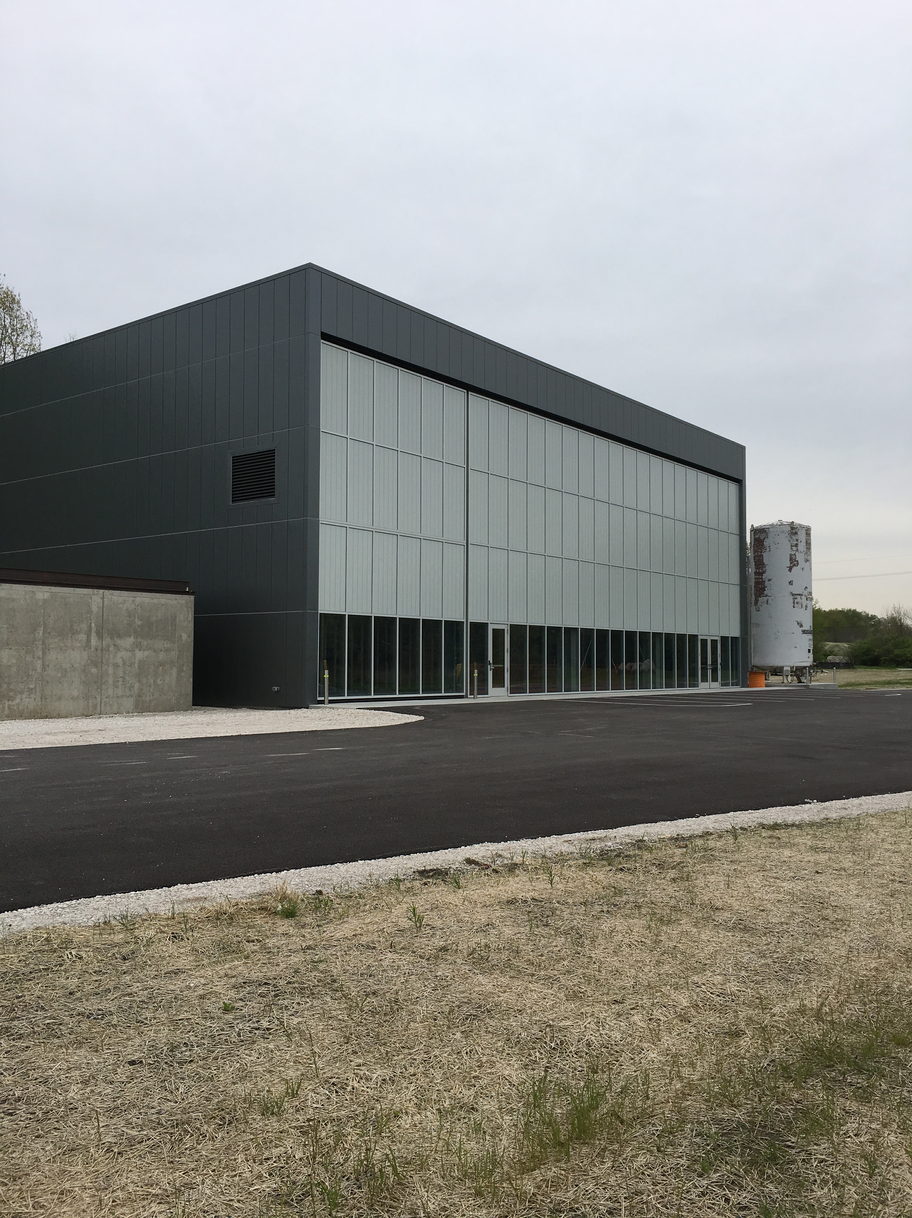
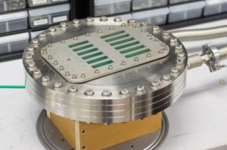
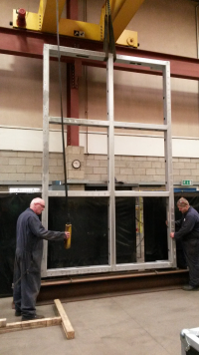
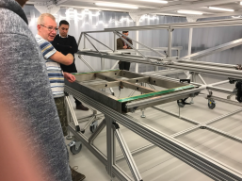
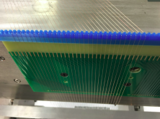
SBND construction
Cosmic ray tagger
HV system
Cathode
Cold electronics
Anode & wires
SBND Building

Slide 19
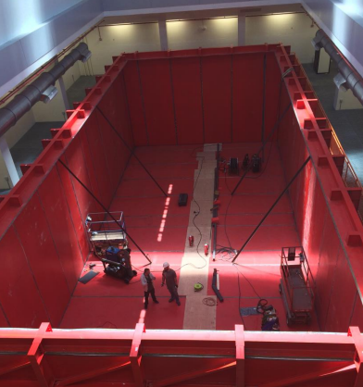
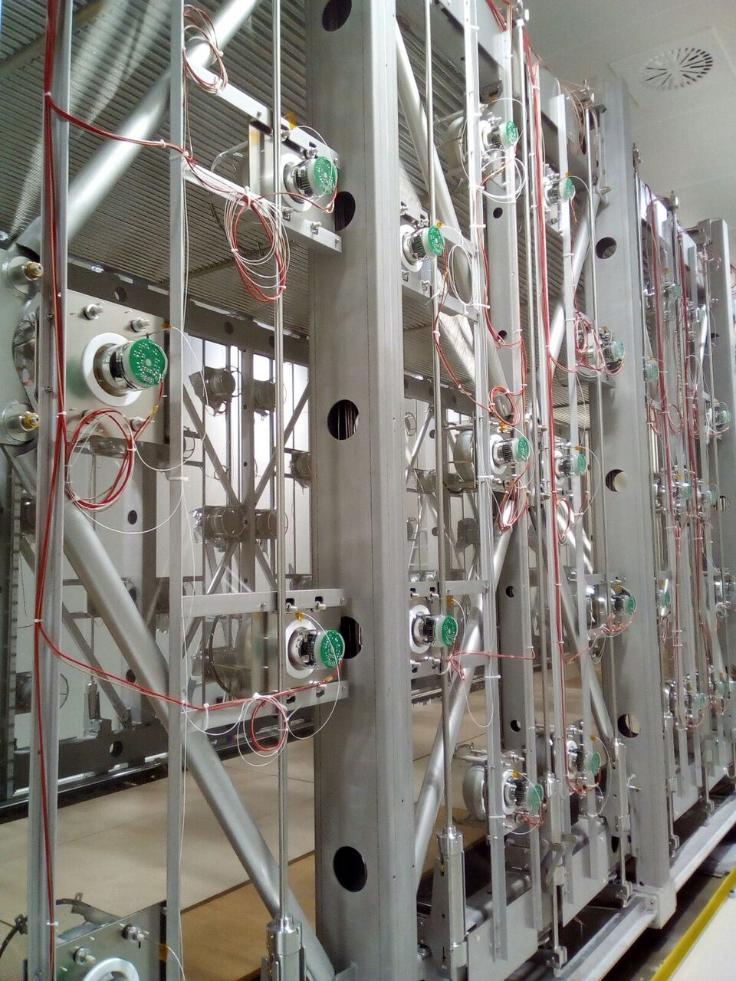
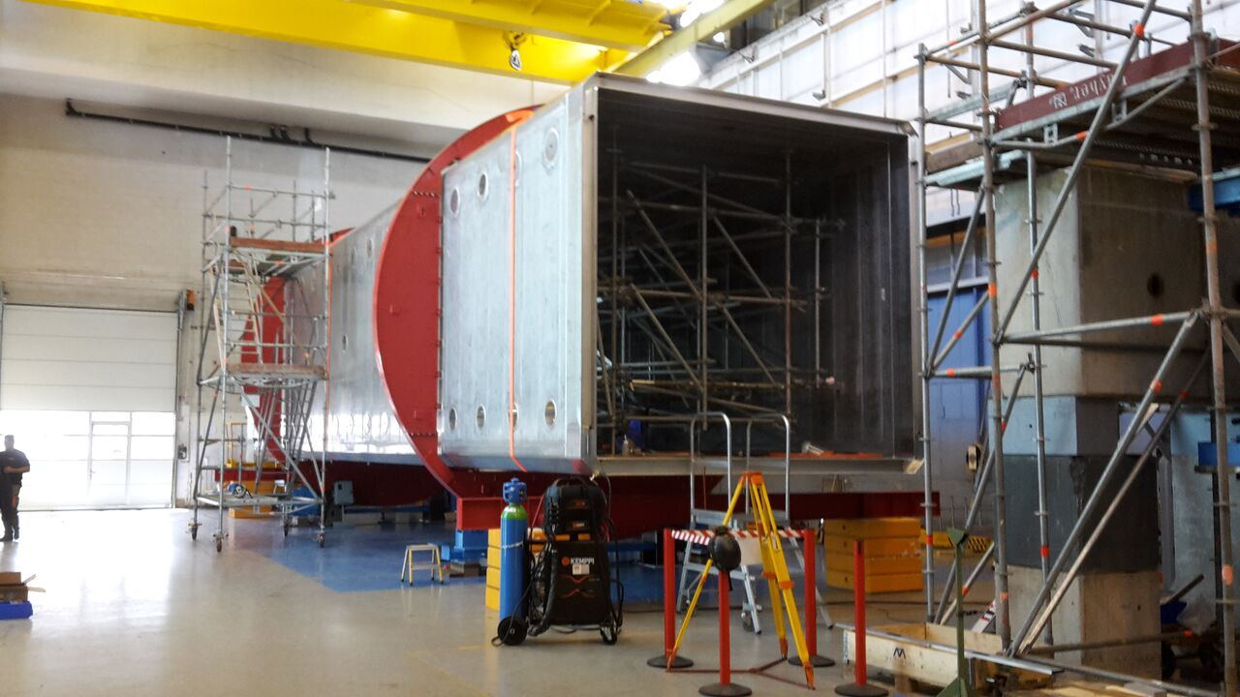
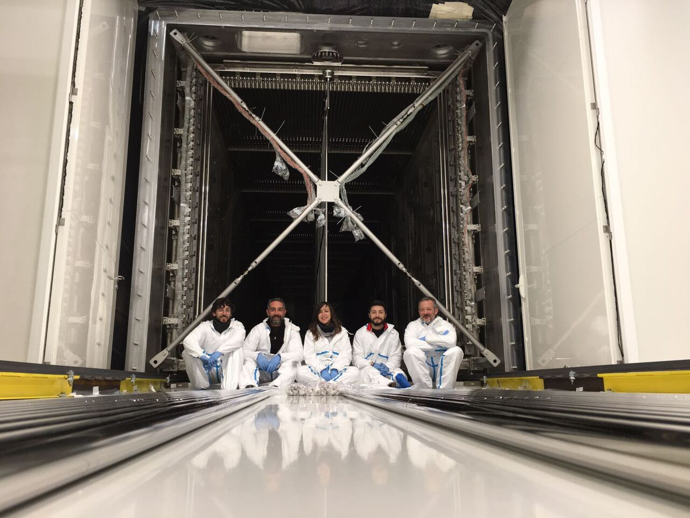
ICARUS installation
Warm vessel assembled in May 2017
See also talk by A. Fava yesterday
TPC refurbishment @ CERN
Cold vessel preparations @ CERN
Both TPCs are ready for shipment from CERN to FNAL. Shipping date: June 12!
Watch this space to follow ICARUS:
http://icarustrip.fnal.gov

Slide 20
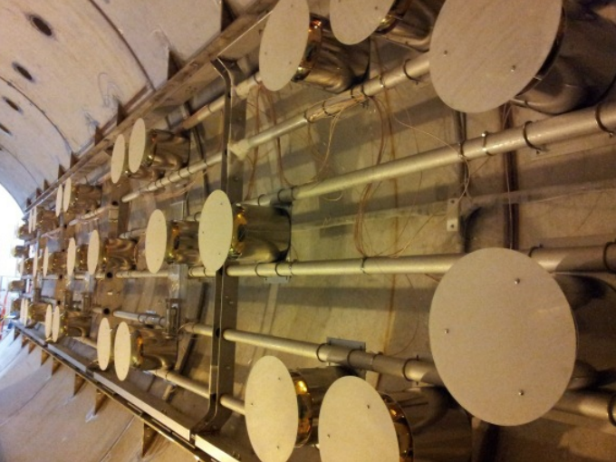
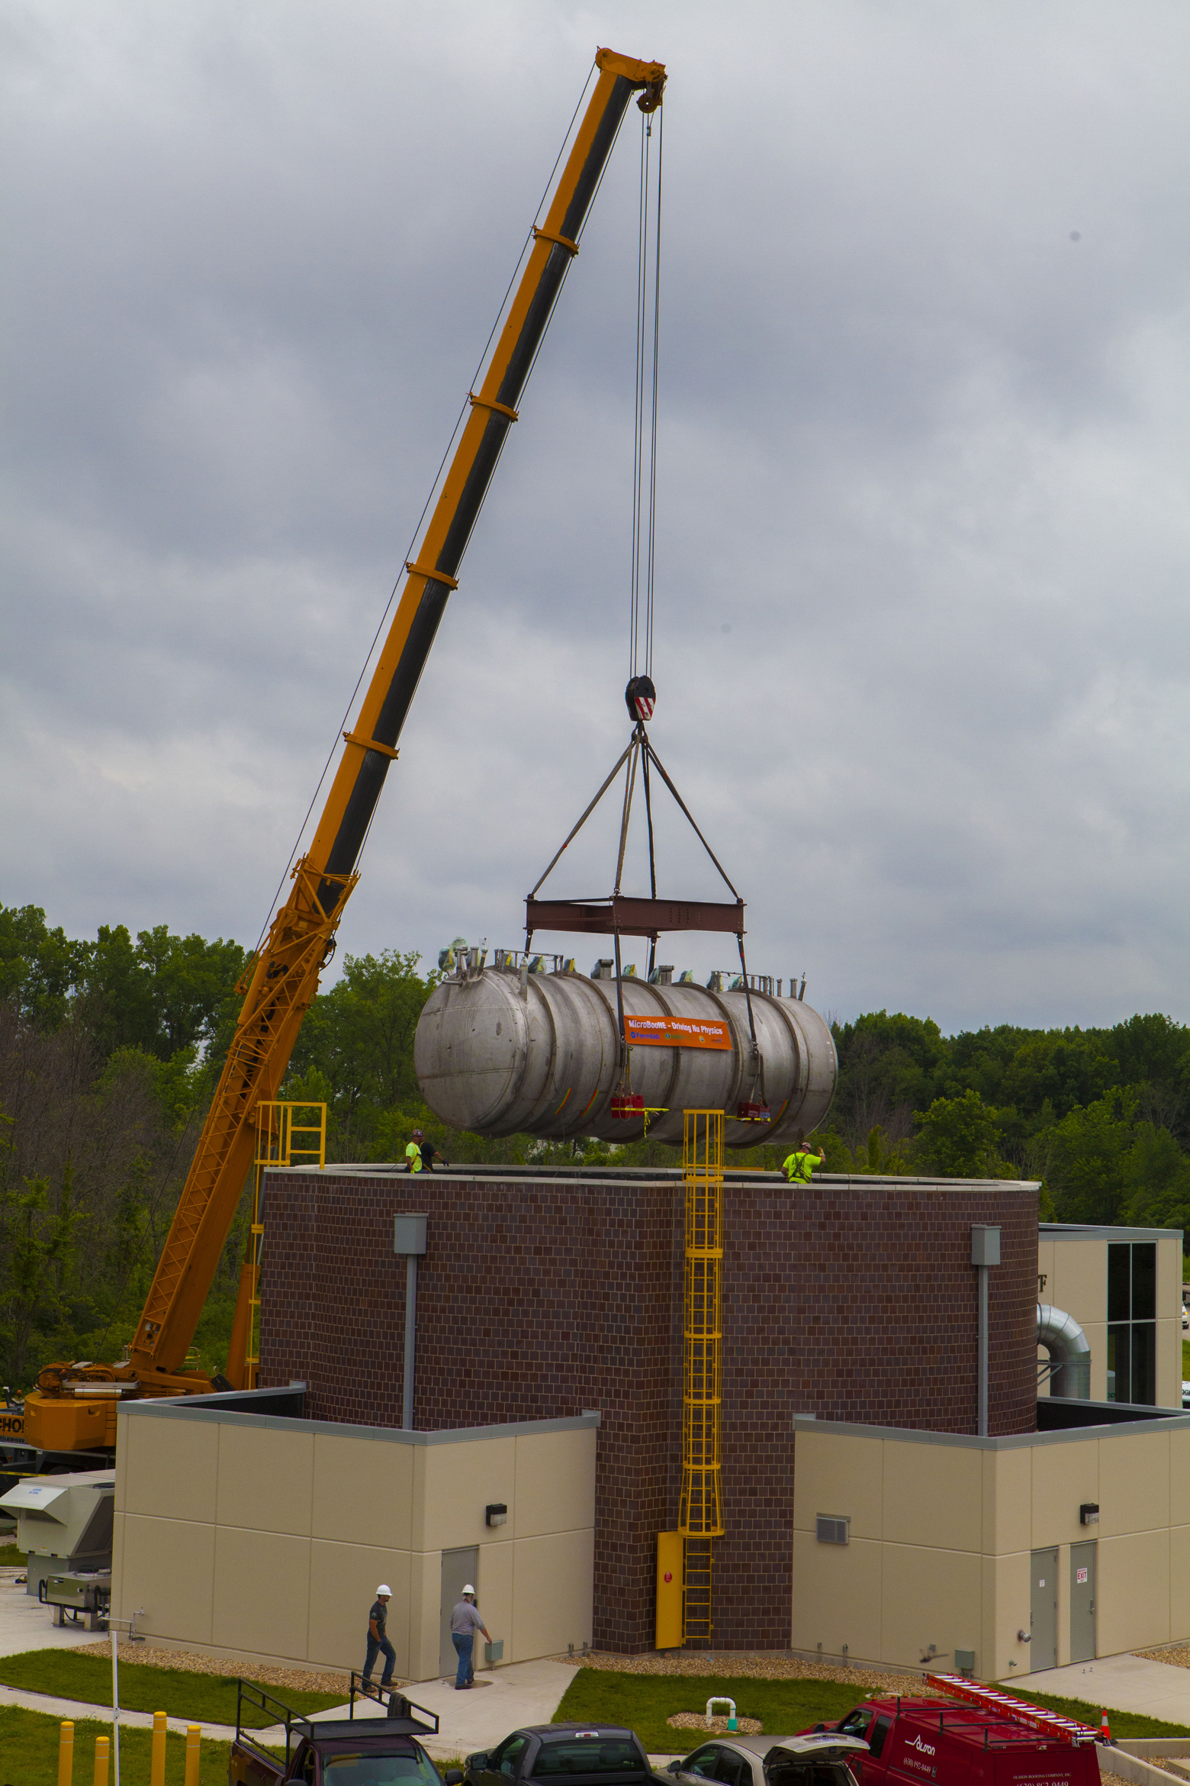




MicroBooNE – installation completed in 2015
PMT system installation: Dec 2013
Electronics installed
TPC insertion: Dec 23rd, 2013
MicroBooNE’s home in the beam line:
The LAr Test Facility

Slide 21

The first neutrinos in MicroBooNE
MICROBOONE-NOTE-1010-PUB
MICROBOONE-NOTE-1002-PUB
First neutrinos seen and automatically identified a few days after receiving first beam in Oct 2015.
(stat. uncertainties only)
Successful automated reconstruction and event selection chain.
First kinematic event distributions presented at NEUTRINO2016.
MicroBooNE public notes:
http://www-microboone.fnal.gov/publications/publicnotes/

Slide 22




MicroBooNE operations
Thanks to the lab’s accelerator and operations team!
BNB
BNB
NuMI
~ 5.5e20 POT BNB collected.
MicroBooNE uptime ~97% during stable operations.
~7.6e20 POT NuMI collected.
Switch to antineutrino-mode running on 02/20/17
Oct 2015 May 2017
Oct 2015 May 2017
In other words:
  ~ 140 000 $νμ$ CC interactions
  ~ 55 000 $νμ$ NC interactions
  ~ 90 000 $νμ$ CC 0$π$interactions
  ~ 10 000 $νμ$ NC $π0$interactions
  ~ 60 000 $νμ$ CC and ~ 12 000 $\overline{νμ}$ CC interactions
  ~ 25 000 $νμ$ NC and ~ 8 000 $νμ$ NC interactions

Slide 23






MicroBooNE physics goals:
Low-energy electromagnetic event excess
$$p$$
Spectrum of electron-like events
What MicroBooNE can do without SBND and ICARUS:
Definitively answer the question if the MiniBooNE excess is electron- or photon-like
$$e$$
$$γ?$$
MicroBooNE simulation
OR
Electrons?
Or photons?
γ₂
Spectrum of electron-like events
γ₁
?
MiniBooNE
MiniBooNE collaboration;
Phys. Rev. Lett. 110, 161801 (2013)

Slide 24













MicroBooNE physics goals:
Neutrino-Argon cross section measurements
Excellent for
Tracking
Reconstruction of hadronic contribution
Calorimetry
Angular phase space coverage
High statistics
$$μ$$
MicroBooNE simulation
MICROBOONE-NOTE-1010-PUB
Quasi-elastic-like:
Muon and proton kinematics
Single and double differential cross sections
Kaon production and ID
$$p$$
MICROBOONE-NOTE-1010-PUB
CC $π$⁰ production
Proton/track multiplicity measurements
NC elastic
MICROBOONE-NOTE-1006-PUB
MICROBOONE-NOTE-1025-PUB
$$μ$$
$$p$$
$$p$$
$c$osmic
$$p$$
$$p$$
$c$osmic
… and much more!

Slide 25



How do we get there?
Results
Data

Slide 26
Roadmap
Results
Energy reconstruction and energy scale calibration
Momentum reconstruction
Particle & event ID
Cosmic removal
Data
2D & 3D event reconstruction
Noise filtering & signal processing
Detector response calibration & simulation
LAr/e propagation properties

Slide 27
Publications
Results
Michel Electron Reconstruction Using Cosmic-Ray Data from the MicroBooNE LArTPC; arXiv:1704.02927
Determination of muon momentum in the MicroBooNE LArTPC using an improved model of multiple Coulomb scattering; arXiv:1703.06187
Energy reconstruction and energy scale calibration
Momentum reconstruction
Measurement of cosmic-ray reconstruction efficiencies in MicroBooNE using a small external cosmic-ray counter; coming soon
Particle & event ID
Cosmic removal
Convolutional Neural Networks Applied to Neutrino Events in a Liquid Argon Time Projection Chamber; arXiv:1611.05531
Data
2D & 3D event reconstruction
The Pandora multi-algorithm approach to automated pattern recognition of cosmic-ray muon and neutrino events in the MicroBooNE detector; coming soon
Noise filtering & signal processing
Detector response calibration & simulation
Noise Characterization and Filtering in the MicroBooNE Liquid Argon TPC; arXiv:1705.07341
LAr/e propagation properties
Design and Construction of the MicroBooNE Detector; arXiv:1612.05824

Slide 28
Public notes
Results
http://www-microboone.fnal.gov/publications/publicnotes/
Michel Electron Reconstruction Using Cosmic-Ray Data from the MicroBooNE LArTPC; arXiv:1704.02927
Determination of muon momentum in the MicroBooNE LArTPC using an improved model of multiple Coulomb scattering; arXiv:1703.06187
Energy reconstruction and energy scale calibration
Track multiplicities
Momentum reconstruction
Measurement of cosmic-ray reconstruction efficiencies in MicroBooNE using a small external cosmic-ray counter; coming soon
CC muon kinematics
3D shower reco
Particle & event ID
Proton ID
Convolutional Neural Networks Applied to Neutrino Events in a Liquid Argon Time Projection Chamber; arXiv:1611.05531
Data/MC agreement
Cosmic removal
Cosmic shielding studies
Data
2D & 3D event reconstruction
The Pandora multi-algorithm approach to automated pattern recognition of cosmic-ray muon and neutrino events in the MicroBooNE detector; coming soon
Noise filtering & signal processing
Charge extraction
Detector stability studies
Detector response calibration & simulation
Noise Characterization and Filtering in the MicroBooNE Liquid Argon TPC; arXiv:1705.07341
Space charge studies
LAr/e propagation properties
Design and Construction of the MicroBooNE Detector; arXiv:1612.05824
[~ since last year’s User’s meeting]

Slide 29




Cosmic removal in MicroBooNE
A typical recorded event in MicroBooNE:
Ionization electrons: SLOW! $(\sim$ 2.3 ms from cathode to anode)
Scintillation light: FAST!
Cosmic removal strategy:
Require scintillation light at the time of the beam spill arrival (width 1.6us)
Additional topological cuts
First attempt of $νμ$ CC selection (NEUTRINO2016)
Most challenging: Cosmics & neutrinos in the same event
Sufficient for some physics analyses but not for all
Cosmic removal
= Challenge.

Slide 30





Successful installation of a cosmic ray tagger
73 Modules and readout designed and built at University of Bern
Scintillator bars with two fibers & SiPMs per strip.
X-Y layout for position resolution
Completed in March 2017
~85% coverage
Will be used for cosmic removal and detector physics studies using cosmics
Details: arXiv:1612.04614

Slide 31





Muon momentum estimation with Multiple Coulomb Scattering
Multiple scattering for momentum estimation of contained and exiting muons
Tuning of the Highland formula for application in LArTPCs
Demonstration on MC and data.
exiting
Analyze scattering deflection angles in
x and y direction
Expect Gaussian with RMS $σ$.
$σ$ = $σ$(p)
Fit for momentum p.
< 15% momentum res.
contained
< 10% momentum res.
Details: arXiv:1703.06187

Slide 32




Michel electron reconstruction
Michel events are useful for:
Energy calibration
Muon tagging
Stopping muon identification
Energy reco:
Collect all charge from the reco electron track
Collect all charge from radiative phtons
Calibration factor from ADC founts to charge
Recombination correction
Lifetime correction
Details: arXiv:1704.02927

Slide 33








Cross section physics: From MicroBooNE to SBND
Once SBND is up and running, the MicroBooNE cross section program will be continued with SBND and unprecedented statistics!
Study of nuclear effects in neutrino-nucleus scattering
$$p$$
$$μ$$
ArgoNeuT
$$p$$
$$p$$
High-statistics $νe$ sample will greatly benefit oscillation analyses in SBN and DUNE
$$e$$
$$p$$
High precision & high statistics allow search for rare interaction processes

Slide 34



Conclusions
SBN is designed to study the baseline dependence of the low-energy event excess and cover the full LSND allowed parameter space with $5σ$.
While waiting for SBND and ICARUS to come online, MicroBooNE is going to investigate the nature of the low-energy excess.
MicroBooNE is doing groundwork for LArTPC calibration, simulation, reconstruction and analysis for future detectors.
An extensive neutrino-Argon cross section program is being setup by MicroBooNE, and will be followed by SBND with much larger statistics.
MicroBooNE is up an running and working on its first standalone physics results.
SBND and ICARUS will follow in 2018 and 2019.
Under construction.
SBND
Working hard on first results. Stay tuned!
MicroBooNE
I am coming soon!
Follow my travels on http://icarustrip.fnal.gov/
ICARUS

Slide 35
Backup

Slide 36


Noise characterization and filtering
Main sources of noise identified and characterized
  Low-voltage regulator for cold ASICS
  HV power supply
  900 kHz burst noise.
Hardware upgrades improved (1) and (2).
Residual noise level is low and stable.
Noise filtering is successfully applied in the signal processing chain.
Valuable input for the design of SBND and DUNE.
Details: arXiv:1705.07341

Slide 37







Convolutional neural nets for particle and event ID
Successfully demonstrated that the technique can be applied to LArTPC images
Neutrino event identification
Single particle identification (simulation)
(stat. uncertainties only)
Work on-going to apply these techniques to neutrino analyses.
Details: arXiv:1611.05531

