Slide 1
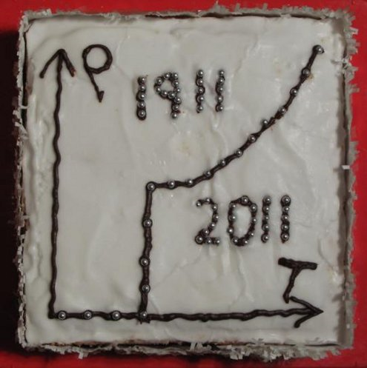
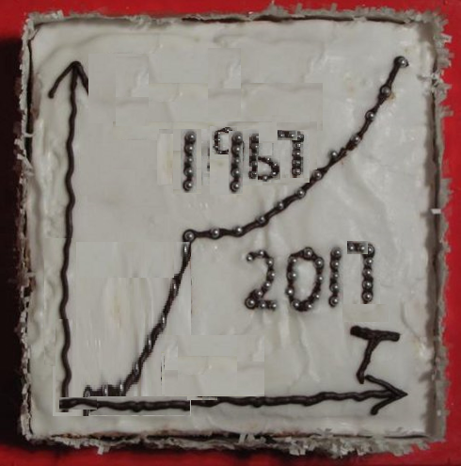

Fifty Years Of Success For Superconducting RF
Hasan Padamsee, Cornell University
Resistance
DC
RF
Nb
Hg
Hasan Padamsee, Cornell University
9.2 K
4.2 K
Temperature
Temperature

Slide 2
Outline
HAPPY BIRTHDAY to Fermilab
50 Years of Advances in SRF science
  => New inventions, new technology
SRF accelerator success stories
  => Present Status
Further advances in SRF science and technology
Prospects for future SRF success stories

Slide 3
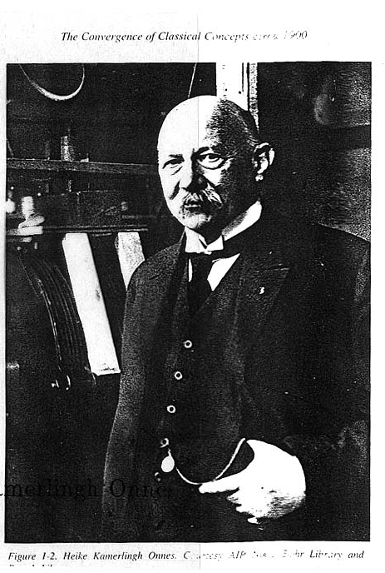
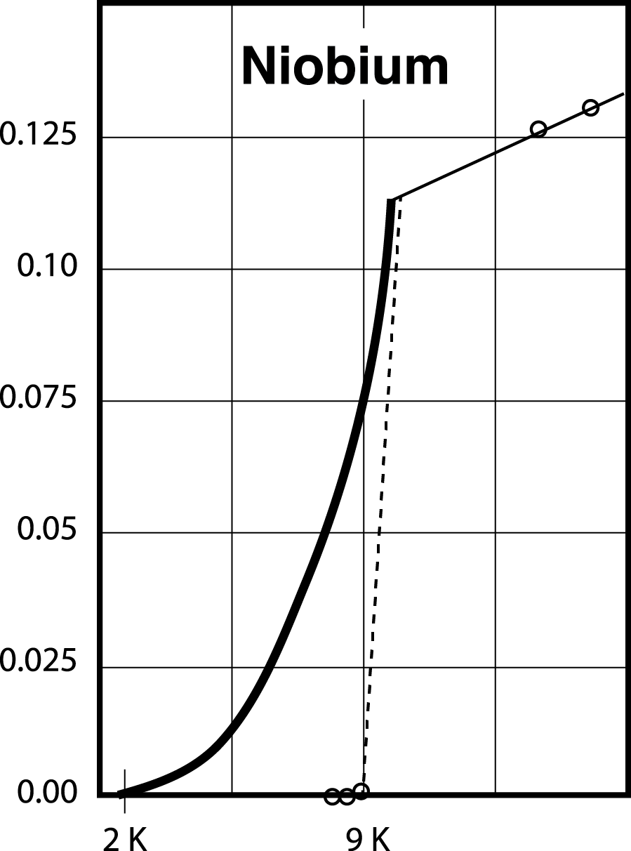
Kamerlingh Onnes, 2011
DC resistance is zero because NC electrons are “shorted out” by SC Cooper pairs.
RF resistance small but finite
Cooper pairs screening imperfect due to their inertia
→ nc electrons not frozen into Cooper pairs “see” the RF electric field.
RF
DC

Slide 4
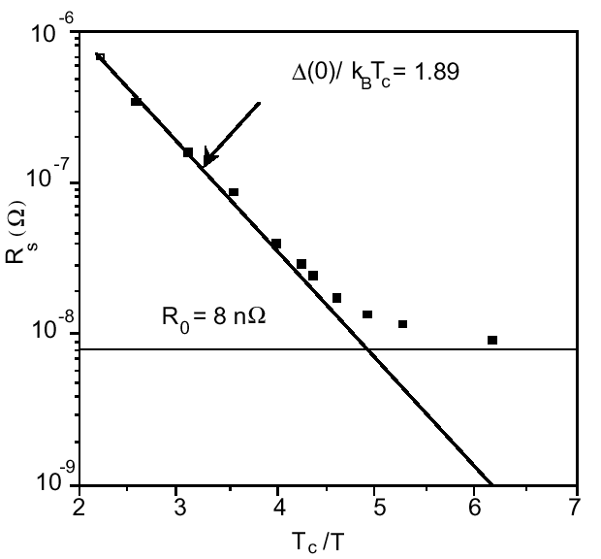
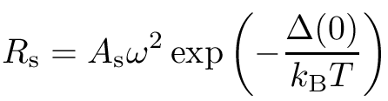
Superconductors: RF Resistance
Compare with Cu: Rs ~ 10 ⁻² Ω
1.5 GHz
Exponential drop
+
Residual resistance
Residual resistance
Choose Nb because
Has high T_{c}, H_{c} → low R_{s}
Easy to fabricate

Slide 5
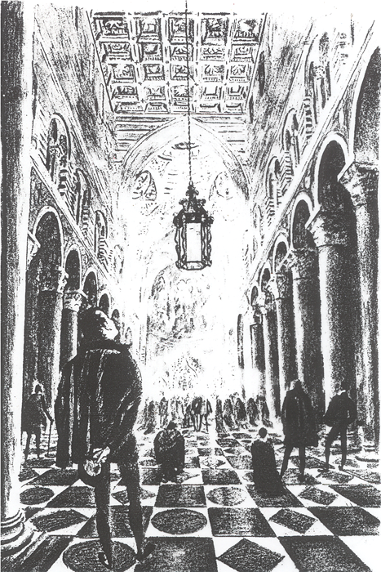

High Q (quality factor) resonators
Superconducting cavity resonators are “almost” perfect:
A tuning-fork with the same quality factor (Q – 10¹⁰) would ring for well over a year
Galileo’s pendulum would still be oscillating today - 400 years later!

Slide 6
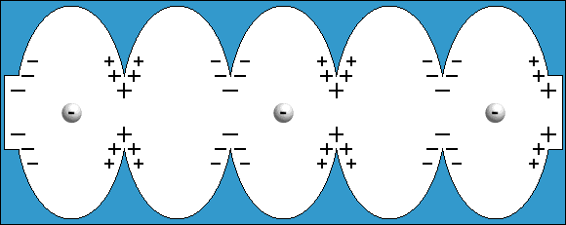
RF Cavities for Accelerators
Key component for acceleration
Microwave cavity
  RF frequency :100 MHz and 3000 MHz
Imparts energy to charged particles.
Animation of accelerating cavity
http://education.jlab.org/sitetour/guidedtour05.l.alt.html

Slide 7
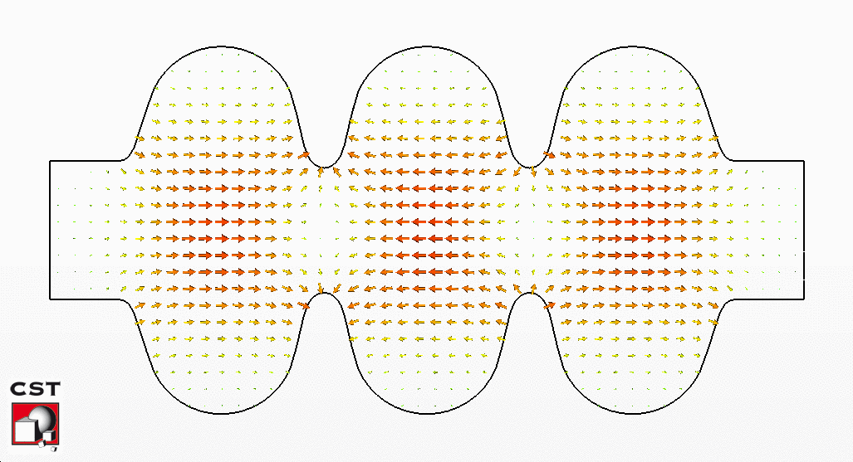
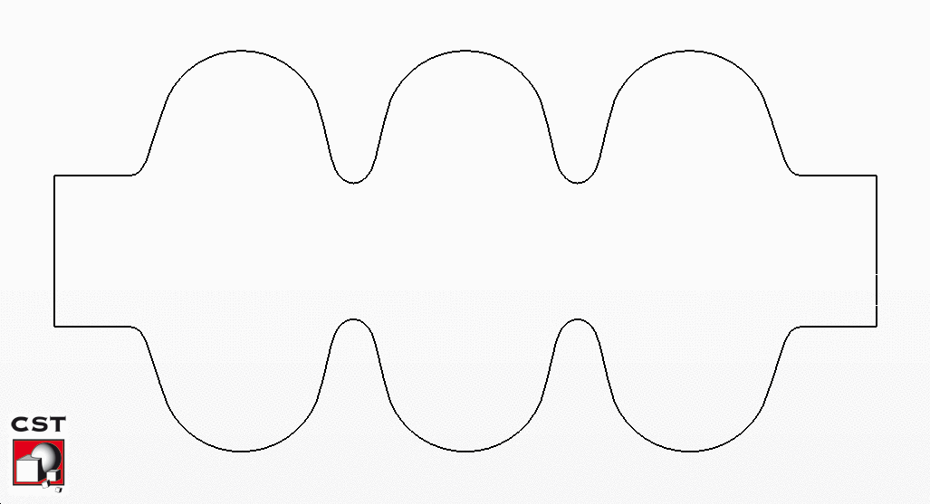
Radio Frequency
Electric & Magnetic Fields in a Cavity
Electric Fields
Magnetic Fields

Slide 8
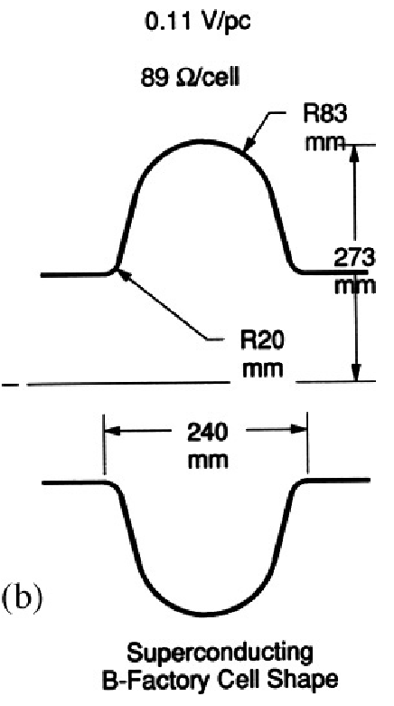
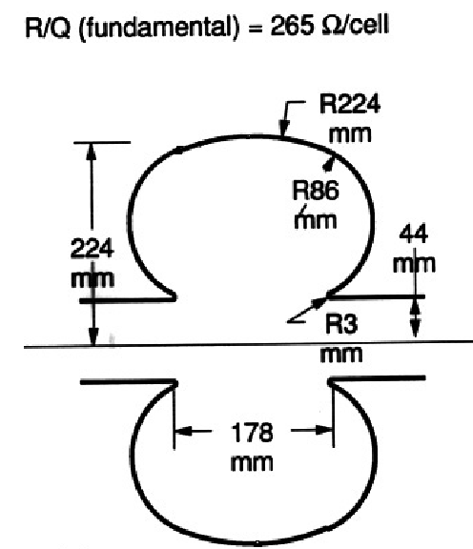
Main Advantages of Superconducting Cavities for Accelerators
A superconducting cavity reduces the wall dissipation by many orders of magnitude over a copper cavity
=> Affordable higher CW/long pulse gradients
Larger aperture cavity geometry for better beam quality
  Less harmful interaction with beam through wakefields and higher order modes
Copper cavity shape

Slide 9
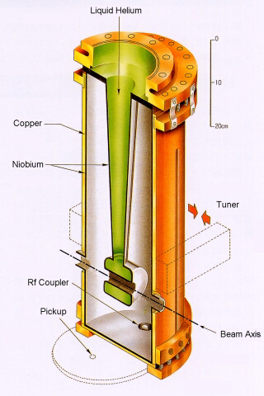
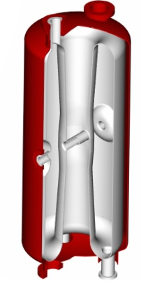
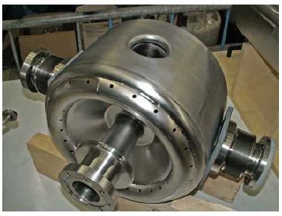
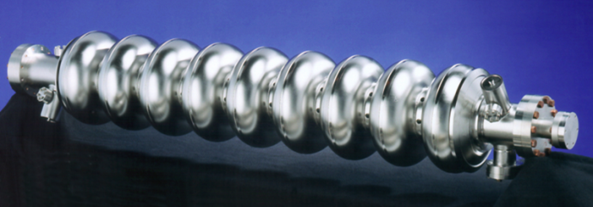
Typical Accelerating Cavities for Low Velocity Particles
Accelerating Cavity for High Velocity Particles

Slide 10
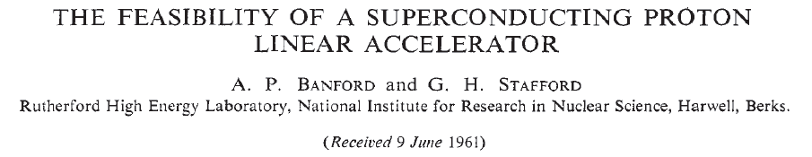
> 50 Years Ago !
1961
A. P. Banford and G. H. Stafford
  Plasma Physics, J.Nucl. Energy, Part C, 3, 287(1961)

Slide 11
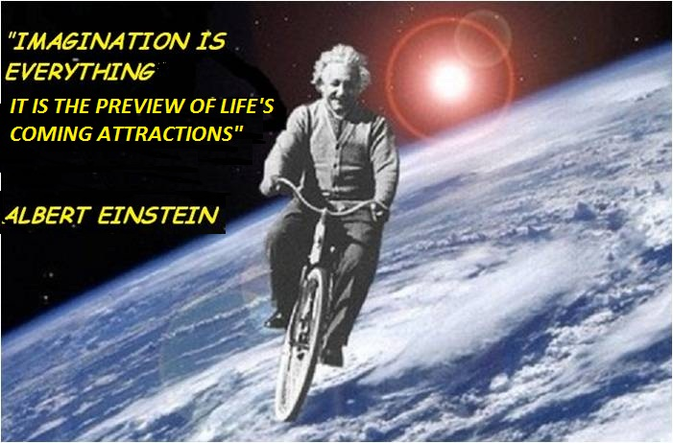

Slide 12
1962: Stanford Pioneers:
Small Scale TE011 and TM010 Cavities
Fairbank, Schwettman and Wilson, Turneaure
obtained a Q of 10¹⁰ at 1.7°K
And near 30 MV/m acceleration field with cavities machined from solid Nb

Slide 13
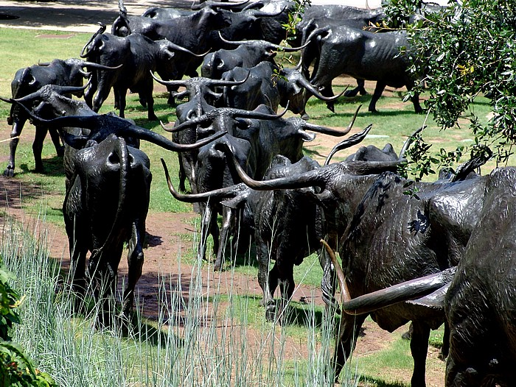
Stanford Charges Ahead!

Slide 14
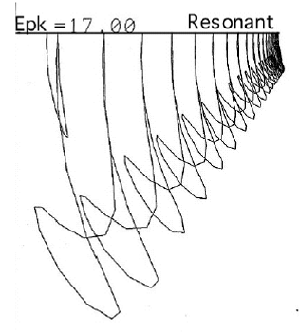
Stanford Charges Ahead !
1963: The Stanford group published a preliminary design:
  20 GeV !!!!! - 10% duty cycle superconducting accelerator
This at a time when no real cavity had ever been built!
A bit less ambitious
Prof. Robert Hofstadter made plans to build a 2 GeV superconducting accelerator
  At gradient of about 13 MeV/m.
Despite heroic efforts, they obtained a gradient of only 2-3 MeV/m in full scale accelerator structures at 1.3 GHz
Electron multipactor was the culprit.

Slide 15
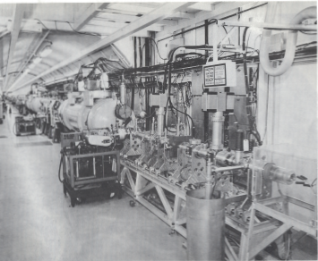
1970’s Snatching Victory from the Jaws of Defeat!
The superconducting accelerator structure is 48 m in length operating at a gradient of about 3 MeV/m, giving a final energy of 600 MeV.
Nevertheless:
Demonsrated first FEL
Demonstrated 98% energy recovery

Slide 16
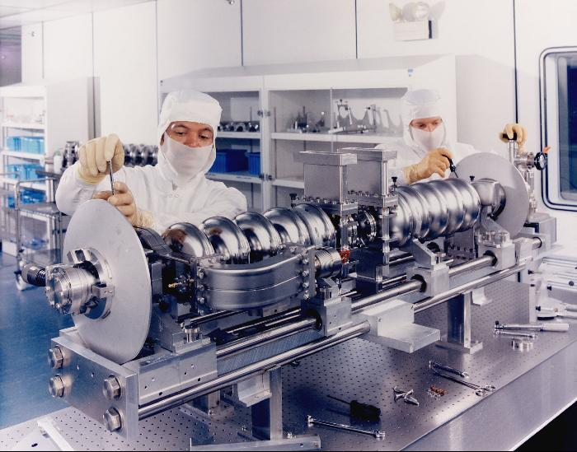
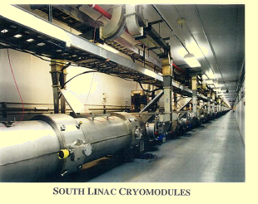
Two Decades Later :JLAB Completes 5 GeV, 5-pass
Electron Recirculator With 300 Nb Cavities

Slide 17
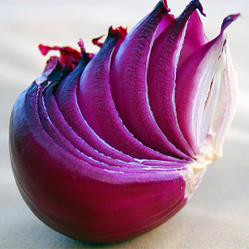
How did we get from 3 MV/m to 35 MV/m?
R&D to Peel Back Layers of Performance Impediments
1975, Multipacting, 3 MV/m
1985, Thermal Breakdown of SC, 6 MV/m
1990, Field Emission, 15 MV/m
1995, High Field Q-Slope, 25 MV/m
Ultimate gradient,
>50 MV/m
2010,
45 MV/m
Q
Breakthrough

Slide 18
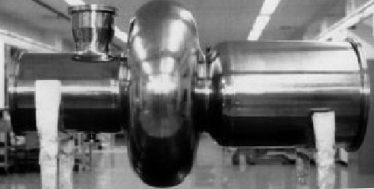
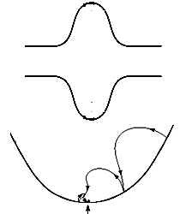
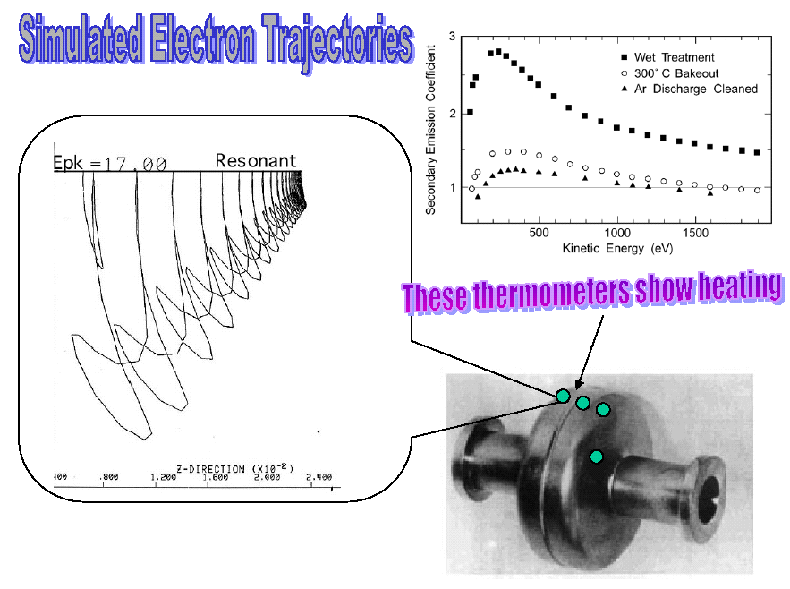
Solution: Spherical/ elliptical cavity shape
Multipacting

Slide 19
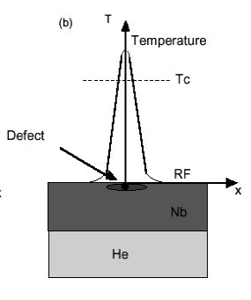
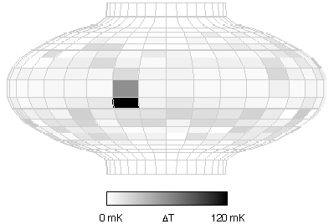
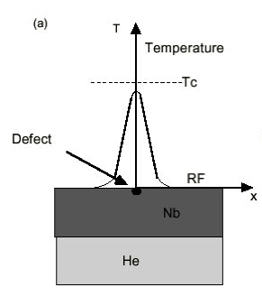
1980’s Thermal Breakdown - Quench
Resistive imperfection leads to heating above Tc, and quench
Solution:
Increase thermal conductivity of Nb
Reduce heating

Slide 20
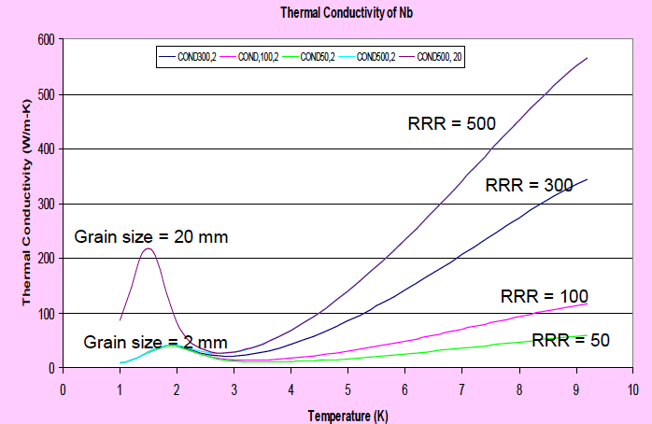
Increase Thermal Conductivity at T > 4.20 K
By Increasing Nb Purity
Nb Purity
Important temp region

Slide 21
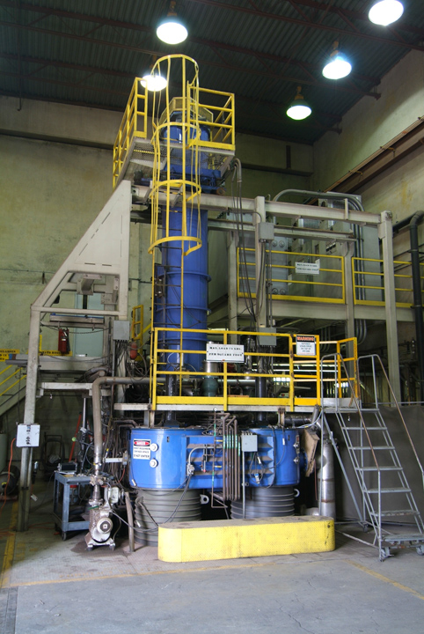
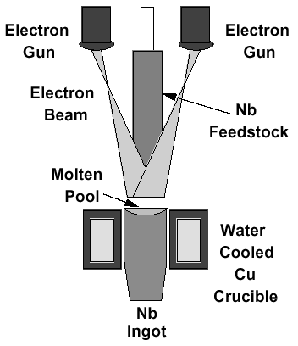
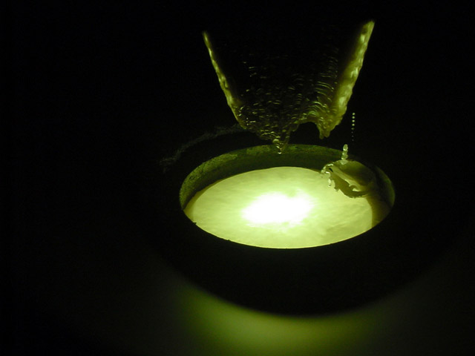
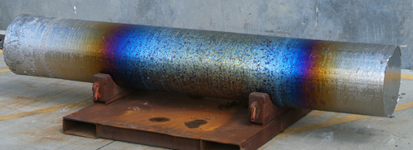
Nb Purification by Electron Beam Melting
Co-operation with Worldwide Industries Wah Chang, Tokyo Denkai, Heraeus…
Nb Ingot
Interstitial O, N and C are the major impurities limiting Nb RRR (purity)
Need to bring down total < 10 ppm

Slide 22
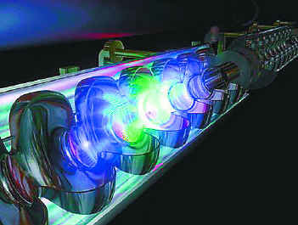
R&D Progress => Technological advances
Many accelerators built with SRF cavities at 6 – 8 MV/m

Slide 23
1980 – 2000 => 7 GeV Installed (500 cavities)
Nuclear Physics
  Ions (total > 1 GeV installed voltage)
    Low Energy
    Nuclear Astrophysics
    ATLAS, ISAC, ALPI….
High Energy Physics- Energy and Luminosity Frontiers
  Electrons (total 12 GeV installed voltage)
    TRISTAN, HERA, LEP-II, CESR, KEK-B, BEPC
  Protons
    LHC
Light Sources
  Electron Storage Rings
    CESR, DIAMOND, CANADIAN-LS, TAIWAN-LS, ESRF, SOLEIL, POHANG
  Free Electron Lasers (FELs)
    JLAB-FEL, JAERI

Slide 24
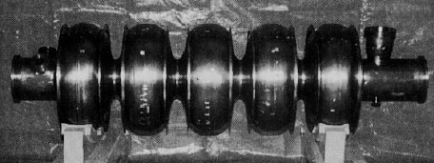
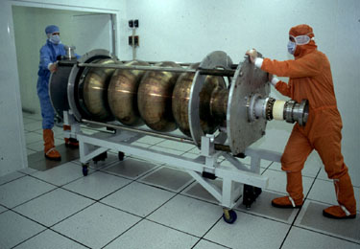
Spherical Cavities For TRISTAN, HERA, LEP, CEBAF, CESR, KEK-B
TRISTAN - KEK
CORNELL -CEBAF
LEP-II
Sputtered Nb On Cu
KEK-B

Slide 25
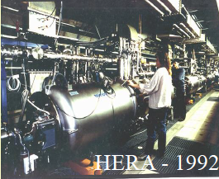
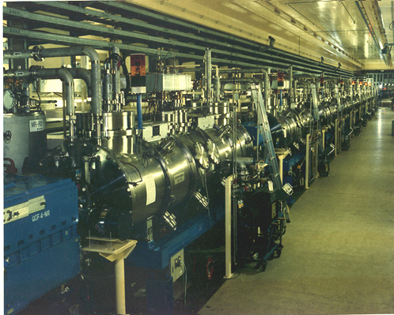
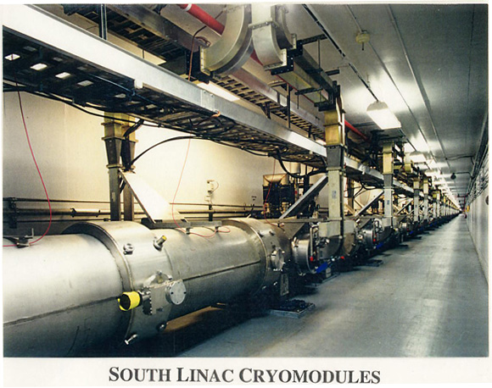
Installed Cryomodules
TRISTAN - 1986
CEBAF - 1995
LEP-II - 1998

Slide 26

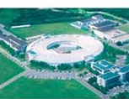

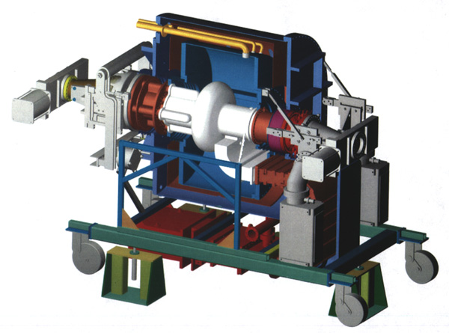
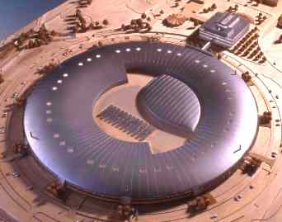
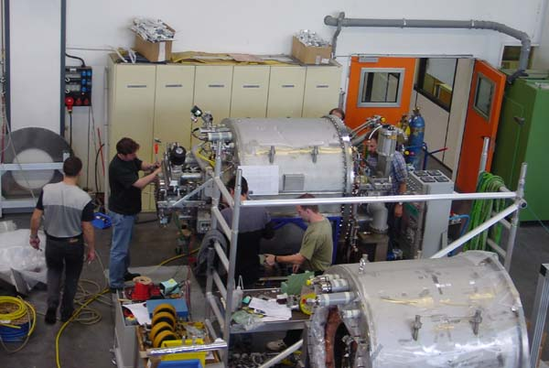
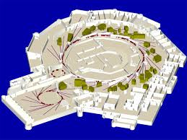


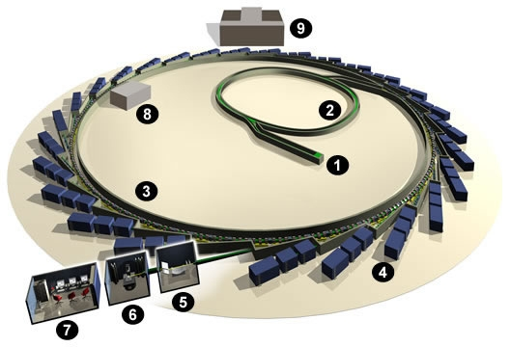

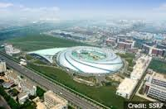
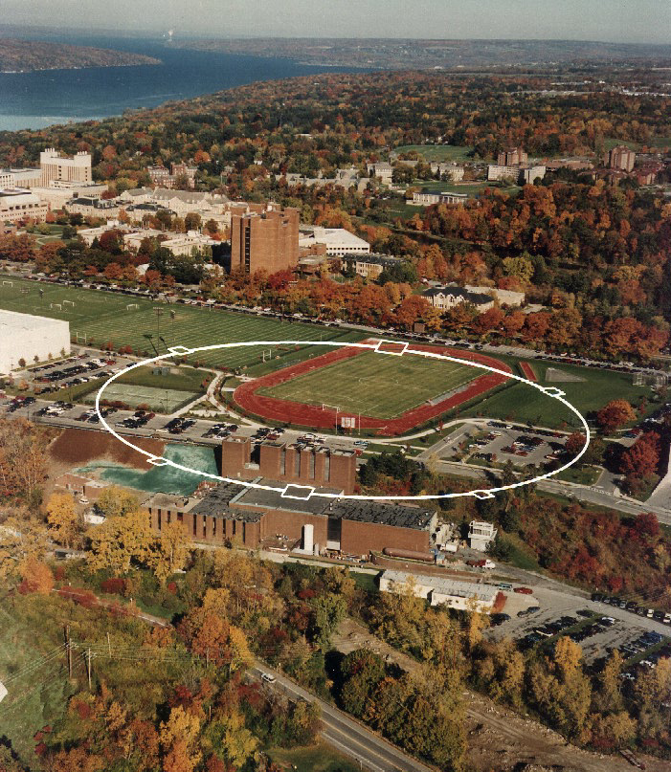
SRF for Storage Ring Light Sources Around the World
Pohang Light Sourrce
NSLS-II, BNL
Shangai Light Source
Taiwan Light Source
CHESS at Cornell
X-ray beam

Slide 27
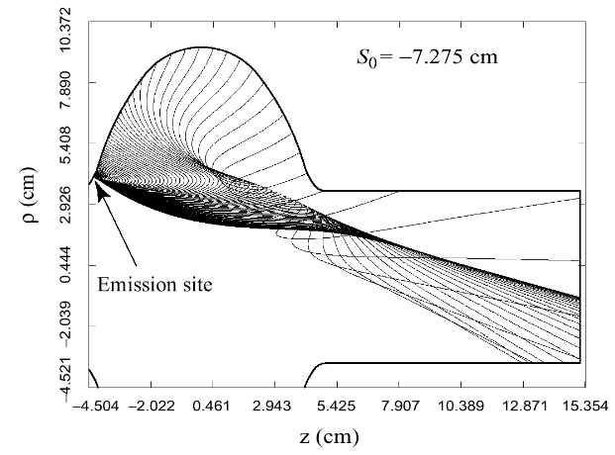
1990- 2000: Above 15 MV/m =>
Field Emission, Q Falls
Understanding
Field Emission

Slide 28


Solution to Field Emission:
Eliminate Surface Contaminants and Dust
High Pressure (100 bar) Water Rinsing
Clean Room Assembly

Slide 29

2000: Gradients and Q Rise to 25 MV/m, 10¹⁰
Next Layer: “High Field Q-Slope”

Slide 30


New Accelerator Capabilities: FLASH at DESY
Gradient 15 – 20 MV/m
56 cavities in 7 modules provide >1 GeV beam:
UV Laser: Lasing at 6.5 nm, now 2.5 nm

Slide 31


SNS (1 GeV protons, > 1 MW Beam Power)
~ 100 Cavities,
Gradients near 15 MV/m, Q near 10¹⁰
2005 The Dream of 1961 Comes Alive !!
Oak Ridge Laboratory - Tennessee
Niobium Cavities, 804 MHz

Slide 32

High Field Q-Slope Solved!
BCP Chemistry gives rough surface
Electropolishing provides smooth surface
Plus 120 baking for 24 – 48 hours

Slide 33


We’ve Come A Long Way!
Field Emission
35 MV/m !!
Q-SLOPE
Thermal Breakdown
Multipacting

Slide 34
> 2010: Dawn of a New Age:
Variety of Accelerators Underway
≈ 2000 Nb Cavities, Installed Voltage will rise from 7 GeV => 25 GeV
CEBAF Upgrade - JLAB (80 cavities)
  Upgrade 6.5 GeV => 12 GeV electrons
XFEL – Hamburg (840 cavities)
  17.5 GeV electrons – for Xray Free Electron Laser – Pulsed)
LCLS-II – SLAC (300 cavities)
  4 GeV electrons –CW XFEL (Xray Free Electron Laser)
ARIEL – TRIUMF
SPIRAL-II – France (28 cavities)
  30 MeV, 5 mA protons -> Heavy Ions
FRIB – MSU (340 cavities)
  500 kW, heavy ion beams for nuclear astrophysics
ESS – Sweden (150 cavities)
  1 – 2 GeV, 5 MW Neutron Source ESS - pulsed
PIP-II – Fermilab – 800 MV (115 cavities)
  High Intensity Proton Linac for Neutrino Beams
Electrons
Ions
Protons

Slide 35
EXFEL
17.5 GeV
World’s largest SRF application
Construction complete!
Cryomodules spec gradient 23.5 MV/m
Commissioning started
14 GeV electron beam
First lasing achieved!

Slide 37

Best Cavities
47 of 420 cavities of RI cavity production exceed 40 MV/m
From M Pekeler, RI

Slide 38

Michigan State University
340 cavities

Slide 39
From Pulsed to CW: XFEL to LCLS-II at SLAC
Need to Raise Q for CW Operation
FNAL Discovery!
N doping drastically increases Q
SRF Linac based on XFEL/ILC technology
  but 100% duty cycle
High gradient (16 MV/m)
High dynamic heat loads
High Q₀ needed to reduce cryogenic loads
Nitrogen Doping
XFEL Preparation
2
120C bake

Slide 40

N doping
Diffusing in a small concentration of nitrogen (about 50 ppm)
Temp
N
pressure
Injection of small nitrogen partial pressure at the end of 800C degassing-> drastic increase in Q

Slide 41

High Q values by N-Doping
Repeatedly on 9-cell ILC Cavities for LCLS-II
Pre-doping state of the art
Standard treatment Q

Slide 42


LCLS-II Prototype Cryomodules
17 CM from FNAL and 17 CM from JLAB
At Jlab
Av Gradient 16.8 MV/m
At FNAL
Av. Gradient > 18 MV/m
Q > 3x10¹⁰

Slide 43



Fermilab Proton Improvement Plan: PIP-II
IS
LEBT
RFQ
MEBT
β=0.11
β=0.22
β=0.51
β=0.61
β=0.9
RT
SC
162.5 MHz
0.03-11 MeV
325 MHz
11-177 MeV
650 MHz
177-800 MeV
(115 Cavities)
Medium-Beta Elliptical Cavities
Spokes
High-Beta Elliptical Cavities
Half Wave

Slide 44

Higher gradients
  35 => 50 MV/m => 100 MV/m?
Higher Qs with higher gradient
  Q > 2 X10¹⁰
New materials
  Nb3Sn…
Non-Accelerator Applications
  Quantum Computing
Material | Tc (K) | Hsh (mT) | E_{acc} (Max) best shape
Niobium | 9.2 | 210 | 57 MV/m
Nb3Sn | 18 | 410 | 107 MV/m

Slide 45

High Q/High Gradient for Nb 1-cell Cavities
Via Nitrogen Infusion – Another Fermilab Discovery!
45 MV/m Q ~2x10¹⁰
A. Grassellino et al
120 C N Infusion
XFEL Prep

Slide 46







Advanced Shape Cavities > 52 MV/m in Single Cells !
With Lower Surface Magnetic Field & RF Lower Losses (Cornell/KEK)
60 mm Re-entrant
CornellKEK
70 mm Re-entrant
CornellKEK
70 mm Tesla Shape

Slide 47

Best Nb₃Sn Result 18 MV/m - Cornell
4.2 K !!
1990 results

Slide 48

SRF Cavities for Quantum Computing
State-of-the-art quality factors Q in ‘quantum computing’ ~10⁸
SRF cavities offer Q values > 10¹⁰.
  Quantum coherent state can persist 100 x longer
Need to demonstrate Josephson Junction(s) in a high Q Niobium cavity at 20 mK to minimize thermal noise.
Need for He3 dilution refrigerator technology to reach 20 mK

Slide 49

HEP Accelerators for Future - Using SRF
-100 km
-100 km
ILC Stage 1 = 20 km, 8000 Cavities, 10x XFEL

Slide 50


500 GeV cm
1.3 GHz Nb 9-cell Cavities | 16,024
Q | Near 10¹⁰
Cryomodules | 1,855
SC quadrupole | 673
10 MW Klystrons & modulators | 436

Slide 51
Summary - Total Installed Voltage
FLASH
MVolt
SNS
XFEL, LCLS2
LEP-II
Jlab
Jlab-Upgrade
Year

Slide 52
Next Decade
ILC SPPC, FCC
ESS
MVolt
XFEL
PIP-II, ERL, e-RHIC

