Slide 1
Update analysis
K. Yonehara

Slide 2
Build algorithm
Reconstruct beam intensity in single HPRF cell from RF signal
Use the past HPRF beam result to develop the algorithm
  Note plasma density is quite different
    10e15 cc in the past beam test
    < 10e13 cc in the LBNF RF cell (2.4 MW)
  So, the algorithm for MTA can be different from the one for LBNF

Slide 3
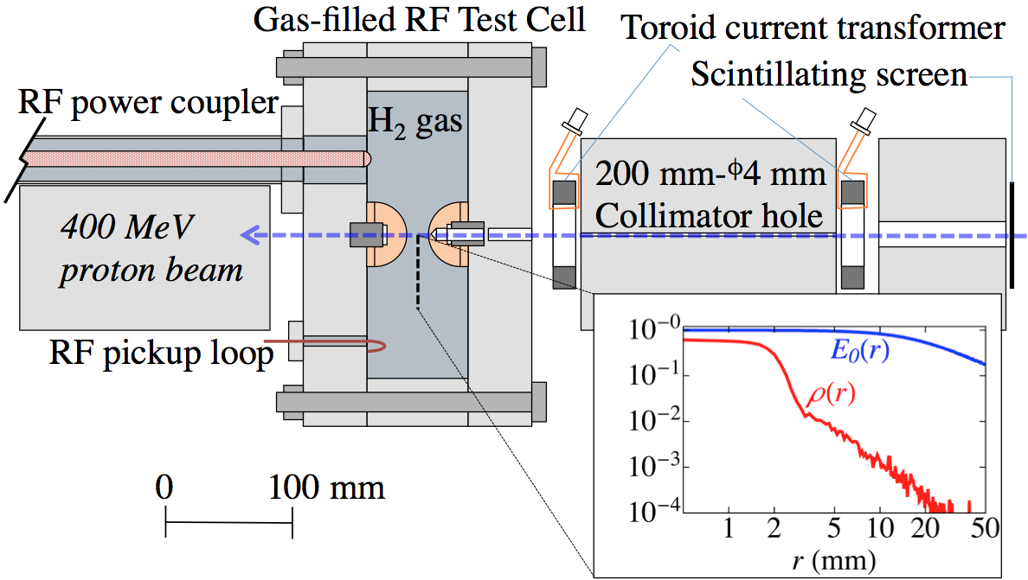
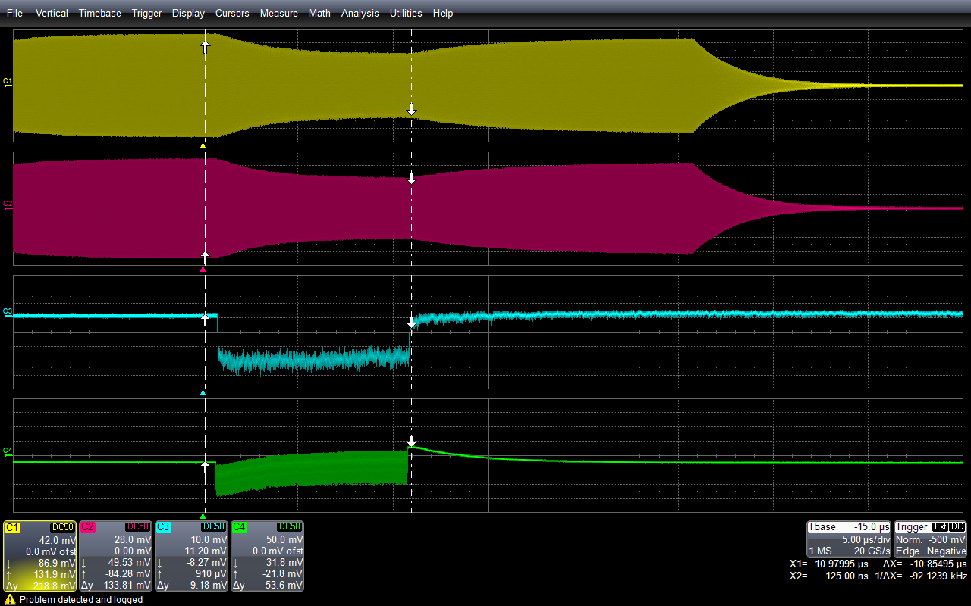
RF Signal in HPRF test cell
• Use H2 + Dry Air
- Data taken in wide dynamic range
- Important plasma parameters were
analyzed with some accuracy
RF pickup 1
Run#65 Pulse#479
Gas pressure = 300 psi
DA concentration = 5 %
Maximum RF amplitude = 5 MV/m
Total beam intensity = 4.1e11 ppp
Beam pulse length = 9.5 μs
RF pickup 2
PMT
Toroid

Slide 4
Energy dissipation
Beam on
Integrated beam intensity (10⁹)
RF envelope was derived from
fitting raw RF signal by trigonal function (use 8 RF cycles for fitting)
RF envelope (mV)
Time (μs)
Deposit energy [W]
Use formula
to convert RF amplitude to the energy deposition in the plasma
Time (μs)
R = 1.48 MOhm
C = 1.53e-12 F

Slide 5
Estimate ion pairs from P
Amount of plasma is estimated
from the formula
15 % discrepancy
Reconstructed beam intensity
from toroid
where dw is
Estimated beam intensity
from RF signal
Time (μs)
μ_{H} = 9.6 cm²/Vs
μ_{O} = 11.4 cm²/Vs
Beam intensity is
• Estimated beam intensity is lower
than the recorded beam intensity
• Discrepancy is ~15 %
• Ion-Ion recombination?
where N_{ionpair} is

Slide 6
Add correction term
α is set to 0.016.
It makes 0.016 times smaller than
what is expected from the observed
ion-ion recombination.
Mystery!!
I must make some mistakes in
my calculation…
η can be a function of X = E/p.
I used a constant (30e-8).
Anyway, this will not be an issue for LBNF
since the plasma density of LBNF is 2-3 orders
of magnitude smaller than that at MTA.

