Slide 1
Hadron Monitor Comments
Avt
9-16-2016

Slide 2
We need to fix a model toy cavity.
We don’t need new measurements to do this.
The voltage level we work at influences the read out, the power source, the rf feed, the cavity pressure, the gas. Everything!
The frequency also has profound effect. For instance cavity size fixes the special resolution.
Next slide shows a comparison of nitrogen and hydrogen with a cavity pressure of 1 atm.

Slide 3
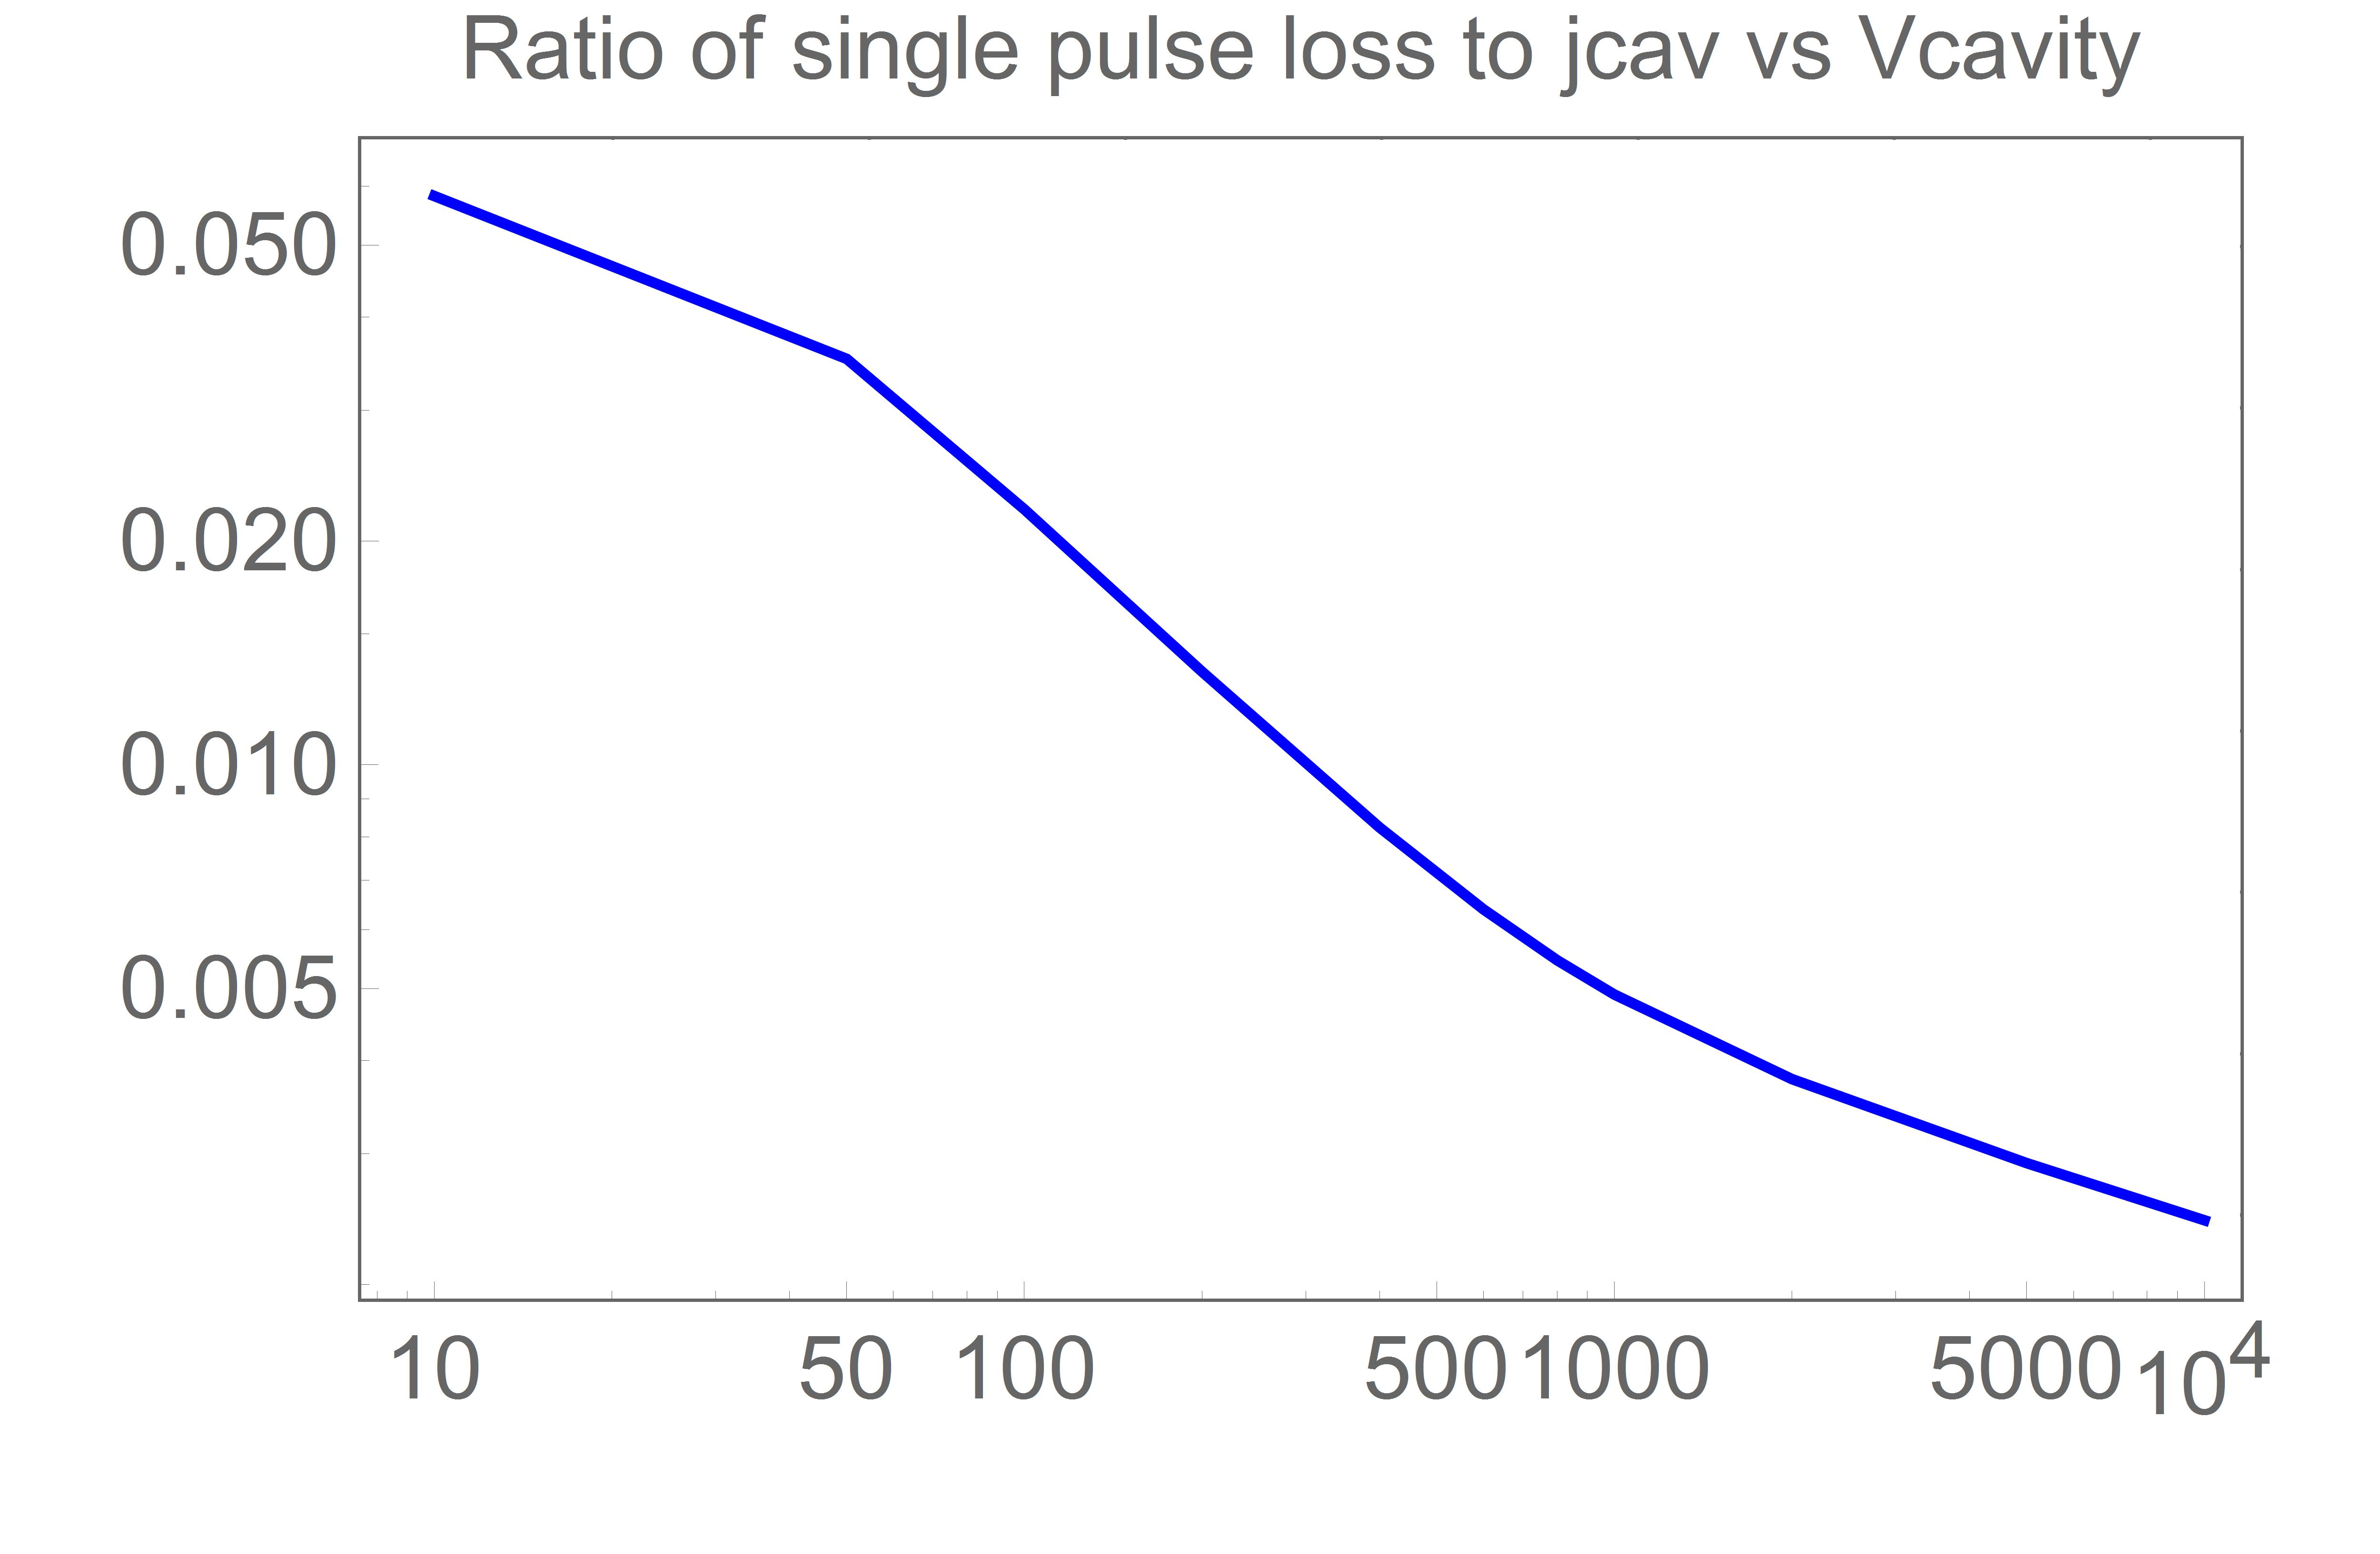
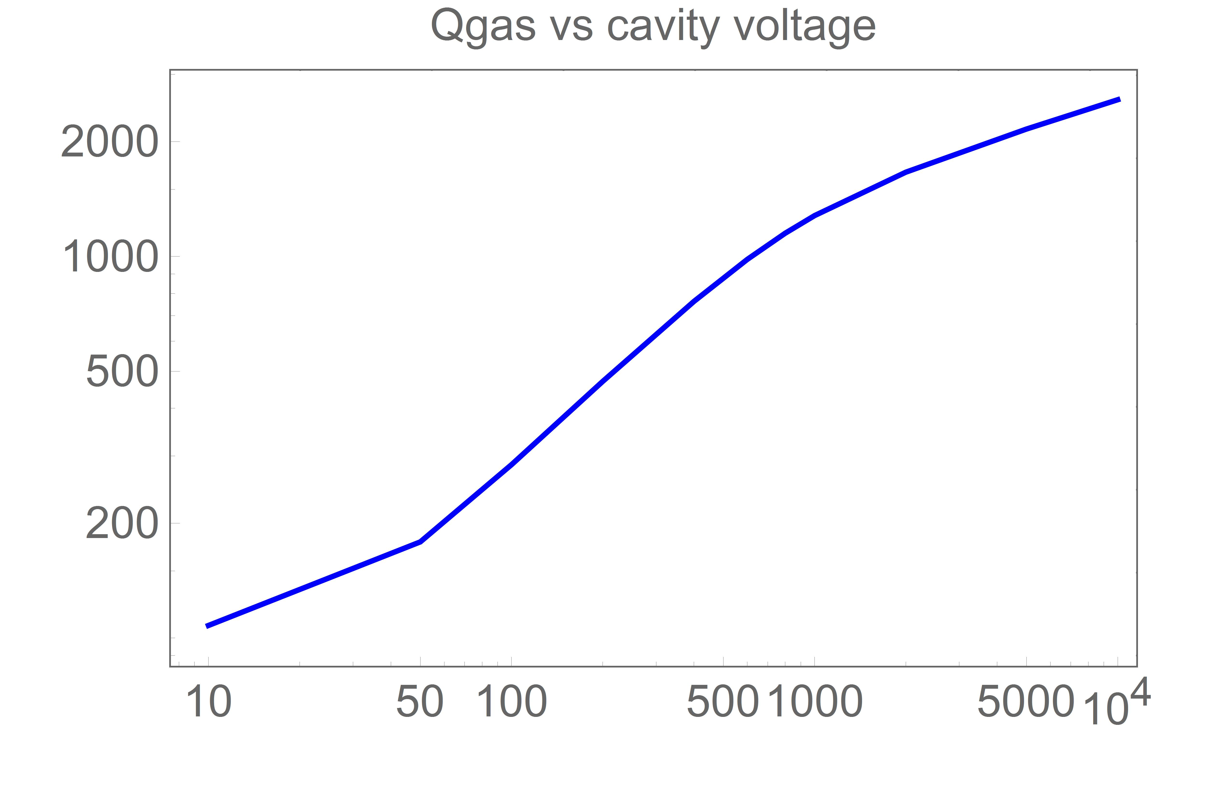
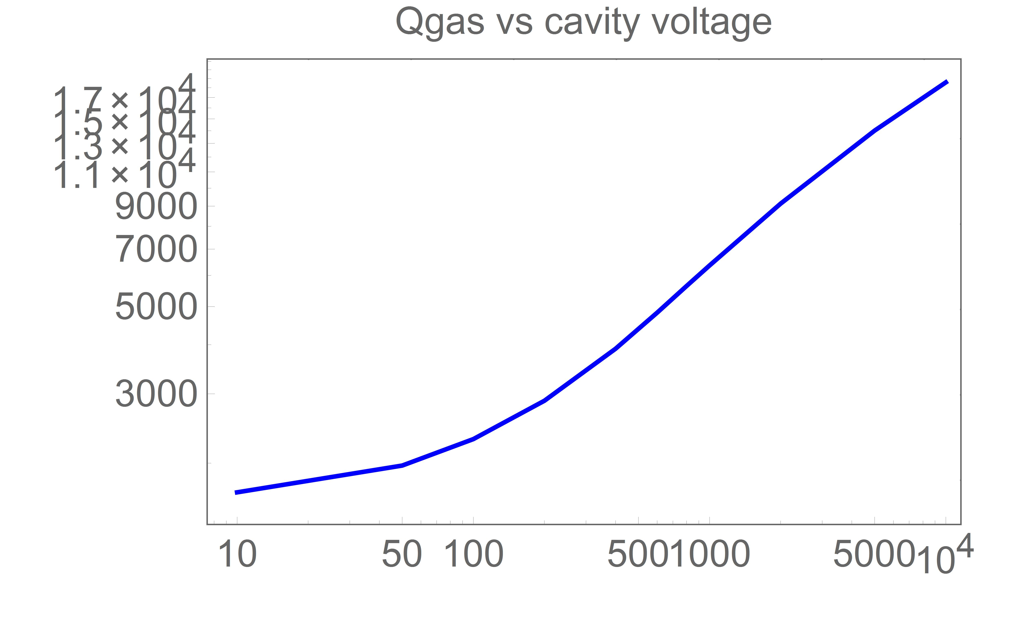
HYDROGEN Qcav = 10^4 NITROGEN

Slide 4
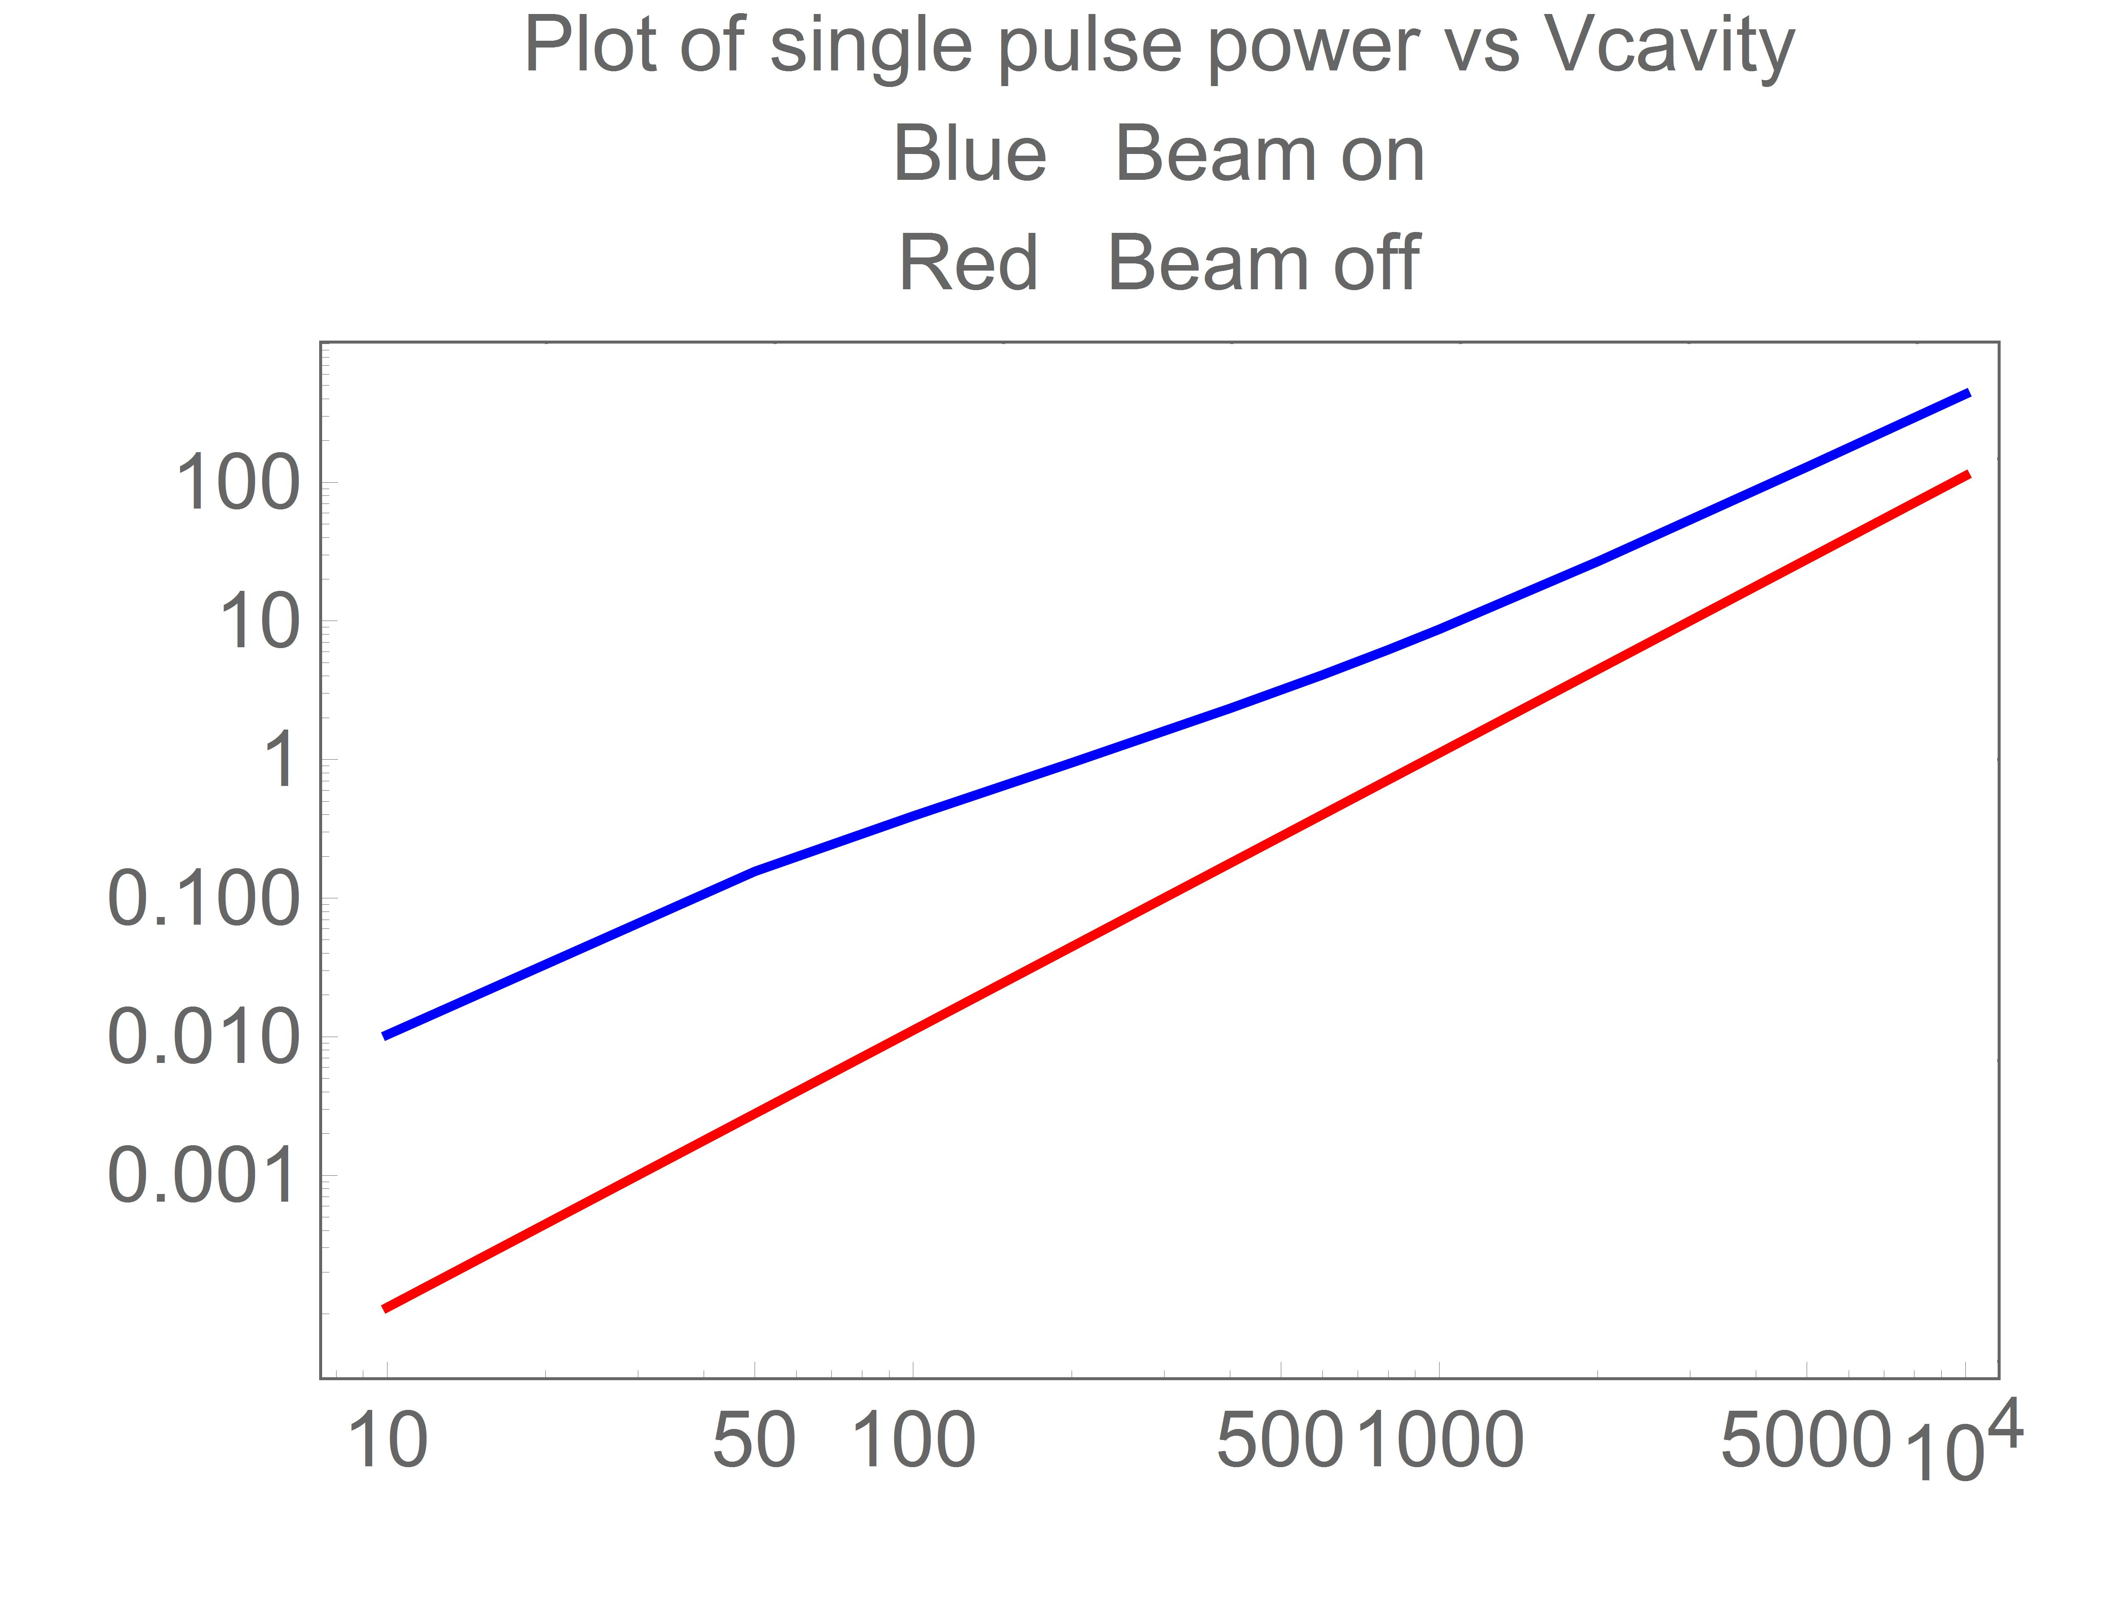
HYDROGEN NITROGEN
Time line: frf = 2800 MHz gives 7.5 cm cell We assume it is 3 x 805
There are 500 beam pulses
20 805 MHz cycles 60 readout cycles

Slide 5
Table of numbers for Nitrogen with Vcav= 100 & 5000
Table of numbers for Hydrogen with Vcav= 100 & 5000

Slide 6
1. Can we fix a model now?
2. Must get energy into the cavity during pulse.
3. The loading of different cells will be different by factors of 100.
4. Does looking at reflected wave make sense?
5. Need Readout line for each cavity.
6. The readout must cope with variations in beam intensity.
7. There will be a varying background signal in the cavity that will limit the smallest signal that can be seen.
8 Need a model of the readout!
9. Above questions will determine the goals of the beam test.

