Slide 1
Field Cage studies and R&D
Francesco Pietropaolo

Slide 2
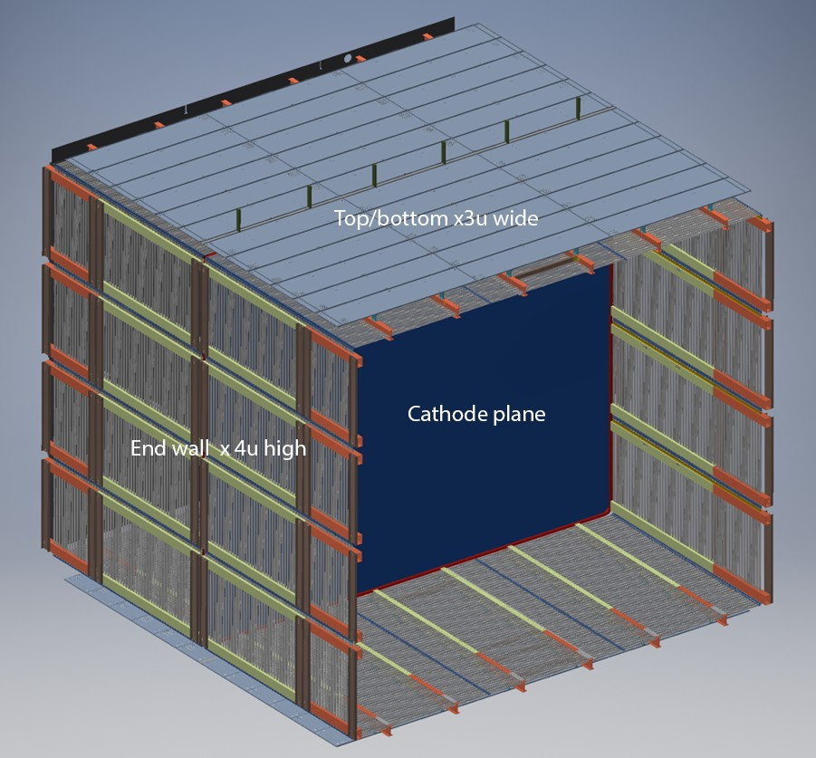
Proposed field cage for DUNE single phase
The present design of the DUNE single phase field cage is based on several independent panles of roll-formed (or extruded) metallic profiles held together through pultruded fiber glass beams.
Each panel will have his own resistor-chain for voltage degrading and will be electrically insulated from the adjacent ones
Ground plane made of punched stainless steel plated are also included
  below the LAr surface to avoid E-field leakage in the gas phase
  above the corrugated membrane walls to further smoothen the E-field in the LAr dead volume.
Baseline option for profiles material choice is stainless-steel; extruded aluminum is the alternative.

Slide 3
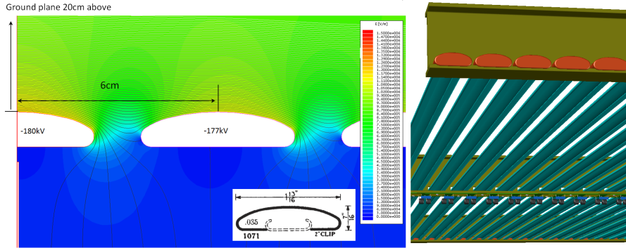
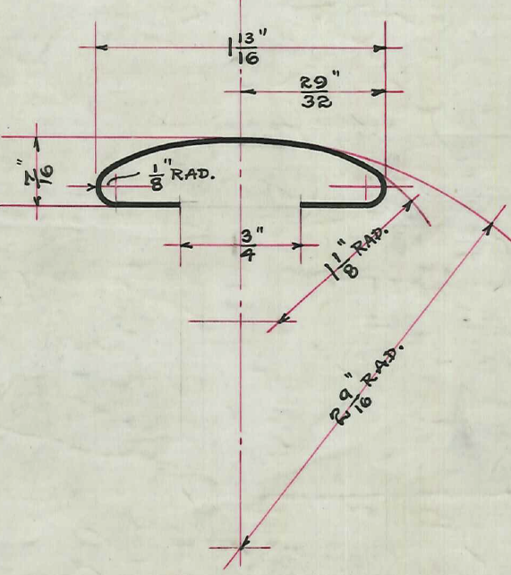
Roll-formed profiles
Open roll-formed metallic profiles for field cage electrodes are preferred for LAr purity considerations.
Optimized shape of profiles allows keeping the electric field strength on the highest biased electrodes under 15kV/cm even with only 20 cm clearance from the ground plates.
A safe way of dealing with the ends of the profiles based on PE caps should allow minimizing the top and bottom TPC clearance thus making more efficient use of the LAr.

Slide 4
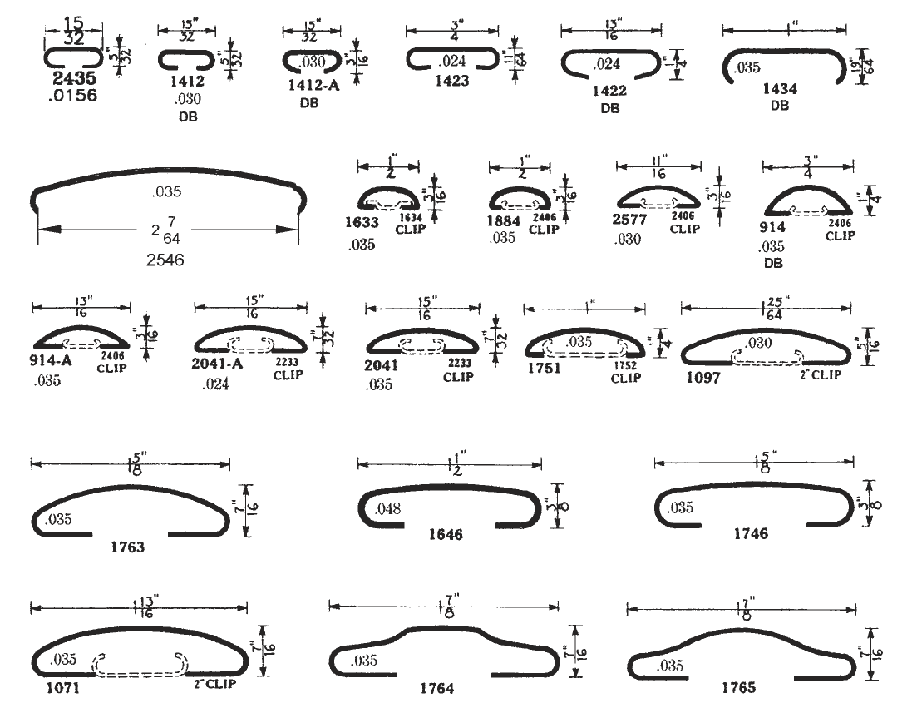
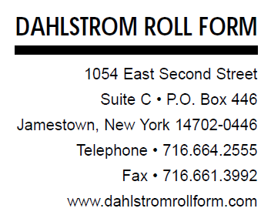
Standard Catalog Shapes
Materials: cold rolled, hot rolled pickled and oiled, high strength low alloy, galvanized and galvannealed steels; stainless steel; copper; brass; bronze; aluminum; and titanium.
Up to 85’ (26m) long
https://www.dahlstromrollform.com/Media/Files/DRF-Full-Catalog-140225.pdf
For application in the DUNE SP Field Cage, in addition to the “standard” choice of Stainless Steel, Aluminum has also been retained due to interesting properties such as weight and production cost.

Slide 5
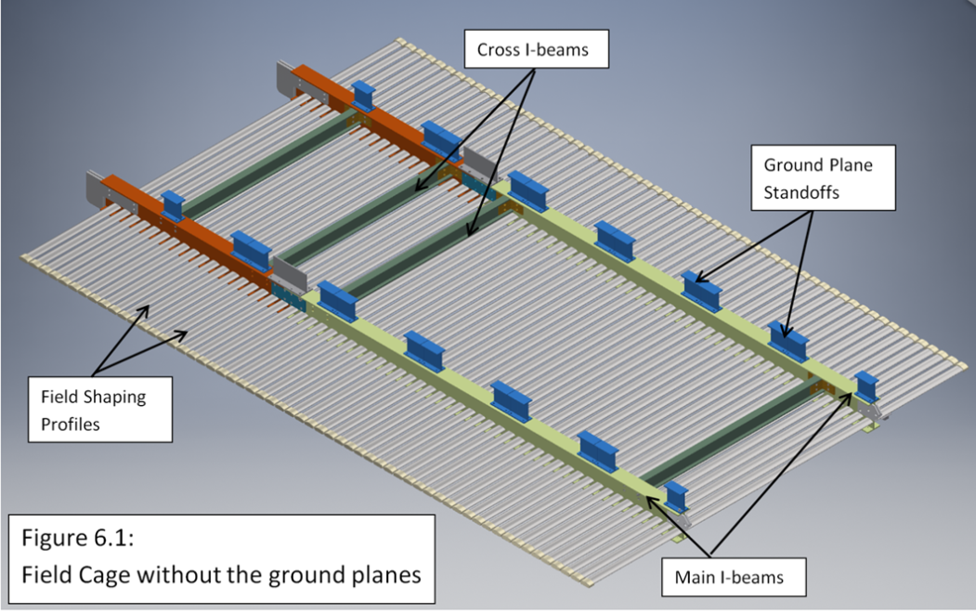
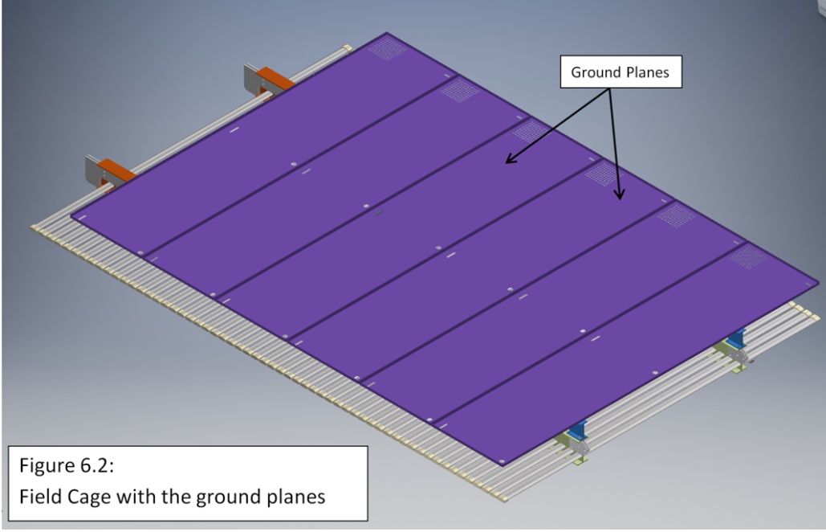
Top/bottom FC
Top/Bottom FC Design:
Each top and bottom panel is as wide as the APA/CPA (2.3 m) and are hold with I-profiled beams (~ 6x3 inches)
Material used for building Structure is Fiberglass Reinforced Plastic (FRP)
Field shaping profiles are of SS (baseline) or extruded aluminum
Ground planes are made of stainless steel and are mounted at a fixed distance of approximately 20 cm away from the top of the field shaping profiles
Total weight ~ 150 Kg

Slide 6
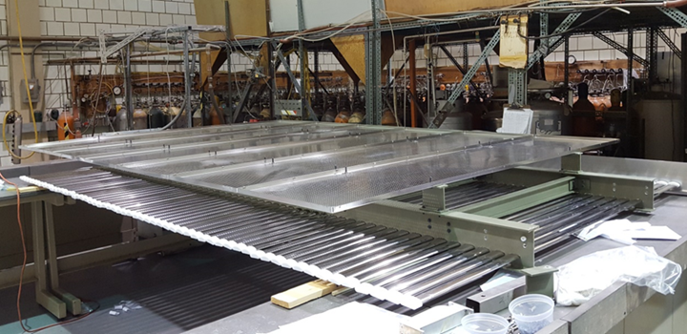
Top/Bottom FC Construction
Mock-ups under construction in US
  Assembly sequence
  Mounting operation
  QA/QC
Structural analysis show minimal deflections (~mm level).

Slide 7
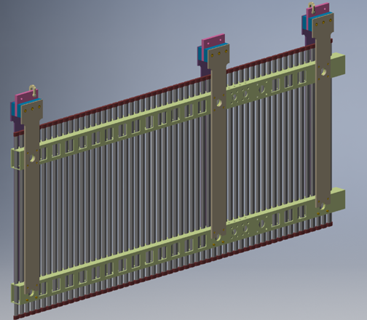
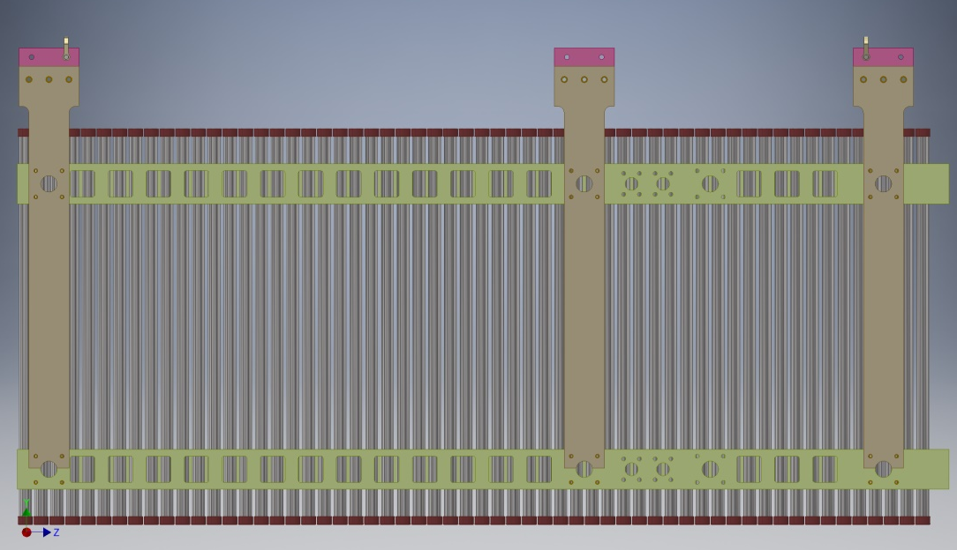
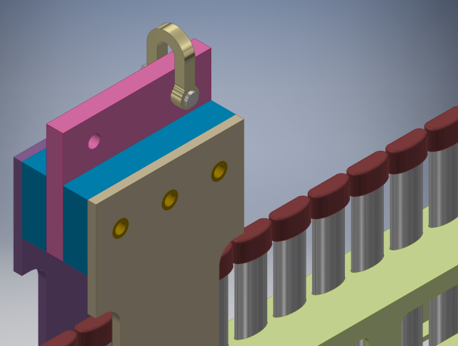
End Wall Panel with Hangers
Vertical Wall FC Design:
Four panels, 1.5m wide, on top of each other to build up to the 6m height of the APA.
Box-shaped FRP beams (~ 6x3 inches) for structural optimization
No ground planes
Similar weight as for the top/bottom panels

Slide 8
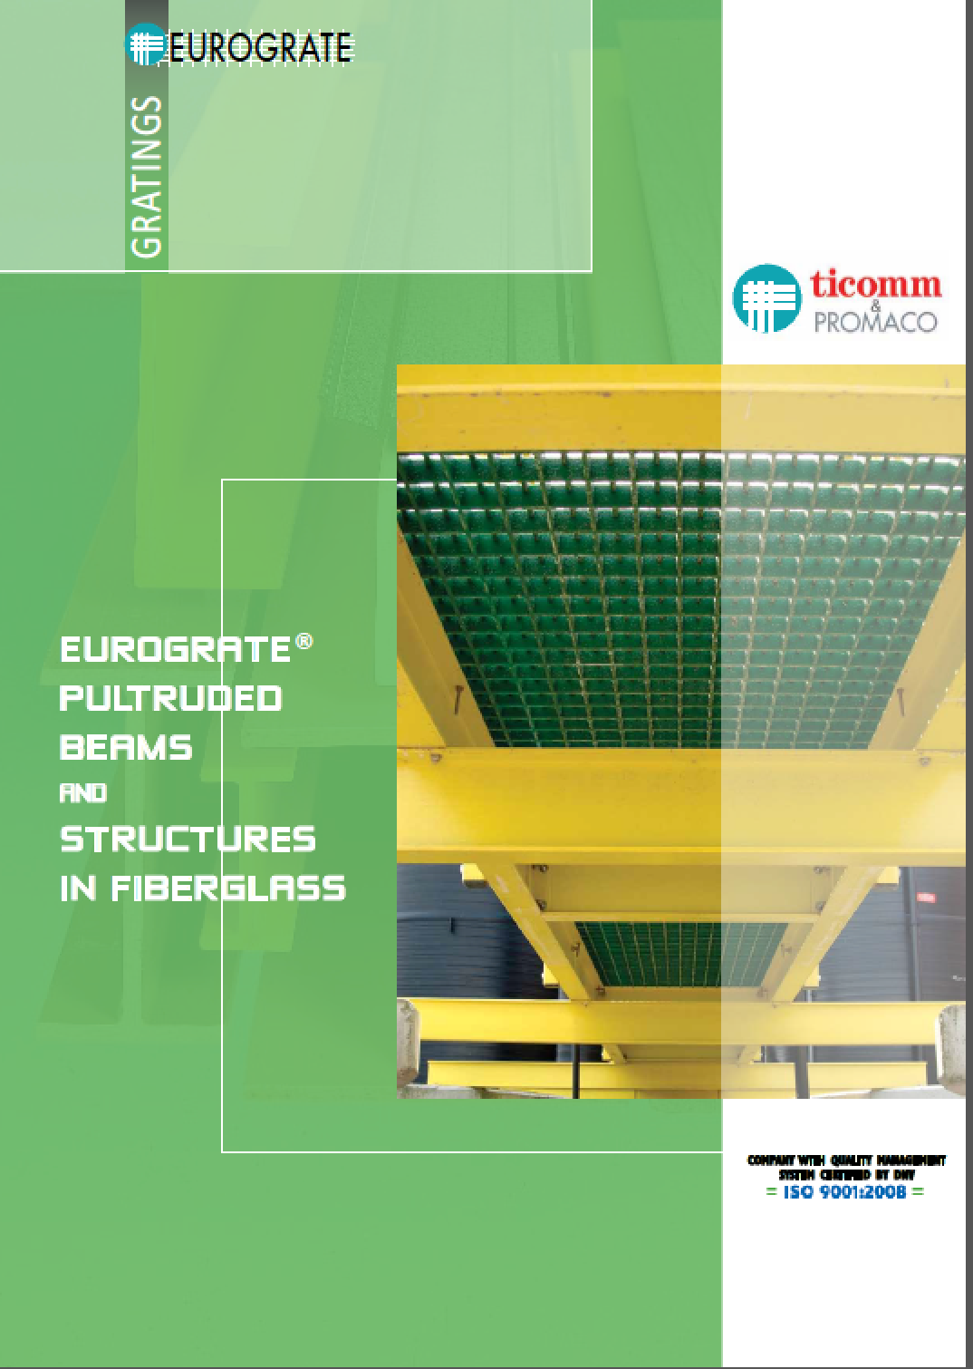
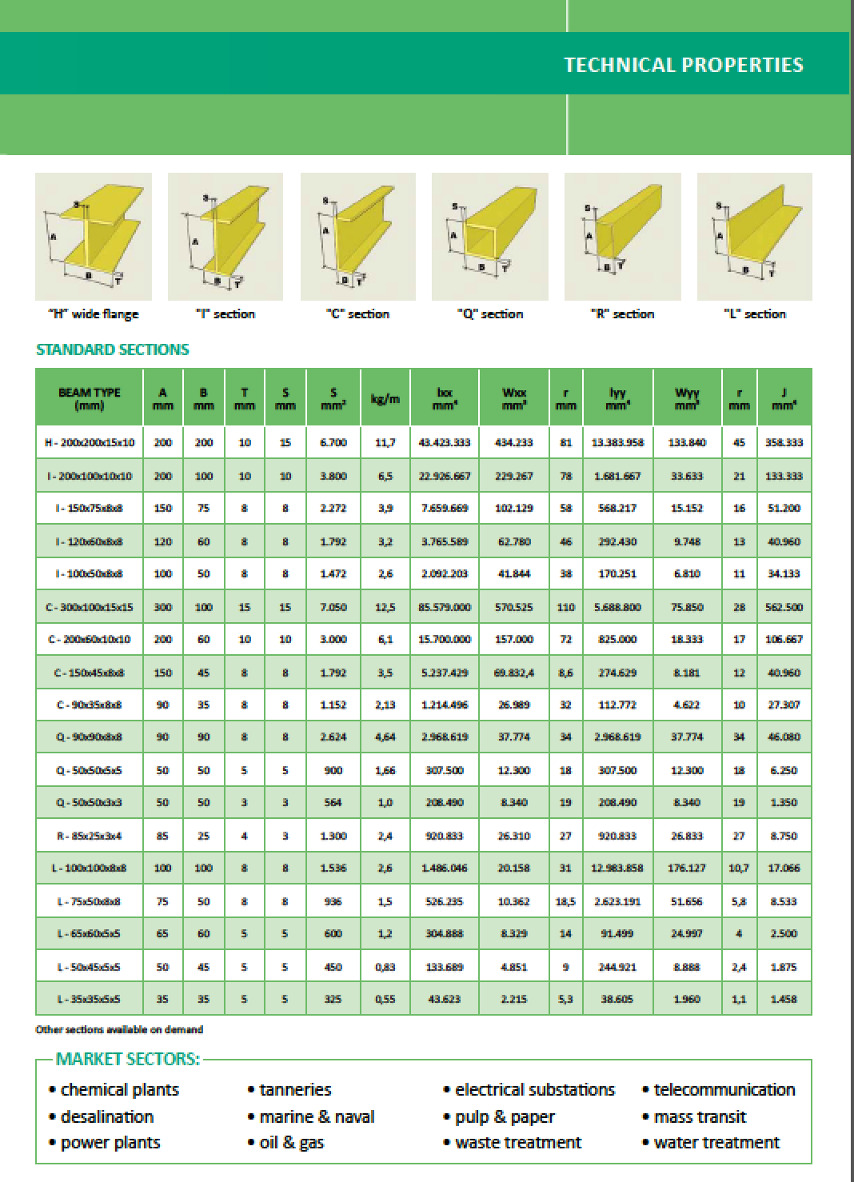
FRP beams availability
Appropriate beam shapes available from standard catalogues both in US and EU.
EU vendors provide also “halogen free” version which is the preferred option at CERN

Slide 9
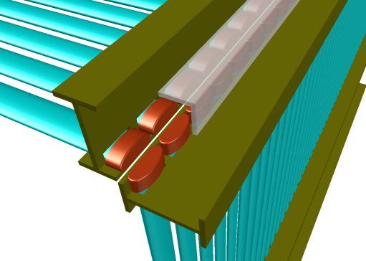
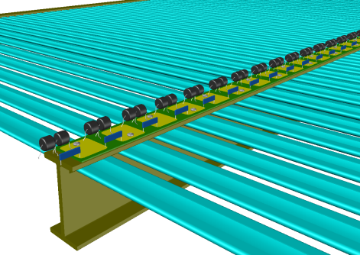
Additional Views of the Design
Corner treatment (UHMW PE caps, and optional PE angles) to minimize the exposed electric field
Resistive divider and surge suppressor chain

Slide 10
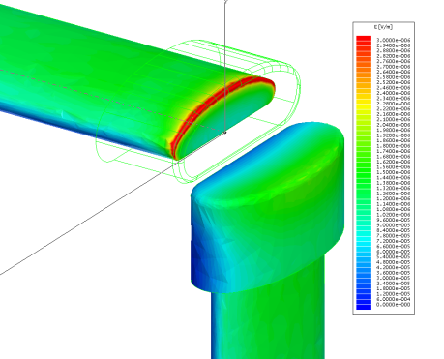
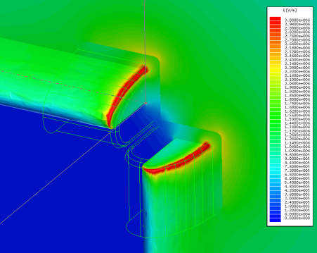
FEA of the field cage corner with PE Caps
20cm ground clearance, -180kV, UHMW PE cap thickness: 5mm
The exposed field in the LAr is ~ 25kV/cm
Plot of the E field on the symmetry plane bisecting the metal profiles
The field in the LAr is ~ 50% higher than the PE cap surface due to dielectric constant difference

Slide 11
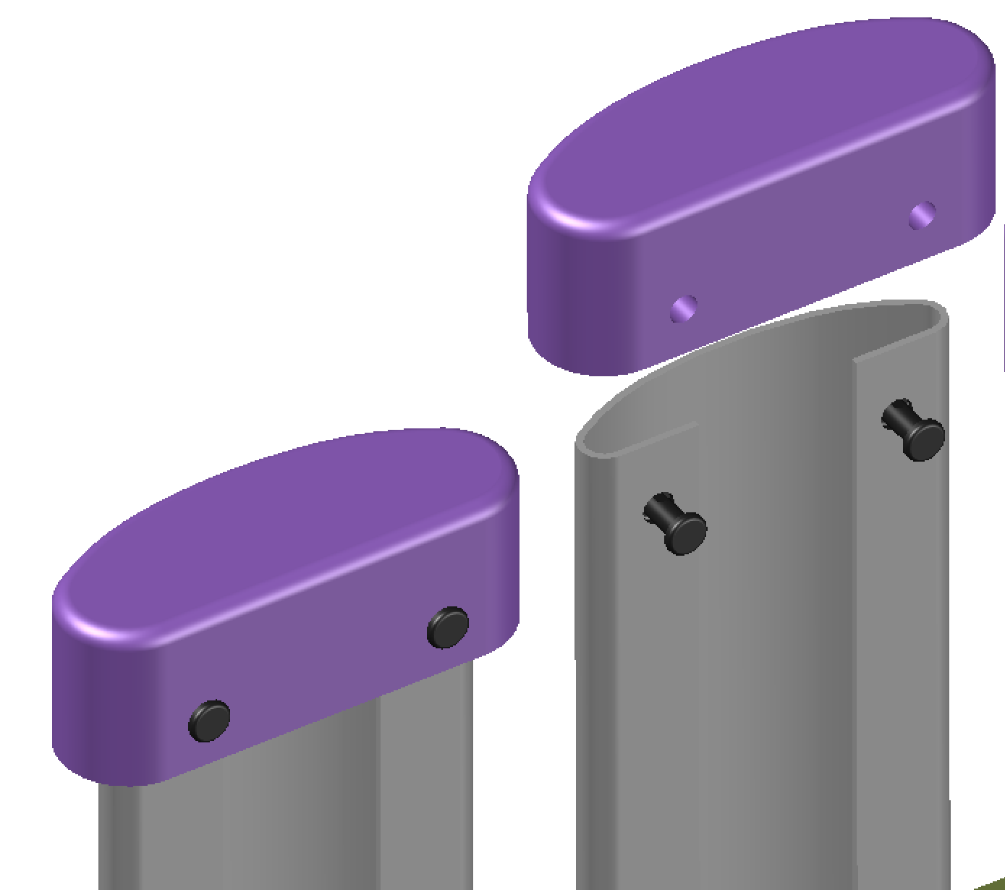
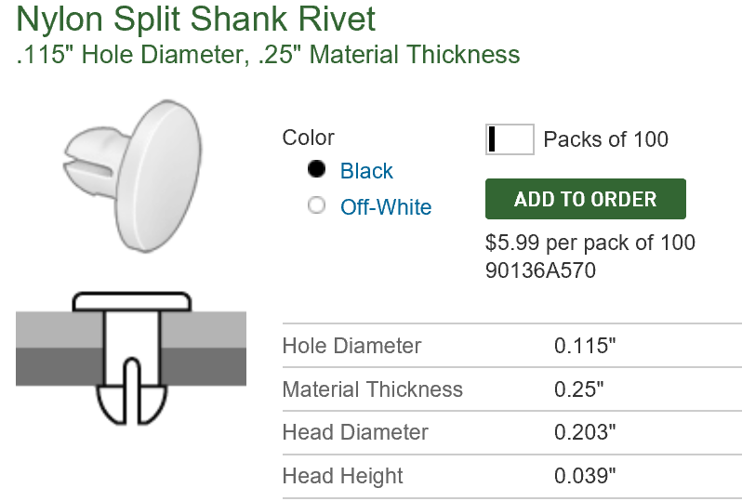
PE Cap Locking
Drill the PE cap, drill the profile, insert 2 nylon rivets to lock the profile with the cap
The caps has been tested in liquid argon without the holes and fasteners. Adding the holes and rivets/screws might reduce the voltage holding capability.
But making the caps deeper and put the screws further away from the profile ends should not increase the risk (the hole locations are currently un-covered anyway).

Slide 12
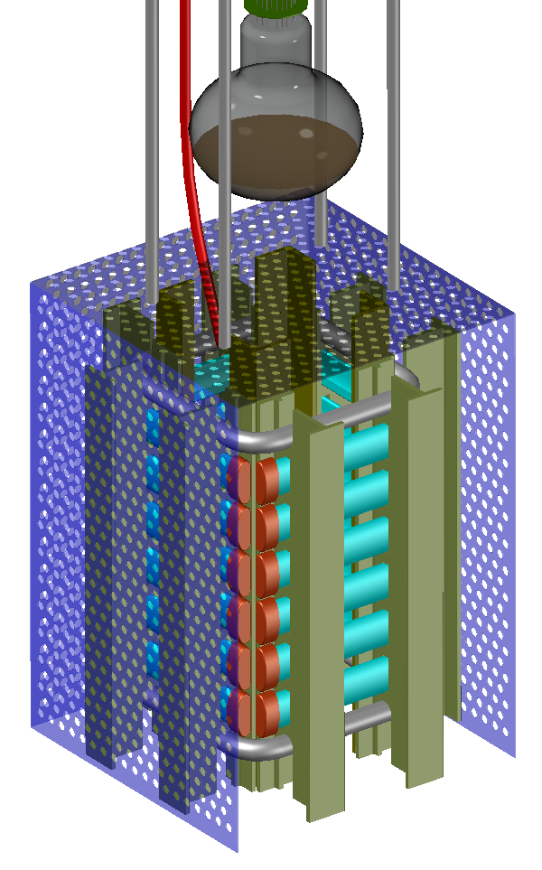
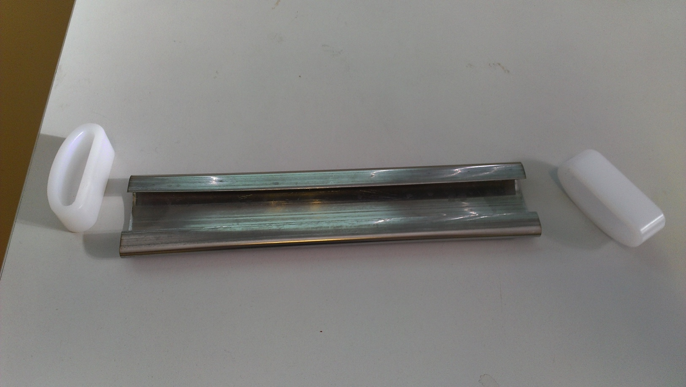
Roll-Formed Field Cage Test Setup
To validate the field cage concept in pure LAr
Designed to fit in the ICARUS 50 liter cryostat
Roll-formed metal profiles with UHMW PE caps
  Choice of metal (Al, SS) and surface finish
Pultruded fiberglass I-beams form 4 mini panels
All profiles are at same potential to simplify
HV connection
Perforated ground planes 66mm away
Requires 1/3 of FD bias voltage to reach
same E field
Ground planes can be connected to external
amplifiers to monitor micro-discharges
PMT detects any light from discharges
Results: up to 100kV over the 66mm gap
No difference between Al and SS profiles
No difference between polished and scratched
profile surfaces
PE caps can hold 150kV in LAr

Slide 13
Stainless steel vs aluminum issues
Both are commercially available in roll-formed profiles
Aluminum lower density could allow overall weight gain up to 20 kg/panel
Aluminum extrusion is also possible, allowing:
  more complex profile shapes (beneficial to optimize mounting and panel assembly procedures)
  sizable cost reduction
HV issues due to surface finishing:
  SS electro-polishing allows a final residual roughness below 1 um
  extruded aluminum exhibits roughness not better than ~5 um
  SS is more robust against scratches during assembly
Aluminum surface gets rapidly oxidized with a layer of insulating alumina:
  this could affect HV long term stability (charging up, Malter effect)
  if needed, it could be treated with low cost thick chemical coating (e.g: ~20 μm electro-less Nickel plating) with improvement of the surface finishing as well
Aluminum higher CTE should not be an issue in the “modular” approach of the DUNE SP Field Cage.

Slide 14
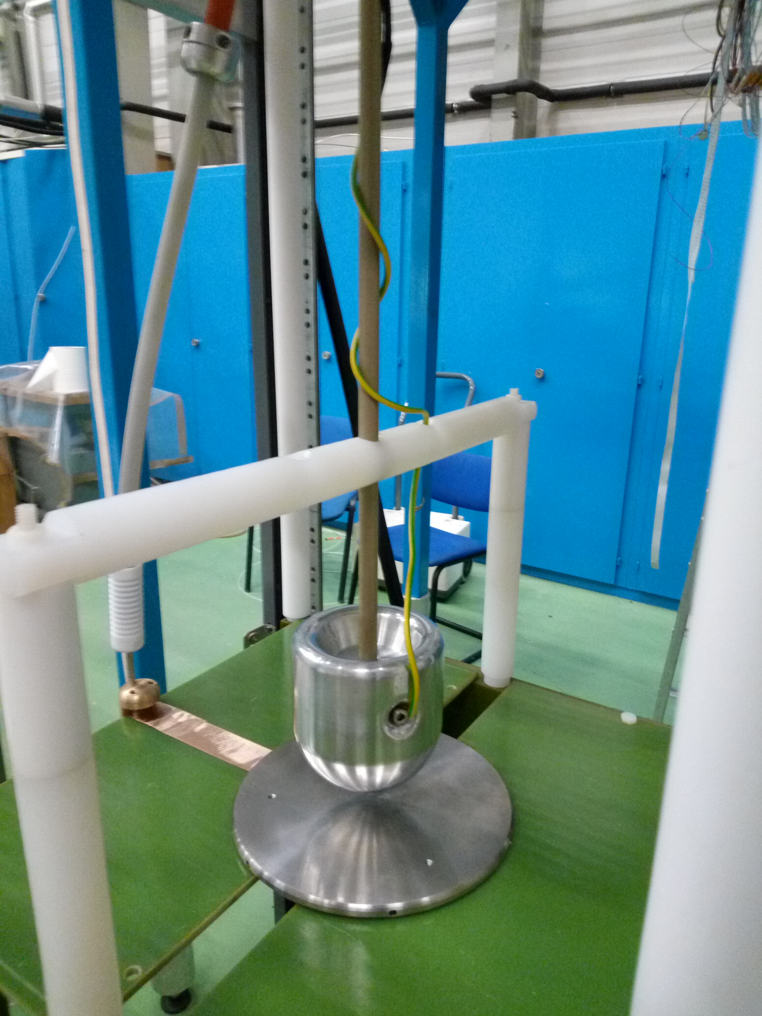
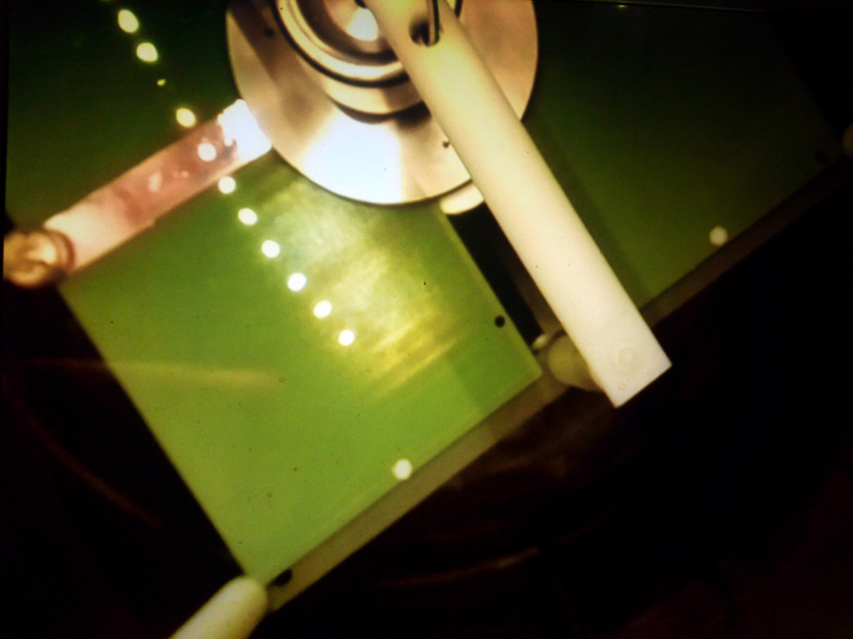
Specific HV test on extruded Al surface
Material for comparison test:
  Extruded aluminum (from ICARUS cold body: ~ 5 μm residual roughness)
  Polished SS (< 1 μm residual roughness)
Negative HV applied in LAr on flat test surface against grounded polished semi-sphere (4.5 cm radius, 1 μm residual roughness) to minimize edge effects.
  Adjustable gap between electrodes (sub-millimetric regulation)
Test finding in LAr (~ ppm purity in 50 liter dewar):
  In stable thermal conditions (without bubble formation), HV values up to 10 kV/mm can be safely applied;
  linear behavior in gap ranging from 1 mm to 5 mm
  Long term stability verified (up to 2 days at the 5 mm gap)
  Instability building up in the 10-11 kV/mm range
  Strong dependence on LAr thermal condition; evident performance degradation after sparks: several hours thermalisation of the LAr bath required before re-applying HV
  No apparent dependence on material and surface finish.

Slide 15
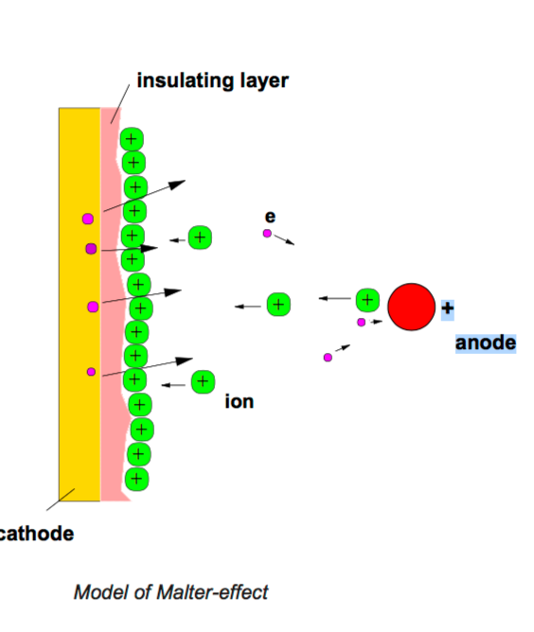
Possible effect of Al surface oxidation
Alumina oxide is known to build rapidly on Aluminum surface in few nm layers.
Due to the good insulation properties of Alumina, charging up of its surface could occur producing high electric field through the insulation layer.
This could result in electron emission through the surface (similar to Malter effect in drift chamber) which in turn could induce noise on FE electronics
  Investigation with the surface treatment experts at CERN, seems to indicate that this effect, if any, should be highly mitigated by density of LAr that strongly reduces the electron mean free path in the liquid, making the electrons stop near the insulator surface contributing to fast ion neutralization.
To test the effect: requires long term exposure of a LAr TPC equipped with Aluminum electrodes.
Further mitigation of this effect could be however obtained with conductive coating.

Slide 16
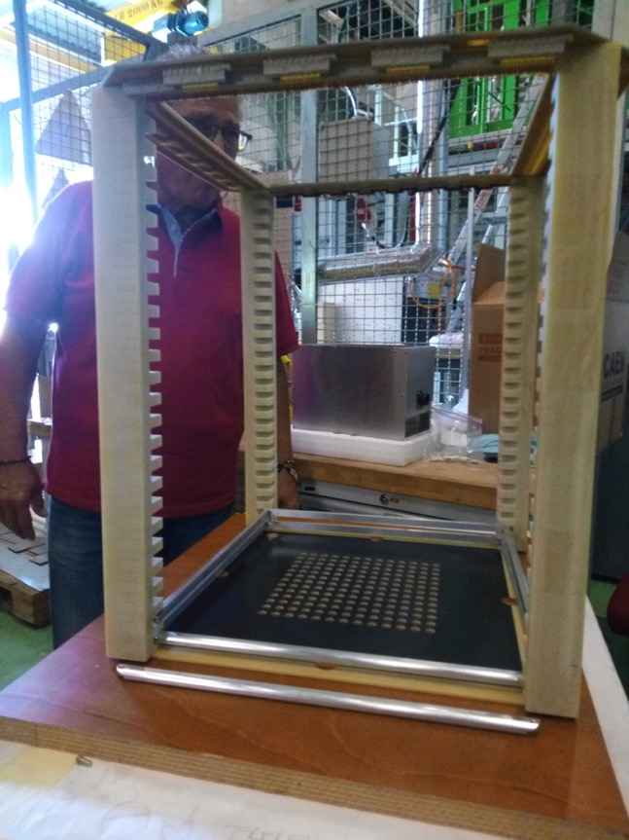
R&D on aluminum field cage
Test effects of possible charge-up due to oxidation on uncoated aluminum surface of FC:
  A new field cage of 50 liter LAr-TPC is under construction.
  50 rings made of uncoated extruded 10x10 mm2 aluminum bars with rounded outer corners (4 mm radius)
  Spaced by 10 mm
  Coupled with resistive cathode
  Minimum distance of rings from detector vessel wall: 5cm
  Max local e-field at ring surface ~ 26 kV/cm (for Vcath=-25 kV, 500 V/cm drift field) similar to ProtoDUNE SP case
Under test by end of September to verify HV stability, electronic noise on wires, possible production of UV light

Slide 17
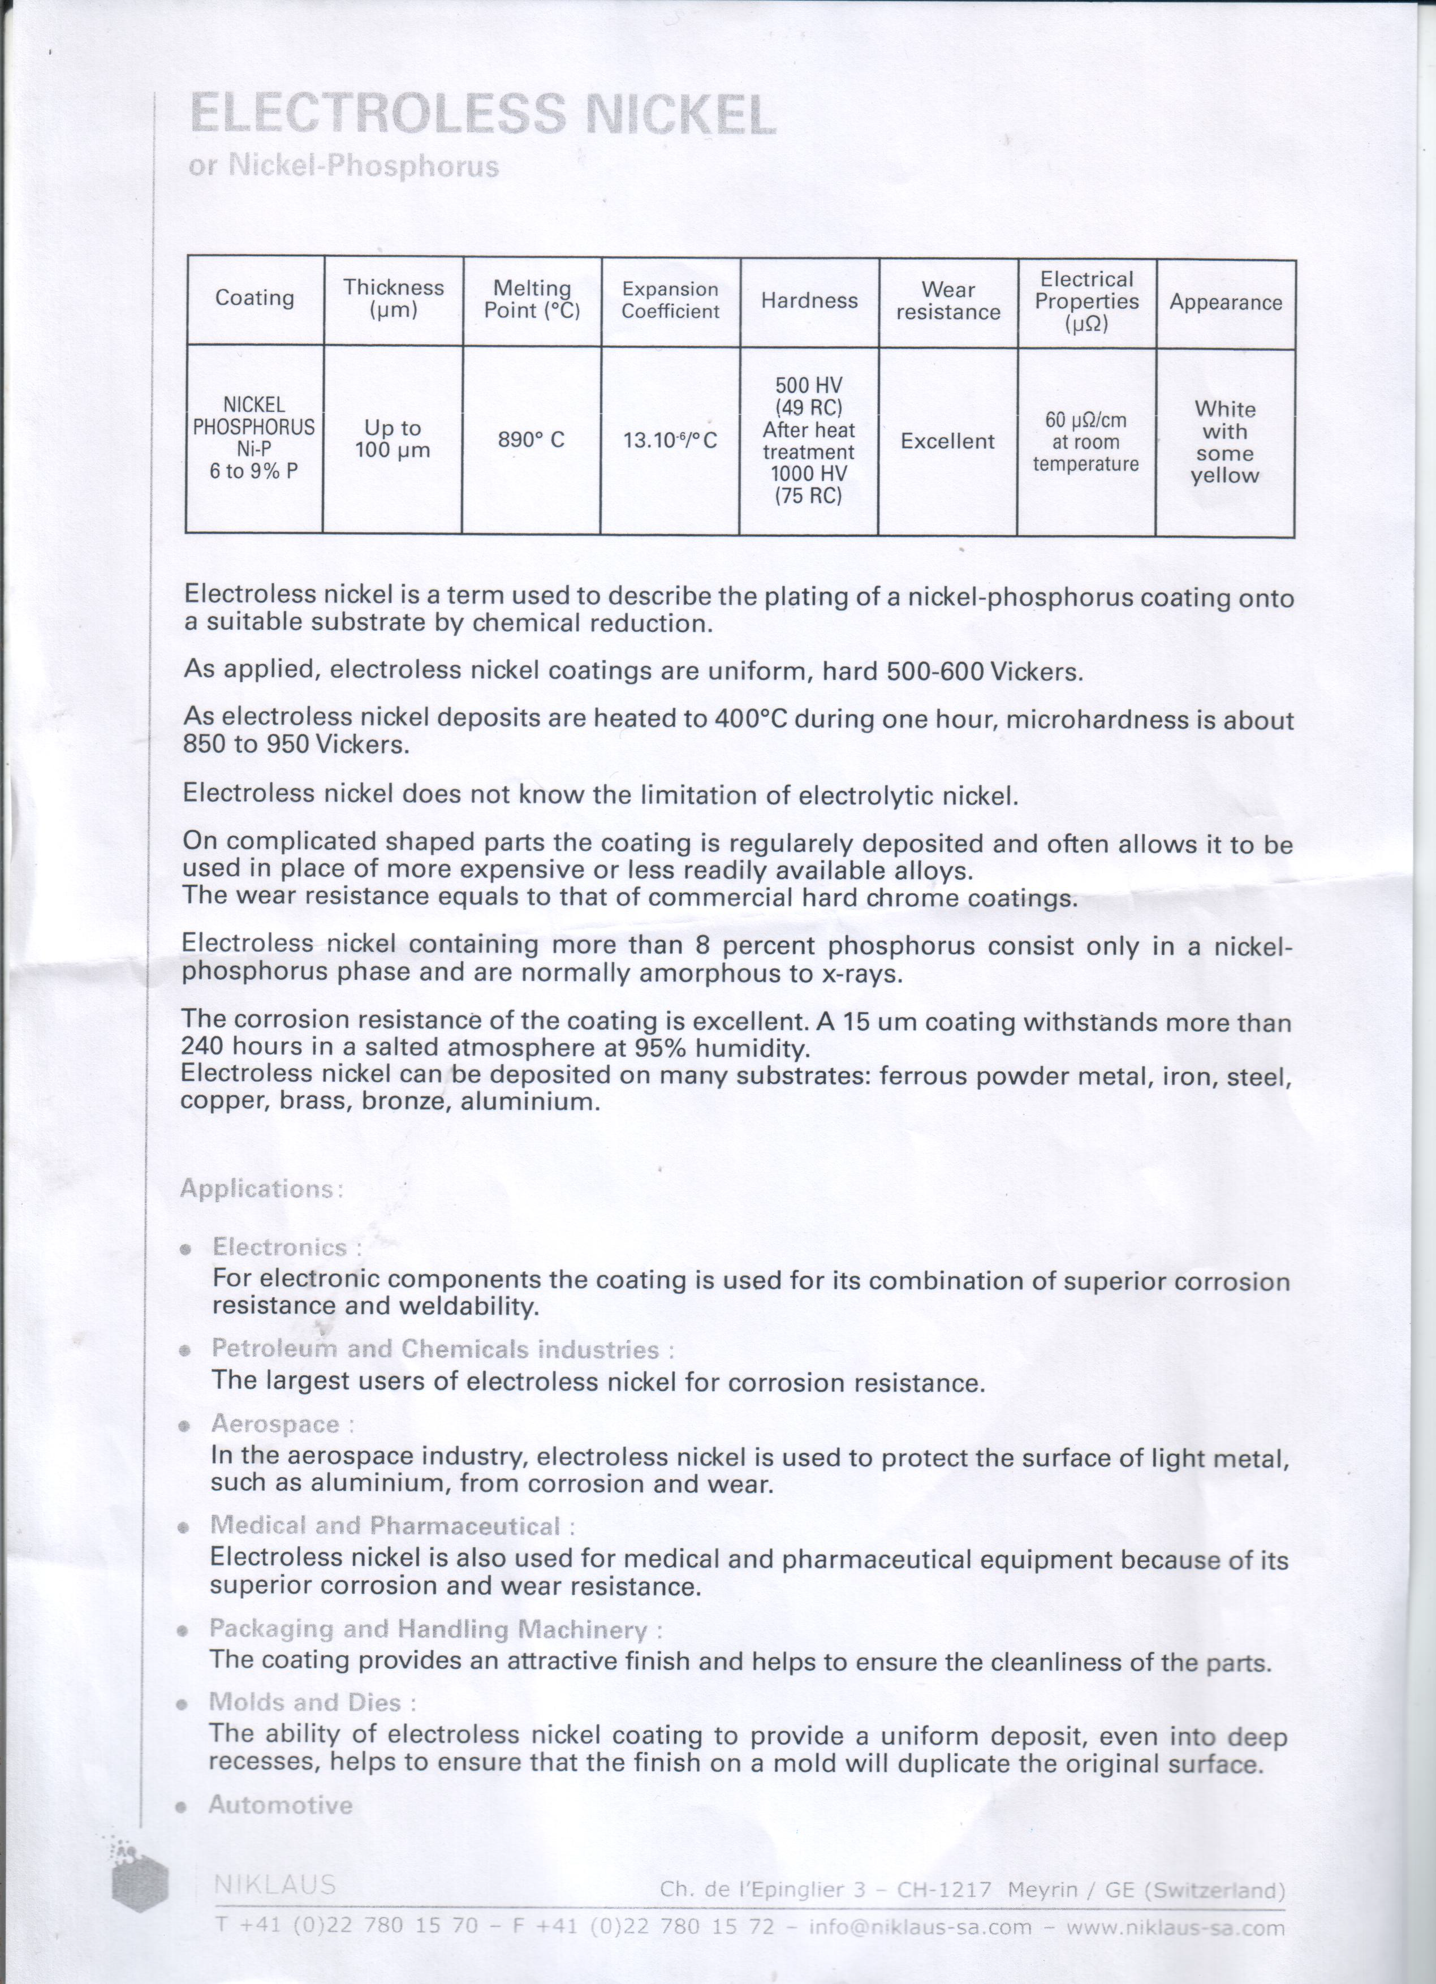
Electroless nickel plating of Aluminum
Chemical deposition. Advantages:
  Thickness up 100 um available.
  Very uniform deposition also on complex shapes.
  Bath available for long profiles (2.3 m possible)
  fast procedure (preliminary extimate: few kCHF for the ProtoDUNE SP case)
  Cons: Expensive!
Positive experience at CERN:
  Nickel plated copper in cryogenic environment
Test on small scale aluminum profiles under way:
  stability to temperature gradient
  Robustness to scratches
  Surface finish

Slide 18
Summary of SS vs Alu
No strong indication in favor or against Aluminum vs Stainless Steel arisen from the HV tests on small scale set-up.
  Both metals are compatible within similar safety margin with the present DUNE SP field cage design (in terms of HV and electric field requirement)
  Instability due to possible Al oxide layer formation were not disentangled and could be however cured with conductive plating.
  Robustness to scratches has been checked up to 100 μm depth
The choice can then be made based on other design considerations (weight, profile shape optimization, production costs, …)
Present strategy for ProtoDUNE SP: FC design based on stainless steel profiles but fully compatible with aluminum
Aluminum prototyping and full profile procurement done in parallel at CERN to allow a choice as late as possible based on:
  New CERN small TPC tests
  ProtoDUNE CPA/FC/HV test at FNAL in the 35 ton facility

Slide 19
Survey on extruded profiles production
Several companies have replied to the CERN enquiry:
  MIFA-Netherland
  SAPA-Sweden
  PROFALL-Italy
  ALEXIA-Italy
  Alu Menziken, Switzerland
They all propose aluminum extrusion. One selected SS extrusion company (from Switzerland) has declined to propose an offer.
Any profile shape is is acceptable for most vendors.
Same aluminum type:
  AW 6060-T6 or T5 (PROFALL) and (AW6101 for ALEXIA)
Similar cost of the die:
  ranging from 1000 to 1400 Euros.
Similar delivery timelines:
  3/5 weeks for the die and prototyping
  3/4 weeks for full Proto-DUNE SP production (~3 km profile length + spare) after acceptance of prototype samples

Slide 20
Differences in the offers
Company | Aluminum alloy | Die cost (EUR) | Thickness | Conductive coating | Reinforcing ribs | Price/m (EUR) | Delivery time (weeks)
MIFA (NL) | AW 6060 T6 | 1250 | 0.8 | yes (1) | yes | 4.9 7.1 (1) | 5 + 8
SAPA (S) | AW 6060 T6 | 1050 | 1.5 | no | no | 1.75 | 4 + 5
ALEXIA (I) | AW 6101 T6 (2) | 1350 | 0.9 | no | yes | 1.1 | 5 + 6
PROFALL (I) | AW 6060 T5 (3) | 1400 | 1.0 | no | yes | 1.25 | 3 + 3
MENZINKEN (CH) | AW 6060 T6 | 1600 CHF | 1.0 | no | yes | ~1.6CHF | 8
  MIFA optionally include in the offer a conductive coating with SURTEC-650 (~1um) applied in house.
  High conductivity alloy
  Softer alloy

Slide 21
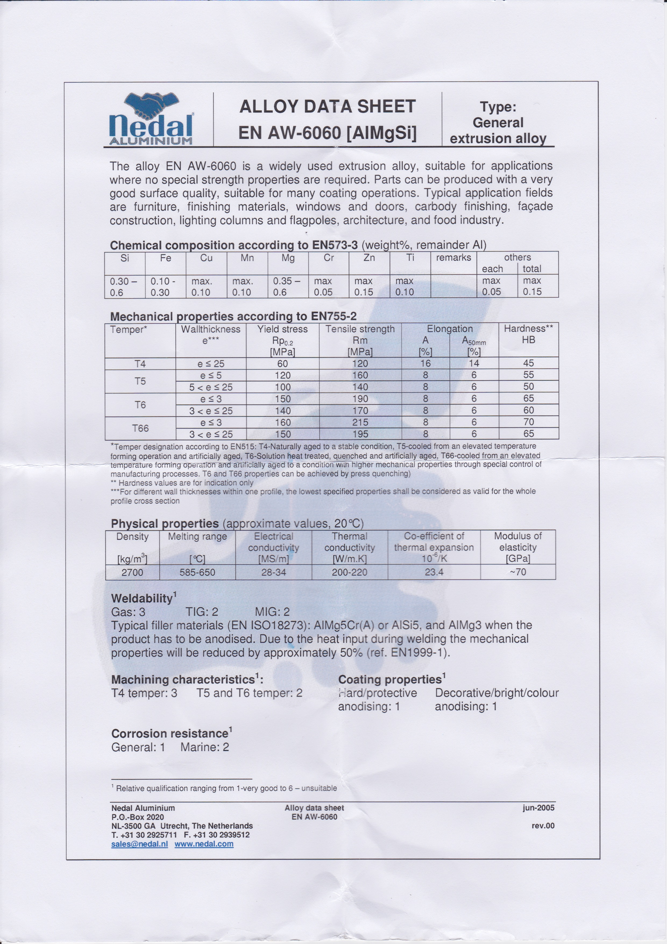
Aluminum Alloys

Slide 22
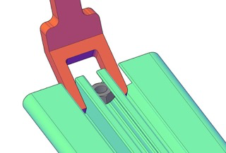
Extruded aluminum profiles for FC
Production:
  Optimization of stiffened aluminum extruded profiles (compatibility with standard locking nuts and tooling for mounting)
  FEA calculation verified at CERN
  Design compatible with the use in NP02 field cage
  Production of prototyping phase started at selected producers sites in Europe (ALEXIA-Italy, MIFA-Netherland) with different aluminum alloy and with the possibility of conductive coating (with some cost increase).
  First 100 m prototype available within end of October (total length sufficient for second phase of the 35 ton HV test): 50m coated, 50 not coated
  Full production (~3km) for protoDune (SP and/or DP) available within few week from green light

Slide 23
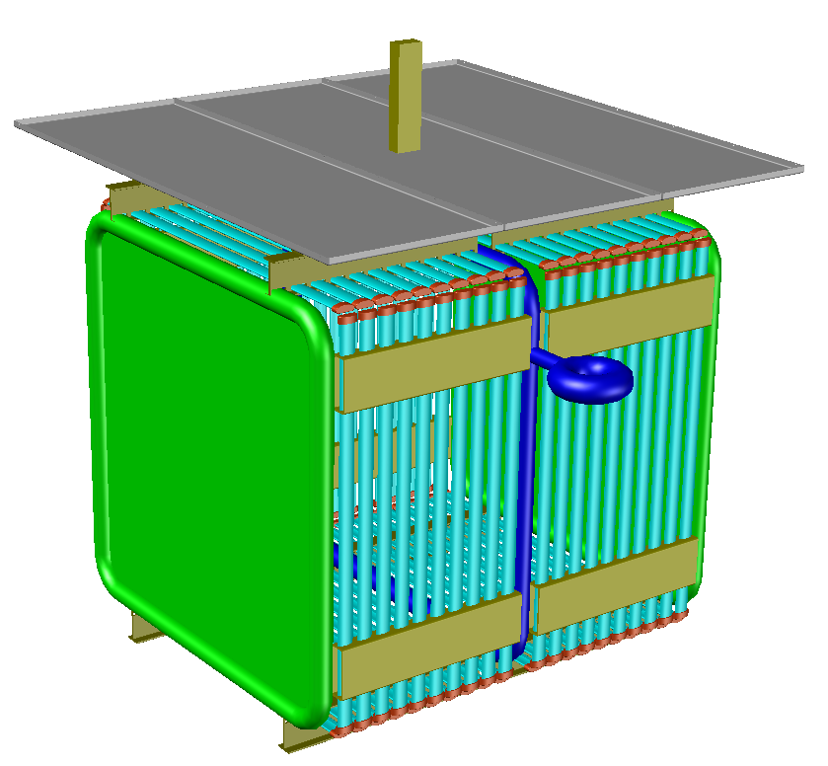
PRotoDUNE SP CPA/FC/HV test setup
This setup will be able to test the following features at full scale for E field purpose:
CPA lifting fixture
Ground plane
Ground plane overhang
Field cage support structure
CPA edges
Field cage profiles
Profile caps
End wall FC box beams
HV cup
First Run foreseen in next months
Second Run beginning of next year
including:
Laser window
Beam plug window
Aluminum profiles
in the 35 ton facility at FNAL
1.5m
1.5m
1.5m

Slide 24
Synergies with FC for ProtoDUNE DP
Similar but simplified panel design (single type), vertical deployment
Similar panel-to-panel hanging system
Similar material procurement (I-beams, metal profiles)

Slide 25
Further R&D
End-cap removal and replacement with profile “sliders”:
Detail study required for:
  Electrical continuity (sliders slide due to thermal contraction)
  Elbows design and mounting

