Slide 1
Technical Board Meeting, 21/9/2016

Slide 2
Finalization of the 6x6x6 design:
Field cage and cathode design + basic elements and procurement

Slide 3
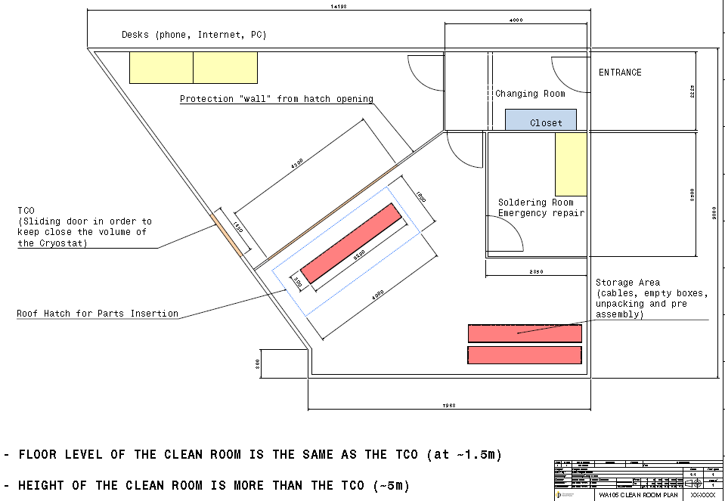
Milestone to finalize the 6x6x6 executive design by the end of November
Adamo presented the design of the field cage (with linking elements and the hanging system) and the design of the cathode at the last two TB meetings:
https://indico.fnal.gov/conferenceDisplay.py?confId=12809 24/8/2016
https://indico.fnal.gov/conferenceDisplay.py?confId=12884 7/9/2016
The field cage design is based on the use of panels 1920x3100 mm similar as for the SP design. Some pictures are shown in the next slides.
Adamo could not attend the meeting Today. Meanwhile he advanced on the design of the CRB which is dedicated to the manipulation of the basic detector elements (CRP, FC, cathode) for which logistics has been standardized in terms of elements/boxes of similar 3.2x3.2x0.5 m3 size → we will further discuss this point at the next TB

Slide 4
Worst case scenario with SS profiles instead than Al

Slide 5
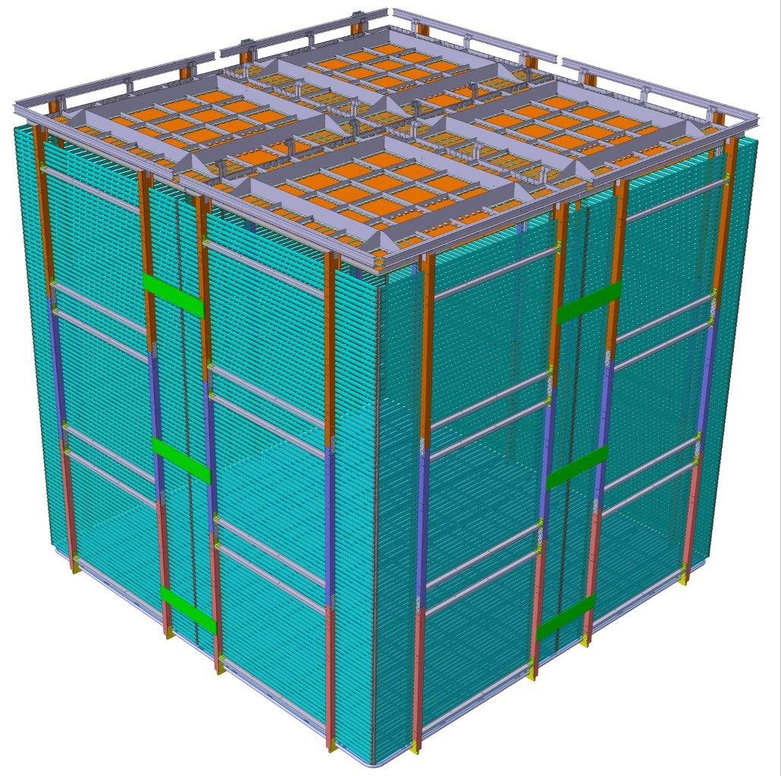

Slide 6
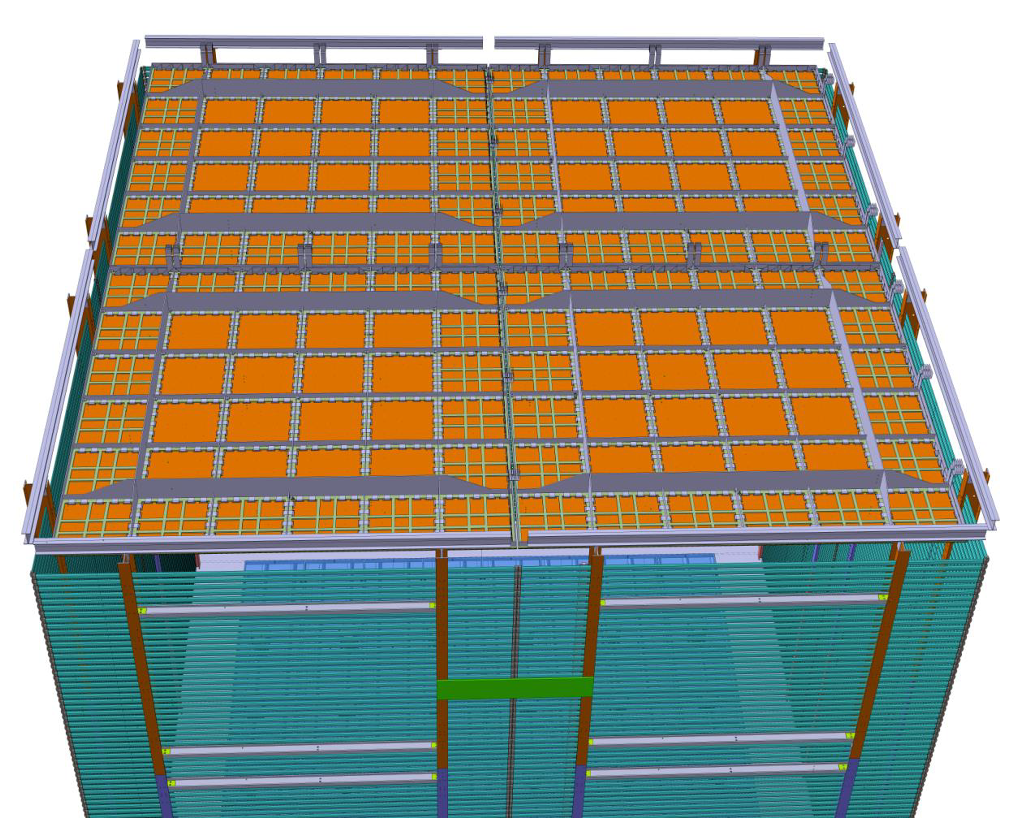

Slide 7
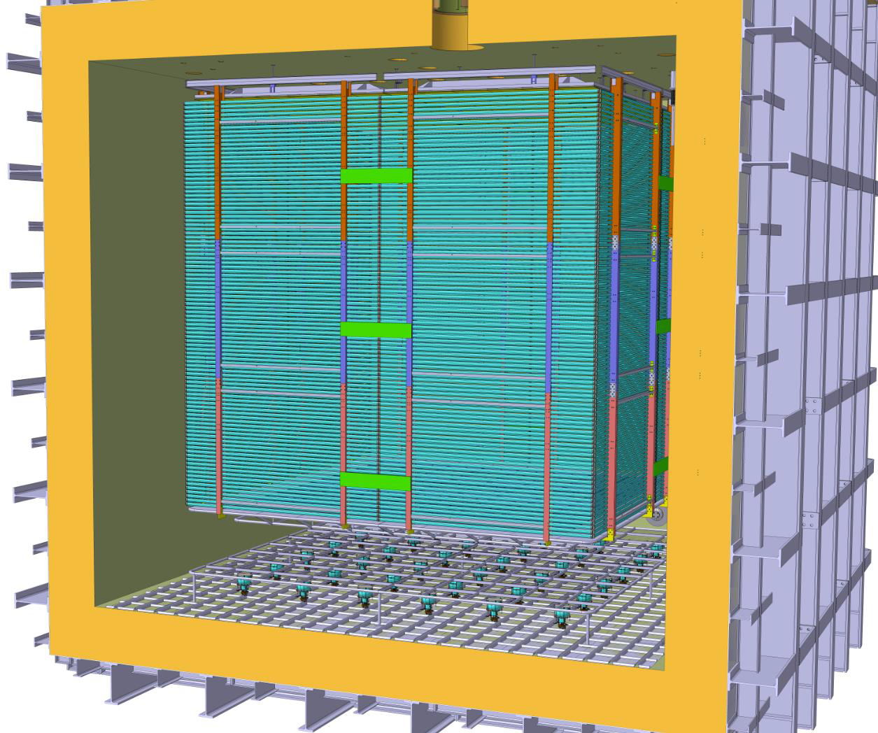

Slide 8
Today we are going to discuss the details on the design and procurement of the basic elements
Francesco: status of the R&D on the aluminum profiles and procurement of the elements of the field cage panels
Jae Yu: design integration and procurement of the electrical elements (resistors, surge arrestors
Christian update on the design and procurement of the TPB/ITO coated PMMA plates integrated in the cathode

