Slide 1
In-house electrospinning set up for fabricating and designing candidate future high power target material micro-structure
Sujit Bidhar
TSD topical meeting
22 Sep., 2016

Slide 2
Outline
Background
Objectives
Motivation
Electrospinning process
Setting up electrospinning unit
Candidate target material and microstructure
Summary & Schedule

Slide 3
Background- Target material
Demand of multi-MW high performance particle production targets
  LBNE 2.3MW proton beam, 1.6X10¹⁴ p/pulse
Structural integrity over time
  High temperature, thermal stresses, dynamic stresses
Withstand radiation damage
  Hydrogen embrittlement, radiation corrosion, swelling

Slide 4
Current Target
ANU/NOvA, 700KW→Graphite bars
Water cooling
Proton beam
Water cooling
Beam spot size<<target dimension
Solid continuum→ high local temperature gradient, thermal stress wave
Can it perform satisfactory at higher energy??

Slide 5
HPT Issues
Stress waves, thermal shocks
Heat removal
Radiation damage, gas production
Radiation assisted corrosion

Slide 6
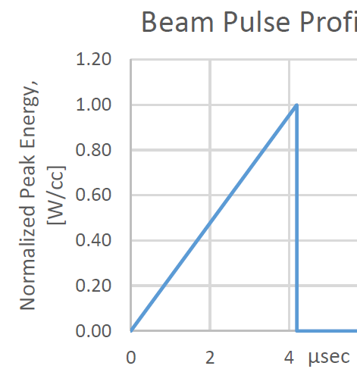
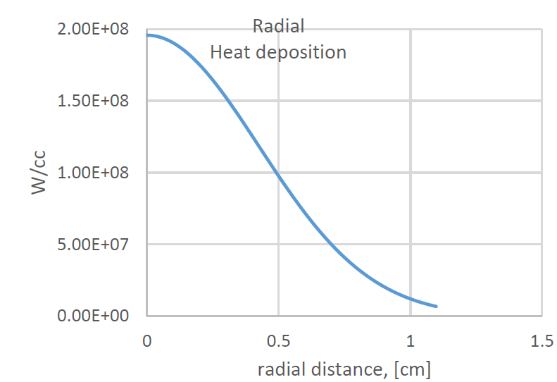
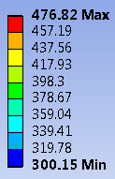
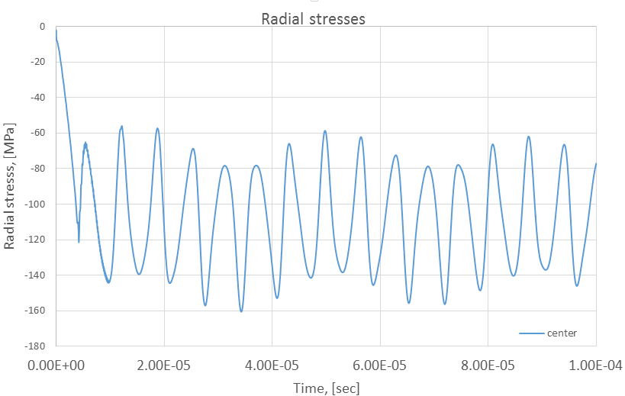
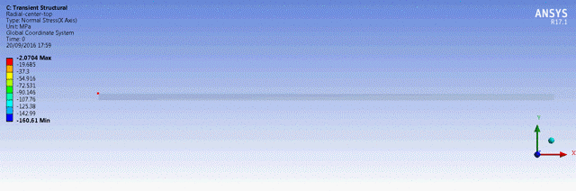

Stress wave
Gaussian beam
Sigma 4mm
40mm
Radial temperature distribution at end of pulse
Prone to fatigue failure (Mode II)
Reduce amplitude, decrease wave speed

Slide 7
Stress wave (1-D)
Temperature distribution at end of pulse
Material compression
ΔL=LαΔT
ΔT→ temp. rise
α→ Coeff. Thermal expansion
L
Δt→ beam pulse duration(heating time)
ΔL
Equilibrium equation
u displacement
→Elastic wave speed
Impulse- Momentum equation
→Particle velocity
→Initial stress wave amplitude
Design material to have minimize local temp. gradient
High thermal diffusivity/conductivity

Slide 8
HPT Target material design feature
Material properties
  High thermal conductivity to minimize cyclic loading due to thermal stress wave
  Low Z
  High strength
  Low Young’s Modulus
  High density
Target geometry
  Rotating ,Fluidized, liquid target (Water hammer, thermal stress wave)
  Exfoliated, foam
Alloying elements to mitigate radiation damage, corrosion

Slide 9
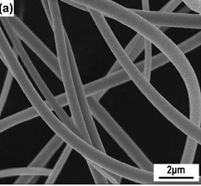
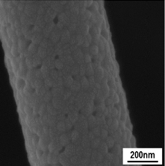
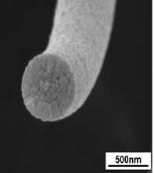
Candidate material- Electrospun nanofiber
Design Microstructure to mitigate issues
Electrospun nano-fiber→Sinuous target
Electrospun Zirconia nanofiber

Slide 10
Objective
Fabricate ceramic/metal, composite material nano-fiber with high strength, high density and alloying elements to reduce radiation damage.
  Set up in-house electrospun unit
  Fabricate polymer nanofiber to gain confidence
  Fabricate ceramic composites nanofiber by combining different materials
  Micro-mechanic study single fiber mechanical characterization
  Simulation for fiber damage and thermal-structural analysis

Slide 11
Advantages & limitations
Advantages:
Discrete continuum at micro scale (broken target) but continuous at meso-scale
  Local damage of single fiber won’t affect target structural integrity as a whole
Reduced thermal stress wave
  Reduced temp. gradient, limited to fiber axis only
  High surface area & gaps → effective local heat removal by passing He gas
Customize material properties by mixing different materials
Limitations:
Widely used for polymer nanofibers
Limited research in ceramics/metal nanofiber
Low density (long target)

Slide 12
Motivation
Cost: Commercially available set up are expensive (~US$ 50,000 or more)
  Suitable for mass producing nanofiber
  Too much sophistication/automation
Have to depend on supplier for customizing individual part for unconventional electrospinning
Goal is to build electrospin unit under US$7,500
Flexibility of customizing individual parts in house as per need

Slide 13
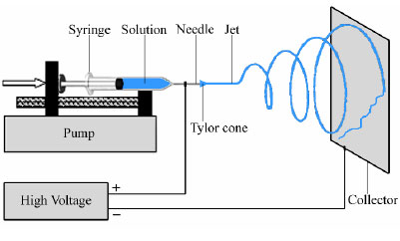
Basic electrospinning Set up
Collector
Fixed type
Rotating drum type
5-10 cm
10-30 KV DC
10-30 cm
Process carried out at room temp. and atm. pressure

Slide 14
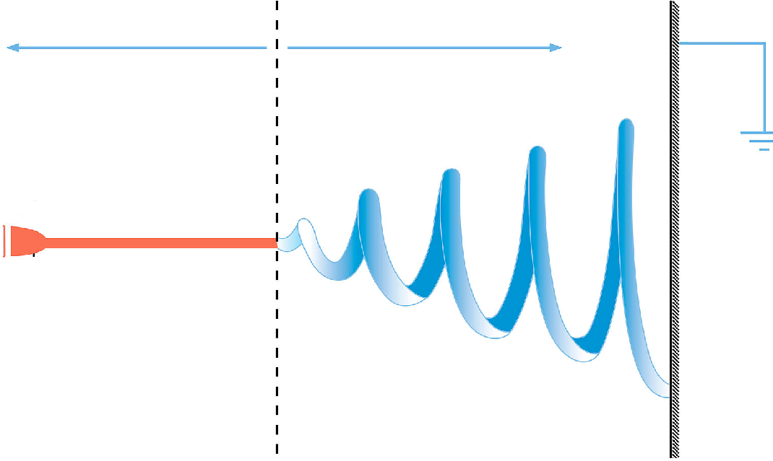
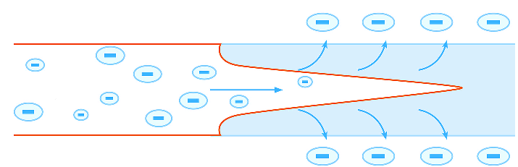
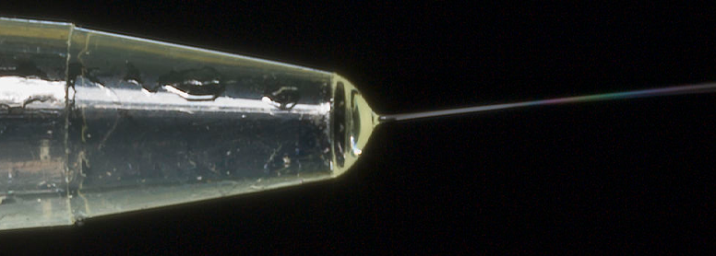
Electrospinning Principle
Ohmic flow
Convective flow
Electrostatic repulsion> surface tension
Droplet is stretched
Jet elongated by whipping action
Slow acceleration
Rapid acceleration
Flat needle
Collector plate
+/- KV
Transition liquid to solid
Taylor cone
Liquid
Solid
Flow direction

Slide 15
Parameters
Molecular weight of polymer
Solution properties (Viscosity, conductivity, surface tension)
Concentration, electrical potential, flow rate
Distance between needle and collector
Needle gage
Ambient temperature, humidity, air flow

Slide 16
Raw material for electrospinning solution
Polymer
Solvent
Asphaltene
Nylon
Polyacrylonitrile
(PAN)
Polyvinylepyrrolidone
(PVP)
Toluene
Formic acid
N-N,dimethyle-
formamide
Ethanol
Salt additives
(surfactants)
Fiber diameter
Stable jet length
Morphology
Inorganic precursor
Ceramics
TiO₂
WO₃
Zirconia
Precursors
Titanium(IV) propoxide
Ammonium Metatungstate Hydrate
Zirconium Carbonate

Slide 17
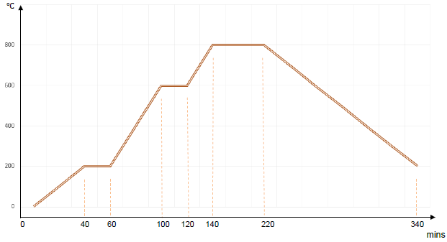
Ceramics nanofiber fabrication
Inorganic precursor(ceramic+precursor solution)
Polymer solution(polymer+solvent)
Salt additives (surfactants)
Solution for electrospinning→polymer-ceramic nanofiber
Calcination (Heat treatment)
Vaporize polymer
Promotes crystal growth
Bonding
Representative heating profile

Slide 18
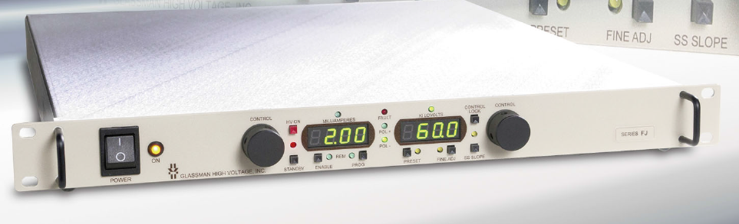
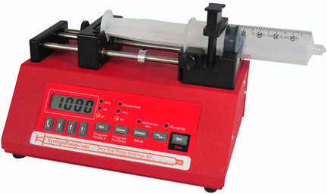

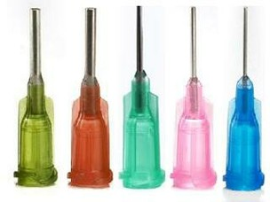
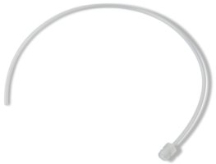
Electrospun nano-Fiber Production Set-Up
Enclosure $ 750
Exhaust Fan to duct
High Voltage Supply: 60 KV, 120 Watt
$ 3600
Syringe pump
Needle
Collector plate
Programmable syringe pump
$ 780
High Voltage supply
Syringes, blunt needles, accessories
Intended electrospinning set up
Space requirement 2’ x 2’ x 2’
Location: MI8
$ 500
Approx. $ 6000

Slide 19
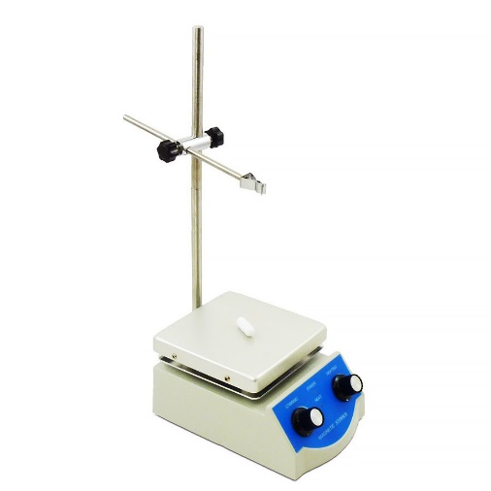
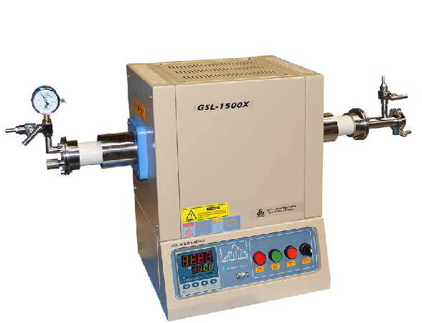
Electrospun nano-fiber Material Pre-Post Processing set Up
Chemical solution handling set up
Lab Hot Plate with Magnetic Stirrer
Sonicator (Ultrasonic bath)
Beakers, pipets, storing bottles
Gloves, goggles, safety items etc.
$ 150
$ 500
Raw materials for nano-fiber
Material specific polymer solution.
Ceramic /material precursor solution.
$ 2000
Post processing- Heat treatment set up
Tube furnace (1500 C) programmable
Thermal gloves, accessories etc.
$ 4500

Slide 20
Safety requirements
Electrical Safety
  30KV DC power supply comes with safety features to prevent short circuit, arcing etc.
  Additional safety clearance from ES&H (??)
Raw material storage & handling
  Some chemicals are flammable, corrosive→ Special cabinet
  Others are in powder /crystal form → general cabinet
  Poisonous if taken orally, may be skin irritant → gloves, apron, goggles
  Magnetic/ultrasonic stirring with some volatile chemicals → Fume hood
Disposal of left over chemicals & processed nanofibers
  Containers
Duct work for exhaust from electrospinning unit
Additional precaution for furnace

Slide 21




Problems
Beading
Ribbons
Porous globe
Aligned fiber
Troubleshoot
Increase flow rate
Increase polymer concentration or solvent with high evaporation
Salt additives (Surfactant)
Adjust distance between needle and collector
Porosity→evaporative characteristic of solvent

Slide 22
Candidate electrospin nanofiber
Polymer (for Starter)
Nylon 6
Metal/Ceramic
Alumina
Zirconia
WO₃
Titania
Graphite
Carbon-nanotube Composite(Ultimate)
CNT-Alumina
CNT-Zirconium

Slide 23
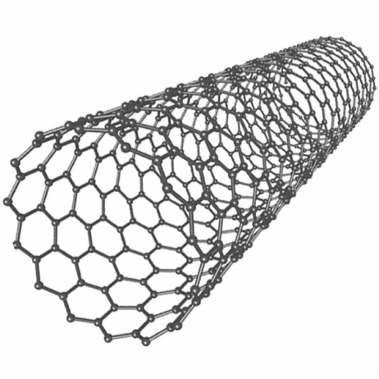
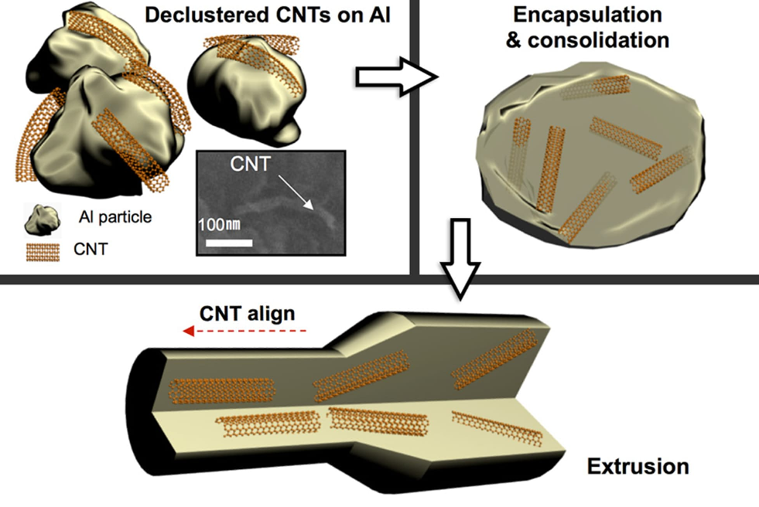
CNT-ceramics nanofiber composites-advantage
Excellent mechanical properties
E : 1~5 Tpa
Tensile strength : 15-50 Gpa
Elongation % : 16%
High thermal conductivity (axial), insulator lateral
1-3 nm
µm-mm
SWNT
1~2 Vol% CNT
Protects Aluminum metal against
radiation damage
1-D transport network for He to escape
Bulk not nanofiber!!
MIT-research

Slide 24

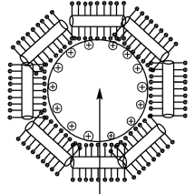
CNT-Zirconia/Alumina proposed nanofiber
Sonification
deionized water
Add Alumina
SWNT
Surfactant
Calcination/
Heat treatment
Add polymer
Solution
CNT filled ceramic nanofiber
+ve charged alumina
Nano-particle
Electrospin
Ceramic(Zirconia) will have high Z value
Increase bulk density of nanofiber target than pure CNTs
CNT will enhance mechanical strength, provide protection against radiation damage

Slide 25
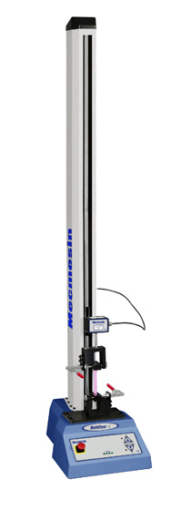
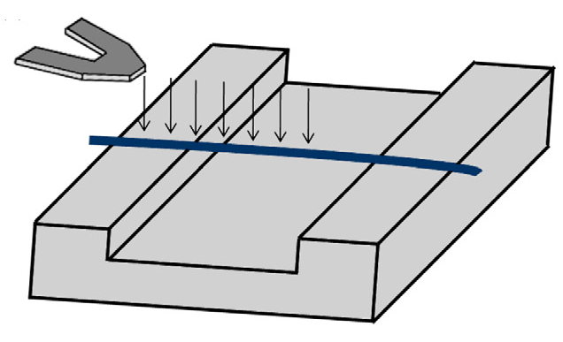
Mechanical characterization
Macro testing electrospun nanofiber mat
Micro testing single fiber
AFM tip
Substrate channel
nanofiber
10-15µm

Slide 26
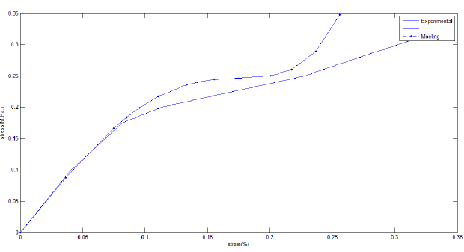
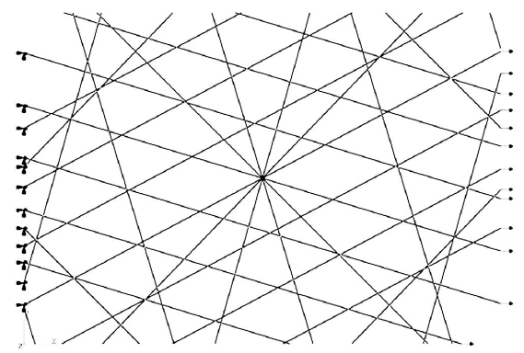
Sinuous target material- Mechanical simulation framework
Mathematical Homogenization through periodic boundary condition
microscopic material properties
Macroscopic response
Thermal stress simulation
Damage model
Check for damage ,i,e. fiber breakage, extent of local plastic deformation
Dynamic stress
Nano-fiber representative Network
Validate model against testing
Change fiber network/material in electrospinning

Slide 27
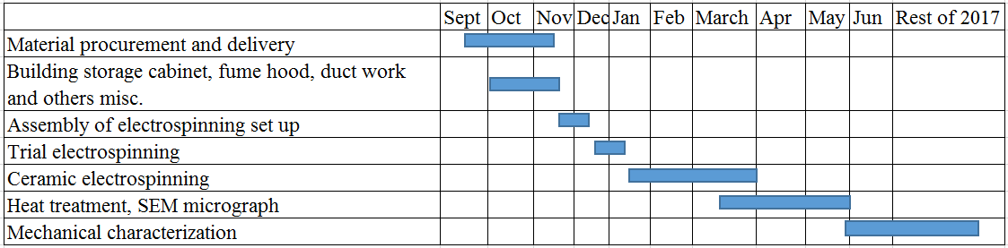
Summary and Schedule
Detail planning and procurement of a low cost electrospinning set up has been done (~US$6000)
Expected to produce different ceramics, metallic and CNT composites nanofiber
  Methods to fabricate ceramics-CNT composite is in place
Optimize nanofiber parameters to get better material properties
  Macro/micro mechanical characterization and simulations
Schedule

