Slide 1

Nb₃Sn Inner Triplet Quads Q1/Q3
Giorgio Ambrosio
Magnets L2
U.S. HL-LHC Accelerator Upgrade Project
CERN Machine Advisory Committee, 12th
17-19 October 2016

Slide 2
Outline
Scope
Design & Test Results
Prototypes & Risks
Manufacturing Plans
Conclusions

Slide 3
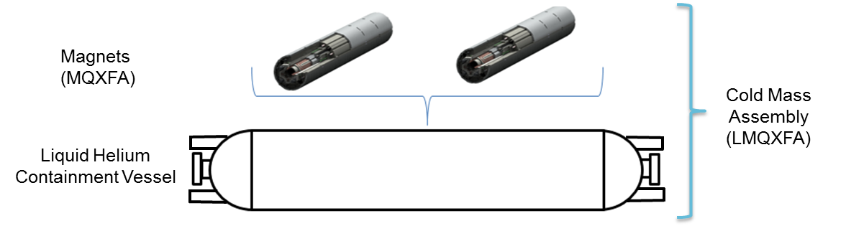
US Magnets “New” Scope
Threshold
  Five Q1 and Five Q3 Cryostated Magnets
    Includes one spare for each (8 for tunnel + 2 spares)
      Q1 and Q3 cold masses expected to be ~identical
    Q1/Q3 magnetic length = 4.2 + 4.2 m
    Cryostats from CERN as “assembly kits”
Objective
  One additional Cold Mass Assembly spare

Slide 4
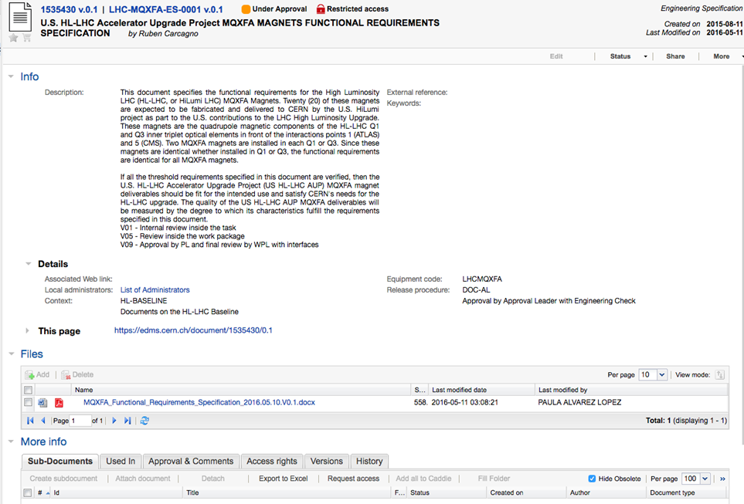
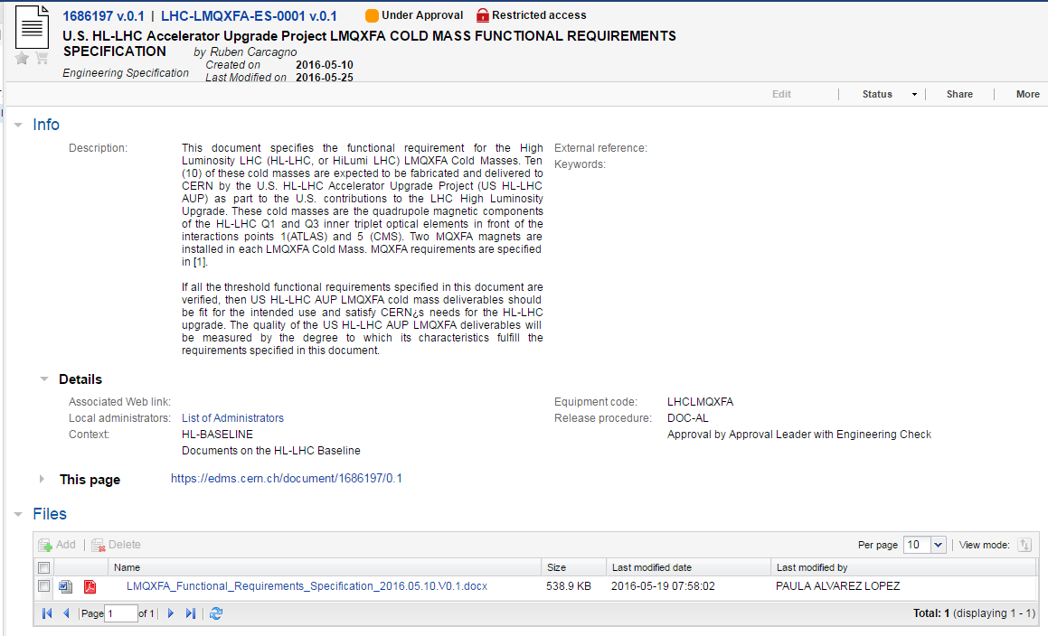
Scope (Cont.)
Magnet and Cold Mass Functional Requirements
  In CERN EDMS, out for Work Package Review and Approval
    LHC-MQXFA-ES-00001 (EDMS #1535430)
    LHC-LMQXFA-ES-00001 (EDMS #1686197)
  Has been working with CERN since May 2015 to identify and agree on requirements
    Main remaining open issue: pressure vessel safety requirements
Interface Documents, Requirements Verification Procedures and Acceptance Document next (to be done)

Slide 5
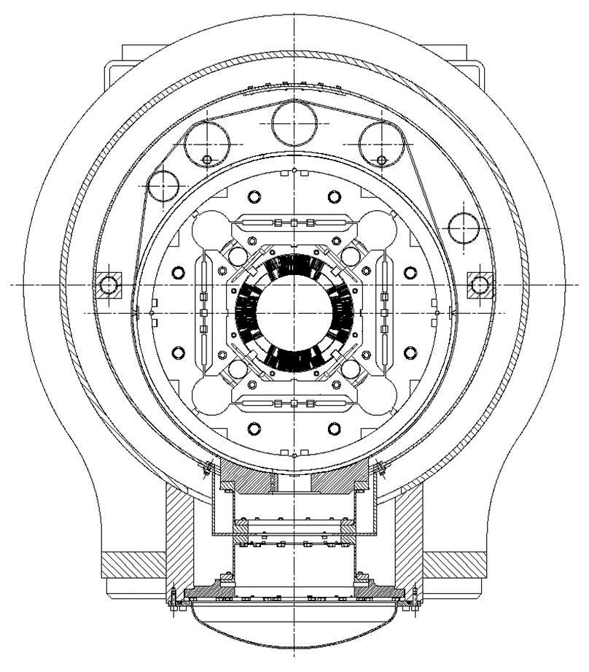
Design
Q1/Q3 Cryostated magnets are ~identical to Q2a/b
  Identical cross-sections through the magnets
  Minor differences: magnet length, 2 magnets in 1 cold-mass, no correctors in Q1/Q3, bus-bars
  Cryostat kit from CERN

Slide 6
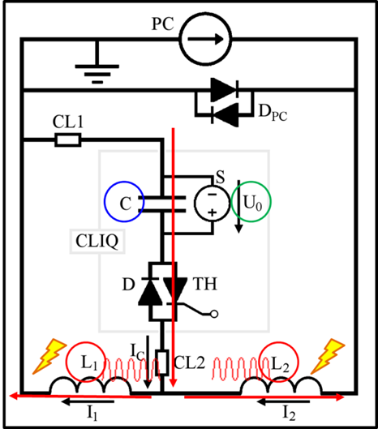
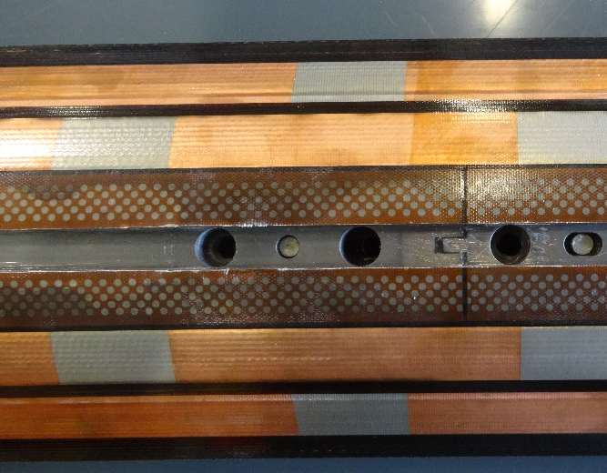
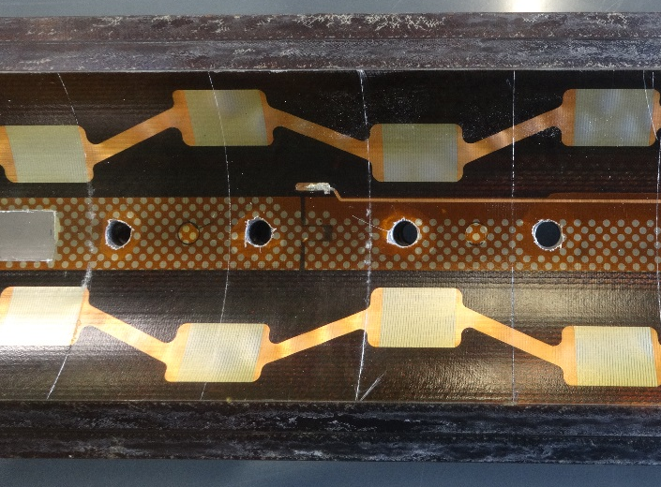
Design – Quench Protection
Challenges:
  1.5 times energy density of LHC MB
  No extraction (not efficient due to high inductance)
Solution: Heaters & CLIQ
  Outer Layer heaters: very reliable
  Inner layer heaters: delamination issue being addressed
  CLIQ (Coupling-Loss-Induced-Quench): very promising but system integration has some challenges
  Plan: test all 3 systems on prototypes then decide
  Plan was approved by Circuit Review & International MQXF Review
OL heaters
IL heaters
CLIQ

Slide 7
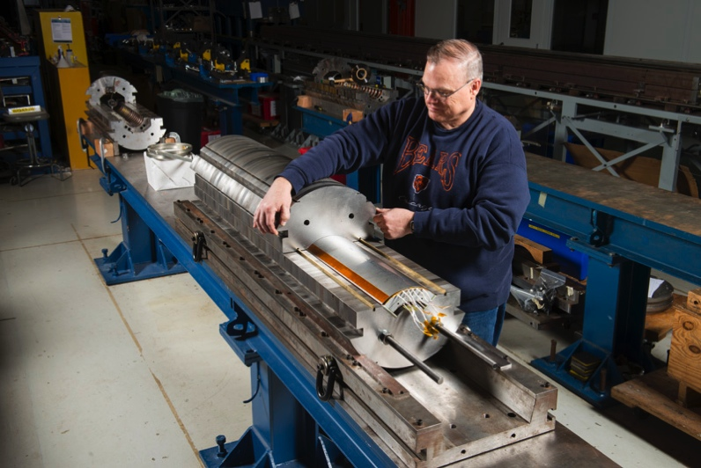
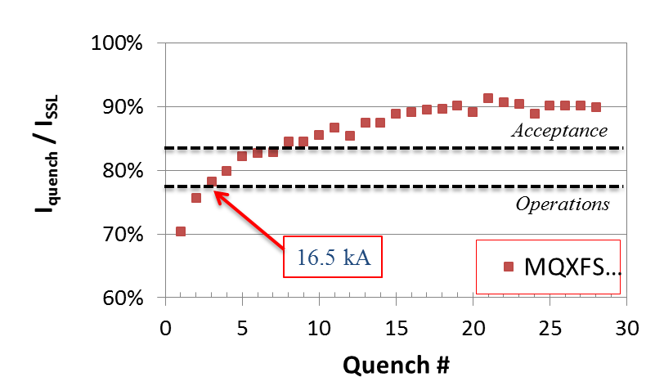
Test Results: MQXFSM1
Single coil in mirror structure:
  Successfully demonstrated coil & parts design, and coil fabrication process
Quench history of MQXFSM1
tested at FNAL VMTF
First QXF Short Coil assembly in Mirror structure (MQXFSM1)

Slide 8
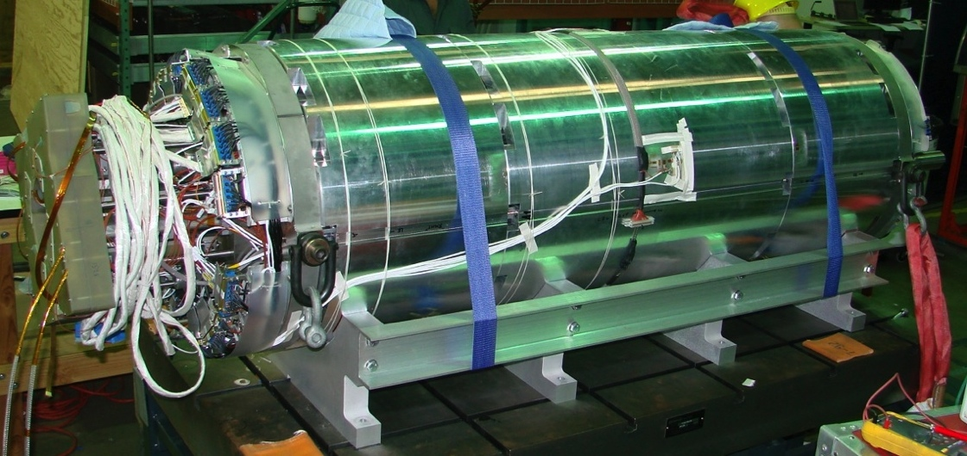
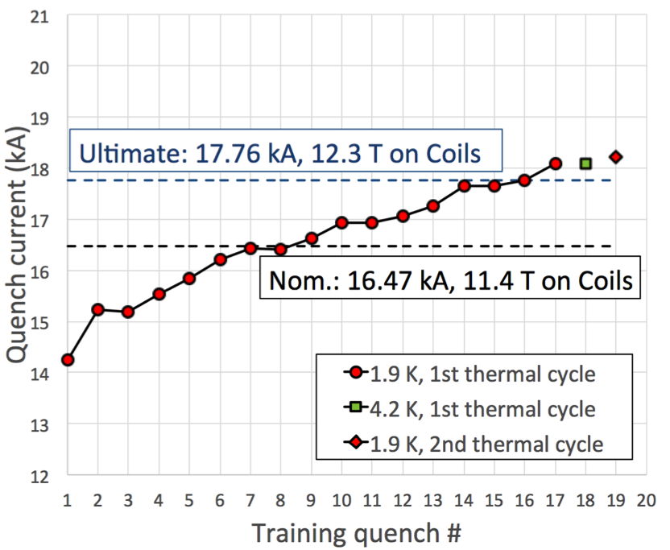
Test Results: MQXFS1
Short MQXF magnet, with 2 coils by LARP, 2 coils by CERN, and segmented structure
  Exceeded ultimate current
    Training was stopped to increase preload
  Demonstrated temperature margin
  Demonstrated excellent memory
Quench history of MQXFS1
tested at FNAL VMTF
First MQXF Short Model (MQXFS1)

Slide 9
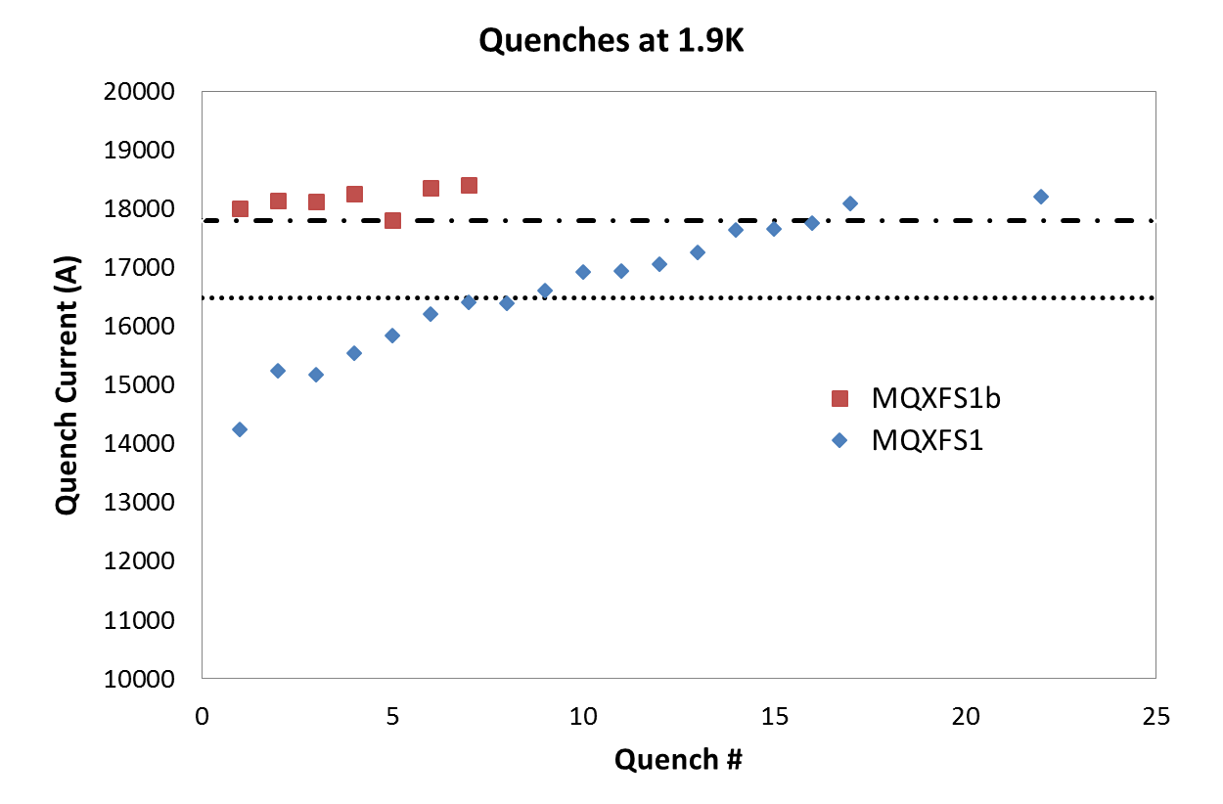

Test Results: MQXFS1b (in progress)
Very good memory after shipment & pre-load increase
➔ confirms plans for Q1/Q3 magnets
Ultimate current
Nominal current

Slide 10


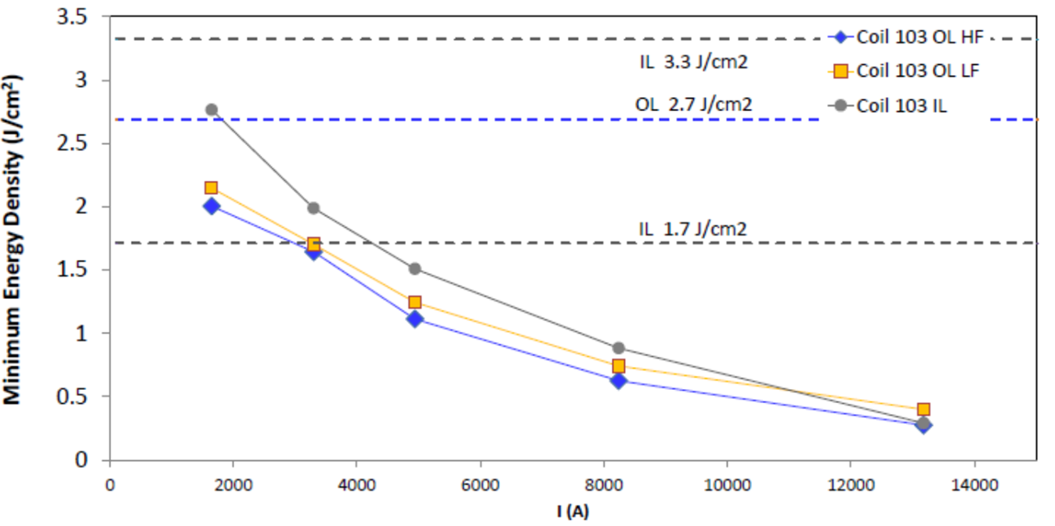
Test Results - QP Heaters
MQXFS1 QP tests confirmed strategy and validated OL heater simulations
  Very good agreement with Outer Layer heaters data
  Inner layer delays are longer than in simulations
Minimum energy density for quenching MQXFS1
Delays of MQXFS1 Outer Layer High Field heaters & simulations
G. Chlachidze, S. Izquierdo-Bermudez & E. Ravaioli
Simulations performed with CoHDA by T. Salmi

Slide 11
Test Results - CLIQ
CLIQ on MQXF magnets will be tested shortly on short models reproducing full length magnets
MQXFS1b @ FNAL
MQXFS3 @ CERN

Slide 12
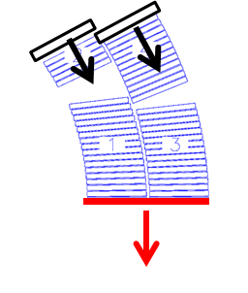
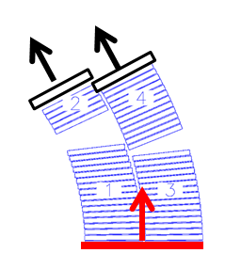
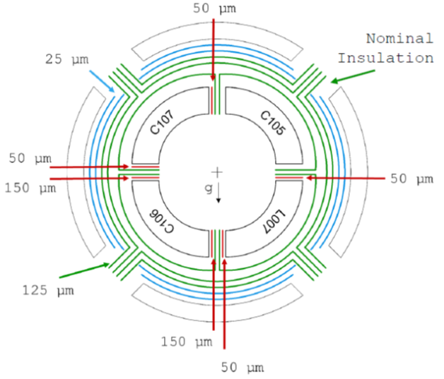
Test Results - Field Quality
Field Quality
  Some MQXFS1 harmonics above target
    Coil assembly focused on uniform stress instead of FQ
    MQXFS3 assembly focused on FQ
Solution: shimming
  During coil fabrication (S2-glass)
  During coil-pads assembly (Polyimide)
  After magnet assembly (Magnetic shims)

Slide 13
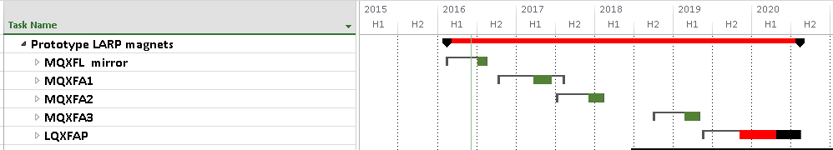
Q1/Q3 Prototypes
4m coil in mirror magnet is under test
First prototype magnet test in spring 2017
  4 m coils: one 1st gen + three 2nd gen coils
Second prototype magnet test in 2017-2018
  4.2 m coils: all 2nd gen coils (first tunnel ready MQXF)
Third prototype magnet test in early 2019
  4.2 m coils, 1st structure changing thick➔thin laminations
First prototype cryostated magnet test in early 2020
CD2/CD3b
CD3c

Slide 14
Q1/Q3 Prototypes (MQXFA & Cold-Mass)
  Effort so far:
    4 Coils completed + 3 in progress
    1 Coil under in mirror structure
    1 Structure procured & instrumentation in progress (MQXFA1)
  Effort in FY17/18 (and Q1-Q2 of FY19)
    11 Coils (3 completely fabricated at BNL)
    2 Structure assemblies (MQXFA1/2)
    1 Structure re-assembly (MQXFA3 with thin laminations)
    3 Magnet assemblies (MQXFA1/2/3)
    3 Magnet tests (MQXFA1/2/3)
    1 Magnet re-test with higher preload (MQXFA1b) - optional
    1 Cold Mass & Cryostated Magnet assembly
    1 Cryostated Magnet test

Slide 15
Risk Mitigation Plan
2 magnets in 1 Cold Mass ➔ Two Coil Fabrication lines
Assessing safe pre-stress range
Field Quality & correction:
  Understand systematic & random harmonics
  Demo correction with magnetic shims
  Demo correction with intra-coil shims
Demo Quench Protection
Demo alignment & verification plan
Test SS skin welding
Demo Cold Mass assembly
SM
SM + P
SM + P
SM + P
SM
SM + P
P
SM
P
SM = Short Models – 1.2 m
P = Prototypes – 4/4.2 m

Slide 16
Manufacturing Plan

Slide 17
Q1, Q3 Manufacturing Flow Plan
(Quantities are minimum required)
Coil Fabrication
(x40)
(FNAL)
Strand Procurement
(1,600 km)
(FNAL)
Cable Fabrication
(80 x 500 m)
(LBNL)
Cable Insulation
(80)
(Vendor)
Magnet Fabrication
(x20)
(LBNL)
Magnet Test
(x20)
(BNL)
Coil Fabrication
(x40)
(BNL)
Cryostats
(x10)
(CERN)
Shipment to FNAL
Cold Mass Assembly
(x10)
(FNAL)
Cryo-
Assembly Test
(x10)
(FNAL)
Incoming Inspection
(x10)
Beam screen
installation
(CERN)
Tunnel Installation
(x8)
(CERN)
Cryo-Assembly
(x10)
(FNAL)
Shipment to CERN

Slide 18
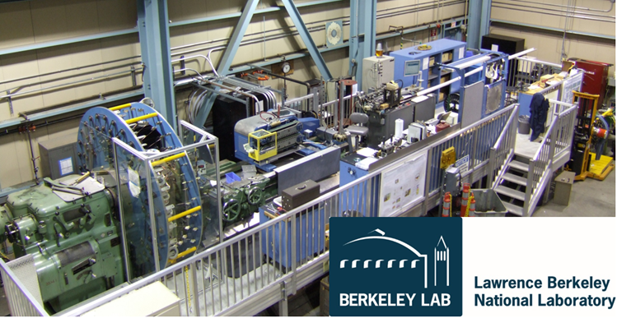
Facilities & Equipment: Conductor
Strand procurements and QC
Cabling @ LBNL
Cable insulation @ vendor

Slide 19
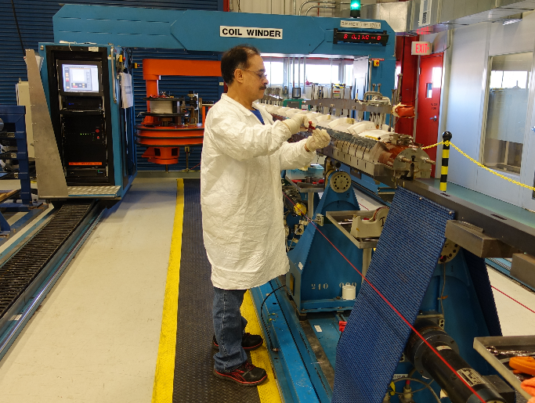
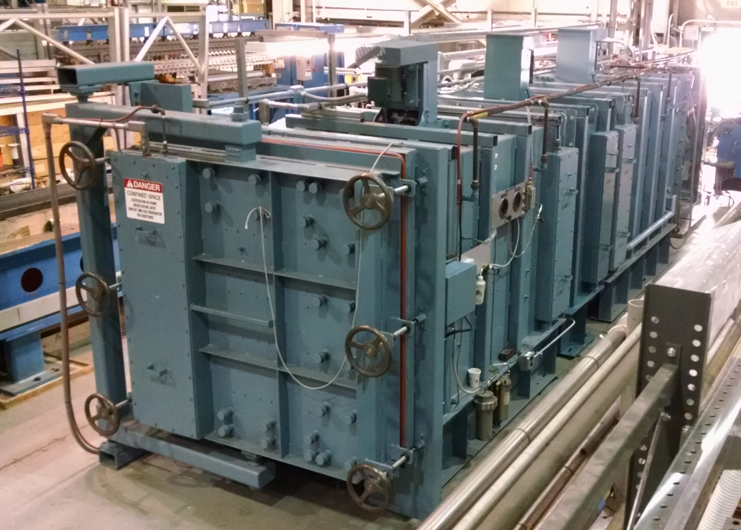
Facilities & Equipment: Coils
  @FNAL @BNL
Winding FY17
Curing FY17
Reaction
Impregnation
QXFA1b outer coil winding
BNL oven recently upgraded

Slide 20
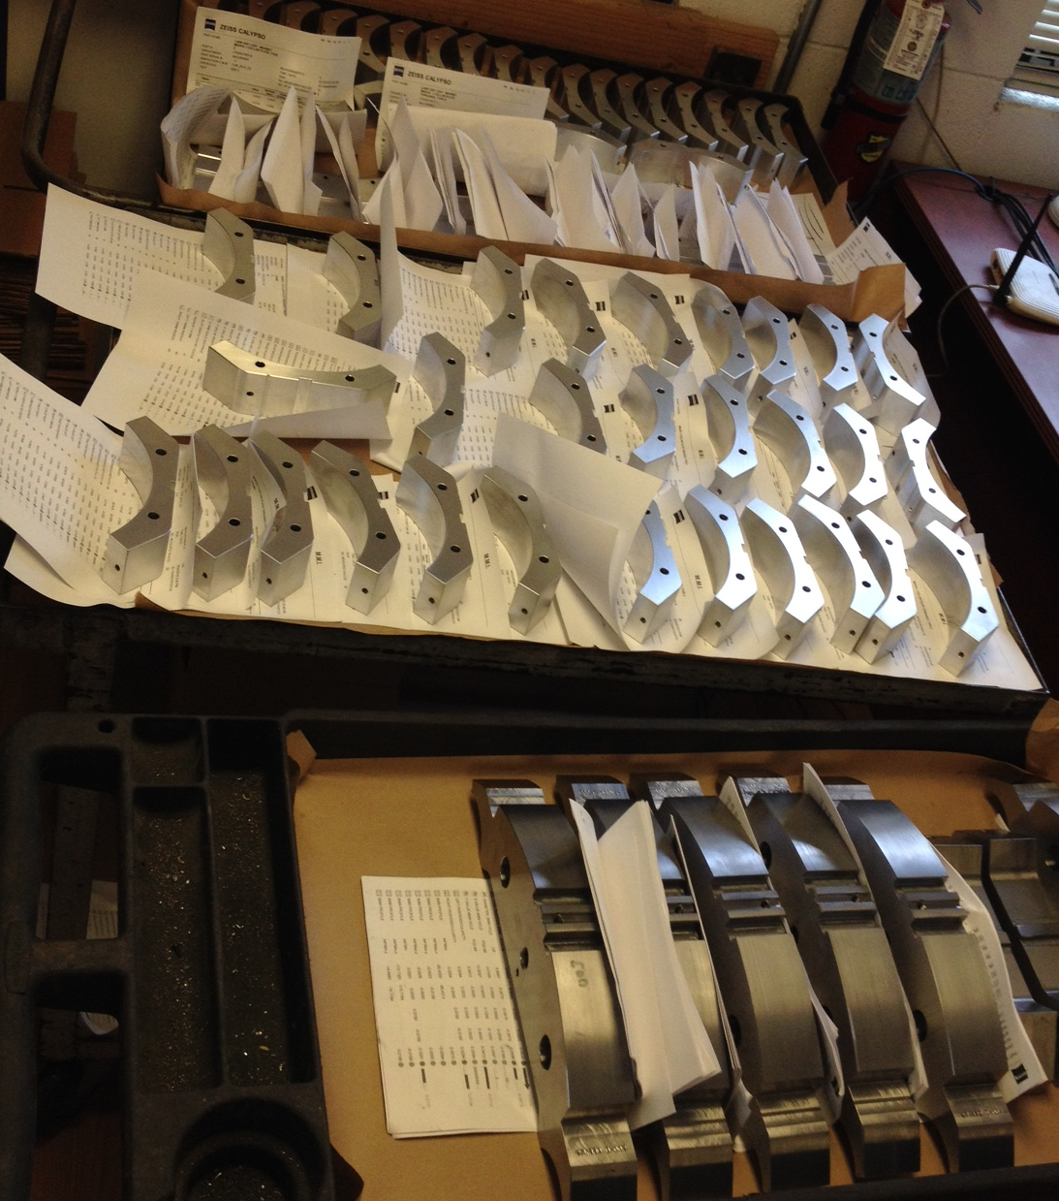
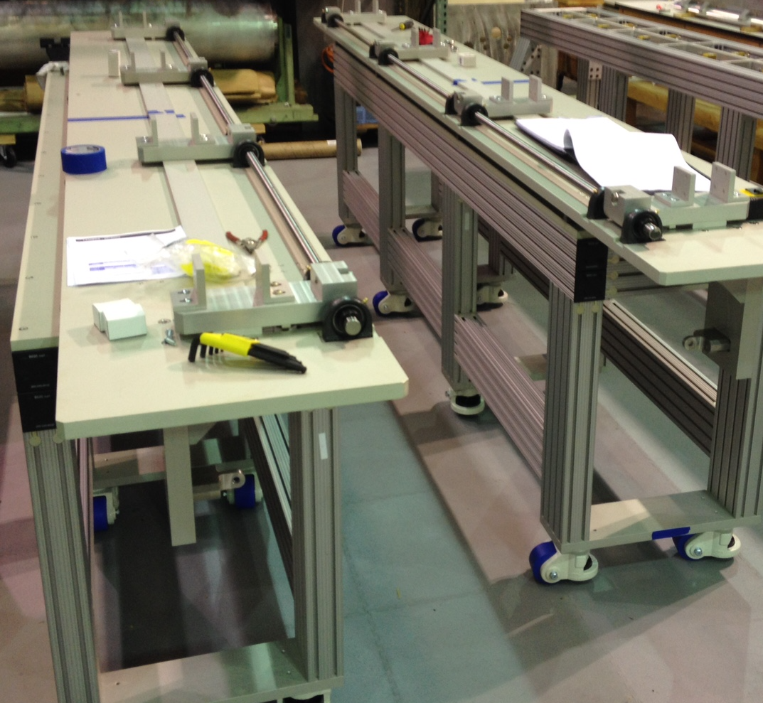
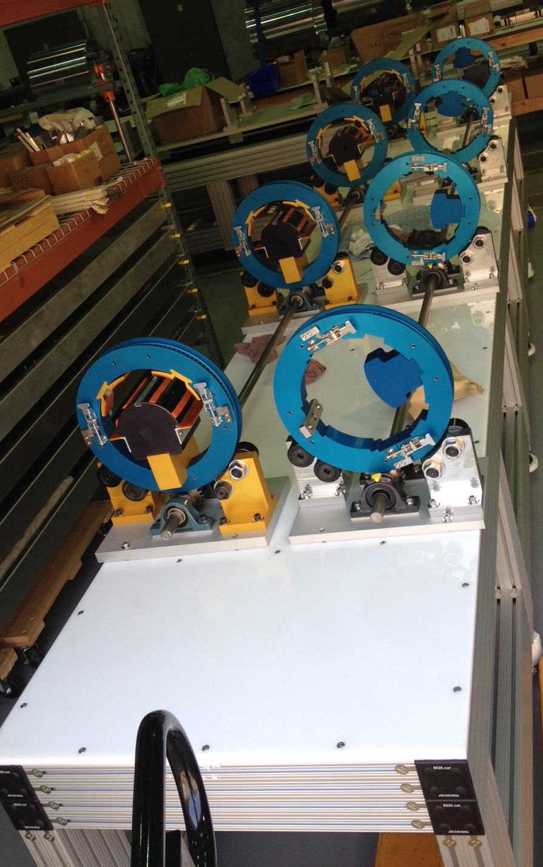
Facilities & Equipment: Magnet Assembly
Parts procurement
Sub-assembly & instrumentation
Magnet assembly @ LBNL

Slide 21
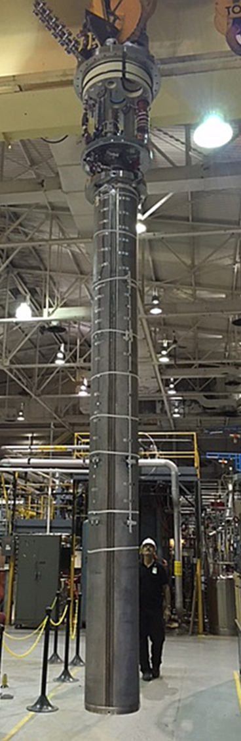
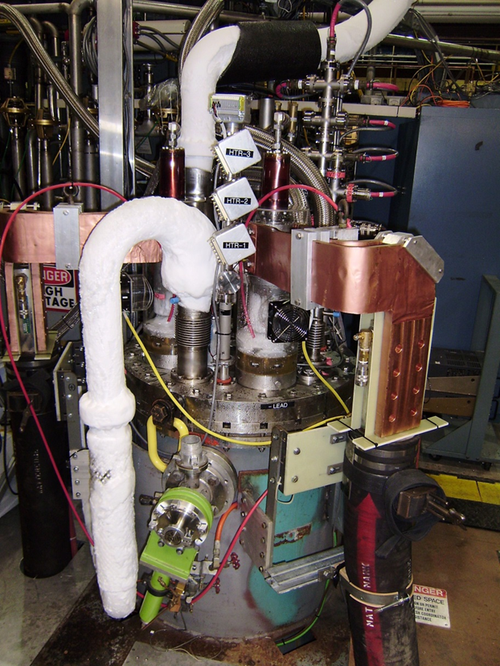
Facilities & Equipment: Magnet Test
Vertical Test Facility @ BNL
  Commissioning successfully completed
  T = 1.88 K
  I = 22 kA
4m coil ready for test

Slide 22
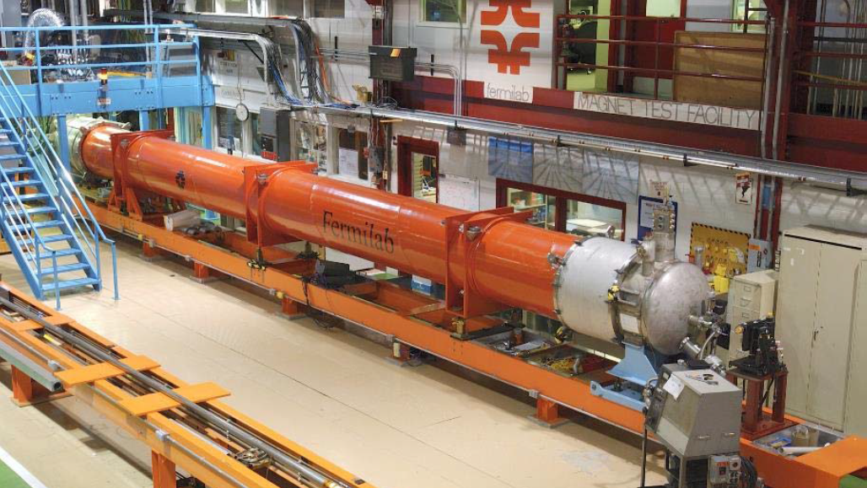
Cold Mass & Cryostat
Plans for assembly of Cold Mass & Cryostat have to be finalized
  Cryostat kit from CERN
Horizontal Test facility @ FNAL to be upgraded

Slide 23
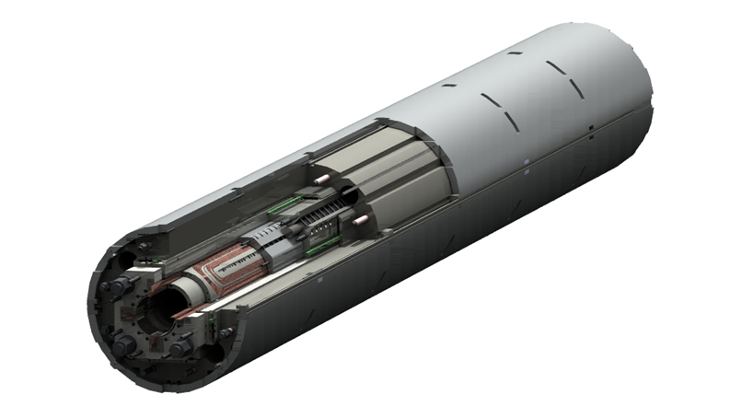
Magnet Fabrication Schedule
Step | Duration
Strand Delivery | 12 months
Cable Fabrication (4 UL) | 2 months
Cable Insulation (4 UL) | 2 months
Set of 4 coils | 5 months
Magnet Assembly | 2 months
Magnet Test | 2 months
TOTAL | 25 months

Slide 24
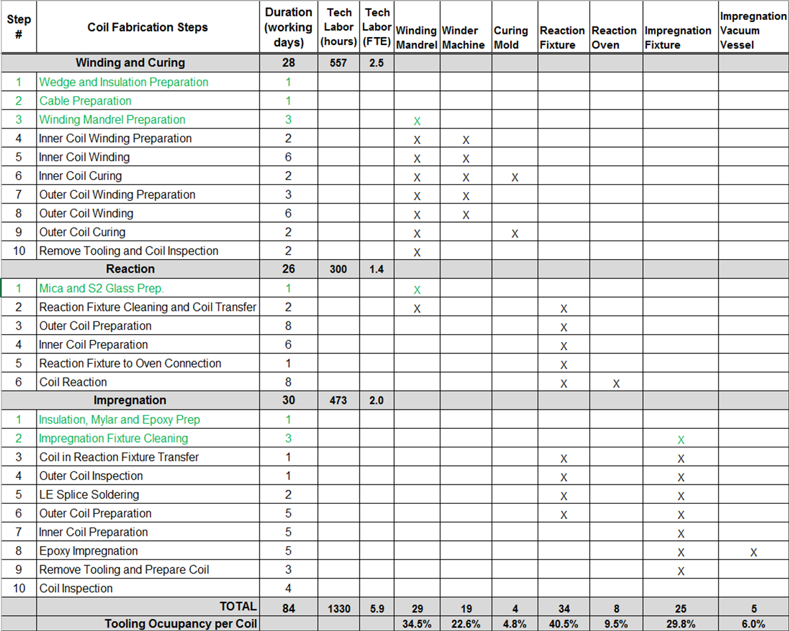
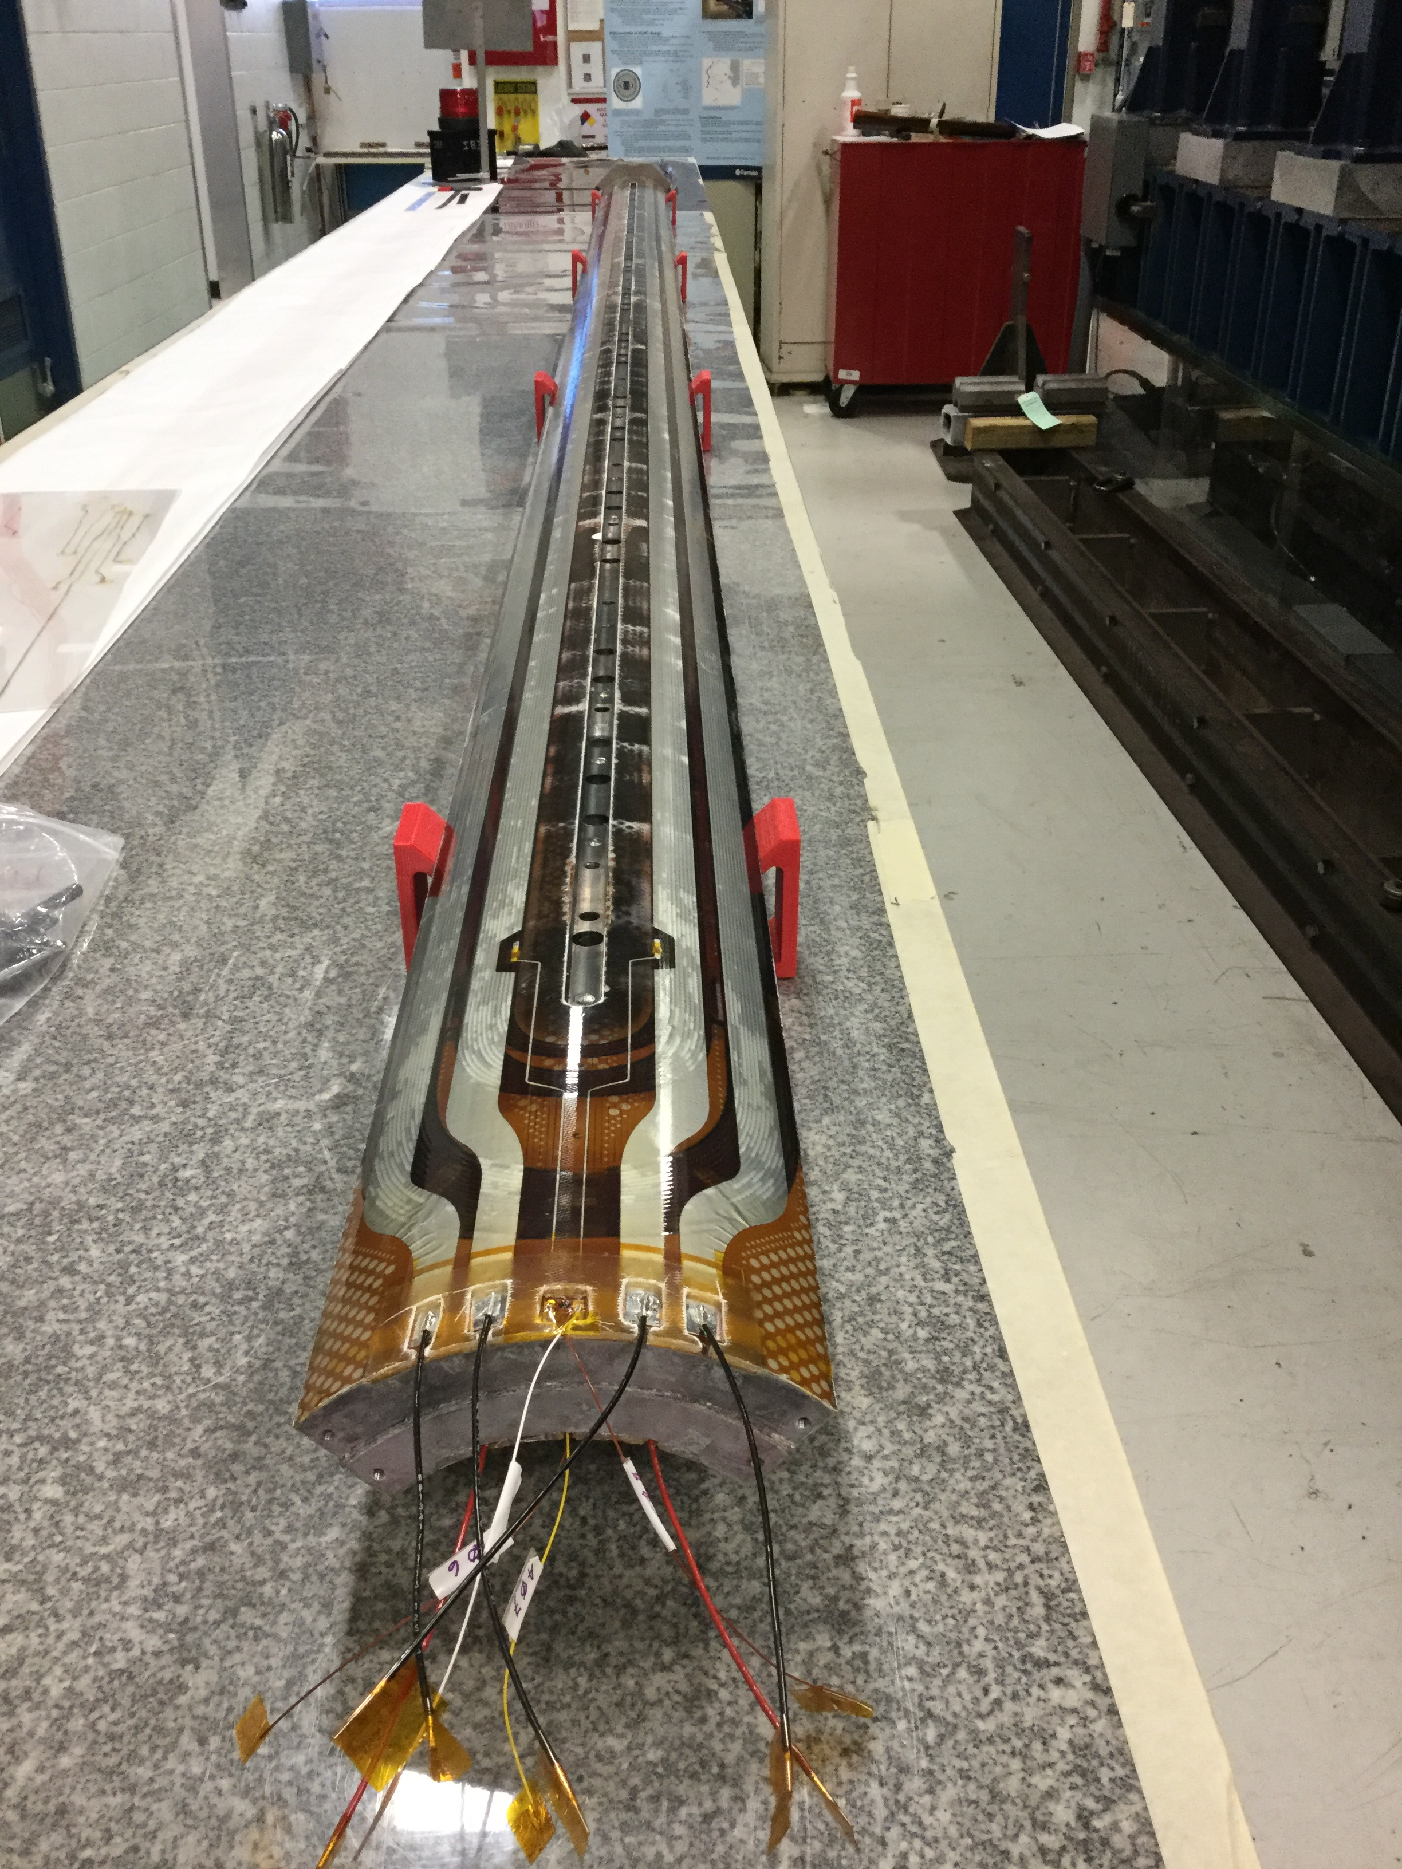
Coil Fabrication: Labour & Tooling Usage
Fermilab is collecting data during long coil prototype fabrication to validate estimate before production starts

Slide 25
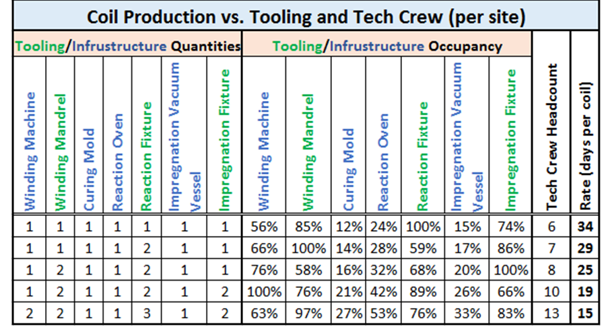
Coil Production Rate Analysis* (per site)
Peak LARP Rate
Peak Project Rate
Based on the results in Table 6, and adding a little bit of margin, the following will be assumed for peak coil production rate:
  • Production Rate: 1 coil every 20 working days
  • Technician Crew Size: 10
  • Winding Machine: 1
  • Winding Mandrel: 2
  • Curing Mold: 1
  • Reaction Oven: 1
  • Reaction Fixture: 3 (to bring occupancy below 80%)
  • Impregnation Vacuum Vessel: 1
  • Impregnation Fixture: 2
*MQXFA Coil Fabr. Analysis US-HiLumi DocDB #95

Slide 26
Q1/Q3 Horizontal Test Schedule
Horizontal Test | Finish
Test LMQXFA-1 | 15-Mar-21
Test LMQXFA-2 | 10-Dec-21
Test LMQXFA-3 | 9-May-22
Test LMQXFA-4 | 29-Aug-22
Test LMQXFA-5 (fails) | 13-Jan-23
Test LMQXFA-6 | 5-May-23
Test LMQXFA-7 | 3-Aug-23
Test LMQXFA-8 | 8-Jan-24
Test LMQXFA-9 | 22-Apr-24
Test LMQXFA-10 | 15-Jul-24
Test LMQXFA-R1 | 21-Oct-24
For LHC tunnel
Spares
"Cryostated magnets are tunnel ready after beam screen insertion at CERN"

Slide 27
Quality of U.S. Project deliverables
The quality of the U.S. project deliverables is the degree to which they fulfill requirements
  MQXFA and LMQXFA Functional Requirements Specification documented (in CERN EDMS) and close to being finalized/approved
  Detailed verification procedures and acceptance criteria for deliverables to be defined and documented
    Will include testing at nominal HL-LHC operating temperature (1.9K) and HL-LHC ultimate gradient (143 T/m)
  Compliance with CERN QA requirements

Slide 28
Conclusions
The MQXF design phase is complete
  Cryostat design is in progress
Short models have demonstrated that the design can meet requirements
Prototype tests are starting
The U.S. Magnet production project planning is ramping up with progress on all fronts
  Good understanding of US institutions scope and availability of existing production facilities and infrastructure at FNAL, BNL, and LBNL

Slide 29
Back up slides

Slide 30
Risk Mitigation: Failure Rate Assumptions
Cable Yield: 100 Unit Length of cable will have to be fabricated to produce 90 acceptable cables (a 10% failure rate in cable production). A rejected cable is assumed to be scrapped.
Coil Yield: 90 coils will have to be fabricated to produce 80 acceptable coils (a 11.1% failure rate in coil production). A rejected coil is assumed to be scrapped.
Magnet Yield: 3 of the 20 magnets will not pass vertical testing and will have to be re-worked and re-tested to produce an acceptable magnet (a 15% failure rate in magnet production).
Cold Mass Yield: 1 of the 10 cold masses will not pass horizontal testing and will have to be re-worked and re-tested to product an acceptable cold mass (a 10% failure rate in cold mass production).
If during project execution these failures do not materialize and adequate contingency is earned back, additional spares (up to an entire cold mass assembly) could be delivered to CERN (proposed Objective KPP)

Slide 31
Both ends of Magnet stayed below 1.9K while PS was ramped to ~ 18 kA, below 1.95K while PS was ramped to 22KA
Test Results
Mag Temp K
Seconds
PS Current- A
Seconds

