Slide 1
Connecting Resources with Science via HTCondor-CE
Brian Lin
OSG All Hands 2017

Slide 2
A fundamental problem of scientific computing at scale is matchmaking

Slide 3
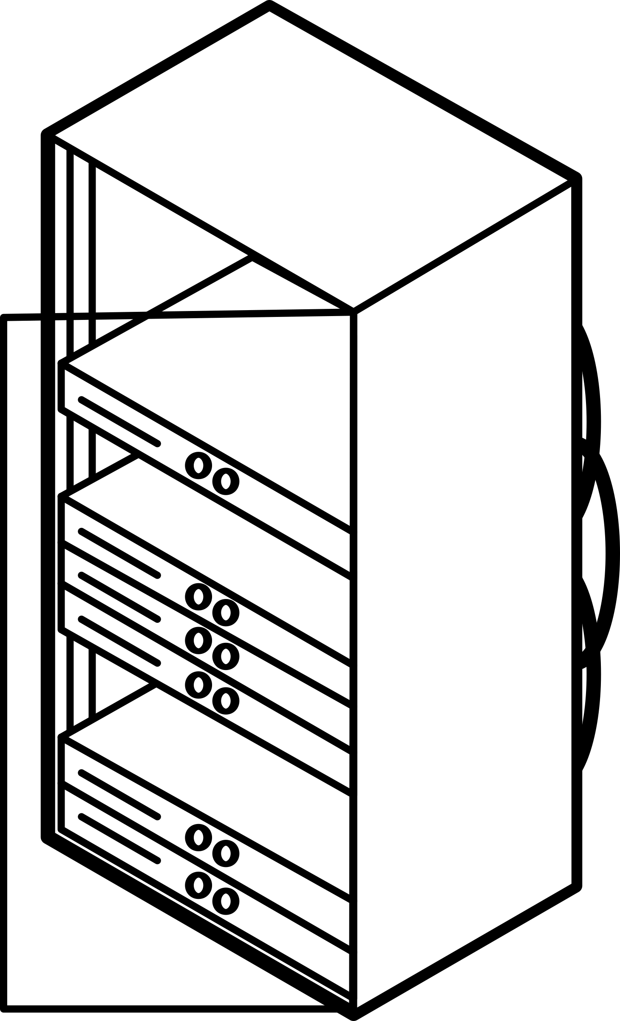

Slide 4
Managing Scale

Slide 5
Managing Scale

Slide 6
The OSG Model
Site Gateway
User Submit
OSG

Slide 7
The OSG Model
Site Gateway
User Submit
OSG

Slide 8
The OSG Model
Site Gateway
User Submit
OSG

Slide 9
The OSG Model
Site Gateway
User Submit
OSG

Slide 10
HTCondor-CE: Site Gateway
Site gateway = HTCondor-CE on batch system submit host
OSG entry point for pilot jobs
Filter and transform incoming jobs for compatibility with site policy
Based on core HTCondor features
Site Gateway
HTCondor-CE
Site Submit Software

Slide 11
The OSG Model: HTCondor-based
Site Gateway
User Submit
OSG

Slide 12
HTCondor-CE: Central Collector
Central storage for site details
Takes advantage of core HTCondor ‘advertising’ feature
Allows us to transition away extra supporting software/protocols
Site Gateway
Site Information
OSG

Slide 13
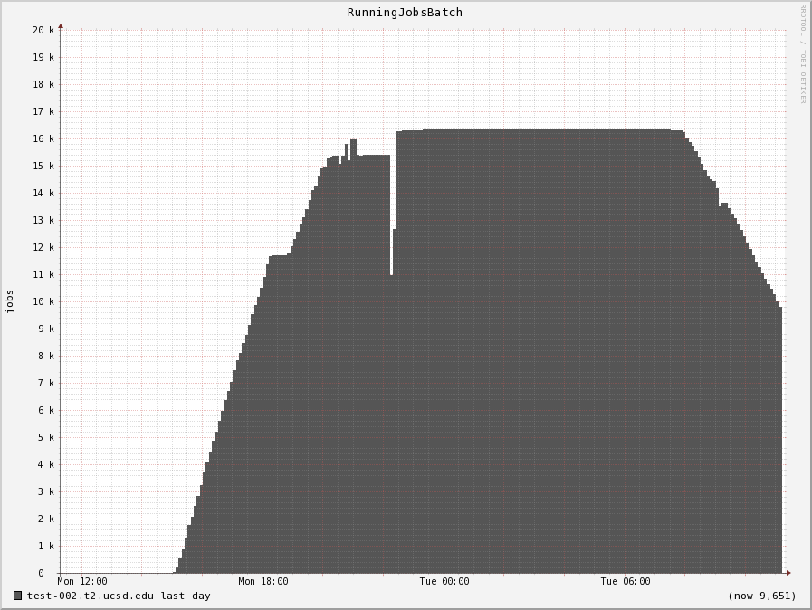
HTCondor-CE: Scalable
Benefit from HTCondor scale improvements
Last round of scale tests by Edgar in 2015
16k* jobs, 2 ports per-job with a start-up rate of 70 jobs/min
Scales horizontally!
* bottlenecked by the backend cluster

Slide 14
HTCondor-CE: In the Wild
Site | Cluster Type | Site Policy
Vanderbilt | Slurm | Stakeholder jobs run in preferred Slurm partitions; incoming jobs modified to accommodate hyper-threading
Purdue | HTCondor | Avoid subclusters that can’t run OSG jobs
 | PBS | Set PBS accounting group based on job submitter
Nebraska | Slurm | GPU jobs should run under a separate Slurm partition
 | HTCondor | Jobs need to run inside Docker containers
Syracuse | HTCondor | Jobs run under custom VM infrastructure
Langston University | HTCondor | Separate cluster for specific OSG jobs via chained CEs!

Slide 15
HTCondor-CE: Job Router, HTCondor backend
Syracuse | HTCondor | Jobs run under custom VM infrastructure
Site Gateway
HTCondor-CE
Site Submit Software
Job Router
Distro = RHEL7
VM_NAME = "ITS-SL72-OSG..."

Slide 16
HTCondor-CE: Job Router, non-HTCondor backend
Vanderbilt | Slurm | Stakeholder jobs run in preferred Slurm partitions; incoming jobs modified to accommodate hyper-threading
Site Gateway
HTCondor-CE
Site Submit Software
Job Router
Gridmanager
blahp
User = “cms”; CPUs = 3
Partition = “high_prio”; CPUs = 2

Slide 17
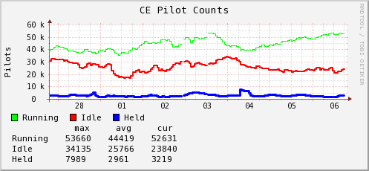
HTCondor-CE: Looking Forward
We have pilot job tracking and introspection
Missing easy payload job introspection and history

Slide 18
HTCondor-CE: Summary
Pros
Public, uniform job entry point
Scalable
Site-local, flexible configuration
Cons
Site-local, flexible configuration
Administrative overhead

Slide 19
Not ready to run your own HTCondor-CE?
See next talk on OSG-hosted CEs!

Slide 20
Site Admin Sessions
Office Hours - Thursday @ 9 AM
Site Installation Overview - Thursday @ 11 AM

Slide 21
Questions?

