Slide 1
HTCondor Annex
(There are many clouds like it, but this one is mine.)
Notes:
To simplify, just say I’m from UW-Madison. :)

Slide 2
Annex means (an) Addition
An annex is “a building joined to main building, providing additional space or accommodations”
An HTCondor annex could provide:
  more machines
  specialized hardware (GPUs)
  specialized policies (longer runtimes)
To condor_annex is then “to append or add as an extra or subordinate pool”
Notes:
Mention very-large memory machines as another specialized hardware option.

Slide 3
What is the cloud?
Commercial services which rent computational resources by the hour
They own the hardware
You provide the software
  (OS, applications, configuration, data)
You can configure the networking and storage as well
Notes:
A virtual machine – if I say that instead of “computational resource” – is a way to time-share hardware such that nobody can tell they don’t have a full machine.

Slide 4
Why not keep using the Grid?
Cloud resources are typically available faster and in greater quantity
Cloud resources are more customizable
  (networking, software, configuration/policy, etc)

Slide 5
A Tool for Users
The condor_annex tool was first released last week, in HTCondor 8.7.0
Labeled as “experimental” because the interface(s) might change
First version has limited functionality and hence limited applicability
Notes:
I’ll discuss the limitations later, after I’ve convinced you that a user-oriented tool is a good idea.

Slide 6
Use Case 1: Deadlines
How important is that user’s deadline?
  Is she willing to spend money on it?
Make it easy for the user to run jobs in the cloud, trading money for job completion
  automation
  sane defaults
  admin configuration
Notes:
Be sure to say right away that this use cases addresses users directly.

Slide 7
Use Case 2: Capability
Meet intermittent needs for hardware
  with lots (TBs) of memory
  with GPUs
  with fast local storage of shared data
    especially if one of the AWS public data sets
Special job policies, like long runtimes
Notes:
This use case is for both users and admins.
The AWS public data sets include, for example, Landsat, the Sloan digital sky survey, or the 1000 genomes project.

Slide 8
Use Case 3: Capacity
Lower costs through higher utilization, with cloud rentals covering usage bursts
Without condor_annex, expanding an HTCondor pool into the cloud isn’t easy
Notes:
This use case is for admins.

Slide 9
demonstration
A brave but ill-considered live

Slide 10
Instructions
https://htcondor-wiki.cs.wisc.edu/index.cgi/wiki?p=HowToUseCondorAnnexWithOnDemandInstances

Slide 11
Opportunities for Improvement
Only works with Amazon
One configuration at a time, so you shouldn’t start a second annex until the first one is up
Hard to restrict annexed resources to the user who’s actually paying for them
Initial set-up documented, but long and detailed

Slide 12
Annex lifecycle
A brief overview of the

Slide 13
Annex Lifecycle
User requests resources
Then condor_annex starts resources
Resources join pool
Resources stop spending your money:
  if they become idle
  after the pre-selected duration

Slide 14
User Requests Resources
User requests may specify:
  hardware (CPUs, memory, disk, GPUs)
  disk image (OS and pre-installed software)
  number of resources and maximum lifetime
  sane defaults for all of these
Two types of resource
  on-demand: pricier, yours until you stop them
  spot: cheaper, can be lost to a higher bidder after a two-minute warning
Notes:
Generally, we’d like to be able to have the HTCondor admin tweak the default for their users. For instance, if all of your pool’s machines have R installed, you might want to modify the annex default image to include R.

Slide 15
Spot Fleet
Amazon offers, and condor_annex supports, a mechanism called “Spot Fleet”
A “Spot Fleet” automatically chooses the cheapest way to satisfy spot resource requests which aren’t picky about their hardware requirements
Spot instances only suitable for short or resumable jobs.

Slide 16
condor_annex Starts Resources
condor_annex machinery starts each resource, specifying two extra things:
  a “client token” (intended for fault tolerance); we use it to indelibly mark each resource as part of a particular annex
  a “role,” which helps connect the resource to your HTCondor pool
Notes:
The “role” is one of the details handled by the set-up instructions.

Slide 17
Resource Securely Joins Pool
A “role” is a set of permissions.
The annex role’s permissions are to:
  read a file from otherwise-private cloud storage
  look at the role
When HTCondor starts up, it inspects the role to figure out which file it has permission to read – and then does.
Admins: this leaves the “user data” avaible for you to use.

Slide 18
Resources Stop Spending
Fail-safe: the resources always stop
  Even the user’s machine goes offline
Implemented entirely in the cloud
  (Uses AWS Lambda and CloudWatch Events)
Checks the duration every five minutes
  (Uses “client token” to identify annex instances)
Notes:
The initial set-up instructions create the Lambda function; the per-annex timer is set up by condor_annex.

Slide 19
Customization

Slide 20
Disk Image Customization
A resource must have a disk image
  (OS, applications, configuration, maybe data)
HTCondor provides a default disk image that should work for most users
If you create disk images for your users, you can copy and customize the default image for them, or make your own from scratch, subject to a few restrictions
Notes:
We’d like to have condor_annex automatically pick up on its pool’s default image, but that’s at least another version away.

Slide 21
Disk Image Requirements
The default disk image does all this
Start-up to fetch config and security data
  currently requires AWS CLI tool
HTCondor configured to turn off when it’s idle for too long.
  STARTD_NOCLAIM_SHUTDOWN
HTCondor configured to turn instance off when the master exits.
  DEFAULT_MASTER_SHUTDOWN_SCRIPT
Notes:
So that’s not a whole lot that’s required; you have a great deal of freedom in making an annex-compatible image.

Slide 22
Image Suggestions
The default disk image does all this
Advertise instance ID in master and startd
Use public IP addresses and set TCP_FORWARDING_HOST
Turn communications integrity and encryption on
Encrypt the run directories

Slide 23
What can you do today?

Slide 24
Initial Set-Up
Follow the initial set-up instructions to connect condor_annex to an AWS account via HTCondor configuration
Assumptions (mostly for simplicity):
  public IP address, open port
  Linux
  new, private HTCondor pool
https://htcondor-wiki.cs.wisc.edu/index.cgi/wiki?p=UsingCondorAnnexForTheFirstTime

Slide 25
Use Cases
Deadlines – not recommended
  resource not isolated by default
  user’s jobs in another queue
Capability – should be usable for admins
Capacity – should be usable for admins
  Contact us if you have trouble adapting the instructions for your particular situation.

Slide 26
Plans for the Next Release
Allow changes to annex lifetimes
Allow multiple simultaneous annexes
Automate initial set-up (and verify it)
Check network back to your pool on start
UI improvements

Slide 27
Contact Us
Please sign up for a time to talk!
Administrators
  Todd Miller
  tlmiller@cs.wisc.edu
  (608) 262-3924
Users, especially of osg-connect
  Mats Rynge
  rynge@isi.edu
  (310) 448-8414
Notes:
[Something about where the sign-up sheet is.]

Slide 28
Extra material
advanced usage only beyond this point

Slide 29
Private Annexes?
Instructions create a private, single-user annex with no jobs, but our use cases all assume you already have too many.
Lots of ways to solve this problem.
I haven’t tried any. :(
Maybe a personal job router? It wouldn’t require any configuration changes to the existing pool…
Notes:
This is a good place to start, I think, because it’s simple to explain and works relatively well. It’s a bad place to start because our use cases all kind of assume a populated

Slide 30
Other Installation Thoughts
Job transfer mechanisms?
  Flocking? Job router?
  Using START expressions instead?
    (Security implications of sharing pool password?)
What about an infrastructural annex?
What about an annex for a group?
  (secure group identification?)

Slide 31
Demonstration
it’s dead, Jim

Slide 32
submit-3:/scratch/tlmiller/condor-8.7.0$ condor_status
Name OpSys Arch State Activity LoadAv Mem Act
slot1@submit-3.batlab.org LINUX X86_64 Claimed Busy 0.680 1992 0+0
slot2@submit-3.batlab.org LINUX X86_64 Claimed Busy 0.000 1992 0+0
slot3@submit-3.batlab.org LINUX X86_64 Claimed Busy 0.000 1992 0+0
slot4@submit-3.batlab.org LINUX X86_64 Claimed Busy 0.000 1992 0+0
slot5@submit-3.batlab.org LINUX X86_64 Claimed Busy 0.000 1992 0+0
slot6@submit-3.batlab.org LINUX X86_64 Claimed Busy 0.000 1992 0+0
slot7@submit-3.batlab.org LINUX X86_64 Claimed Busy 0.000 1992 0+0
slot8@submit-3.batlab.org LINUX X86_64 Claimed Busy 0.000 1992 0+0
Total Owner Claimed Unclaimed Matched Preempting Backfill Drain
X86_64/LINUX 8 0 8 0 0 0 0 0
Total 8 0 8 0 0 0 0 0
Notes:
Start with a small, private condor pool on a single 8-core machine.

Slide 33
submit-3:/scratch/tlmiller/condor-8.7.0$ condor_q
-- Schedd: submit-3.batlab.org : <128.104.100.22:50002?... @ 03/02/17 17:02:24
OWNER BATCH_NAME SUBMITTED DONE RUN IDLE TOTAL JOB_IDS
tlmiller CMD: /bin/sle 3/2 09:59 320 8 672 1000 3.320-999
680 jobs; 0 completed, 0 removed, 672 idle, 8 running, 0 held, 0 suspended
Notes:
I have a lot of jobs left…

Slide 34
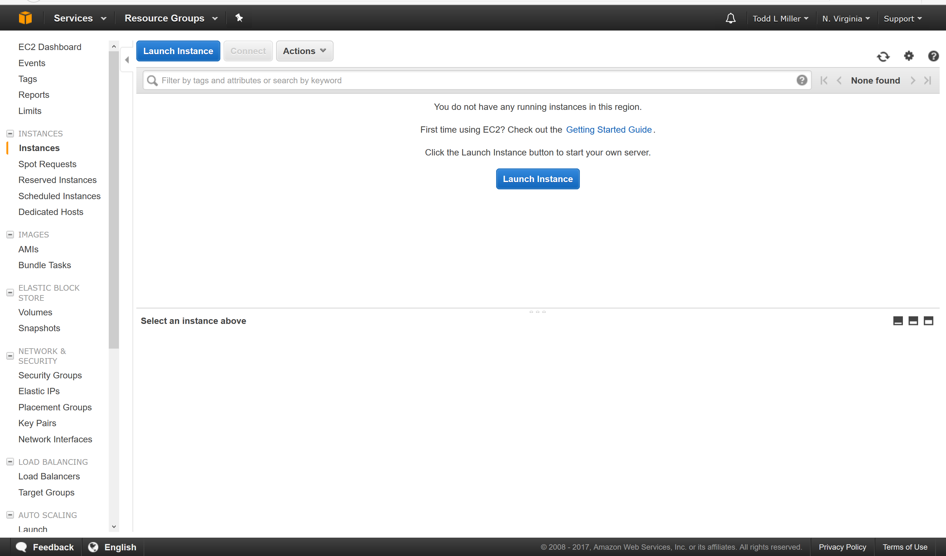
Notes:
… and an Amazon account that’s not doing anything.

Slide 35
submit-3:/scratch/tlmiller/condor-8.7.0$ condor_annex -count 4 -annex-name DemoAnnex
Will request 4 m4.large on-demand instances for 0.83 hours. Each instance will terminate after being idle for 0.25 hours.
To change the instance type, use the -aws-on-demand-instance-type flag.
To change the lease duration, use the -duration flag.
To change how long an idle instance will wait before terminating itself, use the -idle flag.
DemoAnnexfd036dff-2a62-431f-95b4-d03ebe407729
Notes:
So I ask condor_annex to get me four more machines with the name “DemoAnnex.” condor_annex prints out more about what I’m asking it do, including the default values that I didn’t supply – like what kind of hardware I’ll get, how long it’ll be before the annex expires, and how long each resource can be idle for before it gives up. The next few lines are instructions about how to change the defaults, if you want to. In the next version, it probably won’t bother to tell you about options you’ve already used; it may also ask you to confirm that you want to make such an annex. The last line is an identifier – called the “client token” – that’s only useful for debugging. I’ll talk a little bit more about it later on, but the next version probably won’t bother to print it.

Slide 36
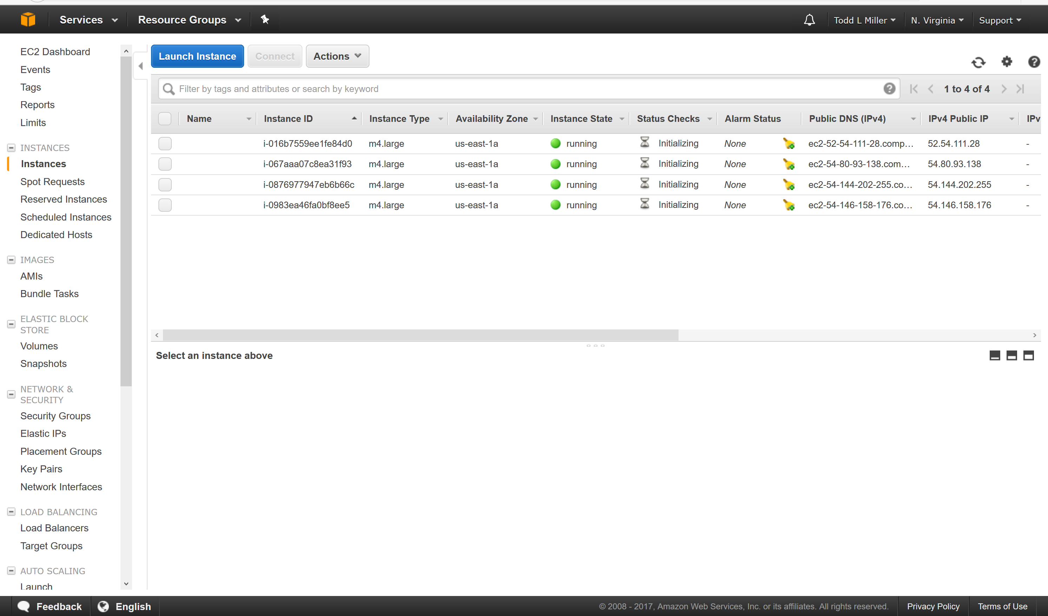
Notes:
Almost immediately – on the order of a few seconds – we see that Amazon has given us four machines, and that they’re booting up.

Slide 37
submit-3:/scratch/tlmiller/condor-8.7.0$ condor_status
Name OpSys Arch State Activity LoadAv
slot1@ip-172-31-1-200.ec2.internal LINUX X86_64 Claimed Busy 0.750
slot2@ip-172-31-1-200.ec2.internal LINUX X86_64 Claimed Busy 0.000
slot1@ip-172-31-7-143.ec2.internal LINUX X86_64 Claimed Busy 0.820
slot2@ip-172-31-7-143.ec2.internal LINUX X86_64 Claimed Busy 0.000
slot1@ip-172-31-8-173.ec2.internal LINUX X86_64 Claimed Busy 0.590
slot2@ip-172-31-8-173.ec2.internal LINUX X86_64 Claimed Busy 0.000
slot1@ip-172-31-15-86.ec2.internal LINUX X86_64 Claimed Busy 0.650
slot2@ip-172-31-15-86.ec2.internal LINUX X86_64 Claimed Busy 0.000
slot1@submit-3.batlab.org LINUX X86_64 Claimed Busy 0.940
slot2@submit-3.batlab.org LINUX X86_64 Claimed Busy 0.000
slot3@submit-3.batlab.org LINUX X86_64 Claimed Busy 0.000
slot4@submit-3.batlab.org LINUX X86_64 Claimed Busy 0.000
slot5@submit-3.batlab.org LINUX X86_64 Claimed Busy 0.000
slot6@submit-3.batlab.org LINUX X86_64 Claimed Busy 0.000
slot7@submit-3.batlab.org LINUX X86_64 Claimed Busy 0.000
slot8@submit-3.batlab.org LINUX X86_64 Claimed Busy 0.000
Total Owner Claimed Unclaimed Matched Preempting Backfill Drain
X86_64/LINUX 16 0 16 0 0 0 0 0
Total 16 0 16 0 0 0 0 0
Notes:
A little bit later, without any further interaction from the user, those machines will show up in the pool and start running jobs. We’ve doubled the size of my pool with one command.

Slide 38
submit-3:/scratch/tlmiller/condor-8.7.0$ condor_status -annex DemoAnnex
Name OpSys Arch State Activity LoadAv
slot1@ip-172-31-1-200.ec2.internal LINUX X86_64 Claimed Busy 0.010
slot2@ip-172-31-1-200.ec2.internal LINUX X86_64 Claimed Busy 0.000
slot1@ip-172-31-7-143.ec2.internal LINUX X86_64 Claimed Busy 0.820
slot2@ip-172-31-7-143.ec2.internal LINUX X86_64 Claimed Busy 0.000
slot1@ip-172-31-8-173.ec2.internal LINUX X86_64 Claimed Busy 0.590
slot2@ip-172-31-8-173.ec2.internal LINUX X86_64 Claimed Busy 0.000
slot1@ip-172-31-15-86.ec2.internal LINUX X86_64 Claimed Busy 0.650
slot2@ip-172-31-15-86.ec2.internal LINUX X86_64 Claimed Busy 0.000
Total Owner Claimed Unclaimed Matched Preempting Backfill Drain
X86_64/LINUX 8 0 8 0 0 0 0 0
Total 8 0 8 0 0 0 0 0
Notes:
You can also pass the –annex flag to condor_status, if you only want to know about the annex in question.

Slide 39
submit-3:/scratch/tlmiller/condor-8.7.0$ condor_off -master -annex DemoAnnex
Sent "Kill-Daemon" command for "master" to master ip-172-31-7-143.ec2.internal
Sent "Kill-Daemon" command for "master" to master ip-172-31-1-200.ec2.internal
Sent "Kill-Daemon" command for "master" to master ip-172-31-8-173.ec2.internal
Sent "Kill-Daemon" command for "master" to master ip-172-31-15-86.ec2.internal
Notes:
We’ve also added the annex flag to tools like condor_off, which you can see here identifying the machines in the annex and shutting them down. I’ll explain how that works in a bit.

Slide 40
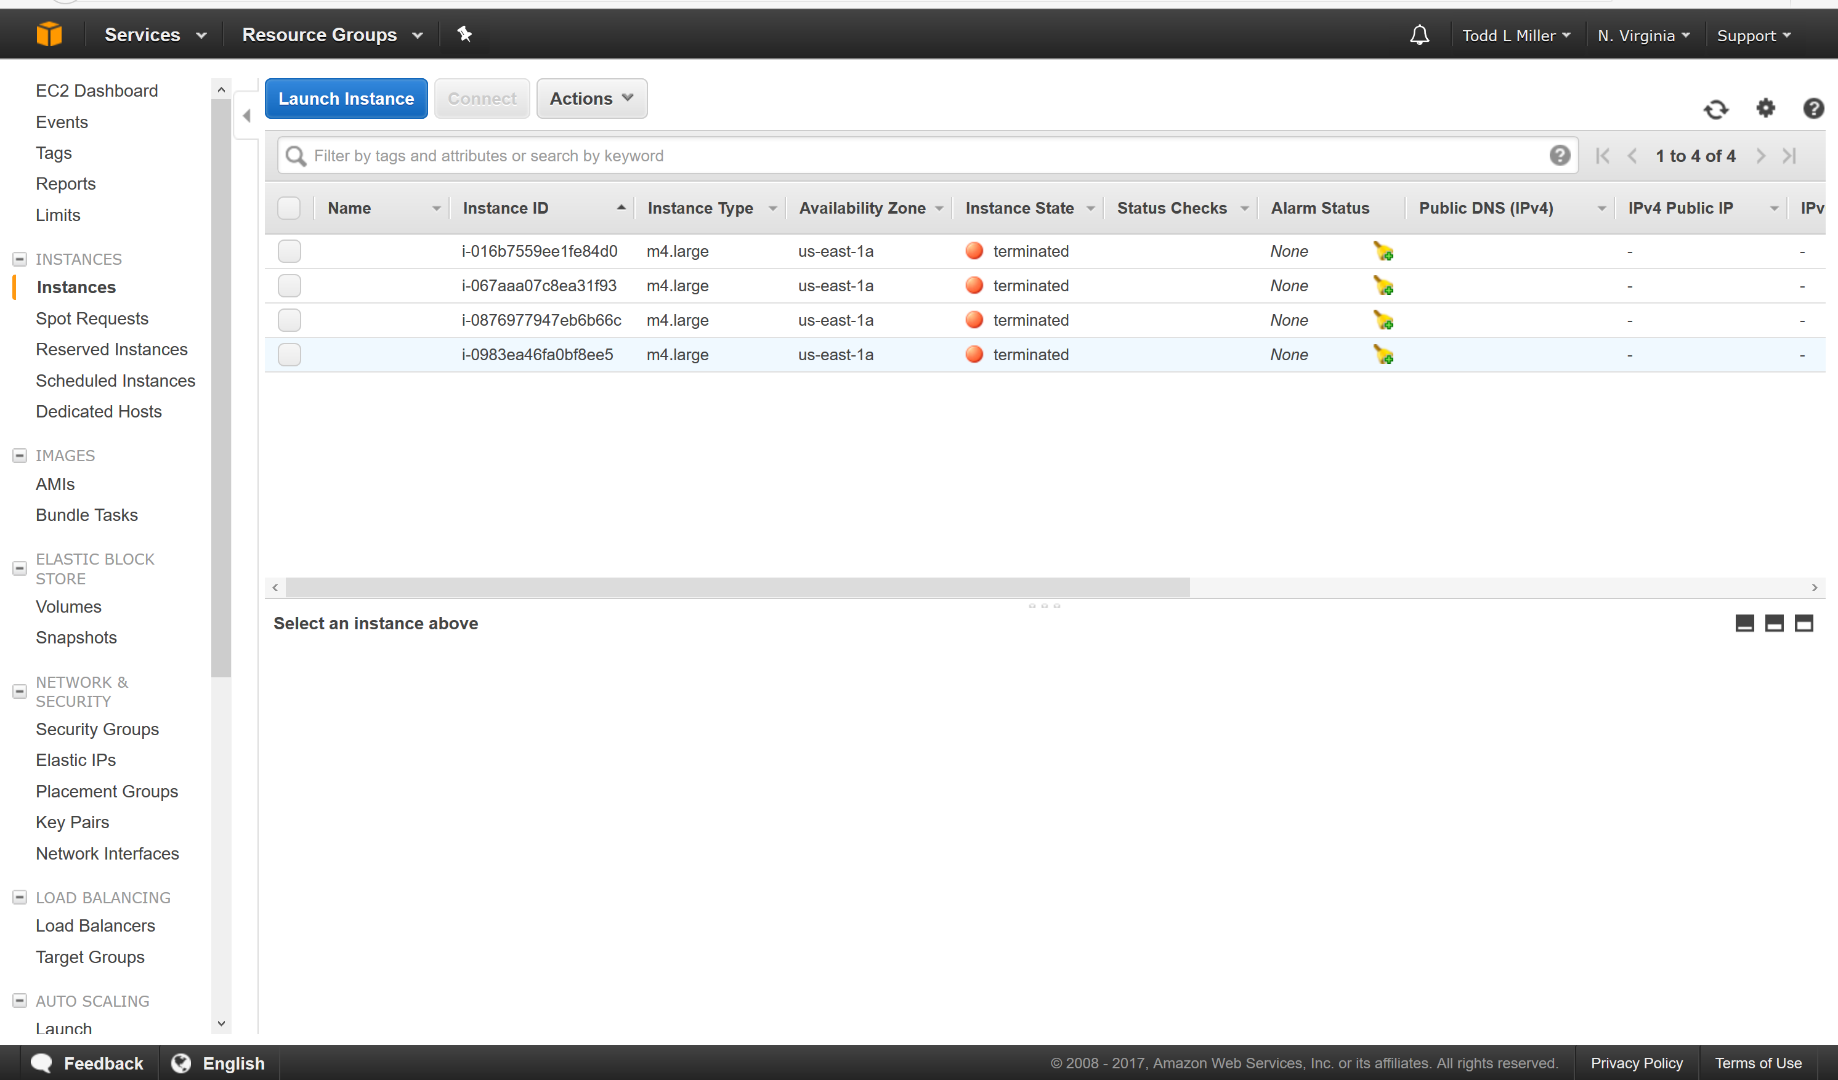
Notes:
But you can see on the console that those machines have terminated.

Slide 41
submit-3:/scratch/tlmiller/condor-8.7.0$ condor_status
Name OpSys Arch State Activity LoadAv Mem Act
slot1@submit-3.batlab.org LINUX X86_64 Claimed Busy 0.000 1992 0+0
slot2@submit-3.batlab.org LINUX X86_64 Claimed Busy 0.820 1992 0+0
slot3@submit-3.batlab.org LINUX X86_64 Claimed Busy 0.000 1992 0+0
slot4@submit-3.batlab.org LINUX X86_64 Claimed Busy 0.000 1992 0+0
slot5@submit-3.batlab.org LINUX X86_64 Claimed Busy 0.000 1992 0+0
slot6@submit-3.batlab.org LINUX X86_64 Claimed Busy 0.000 1992 0+0
slot7@submit-3.batlab.org LINUX X86_64 Claimed Busy 0.000 1992 0+0
slot8@submit-3.batlab.org LINUX X86_64 Claimed Busy 0.000 1992 0+0
Total Owner Claimed Unclaimed Matched Preempting Backfill Drain
X86_64/LINUX 8 0 8 0 0 0 0 0
Total 8 0 8 0 0 0 0 0
Notes:
And if you ask HTCondor, they’ve exited the pool cleanly.

