Slide 1
OSG Site Installation Overview
Brian Lin
OSG All Hands 2017

Slide 2
Phase 0: Is the OSG for you?

Slide 3
The OSG Model
Site Gateway
User Submit
OSG

Slide 4
The OSG Model
Site Gateway
User Submit
OSG

Slide 5
The OSG Model
Site Gateway
User Submit
OSG

Slide 6
The OSG Model
Site Gateway
User Submit
OSG

Slide 7
Base OSG Requirements
Batch Systems: HTCondor, Slurm, Torque/PBS, LSF, SGE
Operating Systems: Red Hat Enterprise Linux, CentOS, Scientific Linux
Outgoing WAN access from worker nodes

Slide 8
Phase 1: Hosted CE or HTCondor-CE?

Slide 9
Hosted CE or HTCondor-CE?
Do you want > O(10⁴) OSG jobs?
Are you ok with all OSG jobs being submitted as a single user?
Are there special rules or policies for submitting jobs to your site?
Do you want to change your configuration frequently?
If you answered no to the above questions, the hosted CE solution could work for you.
Step 1: create user account with submit privileges and SSH access via SSH key
Step 2: If running a non-HTCondor batch system, share the user’s home dir with the worker nodes
Still not sure? Ask us at user-support@opensciencegrid.org

Slide 10
OSG-Hosted CE
Your Site
SSH
Site Gateway

Slide 11
You’re done!

Slide 12
HTCondor-CE
Your Site
Direct
Submission
Site Gateway

Slide 13
OSG Information Management System
Request a user certificate (if you don’t have one already) Https://oim.opensciencegrid.org/oim/certificaterequestuser
Register a facility, site, resource group, and resource if not already in the topology https://twiki.opensciencegrid.org/bin/view/Operations/OIMRegistrationInstructions#Facility_Registration
Register as a grid administrator https://oim.opensciencegrid.org/oim/gridadmin
Request a host certificate for your CE https://oim.opensciencegrid.org/oim/certificaterequesthost
Questions/Issues? goc@opensciencegrid.org

Slide 14
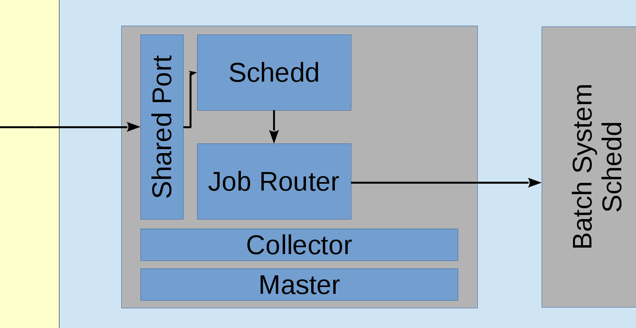
HTCondor-CE Architecture: HTCondor backend

Slide 15
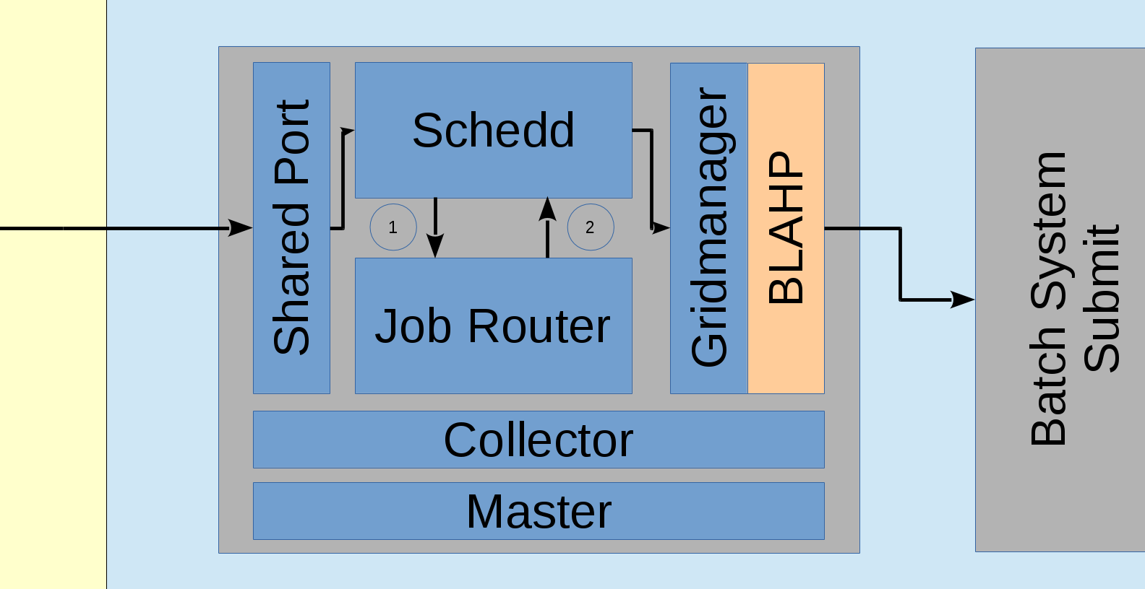
HTCondor-CE: Non-HTCondor backend

Slide 16
HTCondor-CE Requirements
Open port (TCP) 9619
Shared FS for non-HTCondor batch systems for file transfer
Ensure mapped users exist
Minimal hardware requirements
Handful of cores
HTCondor backends should plan on ~½ MB RAM per job
Expecting high rates of jobs? HTCondor-CE SPOOL dir should live on an SSD
Default /var/lib/condor-ce/spool (condor_ce_config_val -v SPOOL)
Same thing applies for HTCondor backends Default: /var/lib/condor/spool (condor_config_val -v SPOOL)
https://twiki.grid.iu.edu/bin/view/Documentation/Release3/InstallHTCondorCE

Slide 17
edg-mkgridmap vs GUMS
Authentication methods
edg-mkgridmap is simpler, creates /etc/grid-security/grid-mapfile that holds a mapping of certificate Distinguished Names to local unix accounts
Use GUMS only if you know you need it:
You want to map users based on rules
You need to support multiple VO roles
You need to support gLExec for pilot jobs
https://twiki.grid.iu.edu/bin/view/Documentation/Release3/InstallHTCondorCE#Configuring_authorization

Slide 18
HTCondor-CE Configuration
`osg-configure -v` and `osg-configure -c` handles most of the configuration
Most HTCondor-CE configuration goes into the job router
Job router filters and transforms incoming grid jobs into “routed” jobs
Configured using declarative ClassAds with the JOB_ROUTER_ENTRIES variable
Each entry in JOB_ROUTER_ENTRIES is combined with the JOB_ROUTER_DEFAULTS configuration variable to create each job route
https://twiki.opensciencegrid.org/bin/view/Documentation/Release3/JobRouterRecipes

Slide 19
Alice has an HTCondor pool and she wants CMS jobs submitted to her CE to be forwarded to her pool and requesting x86_64 Linux machines and setting the attribute “foo” on her routed job to “bar”. All other jobs should be submitted to the pool without any changes.
JOB_ROUTER_ENTRIES = [ \
name = "condor_pool_cms"; \
TargetUniverse = 5; \
Requirements = target.x509UserProxyVOName =?= "cms"; \
set_requirements = (Arch == "X86_64") && (TARGET.OpSys == "LINUX"); \
set_foo = “bar”; \
] \
[ \
name = “condor_pool_other”; \
TargetUniverse = 5; \
Requirements = target.x509UserProxyVOName =!= "cms"; \
]
https://twiki.opensciencegrid.org/bin/view/Documentation/Release3/JobRouterRecipes

Slide 20
Alice has an HTCondor pool and she wants CMS jobs submitted to her CE to be forwarded to her pool and requesting x86_64 Linux machines and setting the attribute “foo” on her routed job to “bar”. All other jobs should be submitted to the pool without any changes.
JOB_ROUTER_ENTRIES = [ \
name = "condor_pool_cms"; \
TargetUniverse = 5; \
Requirements = target.x509UserProxyVOName =?= "cms"; \
set_requirements = (Arch == "X86_64") && (TARGET.OpSys == "LINUX"); \
set_foo = “bar”; \
] \
[ \
name = “condor_pool_other”; \
TargetUniverse = 5; \
Requirements = target.x509UserProxyVOName =!= "cms"; \
]
https://twiki.opensciencegrid.org/bin/view/Documentation/Release3/JobRouterRecipes

Slide 21
Alice has an HTCondor pool and she wants CMS jobs submitted to her CE to be forwarded to her pool and requesting x86_64 Linux machines and setting the attribute “foo” on her routed job to “bar”. All other jobs should be submitted to the pool without any changes.
JOB_ROUTER_ENTRIES = [ \
name = "condor_pool_cms"; \
TargetUniverse = 5; \
Requirements = target.x509UserProxyVOName =?= "cms"; \
set_requirements = (Arch == "X86_64") && (TARGET.OpSys == "LINUX"); \
set_foo = “bar”; \
] \
[ \
name = “condor_pool_other”; \
TargetUniverse = 5; \
Requirements = target.x509UserProxyVOName =!= "cms"; \
]
https://twiki.opensciencegrid.org/bin/view/Documentation/Release3/JobRouterRecipes

Slide 22
Alice has an HTCondor pool and she wants CMS jobs submitted to her CE to be forwarded to her pool and requesting x86_64 Linux machines and setting the attribute “foo” on her routed job to “bar”. All other jobs should be submitted to the pool without any changes.
JOB_ROUTER_ENTRIES = [ \
name = "condor_pool_cms"; \
TargetUniverse = 5; \
Requirements = target.x509UserProxyVOName =?= "cms"; \
set_requirements = (Arch == "X86_64") && (TARGET.OpSys == "LINUX"); \
set_foo = “bar”; \
] \
[ \
name = “condor_pool_other”; \
TargetUniverse = 5; \
Requirements = target.x509UserProxyVOName =!= "cms"; \
]
https://twiki.opensciencegrid.org/bin/view/Documentation/Release3/JobRouterRecipes

Slide 23
Alice has an HTCondor pool and she wants CMS jobs submitted to her CE to be forwarded to her pool and requesting x86_64 Linux machines and setting the attribute “foo” on her routed job to “bar”. All other jobs should be submitted to the pool without any changes.
JOB_ROUTER_ENTRIES = [ \
name = "condor_pool_cms"; \
TargetUniverse = 5; \
Requirements = target.x509UserProxyVOName =?= "cms"; \
set_requirements = (Arch == "X86_64") && (TARGET.OpSys == "LINUX"); \
set_foo = “bar”; \
] \
[ \
name = “condor_pool_other”; \
TargetUniverse = 5; \
Requirements = target.x509UserProxyVOName =!= "cms"; \
]
https://twiki.opensciencegrid.org/bin/view/Documentation/Release3/JobRouterRecipes

Slide 24
Alice has an HTCondor pool and she wants CMS jobs submitted to her CE to be forwarded to her pool and requesting x86_64 Linux machines and setting the attribute “foo” on her routed job to “bar”. All other jobs should be submitted to the pool without any changes.
JOB_ROUTER_ENTRIES = [ \
name = "condor_pool_cms"; \
TargetUniverse = 5; \
Requirements = target.x509UserProxyVOName =?= "cms"; \
set_requirements = (Arch == "X86_64") && (TARGET.OpSys == "LINUX"); \
set_foo = “bar”; \
] \
[ \
name = “condor_pool_other”; \
TargetUniverse = 5; \
Requirements = target.x509UserProxyVOName =!= "cms"; \
]
https://twiki.opensciencegrid.org/bin/view/Documentation/Release3/JobRouterRecipes

Slide 25
Alice has an HTCondor pool and she wants CMS jobs submitted to her CE to be forwarded to her pool and requesting x86_64 Linux machines and setting the attribute “foo” on her routed job to “bar”. All other jobs should be submitted to the pool without any changes.
JOB_ROUTER_ENTRIES = [ \
name = "condor_pool_cms"; \
TargetUniverse = 5; \
Requirements = target.x509UserProxyVOName =?= "cms"; \
set_requirements = (Arch == "X86_64") && (TARGET.OpSys == "LINUX"); \
set_foo = “bar”; \
] \
[ \
name = “condor_pool_other”; \
TargetUniverse = 5; \
Requirements = target.x509UserProxyVOName =!= "cms"; \
]
https://twiki.opensciencegrid.org/bin/view/Documentation/Release3/JobRouterRecipes

Slide 26
Cameron has a PBS pool and she wants CMS jobs submitted to her CE to be forwarded to her pool. All other jobs should be submitted to her pool without any changes
JOB_ROUTER_ENTRIES = [ \
name = "pbs_pool_cms"; \
TargetUniverse = 9; \
GridResource = "batch pbs"; \
Requirements = target.x509UserProxyVOName =?= "cms"; \
] \
[ \
name = "pbs_pool_other"; \
TargetUniverse = 9; \
GridResource = "batch pbs"; \
Requirements = target.x509UserProxyVOName =!= "cms"; \
]
https://twiki.opensciencegrid.org/bin/view/Documentation/Release3/JobRouterRecipes

Slide 27
Cameron has a Slurm pool and she wants CMS jobs submitted to her CE to be forwarded to her pool. All other jobs should be submitted to her pool without any changes
JOB_ROUTER_ENTRIES = [ \
name = "slurm_pool_cms"; \
TargetUniverse = 9; \
GridResource = "batch slurm"; \
Requirements = target.x509UserProxyVOName =?= "cms"; \
] \
[ \
name = "slurm_pool_other"; \
TargetUniverse = 9; \
GridResource = "batch slurm"; \
Requirements = target.x509UserProxyVOName =!= "cms"; \
]
https://twiki.opensciencegrid.org/bin/view/Documentation/Release3/JobRouterRecipes

Slide 28
HTCondor-CE Monitoring
For graphs showing pilot jobs and CE load
yum install condor-ce-view
Configuration lives in /etc/condor-ce/config.d/05-ce-view.conf
Uncomment DAEMON_LIST
Defaults to port 80 but can be configured by changing HTCONDOR_VIEW_PORT
Restart condor-ce service after config changes
https://twiki.grid.iu.edu/bin/view/Documentation/Release3/InstallHTCondorCE#CeView

Slide 29
Validation
Run as regular user with certificate on CE $ voms-proxy-init $ condor_ce_trace -d `hostname`
Not working? Consult the troubleshooting guide: https://twiki.opensciencegrid.org/bin/view/Documentation/Release3/TroubleshootingHTCondorCE
Still stuck? goc@opensciencegrid.org

Slide 30
Phase 2: Preparing your worker nodes

Slide 31
OSG Worker Node Client
Thin collection of software necessary for pilot job execution
Available via RPM package, tarball, docker image (new!), and OASIS
RPM: https://twiki.grid.iu.edu/bin/view/Documentation/Release3/InstallWNClient
Tarball: https://twiki.grid.iu.edu/bin/view/Documentation/Release3/InstallWNClientTarball
OASIS: https://twiki.grid.iu.edu/bin/view/Documentation/Release3/UsingOSGWnClientFromOASIS

Slide 32
OSG Worker Node Requirements
Outgoing WAN access!
OSG worker node client
Pilot job temp space (OSG_WN_TMP)
Set by worker_node_temp configuration in /etc/osg/config.d/10-storage.ini on the CE
10GB disk/core minimum
Site responsible for cleanup, e.g. tmpwatch
Cleanup /tmp (recommendation)

Slide 33
Example site
Internet
Your Site
wn-client
wn-client
wn-client
Direct
Submission
wn-client
Site Gateway
wn-client
wn-client

Slide 34
Validation: Request test pilots
osg-gfactory-support@physics.ucsd.edu

Slide 35
OSG Application Software Installation Service
Software distribution over CernVM File System (CVMFS), which uses http. Requires Squid proxy node: https://twiki.opensciencegrid.org/bin/view/Documentation/Release3/InstallCvmfs https://twiki.opensciencegrid.org/bin/view/Documentation/Release3/InstallFrontierSquid
More and more jobs in the OSG want CVMFS
Optional but recommended

Slide 36
Example site with OASIS
Internet
Your Site
OASIS
Squid
OASIS
OASIS
Direct
Submission
OASIS
Site Gateway
OASIS
OASIS

Slide 37
Summary: Decision points
OSG-Hosted CE vs HTCondor-CE; if hosted CE, you’re done!
edg-mkgridmap vs GUMS on HTCondor-CE
osg-wn-client installation method
Optional but recommended OASIS on worker nodes

Slide 38
Summary: Networking
Open outbound WAN access from worker nodes
Open port 9619 (TCP) on HTCondor-CE

Slide 39
Summary: Links
OIM: http://oim.opensciencegrid.org/
HTCondor-CE installation guide: https://twiki.grid.iu.edu/bin/view/Documentation/Release3/InstallHTCondorCE
HTCondor-CE job router configuration guide: https://twiki.opensciencegrid.org/bin/view/Documentation/Release3/JobRouterRecipes
HTCondor-CE troubleshooting guide: https://twiki.opensciencegrid.org/bin/view/Documentation/Release3/TroubleshootingHTCondorCE
osg-wn-client installation guides:
RPM: https://twiki.grid.iu.edu/bin/view/Documentation/Release3/InstallWNClient
Tarball: https://twiki.grid.iu.edu/bin/view/Documentation/Release3/InstallWNClientTarball
OASIS: https://twiki.grid.iu.edu/bin/view/Documentation/Release3/UsingOSGWnClientFromOASIS
OASIS installation guide: https://twiki.opensciencegrid.org/bin/view/Documentation/Release3/InstallCvmfs
Squid installation guide: https://twiki.opensciencegrid.org/bin/view/Documentation/Release3/InstallFrontierSquid

Slide 40
Interested in an OSG-Hosted CE? user-support@opensciencegrid.org
Want pilot jobs?
osg-gfactory-support@physics.ucsd.edu
Issues? goc@opensciencegrid.org

Slide 41
Questions?

