Slide 1
Update news at 9/23/16
SOW still in progress
Possible intensity upgrade NOvA and NuMI
Adam uploaded SY120 beam line

Slide 2
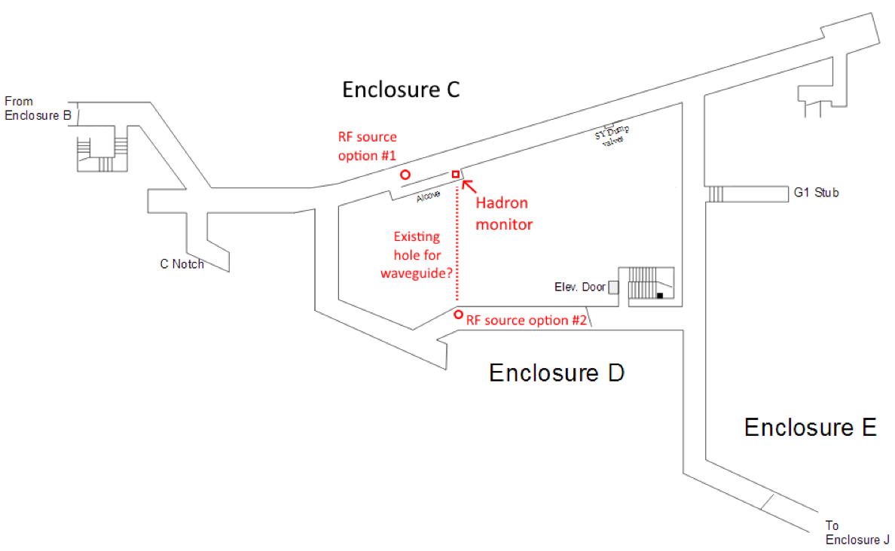
SY120

