Slide 1
Hadron Cal
AVT sept 23 2016VT

Slide 2
R = Rg || Rcav
Ccav = 2 Wcav/Eo^2
Lcav = 1 / [(2 Pi Frf)^2 Ccav]
R Lcav Ccav Rgas(t)
io(t)=Eo/R

Slide 3
Hydrogen
C = 1 cm
Hydrogen
C = 10 cm
Nitrogen
C= 10 cm
Nitrogen
C= 1 cm

Slide 4
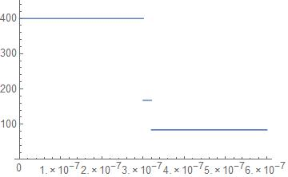
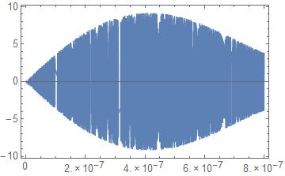
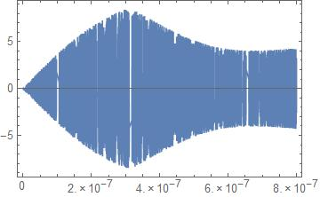
Example 1.
Q = 10^4, Rcav = Q To V^2 /(4 Pi Wcav) = 448000
nP Exp[-2]/(2 π σx²) Exp[-(x² +y²)/(2 σx²)];
nP= 2.5 10¹¹ ; σx=7.5;σy=7.5; Nb = 500;

Slide 5
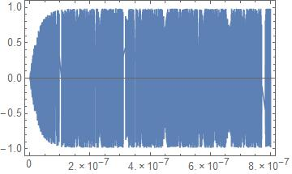
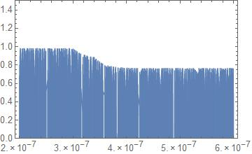
Rcav = 10K

