Slide 1
LArG4 support project report
Hans Wenzel
LArSoft Coordination Meeting
27th September 2016

Slide 2
Status:
Lynn got me set up → so can start developing. Made necessary changes (Saturation) so that LarSoft works with latest version of Geant4.
Start looking into:
Step limiter vs. voxels to match to wire pitch. (CPU, memory...)
Use of reference physics lists.
New Geant4 interface to access optical photon processes (scintillation/Cerenkov)
Is the info written out sufficient to do all the physics studies of interest?
→ no subprocesses which are available in Geant4.
→ processes not resulting in new particles but available via stepping action.
Replace LarG4 by more general module (artg4tk) → liquid Argon would be just a special sensitive detector?
Hans Wenzel LArSoft Coordination Meeting
9/27/16

Slide 3
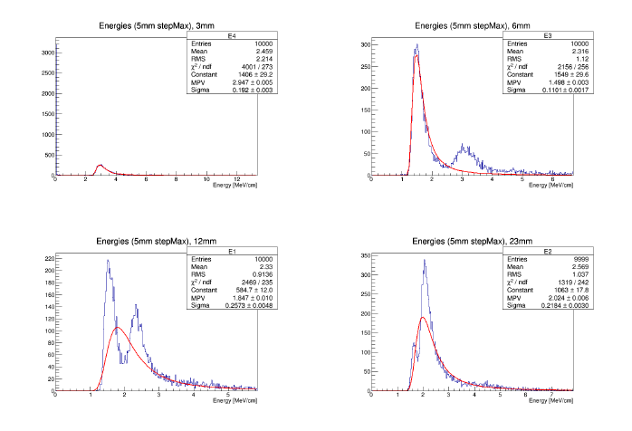
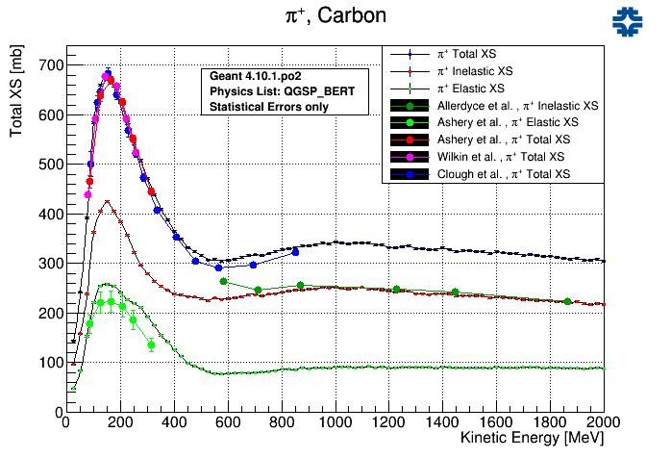
Validate physics relevant to liquid Ar TPC’s (Isaac):
dE/dx
Cross sections (K^{+/-},p^{+/-}, p ..).
em shower shapes, e g separation, energy resolution (combine dE/dx and scintillation).
m⁺ m⁻ separation.
p interactions, p⁺p⁻ separation hadronic energy resolution.
Hans Wenzel LArSoft Coordination Meeting
9/27/16

Slide 4
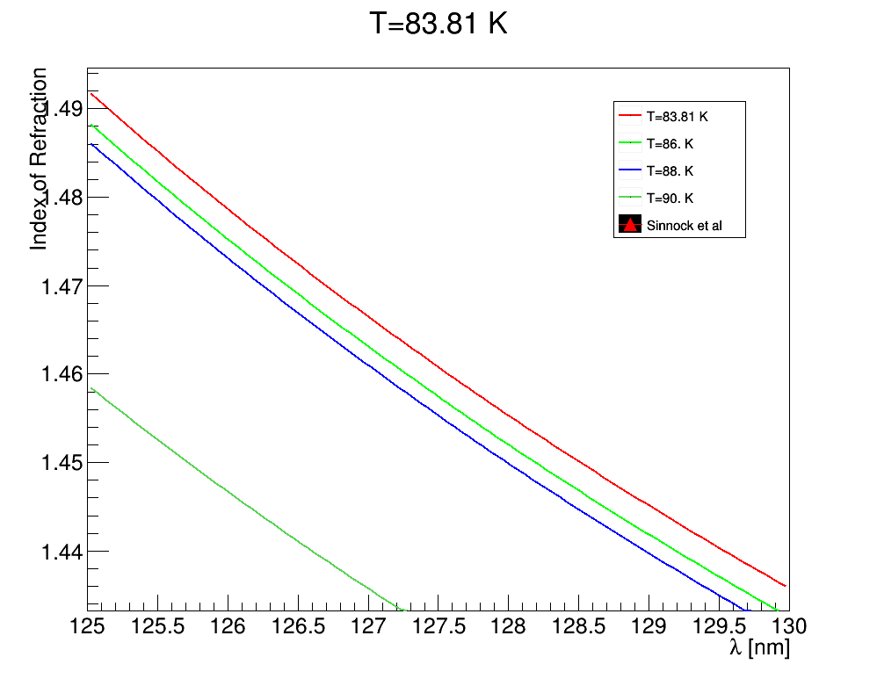
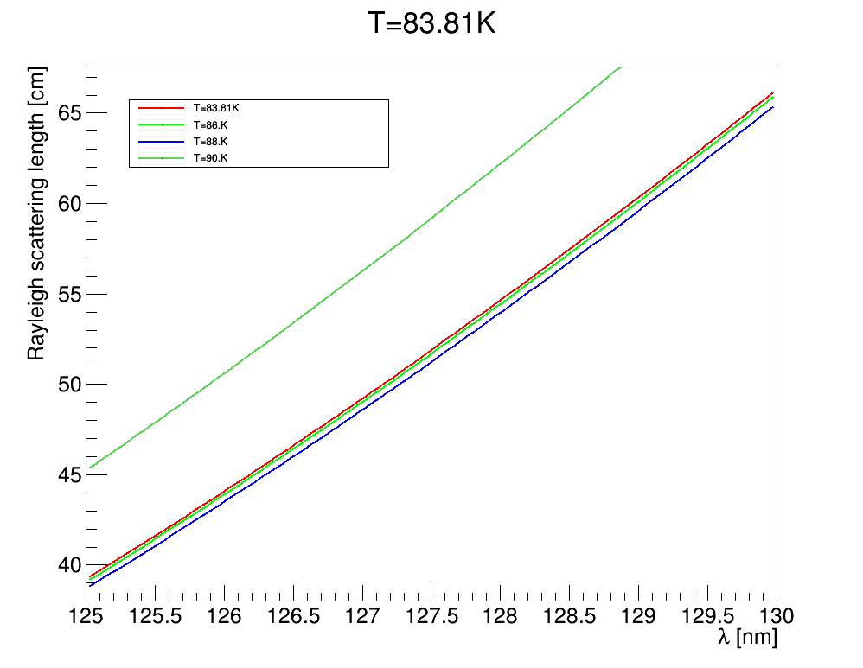
Optical properties of liquid Argon: LAr.C root macro
Formulas and numbers are based on: arXiv:1502.04213 and private communication with one of the authors Emily Grace: emilygrace.k@gmail.com
Geant4: optical properties input the user has to provide in form of histograms →Functions to get smoother response?
Hans Wenzel LArSoft Coordination Meeting
9/27/16

