Slide 1
PIP-II Conceptual Design
Valeri Lebedev
DOE Independent Project Review of PIP-II
15 November 2016

Slide 2
Valeri Lebedev
PIP-II Project Scientist
Relevant Experience
CEBAF commissioning
Tevatron Run-II commissioning and luminosity upgrade

Slide 3
Outline
PIP-II Performance Goals
Major changes since previous review
Linac
Transfer line
Booster
Recycler and MI
Summary

Slide 4
PIP-II Performance Goals
Charge Items: #1 & 3
Increase MI power from 700 kW (NOvA) to >1 MW (LBNF) in the energy range 60 – 120 GeV
Increase Booster power from 80 to 160 kW
8 GeV program: SBNE, …
Future upgrades
Mu2e at 0.8 GeV and ~100 kW
Beam power to LBNF to >2 MW
Provide a platform supporting a high duty factor/CW operation for future intensity frontier experiments

Slide 5
Major Changes since Previous Review (June 2015)
Charge Item: #1
RDR -> CDR
Draft is ready – Booster transition-crossing is understood
Beam Optics
No changes in optics of the SC linac
Advances in design may result in minor L. displacements of optics related elements (quads, solenoids, cavities, correctors, BPMs, …)
Beam transport to the Beam dump, Booster and Mu2e upgrade is finalized
Crossing of Tevatron tunnel is addressed
Tunnel and service buildings are swapped
Great progress with civil construction
Different location of the beam dump
BPMs in the first arc will be used for energy stabilization feedback
instead of the time-of-flight measurements at the linac end
Consistent with eventual delivery of 800-MeV beam to Muon Campus
Fast switch between beam dump, Booster and Mu2e

Slide 6
Major Changes since Previous Review (continue)
Charge Item: #1
Progress with PIP2IT
LEBT-> RFQ -> Short MEBT->Full MEBT
Progress in construction of HWR and SSR1
Progress in design of SSR2, LB650 & HB650
A requirement to operate in a pulsed regime greatly helped to make better cryomodules
Reduced sensitivity to LFD; better reliability of fast tuners
Transition crossing in Booster understood and looks realistic
IIFC (Indian Institutions Fermilab Collaboration) will supply a cryo-plant supporting CW operation at Day-0
High Q₀ studies support an increase of Q₀ for LB and HB
LB: (1.5->2.15)10¹⁰ ; HB: (2->3)10¹⁰

Slide 7
Approach to the PIP-II Accelerator Physics Design
Charge Item: #1
New SC Linac (800 MeV)
Design compatible with CW operation => 2 mA beam current
MEBT bunch-by-bunch chopper chops out bunches at boundaries of Booster RF buckets and from the extraction gap
Emittance less than 0.3 mm mrad (RMS, norm)
to minimize injection loss and to support tailless transverse painting
Energy stability of ~10⁻⁴ to support longitudinal painting
Booster upgrade
Rep. rate: 15 -> 20 Hz (leaves more power at 8 GeV)
Injection energy: 400 -> 800 MeV => intensity×1.5, still reduction ΔQ_{SC}
Transverse and longitudinal painting: small I_{beam} helps
Reduces tails and, consequently, ΔQ_{SC} (KV-like distribution)
Improved energy stability at injection (required for long. painting)
Recycler (intensity ×1.5 times)
Booster repetition rate increase
=> larger momentum separation in slip-stacking => smaller loss
MI (τ_{cycle}: 1.33 -> 1.2 s, I_{beam} & RF power ×1.5 times, P>1 MW @ 60 GeV)

Slide 8
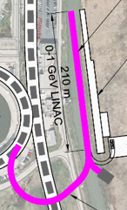
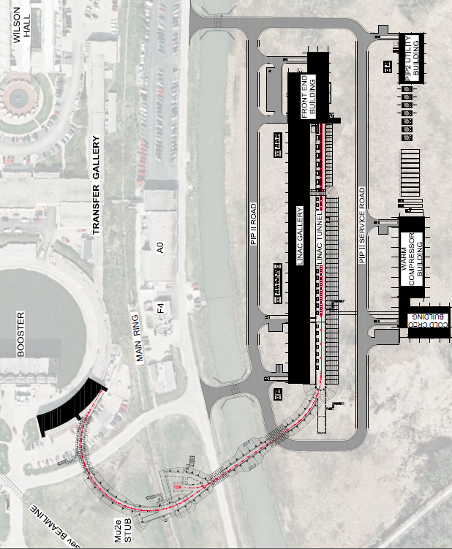
Major PIP-II Components
Charge Items: #1 &2
New 0.8 GeV linac
L≈210 m
Includes 4 empty slots at the linac end, L≈40 m
Possible energy upgrade
~200 m linac extension is anticipated
New Linac-to-Booster transfer line
L≈300 m
Better understanding of civil construction
New location of beam dump
Upgraded Booster
20 Hz, 800 MeV injection
New injection girder
More RF cavities (18 -> 22) (almost there)
Upgraded Recycler & MI
RF and collimation

Slide 9
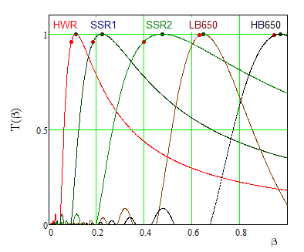
SC part of PIP-II linac
Transition points are chosen to minimize number of cavities/ cryomodules (i.e. cost)
Altogether - 25 cryomodules
Type | N CM | Cav/CM
HWR | 1 | 8
SSR1 | 2 | 8
SSR2 | 7 | 5
LB650 | 11 | 3
HB650 | 4 | 6

Slide 10
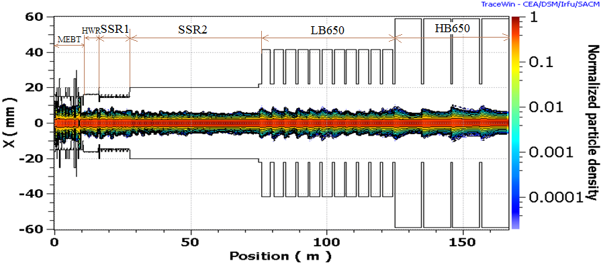
Beam Loss and Emittance Growth in SC Part
Simulations do not show dangerous halo growth
Verified by SNS experience at ~twice larger value of N_{b}/ε⊥
Ratio of beam size to aperture stays approximately the same downstream of HWR
Intrabeam stripping is expected to be the major loss mechanism

Slide 11
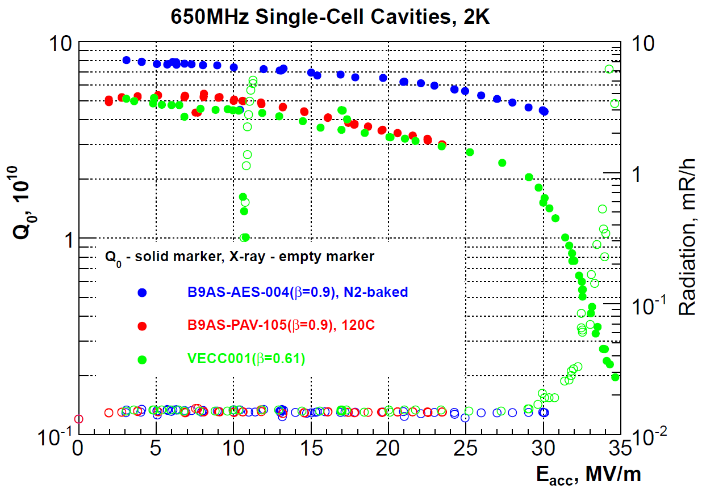
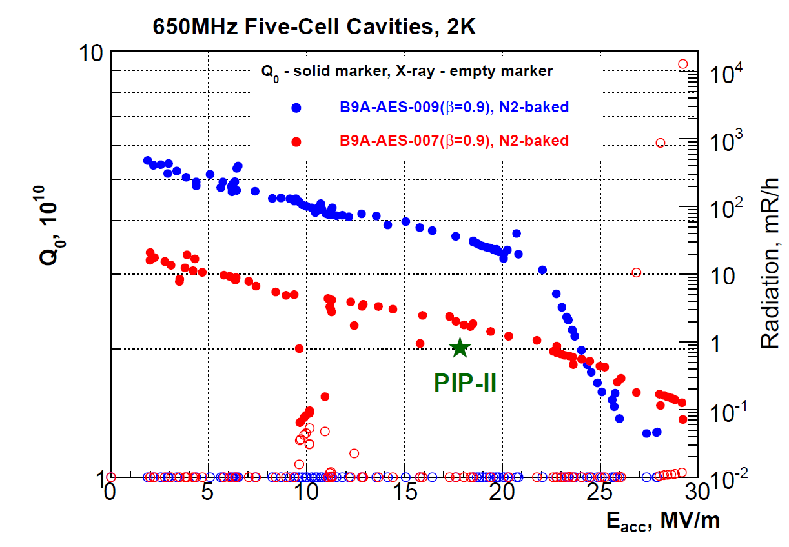
High Q₀ program
LCLS-II: from discovery to technology
New requirements for Q₀ for PIP-II (@ 2K)
LB 650 HB 650
RDR 1.50e10 2.0e10
CDR 2.15e10 3.0e10
Single-cell B=0.90 and B=0.61 test results. Five-cell B=0.90 test results.
The results are very promising, but statistics is still insufficient

Slide 12
Cryogenic Requirements
Dynamic and static loads are about equal in pulsed regime
Solenoids and couplers are included in the static load
Cryo-plant power has sufficient operating margins at all temp.
T[K] Cryo-plant(W) ΣCryomodules(W)
70 13,000 2,830
5 1,900 715
2 2,000 1,676(315)
RMS pressure fluctuations have to be <0.1 mbar
Passive microphonics suppression
Cryo-loads
per CM at 2K in CW
CM Type | Static cryo-load (W) | Dynamic cryo-load (W) | Total cryo- load (W)
HWR | 14 | 23.3 | 37.3
SSR1 | 12 | 23.1 | 35.1
SSR2 | 8.8 | 52.3 | 61.1
LB650 | 2.5 | 52.4 | 54.9
HB650 | 4.7 | 130 | 134.7
Total | 146 | 1532 | 1676

Slide 13
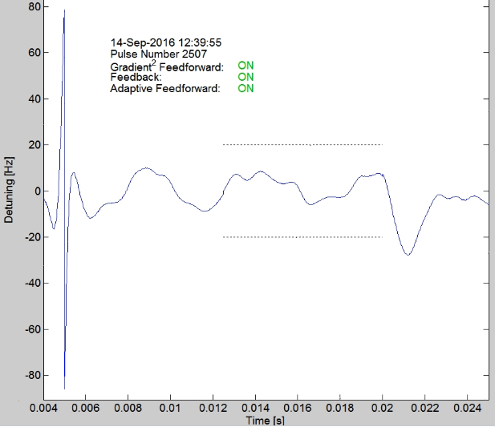
Microphonics and LFD
Charge Item: #1
Warren Schappert
High E_{acc} & small I_{beam} => small cavity bandwidth => high sensitivity to microphonics and LFD
Major sources of cavity detuning:
Variations in He pressure
Mechanical vibrations driven by external sources
Lorentz Force Detuning (LFD)
Pulsed operation greatly complicates LFD compensation
Passive means
Reduction of sensitivity to He pressure and LFD
Engineering aimed at noise reduction in the tunnel
Active means
Piezo tuners
Adaptive feedback (SSR1 tests yield result close to specs: ±20 Hz→σ≈3 Hz)

Slide 14
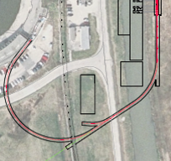
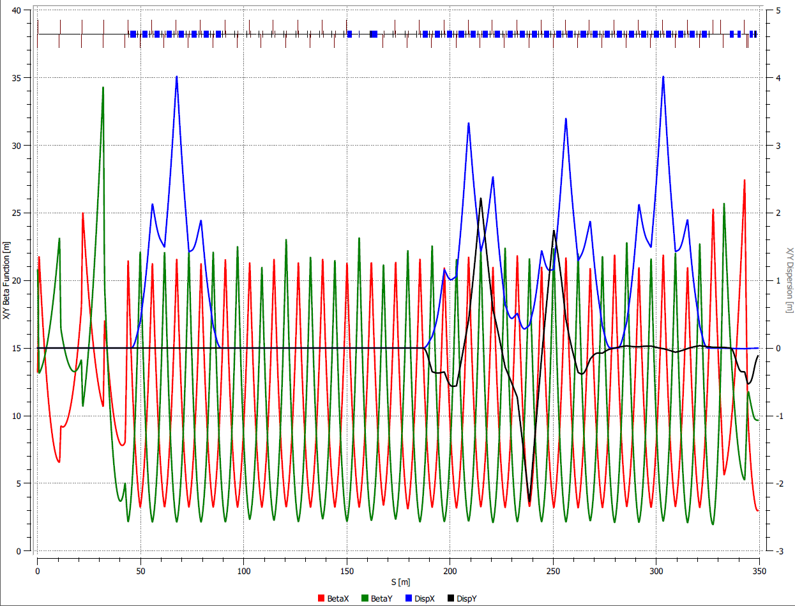
SC Linac-to-Booster Transfer Line
Major design features
Bending radius is chosen to prevent Lorentz stripping
Simple FODO optics, minimum number of power supplies
2 arcs, zero dispersion straight between them with beam switch
Beam based energy stabilization based on the 1st arc BPMs
Fast switching (~20 μs) from beam dump to Booster and Mu2e
Line has an overpass in the Tevatron tunnel area to avoid the existing line to the Fixed Target area (possibility of free pass to BSY)

Slide 15
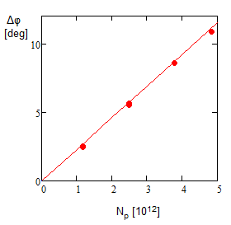
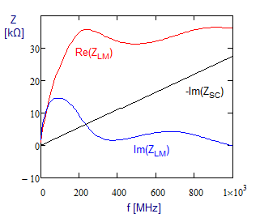
Acceleration in Booster
Charge Item: #1
Ioanis Kourbanis
Beam aperture in the Booster is formed by poles of laminated combined function dipoles
That greatly amplifies Booster impedance
Impedance was benchmarked by wire measurements (J. Crisp, 2001) and beam based measurements (2016)
Simulations were benchmarked by beam measurements
Simulations ignore multi-bunch modes
Aimed to study transition-crossing
Good coincidence between simulations and measurements

Slide 16
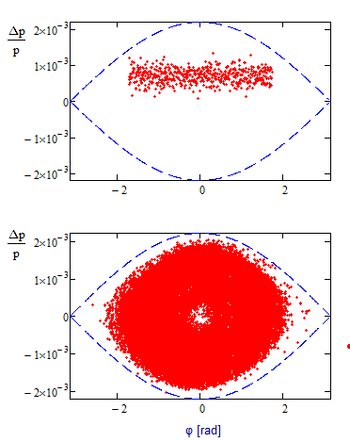
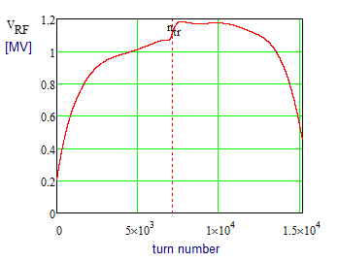
Acceleration in Booster (continue)
Injected beam is painted longitudinally for 300 turns
Using chopping in MEBT
Large voltage is required to suppress longitudinal emittance growth
Values of 2nd order slip-factor and delay of transition-X phase jump were adjusted to minimize emittance growth

Slide 17
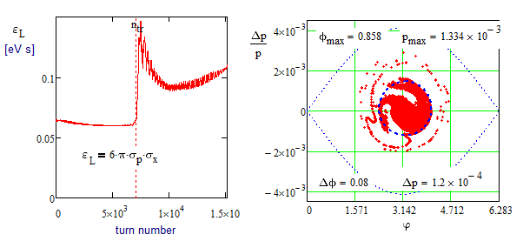
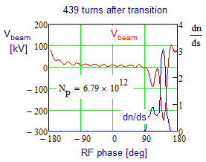
Emittance Growth due to Transition Crossing
Simulations show that the target value of 97% particles in 0.1 eV·s is achievable in Booster
Q-jump with present trim quads helps to reduce Δε|| ; ΔQ=±0.047
Timing for sextupole sign flip controls 2nd order slip-factor
Large RF voltage after transition reduces non-linearity of longitudinal focusing and emittance growth
1.2 MV is required
max(V_{beam}) ~ 250 kV limits further intensity increase in the Booster

Slide 18
Recycler and Main Injector
Charge Item: #1
Ioanis Kourbanis
Recycler: Slip stacking with 50% more beam
It requires an increase of slip stacking efficiency: 95% → 97%
Increased rep. rate (15→20 Hz) increases bucket separation ⇒ helps
But there are still severe limit on the tails of Booster beam L. distr.
Scrubbing is used to suppress ep-instability at present intensity
More powerful RF system in MI
Present system can accelerate up to 6.2•10¹³
PIP-II requires 7.5•10¹³
A conceptual design of γ_{t} jump system exists for long time
Simulations confirmed, γ_{t} jump is needed for loss-free transition-X
Electron cloud simulations indicate that a SEY smaller than 1.4 is sufficient to suppress the e-cloud in both MI and Recycler.
We have a capability to coat both MI & Recycler beam pipes.
The MI beam coating has to be done in situ.
The Recycler beam pipe can be replaced.

Slide 19
Summary
Charge Item: #1
The PIP-II design concept is mature and is likely to meet the specified technical performance requirements.
Areas of technical risk have been identified and provide R&D focus.
The design concept is solid and has not changed in any significant way since June 2015
The CDR represents an expansion of the RDR developed for the June 2015 IPR, and a first draft is now available
In the course of last year a considerable progress has been achieved in
Design of SRF cavities
Microphonics and LFD suppression
Understanding of transition crossing in Booster
Understanding of ep-instability in Recycler and ways of its suppression
The next step is completion and review of the CDR (P2MAC, spring 2017).
Studies aimed at improvements of existing accelerators and understanding issues related to PIP-II intensity will continue

Slide 20
Backup Slides

Slide 21
Questions and Answers
Summarize significant changes in the design since the 6/15 CD0 review
Improved design of transfer line optics
Different location of the beam bump
Swapped locations of linac tunnel and service building
Increased pipe size for LB-650 cavities enables a usage of the same tuners and couplers as for HB-650, and makes similar the design of cryo-vessels
Major R&D done since then beyond the effort at PIXIE
Significant advances in design of SC cryomodules (SSR2, LB&HB650)
LFD and microphonics suppression
Better understanding of Booster transition crossing
Better understanding of ep-instability in Recycler

Slide 22
PIP/PIP-II Performance Goals
Performance Parameter | PIP | PIP-II
Linac Beam Energy | 400 | 800 | MeV
Linac Beam Current | 25 | 2 | mA
Linac Beam Pulse Length | 0.03 | 0.5 | ms
Linac Pulse Repetition Rate | 15 | 20 | Hz
Linac Beam Power to Booster | 4 | 18 | kW
Linac Beam Power Capability (@>10% Duty Factor) | 4 | ~200 | kW
Mu2e Upgrade Potential (800 MeV) | NA | >100 | kW
Booster Protons per Pulse | 4.2×10¹² | 6.5×10¹²
Booster Pulse Repetition Rate | 15 | 20 | Hz
Booster Beam Power @ 8 GeV | 80 | 160 | kW
Beam Power to 8 GeV Program (max) | 32 | 80 | kW
Main Injector Protons per Pulse | 4.9×10¹³ | 7.6×10¹³
Main Injector Cycle Time @ 60-120 GeV | 1.33* | 0.7-1.2 | s
LBNF Beam Power @ 60-120 GeV | 0.7* | 1.0-1.2 | MW
LBNF Upgrade Potential @ 60-120 GeV | NA | >2 | MW
*NOvA operates exclusively at 120 GeV

Slide 23
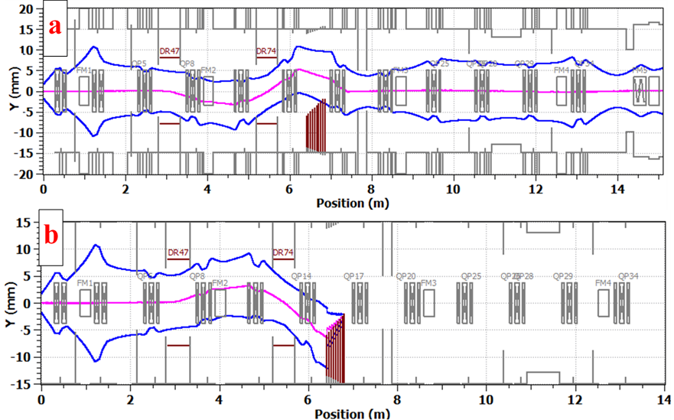
Chopping in the MEBT to form Bunch sequence for Booster injection
I_{RFQ}=4 mA, 50% bunches are removed => I_{SC_linac}=2 mA
Chopping removes linac bunches at the boundary of RF bucket and forms 2 buckets extraction gap
RF frequencies of Booster and SC Linac are not harmonically related: 162.5 MHz versus 44.705 MHz
Fluctuations in number of injected linac bunches per Booster bunch: 588 ± 2 bunches (0.34%)
2 kickers separated by 180⁰ are used for chopping
~4 times reduction in required power

Slide 24
Linac Major Components
H⁻ ion source: 30 kV, 10 mA
LEBT – differential pumping, optics match, beam switch for MPS
RFQ – 2.1 MeV, CW
MEBT – bunch-by-bunch chopper with 20 kW beam dump, optics match, differential pumping, prevent micro-particle migration
SC linac – 800 MeV, 2 mA, CW compatible operation

Slide 25
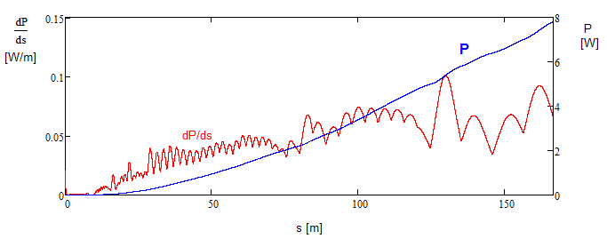
Beam Loss
Intrabeam stripping is the main source of particle loss in the SC linac
The loss value (<0.1 W/m) for CW beam (2 mA, with 5 mA RFQ) is well within requirements
Not an issue for PIP-II operating at ~1% duty factor

Slide 26
General Approaches to Design of Cryomodules
All the CMs are based on SSR1-type concept
They should contain as much identical parts as possible
SSR1 and SSR2 should be as much similar as possible
The same concept of the He vessel with small df/dP
The same high power couplers
Similar tuners. The goal is to use identical tuners
Similar designs of solenoids
LB650 and HB650 should be as much similar as possible
The same concept of He vessel
small df/dP & no magnets inside
Similar magnetic screens
The same HP coupler as HB 650
Similar tuners as HB 650. The goal is to use identical tuners

Slide 27
SC Linac Design Choices
Separate SC cryomodules
Collimators between cryomodules to minimize beam loss inside them
Solenoidal focusing for HWR, SSR1&2
SC solenoids inside cryomodules (with attached BPMs and built-in trims)
Doublet focusing between cryo-modules for LB650 and HB650
Warm correctors and BPMs
Energy stability of ≈10⁻⁴ is supported by the beam based feedback
Cavities of the last cryo-module are used for correction
4 empty slots at the linac end are used for time-of-flight energy measurements
All beam instrumentation with exception of BPMs in HWR and SSR1&2 cryo-modules is located between cryomodules

Slide 28
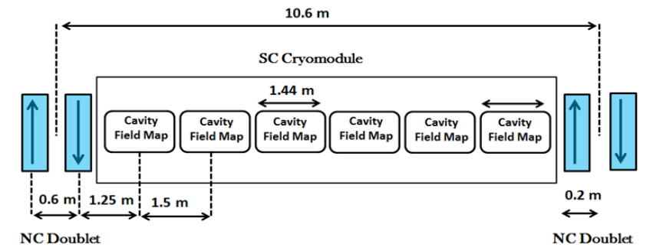
Warm Sections of SC linac
LB&HB650 sections of SC linac include 2 warm quads (Q), 1 dipole corrector (D) (X&Y), and strip-line BPM
Configurations are:
Low Beta : (QDQ) (CCC) (QDQ) ………. : 11 CM
High Beta :(QDQ) (CCCCCC) (QDQ) ….. : 4 CM

Slide 29
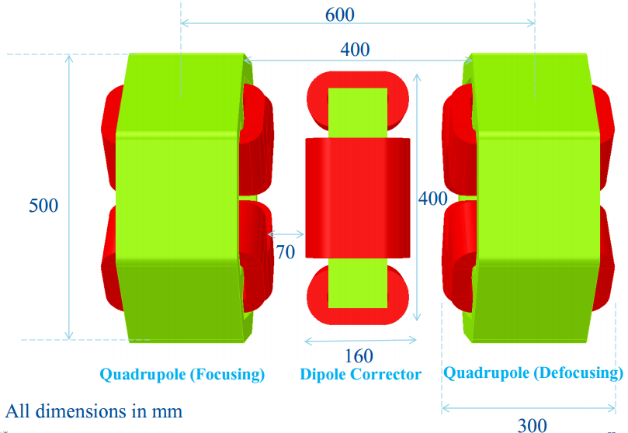
Magnets & BPMs
Quads
GdL (T) | 3
G (T/m) | 13.5
2*a [mm] | 48
Dipoles
BdL (mT m) | 10
2*a [mm] | >48
BPMs
Strip-line
4 electrodes
Located between quads

Slide 30
RF Power Requirements
RF power requirements include
Up to 20 Hz microphonics driven detuning
1 dB allowance for regulation
Power transfer inefficiency:
0.5dB - HWR&SSR (coaxial);
0.25 dB – LB&HB (wave guide)
CM type | Power trans-ferred to beam per cav. (kW) | Cavity half-bandwidth, f / 2Q_{L}, (Hz) | Peak RF power per cavity (kW) | Power of RF Amplifier (kW)
HWR | 4 | 33 | 6.5 | 7
SSR1 | 4.1 | 43 | 6.1 | 7
SSR2 | 10 | 28 | 17 | 20
LB 650 | 23.8 | 29 | 38 | 40
HB 650 | 39.8 | 29 | 64 | 70

Slide 31
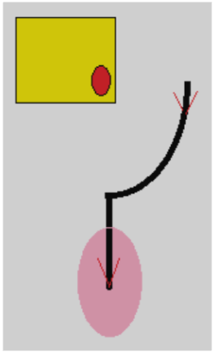
Transverse Painting
H⁻ strip injection
Linac beam comes to the foil corner
Like in the SNS
Reduced beta-functions for linac beam to reduce secondary heats of stripping foil
Zero dispersion of linac beam
Non-zero Booster dispersion and non-zero momentum offset reduce secondary hits

Slide 32
Booster Injection
No significant changes since last MAC
More work is required and planned in support of CDR
Final choice of the scheme
New short dipoles adjacent to injection straight versus tightly located elements of the injection straight
Conceptual design of injection straight magnets and, possibly, short Booster dipoles

Slide 33
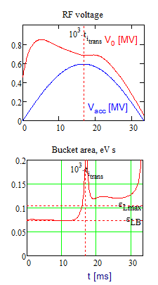
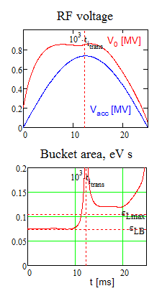
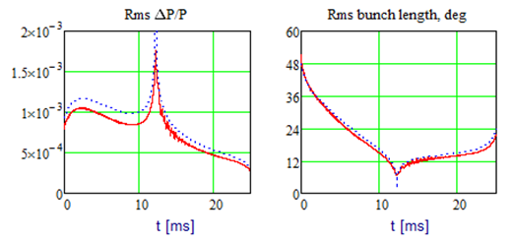
Acceleration in Booster
Transition from 15 to 20 Hz rep. rate would not require additional RF voltage if beam current is not changed
Due to smaller slip factor at injection
Increase of beam current (planned for PIP-II) requires additional voltage
Deceleration due to RW impedance
Suppression of quadrupole oscillations after transition
15 Hz 20 Hz

Slide 34
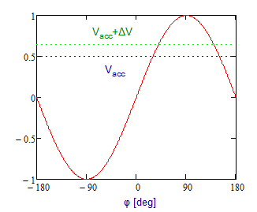
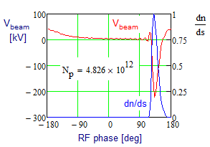
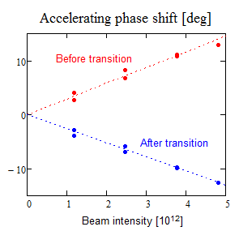
Results of Booster Transition Crossing Studies (3)
Measured shift of accelerating phase with beam intensity yielded a calibration of Z_{L}
The peak deceleration voltage expected at PIP-II design intensity of 6.5•10¹² is ~300 kV
Decent coincidence of simulations and measurements is achieved
Studies of transition crossing at PIP-II intensity will follow shortly

Slide 35
Booster Transition Crossing Studies
Present transition-X is quiet sophisticated and very well tuned. It effectively suppresses quad-oscillations introduced by X.
Optimization of transition-X at PIP-II intensity requires good modeling of Booster acceleration and its L. impedance
4 sets of measurements (Jan,July&Nov/2015, & Jan/2016)
Usefulness of data was improved with time
Data are taken at injection and transition (few ms each)
RF sum + RWM + Rpos (0.2→ 0.8 ns sampling time, 6•10⁶ points)

Slide 36
Development of Software for Simulations of Longitudinal Dynamics (F. Ostiguy)
To assure the simulation results the Booster simulations are done with a code specially developed for Booster acceleration
No GUI, minimally required numerical engine
ESME was not used
However for over 3 decades, the code ESME has been used to simulate long. dynamics, both at Fermilab and elsewhere.
While ESME remains in use, the main author is retired and the code is minimally maintained.
Details of its inner workings and of underlying approximations are not well documented. Code structure and organization reflect limitations of late 1980s software technology.
Even minor modifications are hard to implement and debugging is often a non-trivial endeavor.
To address this deficiency as well as to model the Booster and other machines we initiated development of a new code based on a code developed for Booster simulations.

Slide 37
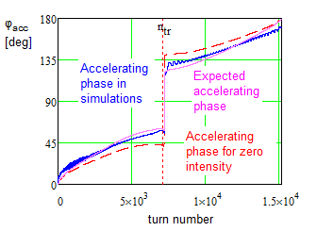
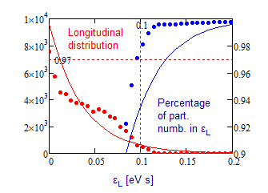
Emittance Growth due to Transition Crossing
Simulations show that the target value of 97% particles in 0.1 eV·s is achievable in the Booster
Q-jump with present trim quads helps to reduce Δε|| ; ΔQ=±0.047
Timing for sextupole sign flip controls 2nd order slip-factor
max(V_{beam}) ~ 250 kV

Slide 38
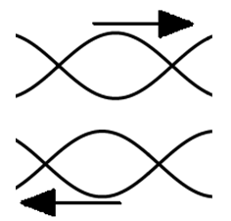
Slip Stacking in Recycler
Twelve Booster batches are slip-stacked in Recycler
An increase of Booster rep. rate from 15 to 20 Hz requires faster slipping => larger momentum separation => larger RF bucket size => smaller loss at slip stacking

Slide 39
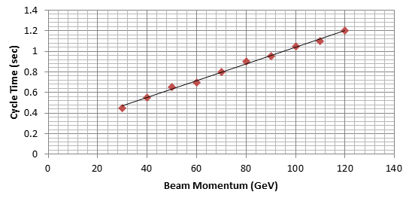
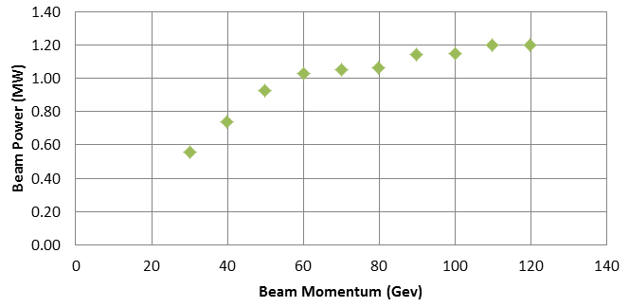
Beam Acceleration in MI
The accelerating rate in MI is determined by maximum slue rate of magnetic field and RF voltage
That determines the dependences of (1) cycle time duration and (2) beam power on the final beam energy
MI RF power upgrade is required to support the beam intensity increase

Slide 40
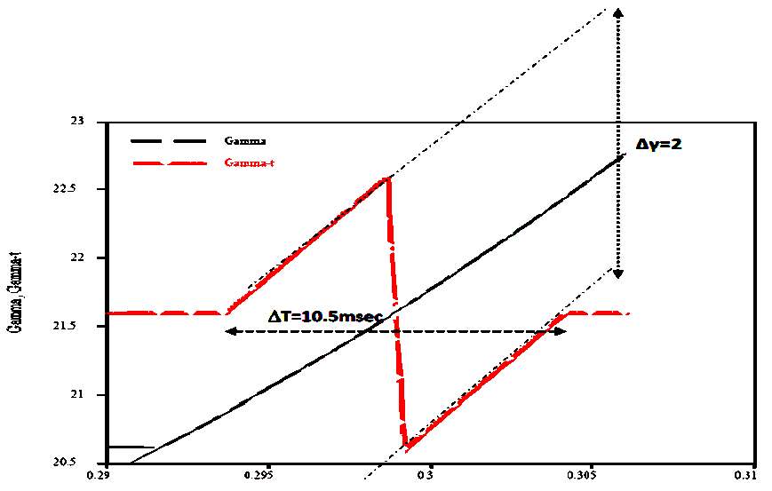
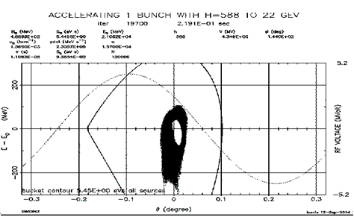
MI Transition Crossing
Increased beam intensity and larger longitudinal emittance complicate transition crossing
γ_{t} jump is preferred method for transition crossing in MI
ESME simulations do not show significant increase of L. emittance and longitudinal tails
Additional hardware for fast tune change is required
Phase space distribution after transition in MI. The hole in the center is a result of slip stacking

