Slide 1
Questions from the Committee
DOE Independent Project Review of PIP-II
15 November 2016

Slide 2
Table of Responsibilities

Slide 3
Table of Responsibilities
Notes:
  INFN potential interest is LB650 cavities
  STFC potential interest is HB650 cryomodules
  LBNL is a likely collaborator on LLRF as a continuation of LCLS-II
  ANL is likely to be involved in providing SRF support beyond HWR

Slide 4
Planned vs actual dates for IIFC deliverables to date

Slide 5
Planned vs actual dates for IIFC deliverables to date

Slide 6
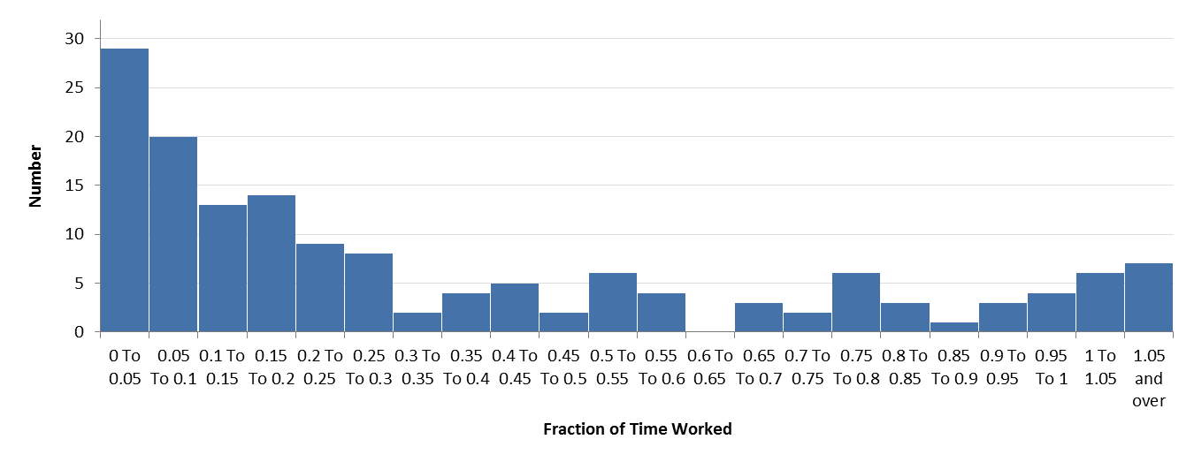
Distribution of effort by FTE (FY2017 YTD)
Number of people as a function of fractional effort on PIP-II
There are 53 FTE distributed over 151 individuals

Slide 7
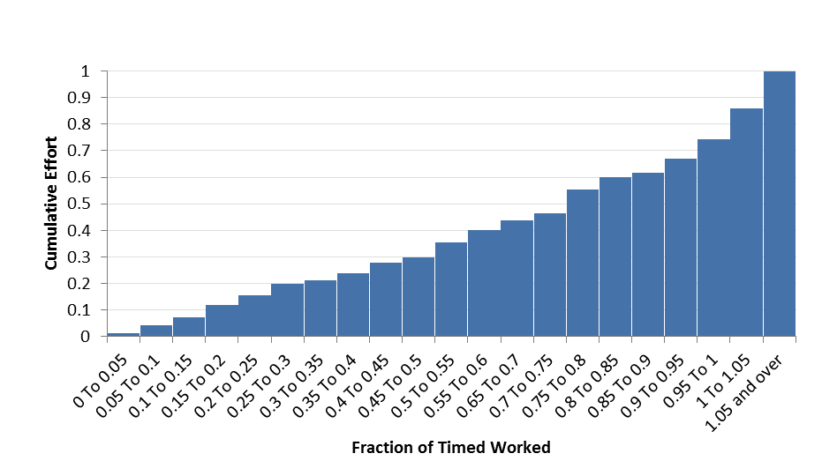
Distribution of effort by FTE (FY2017 YTD)
Cumulative effort as a function of fractional effort
  e.g. ~50% of total effort is provided by people working provided by people working 75% or less/more.

Slide 8
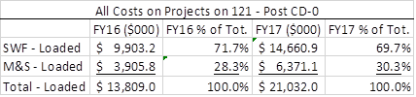
Portion of Budget Devoted to Salaries
Notes:
  FY16 funds are only for the portion of the year following initiation of project accounting (in late January 2016)
  FY17 funds include new BA ($18.2M + FY16 carryover)

Slide 9
TEC / OPC split for $516: 421 / 95
OPC $95M
TEC $421M

Slide 10
Special Overhead Rates of Support for Project
The laboratory provides a lower Special Line Item (SLI) overhead for Line Item Construction Projects, generally applicable post-CD-3 (non-PED)
The following rates were used in the PIP-II point estimate:
M&S Rates:
  23.5% (Standard)
  18.6% (SLI)
Labor Rates:
  85.4% (Standard)
  73.5% (SLI)
Whether PIP-II will be assigned procurement support via overhead or direct support is TBD.

