Slide 1
Booster/Recycler/Main Injector
Ioanis Kourbanis
DOE Independent Project Review of PIP-II
15 November 2016

Slide 2
Ioanis Kourbanis
Acting Level 3 Manager for Existing Accelerator Upgrades.
Relevant Experience
Main Injector Department Head.
L3 Manager for NOvA Main Injector Upgrades.

Slide 3
Outline
Booster in PIP II.
Booster R&D.
MI/RR in PIP II.
MI/RR R&D and Issues.
Conclusions.

Slide 4
Booster in PIP II
PIP II will require 50% higher intensity and 33% higher Repetition Rate than the planned PIP operations.
PIP flux FY17: 2.3e17 pph
PIP-II flux: 3.5e17pph (15Hz)
PIP-II flux: 4.6E17pph (20Hz)

Slide 5
Booster R&D
New injection point at L11
New injection girder
Space charge mitigation: painting
New stripping foil system
H°, H- absorber
RF capture
Capture scheme
2nd harmonic cavities
Transition crossing
Damper upgrades
Longitudinal quad damping during transition
Longitudinal coupled bunch mode damping at high field
Transverse dampers for coupled bunch modes.

Slide 6
R&D (cont’d)
Collimation system
Evaluation of the present system w.r.t expected PIP II
New shielding assessment
Beam quality at extraction
Beam emittances and dp/p
20 Hz operation
GMPS
Pulsed systems
Controls

Slide 7
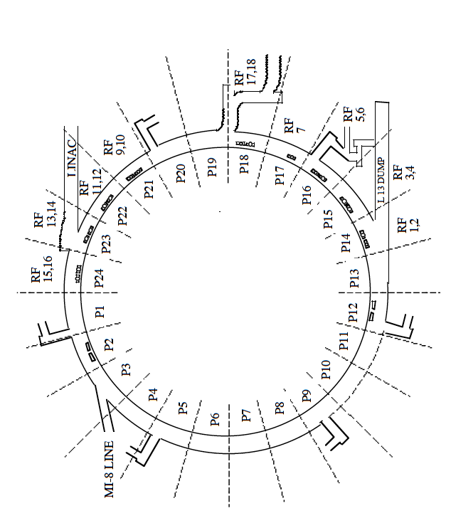
PIP II Injection into Booster
Current Linac
Present injection point at L1
New injection point at L11

Slide 8
New Booster injection girder
Beam can enter either horizontally or vertically.
A new 3 bump system that take 800 MeV beam (2x stronger)
Beam painting to mitigate space charge effects because of longer injection time (0.6 msec).
Carbon foil for stripping (315 turns vs 15 turns)
Lifetime effects.
New beam absorber for H° and H-
Build inside a gradient magnet.
Design new stronger and shorter gradient magnet to make space for an absorber.
Finalize the design of the injection girder.
Need about 2 years to finalize the design
Denotes deliverable

Slide 9
Vertical Injection Concept
Using a three-bump chicane within the unmodified length of the long straight section

Slide 10
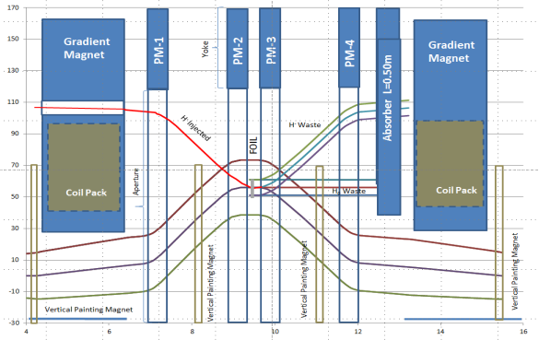
Alternative design for injection girder
D. Johnson
New shorter gradient magnets; larger absorber outside the magnet

Slide 11
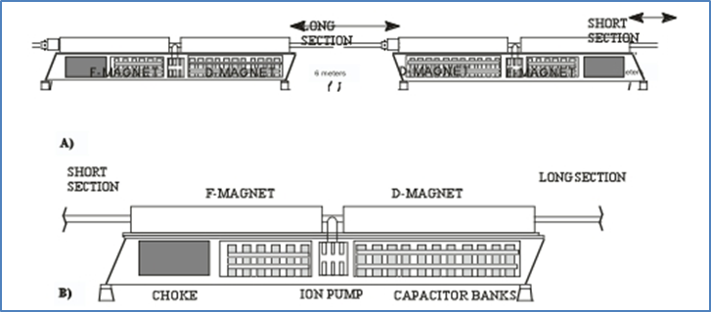
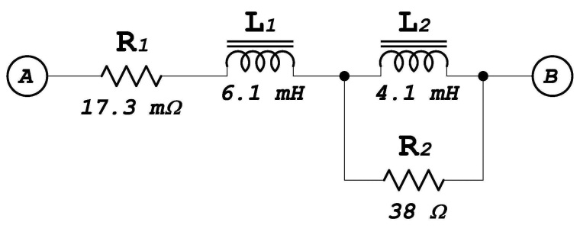
20 Hz operations
Booster magnet system
Booster is a 15 Hz resonance system
Pulsed devices
Injection bump
Extraction systems
Kickers
Septas
Correctors
Controls
Lab built around 15 Hz clock system
Complete the 20 Hz studies

Slide 12
Booster Magnets 20 Hz
We have looked at Booster 20 Hz operations several times….most recently by AD/EE support (George Krafczyk)
‘Measurements were performed on both a Booster gradient magnet and a Booster choke with the intent to compare the 15 Hz losses with the 20 Hz losses for a proposed Booster upgrade.’
This analysis suggests that running the booster at 20 Hz with a current equal to the present 15 Hz Booster will require about 3.9% more power. Capacitor voltage will increase by about 32% and the resonant capacitor at each “Girder” must decrease from ~8.33 mF to ~4.69 mF. This also carries the implication that the RMS current per µF will also increase as well.

Slide 13
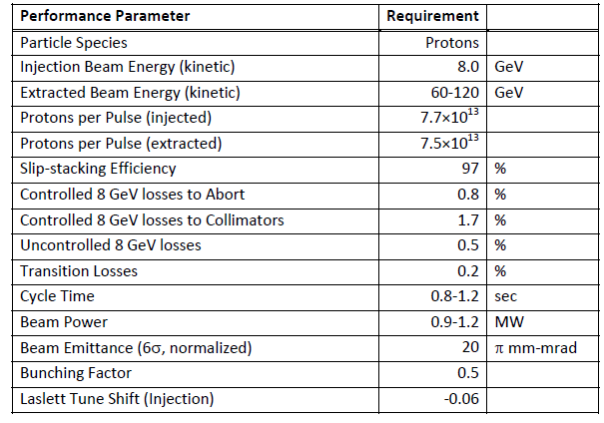
MI/RR Performance Requirements
Slip stack and accelerate 50% more intensity.
Run MI at lower energies.

Slide 14
MI/RR Accelerator Issues
Can we slip stack and accelerate 50% more intensity.
Power loss from slip stacking (8 GeV)
RF Power (Acceleration)
Running Recycler 53 MHz Cavities CW (Running at 60 GeV)
Transition crossing.
Electron cloud.
Beam loss control/mitigation.

Slide 15
Slip Stacking in the Recycler
We need to maintain the same power loss from slip stacking with 50% more intensity per bunch (120 GeV operation).
Increase slip stacking efficiency from 95% to 97%.
Limits on longitudinal emittance and bunch height from Booster beam are not much different than the NOvA ones due to the higher frequency separation and RF voltage.
Higher chromaticity will be required.
For MI operation at energies lower than 120 GeV the power loss will increase up to 50% in both MI and RR.
Have no un-controlled losses (Collimators).
Collimators should be able to handle the extra loss.

Slide 16
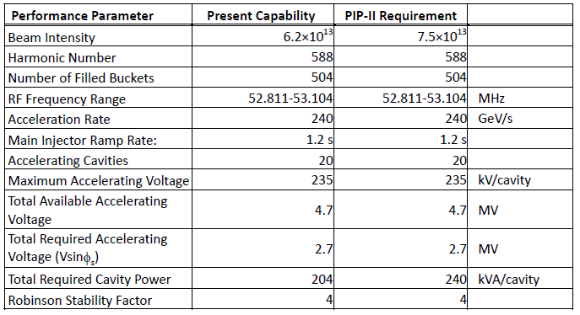
Present and Required MI RF Capabilities
*
* Maximum Beam Intensity capable with current RF system. It is 27% higher than the required Beam Intensity for PIP I (4.9E13).
Present RF System does not have the power to accelerate the PIP-II Beam intensities

Slide 17
MI RF Options for higher power
Operate the current RF cavities with two power tubes instead of one in a push-pull configuration.
Need to double the number of modulators and solid state drivers.
Use a new more powerful power tube (EIMAC 4CW250,000B).
New mounting configuration (much longer tube).
New modulators and upgraded PA cooling.
Test and evaluate both options.
We estimate ~2 years to evaluate both options.

Slide 18
New RR RF Cavities
The present Recycler 53 MHz cavities used for slip stacking have a high power dissipation (90 KW, 60% DF) because of the low R/Q (13 Ohms).
Running MI at energies as low as 60 GeV will require the slip stacking cavities to run CW.
Running Booster at 20 Hz will require higher RF voltage (140 KV instead of 80 KV).
We only have space for 3 cavities
Design a cavity with higher R/Q and active beam loading compensation.
Preliminary design exists.
Estimate ~ 2years to finalizing the design and be ready to build a prototype.

Slide 19
Transition crossing
A design of a first order gamma-t jump system for the Main Injector was developed as part of the Project X Reference design (2.3 MW operation).
Transition crossing simulations for the PIP II intensities and emittances have confirmed that the gamma-t jump system is needed for loss free transition crossing.
Only half of the originally planned gamma-t jump ($±$1/2 unit) will be required.
We plan to revisit the MI transition crossing simulations with the new codes currently under development.
Design and build a gamma-t quadrupole.

Slide 20
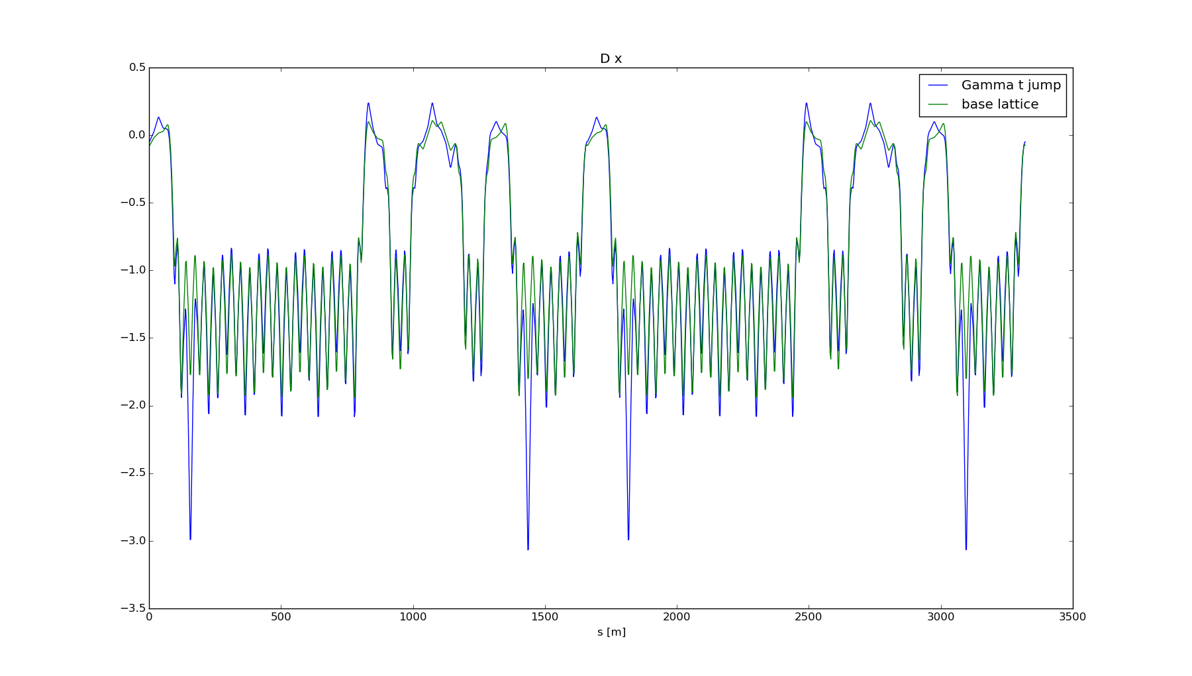
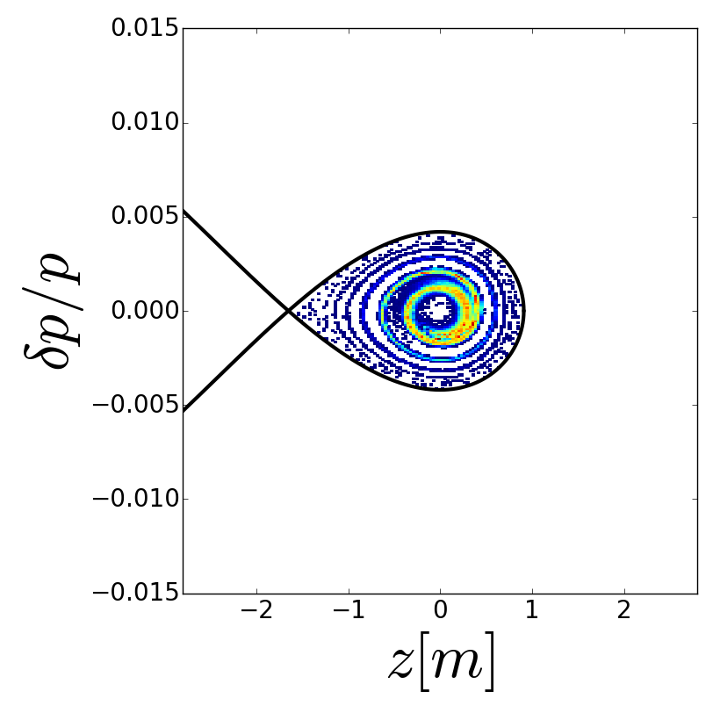
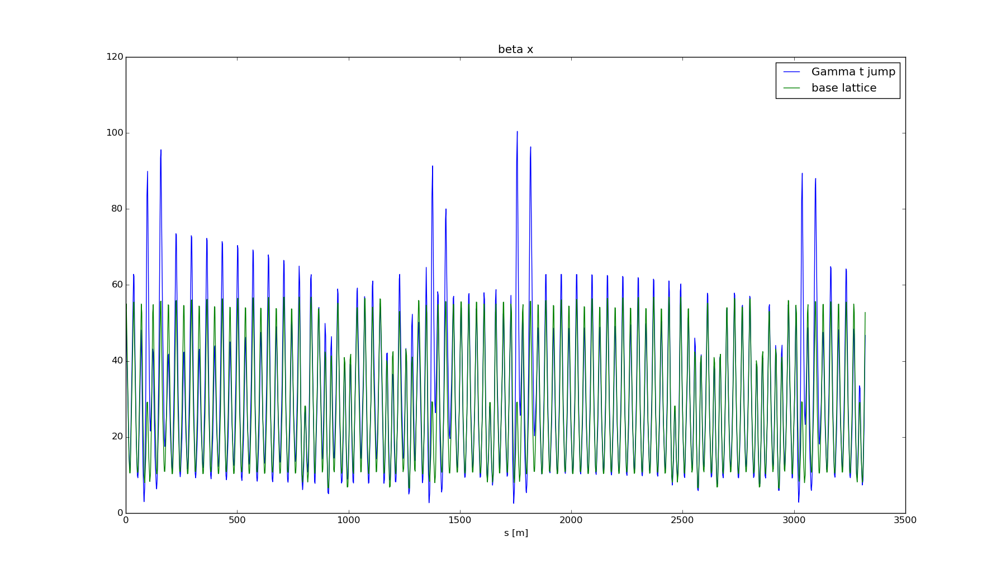
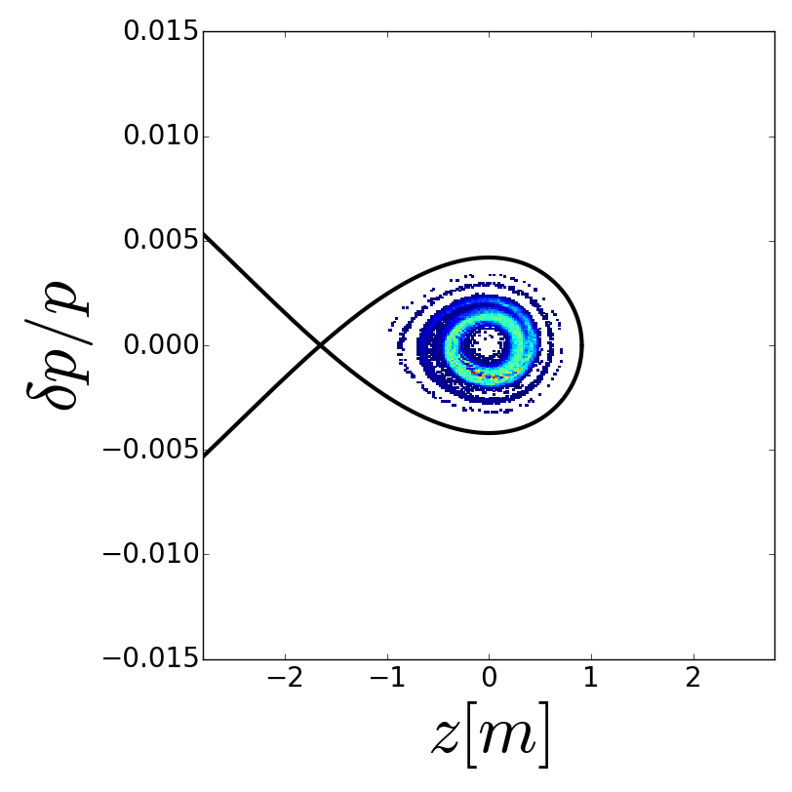
MI Transition crossing simulations with a gamma-t jump
Lattice Functions
Longitudinal Distributions at 40 GeV
SYNERGIA Simulations
R. Ainsworth et al.
No-Jump
$$±\frac{1}{2}unit jump$$

Slide 21
Loss control
Need to understand and control the space charge losses with the higher intensity beam in MI and Recycler.
In MI the collimators intercept most of these losses.
One primary and two secondary collimators were installed during the current shutdown in the Recycler.
Realistic simulations(real apertures, magnet multipoles, space charge..) using SYNERGIA are under way.
Comparing slip stacking in PIP II to current operations.

Slide 22
Conclusions
The new Booster injection girder for PIP II is the biggest item that we need to finalize the design.
The progress that being made in Booster higher flux operations will help us understand most of the high intensity PIP II issues.
We need to establish a plan for upgrading the MI RF power and finalize the design of the RR 53 MHz ASAP.
Loss control in MI/Recycler will continue to be a challenge.

