Slide 1
Organization and Management Strategy;
Wrap-up
Steve Holmes
DOE Independent Project Review of PIP-II
15 November 2016

Slide 2
Outline
Project Organization
Management Team
R2A2s
Project Office Evolution
Project Strategy
Wrap-up

Slide 3
Project Organization
We have established an organizational structure that is appropriate for a DOE413.3b project
This organization has been leading the R&D phase, and has managed the transition to formal project status over the last year.
The organization is currently ~90% populated through level 3; open positions will be filled as conditions warrant
This organization is fully capable of successfully constructing and commissioning an accelerator that will perform as specified

Slide 4
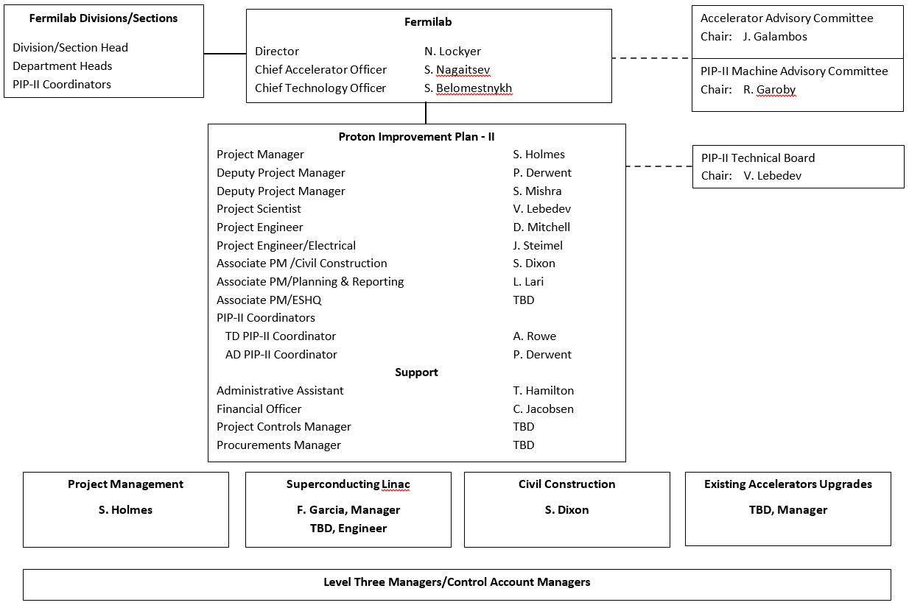
Project Organization/Management Team

Slide 5
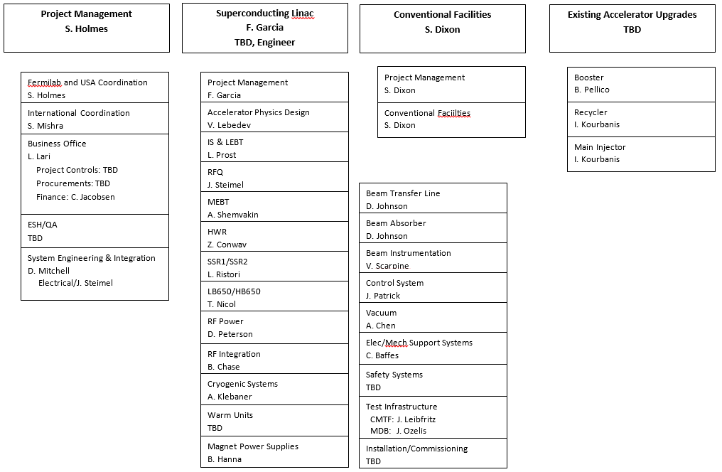
Project Organization/Management Team

Slide 6
Project Organization/Advisory Committees
Accelerator Advisory Committee reports to the Fermilab Director
Charged to provide advice on the strategic approach and effectiveness of the accelerator program at Fermilab
Operations and Performance Improvements
Projects
Advanced Accelerator R&D
Chair: John Galambos/Accelerator Physics, Beam Instrumentation, and Ion Source Group Leader/SNS
PIP-II Machine Advisory Committee reports to the Accelerator Division Head
Charged to provide advice on the technical approach to PIP-II and the corresponding development program
Formally convened as a subcommittee of the AAC
Chair: Roland Garoby/Technical Director/European Spallation Source
Technical Board advised the Project Scientist
Charged with controlling the technical configuration of PIP-II
Chair: Valeri Lebedev/PIP-II Project Scientist

Slide 7
Management Team
The PIP-II management team has extensive experience in DOE construction projects and in the commissioning/operations of accelerators
S. Holmes: Main Injector Project Manager, Accelerator Division Head, Associate Laboratory Director for Accelerators
P. Derwent: NOvA Associate Project Manager, PIP-II Department Head, Recycler Department Head, Antiproton Source Department Deputy Head
S. Mishra: Main Injector Commissioning Coordinator, Main Injector Department Head, ILC/Fermilab Deputy Director, India Collaboration Development
V. Lebedev: CEBAF Commissioning Team, Tevatron Run II accelerator physics
D. Mitchell: Design/Drafting Department Head, U.S. LHC Accelerator Project
S. Dixon: NOvA construction manager, Short Baseline Neutrino GPP manager
L. Lari: Lead planner ESS linac, LHC installation coordination team

Slide 8
R2A2s
Roles, responsibilities, authorities, and accountabilities exist in draft form for all members of the Project Management Team
The Management Team is currently operating according to these descriptions
Example: PIP-II Project Manager
Authority and responsibility for organization, management, and execution of the PIP-II Project including:
Develop a complete PIP-II Conceptual Design, followed by a Technical Design appropriate for construction;
Develop and manage the PIP-II R&D Program;
Establish the PIP-II baseline including the project scope, and associated technical performance, cost, and schedule goals;
Manage the construction phase of PIP-II;
Coordinate with the Fermilab Division and Section Heads to assure that resources are appropriately identified and managed;
Coordinate efforts of national and international partners;
Coordinate all project documentation and reporting as required by DOE 413.3b;
Serve as Accelerator Division Associate Head;
Provide oversight for all activities required to assure successful integration of PIP-II within the accelerator complex;
Organize and manage the PIP-II Project Office.
Accountable to: Accelerator Division Head

Slide 9
Plan to Populate the Project Office
At CD-1 we expect to have in place the people listed as TBD on slide 4
APM_ESHQ
Project Controls Manager
Procurements Manager
Existing Accelerators Manager
Superconducting Linac Lead Engineer
Eventually the Office staff will include a few more support staff, including additional project controls specialists
When fully staffed (CD-2) it is estimated the Project Office will comprise 21 FTE

Slide 10
Project Strategy
Goal is 1.2 MW at start of LBNF/DUNE operations (~2025)
Construction phase is 6 years: 2020-25
CD-3 in FY20
CD-2/3a in FY18/19
CD-1 in FY17
CD-0 in FY16
CD-1: Q4FY17 (early date)
CDR
RLS/Cost Estimate
Independent Cost Review
Independent Design Review
Initiate NEPA
Keep R&D on track
Management Additions: APM-ESHQ, PCM, L2Ms

Slide 11
Project Strategy
CD-2/3a: Q1FY19 (early date)
Engineering Design: More engineers, designers, drafters
EVMS: More project controls specialists
Complete NEPA documentation
Keep R&D on track, national and international
Independent design reviews (following Fermilab process)
Joint (Fermilab-India) technical reviews
Finalize international deliverables
Management Additions: CAMs
CD-3: Q4FY20 (early date)
Final Design
Independent design reviews
Joint (Fermilab-India) technical reviews
EVMS operational
Complete R&D
Long-lead procurements: Nb, initial cavity contract, cryoplant, civil construction initial site activities
CD-4: Q3FY26 (early date)
KPPs

Slide 12
Wrap-up
Suggested Charge responses
Yes. Yes.
Yes.
Yes.
Yes. Yes. Yes.
Yes.
Yes. Yes.
More specifically…

Slide 13
Wrap-up
PIP-II conceptual design is responsive to the goals established by the Mission Need Statement
Draft CDR exists
CDR to be reviewed by P2MAC in April 2017
R&D program mitigates risks associated with the conceptual design
Front end systems test (PIP2IT) and RF controls; SRF development
In collaboration with India/DAE laboratories
Monitored by P2MAC
Planning for completion in FY2020
Cost estimate prepared in June 2015 corresponds to the scope included in the conceptual design
Point estimate: $516M; Upper cost range: $650M
Cost to DOE after incorporating international offsets
Some known adjustments to be incorporated at CD-1
Beam commissioning per KPPs
Escalation per assumed funding profile
To be developed as part of RLS

Slide 14
Wrap-up
Resource Loaded Schedule is under development
WBS established
Major elements of the R&D phase incorporated
Major milestones for R&D and construction phases identified
Will extend through construction phase at CD-1
An experienced management team is in place that can be expected to successfully execute the PIP-II project.
ESH is being integrated into the project, following laboratory policies and procedures
Accelerator shielding and operations requirements at PIP2IT
NEPA strategy developed and initial steps in process
Wetlands delineation
EENF
The collaboration with India/DAE labs is maturing and starting to deliver collaboratively developed hardware
Joint R&D document defines the R&D phase deliverables
Potential European contributions under discussion
We expect to be ready for a CD-1 review in 6-8 months
Most required elements are currently moving forward

