Slide 1
PIP-II Goals, Status, and Strategy
Steve Holmes
DOE Independent Project Review of PIP-II
15 November 2016

Slide 2
Steve Holmes
Charge Item: #4
Role on PIP-II
  Project Manager
  IIFC Technical Coordinator (FNAL, delegated)
Relevant Experience
  Main Injector Project Manager
  Accelerator Division Head
  Associate Laboratory Director for Accelerators

Slide 3
Charge Elements
Technical Design: Is the conceptual design for the PIP-II linac sound and likely to meet the specified technical performance requirements? Are R&D efforts being effectively managed to maximize benefits and minimize technical risks to the project?
Scope: Is the project's scope sufficiently well-defined to support the preliminary cost and schedule estimates?
Cost and Schedule: Are the cost and schedule estimates sufficiently well-defined and of adequate maturity to support the forecasted critical decision milestones and cost range?
Management: Is the project being properly managed at this stage? Does the management team possess the skills, expertise and experience necessary to successfully execute the project? Are plans to identify and allocate staffing and resources consistent with current funding guidance?
Environment, Safety, and Health: Is environment, safety, and health being properly addressed given the project's current stage of development?
India Institutions and Fermilab Collaboration (IIFC): Is the collaboration proceeding
satisfactorily towards meeting the goals outlined in the Joint R&D document? Will the deliverables outlined in the Joint R&D document position India for a successful contribution to the PIP-II construction phase?

Slide 4
Since June 2015 IPR
First hardware deliverables arrive from DAE July 2015
Seven DAE engineers/scientists arrive for October 2015
2-year residencies
MNS approved and CD-0 issued November 2015
Project accounting initiated January 2016
Joint IIFC Meetings January/July 2016
North American elliptical cavity vendors March/August 2016
close shop
Associate Project Manager for April 2016
Planning and Reporting on-board
RFQ commissioned with beam February-November 2016
Wetlands delineation report received July 2016
Analysis of Alternatives submitted for review July 2016
  Review committee validation/to OHEP September 2016
Draft CDR Released October 2016
Responses to all Action Items October 2016
  See website

Slide 5
Goals/Mission Need
The goal of PIP-II is to support long-term physics research goals as outlined in the P5 plan, by delivering world-leading beam power to the U.S. neutrino program and providing a platform for the future
Mission Need Statement/CD-0 approved November 2015
  Based on Reference Design/cost estimate (June 2015 IPR)
  India collaboration was critical
Capability gap/mission need
  Reduce time required for LBNF/DUNE to achieve world-first results
  Sustain high-reliability operations of the Fermilab accelerator complex
Construction period FY2019-FY2025
Cost range: $465-$650M
  (Cost to U.S. DOE after international contributions)

Slide 6
Proposed Technical Approach
Charge Item: #1
Lebedev
Construct a modern 800-MeV superconducting linac, of CW capable components, operating initially in pulsed mode
  Ameliorate space-charge forces at Booster injection, allowing an increase Booster/Recycler/Main Injector per pulse intensity of ~50%, while preserving transverse & longitudinal emittance at current levels
Accompanied by modifications to Booster/Recycler/Main Injector to accommodate higher intensities and higher Booster injection energy
Increase Booster repetition rate to 20 Hz
  Maintain 1 MW down to 60 GeV or,
  Provide factor of 2.5 increase in power to 8 GeV program
Described in the draft Conceptual Design Report

Slide 7
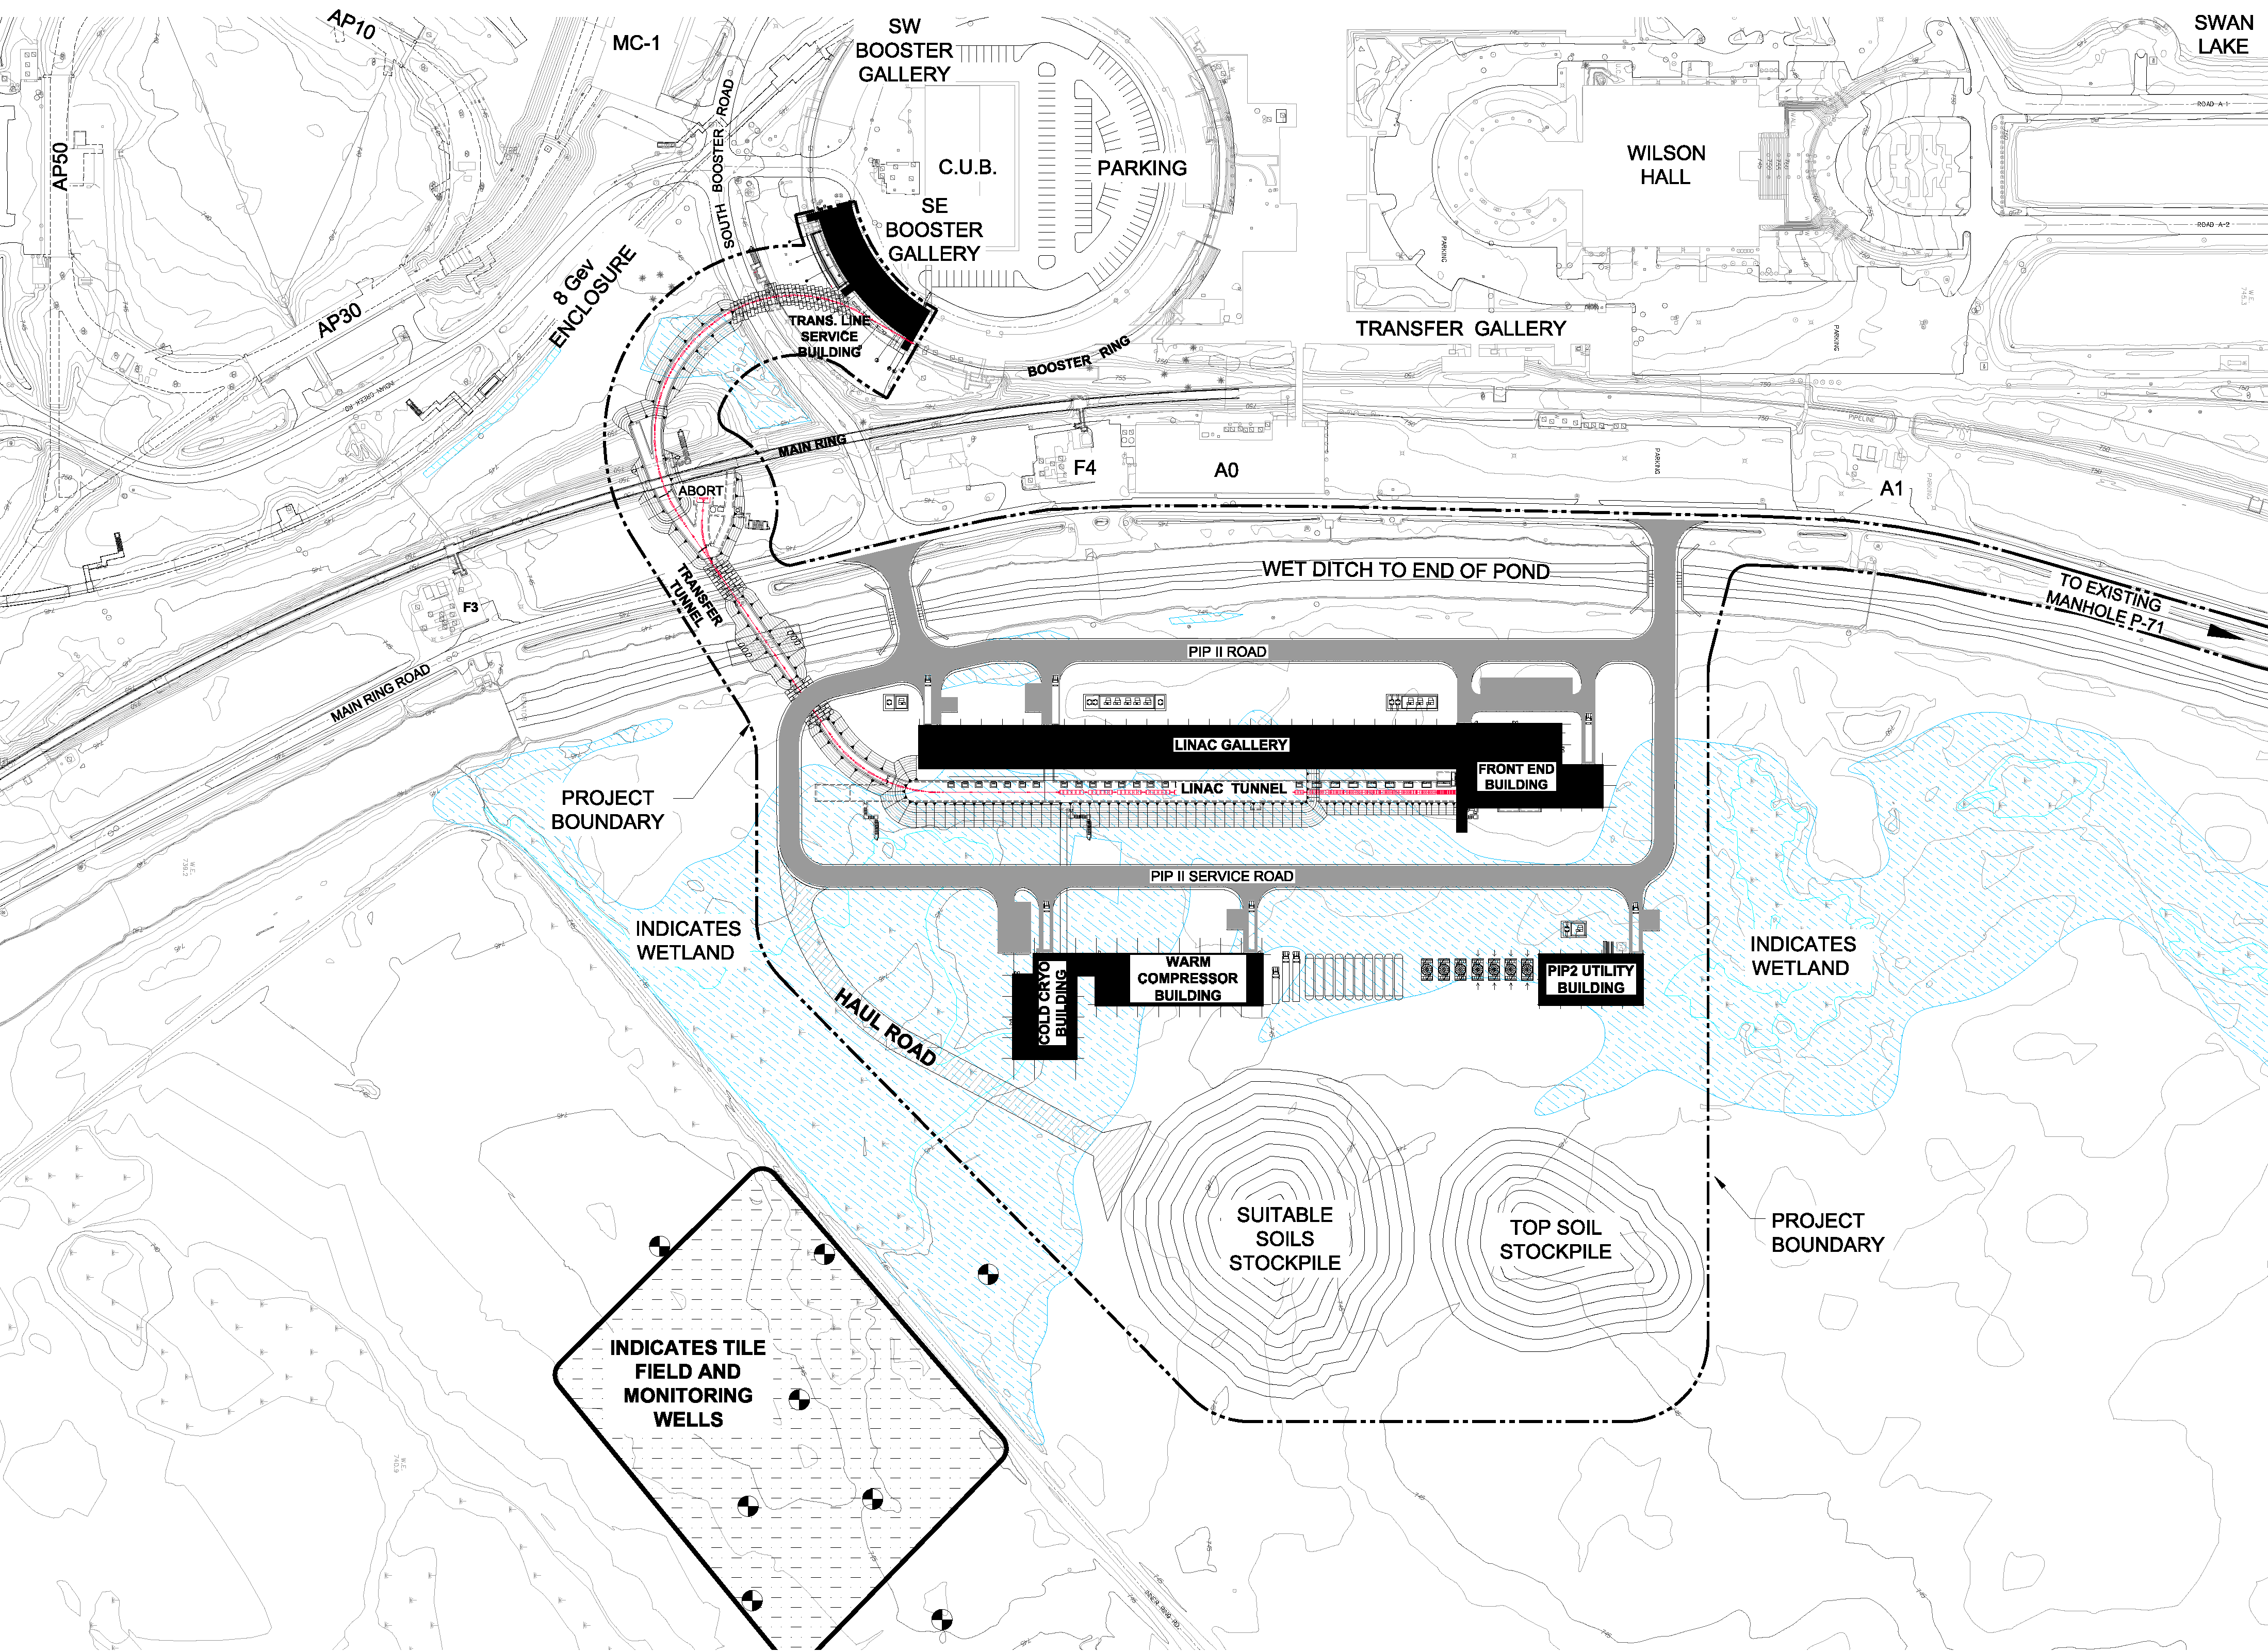
Proposed Technical Approach/Site Layout
Charge Item: #1
Dixon

Slide 8
Performance Goals
Charge Item: #1
Lebedev
Performance Parameter | PIP | PIP-II
Linac Beam Energy | 400 | 800 | MeV
Linac Beam Current | 25 | 2 | mA
Linac Beam Pulse Length | 0.03 | 0.54 | msec
Linac Pulse Repetition Rate | 15 | 20 | Hz
Linac Beam Power to Booster | 4 | 17 | kW
Linac Beam Power Capability (@>10% Duty Factor) | 4 | ~200 | kW
Mu2e Upgrade Potential (800 MeV) | NA | >100* | kW
Booster Protons per Pulse | 4.3×10¹² | 6.5×10¹²
Booster Pulse Repetition Rate | 15 | 20 | Hz
Booster Beam Power @ 8 GeV | 80 | 166 | kW
Beam Power to 8 GeV Program (max) | 32 | 83 | kW
Main Injector Protons per Pulse | 4.9×10¹³ | 7.5×10¹³
Main Injector Cycle Time @ 60-120 GeV | 1.33** | 0.7-1.2 | sec
LBNF Beam Power @ 60-120 GeV | 0.7** | 1.0-1.2 | MW
LBNF Upgrade Potential @ 60-120 GeV | NA | >2 | MW
**NOvA operations at 120 GeV
* India in-kind cryoplant would support CW operations on day-1

Slide 9
Scope
Charge Item: #2
The scope of PIP-II includes all management, permitting, design, development, fabrication, construction, and procurement activities associated with the construction and commissioning of:
An 800-MeV superconducting linac, constructed of CW-capable accelerating structures and cryomodules, operating with a peak current of 2 mA and a beam duty factor of 1.1%;
Beam transport from the end of the SC Linac to the new Booster injection point, and to a new 800-MeV beam dump;
Upgrades to the Booster to accommodate 800-MeV injection, and acceleration of 6.5×10¹² protons per pulse;
Upgrades to the Recycler to accommodate slip-stacking of 7.7×10¹³ protons delivered in twelve Booster batches;
Upgrades to the Main Injector to accommodate acceleration of 7.5×10¹³ protons per pulse to 120 GeV with a 1.2 second cycle time, and to 60 GeV with a 0.7 second cycle time.
All associated conventional facilities and infrastructure
Notes:
I am not sure about Collimator upgrade in MI. We will need collimator in Recycler but it should be done before PIP-II

Slide 10

Scope/Technology Map
Charge Item: #2
Section | Freq | Energy (MeV) | Cav/mag/CM | Type
RFQ | 162.5 | 0.03-2.1
HWR (β_{opt}=0.11) | 162.5 | 2.1-10.3 | 8/8/1 | HWR, solenoid
SSR1 (β_{opt}=0.22) | 325 | 10.3-35 | 16/8/ 2 | SSR, solenoid
SSR2 (β_{opt}=0.47) | 325 | 35-185 | 35/21/7 | SSR, solenoid
LB 650 (β_{g}=0.61) | 650 | 185-500 | 33/22/11 | 5-cell elliptical, doublet*
HB 650 (β_{g}=0.92) | 650 | 500-800 | 24/8/4 | 5-cell elliptical, doublet*
*Warm doublets external to cryomodules All components CW-capable
Notes:
Multiple corrections to the table and picture

Slide 11
R&D
Charge Item: #1
Derwent et al
The goal is to mitigate risk: Technical/cost/schedule
Technical Risks
  Front End
    Delivery of beam with required characteristics and reliability
  Operate (high Q_{L}) SC Linac in pulsed mode at low current
    Primary issue is resonance control in cavities
  Booster/Recycler/Main Injector beam intensity
    50% per pulse increase over current operations
    Longitudinal emittance from Booster for slip-stacking
    Transition crossing
    Beam loss/activation
  Develop requisite capabilities of partners and vendors
Cost Risks
  Superconducting RF: Cavities, cryomodules, RF sources represent major portion of construction costs
  Cavity Q₀: plays a critical role in the capital and operating costs of the cryoplant
Current funding profile will support R&D completion in early FY2020
PIP2IT

Slide 12
R&D Strategy
Charge Item: #1
Derwent et al
We would like to have the following protoypes and/or demonstrations completed at the time of CD-3
PIP2IT
  Beam accelerated and characterized through the SSR1 prototype cryomodule
  Demonstration of effective microphonics/LFD mitigation
SRF
  HWR and SSR1 cryomodules tested with beam
  SSR2 and LB650 dressed cavities tested at full rf power
  HB650 prototype cryomodule tested at full rf power
  All utilizing associated RF power and RF controls systems
Main Injector/Recycler
  Selection and demonstration of MIRF power amplifier
  Gamma-t jump prototype magnet

Slide 13
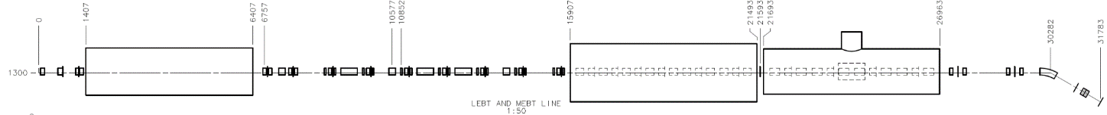
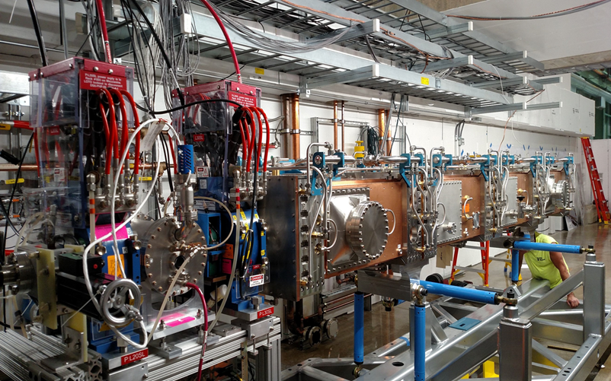
R&D: PIP-II Injector Test
Charge Item: #1
Derwent et al
2015
Now
2017
2018
2019
30 keV
2.1 MeV
10 MeV
25 MeV
RFQ
MEBT
HWR
SSR1
HEBT
LEBT
40 m, ~25 MeV
PIP2IT will address the address/measure the following:
  LEBT pre-chopping: Demonstrated
  Vacuum management in the LEBT/RFQ region: Demonstrated
  Validation of chopper performance
    Bunch extinction, effective emittance growth
  MEBT beam absorber
    Reliability and lifetime
  MEBT vacuum management
  CW operation of HWR
    Degradation of cavity performance
    Optimal distance to 10 kW absorber
  Operation of SSR with beam
    CW and pulsed operation
    Resonance control and LFD compensation in pulsed operations
  Emittance preservation and beam halo formation through the front end
Collaborators
ANL: HWR
LBNL:LEBT, RFQ
SNS: LEBT
BARC: MEBT, SSR1, RF
IUAC: SSR1

Slide 14
Cost Range
Charge Item: #3
Jacobsen
Point estimate developed for the June 2015 IPR:
Propose cost range based on DOE Cost Estimating Guide (DOE G 413.3 – 21) for class 3/4 project maturity
  Range: -10% to +26%
Mission Need Statement Cost Range: $465M – $650M
Cost estimate will be updated as part of the development of the Resource Loaded Schedule in advance of CD-1
PIP-II | Cost Est | Int’l Contrib | DOE TOTAL
Direct, FY13$ | $347M | $108M | $239M
Overheads |  |  | $84M
Escalation (to FY20$) |  |  | $59M
Contingency |  |  | $134M
TOTAL PROJECT COST |  |  | $516M

Slide 15
Schedule
Charge Item: #3
Lari
Resource Loaded Schedule (RLS) under development in P6
WBS established
  Segregates OPC and TEC funds
  Will support EVMS reporting
T0, 1, 2, 3, 4 milestones established for project duration
  I3, I4 milestones: International contributions lie outside DOE scope, but essential to track
Resource loading for R&D phase in process; major activities have been loaded
  PIP2IT
  SSR2, HB650
  RF Sources
  Cryogenic distribution syste (PIP2IT)
  Conventional Facilities

Slide 16
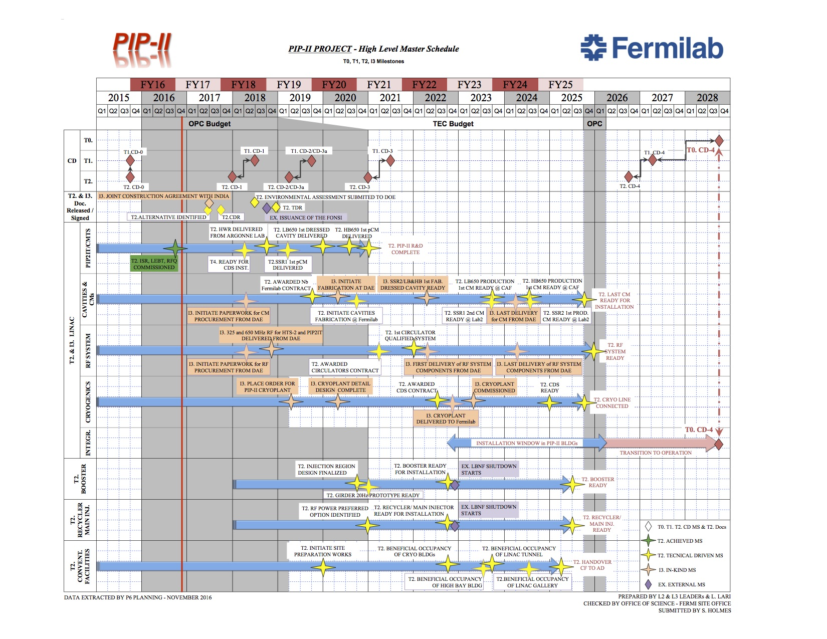
High Level Schedule
Charge Item: #3
Lari

Slide 17
Schedule/Funding Profile
Charge Item: #3
Lari
Currently working with the following profile:
  Sums to upper cost range
Associated CD dates:
RLS required to reconcile funding profile and CD dates
FY16 | FY17 | FY18 | FY19 | FY20 | FY21 | FY22 | FY23 | FY24 | FY25
$15.7 | $18.2 | $25.0 | $40.0 | $60.0 | $100.0 | $100.0 | $100.0 | $100.0 | $91.1
 | MNS | Early | T0/T1
CD-0 | Q1FY16 | Q1FY16 | Q1FY16
CD-1 | FY17 | Q4FY17 | Q4FY18
CD-2/3a | FY18 | Q1FY19 | Q1FY20
CD-3 | FY20 | Q4FY20 | Q4FY21
CD-4 | FY26 | Q3FY26 | Q1FY29

Slide 18
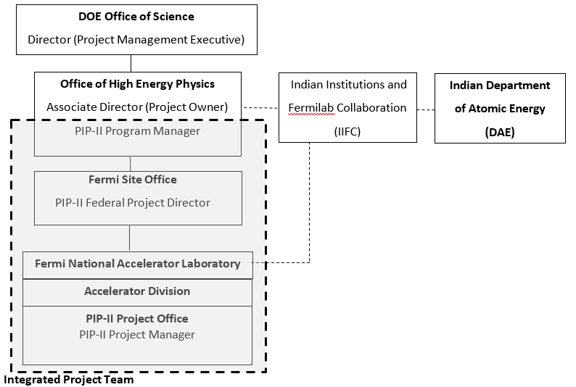
Organization
Charge Item: #4

Slide 19
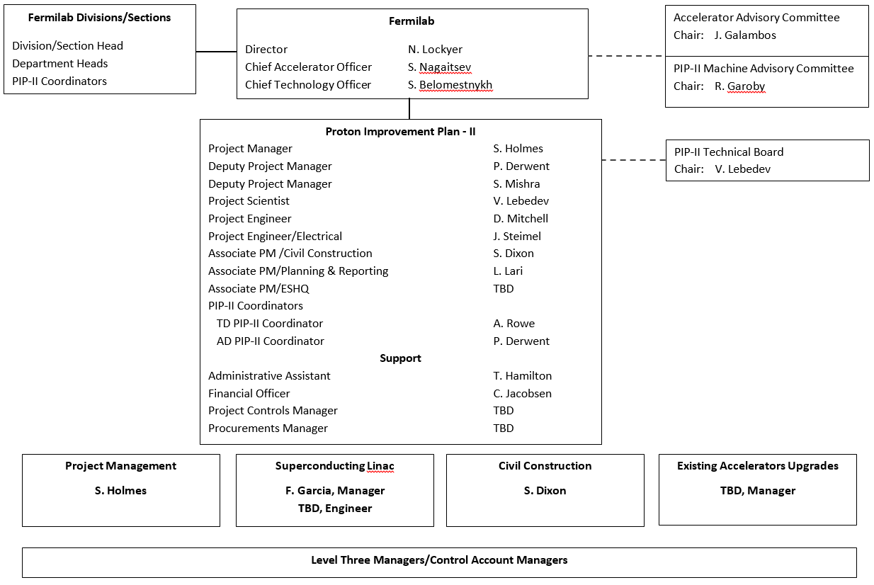
Organization
Charge Item: #4
Holmes_pm
Critical mass of persons experienced in accelerator development, construction, operations; and in DOE and international projects
  Main Injector, NOvA, US LHC Accelerator, PIP, and SBN projects
  LHC and ESS projects
  Tevatron, CEBAF, NOvA operations

Slide 20
Project Strategy/Staffing Requirements
Charge Item: #4
We are able to generate total resource requirements based on FTE estimates gathered as part of the point estimate*.
*Does not include contingency
Note: PIP-II current utilization is 53-59 FTE

Slide 21
ESH
Charge Item: #5
Kuchler
Accelerator Safety Requirements
  PIP2IT operations conform with laboratory policies and procedures
    Shielding assessments
    Interlocked enclosure as required
    ODH (eventually)
    Operations permits specify beam intensity authorization
  Exemption from DOE O 420.2C as a “room-sized accelerator”
National Environmental Policy Act (NEPA)
  Monthly strategy meeting established with FSO, ESH Section, and PIP-II Project
  Environmental Evaluation Notification Form (EENF) drafted and shared with FSO
  Wetlands delineation study complete (summer 2016)
  Environmental Assessment (EA) to be launched late FY17/early FY18 (funding dependent)
  Require FONSI prior to CD-2
Expect to appoint APM/ESHQ at end of FY2017

Slide 22
International Partners/India
Charge Item: #6
Mishra
Indian Institutions and Fermilab Collaboration (IIFC) established in 2009
  Collaborative development of technologies associated with high intensity superconducting proton accelerators
  Critical to achieving CD-0
High-level management via two (DOE & DAE) Principal Coordinators, supported by (Fermilab & DAE)Technical Coordinators
Technical integration of work via Fermilab SPMs and Indian SPCs
  Weekly teleconferences providing coordination
Joint R&D document: defines scope of work and deliverables dates
  Fermilab has proposed revision to the deliverables dates to provide consistency with the current RLS for the R&D phase. Not yet formally accepted by PCs
Semi-annual reviews of progress
Seven Indian engineers/scientists at Fermilab for 2-year residencies
  Plus multiple short term visits
DAE observers/presenters at this review:
  Ranajit Kumar/Head, DAE Nuclear Control and Planning Wing
  Satish Joshi/Head, Proton Linac and Superconducting Cavities Division, RRCAT
  Srinivas Krishnagopal/High Intensity Proton Linac Section, BARC
  Vikas Jain/RRCAT, Fermilab Guest Engineer

Slide 23
Other Partners/Europe
Charge Item: #6
Mishra
Partnership forming with INFN
  LB650 prototype cavity design and fabrication
  Led by INFN/Milano
UK institutions proposal to STFC for support of LBNF/PIP-II
  PIP-II: HB650 cryomodules
  To be led by CI/ASTeC (Daresbury)
The prospects for European deliverables should be clear later this fall
Review observer
  Carlo Pagani (INFN/Milano)

Slide 24
Summary
PIP-II conceptual design meets the requirements outlined in the Mission Need Statement
  Concept is mature; will provide ≥1.2 MW of beam power at LBNF/DUNE startup
  Flexible platform for the future
R&D activities are aligned with the technical and cost risks associated with the conceptual design
  PIP2IT retires risks associated with the front end and resonance control
  SRF program retires risks associated with the superconducting accelerating modules
  R&D program is run jointly with our Indian collaborators
  Major accomplishments over the last year
PIP-II project scope is well defined
  800-MeV superconducting linac
  Modifications to the Booster/Recycler/Main Injector
  Site layout established
Resource Loaded Schedule under development
  WBS and high level milestones established
  Major R&D elements are incorporated
  Will provide consistency with funding profile
Targeting completion of R&D program/initiation of construction (CD-3) in 2020
Notes:
Our biggest vulnerability is when they ask us to show the LCLS-II and PIP-II resource profiles and compare them to available personnel. We need to prepare this ahead of time. THEY WILL ASK.

Slide 25
Summary
An experienced management team is in place that can be expected to successfully execute the PIP-II project.
  Recent addition of Associate Project Manager for Planning and Reporting
Staffing requirements are understood for both R&D and construction phases
  Competition for resources with other projects will require careful coordination at the laboratory level
Laboratory safety policies and procedures are governing beam operations at PIP2IT
NEPA strategy developed and being implemented
  Wetlands delineation complete
  EENF in draft
The collaboration with India/DAE is in the R&D phase
  Deliverables defined in Joint R&D document
  Scope aligned with potential DAE contributions to the construction phase
  Actively managed by DOE/Fermilab/DAE
Potential for Italy/INFN and/or UK/STFC contribution to the construction phase
Next Step: CD-1!*
Notes:
Our biggest vulnerability is when they ask us to show the LCLS-II and PIP-II resource profiles and compare them to available personnel. We need to prepare this ahead of time. THEY WILL ASK.

Slide 26
Backups

Slide 27
Design Criteria
Charge Item: #1
Deliver >1 MW of proton beam power from the Main Injector over the energy range 60 – 120 GeV, at the start of LBNF operations
Support the ongoing 8 GeV program including Mu2e, g-2, and short-baseline neutrinos
Provide an upgrade path for Mu2e
Provide a platform for extension of beam power to LBNF to >2 MW
Provide a platform for extension of capability to high duty factor/higher beam power operations
Goal: Initiate operations in newly-configured complex in ~2025

Slide 28
Cost Estimate
Charge Item: #3
Jacobsen
Point estimate constructed for June 2015 IPR
  Estimate starts in FY16
  Estimate as if everything constructed by Fermilab
  M&S estimates for all major systems, conventional facilities, project management, and R&D
    Scope: Superconducting linac + beam transfer line +required modifications to Booster, Recycler, Main Injector
    Includes component fabrication and installation
    Estimates in direct FY13$
  Effort estimated for above in person-years by skills type
    Includes EDIA
    Translated to SWF at Fermilab FY13 labor rates
  Remove costs for international contributions
  Apply published Fermilab overhead rates
  Apply escalation of 18.2% (FY13 to FY20 @ 2.4%/year)
  Apply across-the-board 35% contingency

Slide 29
Future Directions
The configuration and siting of the PIP-II linac are chosen to provide opportunities for future performance enhancements to the Fermilab proton complex
  >2 MW to LBNF
  100’s kW for a rare processes program
    CW capability at 0.8 – 3 GeV
  Front end for a muon-based facility
The natural next steps would be upgrading the PIP-II linac to CW operations and replacement of the Booster with higher performance accelerator (PIP-III)

Slide 30
PIP-II and Next Generation Mu2e
India is planning on providing, as an in-kind contribution, a cryoplant of sufficient capacity to support CW operations
PIP-II front end can produce arbitrary bunch patterns subject to the following contraints:
  Peak current ≤10 mA
  Average current ≤2 mA
This provides an opportunity for delivering 800-MeV protons directly from the SCL to a second generation Mu2e

Slide 31
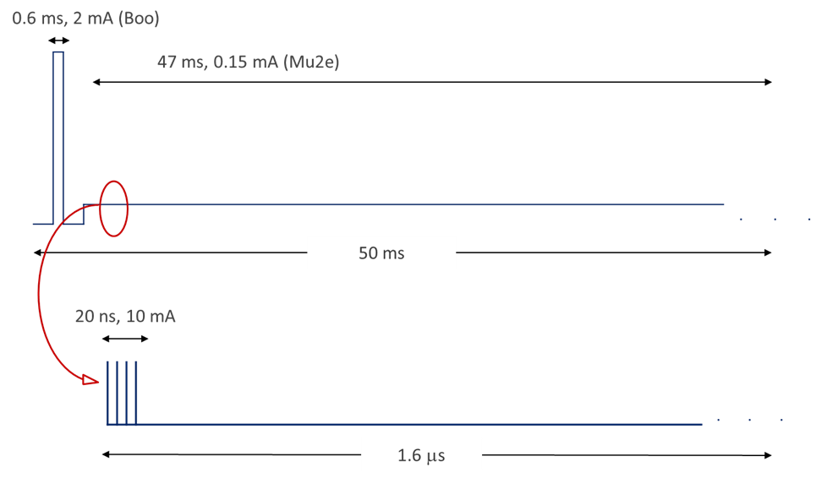
PIP-II and Next Generation Mu2e
Possible beam structure:
  Beam pulse length: ~20 nsec
  Pulse repetition period: 1.6 μsec
  Beam power: 100 kW
  Three-year run achieves
  single event sensitivity of 2×10⁻¹⁸

Slide 32
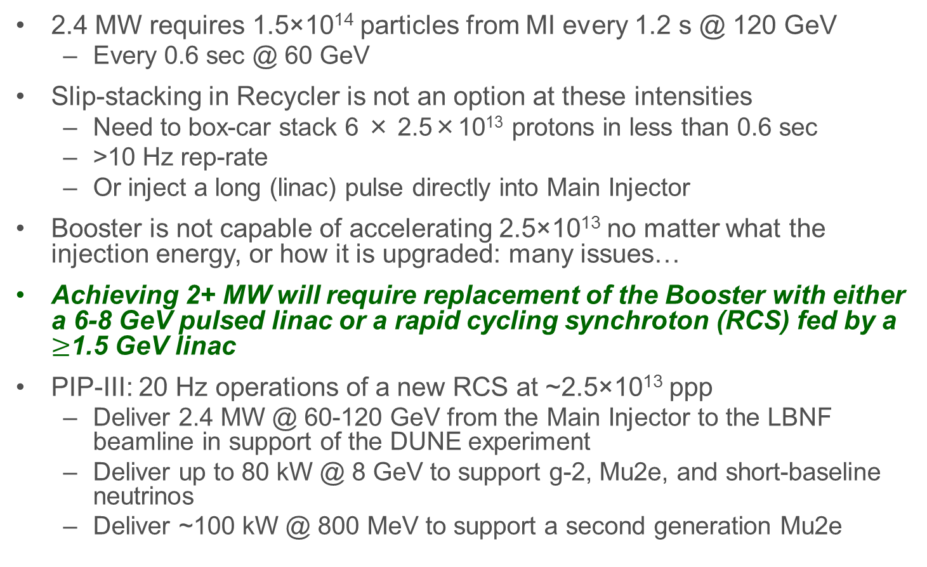
PIP-III (~2030)
2.4 MW requires 1.5×10¹⁴ particles from MI every 1.2 s @ 120 GeV
  Every 0.6 sec @ 60 GeV
Slip-stacking in Recycler is not an option at these intensities
  Need to box-car stack 6 × 2.5×10¹³ protons in less than 0.6 sec
  >10 Hz rep-rate
  Or inject a long (linac) pulse directly into Main Injector
Booster is not capable of accelerating 2.5×10¹³ no matter what the injection energy, or how it is upgraded: many issues…
Achieving 2+ MW will require replacement of the Booster with either a 6-8 GeV pulsed linac or a rapid cycling synchroton (RCS) fed by a $≥$1.5 GeV linac
PIP-III: 20 Hz operations of a new RCS at ~2.5×10¹³ ppp
  Deliver 2.4 MW @ 60-120 GeV from the Main Injector to the LBNF beamline in support of the DUNE experiment
  Deliver up to 80 kW @ 8 GeV to support g-2, Mu2e, and short-baseline neutrinos
  Deliver ~100 kW @ 800 MeV to support a second generation Mu2e

Slide 33
Possible Parameters for post-PIP-II Complex
 | RCS | Linac
Proton Source
Particle Type | p | H-
Beam Kinetic Energy | 8.0 | 8.0 | GeV
Protons per Pulse | 2.5×10¹³ | 1.5×10¹⁴
Beam Pulse Length | 0.0016 | 10 | msec
Pulse Repetition Rate | 20 | 3.33 | Hz
Pulses to Recycler | 6 | NA
Pulses to Main Injector | NA | 1
Beam Power at 8 GeV (Total) | 640 | 640 | kW
Beam Power to Main Injector* | 160/320 | 160/320 | kW
Beam Power Available to 8 GeV Program* | 480/320 | 480/320 | kW
Main Injector
Beam Kinetic Energy* | 120/60 | 120/60 | GeV
Main Injector Protons per Pulse | 1.5×10¹⁴ | 1.5×10¹⁴
Main Injector Cycler Time* | 1.2/0.6 | 1.2/0.6 | sec
LBNF Beam Power* | 2.4/2.4 | 2.4/2.4 | MW
* First number refers to 120 GeV MI operations; second to 60 GeV

Slide 34
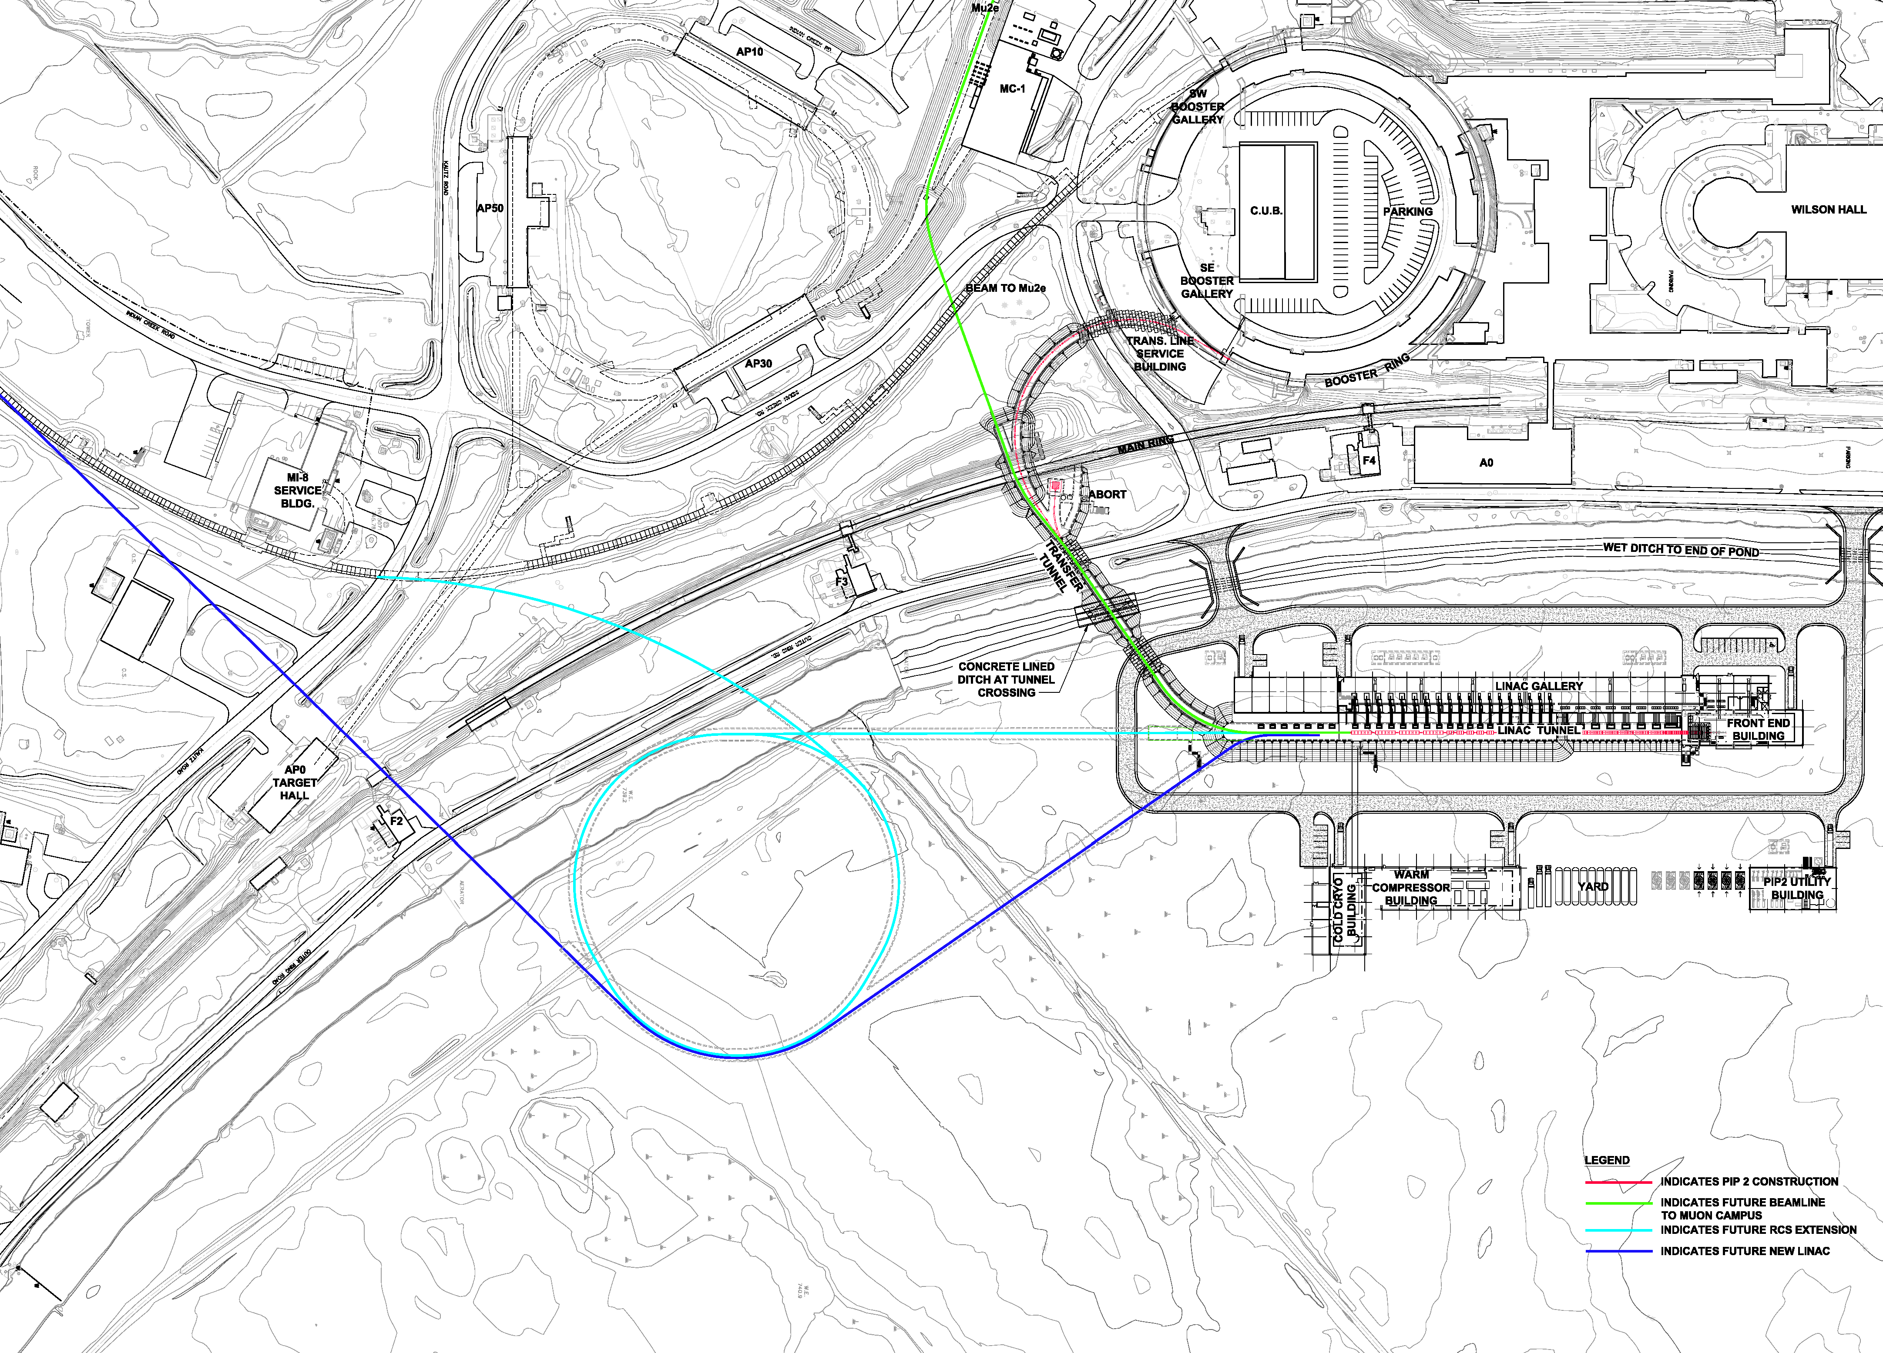
PIP-III (~2030)

