Slide 1
International Collaboration
Shekhar Mishra
DOE Independent Project Review of PIP-II
15 November 2016

Slide 2
Bio of Shekhar Mishra
PIP-II
  Deputy Project Manager
Relevant Experience
  Indian Institutions and Fermilab Collaboration
  International Linear Collider, Deputy Director/Fermilab
  Main Injector and Recycler Ring Department Head
  Main Injector and Recycler Ring Commissioning Team Leader
  Experimental High Energy Physics

Slide 3
Outline
Charge Item: #6
Introduction
R&D Phase Goals
  Technology Map
R&D Schedule to complete
  Division of responsibility between Fermilab and DAE.
Fermilab Information Sharing and Export Control
R&D Status
  R&D Schedule to complete
IIFC: R&D to PIP-II Construction Transition
Summary

Slide 4
Introduction
PIP-II program is envisioned as two continuous phases.
  R&D Phase (CY2008 – CY2020):
    Joint development of technology with International Partners
    Preparation of laboratory and industrial infrastructure towards the construction of PIP-II.
    Reduce technical, cost and schedule risk to a level that will allow initiation of the construction phase.
  Construction Phase (CY2020 – CY2025):
    Fabrication of accelerator components for PIP-II accelerator
    Anticipate significant International contribution

Slide 5
International Collaboration
Indian Institutions and Fermilab Collaboration (IIFC) was established at the institutional level in 2009 and brought under Project Annex I (2015) to collaborate on
  High Intensity Superconducting Proton Accelerators for the respective domestic accelerator programs
    PIP-II, ISNS and MEHIPA
    “Total Project Collaboration”: Open Sharing of Fermilab and Jointly developed Technology of HISPA
  Project Annex I and associate documents provide guidance
    R&D strategy is aligned with a vision of potential construction deliverables.
Fermilab has been exploring possible collaboration with other countries on PIP-II R&D and Construction: Italy/INFN and UK/STFC

Slide 6
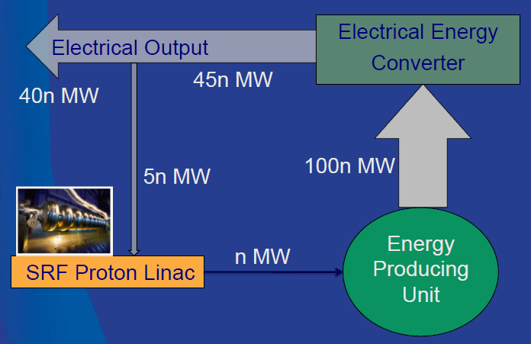
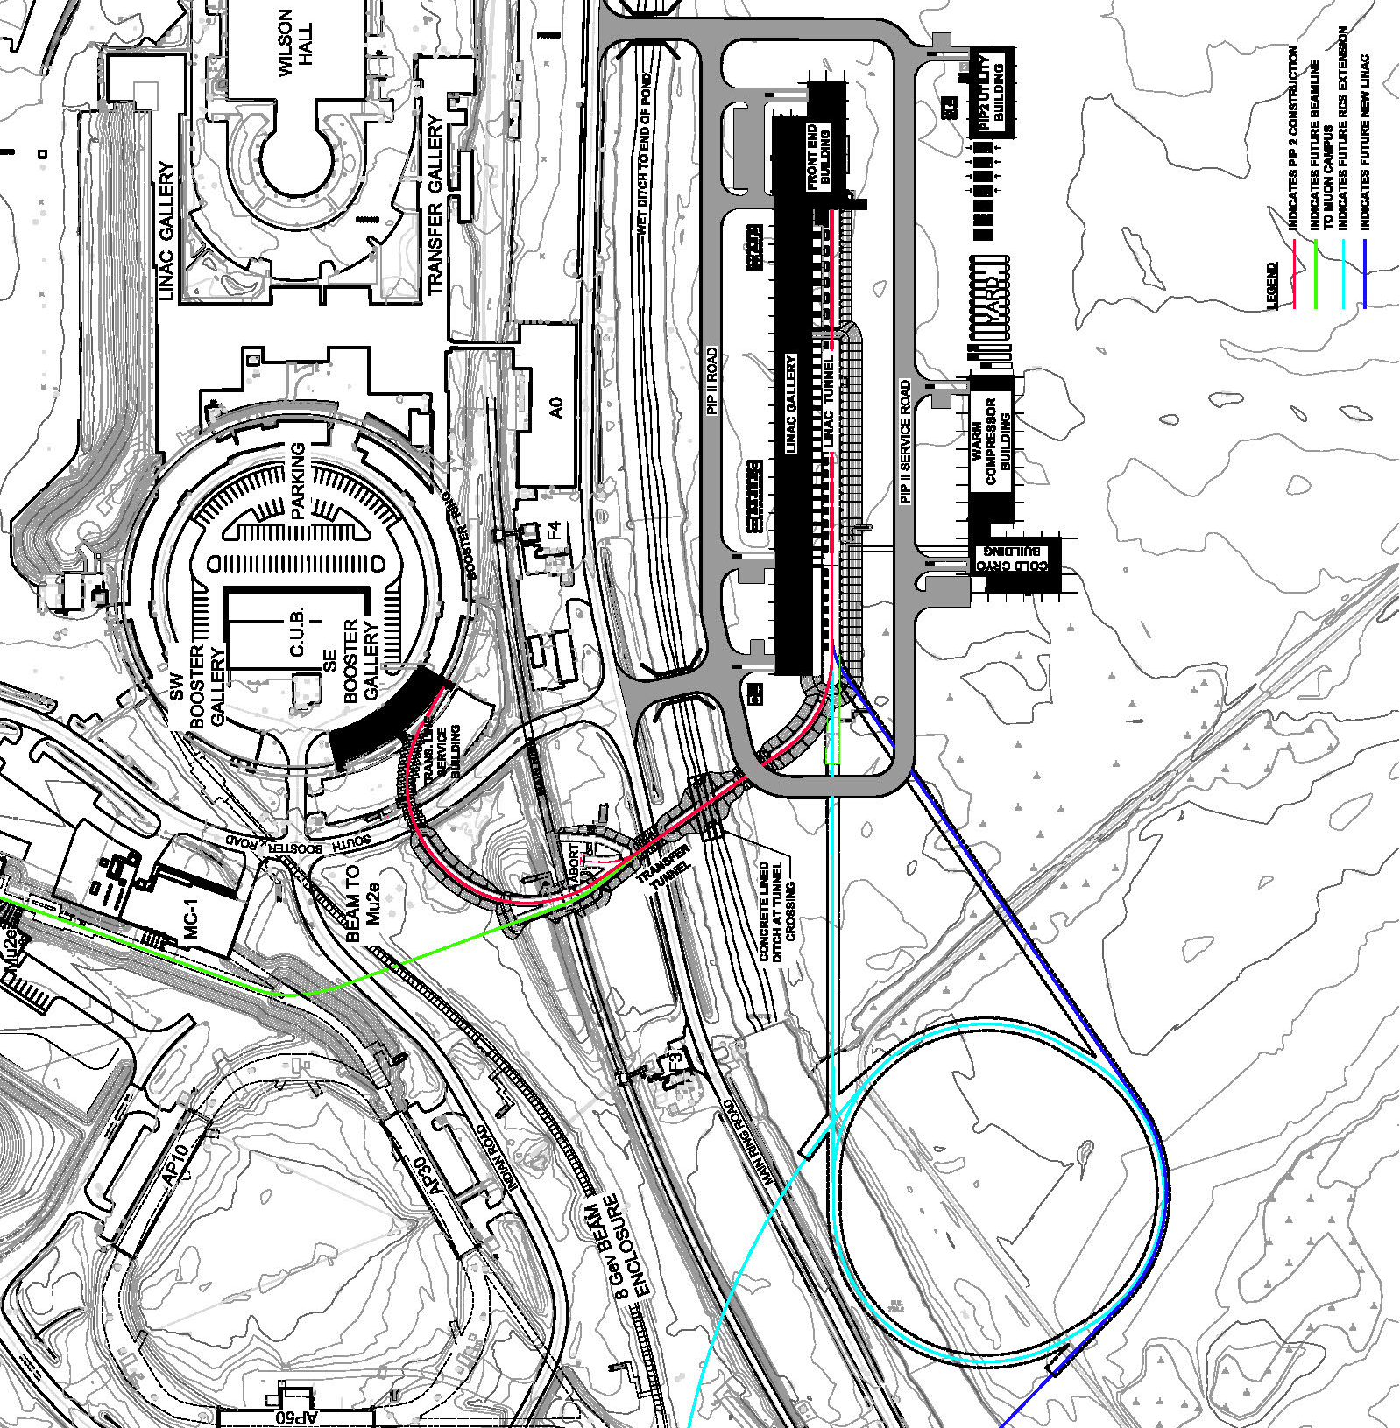
International Interest in Fermilab Accelerator Program
Fermilab is building a High Intensity Superconducting Proton Accelerator PIP-II which is a ~1 GeV SRF Linac.
It is design to provide 1.2 MW of beam for Deep Underground Neutrino Experiment (DUNE) (INFN and UK are collaborators).
35n MW
10n MW
Multi Mega CW beam at ~1 GeV for Nuclear Energy Application
Pulsed SRF Linac for Spallation Neutron Source.
SRF Proton Linac

Slide 7
PIP-II SRF Linac R&D
High Level Goal: The retirement of risks associated with operation of the PIP-II Linac in pulsed mode as required for neutrino operations and described in the CDR (1% duty factor).
  Develop capabilities, reduce technical, cost and schedule risk to a level that will allow initiation of the construction phase.
Major Elements:
Warm Front End (Source, RFQ and MEBT)
HWR CM testing with Beam at PIP2IT (CY19)
  Finish construction of HWR and Install at PIP2IT (CY18)
International Collaboration on:
SSR I CM testing with beam at PIP2IT (CY19)
  Finish construction of SSR1 CM and Install at PIP2IT (CY18)
HB650 CM testing with RF at CMTF (CY20)
  Finish construction of HB650 CM and Install at CMTF (CY19)
LB650 Dressed Cavity High Power test at HTS-2 (CY19)
SSR2 Bare Cavity Low Power test at VTS (CY19)

Slide 8

Mapping International Collaboration onto PIP-II
The DAE laboratories are completely integrated into nearly all aspects of the PIP-II Superconducting Linac R&D.
INFN/Italy and STFC/UK have expressed interest in elliptical 650 MHz Section of the PIP-II SRF Linac.
IIFC

Slide 9
Division of Responsibilities: Fermilab and DAE
Fermilab and collaborating Indian Institutions (BARC, IUAC, RRCAT and VECC) have been Independently or Jointly developing technologies and infrastructure for the High Intensity Superconducting Proton Accelerator (HISPA) (aka PIP-II for Fermilab). (Project Annex I)
  Fermilab shares design, technology and supporting infrastructure knowledge for PIP-II with the Collaborating DAE laboratories for its use in the Indian HISPA program.
  DAE provides engineering resources, design, manufacturing and supply of HISPA hardware for PIP-II.
The scope of work in the R&D phase has been outlined in the Joint R&D document.
  Encompasses design, hardware fabrication and testing

Slide 10
Technology Development Map for HISPA under IIFC
Fermilab (US) Developed Technology
PIP-II Accelerator Design (Pulsed and CW)
Warm Front End (Source and RFQ)
Half Wave Resonator Cavity and Cryomodule
162.5 MHz RF Source
SRF Infrastructure for Cavity and Cryomodule fabrication, tuning and processing techniques, and low and high power testing
SSR1 Cavity and Cryomodule Design
HB650 Dressed Cavity
325 and 650 MHz Power Couplers and Power Distribution
Resonance Control of the SRF Cavity
Cryogenic Technology
Jointly (IIFC) Developed Technology
SSR2 Cavity and Cryomodule Design
SSR2 Solenoid Magnets
LB650 Dressed Cavity
650 Cryomodule Design
RF Protection and Low Level RF System
RF System Controls
Helium Cryogenic plant design
Horizontal Test Stand
650 MHz Cryomodule Test Stand
DAE Developed Technology
325 MHz Solid State RF Amplifier
650 MHz Solid State RF Amplifier
Warm Magnets

Slide 11
Fermilab Information Sharing and Export Control
Fermilab has made available two platforms for sharing detailed technical information with DAE and International collaborators
  Team Center and SharePoint
  Fermilab has published a document ED0005292, which outlines all the document we have or will have at Fermilab and their timeline through 2020 (end of R&D period).
  DAE is setting up its own server in India to hold all jointly developed documents.
Access to third party IP is important in developing DAE capabilities.
  We are interacting with vendors to provide this information, but not always possible.
  Fermilab has considerable experience in developing these technologies and we share our understanding of manufacturing techniques with DAE laboratories.
Developing capabilities at DAE laboratories and access to products under export control in a timely manner are also important for the development of this collaboration.
  We are getting experience in doing this and planning ahead has been helpful.
In all of the above three areas (Fermilab Information, IP and Export Control) collaborative understanding of the underlining issues are very helpful.

Slide 12
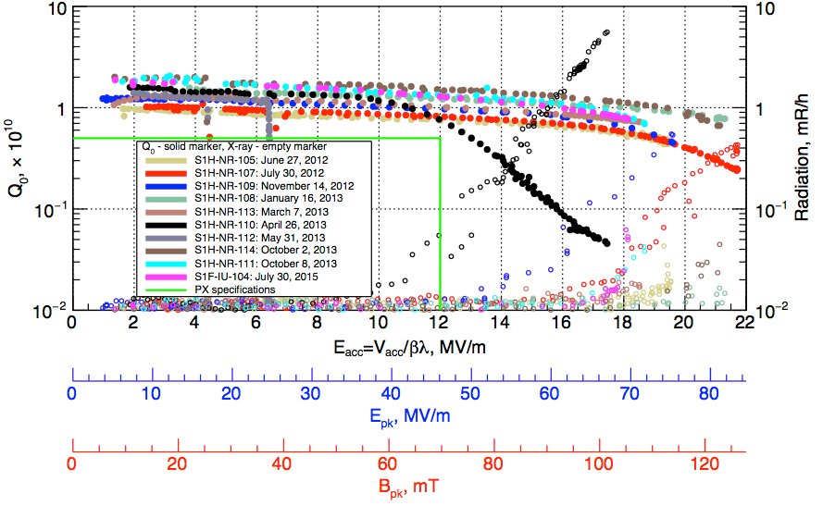
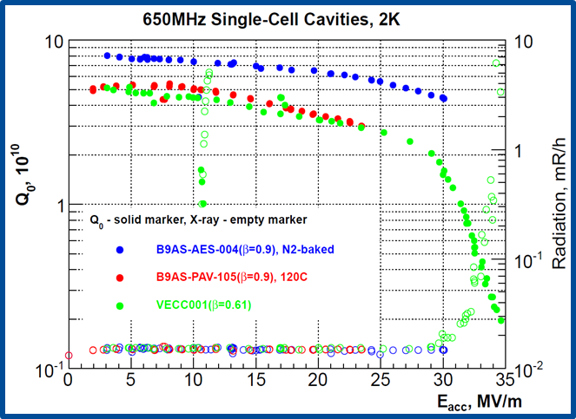
R&D Status: SSR1 and LB650
2 SSR1 cavities have been fabricated by IUAC.
  Chemically processed at ANL and cold-tested at Fermilab
    IIFC cavities meet the PIP-II specifications
At present these two cavities are being jacketed with a Helium Vessel at BARC.
  Will be incorporated in the SSR1 prototype Cryomodule at Fermilab.
5-cell LB650 cavity design carried out Jointly with VECC.
  The necessary parameters are well within the prescribed FRS limits .
The design studies includes
  3D Multipacting
  Lorentz Force Detuning (LFD)
  Pressure sensitivity under external liquid helium pressure
  Structural analysis with Stiffener Rings
Final Mechanical design has started at VECC.
  Design review scheduled for Dec 2016.
Notes:
Why show theses results.

Slide 13
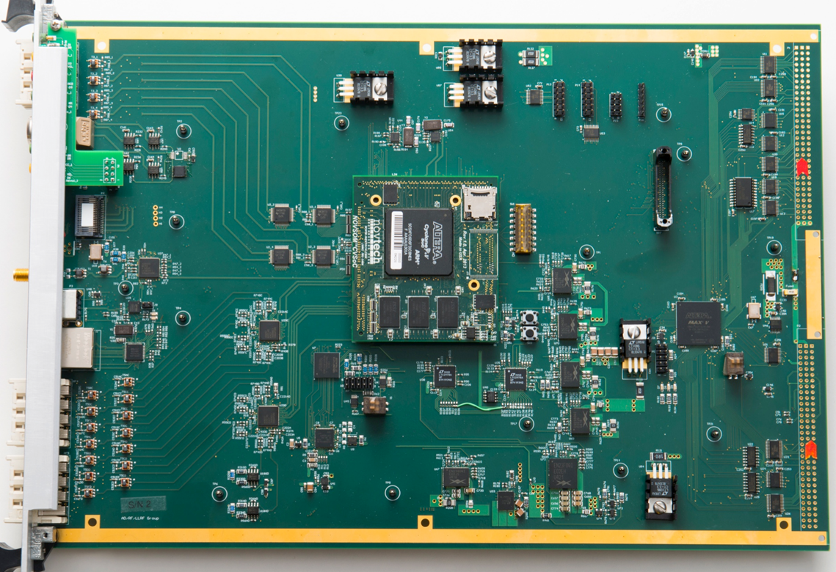
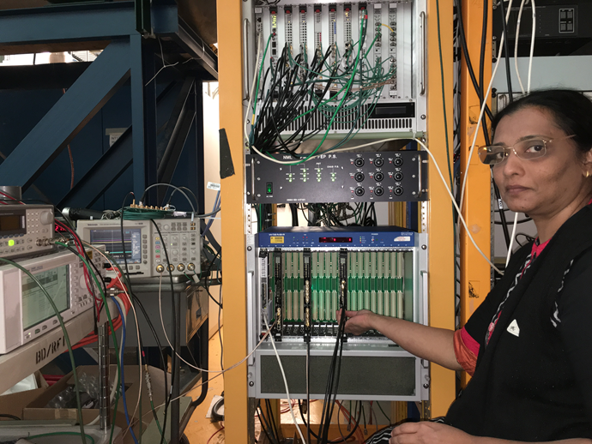
R&D Status: RF Systems (RF Protection and LLRF)
A complete redesign and upgrade of the Fermilab RF Protection Interlock system has been done in collaboration with BARC.
BARC has completed detail test and has provided boards
  At present the system is being tested at Fermilab by integrating it in to Spoke Resonator Test Cryostat (STC).
System on Chip Multi-channel Field Controller
Fermilab Meson Building
Fermilab and BARC are jointly developing the design of a next generation Low Level RF System based on an upgrade of current Fermilab system for PIP-II. The LLRF System includes
  Down and Up Converters
  Resonance Controller
  Digitizer board
  Digital LLLRF board
  RF Reference distribution System
Will be used in HTS-2, PIP2IT and 650 MHz CMTF

Slide 14
PIP-II Cryogenic Plant: System architecture
Refrigeration Load
Capacity (W) | HTTS | LTTS | 2 K
Maximum | ≥ 9,100 | ≥ 1,500 | ≥ 1,900
Nominal | ≥ 7,000 | ≥ 1,150 | ≥ 1,750
Fully segmented Linac
Single cold box with turbines and cold compressors
Distribution box located in a refrigerator room
Cryogenic transferline with bayonet cans that runs parallel to the cryomodules
Status of IIFC (BARC lead) Cryogenic Plant:
Functional Requirement Specification
Procurement Package Ready and approved
Financial Responsibilities document approved
BARC has initiated the procurement process

Slide 15
PIP-II and IIFC: SRF Linac R&D Schedule to Complete*
* Proposed by Fermilab: Consistent with PIP-II RLS, not yet agreed by DAE/DOE

Slide 16
PIP-II R&D to Construction Transition
At the conclusion of R&D, IIFC will jointly finalize all the designs and the R&D areas will morph into the fabrication of components for the PIP-II SRF Linac.
  Fermilab expects to get CD-2/3A for PIP-II in early FY19.
    Establish Project Baseline
      Construction deliverables/schedule to be formalized between DAE and DOE
    This will trigger the Fermilab procurement of all the long lead items for the PIP-II construction and associated contracts
  This is the natural point at which to anticipate that work toward construction phase deliverables could also start
    DAE deliverables will be incorporated into the RLS via I3, I4 milestones

Slide 17
PIP-II SRF Linac Construction Schedule
PIP-II Construction Phase will starts with DOE approving CD-3 for the Project.
Based on the DOE funding profile we are developing the following PIP-II construction schedule after CD-3
  Initiation all fabrication at CD3
  1st set of hardware, ordered at CD-3A, to start arriving for processing and testing (CD3+1yr)
  Completion of SRF Linac components deliverables (CD3+4yrs)
  Cryogenic plant commissioning (CD3+3yrs).
  Completion of Cryomodule and RF stations at Fermilab (CD3+5yrs)
  Installation of PIP-II Linac to complete (CD3+5yrs).
This PIP-II construction schedule will include the agreed upon DAE deliverables.

Slide 18
Summary
PIP-II Joint R&D under IIFC is proceeding satisfactorily.
Recent Joint R&D highlights are
  Delivery and integration of Dipoles and Quadrupoles into MEBT
  Fabrication, processing and testing of two SSR1 Cavity
  Development of 5-cell LB650 Cavity design and 1-cell testing
  Testing of RF Protection System at Fermilab
The deliverables outlined in the Joint R&D document will position India for a successful contribution to the PIP-II construction.
The focus is on the successful completion of the R&D phase.
  This phase is aligned with current vision of DAE contributions to the PIP-II construction phase
We are in discussions with INFN/Italy and STFC/UK for collaboration and contribution to the 650 MHz section of the SRF Linac.

