Slide 1
PIP-II R&D Program
Paul Derwent
DOE Independent Project Review of PIP-II
15 November 2016

Slide 2
Paul Derwent
Charge Item: #4
Scientist , PhD 1990 University of Chicago
Project Role: Deputy Project Manager
Relevant Experience
  Antiproton source: Accumulator stacktail stochastic cooling system, achieved record accumulation rates
  Department Head: Recycler (2006-2009), PIP-II (2014-present)
  Associate Project Manager for Accelerator & NuMI Upgrades, NOvA CD-4 2014 (2009-2014)
    2014 Secretary of Energy’s Award of Excellence

Slide 3
The PIP-II R&D Program
Charge Item: #1
The purpose of the R&D program is to mitigate technical and cost risks, by validating the choices made in the PIP-II facility design and by establishing fabrication methods for major sub-systems and components, including the qualification of suppliers
  Technical risk: impair the ability to meet fundamental performance goals
  Cost/Schedule risk: compromise the ability to meet currently understood cost or schedule goals
    CD-2: Approve performance baseline
    CD-3: Approve start of construction
  To complete in advance of CD-3

Slide 4

PIP-II Scope
Charge Item: #2
PIP-II Injector Test
Section | Freq | Energy (MeV) | Cav/mag/CM | Type
RFQ | 162.5 | 0.03-2.1
HWR (β_{opt}=0.11) | 162.5 | 2.1-10.3 | 8/8/1 | HWR, solenoid
SSR1 (β_{opt}=0.22) | 325 | 10.3-35 | 16/8/ 2 | SSR, solenoid
SSR2 (β_{opt}=0.47) | 325 | 35-185 | 35/21/7 | SSR, solenoid
LB 650 (β_{opt}=0.65) | 650 | 185-500 | 33/22/11 | 5-cell elliptical, doublet*
HB 650 (β_{opt}=0.97) | 650 | 500-800 | 24/8/4 | 5-cell elliptical, doublet*
*Warm doublets external to cryomodules All components CW-capable

Slide 5
Primary areas to address technical Risk
Charge Item: #1
Development and integrated systems testing of PIP-II Front End components (PIP-II Injector Test)
Development and demonstration of cost effective superconducting radio frequency acceleration systems at three different frequencies and with rf duty factors ranging from 10% to 100%
Development of requisite capabilities at international partner institutions to successfully contribute to PIP-II construction
Development of a Booster injection system design capable of accepting extended beam pulses from the PIP-II linac
Development of systems designs capable of supporting a 50% increase in the proton beam intensity accelerated and extracted from the Booster/Recycler/Main Injector complex

Slide 6
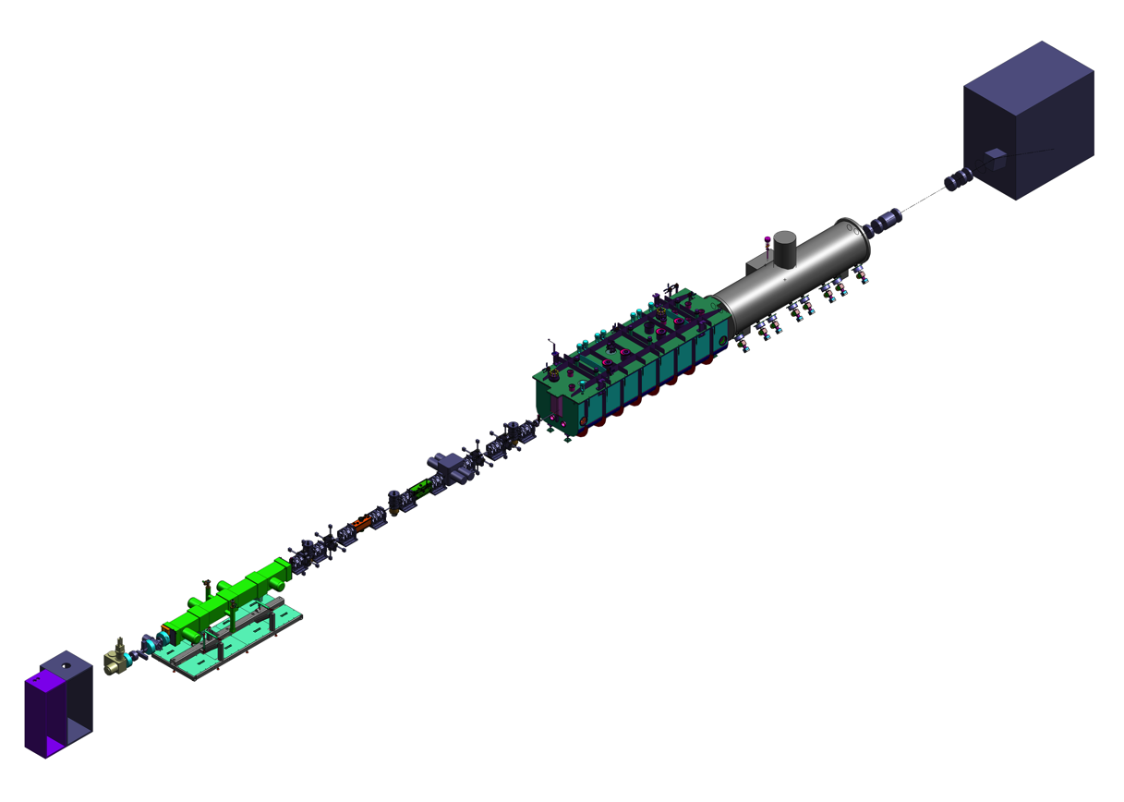
PIP-II Injector Test: PIP2IT
Charge Item: #2
Charge Item: #1
A. Shemyakin
D. Peterson
B. Chase
Scope:
  A CW H- source delivering 5 mA at 30 keV
  A low energy beam transport (LEBT) with beam pre-chopping
  A CW RFQ operating at 162.5 MHz and delivering 5 mA at 2.1 MeV
  A medium energy beam transport (MEBT) with integrated wide band chopper and beam absorbers capable of generating arbitrary bunch patterns at 162.5 MHz, and disposing of up to 5 mA average beam current
  Low β superconducting cryomodules capable of accelerating 2 mA of beam to 25 MeV
  Associated beam diagnostics
  Beam dump capable of accommodating 2 mA at full beam energy for extended periods.
  Associated utilities and shielding

Slide 7
PIP-II Injector Test: PIP2IT
Mission Statement:
The PIP-II Injector Test (PIP2IT) facility replicates the front end of the PIP-II linac through the first SSR1 cryomodule. PIP2IT is intended to serve as a complete systems test that will reduce technical risks associated with the PIP-II linac in both pulsed and CW operating modes. It is anticipated that PIP2IT will be operated for several years beyond the initiation of PIP-II construction, with the eventual relocation of major PIP2IT components and systems into the PIP-II linac enclosure, where they will serve as part of the PIP-II front end. The construction and operating period of PIP2IT splits naturally into two phases.
Phase 1 (R&D plan):
  retirement of risks associated with operation of the PIP-II linac in pulsed mode as required for neutrino operations and described in the CDR (1% duty factor).
  Phase 2 (post-CD-3):
  retirement of risks associated with CW operations, in particular as related to utilization of the PIP-II linac for a second generation Mu2e experiment
  important for future scientific opportunities with PIP-II linac

Slide 8
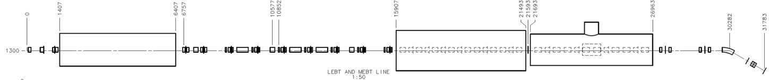
PIP2IT: Phase 1 Deliverables
Charge Item: #2
2015
Now
2017
2018
2019
30 keV
2.1 MeV
10 MeV
25 MeV
RFQ
MEBT
HWR
SSR1
HEBT
LEBT
40 m, ~25 MeV
Phase 1 (R&D plan): retirement of risks associated with operation of the PIP-II linac in pulsed mode as required for neutrino operations and described in the CDR (1% duty factor). The primary risks to be retired during this period include:
Achievement of required beam characteristics from the ion source through the SSR1 cryomodule.
Demonstration of MEBT chopper operations at a level required for Booster injection
Demonstration of the operation of the HWR cryomodule, with beam, in close proximity to the MEBT beam absorber
Demonstration of stable beam acceleration in the SSR1 cryomodule, under the full control of prototype RF control systems, including resonance control within the cavities
Collaborators
ANL: HWR
LBNL:LEBT, RFQ
SNS: LEBT
BARC: MEBT, RF
IUAC: SSR1

Slide 9
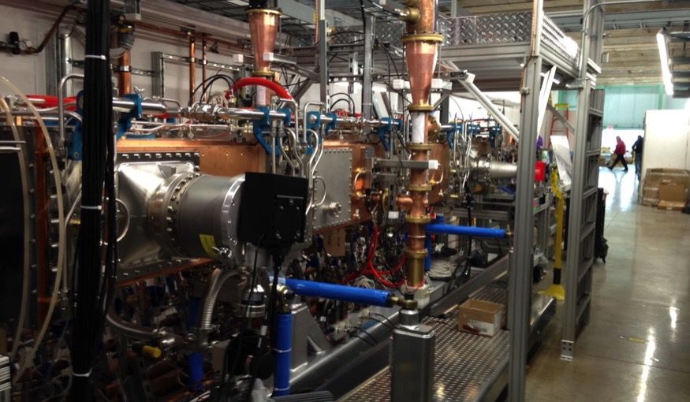
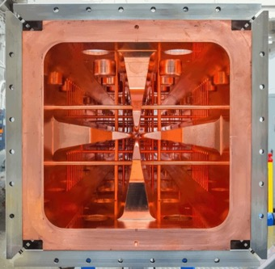
RFQ Status
RFQ Installation is complete.
RFQ successfully conditioned with 120kW input power initially at 5% duty cycle,
  Taking into account measured Q0 and beta, estimate vane potential at 66kV (10% above specified).
95 kW in CW operation
  Equivalent to 62 kV vane potential (60 kV required)
RFQ in Enclosure

Slide 10
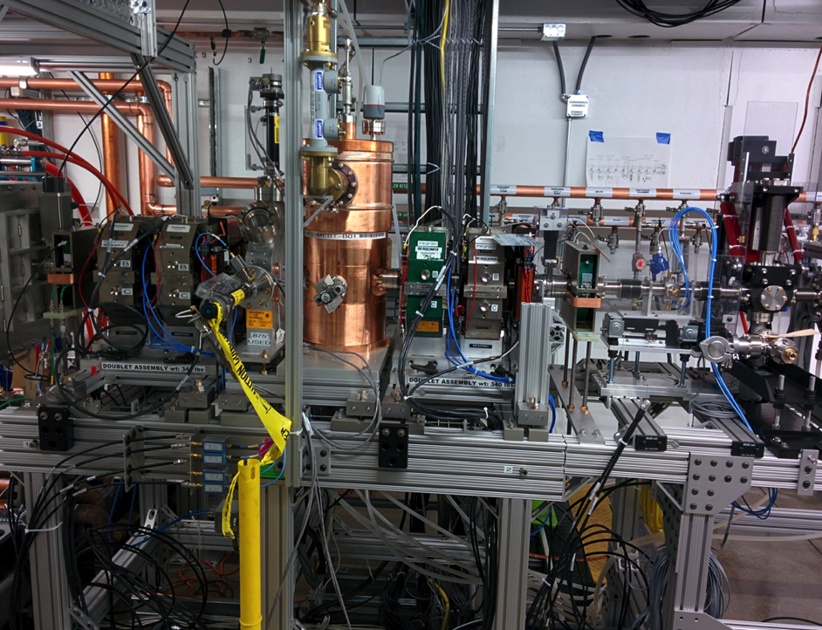
Beam from RFQ
We received permission to run the beam through RFQ on March 23, and saw an accelerated beam within an hour
98% ± 2% transmission efficiency
1 - 10 mA pulsed beam
Energy
  2.11 MeV ± 0.5%
RFQ exit
Current transformer
Time of Flight BPM
Faraday Cup
First doublet (BARC)
Second doublet (BARC)

Slide 11
PIP2IT: MEBT
The MEBT primary technical deliverables:
  Beam Chopping
    Forms the bunch structure required Booster injection
    Testing Prototype kickers in FY17
    Testing Prototype absorber in FY17
  Vacuum Management
    absorber upstream of SRF Cryomodule

Slide 12
SRF
Charge Item: #1
Z. Conway
T. Nicol
V. Jain
W. Schappert
PIP-II includes
  5 different SRF cavity types and cryomodules
    Half Wave Resonator:
    2 Single Spoke Resonators
    2 elliptical cavities
  3 different frequencies (162.5 MHz, 325 MHz, 650 MHz)
R&D program:
  test one complete cryomodule of each frequency to full power
    HWR & SSR1 @ PIP-II Injector Test with beam : FY19
    HB650 in a test stand with RF power : FY20
  test LB650 dressed cavities with RF power : FY19
  test bare SSR2 cavities in vertical test stand : FY19
  Resonance control of cavities in pulsed mode operation (Lorentz Force Detuning)
    Combination of High Q_{ext}, pulsed operation
    Passive means: Mechanical design
    Developing a piezo-based feed forward and feedback system
  Application of High Q₀ R&D to PIP-II 650 MHz cavities

Slide 13
Rings: Scope
Charge Item: #1
I. Kourbanis
700 kW -> 1.2 MW:
  increase pulse intensity
  Increase pulse frequency
Parameter | 700 kW | PIP-II
Booster Injection Energy | 400 MeV | 800 MeV
Booster Pulse Intensity | 4.3e12 | 6.4e12
Booster Repetition Rate | 15 Hz | 20 Hz
RR Pulse Intensity | 5.2e13 | 7.7e13
RR RF Duty Factor | 60% | 50-100%
MI Pulse Intensity | 4.9e13 | 7.5e13
MI Extraction Energy | 120 GeV | 60-120 GeV
MI Cycle Time | 1.33 sec | 0.6-1.2 seconds

Slide 14
Rings: Booster
Charge Item: #1
I. Kourbanis
New injection region: New location and higher energy
  R&D:
    Radiation Deposition in Absorber
    Bump/Painting Magnets and Power supplies
20 Hz vs 15 Hz:
  Resonant magnet system:
    Successfully tested with single gradient magnet and choke
    R&D: build a complete girder (2 gradient magnets, choke, cap bank, & power supply)
  Controls and timing : 15 Hz is the standard clock
    R&D: understand impacts and requirements

Slide 15
Rings: Recycler / Main Injector
Charge Item: #1
I. Kourbanis
RF systems
    Recycler: New Cavity required
      increase in duty factor (up to 100%) -> better cooling
      increase in repetition rate -> increased frequency separation for slip stacking -> larger bucket -> more voltage
      Prototype design exists, needs additional development
    Main Injector: New Power Amplifiers required
      enough voltage but higher power needed
      two solutions
        Higher power tube
        Two tubes of existing design on cavity
Beam Dynamics and Control
  Recycler: understanding of instabilities
  Main Injector: γ_{t} jump for stability through transition
    8 triplets to generate ± 1 unit in 0.5 msec
    test prototype magnet and power supply

Slide 16
PIP-II Priorities
Charge Item: #3
Goal: Complete the R&D Program in advance of CD3
R&D Goals
  PIP-II Injector Test
    Chopper validation
    HWR and SSR1 Operation with beam
  SRF/IIFC
    SSR1 CM (6 US + 2 India)
    HB650 CM (3 US + 3 India)
    LB650 + SSR2 Cavities from India (2 + 2)
    RF systems (8 US + 16 India)
  Rings
    20 Hz: magnet tested, understand control system impact
    Booster Injection: design and prototype magnet
    RR/Main Injector RF: PA tested, prototype RR cavity, prototype γ_{t} magnet
CD Goals
  CD-1 Q4FY17
  CD-2/CD3a FY18/19
  CD3 FY20

Slide 17
R&D Activities: Goals, Priorities, Constraints
Charge Item: #3
PIP2IT
  Beam to end of MEBT and Chopper Test
    MEBT to HWR beam line vacuum transition
  HWR CM Cold with RF Power
  SSR1 CM Cold with RF Power
IIFC
  US HB650 Dressed Cavities to be tested in HTS-2
    Testing bare cavities in modified STC
  DAE HB650 Dressed Cavity
    Commission HTS-2 at RRCAT
  LB650 Dressed Cavity to be tested (2)
  SSR2 Cavity Vertical Tested (1)
  RF Power System delivered and integrated (325 and 650)
Rings
    20 Hz
    Booster Injection
    RR/Main Injector RF
Critical Decisions
  CD-1 FY17: CDR, Analysis of Alternatives, RLS, …..
  CD-2/3a FY18: Environmental Assessment, EVMS, RLS, BoE, TDR,KPP,….
R&D Program completion: FY20
  PIP2IT program
  HB650 pCM
  Rings
Original goals for R&D in FY16-18
slowed down due to FY16/17 funding constraints
Completion has moved outside FY16-18 window

Slide 18
PIP2IT Deliverables
Charge Item: #2
FY17
  Test of Chopper Prototypes & Absorber : Q4
  Full Length MEBT installed : Q4
FY18
  Cryogenic Distribution System Installed : Q4
  HWR Delivery, installation started : Q3
  SSR1 Delivery : Q4
  Note: no beam operation
FY19
  SSR1 installation started : Q1
  Full Length MEBT commissioned : Q3
  Bunch by bunch chopping demonstrated: Q3
  HWR / SSR1 RF commissioned : Q4
  Initial beam to Cryomodules : Q4
FY20
  Beam through Cryomodules : Q1
  Resonance Control Measurements (SSR1) with beam : Q3
Mix of information from RLS and managers estimates

Slide 19
The R&D program will:
Charge Item: #1
At the end of the PIP2IT R&D program:
  have demonstrated understanding of beam dynamics, beam stability, and beam parameters
  have demonstrated beam chopper, absorber, and bunch by bunch selection for pulsed operation
  have determined conditions for operation of SRF cavities with a high power MEBT absorber
  have measured and demonstrated resonance control techniques for pulsed SRF cavities
  validated the critical technologies of the PIP-II Linac front end
At the end of the SRF R&D program:
  have built and tested complete cryomodules at 3 different frequencies
    a good understanding of cost and schedule for construction of the remaining 20+ cryomodules
  have demonstrated the technical capabilities of the collaboration partners
At the end of the R&D program:
  PIP-II will have mitigated technical, cost, and schedule risks
  be prepared to start construction

Slide 20
Backups

Slide 21
Primary Risks and Required R&D
PXIE should mitigate most risks related to the frontend
  HWR and SSR1 prototype cryomodules are in fabrication
Design and testing of SC cryomodules is time consuming process
  5 new types of SC cavities: vigorous design work for SSR2, LB650 and HB650 has to be initiated
  Microphonics and LFD detuning suppression
Major challenge for SC linac − reliable operation in pulsed regime
  Task force was organized and is working on this problem
Longitudinal emittance growth at transition crossing in Booster can increase beam loss at slip stacking. It can limit the beam intensity and, consequently, the beam power
  Detailed simulations of transition crossing are carried out
Suppression of fast beam instabilities at slip stacking can be challenging enterprise
  Better understanding of present problems is required
Notes:
This looks the same as Valeri’s slide – good work!

Slide 22
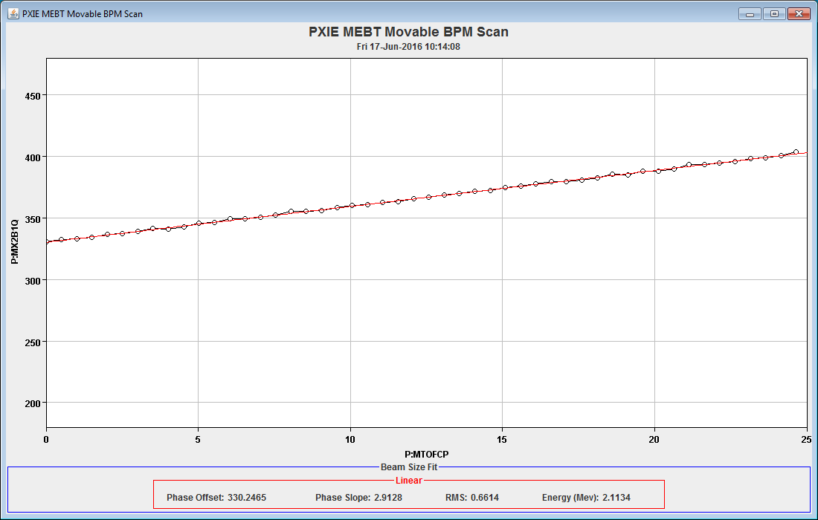
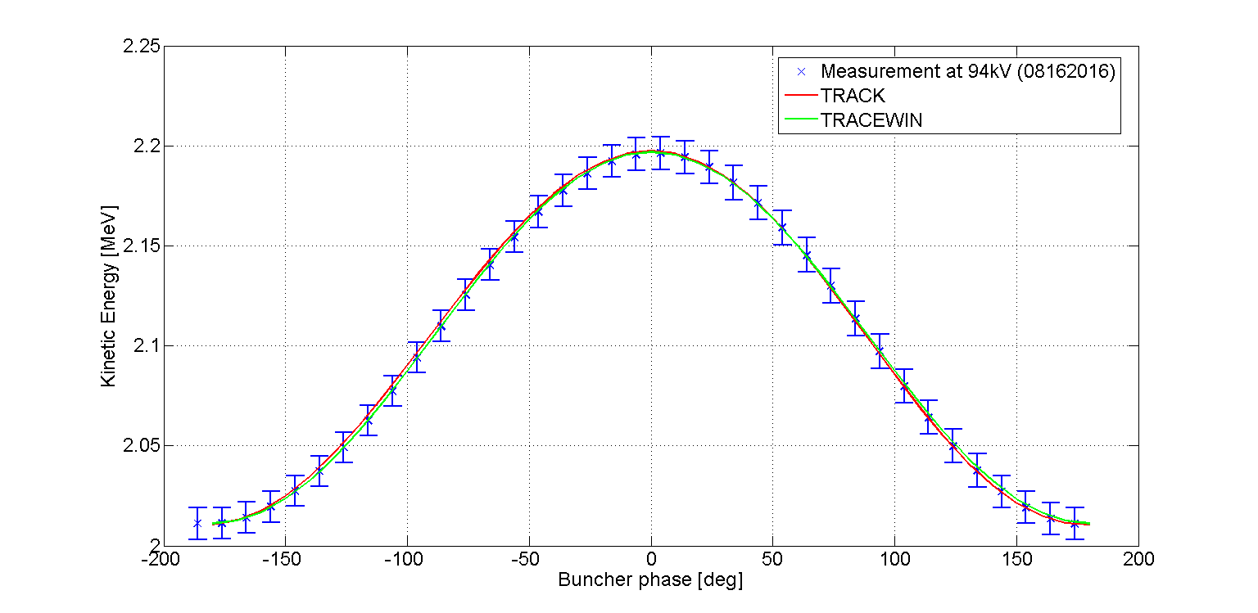
Beam Characterization
Energy Measurement:
  Time of Flight BPM
  2.11 MeV ± 0.5%
Preliminary : working to
understand calibrations
understand optics
understand uncertainties
Energy Measurement:
  Phase difference between 2 BPMs
  vary buncher cavity phase and compare to simulations
  90° is nominal vaue

Slide 23
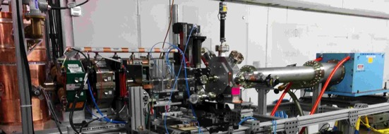
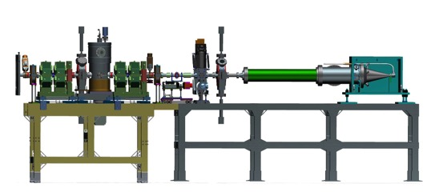
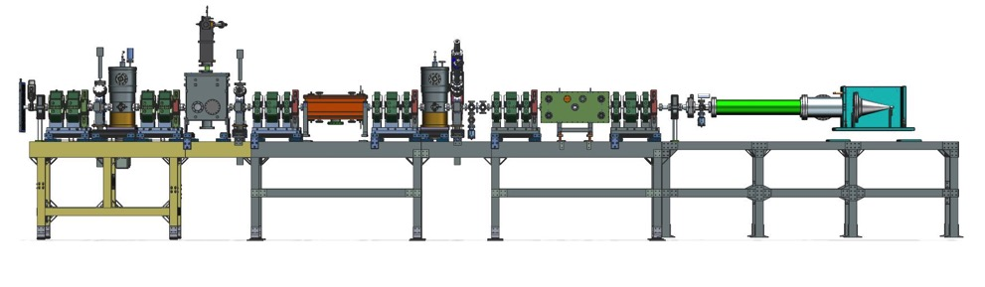
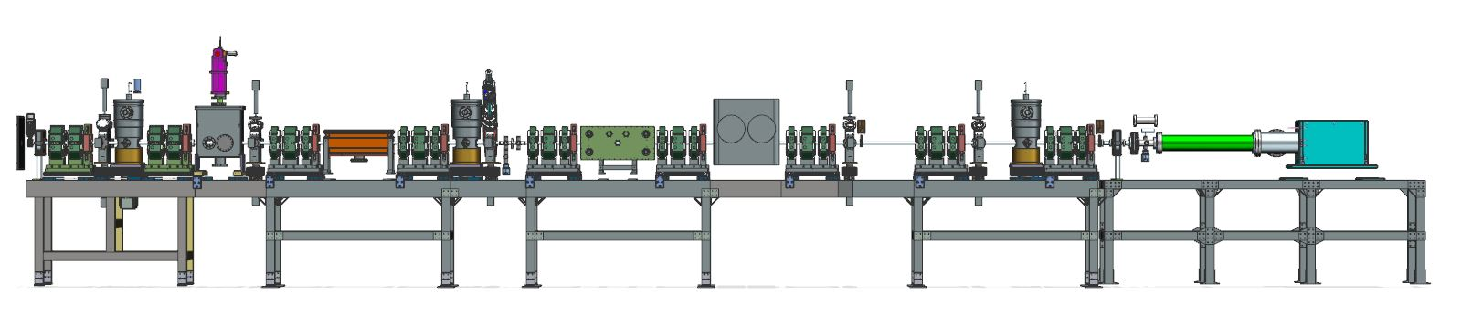
MEBT stages
MEBT is being installed in 3 main stages, different in the number of focusing elements
  Full-length MEBT is expected to be installed in 2017
MEBT-1
1175 mm
MEBT-2
MEBT-3

Slide 24
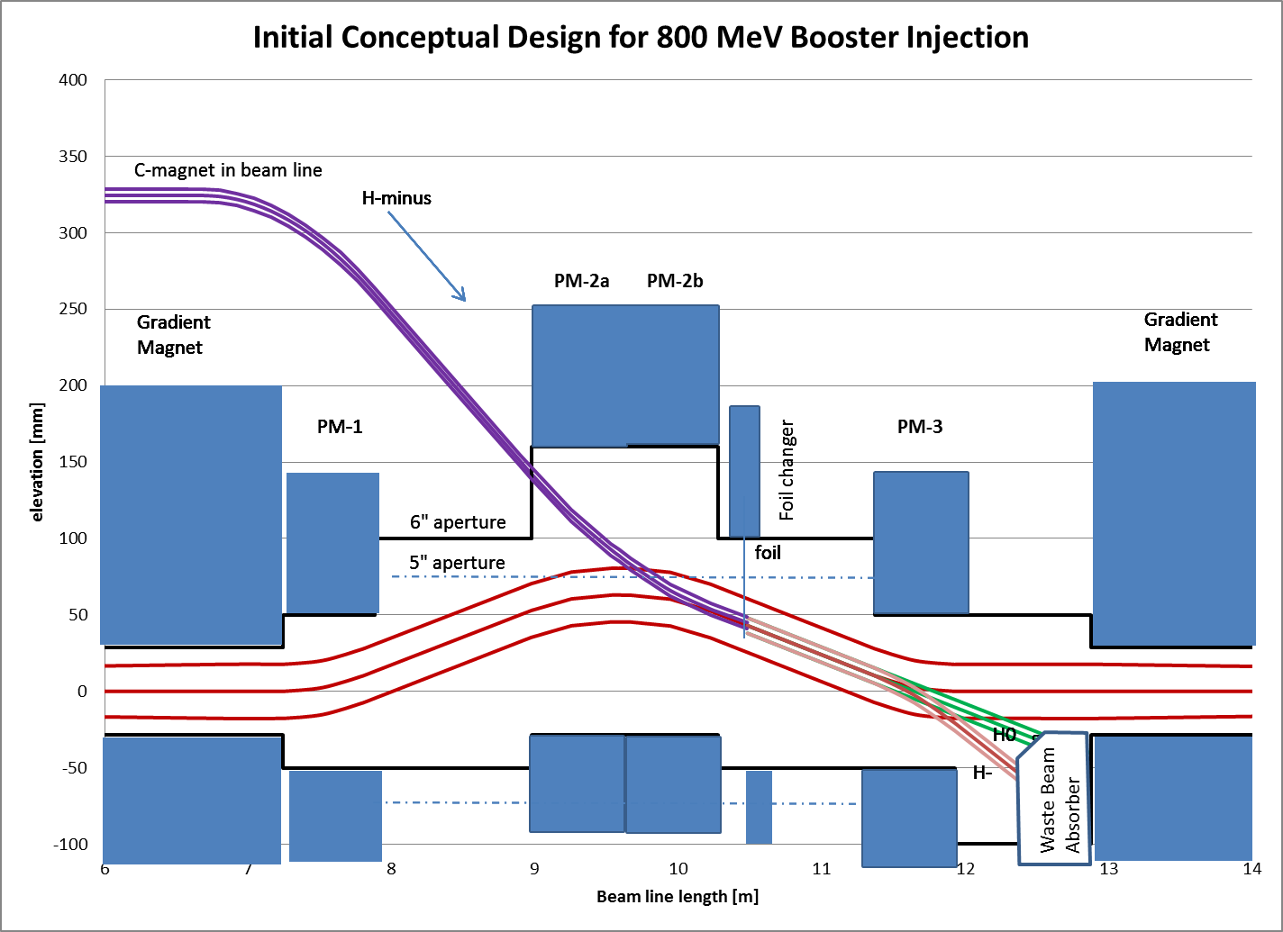
Booster: Injection
new injection point at Long 11, 3 or 4 bump
radiation deposition in area
  an H⁰/H⁻ absorber
  investigating new gradient magnet design to allow for larger absorber

Slide 25
Booster: 20 Hz
Booster is a resonant synchrotron at 15 Hz
  Changes to resonant system to get to 20 Hz
    have tested a single magnet successfully at 20 Hz
    Plan to build and test a complete Booster girder
      2 gradient magnets, choke, cap bank, & power supply
    complete by fall 2017
Controls and timing system built around 15 Hz as fundamental frequency
  understand what needs to be upgraded/modified
    Time Line Generator
    TCLK system
    DAQ front ends
    data collection and sampling

Slide 26
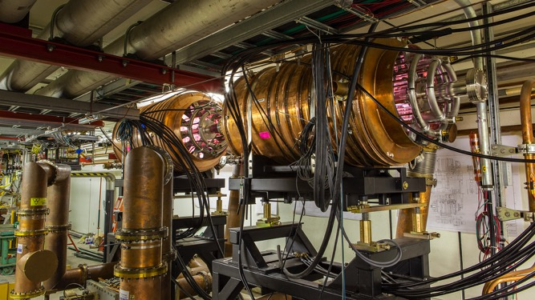
Recycler Ring
With 20 Hz operation and 60 GeV option for LBNF
  need a new 53 MHz RF cavity
    60 GeV option: increase in duty factor -> better cooling
    20 Hz operation: larger separation for slip stacking -> higher peak voltage
  Develop and build a prototype cavity by fall 2018
Beam dynamics and loss control

Slide 27
Main Injector
Two areas of R&D:
  RF Power:
    have enough voltage but PA does not have enough power for 7.5e13 ppp
    With existing cavity, two possible solutions
      use two power tubes (cavity has requisite ports) of current type
      use a single higher power tube
      With the spare cavity, investigate operation in test stand of both solutions
      ready for testing by the end of 2016
  Transition crossing: need a γ_{t} jump for loss control
    8 quad triplets to generate ±1 unit in 0.5 msec at transition
    build and test a prototype magnet and power supply by fall 2017
Notes:
Note: Valeri did not identify gammat jump in his talk (but I requested that he add it)

Slide 28
NB
two different approaches coming up
Should put in slide with Mission Statement (and make it look better)
  R&D ends with phase 1, phase 2 important for future scientific opportunities with PIP-II linac
  Then PIP2IT with Phase 1
  Move phase 2 into backups

Slide 29
PIP2IT: Deliverables
2015
Now
2017
2018
2019
30 keV
2.1 MeV
10 MeV
25 MeV
RFQ
MEBT
HWR
SSR1
HEBT
LEBT
40 m, ~25 MeV
PIP2IT will address the address/measure the following:
  LEBT pre-chopping : Demonstrated
  Vacuum management in the LEBT/RFQ region : Demonstrated
  Validation of chopper performance
    Bunch extinction, effective emittance growth
  MEBT beam absorber
    Reliability and lifetime
  MEBT vacuum management
  CW Operation of HWR
    Degradation of cavity performance
    Optimal distance to 10 kW absorber
  Operation of SSR1 with beam
    CW and pulsed operation
    resonance control and LFD compensation in pulsed operations
  Emittance preservation and beam halo formation through the front end
Collaborators
ANL: HWR
LBNL:LEBT, RFQ
SNS: LEBT
BARC: MEBT, RF
IUAC: SSR1

Slide 30
PIP2IT: Phases and Deliverables
2015
Now
2017
2018
2019
30 keV
2.1 MeV
10 MeV
25 MeV
RFQ
MEBT
HWR
SSR1
HEBT
LEBT
40 m, ~25 MeV
PIP2IT will address the address/measure the following:
Phase 2 (post-CD-3, off project?): retirement of risks associated with CW operations, in particular as related to utilization of the PIP-II linac for a second generation Mu2e experiment. The primary risks to be retired during this period may include:
  Full demonstration of the ability of the MEBT chopper to provide customized beam patterns at the bunch-by-bunch level
  Demonstration of the MEBT beam absorber at power levels up to 20 kW
  Demonstration of stable beam acceleration through the HWR and SSR1 cryomodules, with a beam current of up to 2 mA and at 100% duty factor
  Measurement of beam extinction provided by the MEBT chopper system, with a goal of 1E-9.
Collaborators
ANL: HWR
LBNL:LEBT, RFQ
SNS: LEBT
BARC: MEBT, RF
IUAC: SSR1

