Slide 1
Resource Loaded Schedule
Luisella Lari
DOE Independent Project Review of PIP-II
15 November 2016

Slide 2
Luisella Lari
PIP-II Associated Project Manager for Planning and Reporting Accelerator Division.
Relevant Experience:
  More than 15 years in scientific (PhD in Physics) and in project management (PMP certified) fields.
  In particular:
  Lead Planner for ESS Linac, ESS, Sweden;
  (> 50% in-kind contribution project)
  LHC Main Ring Installation Reference Planner, CERN, Switzerland;

Slide 3
Outline
Charge Item: #3
Steps performed to develop the RLS up-to-date;
The RLS defined as a Multi-Phases, Multi-Levels, Deliverables Oriented that integrates In-Kind Contributions;
The WBS for the whole PIP-II Project;
The systematic approach applied for all the RLS sub-projects;
RLS R&D status;
Some Examples of the RLS for major R&D sub-projects;
Next steps i.e. ready for CD-1;
Summary;

Slide 4
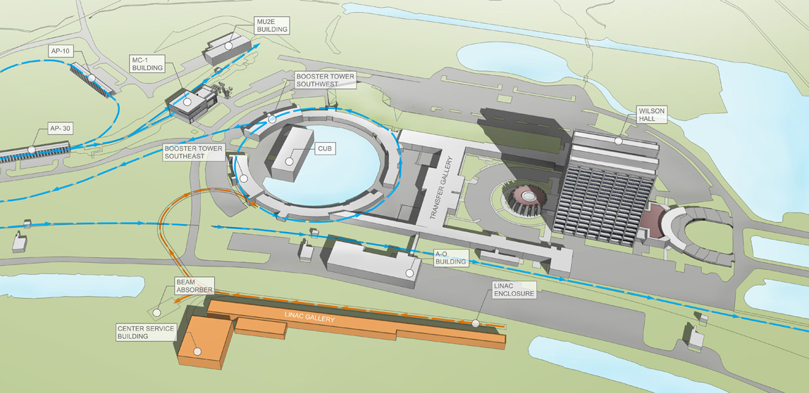




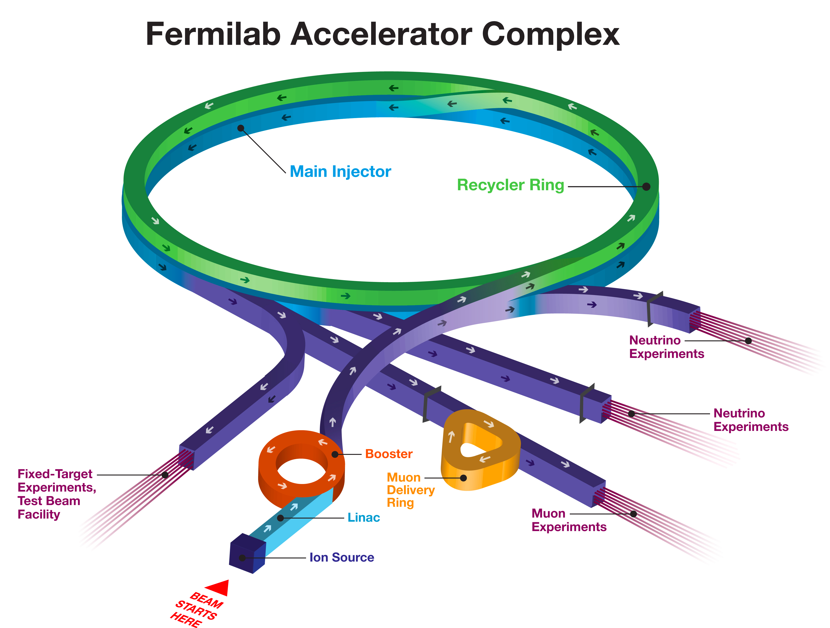

Steps Performed up-to-date (1/3)
The PIP-II Project requires a complex RLS
External Constraints
Deliverables from USA laboratories
FONSI
LBNF shutdown
Civil Engineering
In-kind Contributions
A new 800 MeV Linac
Upgrades of existing machines

Slide 5
Steps Performed up-to-date (2/3)
Since April 2016, the process to develop the RLS was started from CD-0. In details:
WBS for R&D and Construction phases defined;
Target dates i.e. Milestones technical oriented to complete the whole PIP-II Project in the timeframe foreseen defined;
High-level in-kind Milestones to be integrated into the plan identified;
R&D phase RLS scope of work and timeframe checked using a top-down and bottom-up approach;
R&D phase RLS developed, focusing on major R&D deliverables and using a systematic approach;

Slide 6
Steps Performed up-to-date (3/3)
Methodology applied to develop the PIP-II RLS:
The PIP-II WBS was developed as a best practice, following the field of competencies required;
L2 and L3 Managers were identified and assigned as responsible to each PIP-II sub-project (90% done) @ L2 and L3 of the WBS;
The major target dates were identified/proposed by the PIP-II management team;
Starting from R&D phase the RLS was developed, following technical constraints and DOE requirements, by the technical experts i.e. L2 and L3 Managers and me;
Iterate as necessary;
Once implemented in P6, the RLS was checked by the sub-project L2 & L3 managers, owners of the schedule;

Slide 7
The RLS definition (1/7)
The PIP-II RLS is a Multi-Phases, Multi-Levels, Deliverable Oriented plan developed with the scope of reporting to DOE the progress with respect to the DOE given budget.
Multi-Phases
R&D phase and Construction phase
T0, T1, T2, T3, T4 Milestones and Different Levels of Responsibilities for the PIP-II Managers
Multi-Levels
Working schedule @ Level 4 that includes all the major technical deliverables from Fermilab (T4) and from In-kind partners (I4)
Deliverable Oriented

Slide 8

The RLS definition (2/7)
High Level Milestones
T4
3 m
T3
Working schedule
PM
6 m
T2
1 y
DOE Fermi
T1
DOE direction / 2.5y
T0

Slide 9
The RLS definition (3/7)
The PIP-II RLS is a Multi-Phases, Multi-Levels, Deliverable Oriented plan developed with the scope of reporting to DOE the progress with respect to the DOE given budget.
Multi-Phases
R&D phase and Construction phase
T0, T1, T2, T3, T4 Milestones and Different Levels of Responsibilities for the PIP-II Managers
Multi-Levels
Working schedule @ Level 4 that includes all the major technical deliverables from Fermilab (T4) and from In-kind partners (I4)
Deliverable Oriented

Slide 10
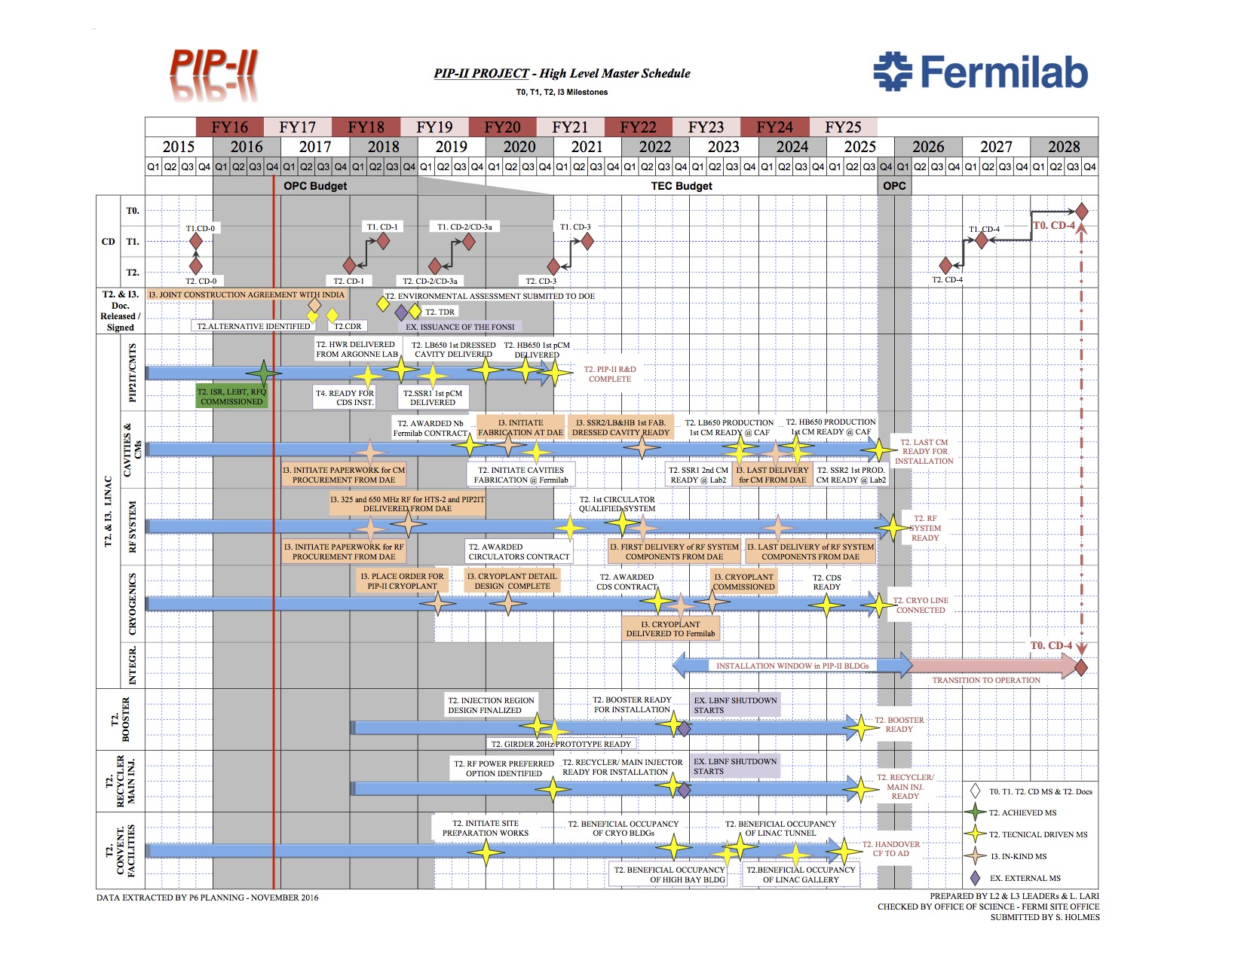
The RLS definition (4/7)
High Level Master Schedule (T0, T1, T2, I3 & External MS)
OPC budget covers conceptual design and “Phase 1” PIP2IT scope of work, i.e. R&D phase, as well as commissioning associated costs.
TEC budget covers construction and installation costs i.e. Construction phase.

Slide 11
The RLS definition (5/7)
The PIP-II RLS is a Multi-Phases, Multi-Levels, Deliverable Oriented plan developed with the scope of reporting to DOE the progress with respect to the DOE given budget.
Multi-Phases
R&D phase and Construction phase
T0, T1, T2, T3, T4 Milestones and Different Levels of Responsibilities for the PIP-II Managers
Multi-Levels
Working schedule i.e. Early dates @ Level 4. It includes all the major technical deliverables from Fermilab (T4) and from In-kind partners (I4)
Deliverable Oriented

Slide 12
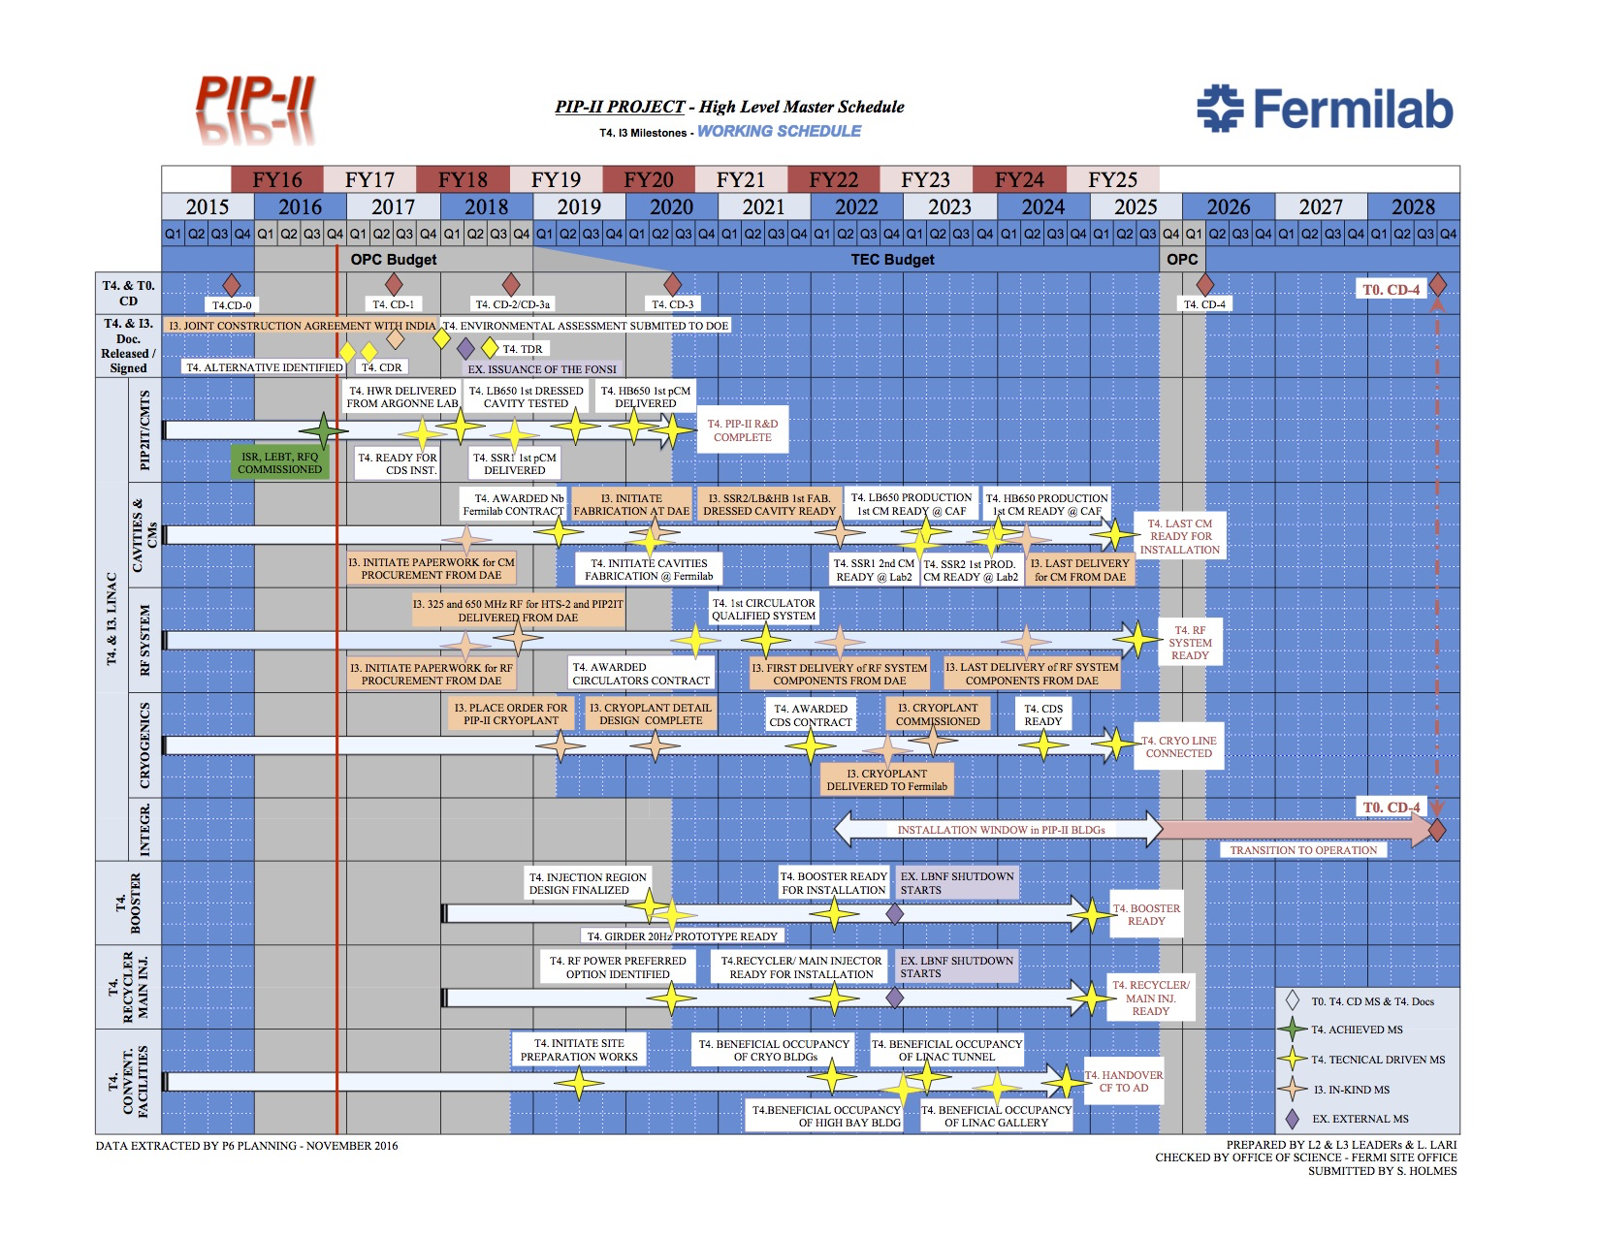
The RLS definition (6/7)
Early dates
High Level Working Schedule (T4, I3 & External MS)
NB: In-kind Milestones are @ the same dates as High Level Master Schedule

Slide 13
The RLS definition (7/7)
The links between Master / Working and P6 schedule:
Late Dates
Early dates
6 m floating between T2 & T4 Milestones
On-going: Each T4 Milestones date is verified through the development of the detailed RLS

Slide 14
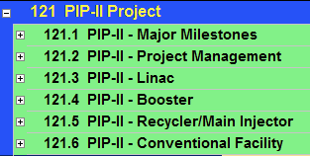
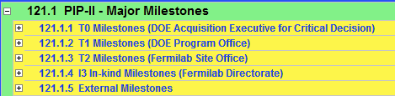
The PIP-II WBS in P6 (1/5)
Level 1 in P6
Level 2 in P6
WBS @ L2
→L2 Managers
Following the directions of the Fermilab Office of Project Support Services (OPSS):
Guidelines for Developing Schedule MS - Doc#12.PM-004.DT-03

Slide 15
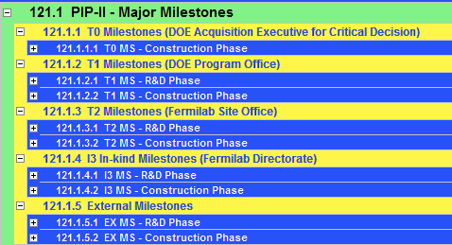
The PIP-II WBS in P6 (2/5)
Charge Item: #3
Jacobsen
Level 3 & 4 in P6
Reminder:
OPS budget is associated to R&D phase
TEC budget is associated to Construction Phase
[See C. Jacobsen presentation]

Slide 16
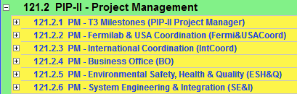
The PIP-II WBS in P6 (3/5)
121.2 Project Management
Identified >120 T3 Milestones,
(excluding the T2 Milestones @ T3 level):
They are mainly “Ready For Installation” Milestones
i.e. delivery dates of the major equipment on-site before the final installation in the PIP-II buildings

Slide 17
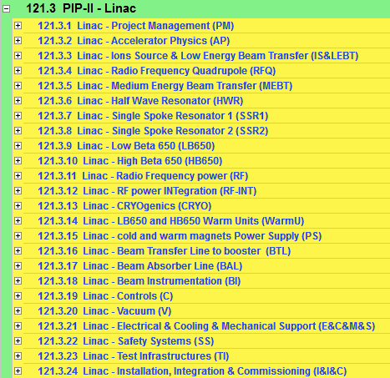
The PIP-II WBS in P6 (4/5)
121.3 Linac
WBS @ L3 →L3 Managers
Construction phase
R&D phase

Slide 18


The Systematic Approach @ lower WBS
Charge Item: #3
Jacobsen
Chargeable Task Codes (CTC) mapping starts at this level
Roll-up to Control Account following the WBS aligned with potential CAM
[see slide 16 – C. Jacobsen presentation]
This approach helps during EVMS analysis

Slide 19
RLS R&D status (1/2)
The P6 PIP-II RLS starts with the release of funds after CD-0 i.e. Jan 2016
The RLS development for the R&D phase is starting:
For FY16 → The P6 R&D RLS covers exactly the costs and the technical achievements
For FY17 → The P6 R&D RLS will check the budget for M&S and for FTEs
> FY18 → The P6 RLS is developed as first as technical oriented and then tuning to try to match the given budget profile, if possible.

Slide 20

RLS R&D status (2/2)
Covering 70% of the R&D budget

Slide 21
RLS R&D status – Examples (1/5)
The scope of the following 2 examples is to show you that the systematic approach can be applied to any PIP-II sub-projects and it helps to easily identify area in the RLS that can potentially subject to changes/revisions during EVMS analysis.

Slide 22
RLS R&D status – Examples 1 – CF (2/5)
Time window:
From: T4 MS - Release of 2016 funds after CD-0 approval (1st JAN 2016)
Until: T4 MS - CD-2 Early date
Tot 6 Contracts with Fermilab pre-qualified vendors
3 already opened
1 to be open for detail design
2 consultant contracts
1 FTE → S.Dixon
3 Major MS to complete:
T4 MS - Documentation & Drawings ready for CDR
T4 MS - Documentation & Drawings ready for CD-1 – End of Preliminary Design
T4 MS - Documentation & Drawings ready for TDR
T4 MS - Documentation & Drawings ready for CD-1 – End of Detail Design
No In-Kind

Slide 23
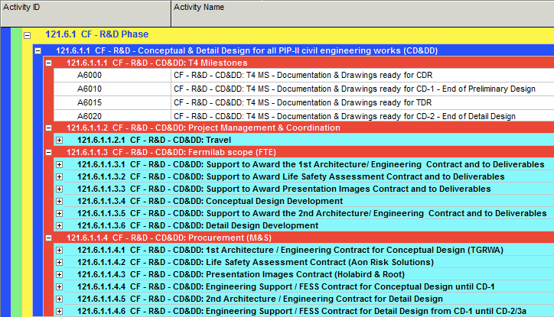
RLS R&D status – Examples 1 – CF (3/5)

Slide 24
RLS R&D status – Examples 2 – SSR1 (4/5)
Time window:
From: T4 MS - Release of 2016 funds after CD-0 approval (1st JAN 2016)
Until: T4 MS – SSR1 first prototype CM delivered for PIP2IT
Contracts:
13 major contracts to be opened using OPC funds (=R&D phase)
FTE profile: ~11 FY16, ~11 FY17, ~9 FY18
13 Major MS to complete for the 1st SSR1 prototype:
T4 MS – 1st Dressed Cavity Qualified (x 8)
T4 MS – 1st IIFC Dressed Cavity Qualified (x 2)
T4 MS – SSR1 String assembled
T4 MS – SSR1 Cold Mass Assembled
T4 MS – SSR1 first prototype CM delivered for PIP2IT
In-kind:
I4 MS – Delivery of 2 IIFC Jacketed Cavities

Slide 25
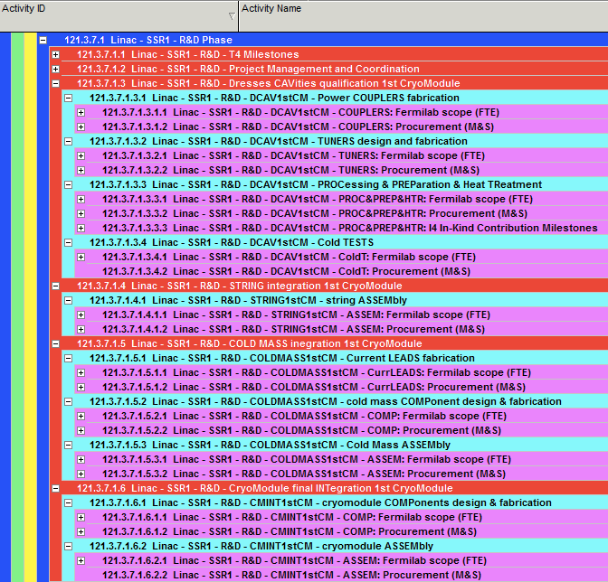
RLS R&D status – Examples 2 – SSR1 (5/5)
For a better lecture T4 Milestones and PM/Coordination is put on top

Slide 26
RLS Next steps → to CD-1
Precondition: The Learning Curve is almost over;
The next steps to be complete before CD-1 for RLS are:
Complete the R&D RLS;
Check the budget profile for FY17, FY18, FY19, FY20;
Develop the RLS for Construction Phase, meeting the early technical driven target dates;
Check the staff plan for Construction Phase;
Compare the results with the proposed budget profile, including obligations and contingency per years;

Slide 27
Summary
WBS established for the full project, including R&D and Construction phases;
PIP-II RLS development is on-going, starting with R&D phase;
Technical oriented target milestones are identified for R&D and Construction Phases;
In-kind deliveries are/will be integrated/linked in the PIP-II RLS, in such a way that they can potentially drive the schedule variance;
A systematic approach is used to develop the PIP-II RLS. It helps during the activities definition and it can be applied independently by the scope of the different PIP-II sub-projects. Moreover this configuration helps to prevent major modifications, if required as following EVMS analysis;
A complete RLS is achievable for CD-1;

