Slide 1
Conventional Facilities
Steve Dixon
DOE Independent Project Review of PIP-II
15 November 2016

Slide 2
Steve Dixon
Charge Item: #4
PIP-II Associate Project Manager for Civil Construction
Relevant Experience
Licensed Architect;
Project Management Professional (PMP);
LEED Accredited Professional;
24+ years at Fermilab;
NOvA Project L2 Manager for Site and Buildings;
General Plant Project Manager
Short Baseline Neutrino (SBN) Near Detector Building;
Short Baseline Neutrino (SBN) Far Detector Building;
CDF Refurbishment;
Experimental Operations Center;

Slide 3
Outline
Construction Phase Scope of Work
R&D Phase Goals
R&D Status
R&D Schedule to Complete
IIFC Interface
Summary

Slide 4
Construction Phase Scope of Work
Charge Item: #2
Conventional Facilities to Support PIP-II:
Site Work
Utilities (electrical, communication, ICW, DWS, sanitary, chilled water);
Site Improvements (roads, parking area, hardstands, tank foundations);
Linac
Below Grade Enclosure;
Linac Service Building;
Transport Line
Transport Line Enclosure;
Beam Absorber Enclosure;
Connection to existing Booster;
Cryo Plant Building
Mechanical Plant

Slide 5
R&D Phase Goals
Conceptual Design:
Conceptual Design Report Text;
Conceptual Design Drawings;
Life Safety Analysis
Support Analysis of Alternates
Support NEPA Process
Prepare for CD-1
R&D Phase resource loaded schedule
Construction Phase resource loaded schedule
Prepare for CD-2/3a
Advanced Preliminary Design for Site Prep work
Advanced Preliminary Design for Cryo Plant Building

Slide 6
R&D Phase Goals and Status
Conceptual Design:
Conceptual Design Report Text; - Draft Complete
Conceptual Design Drawings; - 95% Complete [1]
Life Safety Analysis - Draft Complete [2]
Support Analysis of Alternates – Complete
Support NEPA Process - Ongoing
Prepare for CD-1 – Ongoing
R&D Phase resource loaded schedule - Complete
Construction Phase resource loaded schedule – Ongoing
Prepare for CD-2/3a – Not started
Detailed Design for Site Prep work
Detailed Design for Cryo Plant Building
[1] – Conceptual Design Drawings can be found in TeamCenter ED0005473
[2] – Draft LSA can be found at PIP-II-doc-120
Charge Item: #1
Charge Item: #1
Charge Item: #5
Charge Item: #2

Slide 7
Conceptual Design Process
Meetings with Stakeholders:
Goal: Document the spatial and infrastructure requirements for PIP-II facilities;
Started in January 2016;
Product was the Conceptual Design drawings and text;
Results:
Developed cooling strategies for pulsed mode and continuous wave operation;
Conventional facilities are similar to typical Fermilab construction;
Backup material has additional details

Slide 8
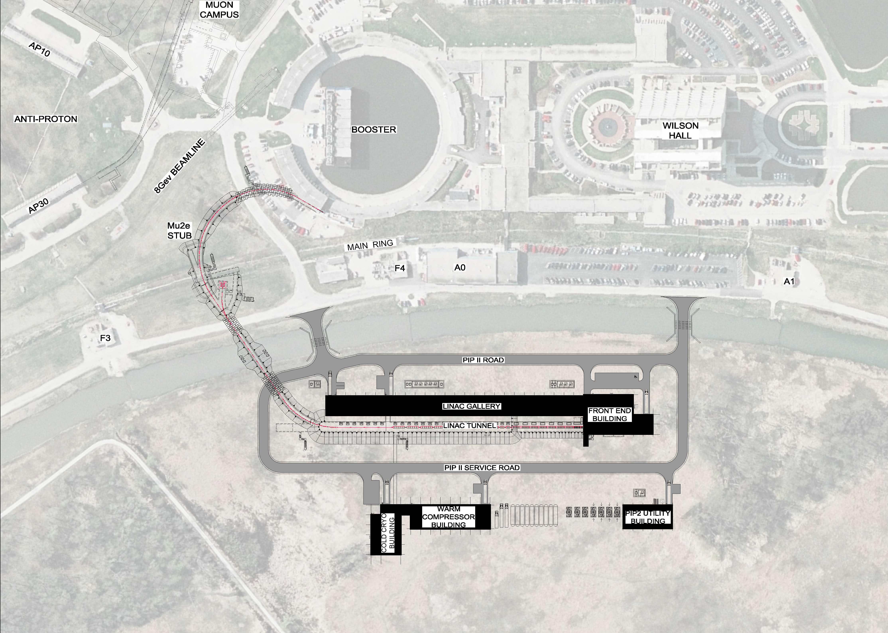
R&D Status – Overview
Booster
Tevatron
Beam Absorber
Transport Line
Linac
Cryo Plant
Utility Building

Slide 9
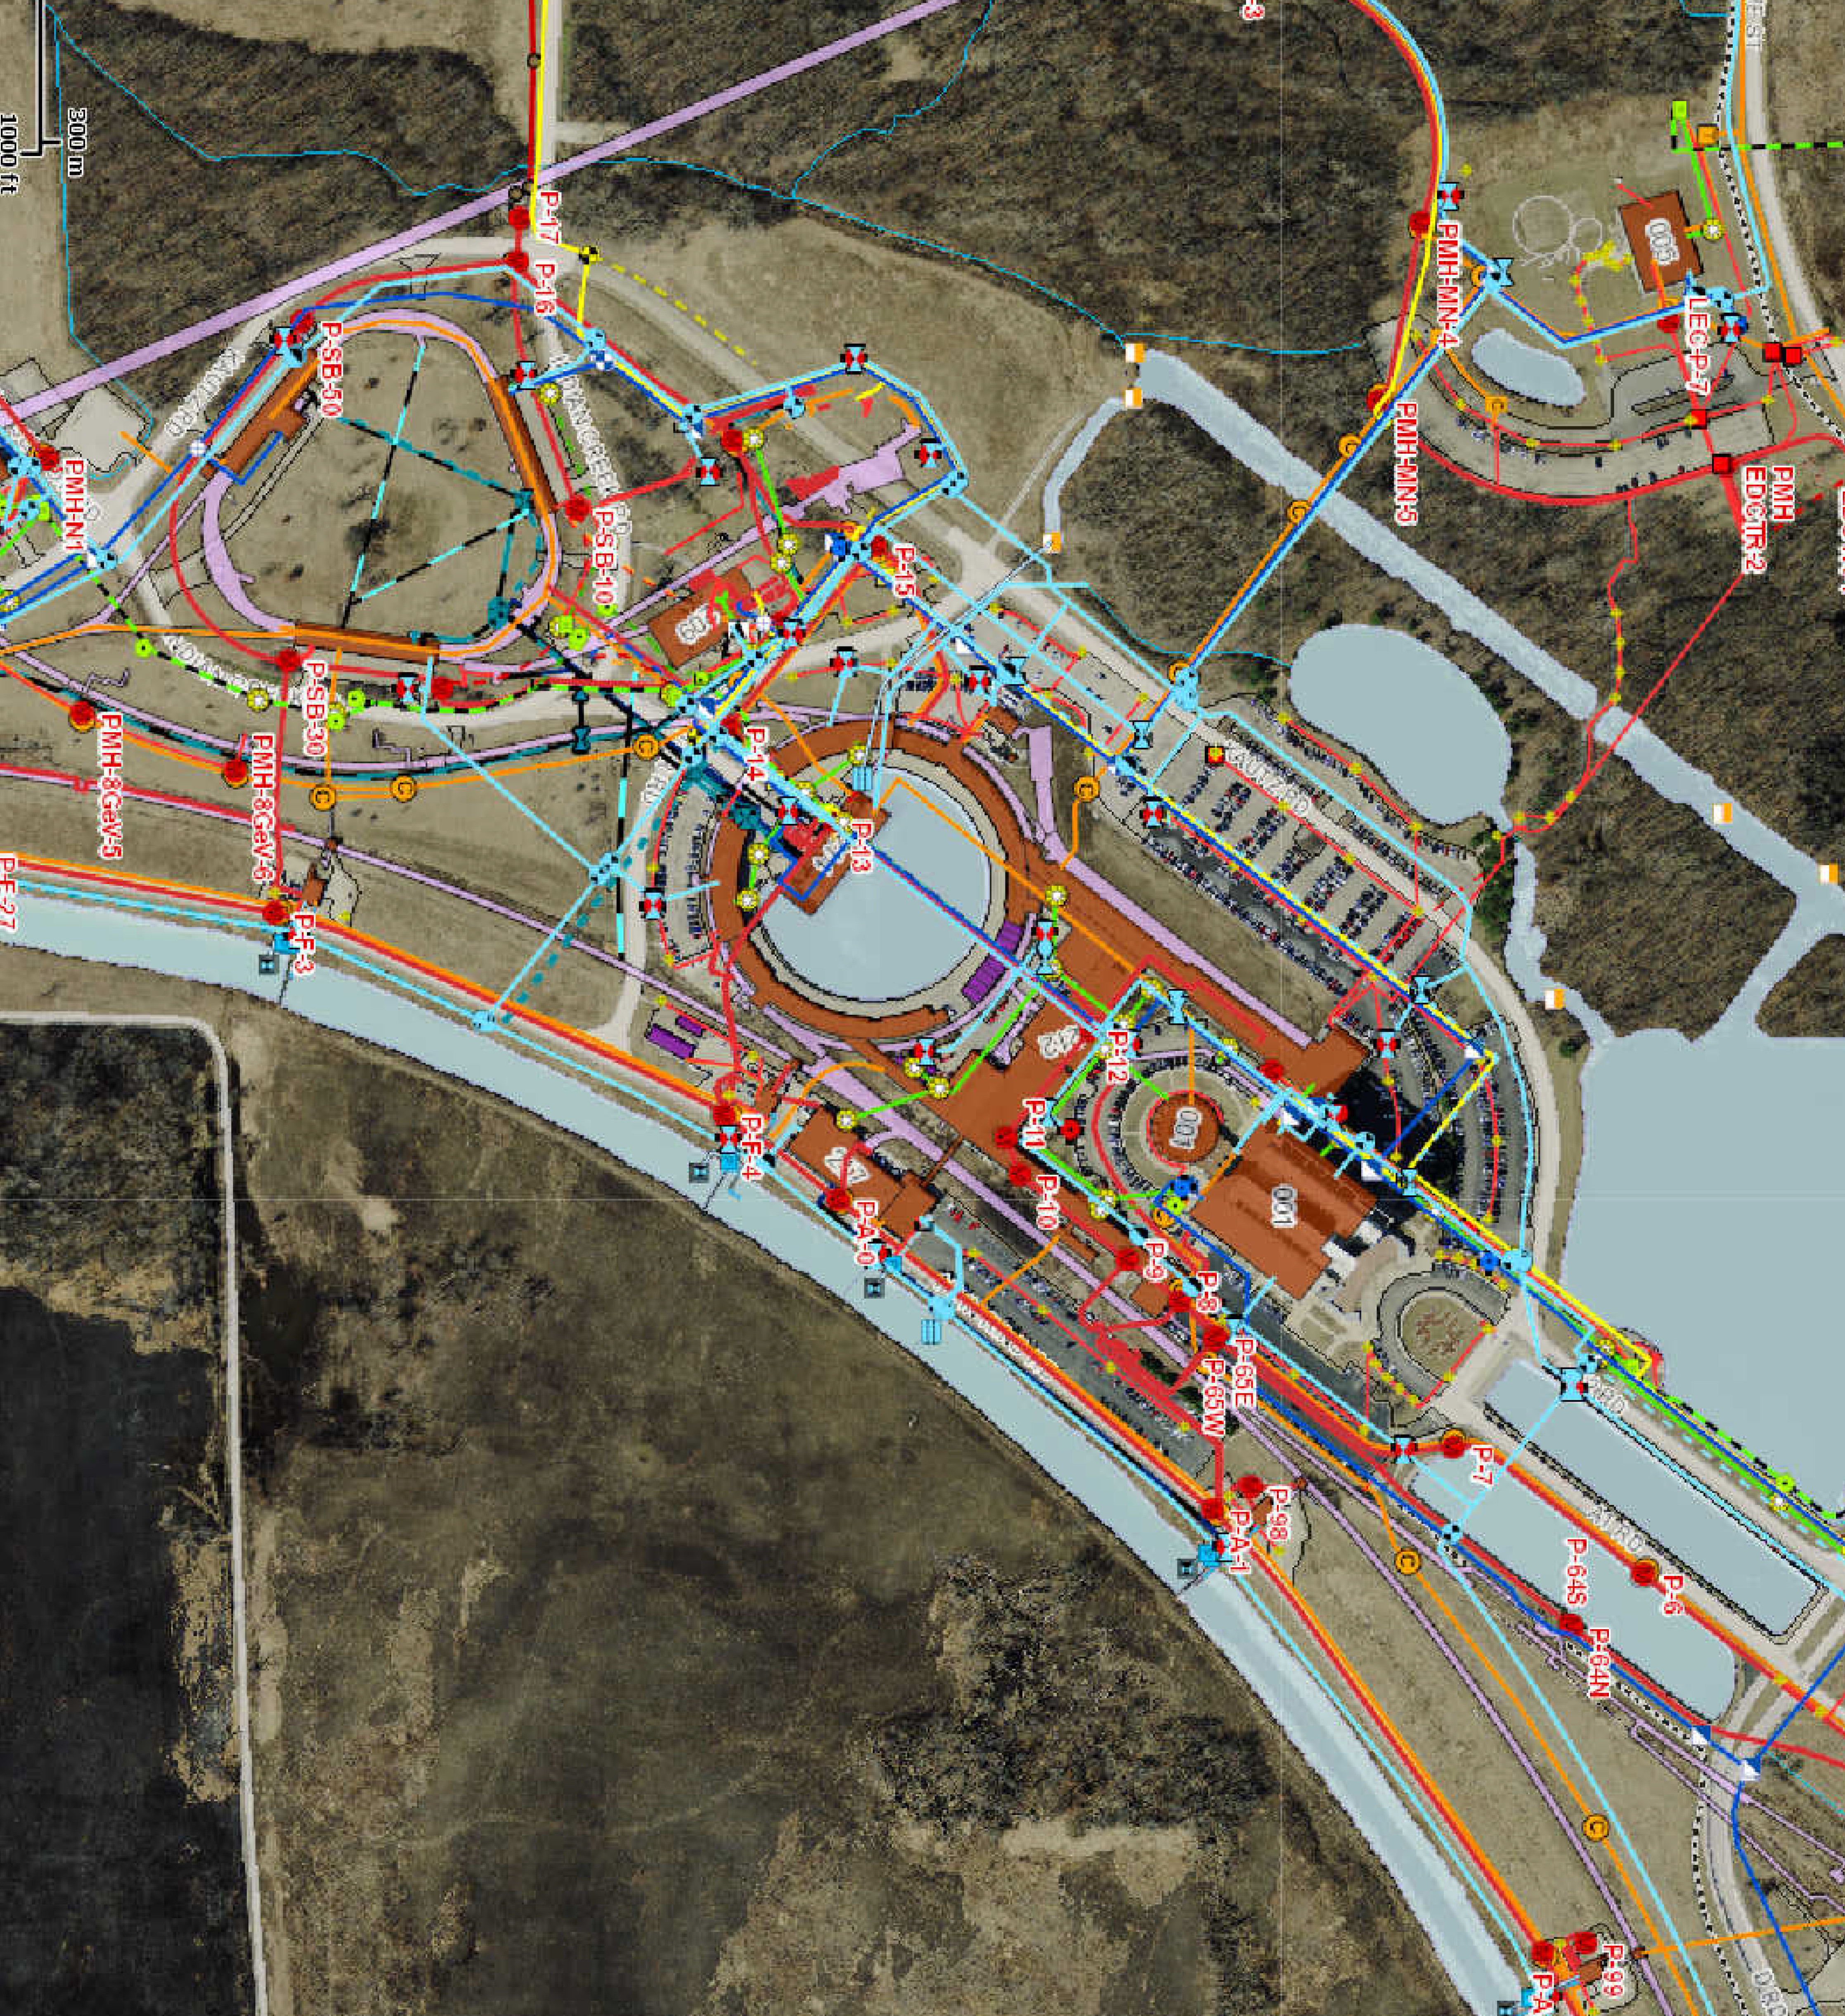
R&D Status – Siting Considerations
Existing Utilities
and Services
Accommodating Future Expansion:
Siting;
Space in Linac for additional cryomodules;
Stub for Linac extension;
Stub for beamline to Muon Campus;
Location of Cryoplant
Size of Linac Enclosure (ongoing)
Site Plan with Possible Future Expansion

Slide 10
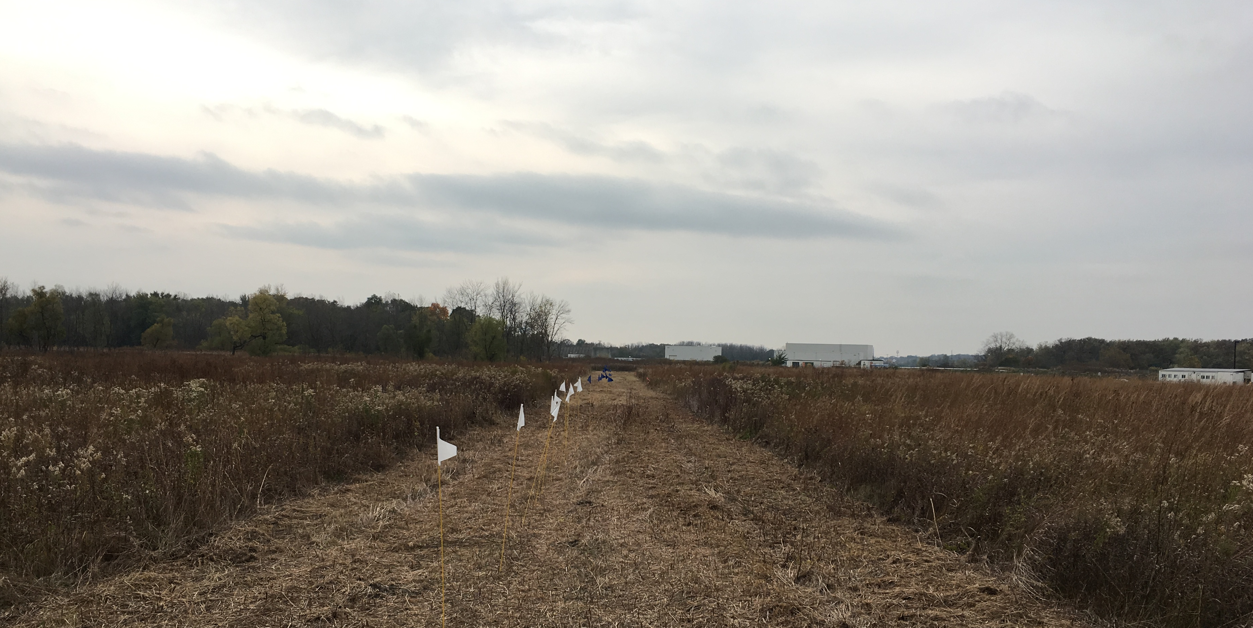
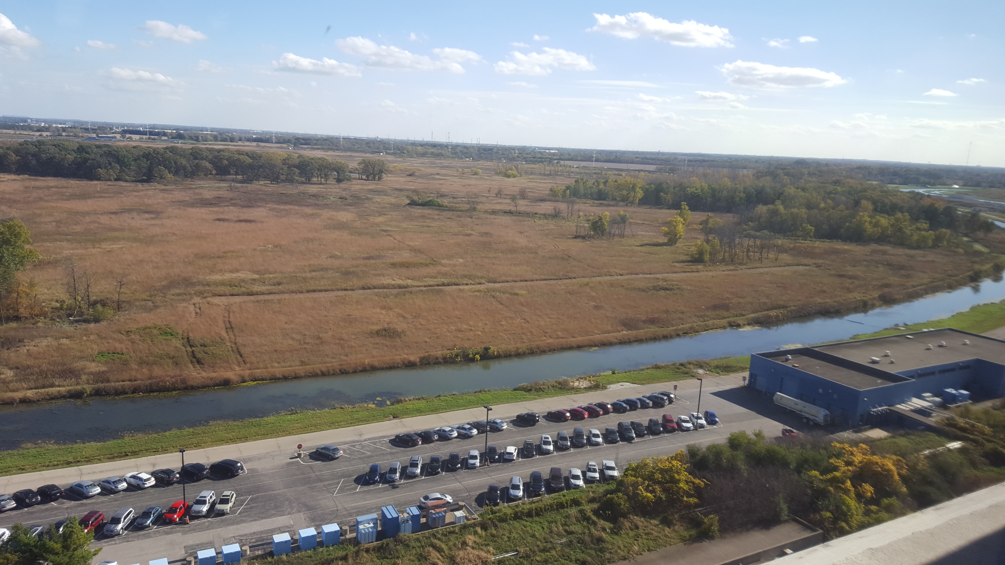
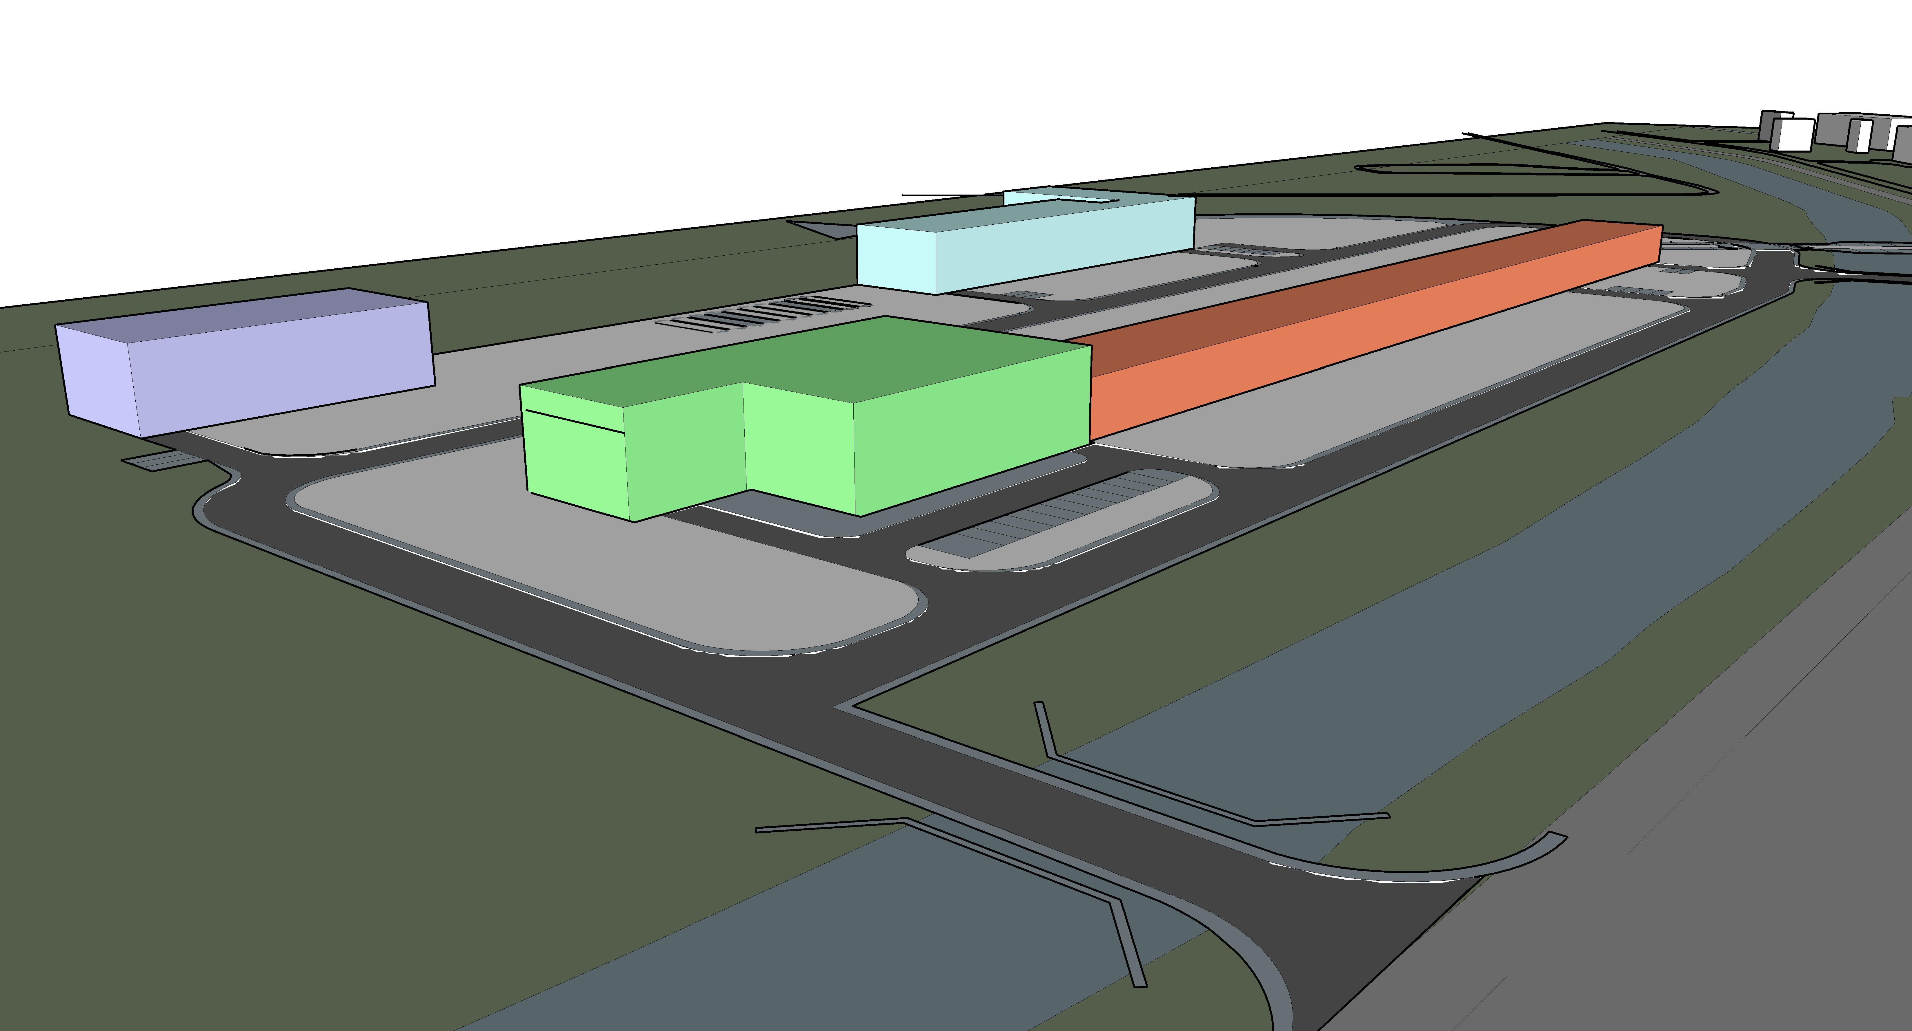
R&D Status
White Flags = Warm Components
Blue Flags = Cold Components
Linac
Looking South Along Beamline
AZero Service Building
Tevatron Enclsoure Berm
Looking Southeast From Wilson Hall
Cryo Plant Building
Utility Building
Linac Service Building
Surface Building Massing

Slide 11
R&D Status Typical Linac Cross Section
Cryo Zone
1’-10”
Aisle
LCW Zone
1’-10”
Aisle
RF Zone

Slide 12
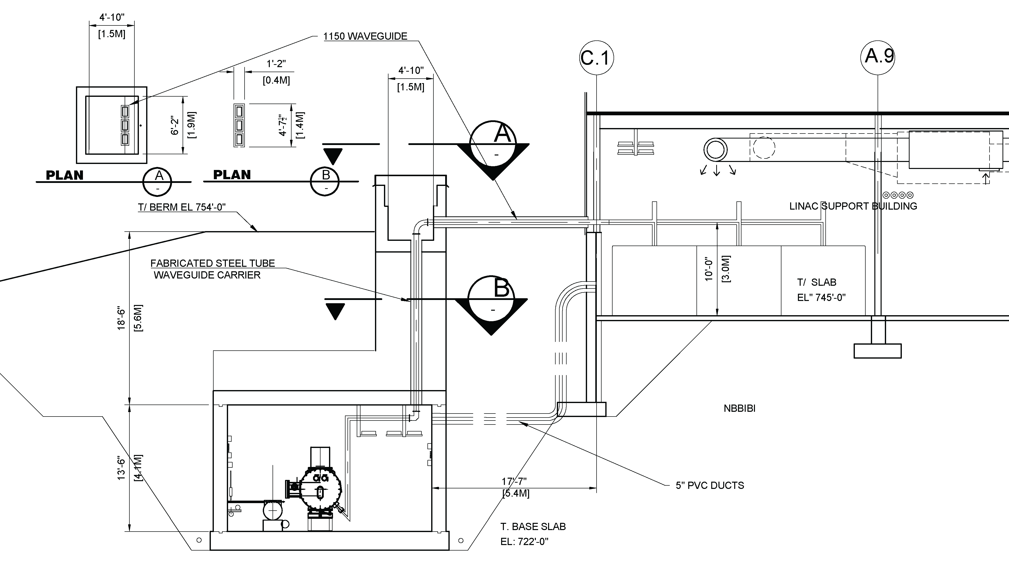
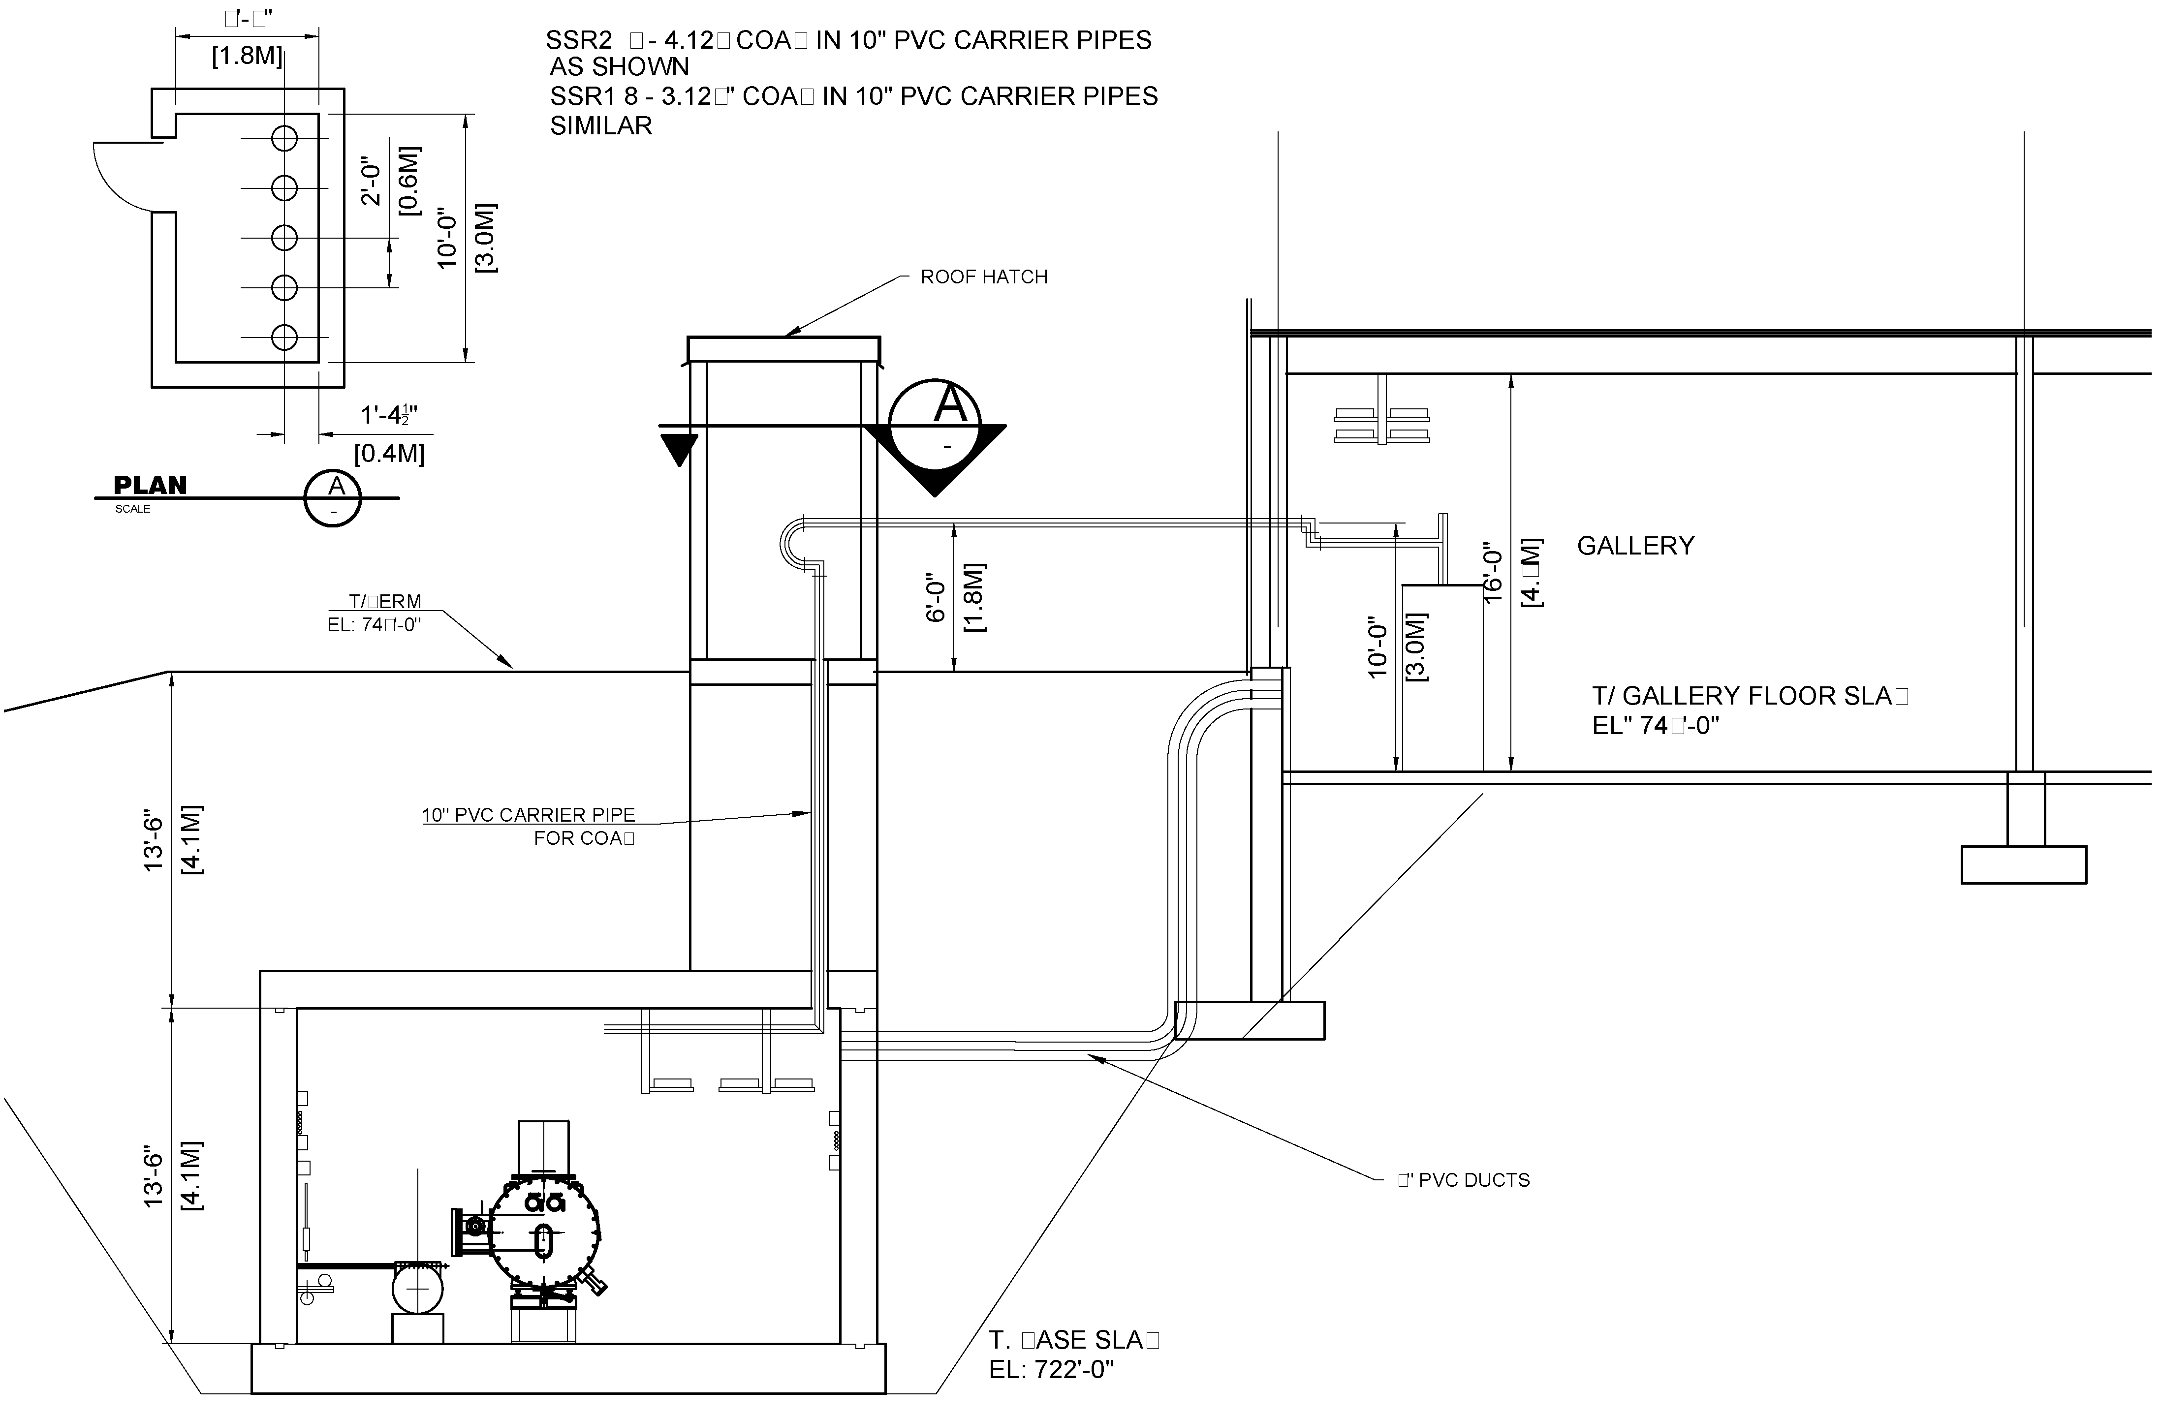
R&D Status – Linac Plan
Public Participation: Viewing Gallery
Cross Section Looking South at Waveguide Penetrations
Cross Section Looking South at Coax Penetrations

Slide 13
R&D Status – Main Ring/Transport Line

Slide 14
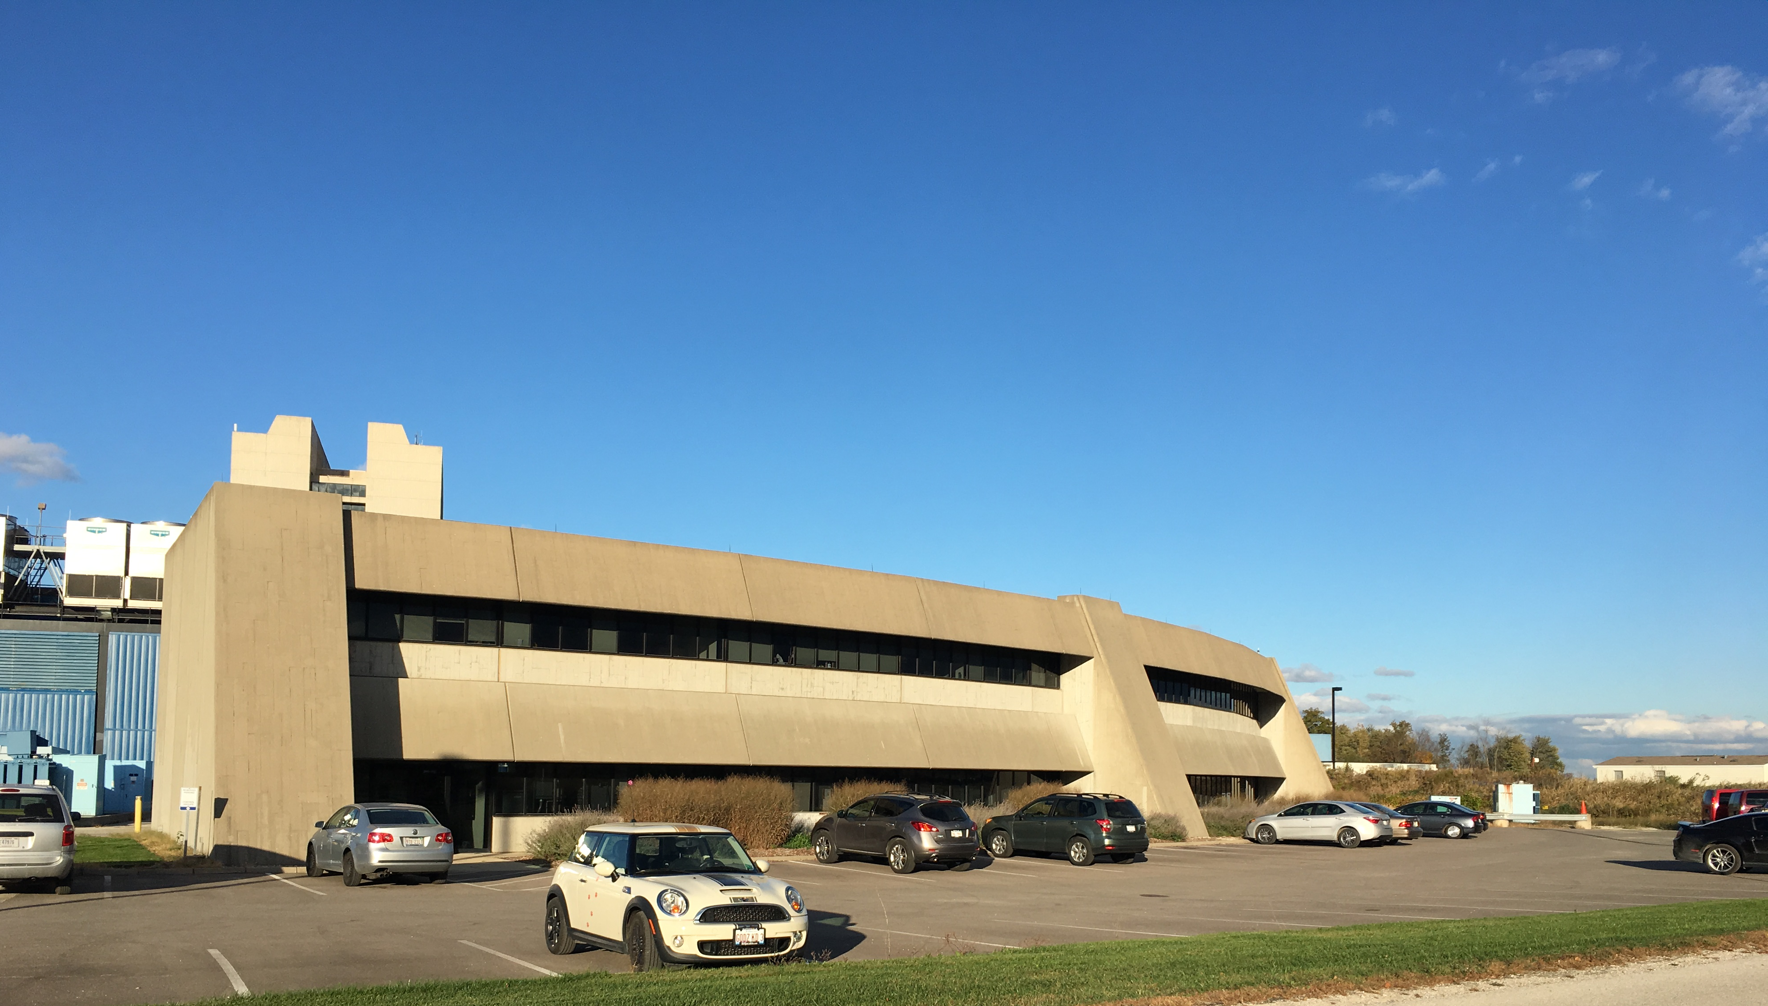
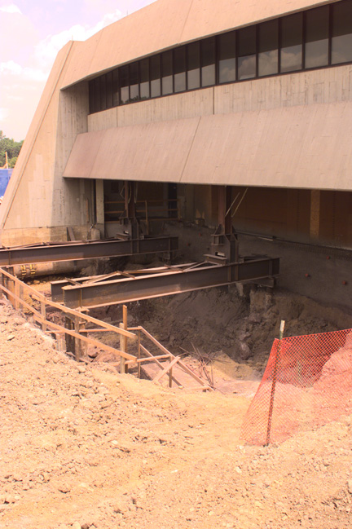
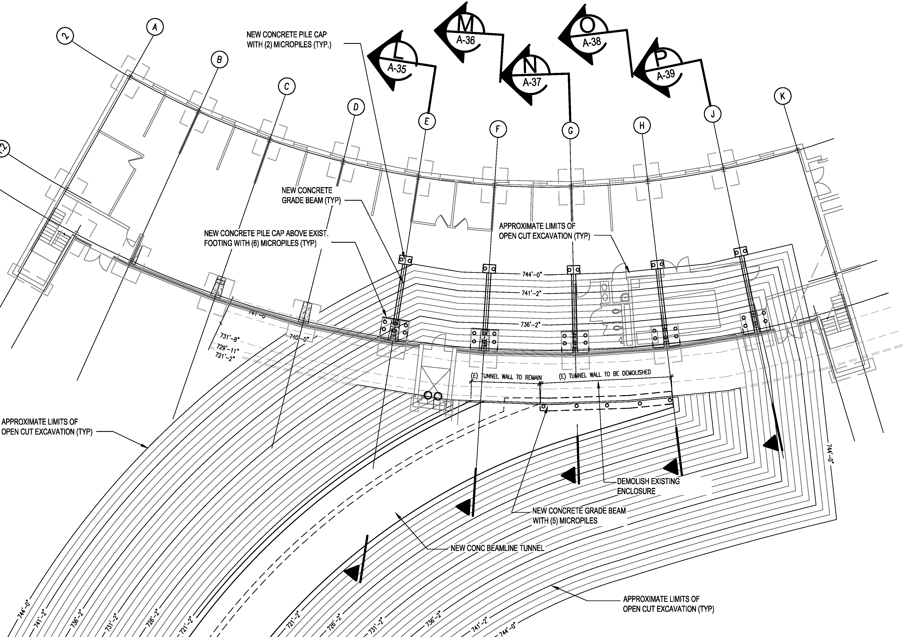
R&D Status – Transport Line/Booster
Looking Northeast Towards Booster Tower East
Booster Tower West
Shielding Upgrade - 1998
Excavation Plan at Booster Tower East

Slide 15
R&D Status – Cryo Plant
68m (225’)
Distance to Linac
Tank Farm
Warm Compressor Station
Risk: Cryoplant induced ground motion and superconducting cavity detuning. LCLS-II Engineering Note [3] recommended distance (30m) and isolated foundations for compressors.
Cold Box Station
[3] – Engineering Note LCLSII-4.8-EN-0326-R0 can be found at PIP-II-doc-122

Slide 16
R&D Status – Utility Building

Slide 17
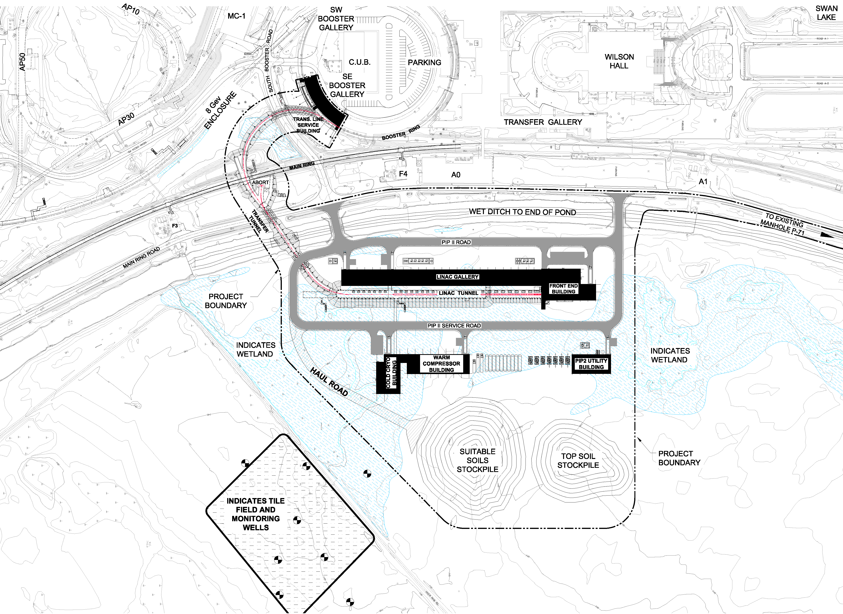
R&D Status – Support NEPA
Charge Item: #5
V. Kuchler
Construction Stockpiles
Site Plan with 2016 Wetland Delineation

Slide 18
R&D Phase Schedule to Complete
FY19 : Final Design begins (includes Site Prep)
FY18:Begin Detail Design for Site Prep package
FY17:Select an Architect/Engineer;
Update the drawings;
Refine cost estimate;
Notes:
Conceptual Design:
Update the Conceptual Design Report Text;
Complete the Conceptual Design Drawings;
Incorporate Life Safety Analysis Recommendations;
Support NEPA process;
Continue to refine and document requirements;
Select an Architect/Engineer;
Update the drawings;
Refine cost estimate;
Prepare for CD-1
Prepare for CD-2/3a
Advanced Preliminary Design

Slide 19
IIFC Interface
Charge Item: #4
Accommodate the cryo plant equipment
Interface is with Cryogenics Department (Arkadiy)

Slide 20
Summary
Technical Design is based in iterative discussions and meetings with stakeholders and the conceptual design of the conventional facilities can meet the specified technical performance requirements;
The scope of the conceptual design for the conventional facilities is sufficiently well defined to support the preliminary cost and schedule estimates;
The cost estimate will be refined in the coming month as part of the early tasking of the architect/engineer (A/E);
To date, the conventional facilities portion has been accomplished by a combination of in-house staff supplemented with consultants. This effort will continue with an A/E firm in FY17;
Conventional facilities has been involved with ES&H activities to date and will continue to be in the coming stages;
The IIFC interface for the conventional facilities is primarily the cryo plant and this interface is well defined;

Slide 21
Backup Material

Slide 22
Stakeholders:
Fermilab:
Alessandro Vivoli, Anindya Chakravarty, Anthony F Leveling, Arkadiy L Klebaner
Beau F. Harrison, Curtis M. Baffes, David E Johnson, David W Peterson
Don Cossairt, Donald V Mitchell, Emil Huedem, Jim Niehoff, Fernanda G Garcia
Jerry R Leibfritz, Jerzy Czajkowski, John E Anderson Jr, Luisella Lari
Matthew Quinn, Maurice Ball, Paul Derwent, Ralph J Pasquinelli
Todd M Sullivan, Valeri A Lebedev, William A Pellico
Consultants:
Tom Lackowski, TGRWA
Ron Jedziniak, LG Associates
Rick Glenn, Jensen Hughes

Slide 23
Meeting Minutes (PIP-II-doc-70)
01 - Coordination Meeting - 17FEB16 (pdf)
02 - Cryogenic Department Meeting 19FEB16 (pdf) – Cryo Meeting
03 - Coordination Meeting - 02MAR16 (pdf) – Linac Enclosure
04 - Coordination Meeting - 09MAR16 R1 (pdf) – Linac Enclosure and Cooling
05 - Coordination Meeting - 24MAR16 R1 (pdf) – Linac Enclosure and Cryo Plant
06 - Cryo Coordination Meeting - 01APR16 (pdf) – ICW Cooling and Cryo
07 - Coordination Meeting - 14APR16 (pdf) – Penetrations and Cooling Strategy
08 - Coordination Meeting - 28APR16 (pdf) – Cooling Strategy
09 - Coordination Meeting r1 - 12MAY16 (pdf) – Shielding and Transport Line
10 - Coordination Meeting - 09JUN16 (pdf) – Shielding Summary
11 - Coordination Meeting - 07JUL16 (pdf) – RF Distribution and LCW Cooling
12 - Coordination Meeting - 21JUL16 (pdf) – High Bay Equipment
13 - Coordination Meeting - 04AUG16 (pdf) – Cryo Summary and Linac Gallery
14 - Coordination Meeting - 15SEP16 (pdf) – Sitewide Electrical Distribution

Slide 24
Drawings (TeamCenter ED0005473)
54 Drawings
One (1) General sheet
Six (6) Civil sheets
Forty-Three (43) Architectural sheets
Three (3) Mechanical sheets
One (1) Electrical sheet

Slide 25
Typical Design Basis Sheet

Slide 26
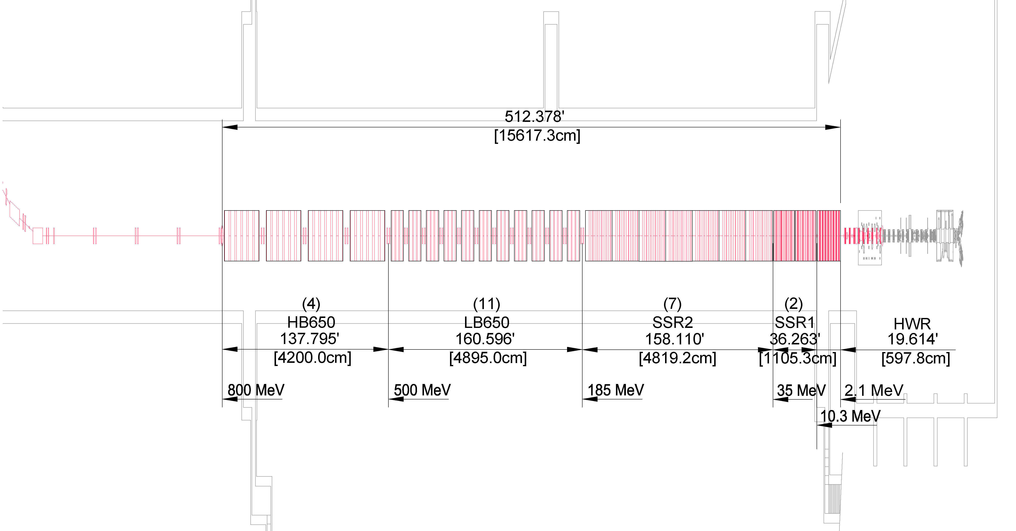
Preliminary Shielding Considerations
Preliminary Shielding Depths shown below. Further analysis required, especially at the Booster.
Used the 10W/m curve for the conceptual design
18.5’
(transport line and absorber)
18.5’
17.5’
7.5’
6’
Thanks to D. Cossairt, T. Leveling and M. Quinn

Slide 27
Cryo Plant
Tank Farm
Warm Compressor Station
Cold Box Station

Slide 28
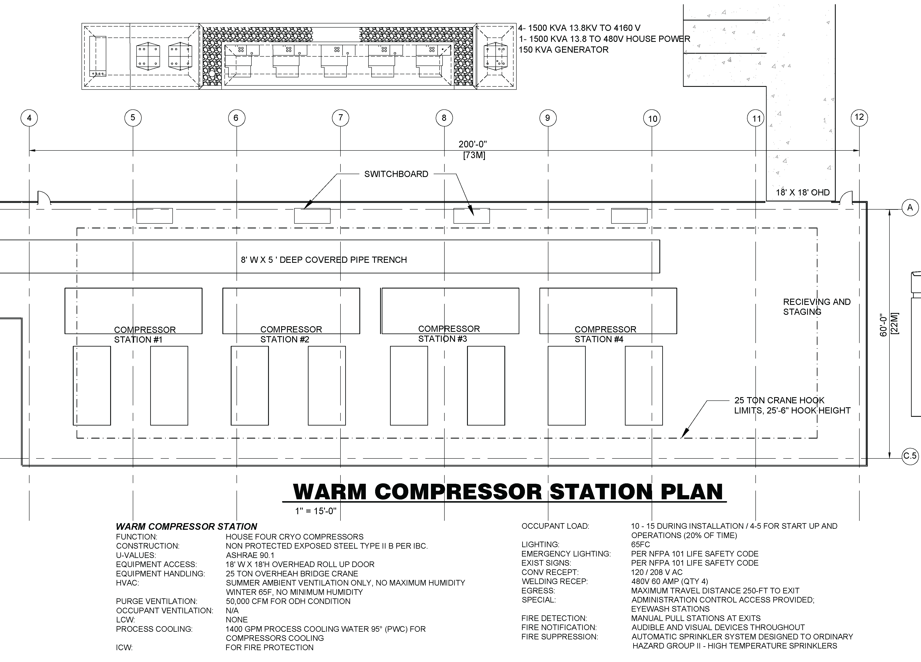
Cryo Plant

Slide 29
Cryo Plant Cooling Requirements
Water Requirements
1,200 – 1,500 gpm flow
Pond System
Chemical characteristics met by Pond system;
Solids content characteristics NOT met by Pond system;
No Pond - ~$500-$700k per acre;
ICW System
Chemical characteristics met by existing ICW system;
Solids content characteristics NOT met by ICW system;
Sampling ICW;

Slide 30
Cryo Plant – Water Quality Requirements
Thanks to A. Klebaner and A. Chakravarty

Slide 31
Cryo Plant – Water Quality Test Stand
Installed as part of the Mu2e Cryo work for CDF;
Installed test ports to sample the ICW before and after the strainer;
Includes a Adams strainer with “standard” slot sizes (baseline);
Two month rental of a Lakos strainer to reduce the solids;
Replacement filter elements in Adams strainer with smaller slot size;
Arranged for FESS/O water testing service to increase the testing to include solids;
Scheduled testing on same duration as CUB;
Compare strainer options with water quality requirements.
Port for Rental Strainer
Port for Rental Strainer
Strainer
BZero Compressor Building

Slide 32
PM vs. CW Considerations
Driven by duty factor of the equipment
15% for Pulsed Mode
100% for Continuous Wave Mode
Common For Both Modes
Physical arrangement of heat producing equipment;
Electrical power supply (not usage);
Conventional Facilities handles the heat load to air (HLA);
Difference is Primarily Cooling
5.0 mw in pulsed mode;
10.5 mw in continuous wave mode;

Slide 33
PM vs. CW Considerations - Cooling
Heat Loads
 |  |  | Pulsed Mode (MW) | Continuous Wave Mode (MW)
Low Conductivity Water (LCW) |  |  | 1.65 | 7.07
Cryoplant Cooling (Cryo) |  |  | 3.4 | 3.4
 |  | Total (MW) | 5.05 | 10.47
 | Industrial Cooling Water (ICW) |  |  | Cooling Ponds (PW) |  |  | Towers (close) |  |  | Towers (open)
Pulsed Mode | MW to GPM Conversion |  | 682.79 | MW to Acres Conversion |  | 800kw/acre
 | LCW | 1,125 | gpm | LCW | 1.98 | acres | LCW | 1.0 | towers | LCW | 1.0 | towers
 | Cryo | 1,400 | gpm @17 Fdt | Cryo | 4.08 | acres | Cryo | 2.0 | towers | Cryo | 1.0 | towers
 |  | 2,525 | gpm |  | 6.06 | acres |  | 3.00 | towers |  | 2.00 | towers
 |  |  |  |  |  |  |  | exclude standby |  |  | exclude standby
CW Mode | MW to GPM Conversion |  | 682.79 | MW to Acres Conversion |  | 800kw/acre
 | LCW | 4,827 | gpm | LCW | 8.48 | acres | LCW | 4.0 | towers | LCW | 2.0 | towers
 | Cryo | 1,400 | gpm @17 Fdt | Cryo | 4.08 | acres | Cryo | 2.0 | towers | Cryo | 1.0 | towers
 |  | 6,227 | gpm |  | 12.56 | acres |  | 6.00 | towers |  | 3.00 | towers
 |  |  |  |  |  |  |  | exclude standby |  |  | exclude standby
 | Other Considerations |  |  | Other Considerations |  |  | Other Considerations |  |  | Other Considerations
 | Strainers, Drought Conditions |  |  | Strainers, Heat Exchangers, Treatment |  |  | Heat Exchangers, Treatment, Make Up |  |  | Heat Exchangers, Treatment, Make Up
 |  |  |  | Drought Conditions |  |  | Building Costs |  |  | Building Costs
 | Note: 1,400 gpm is the highest flow currently available from the existing ICW system
Basis for Estimate
Thanks to E. Huedem

Slide 34
Cooling Design Approach
Goal: Modular approach that allows for efficient operation in both modes;
Pulsed Mode
Heat Load to Air (HLA): Utilize chilled water from existing CUB for equipment cooling (this utilizes the available headroom at CUB);
LCW: (1) Cooling tower
Cryo: (2) Cooling towers
Continuous Wave Mode
Heat Load to Air (HLA): Install a chilled water loop to supplement the pulsed mode system with (2) cooling towers;
LCW: Add (1) Cooling tower
Cryo: No change

Slide 35
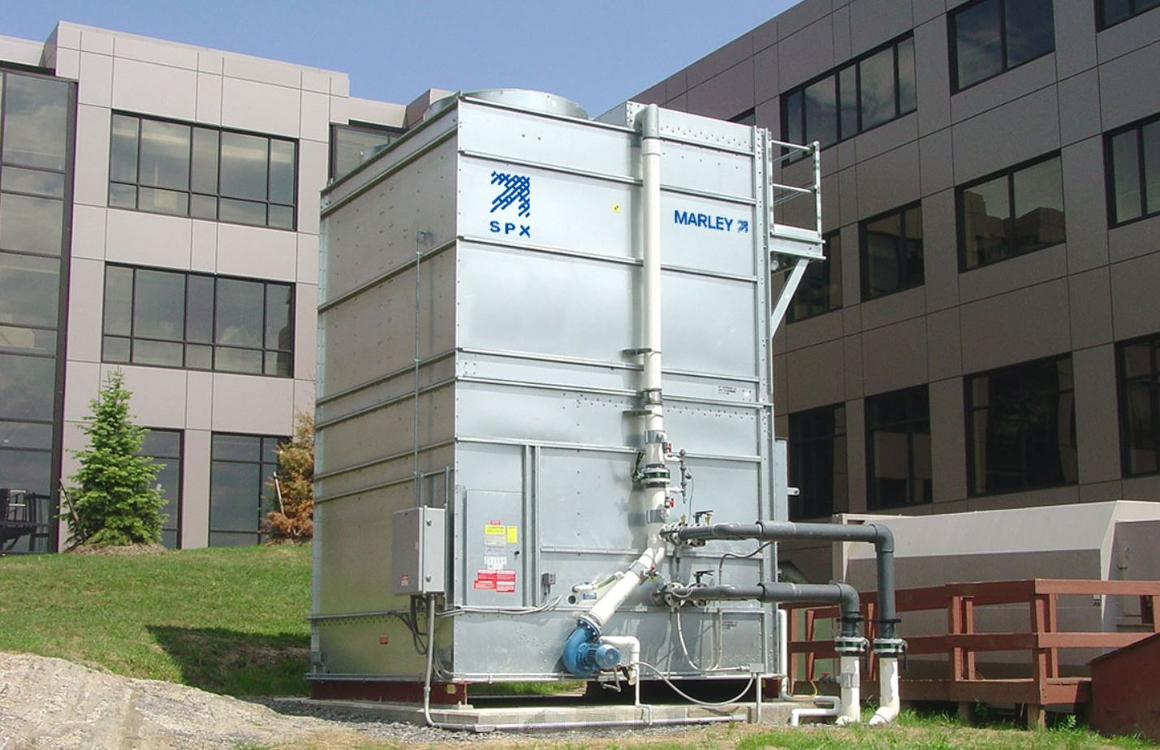
PIP-II Utility Building
7 Towers:
HLA: 0 in PM, 2 for CW
LCW: 1 for PM, 2 for CW
Cryo: 2 for both modes
N+1 Standby: 1
Separate Piping Runs
For PM and CW modes

Slide 36
Mechanical Conceptual Design

Slide 37
MV Electrical Conceptual Design

