Slide 1
Engineering Organization
Don Mitchell, PIP-II Project Engineer
DOE Independent Project Review of PIP-II
15 November 2016

Slide 2
Don Mitchell, P.E.
PIP-II Project Engineer
21 years at Fermilab
  Superconducting magnet R&D
  SRF cavities and Cryomodule development
  5 Years managing TD Design & Drafting department
  Resident expert with Teamcenter, NX, Office Integration
  Teamcenter trainer
  International Collaboration
    DESY XFEL
    ILC
    PIP-II

Slide 3
Outline
Engineering Goals
Documentation Management
Project Organization
Reviews
IIFC Data Sharing
IIFC Documentation Deliverables and Dates
Addresses :
  India Institutions and Fermilab Collaboration (IIFC): Is the collaboration proceeding satisfactorily towards meeting the goals outlined in the Joint R&D document? Will the deliverables outlined in the Joint R&D document position India for a successful contribution to the PIP-II construction phase?
Charge Item: #6

Slide 4
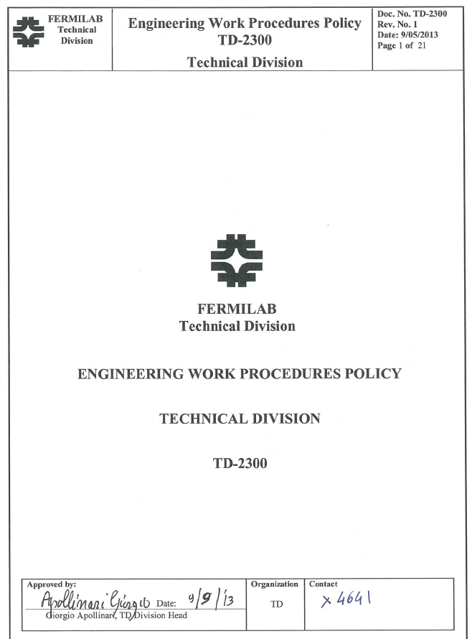
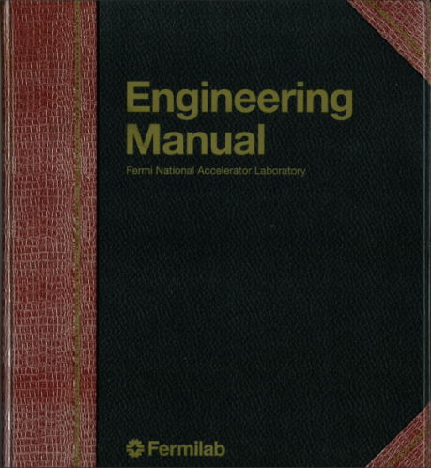
Engineering Goals
Adherence to Fermilab standards
  Engineering Work Procedures Policy
  Fermi Engineering Manual
  FESHM Chapters
  Computer security
Integration of FNAL and DAE efforts
Controlled and organized documentation
  Project management documents
  Revision-controlled documents
  Non revision-controlled documents
Controlled access
  Via User accounts
  Accessible to all collaborators
  Search, Author, Edit, Release

Slide 5
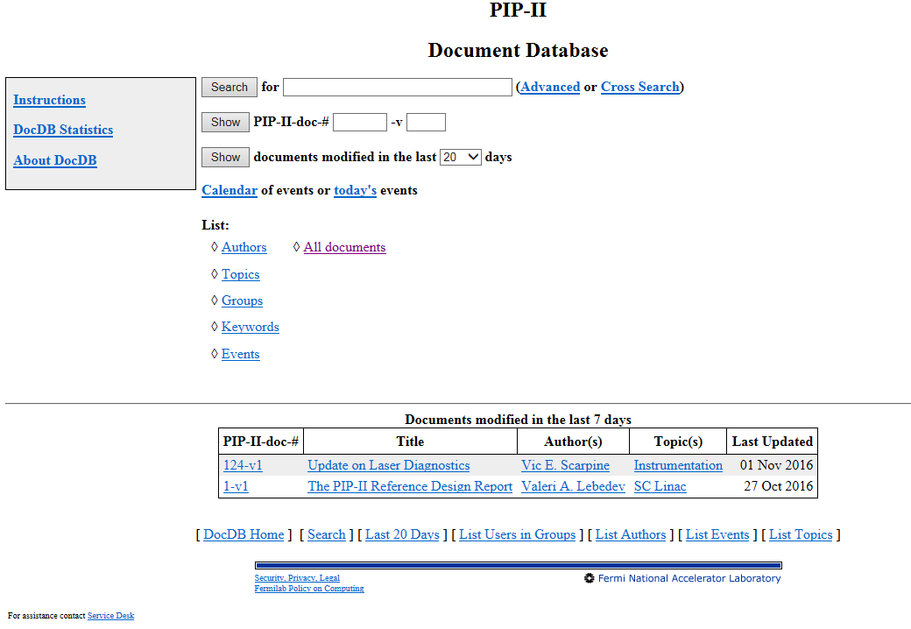
PIP-II Documentation
Docdb
  Scientific publications
  PIP-II department presentations and reviews
  Management reports to FNAL and DOE
SharePoint
  General documents (non revision-controlled)
  Meetings
  Presentations
  IIFC agreements and schedules
Teamcenter
  Revision-controlled engineering documents (FRS, TRS, etc.)
  3-D / 2-D CAD
  Design reviews
  And more…

Slide 6
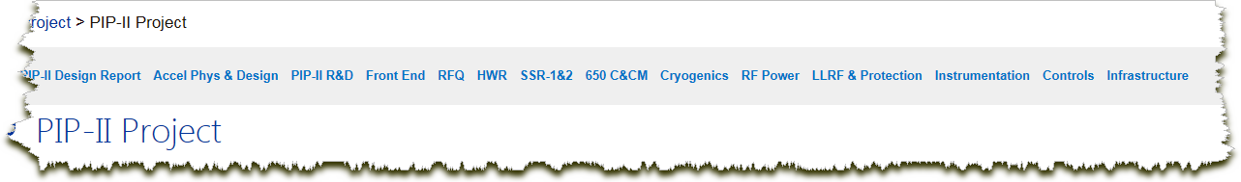
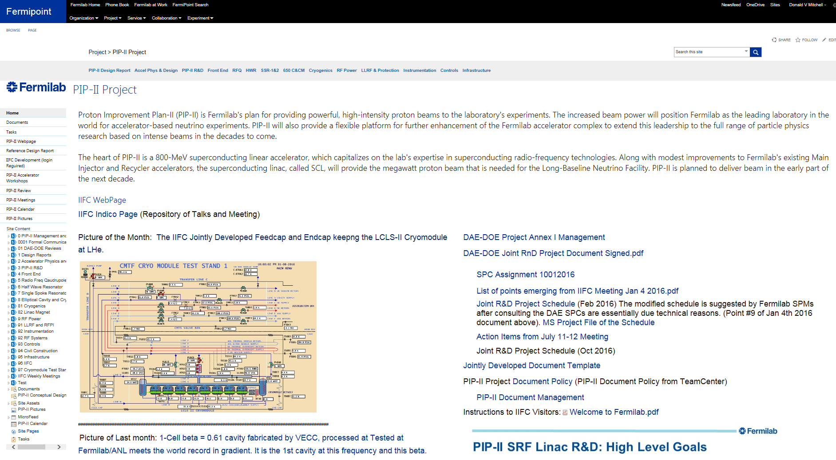
PIP-II SharePoint Documentation

Slide 7
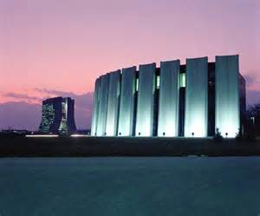
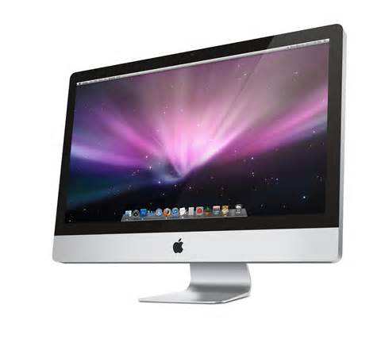




Working in Teamcenter as a Collaboration
All processing performed at Fermilab
World-wide internet access
Keyboard and mouse commands are sent to Fermilab
Screen display is sent to remote location
No file transfers are required
Good for Mac, PC, and LINUX

Slide 8
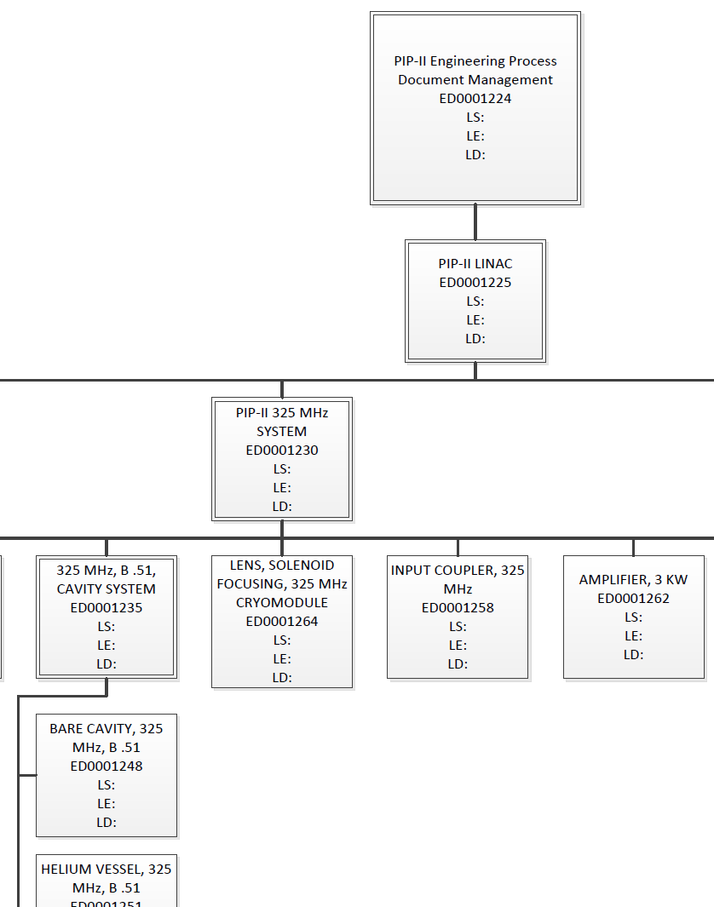
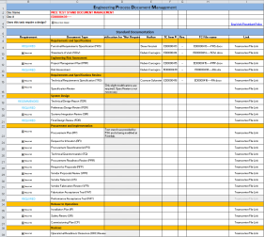

Documentation Organization in Teamcenter
Documentation Packages
EPDM Checklists
Each Document Package is actually a link to the documentation checklist.
Quick access to all documents!

Slide 9
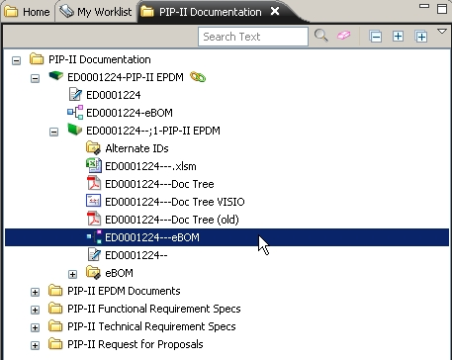
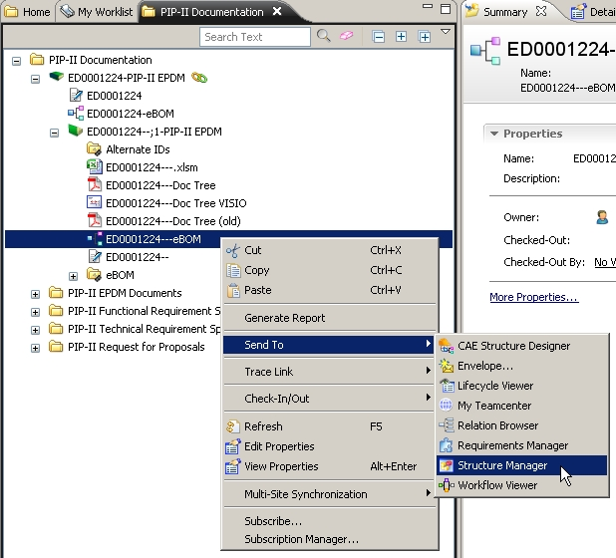
Project Organization in Teamcenter
Top Level Engineering Doc Item
Send the Hierarchy BOM to the Structure Manager.
ED0001224

Slide 10
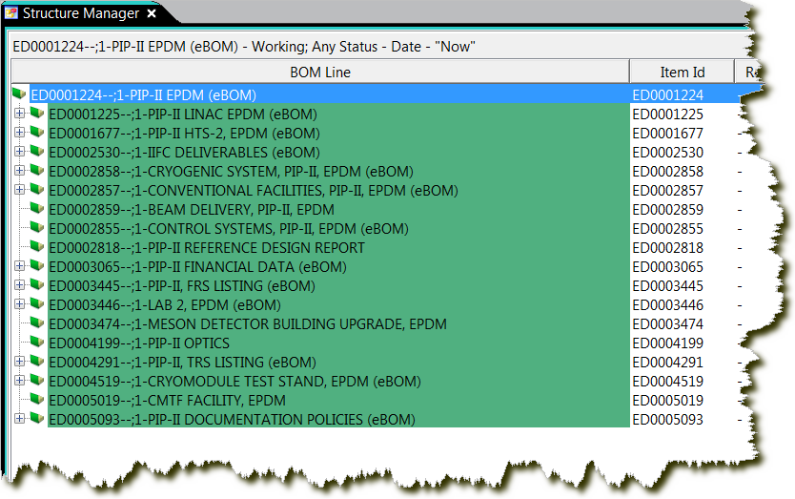
Project Organization in Teamcenter cont.
Work Packages
Links to IIFC
Facilities
Design Reports
Quarterly Reports
Optics files
Policies

Slide 11
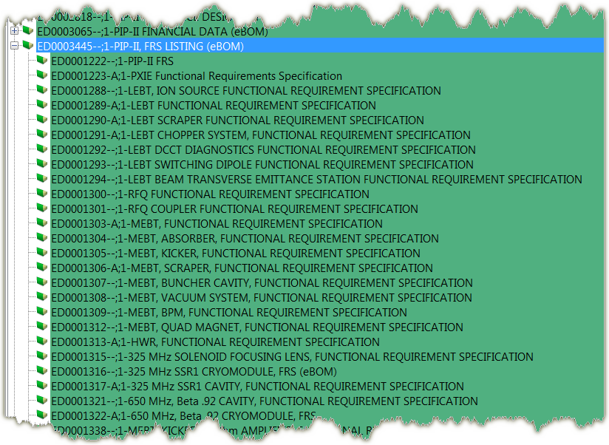
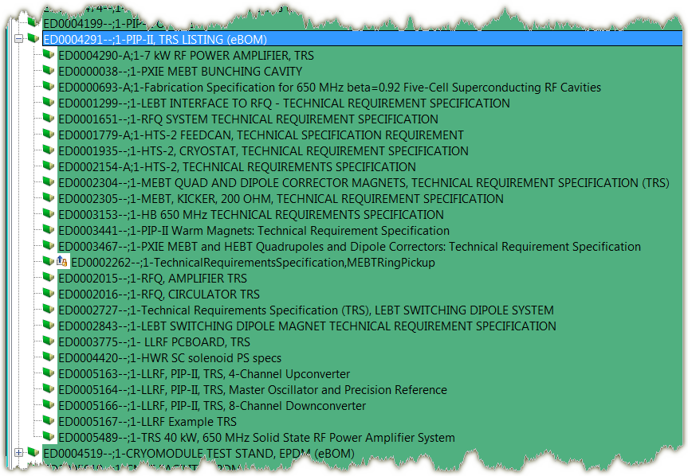
Documentation
~86 Functional Requirement Specifications
~25 Technical Requirement Specifications
Risk Assessments for all design items
Supporting design documentation
  In Teamcenter
  URL links to external data

Slide 12
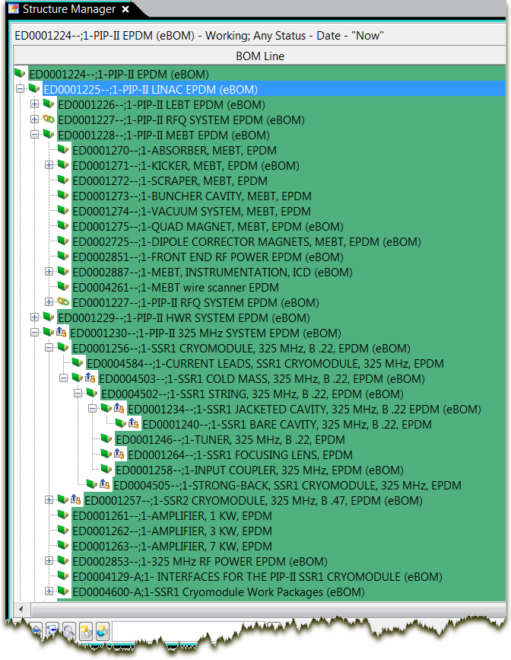
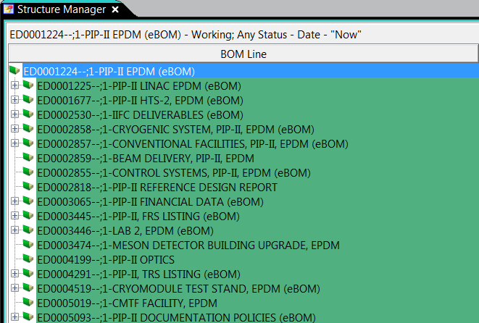
Expanding the LINAC Item
The Document structure contains the project’s work packages (EPDMs).
The data is Live and can be edited at any time.
It can be released and revised for document control.
Work Packages

Slide 13
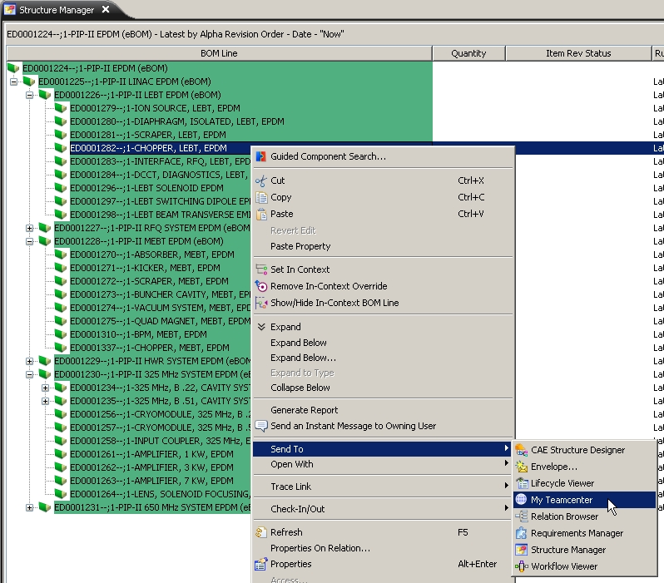
Select any item of interest and quickly send it to
My Teamcenter to access the datasets.
You only need to remember the Top Level document in your project to have direct access to all of the project documentation and CAD data!

Slide 14
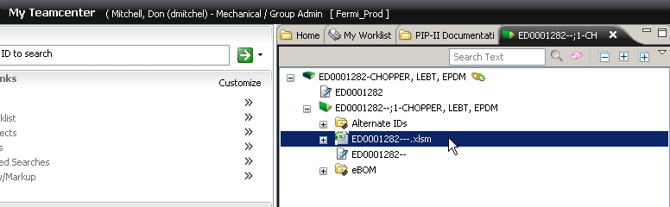
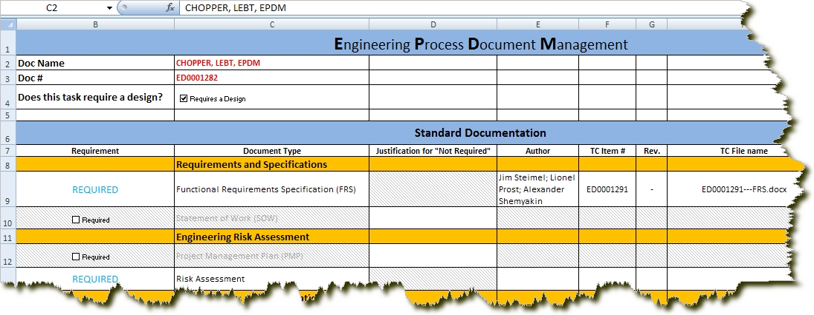
Double-Click on the Excel dataset to launch it into Excel.

Slide 15
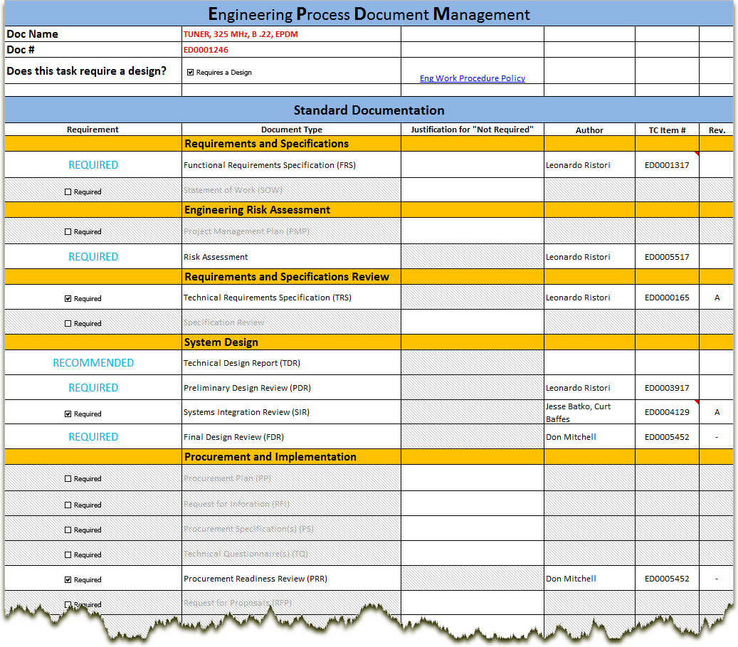

Slide 16
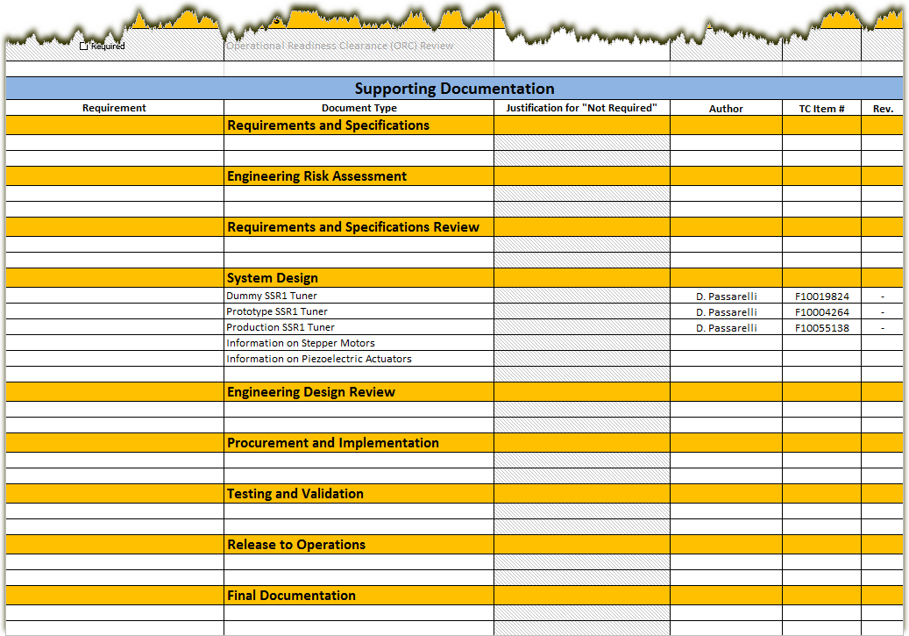
Cradle-to-grave documentation that satisfies the intent of the Fermilab engineering policies for both R&D and Construction phases of PIP-II.

Slide 17
Design Reviews
Types of Reviews
  Preliminary Design Review
  Final Design Review
  Safety Review
  Operational Readiness Clearance
Frequency of Reviews
  As part of the design/engineering process
  Booked in advance according to the delivery schedule
Components of the review
  Charge is written
  Committee is formed
  Supporting documentation is collected
  Report with action items is prepared

Slide 18
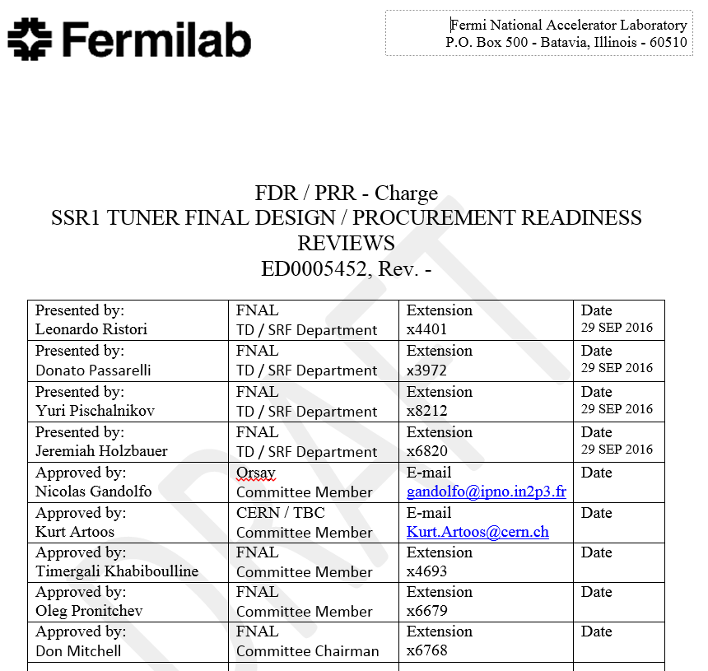
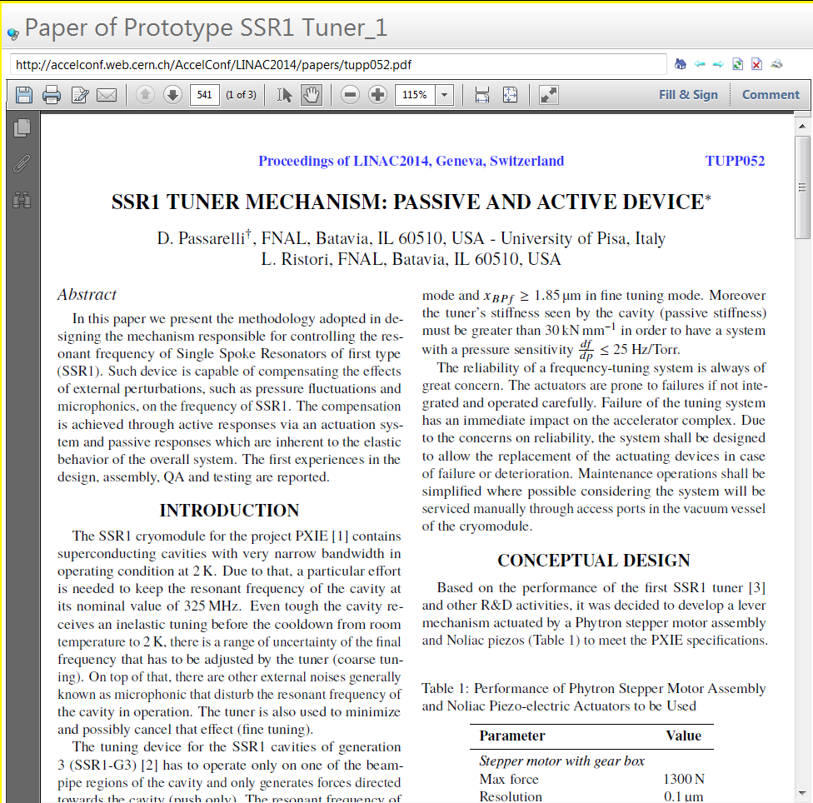
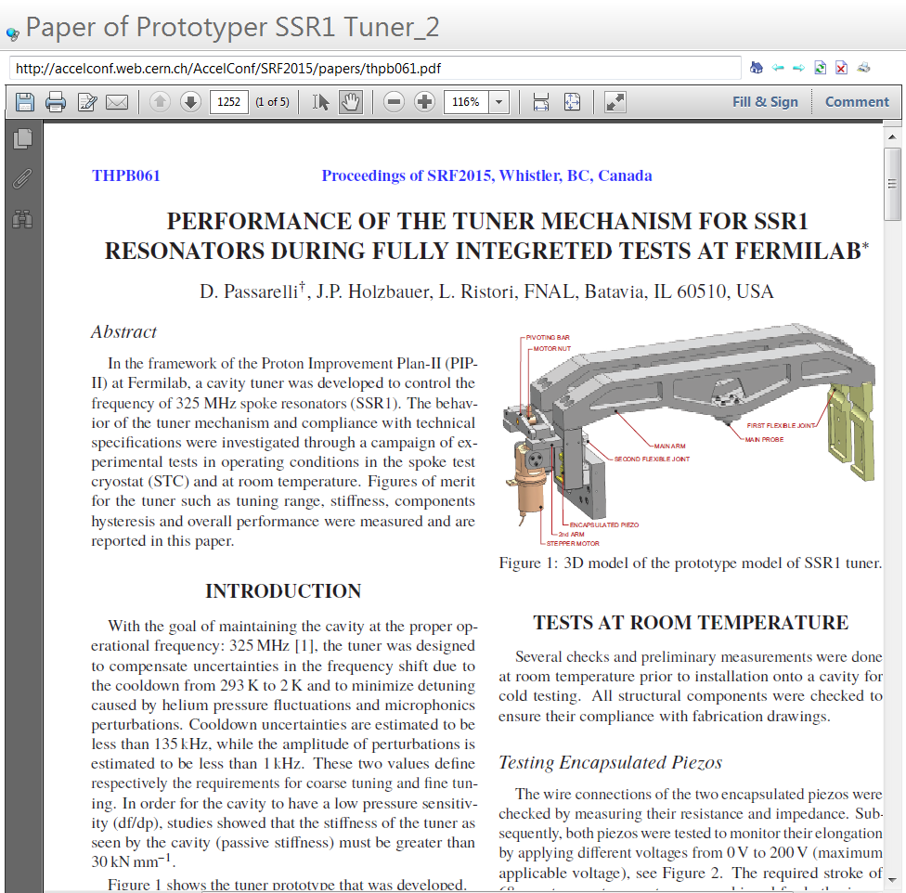
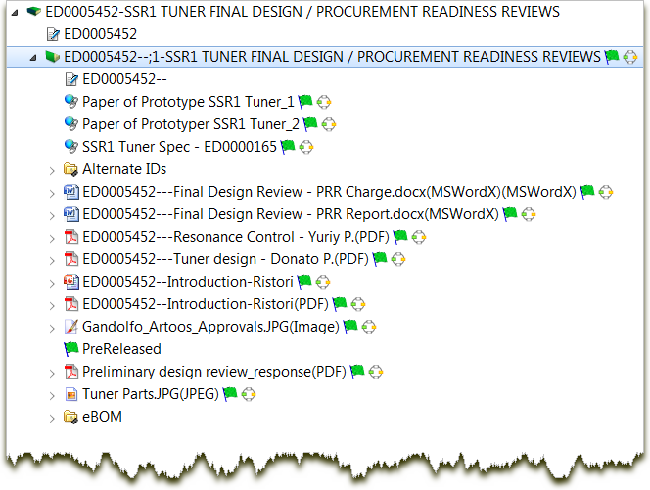
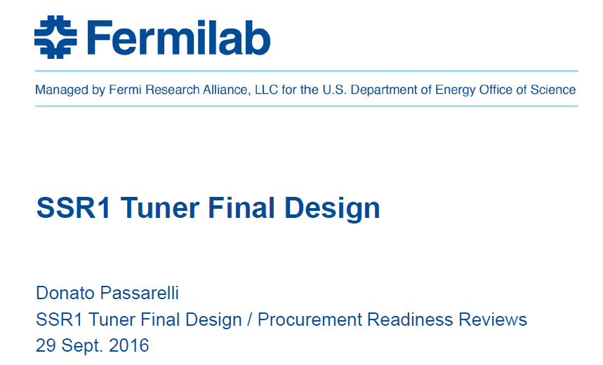
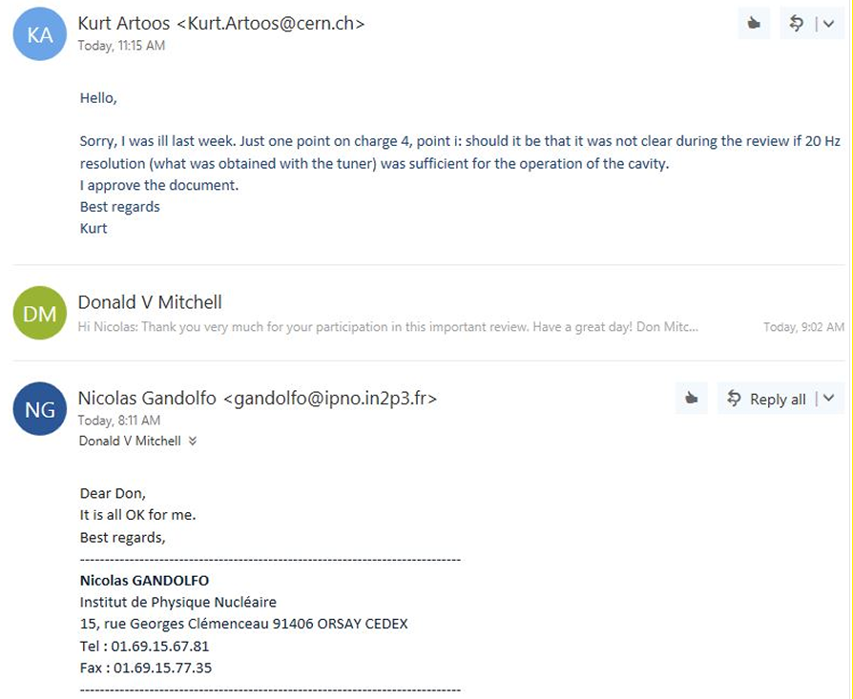
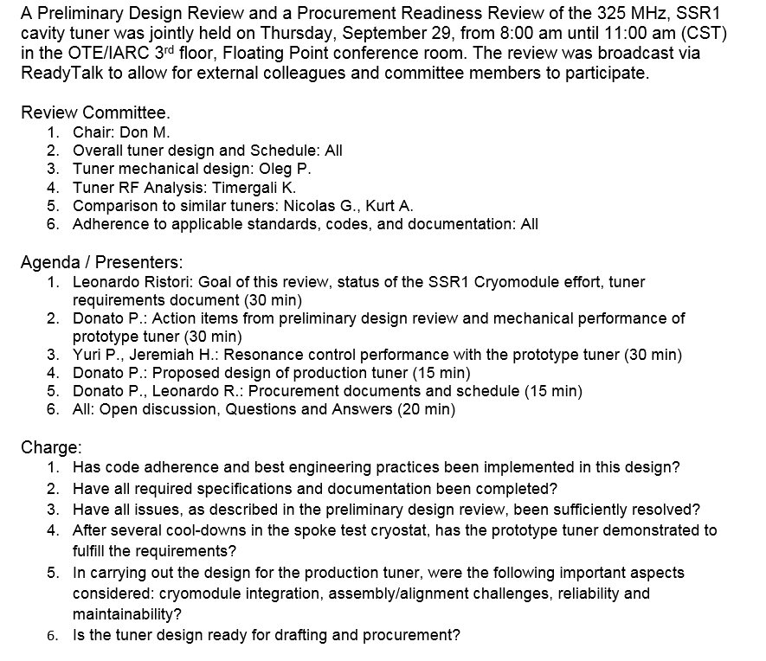
Design Review
Example

Slide 19
PIP-II Collaboration
Collaborative effort by:
  IIFC: Indian Institutions and Fermilab Collaboration
    FNAL, BARC, IUAC, RRCAT, VECC
  European Institutions
    INFN
    STFC – Daresbury
Collaborating on:
  Cavities, Cryomodules, Tuners, Couplers, LLRF, Interlocks,
  Test stands, SC Magnets, RT Magnets, Amplifiers
  Authoring data “jointly” with Fermilab staff
  Reviews:
    Cavities: HB650, LB650 RF design, SSR1, 650 MHz Helium Vessel
    325 MHz Coupler
    Tuners: SSR1, HB/LB650
    Scheduled: SSR2 Cavity, 650 Coupler, SSR1 Cavity String, LB650 Cavity Mechanical design

Slide 20
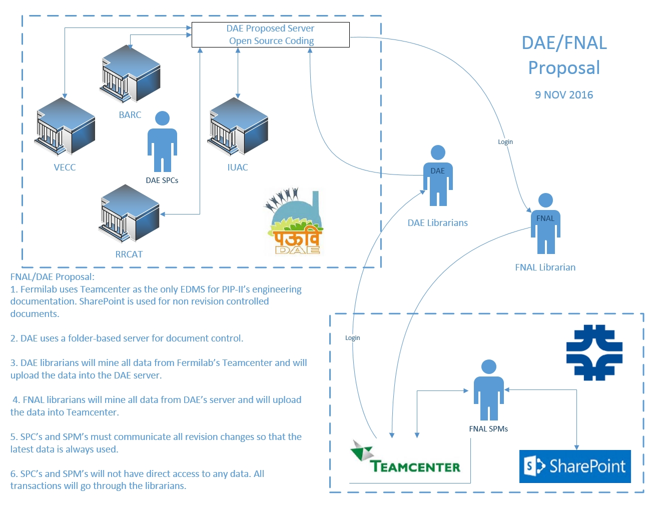
IIFC Data Sharing

Slide 21
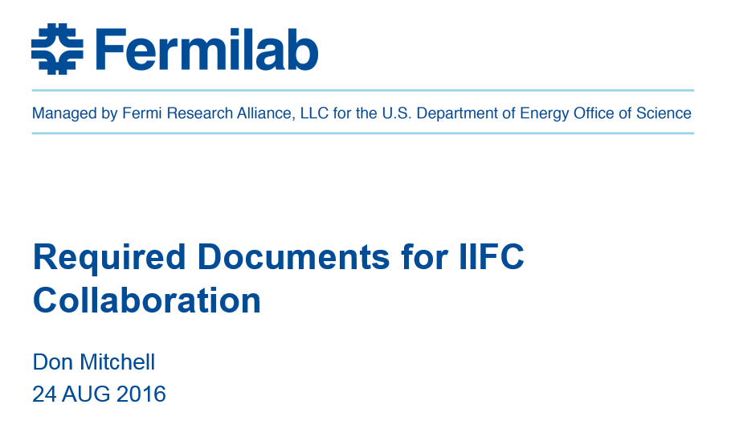
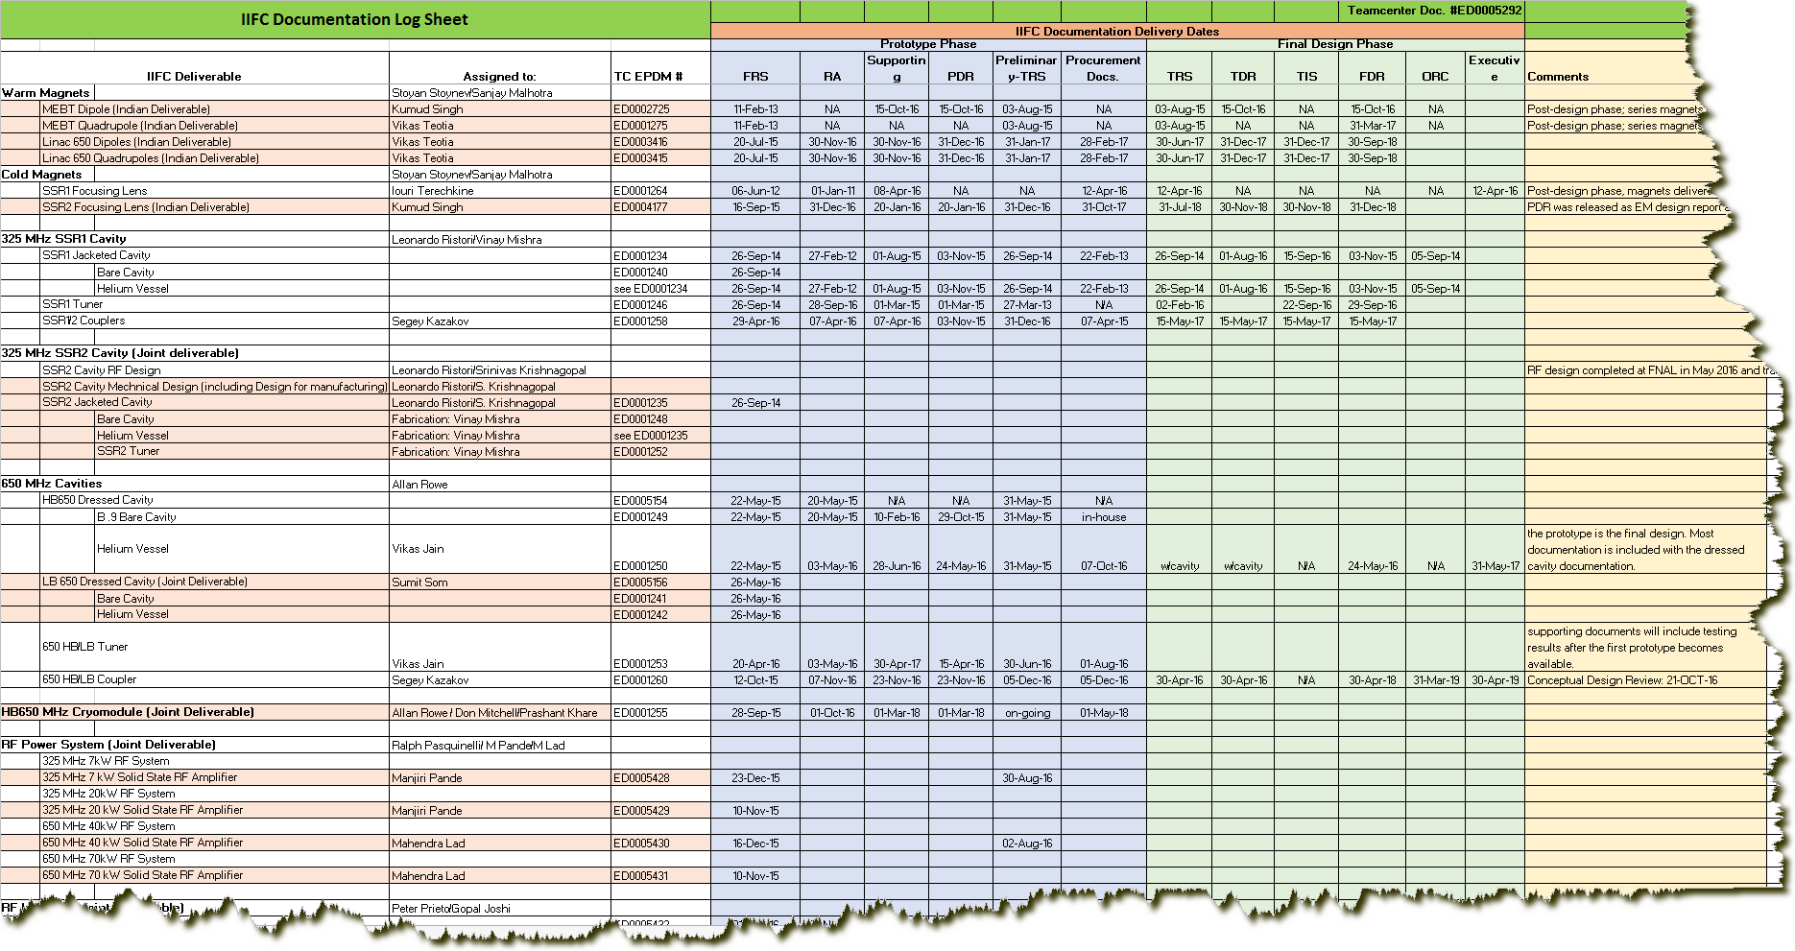
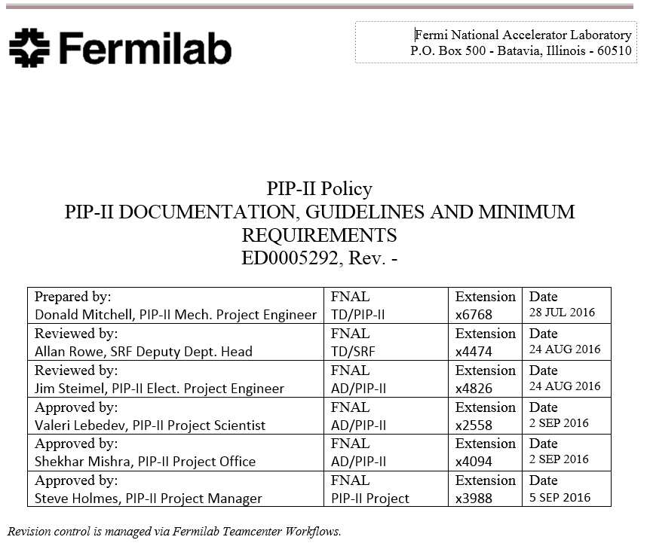
IIFC Documentation Deliverables

Slide 22
Summary
Project documentation is being managed per Fermilab’s policies and guidelines and is accessible to all collaborators.
The DAE/DOE collaboration (IIFC) is progressing positively with DAE and Fermilab engineers and scientists working closely together to accomplish all stated objectives.
Fermilab is coordinating with European institutions to collaborate on cavity and cryomodule deliverables.
Policies and procedures for document management are in place to provide document sharing among all collaborators.
Commercial software at Fermilab is being utilized to allow controlled access to all project data. (Teamcenter and SharePoint)
DAE is developing their own EDMS and is working with Fermilab to resolve outstanding IT issues.
A list of documentation with realistic delivery dates has been established for all IIFC deliverables.

Slide 23
Questions?
Thanks for your attention,
Don - dmitchel@fnal.gov

