Slide 1
Environment, Safety and Health
Victor Kuchler
DOE Independent Project Review of PIP-II
15 November 2016

Slide 2
Speaker Background
Victor Kuchler
Engineer V
39 Years at Fermilab
Facilities Management and Conventional Design for both Fermilab and International Projects
Primary Responsibility for the PIP II Project to oversee the NEPA Compliance Process

Slide 3
Outline
This talk will address Item 5 of the Review Charge, Environment, Safety and Health
PIP II NEPA Compliance Process
Overview and Current Status
Schedule
Additional Wetland Considerations
Conclusions
PIP II Injector Test at Cryomodule Test Facility (CMTF)
Scope
ES&H Requirements
Conclusions
Summary

Slide 4
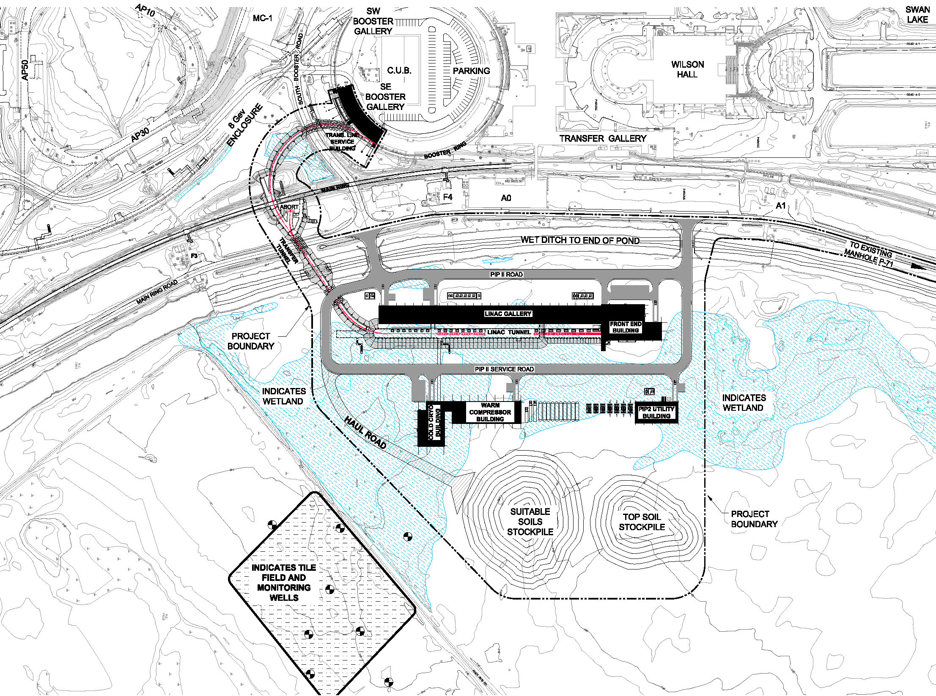
Project Site Overview
Approximately 9 Acres
of Existing Wetlands will be affected by this project

Slide 5
PIP II NEPA Compliance Process
PIP II NEPA Overview and Current Status
PIP II Mission Need Statement - Approved, September 2015
Fermilab Environmental Review Form (ERF) - Completed, February 2016
Continue site specific design to minimize Environmental Impact and Required Wetland Mitigation - On-going
New Wetland Delineation Report - Completed, July 2016
Develop Environmental Evaluation Notification Form (EENF) - Draft EENF Completed, October 2016
Submit EENF to DOE Fermilab Site Office - Pending available funding for Environmental Assessment
Complete Environmental Assessment (EA)
Complete Wetland Mitigation
Develop Application for Permit from the US Corps of Engineers
Receive “Finding of No significant Impact” (FONSI)

Slide 6
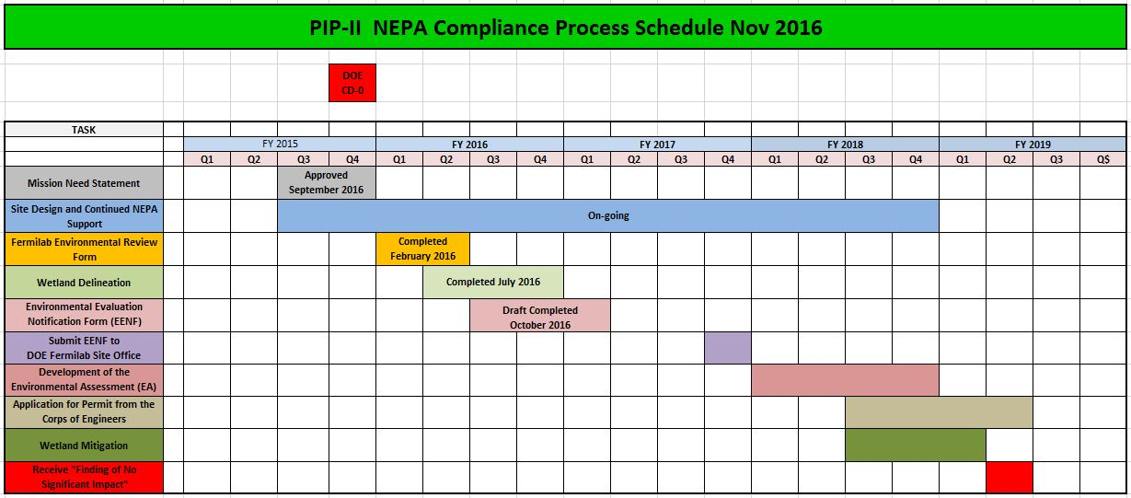
PIP II NEPA Compliance Process
PIP II NEPA Schedule

Slide 7
PIP II NEPA Compliance Process
PIP II NEPA Additional Wetland Considerations
Fermilab is currently pursuing a request to the US Corps of Engineers (COE)
A number of areas on the Fermilab site are isolated wetlands and do not flow into waters of the state
All of the wetlands affected by the PIP II Construction fall into this category
Fermilab will request a determination from the US COE that these wetlands are “Non- Jurisdictional”
This would simplify the NEPA Compliance Process significantly
Wetland mitigation would not be required
Approximately 9 acres of existing wetlands will be affected by this project
Estimated cost of mitigation is $85K per acre
Mitigation ratios of 1:3 and 1:6 are used by the US COE depending on the wetland quality
A “Non-Jurisdictional” determination would save the project $2.3M - $4.6M
A US COE Permit may not be required
Determination Request Process
Fermilab will develop a Report describing the reasons for the Determination Request - In-Progress, completion expected November 2016
Submit request documentation to DOE Fermilab Site Office - Est. November 2016
DOE FSO to submit request documentation to US COE - Est. December 2016
US COE evaluation and determination - Est. December 2017

Slide 8
PIP II NEPA Compliance Process
PIP II NEPA Conclusions
All aspect of the NEPA Compliance process that can be completed, have been completed at this point
FY 17 Budget constraints will delay efforts to initiate the development of the Environmental Assessment
When sufficient funding has been identified to proceed with the Environmental Assessment the EENF will be submitted to the DOE Fermilab Site Office

Slide 9
PIP II Injector Test at the Cryomodule Test Facility
Scope:
A CW H⁻ source delivering 5mA at 30 keV : Installed
A CW RFQ operating at 162.5 MHz, delivering 5 mA at 2.1 MeV : Installed
2 SRF Cryomodules capable of accelerating 2 mA at 25 MeV : FY 2018
Beam Dump for 2 mA at full beam energy : FY 2019
Utilities and Shielding : As required as configuration changes
Beam Dump
SSR1
FY 2019
HWR
MEBT
FY 2018
CW RFQ
FY 2017
CW H- Source
P Derwent

Slide 10
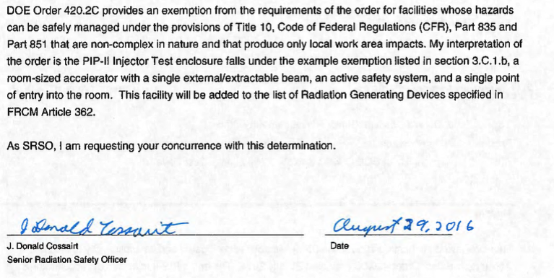
PIP II Injector Test at the Cryomodule Test Facility
ES&H Requirements
Test accelerator is contained inside a single room enclosure with no extractable beamlines, There is a single entrance labyrinth (north end), with an emergency exit labyrinth (south end) for Life Safety reasons.
We requested an exemption from DOE Order 420.2c, Accelerator Safety Order for this facility and it was granted.
P Derwent

Slide 11
PIP II Injector Test at the Cryomodule Test Facility
ES&H Requirements Cont.
Enclosure and operation is covered under Title 10, Code of Federal Regulations, Part 835.
We will treat the enclosure and internal accelerator as a radiation generating device following Fermilab Radiation Control Manual requirements.
including radiation safety interlocks (Oct 2016)
We will continue to review and approve accelerator operations through the laboratory Operational Readiness Clearance (ORC) process.
Chief Accelerator Officer Signs off on the ORC
Have prepared a Safety Analysis Document for 2.1 MeV operation (PIP-II DocDb #40)
updates are in progress to address radiation assessment and safety interlocks
John Anderson (ESH&Q) is the assigned Senior Radiation Safety Officer
P Derwent

Slide 12
PIP II Injector Test at the Cyromodule Test Facility
Conclusions
The ES&H Requirements for the PIP II Injector test are identified and well understood and will continue to be implemented as the installation of equipment continues over the next three years
A review and approval process is established and will be followed as the Injector becomes fully assembled and operational
The Senior Radiation Safety Officer, John Anderson, will oversee and approve the progress of the full PIP II Injector test installation
Documentation for the PIP II Injector test will continue to be updated as installation continues

Slide 13
Summary
The PIP II NEPA process is well understood and a plan is in place that should result in a “Finding Of No Significant Impact”
We will proceed as funding is available
Required in advance of CD-2
There is a three year plan for the completion of the PIP II Injector Test at the Cryomodule Test Facility
The plan is well documented and all appropriate safety and operational controls are being implemented as progress toward completion continues

