Slide 1
Warm Front End and PIP2IT Status
A. Shemyakin
DOE Independent Project Review of PIP-II
15 November 2016

Slide 2
Alexander “Sasha” Shemyakin
Accelerator physicist for 35 years
PhD from BINP, Novosibirsk – 1990
At Fermilab since 1998
ECOOL project – responsible for electron beam
With PIP-II project since 2011
PIP2IT warm front end manager
Responsible for MEBT

Slide 3
Outline
Charge Item: #1
P. Derwent
PIP-II warm front end concept
R&D Goals and PIP2IT
Status of warm front end of PIP2IT
Schedule
Summary

Slide 4
PIP-II warm front end
The warm front end prepares H- beam optimized for Booster injection and provides capabilities for future CW operation
Ion Source (IS) and Low Energy Beam Transport (LEBT)
Radio Frequency Quadrupole (RFQ)
Medium Energy Transport (MEBT)
Output parameters: 2.1 MeV, ε⊥<0.23 µm, ε_{L}<0.31 µm
Nominal current 2 mA averaged over ~µs (from µs to CW)
Bunch-by-bunch selection capability

Slide 5
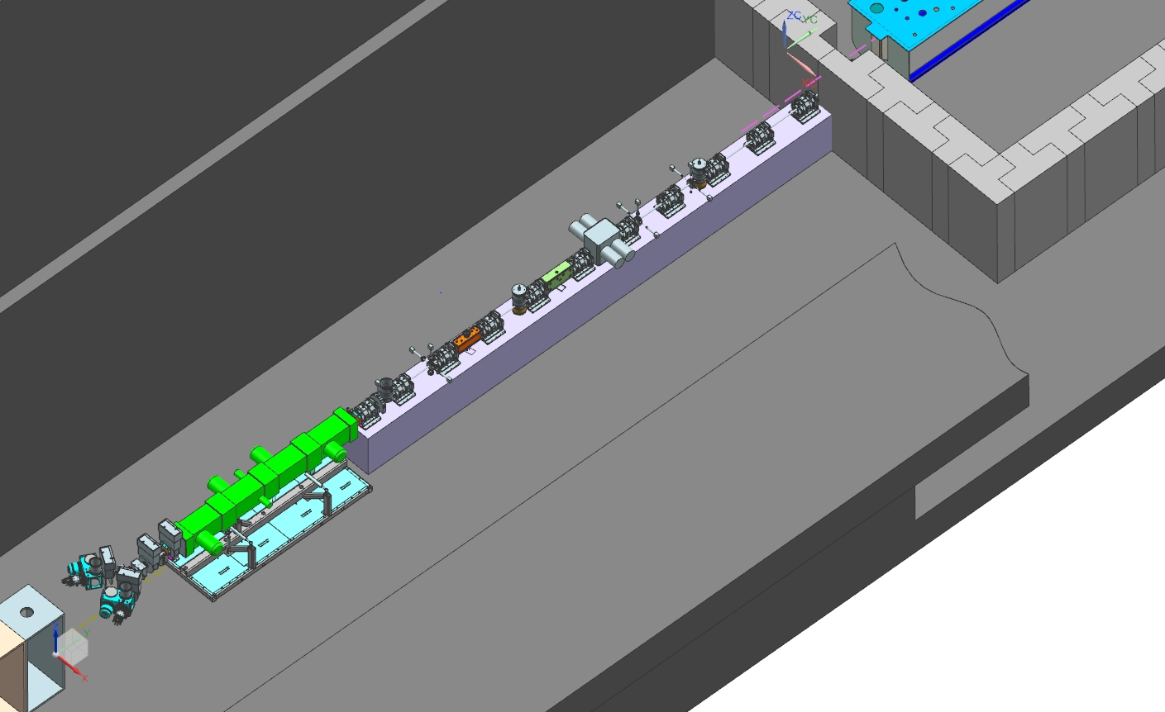
Present conceptual design
Two ion sources with switching magnet (30 keV, 10 mA DC)
2-m long LEBT with partial neutralization
RFQ: 4.4-m, 2.1 MeV, 162.5 MHz CW, 4-vane
MEBT: 14-m, bunch-by-bunch chopping system; radiation protection wall; differential pumping after absorber
HWR
MEBT
LEBT
RFQ
Two ion sources

Slide 6
R&D goals
R&D will mitigate risks associated with the front end for PIP-II and speed up commissioning
The most important R&D issues
LEBT with low emittance growth compatible with chopping ✓
Reliable CW RFQ, including couplers (partially ✓)
Bunch-by-bunch selection in MEBT
Compatibility of high-power deposition in MEBT absorber with SRF downstream
Are being addressed by PIP-II Injector Test (PIP2IT)
30 keV
2.1 MeV
10 MeV
25 MeV
LEBT
RFQ
MEBT
HWR
SSR1
HEBT
Warm front end

Slide 7
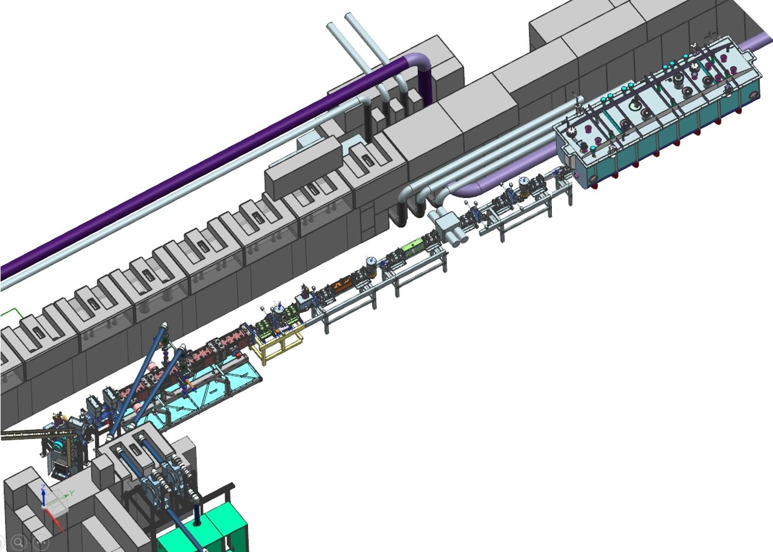
Warm front end of PIP2IT
Warm front end of PIP2IT represents as close as possible the PIP-II front end as it is envisioned now
Same ion source (only one); same LEBT and RFQ
Same MEBT chopping system
Slightly shorter MEBT to fit into CMTF building
By ~3.5 m, 3 triplets, one bunching cavity
No wall across MEBT
Less effective protection from vacuum accidents
Addresses all critical issues of PIP-II front end
Almost all parts will be used at PIP-II
Warm front end of PIP2IT with HWR installed

Slide 8
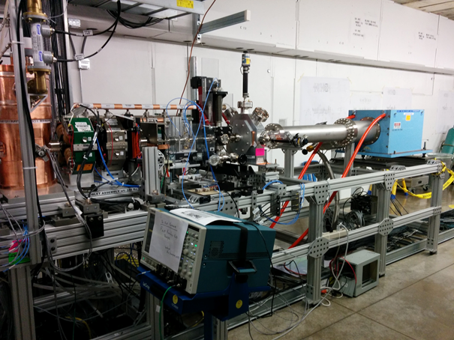
Status of PIP2IT - outlook
LEBT has been fully commissioned in straight configuration
RFQ is RF commissioned in both pulse and CW modes
Parameters of the beam out of RFQ are partially measured
MEBT in two- doublets configuration is characterized
Preparations are underway for CW beam test
Assembly of a longer MEBT will start soon
LEBT bend will be installed at the same time
Full – length MEBT is being designed

Slide 9
DAE contribution: MEBT magnets
All MEBT magnets are produced by BARC, India
FY15 – prototype magnets (two doublets and two dipoles)
Used in the present version of the MEBT
FY16 – all 15 dipole correctors delivered
FY17- all serial quadrupoles will be delivered
Total 36 quadrupoles and frames
PIP2IT MEBT, HEBT, spares

Slide 10
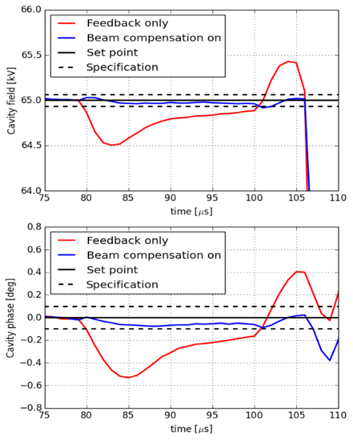
RFQ RF
B. Chase
RFQ was installed and commissioned
Inter-vane voltage checked with X-ray detector
Initial conditioning took a day (pulsed)/several days (CW)
The resonant frequency is regulated by water temperature to vanes and walls
Operate mainly in pulse mode
Typical RF pulse is 0.1 – 5 ms at 10 Hz
Extra level of protection from un-requested long- pulse or CW beam
Lower power consumption
Better reliability
LLRF keeps the flat top amplitude within 0.1% and phase ±0.1º
FF, FB, and beam compensation on

Slide 11
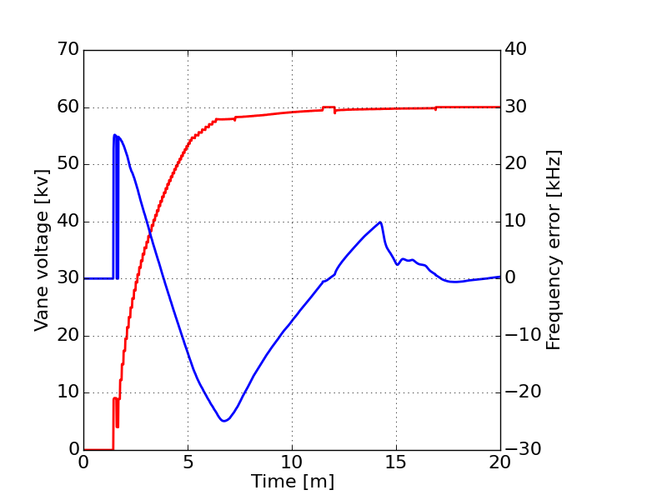
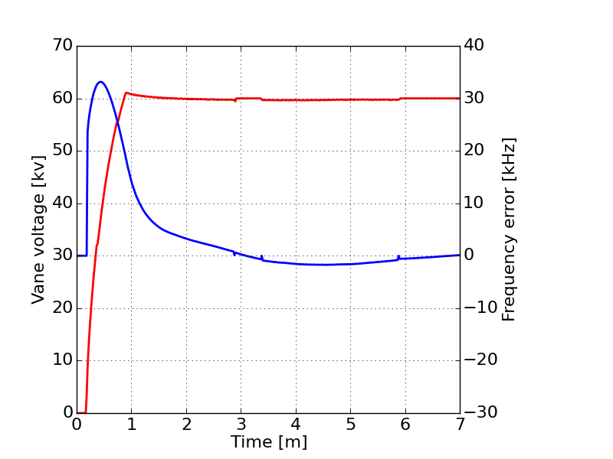
RFQ RF operation
B. Chase
Applications were written to switch the RFQ on/off in both CW and pulsed modes and automatically recover from trips
Resonance control switches from fixed frequency (GDR) to self-excited loop (SEL) if the resonance frequency error is too large
Cold start takes 20-30 min from turn on to nominal frequency
Trip recovery in CW takes from seconds to several minutes
depending on whether the vane voltage restores immediately
Cold start
Trip recovery (after 10 sec delay)
Vane voltage
Gray: RFQ power ramp; resonance control is idle; SEL
Orange: resonance control bringing RFQ to frequency; SEL
Green: RFQ is in GDR and LLRF feedback is active
Frequency error

Slide 12
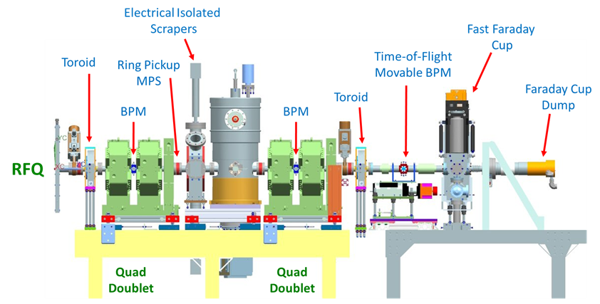
RFQ beam in the short MEBT
Transmission: 98% ±2% (at 5 mA; the best result)
measured as ratio of beam current at entrance and exit of RFQ
Energy: 2.11 MeV ±0.5% (measured with a movable pickup)
Transverse parameters – estimated with quad scans/scrapers
Emittance ~ 0.2 µm at optimum conditions (probably ±20%)
No consistent numbers for Twiss functions yet
Bunch length
Attempts to measure with two versions of Fast Faraday Cup were only partially successful
Considering modifications
MEBT-1.1 configuration

Slide 13
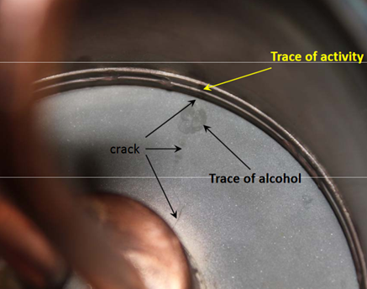
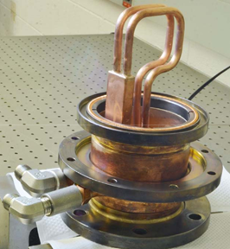
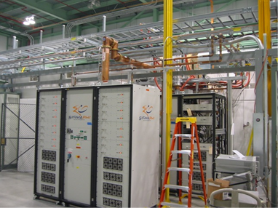
RFQ issues
Coupler failure
One of couplers failed during conditioning in CW
Could be related to a known fabrication flaw, not-optimal conditioning procedure, or (unknown) design deficiency
Was replaced by a spare; changed operation procedures and improved cooling
Amplifier failures
Several “slices” during commissioning
Now have a good set of spares
wall power (480V) connection
intermittent controls issues
D. Peterson

Slide 14
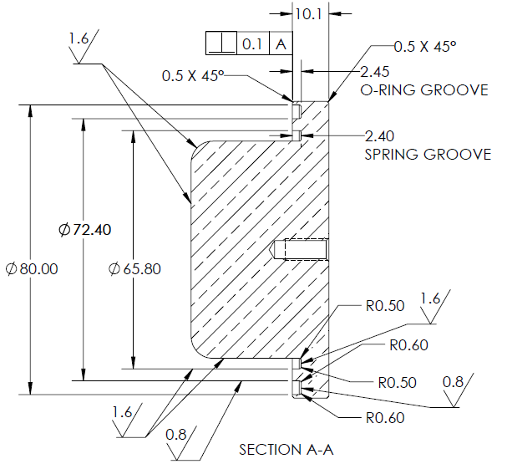
RFQ issues: frequency offset
Resonant frequency is found by 60 kHz lower than expected
Likely due to unforeseen mechanical deformations of RFQ body
Difficult to compensate with wall- vane temperature difference
At the boundary of regulation in CW; ≥10 kHz in pulsed
-16.4 kHz/K vanes; +13.9 kHz/K walls; -2.5 kHz/K together
Now normally run at ~ -80 kHz offset
Is not a problem for present running but needs to be corrected before sending the beam into HWR
Plan suggested by LBNL team: re-machine all 80 fixed plug tuners
Would not perturb field flatness
Discussing to do it in FY18
Existing tuners can be re-machined

Slide 15
Short MEBT
Several setups (different in diagnostics)
Commissioning of diagnostics, development of procedures, beam-based checks and calibrations, beam properties
Up to 10 mA in pulse mode to the dump (losses < 3%)
Radiation: higher than expected (prompt only)
Agrees with simulations by updated MARS code
Average current is limited to 0.25 mA until cave is interlocked
Present configuration is optimized for a high-power run
Goal: run 5 mA CW for 24 hrs. Check stability of operation.
Coming next: MEBT emittance scanner
MEBT-1.2 configuration, optimized for high-power running

Slide 16
Machine Protection
Machine Protection System (MPS)
Plan to test a scheme envisioned for PIP-II
Two-tier list of MPS devices; inhibiting the beam primarily in LEBT; comparing beam current through the machine; shut-off time ~10µs
Exists now: protection from not-requested long pulses, poor vacuum, and RF trips; administrative measures
Coming: operational modes, current comparison, scrapers currents, loss monitors
Protection of vacuum chamber and beam dump in CW run
Two 4 – plate scraper sets. Plates are placed at the beam boundary of an optimized envelope. Permit drops if a scraper current is too high or too low
Comparison of beam current measurements out of RFQ and in the dump

Slide 17
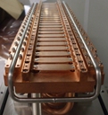
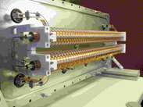
Longer MEBT: kickers’ test
Will be assembled after arrival of magnets for 4 triplets
One more bunching cavity, two kickers, BPM in each triplet
Kickers’ tests: electromagnetic performance and survival
50 Ohm kicker: trajectory response to 81.25 MHz CW
Possible test with wide-band amplifiers on loan
200 Ohm kicker: short bursts of arbitrary chosen “pass/remove” pattern, including ~10 µs of 81.25 MHz
The kick is measured by recording BPM signals with a scope
Optional: with scrapers
Emittance scanner
50 Ohm kicker
200 Ohm kicker

Slide 18
Full-length MEBT
FY17: assemble when magnets for 3 more triplets arrive
Plus: bunching cavity, two scraper sets, differential pumping
FY18 shutdown: MEBT in its final (for PIP2IT) state
Final chopping system: 21 kW absorber, two identical kickers
Full set of diagnostics
Complete MPS, fast vacuum valve and sensors
Particle – free sections downstream of absorber
Scrapers
Temporary part
Absorber
Space for differential pumping

Slide 19
R&D schedule for the PIP2IT warm front end
FY17 – beam run in warm front end with SNS dump
Demonstrate high – power beam accelerated in RFQ
Assemble full – length MEBT
Measure electromagnetic response and survival of kickers
Choose the kicker version
FY18 – shutdown to install cryo distribution system and HWR
Install final MEBT and connect to HWR
FY19 - install and RF – commission both cryomodules
Commission the final MEBT in parallel
Full power to absorber, bunch-by-bunch selection in MEBT
Commission MPS, vacuum protection, diagnostics
FY20 – beam through cryomodules
Supply the beam with final parameters

Slide 20
Summary
Proposed warm front end concept satisfies PIP-II requirements both for Booster injection and for future CW operation
Critical issues are being addressed at PIP2IT
Performance of LEBT and RFQ has been demonstrated
Preparations are under way to test elements of the chopping system
All R&D questions related to the warm front end will be answered by the end of PIP2IT run
PIP2IT warm front end will be ready to inject the beam into HWR in the time of cryomodules installation to test performance of SRF with beam

Slide 21
Backup slides

Slide 22
Comparison of PIP2IT and PIP-II MEBTs
PIP2IT MEBT
Shorter by: ~3.5 m, 3 triplets, one bunching cavity;
No wall across MEBT
Less effective protection from vacuum accidents

Slide 23
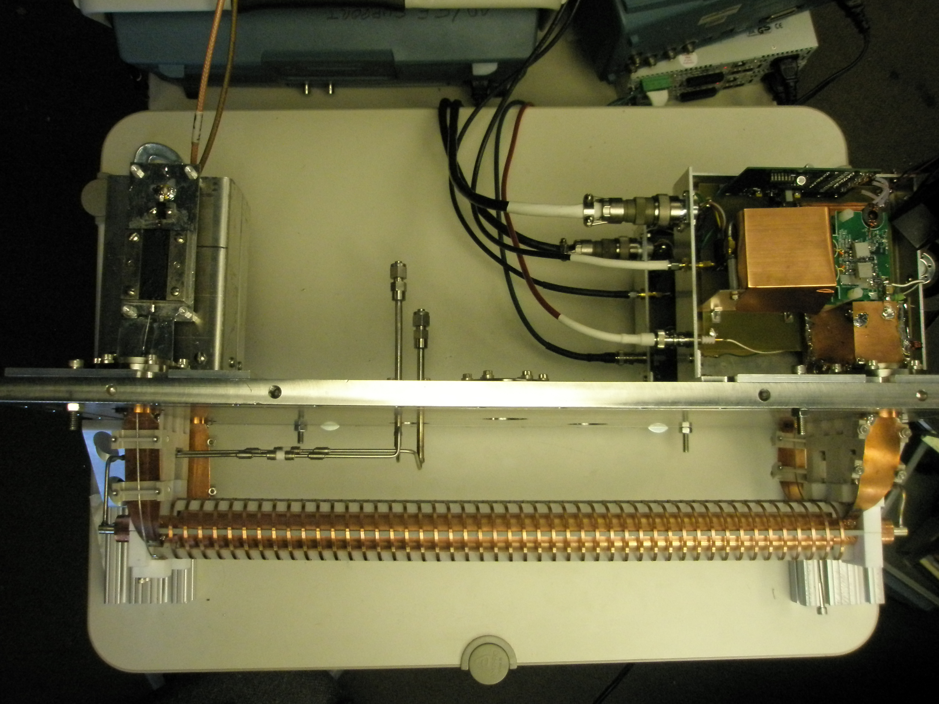
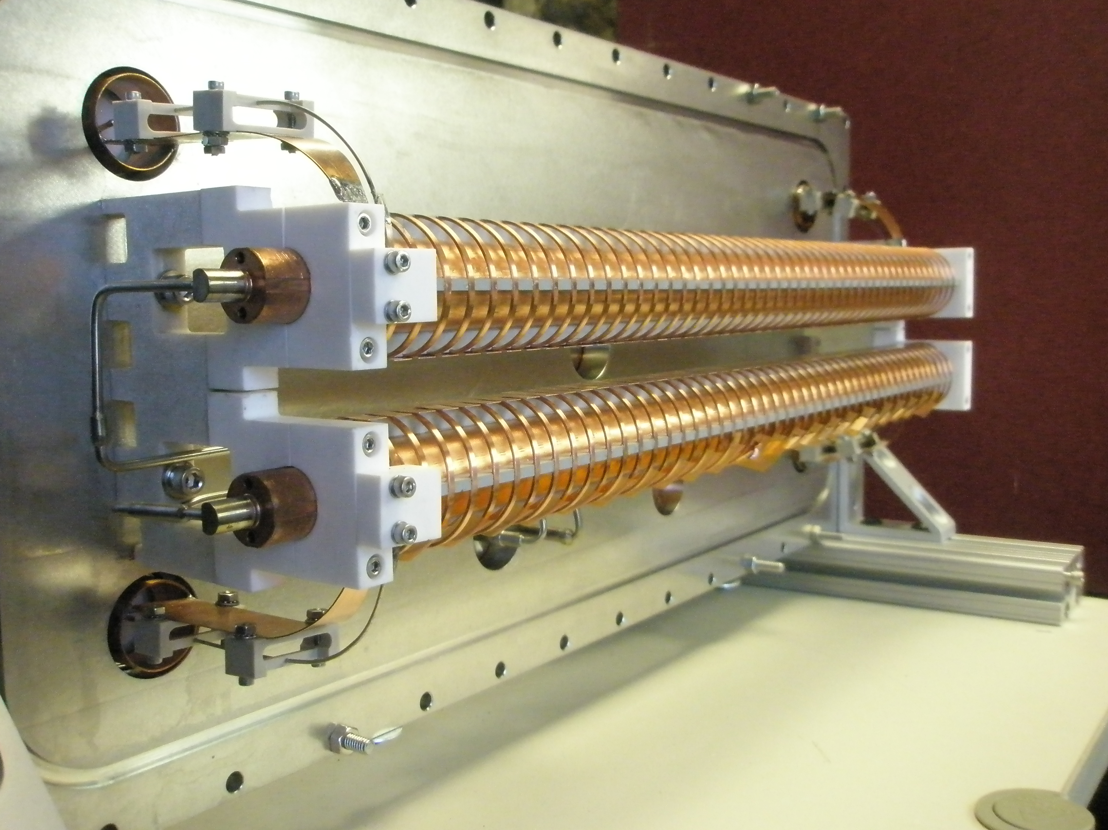
200 Ohm kicker
Kicker is assembled with two drivers and is under RF testing
Top view of 200 Ohm kicker (without vacuum box). Two helixes and two drivers are assembled on the side panel of the vacuum box.
Side view

Slide 24
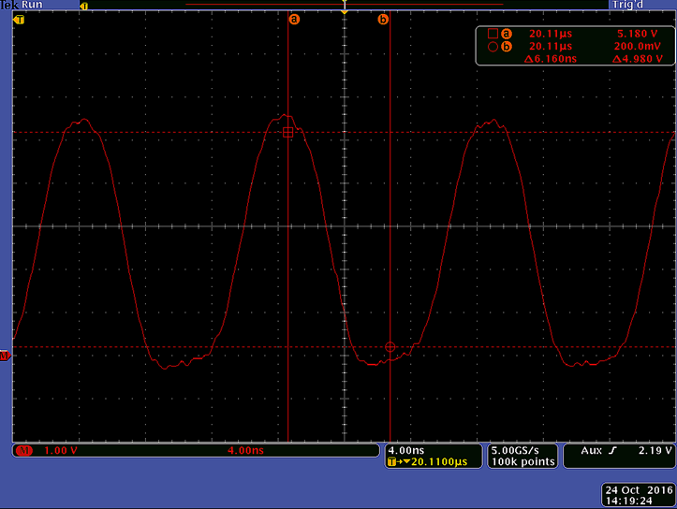
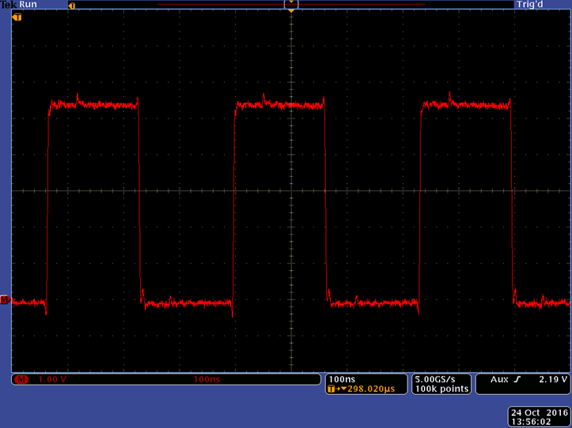
200 Ohm kicker driver
Driver parameters are within specs for short bursts
Transition to CW requires adding of water cooling (doable)
Zoomed in example of wave forms formed by the drivers. Shown are differential signals measured between outputs of the helixes. Peak – peak voltage 1200 V.
50 Hz, 40 µs, 81.25 MHz. Emulates removal of every other bunch of the 162.5 MHz train. 4 ns/div.
20 Hz, 0.6 ms, 3 MHz. Emulates removal of half of bunches in 300 ns batches. 100ns/div.

Slide 25
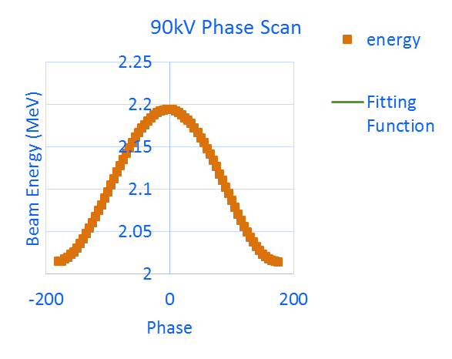
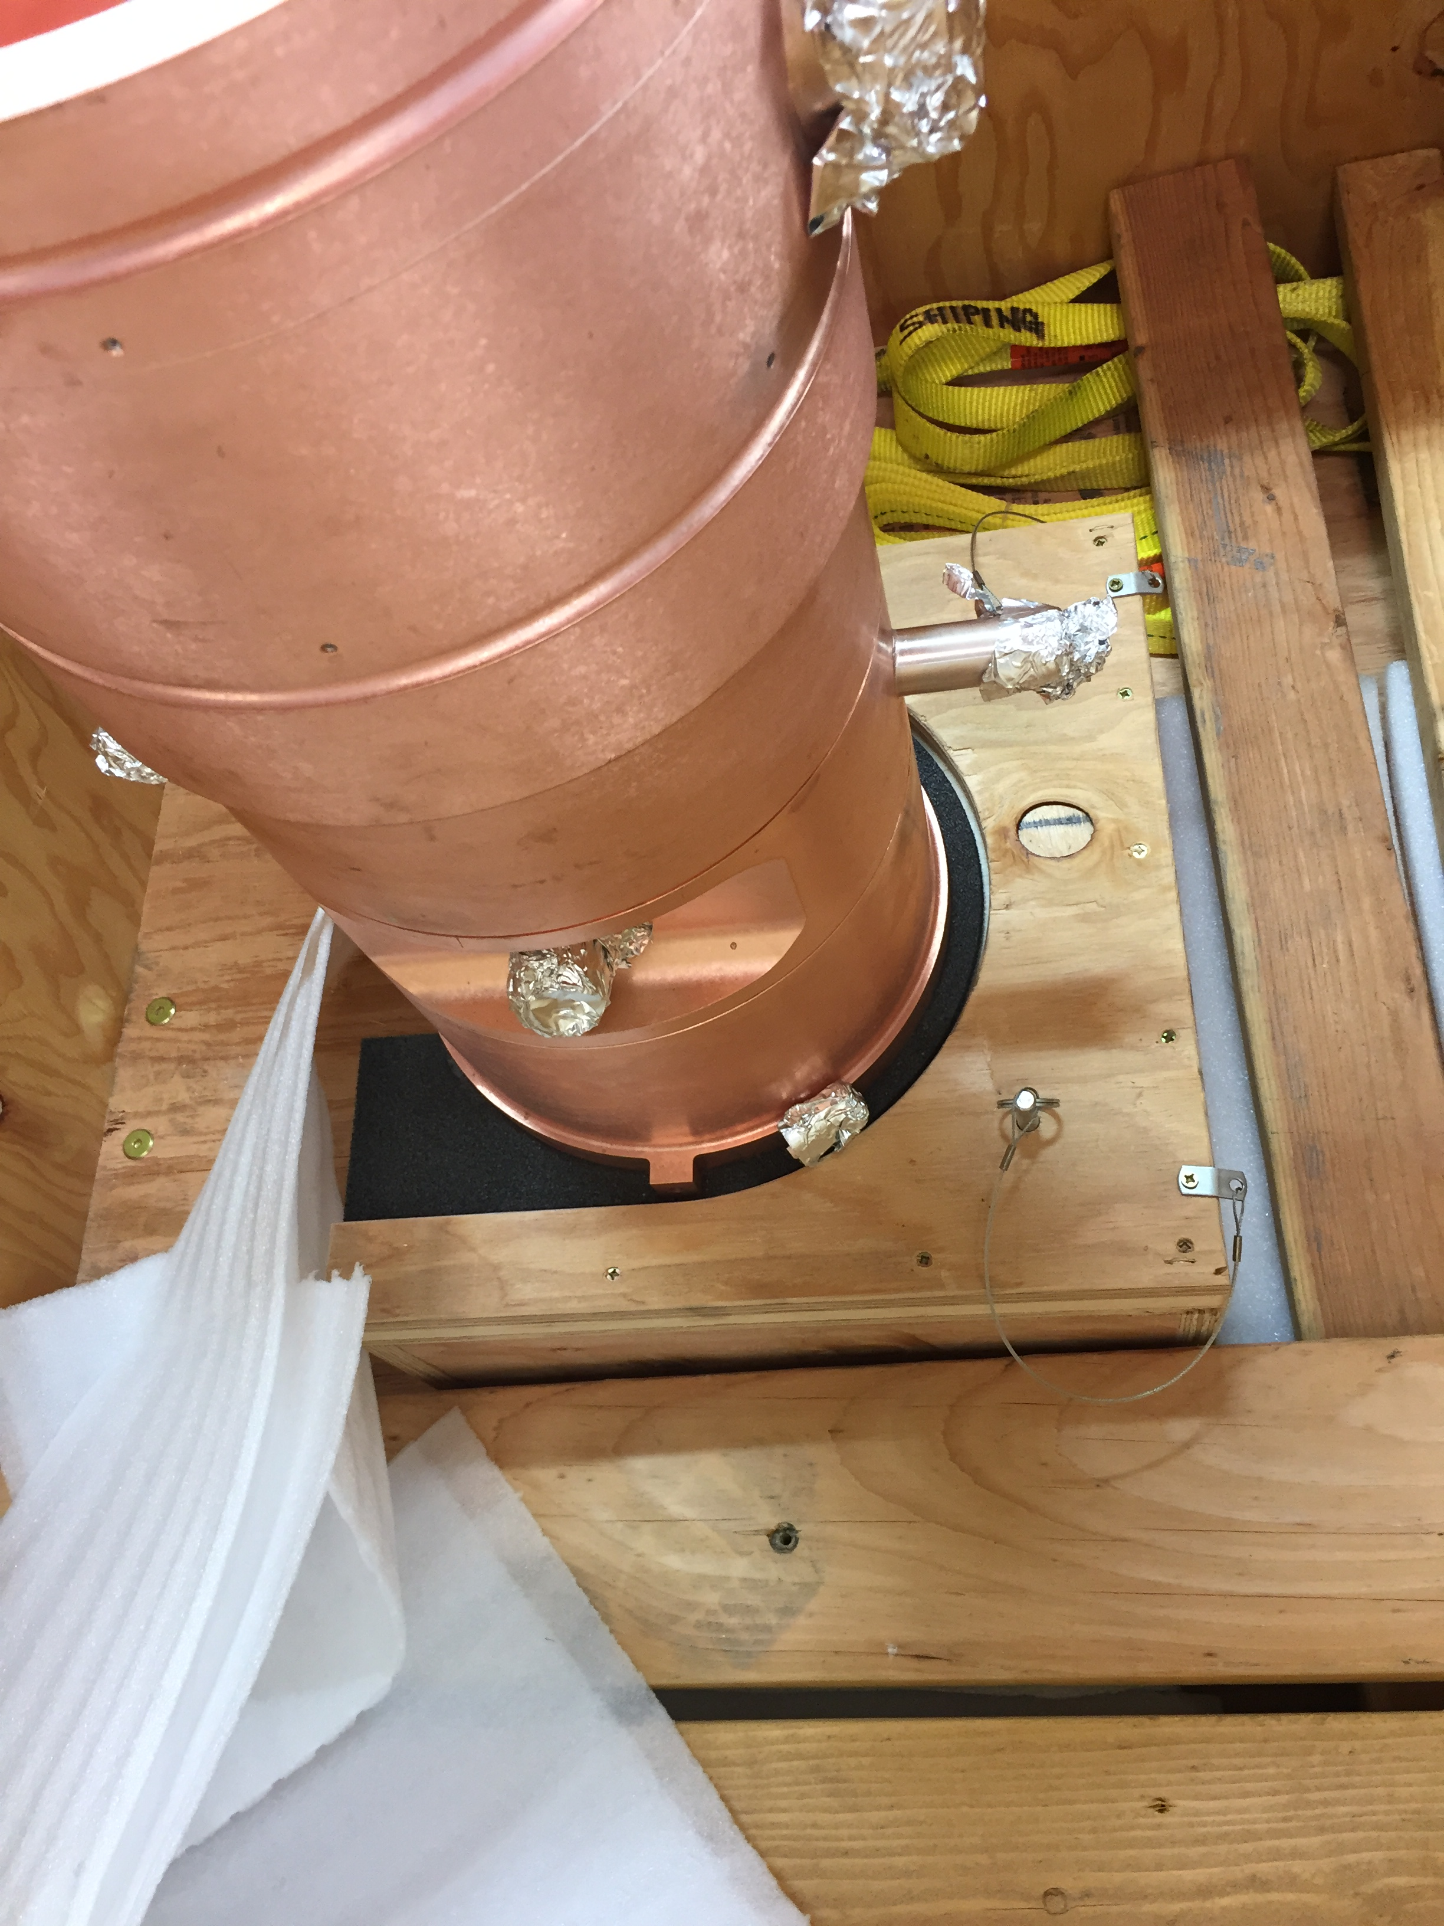
Bunching cavity
Cavity prototype was built and fully commissioned; 3 cavities in production
Calibration by measuring the beam energy with BPMs and a movable Time-of-Flight pickup
This calibration agrees with X-ray measurements
100 kV requires 1.8 kW vs simulated 1.4 kW
Delay with cavities production
Vacuum leaks and shape distortion after first brazing
Repairs will be attempted during following brazing
Body of the first “production” cavity after second brazing

