Slide 1
Satish Joshi (RRCAT)
&
Srinivas Krishnagopal (BARC)
IIFC Technical Coordinators (DAE)
DoE Independent Review of PIP-II
Fermilab, Chicago, 15-16 November 2016
DAE Perspective on IIFC Collaboration
Notes:
1

Slide 2
Satish Joshi
Technical Coordinator (DAE), IIFC
Head, Proton Linac & Superconducting Cavities Division, RRCAT
Cryogenic and accelerator development with experience of 35 years. Involved in design of RFQ, DTL and superconducting cavities and setting up of infrastructure for SCRF cavity development.
Srinivas Krishnagopal
Technical Coordinator (DAE), IIFC
Head, High Intensity Proton Linac Section, BARC
Accelerator physicist with 30 years experience. Worked on beam-beam interaction, free-electron lasers, photocathode guns, electron linacs, RFQ, DTL, superconducting proton linacs, beam dynamics and space charge, laser wakefield acceleration.

Slide 3
Annex-I to the Implementing Agreement - 1
India has a strong interest in High Intensity Superconducting Proton Accelerators (HISPA), for the Indian Spallation Neutron Source (ISNS), Indian Accelerator Driven System (IADS).
Given the commonality of these interests with the PIP-II project at Fermilab an Indian Institutions and Fermilab Collaboration (IIFC) was formalized through an Annex-I to the Implementing Agreement between DAE and DoE USA for Cooperation in the Area of Accelerator and Particle Detector Research & Development for Discovery Science for High Intensity Proton Accelerators, that was signed on 6th Nov 2014.
The contributions of the two parties were spelled out in the Annex-I:
“The HISPA design, technology and supporting infrastructure knowledge transfers from DOE to DAE are the planned in-kind contributions from the United States.”
“The engineering resources, design, manufacturing, and supply of HISPA accelerator hardware from the DAE to DOE, amounting to a maximum total of $200 million (direct cost in US accounting in terms of 2012 US dollars), are the planned in-kind contribution from India over the years 2013-2022.”
Notes:
3

Slide 4
Annex-I to the Implementing Agreement - 2
The DAE contribution to DOE was to be split into two components:
  (1) US$ 60 million from 2013-2017; essentially PIP-II R&D phase.44
  (2) US$ 140 million from 2017-2022; essentially PIP-II construction phase.
Further, the latter was conditional:
“After the joint (DAE-DOE) review of the progress made under India's 12th Plan (2012-17), and if future HISPA projects receive the requisite approvals in both the United States and India ...”
Administration of the Collaboration:
The Principal Coordinators decide to and agree on the itemized list and schedule of deliverables from both sides.
The Technical Coordinators jointly plan the technical approach for accomplishing the objectives, and are responsible for the collaborative program, schedule and coordination.
Notes:
4

Slide 5
Joint Project Document for R&D Phase of IIFC
The next step was to sign a Joint R&D Document for the R&D Phase of IIFC, under the framework of the Project Annex-I.
This document, signed by the Principal Collaborators of DAE and DOE, on 28 August 2015, identifies Joint R&D goals of both parties and lists the deliverables from DAE to DoE with schedules ending in December 2018, co-terminus with the R&D phase of Fermilab’s 1 GeV pulsed accelerator program, PIP-II.
(In the process of revising the dates to align with the extension of PIP-II R&D to 2020)
Notes:
5

Slide 6
XIIth Plan Project in India
Meanwhile, in order to operationalize the Collaboration, DAE proposed a project “Physics and Advanced Technologies for High Intensity Proton Accelerators”, that was approved in October 2014.
This project envisaged an expenditure of Rs. 300 crores in Phase-I, up to March 2017, and Rs. 900 crores in Phase-II, from April 2017 to March 2022.
However, approval for actual expenditure for Phase-II is conditional:
“The progress of the project will be reviewed towards the end of the XIIth Plan (March 2017), and future course of action related to Phase-II will be decided taking into account the progress on all fronts including that at the foreign collaborator's end.”
Notes:
6

Slide 7
IIFC Structure - 1
DAE (BARC, RRCAT, VECC, IUAC) DOE (FNAL)
Principal Coordinator
K. N. Vyas, Director, BARC Jim Siegrist, DOE
Technical Coordinators
Satish Joshi, RRCAT Nigel Lockyer, Director, FNAL
Srinivas Krishnagopal, RRCAT (Steve Holmes)
Sub-Project Coordinators Sub-Project Managers
  (Various) (Various)
Notes:
7

Slide 8
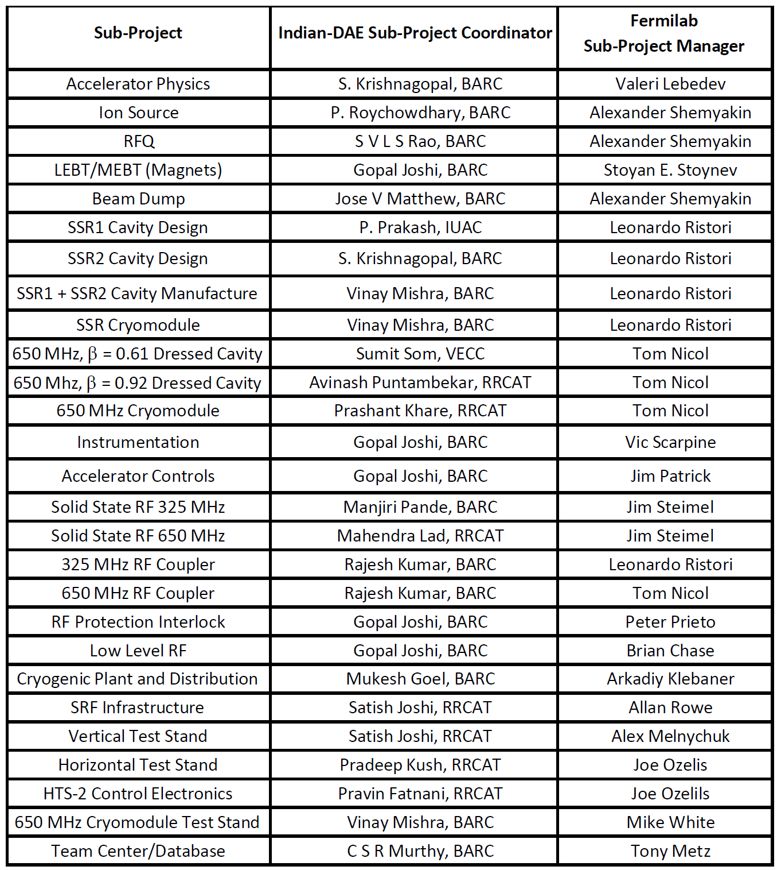
IIFC Structure - 2
Notes:
8

Slide 9
IIFC Progress
IIFC has been very useful in deepening our knowledge and understanding of HISPA science and technology.
Interactions between Indian SPCs and US SPMs have largely been smooth and fruitful.
There have been some issues about flow of information, but we are evolving towards a mutually agreeable framework.
Seven Indian scientists and engineers are on long-term visits (2 year) to Fermilab. They are learning much and their experience and exposure will be very useful after they return to India.
Many scientists and engineers are going to Fermilab on short-term visits (less than 6 months), working on more focused areas, and this has also been a useful experience.
Already, under IIFC, many components have been designed, by Fermilab, DAE, and jointly. Hardware has also started flowing to Fermilab, particularly, magnets, RF amplifiers, superconducting cavities, etc.
Some issues need to be worked out.
Notes:
9

Slide 10
Export Controls
In many cases these items are being denied by US companies because of export-control issues in the US (especially for BARC).
In the July 2016 IIFC Review Meeting Fermilab had agreed to work with the Department of Commerce on the matter, and Chairman, AEC, India, had expressed concern that the collaboration could be jeopardized by these one-sided restrictions.
This matter has been discussed between Chairman, AEC, India, and Secretary, DOE, USA, in Sep 2016 during their bilateral meeting at Vienna, and it was agreed that the matter would be pursued.
A methodology has been established in discussion with Fermilab. Two such items (one hardware and one software) are being pursued to check on the outcome.
This is an important issue for DAE, that needs to be addressed urgently.
Notes:
10

Slide 11
Third-party IPR
As mentioned earlier:
“The HISPA design, technology and supporting infrastructure knowledge transfers from DOE to DAE are the planned in-kind contributions from the United States.”
Since much of the development by Fermilab is done in private industry, there are issues of third-party IPR that may seriously limit DOE's deliverables to DAE.
As a result, DAE labs would be required to spend additional resources, which would result in delays and consequent cost escalations.
In the July 2016 IIFC Review Meeting Fermilab had said that they were working towards resolving one of these issues, related to HB650cavities, and were considering appointing a consultant to help overcome this issue.
This is another important issue for DAE that needs to be addressed urgently.
Notes:
11

Slide 12
Present Status
The Joint Project Document (JPD), envisaged the R&D phase closing by mid-2018.
Meanwhile, due to current financial planning associated with the PIP-II project, DOE and FNAL have extended the R&D phase of the project to 2020.
Modified schedules for the various deliverables (Addendum 1), extending up to 2020 have been finalized, for approval by the Principal Coordinators in the next IIFC Review Meeting scheduled for Jan 2017.
In parallel, a list and schedule of deliverables from DOE to DAE, related to HISPA design and technology, is also being prepared (Addendum 2), for approval.
For continuation of the Indian project beyond March 2017, it will be necessary to prepare a Progress Report for review by the Govt. of India during Q1, 2017.
Notes:
12

Slide 13
The ISNS Project
As a part of the ongoing XIIth plan project titled “R&D activities for high energy proton linac based spallation neutron source”, the work on physics design of various subsystems of the injector linac and accumulator ring has been taken up at RRCAT. For the 1 GeV H⁻ injector linac, physics design studies of individual systems has been completed, and the end to end beam dynamics simulation studies have been performed to ensure that the stringent beam dynamics criteria are satisfied for the optimized lattice. Physics design studies to optimize the linear lattice of the accumulator ring has also been completed. The design studies for the beam transport lines from the injector linac to the accumulator ring, and from the accumulator ring to target are currently in progress. The use of low-β superconducting spoke resonators is similar to the original proposal for Project-X.
Notes:
13

Slide 14
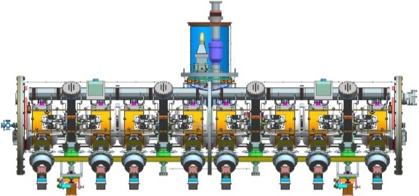
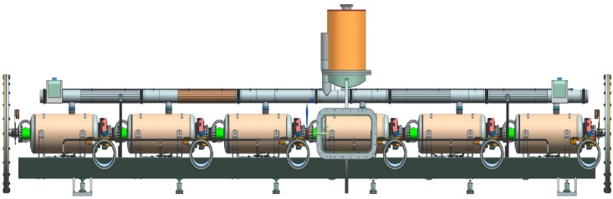
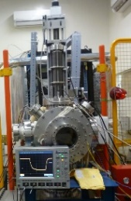
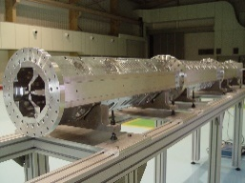
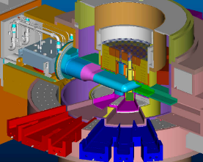
Schematic of 1 GeV Proton Acclerator for Indian Spallation Neutron Source
325 MHz SSR1 CRYOMODULE
650 MHz CRYOMODULE
ION SOURCE
325 MHz RFQ
Length = 5.2 m, dia = 1.219 m
Length = 9.5 m, dia = 1.219 m
1 GeV
1 CRYOMODULES
8 CAVITIES
2 CRYOMODULES
16 CAVITIES
7 CRYOMODULES
35 CAVITIES
10 CRYOMODULES
30 CAVITIES
7 CRYOMODULES
42 CAVITIES
Ion
Source
LEBT
325 MHz
RFQ
MEBT
325 MHz
β_{g}=0.11 SSR0
325 MHz
β_{g}=0.22 SSR1
325 MHz
β_{g}=0.42 SSR2
650 MHz
β_{g}=0.61
650 MHz
β_{g}=0.90
50 keV
(H⁻ beam)
3 MeV
10 MeV
45 MeV
177 MeV
480 MeV
1 GeV
Accumulator Ring
Target

Slide 15
Layout of Proposed 1 GeV Superconducting Proton Accelerator for ISNS Project

Slide 16
The IADS Project
The IADS envisages building a 1 GeV, 10-30 mA, CW superconducting proton linac, with a 325 MHz, 3 MeV RFQ (normal conducting), superconducting single spoke resonators (SSR) accelerating beam from 3-200 MeV, and elliptic cavities accelerating beam from 200 MeV to 1 GeV. There will be 3 classes of spoke resonators at 325 MHz, SSR-A with β_{g} = 0.10, SSR-B with β_{g} = 0.21 and SSR-C with β_{g} = 0.40. There will be two classes of 5-cell elliptic cavities at 650 MHz, ELL-A with β_{g} = 0.60 and ELL-B with β_{g} = 0.80. Detailed electromagnetic designs of all these cavities have been completed, and based on these a detailed beam dynamics design has also been completed. For the first part of the linac, up to 200 MeV, a more detailed reference design has been completed, that gives sub-system details like RF power requirement, cryogenic load, coupler design, etc. An RDR for the 200 MeV Phase-2 accelerator, the Medium Energy High Intensity Proton Accelerator (MEHIPA) is available.
Notes:
16

Slide 17
DOE Participation in DAE HISPA Projects
The Joint Project Document states that:
“The HISPA programs at the Indian DAE laboratories, BARC and RRCAT, and the US DOE's FNAL or Fermilab, are being jointly developed under the IIFC.”
ISNS and IADS are being designed. An RDR for the IADS has been recently released, and a Physics Design for the ISNS is also available.
In addition, Annex-1 to the Implementing Agreement allows for collaborative visits:
“Design and experience developed by the Parties under this Project Annex are to be exchanged. Parties are to arrange collaborative visits. These visits may address research and development programs for the items listed in Section 2.”
DAE looks forward to participation from DOE (specifically Fermilab) in the physics and engineering designs of these accelerators.
Notes:
17

Slide 18
Summary
The IIFC collaboration for PIP-II is proceeding well.
DAE laboratories are actively involved in design and development of many components.
Completion of the R&D phase by 2020 is important not only for PIP-II approvals, but also for getting approval for DAE participation in the construction phase of PIP-II.
Important issues such as export control and third-party IPR remain, and need to be addressed robustly for the health of the Collaboration.
As the ISNS and IADS projects get off the block, the IIFC collaboration will need to work on these projects too.
DAE looks forward to DOEs scientific participation in the DAE HISPA projects as an active partner.
Notes:
18

