Slide 1
PIP-II R&D program: SSR1 Status
Donato Passarelli
DOE Independent Project Review of PIP-II
15 November 2016

Slide 2
Donato Passarelli
Role on PIP-II
  SSR1 Cryomodule System Manager
Relevant Experience
  Jacketed SSR1 cavities and tuners: design, manufacturing, and testing
  Six years in Technical Division, SRF Dept.
  Mechanical Engineer, PhD 2015 University of Pisa

Slide 3
Outline
SSR1 cryomodule for PIP-II
  R&D program and milestones
Status of SSR1 cryomodule
  String assembly
    Jacketed cavities
    Input power coupler
    Solenoids and beam position monitors
  Cold mass assembly
    SSR1 tuner
SSR1 CM schedule
SSR1 Team and work packages
Collaboration within IIFC on SSR1 cryomodule
  Jacketed cavities at BARC
  Production tuners
Summary

Slide 4
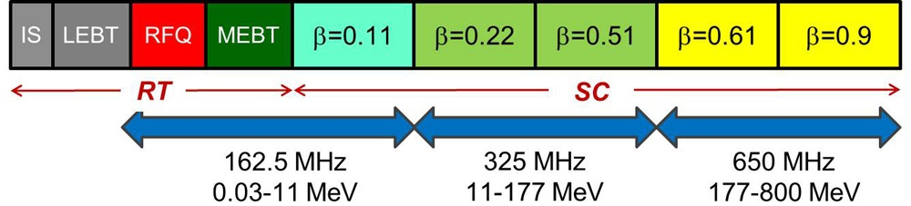



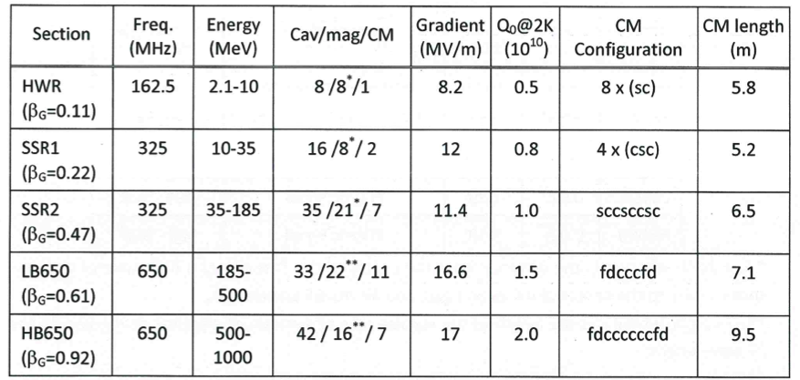
SSR1 cavities and cryomodules for PIP-II
Single Spoke Resonators of type 1 (SSR1) - superconducting cavities - with β_{opt} = 0.22 operating at 325 MHz are employed for the acceleration from 10.3 MeV to 35 MeV
16 SSR1 cavities and 8 focusing lenses compose the two SSR1 cryomodules for PIP-II

Slide 5
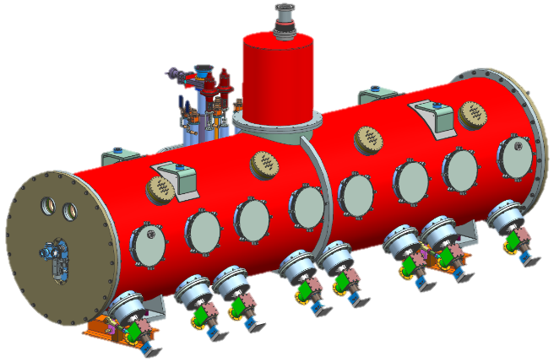
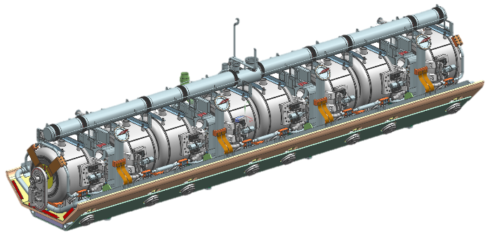
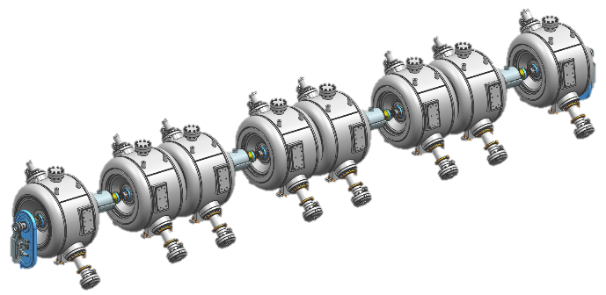
SSR1 R&D phase: scope and milestones
Charge Item: #1
Derwent
Design, make and qualify critical components, and assemble one SSR1 cryomodule for PIP2IT
SSR1 cryomodule – Top assembly
Conceptual design: completed
Final design: ~85% completed
First CM delivered by Sep 2018
SSR1 coldmass
Final design: ~85% completed
Procurement: ~60% completed
Coldmass assembled by Jan 2018
SSR1 string assembly
Final design: 100% completed
Procurement: 100% completed
Assembly completed by Oct 2017

Slide 6
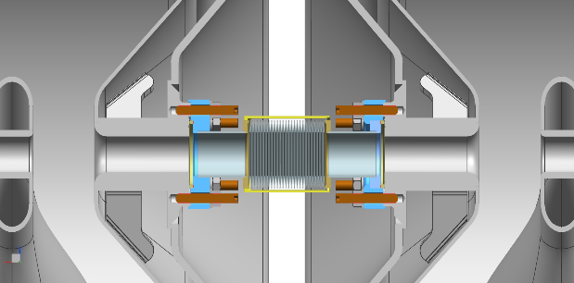
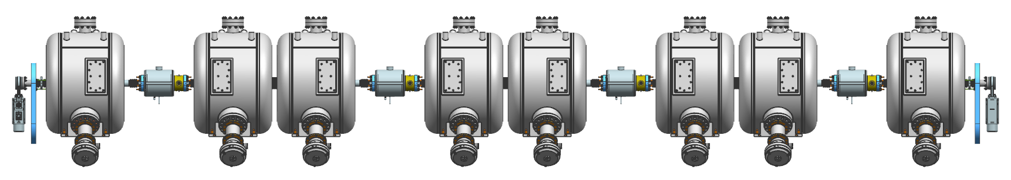
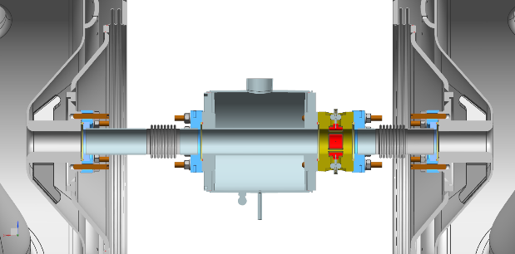
SSR1 String Assembly: design status
Interconnection cavity-cavity
Ultra High Vacuum connection
Edge-welded bellows
Al-diamond seals
SiBr set screws
316L stainless nuts and washers
Status of design: completed
Drawings and documents are in the approval phase
Many lessons learned and challenges addressed
20mm
IIFC SSR1 cavity
IIFC SSR1 cavity
SSR1
Type A
SSR1 Type B
SSR1
Type A
SSR1 Type B
SSR1
Type A
SSR1 Type B
SSR1
Type A
SSR1 Type B
Gate Valve
Gate Valve
Coupler
(cold-end)
Solenoid
BPM
Solenoid-BPM subassembly
Hydro-formed bellows
Ultra High Vacuum connections
Al-diamond seals
SiBr set screws
316L stainless nuts and washers

Slide 7
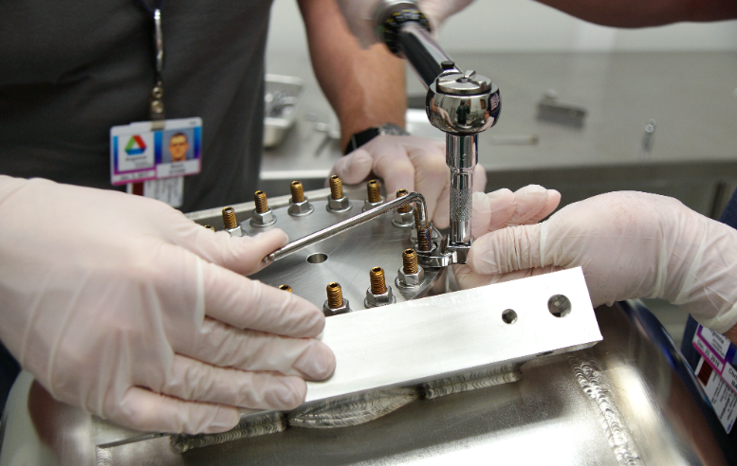
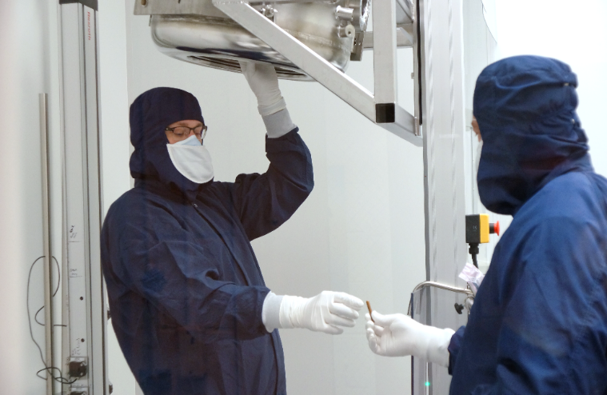
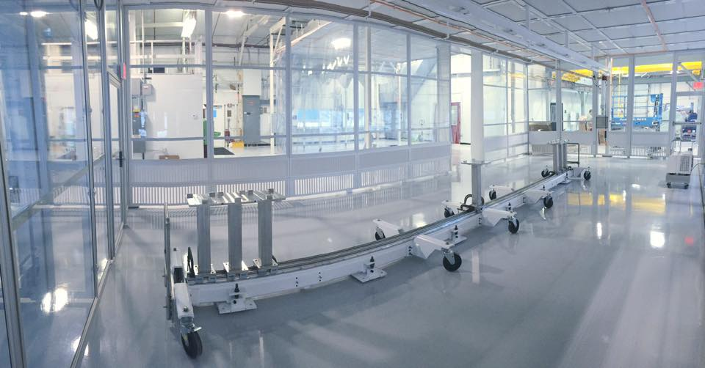
SSR1 string assembly: procedures and facility
General Particle-free assembly procedure is under development ED0004656
The customized particle free procedure for SSR1 flanged connections ensures high reliability and avoids catastrophic damaging of cavity flange threaded holes (ED0004744)
Procedure was successfully validated on two units
  The cleanroom at Lab 2 is ready to receive the SSR1 string assembly
  Cleanroom construction completed and qualified
  Vacuum cart assembled and qualified to provide field emission free venting and pump out
  Ultra Pure Water system and ultrasonic cleaners are fully operational
  900 gal liquid nitrogen dewar installed outside to supply building with nitrogen gas for cleaning parts; line installation completed and undergoing commissioning

Slide 8
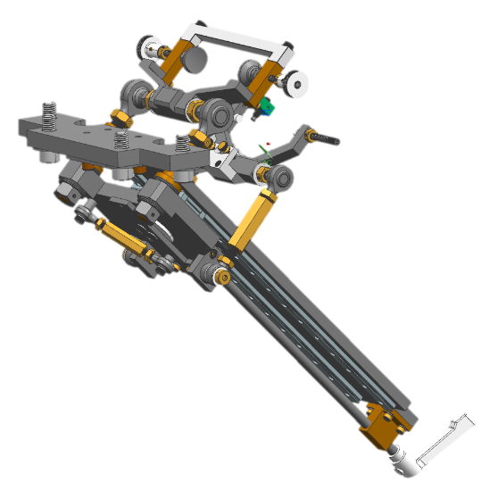
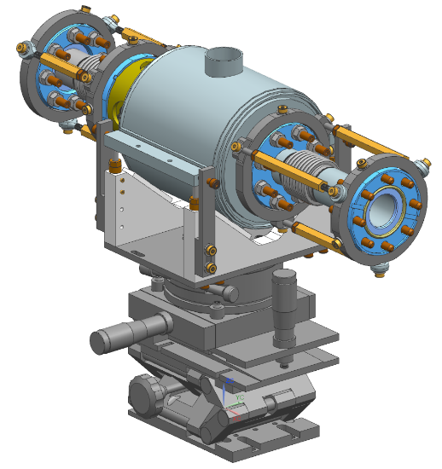
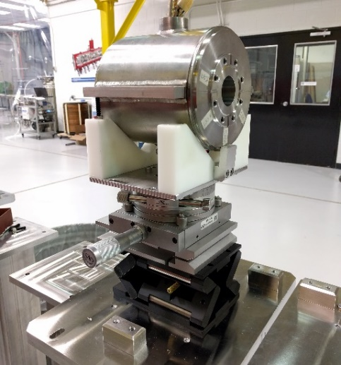
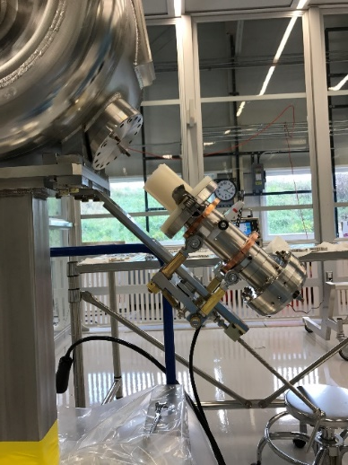
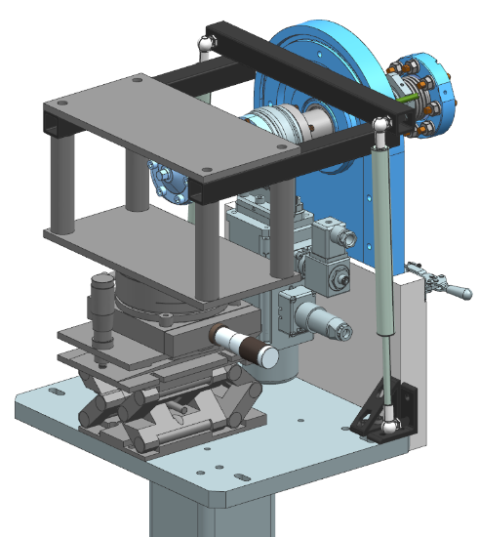
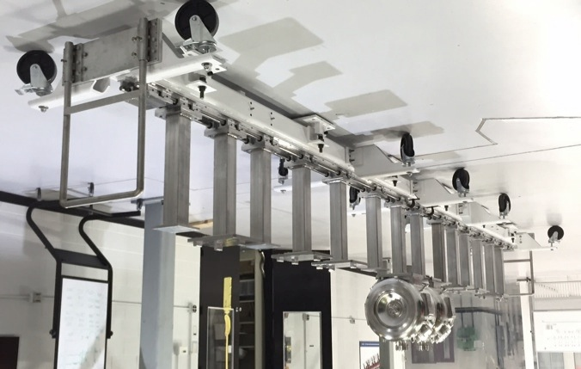
SSR1 string assembly: tooling
Design and procurement of tooling for the string assembly is completed.
Coupler installation tooling: F10048182
Solenoid assembly tooling: F10054275
End-pipe installation tooling: F10058069
Movable rail system: F10044542

Slide 9
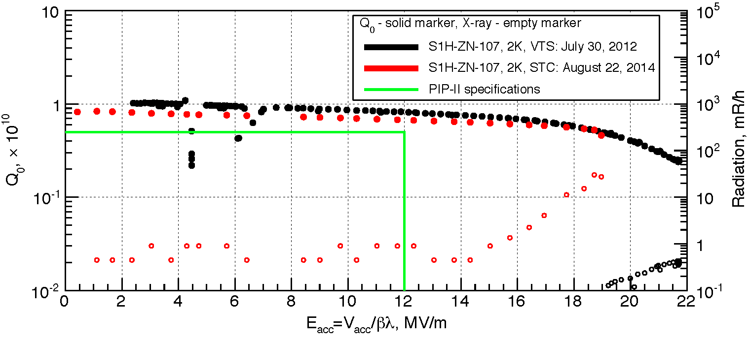
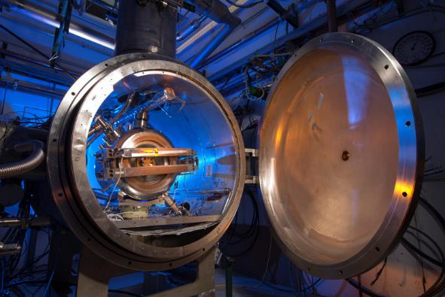
Jacketed SSR1 cavities: status
Eight jacketed SSR1 cavities (made by Fermilab) are ready to be qualified at 2K in the Spoke Test Cryostat (STC) at Fermilab
First jacketed cavity (S1H-NR-107) was tested three times in the STC:
    Prototype coupler and prototype tuner installed
  Performance of cavity, coupler and tuner were confirmed [1, 2]
  Studies of resonance control have been carried out*
Qualification of production of nine jacketed SSR1 cavities (8 made by Fermilab and 2 made by IIFC) in the STC has started and it will be completed by August 2017
Procedures to fully prepare the cavity for STC qualification were written and experimentally qualified
Qualification test plan was defined (ED0005578)
  Meet the gradient and the quality factor
  Perform any needed MP and FE conditioning
  Check input coupler and tuner performance
[1] Result of Cold Tests of the Fermilab SSR1 Cavities, A. Sukhanov et al., Proceedings of LINAC2014, Geneva, Switzerland
[2] Performance of the Tuner Mechanism for SSR1 Resonators During Fully Integrated Tests at Fermilab, D. Passarelli et al., SRF2015, Canada
* See presentation for DOE IPR: Resonance Control of Cavities by W. Schappert

Slide 10
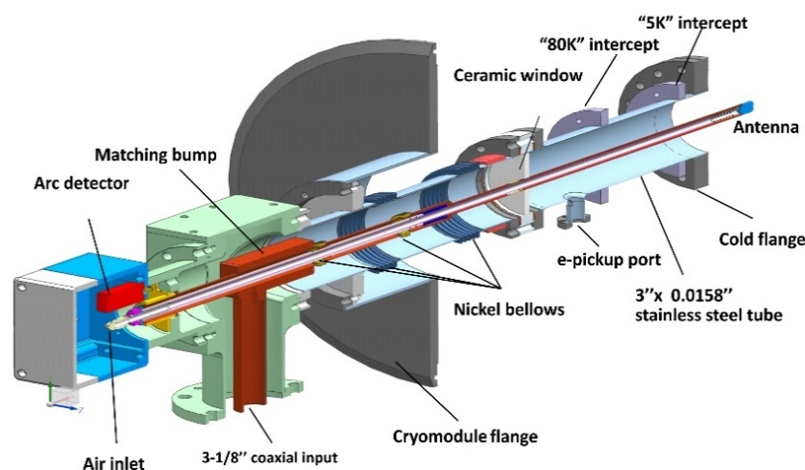
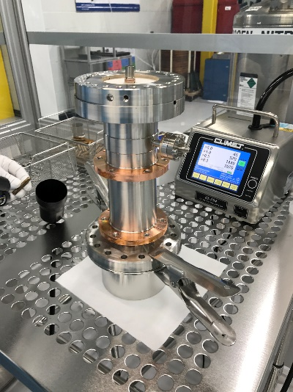
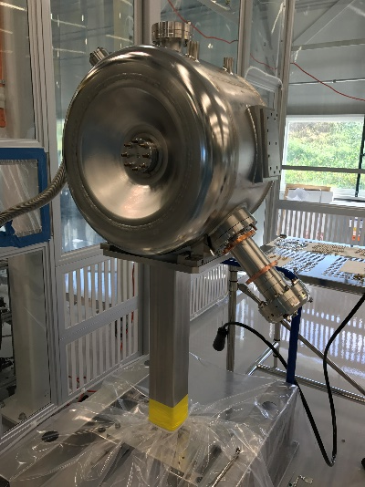
Main Power Couplers: status
Prototype main power couplers
Design, procurement and testing: completed
Three prototypes were procured and tested [1]:
  All units were successfully tested up to 30 kW (in full reflection mode) on the RF test stand at room temperature
  One unit was tested to failure at 47 kW (in full reflection mode) on the RF test stand at room temperature
  One unit was successfully qualified during tests in STC
  Several lessons learned
Production main power couplers
Design completed [2]
Procurement and testing: in progress
Procedures for conditioning and free particles assembling were written and qualified
10 production coupler vacuum ends are in procurement
2 out of 10 units were delivered, conditioned and successfully tested up to at 20kW, in full reflection on the RF test stand at room temperature
First unit successfully installed jacketed cavity (S1H-NR-112) for cold test at STC
[1] Testing of 325 MHz Couplers at Test Stand in Resonance Mode, S. Kazakov, et al., SRF2015, Whistler, Canada
[2] Mechanical Design of a High Power Coupler for the PIP-II 325 MHz SSR1 RF Cavity, O. Pronitchev, et al., SRF2015, Whistler, Canada

Slide 11
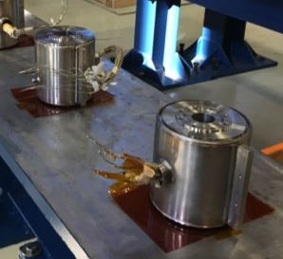
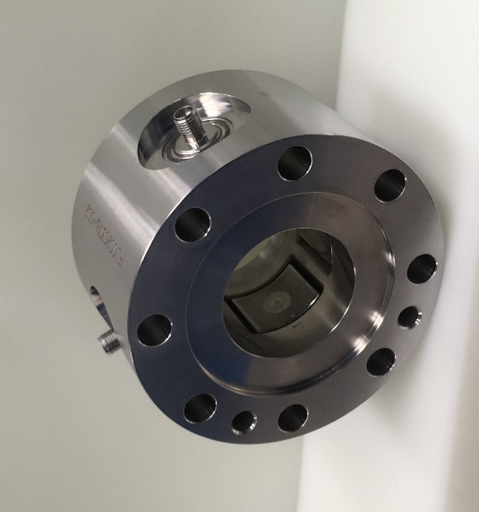
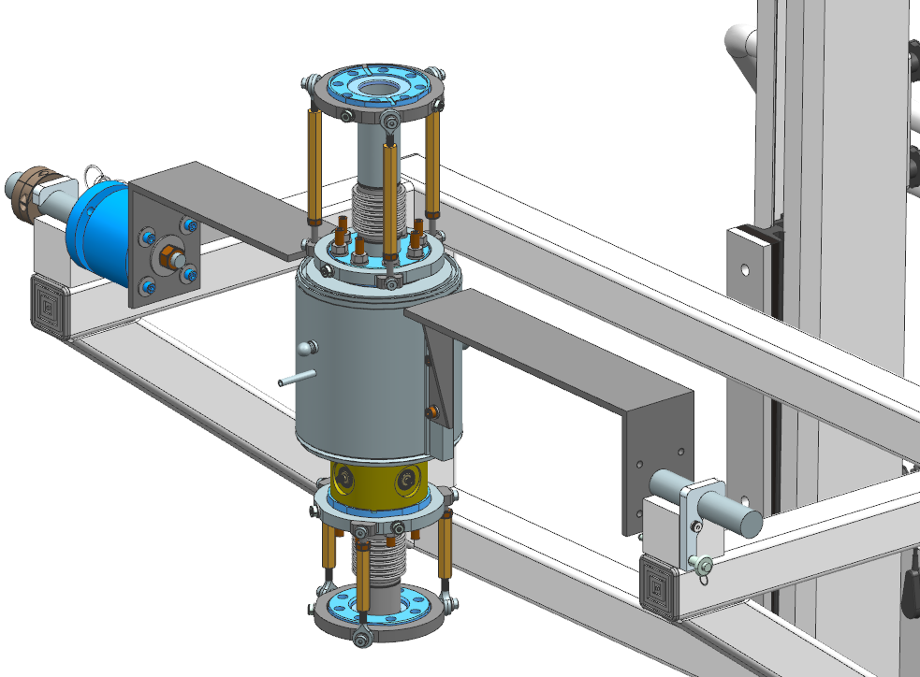
Solenoids and Beam Position Monitors
Four production solenoids were successfully designed, procured and qualified.
Four production BPMs were successfully designed, procured and qualified [1].
Joint collaboration ANL &FNAL
ED0005680
ED0001264
Free particle assembling procedure of the solenoid/BPM sub-assembly is under development
[1] Development of a Low-Beta Button BPM for PXIE Project, A. Lunin, et al., IBIC2013, Oxford, UK

Slide 12
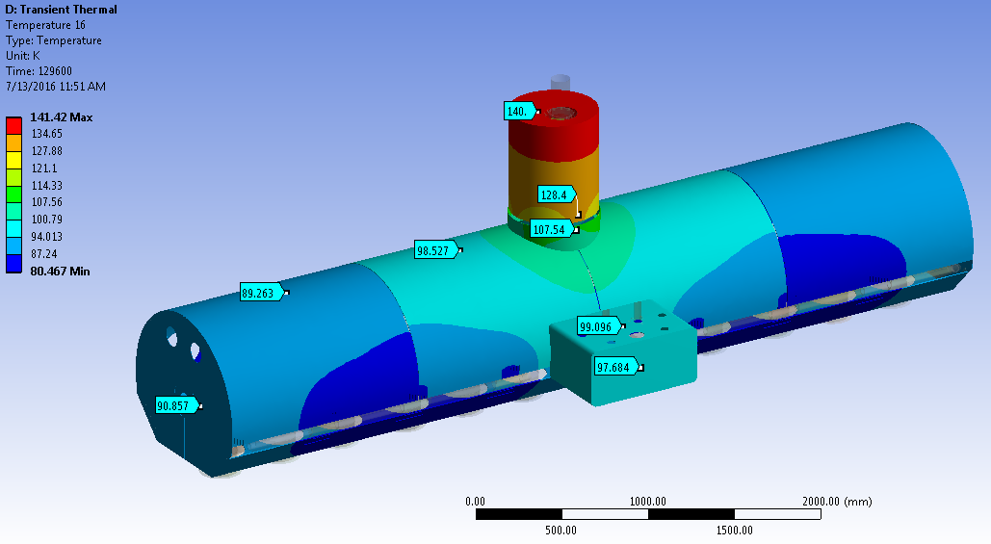
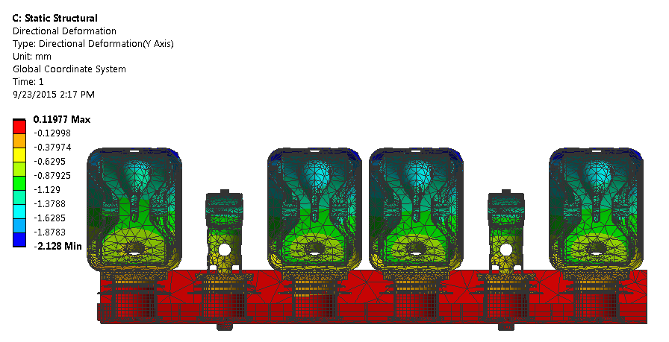
SSR1 coldmass: design status
The design of the coldmass is quite mature
Structural and thermal analyses completed
Piping system, thermal shields and magnetic shields were conceptualized [1]
Strong back and support post were designed and procured
Estimation of cavities and solenoids misalignments due to cooldown
(293K --> 2K) done
[1] SSR1 Cryomodule Design for PXIE, T. Nicol et al., Proceedings of PAC2013, Pasadena, CA USA

Slide 13
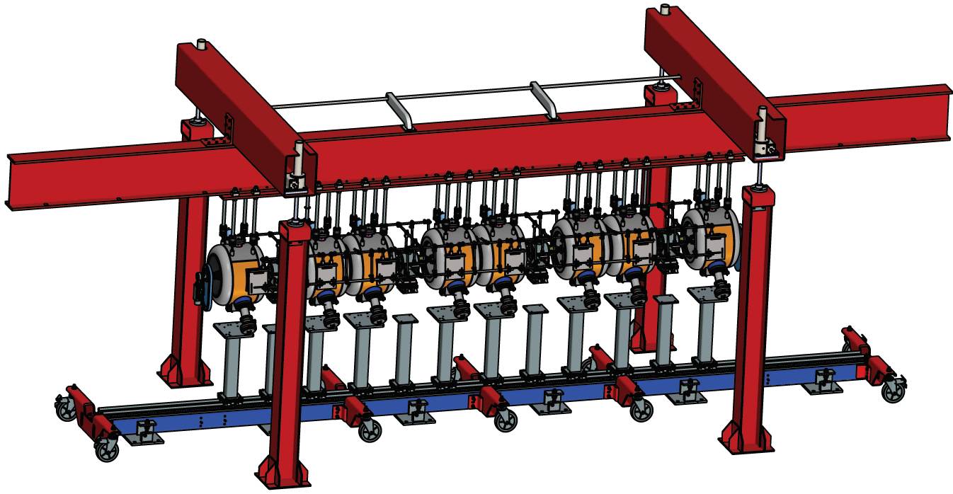
SSR1 coldmass: procurement and assembly
Several components were already procured: strongback, support post, cavity adapting plate, solenoid adapting plate, vacuum vessel (top assembly).
Analytical model to systematically align cavities in the coldmass
The cavities will be aligned according to the geometric axis with the help of the laser tracking technology
The model helps to reach the desired position by suggesting the rotation to be applied at each of the seven screws
Conceptual design of string assembly/coldmass lifting tooling
The conceptual design includes a portal structure realized with standard steel beams and a mechanical lifting system
Structure designed to minimize the deformation during the lifting operation
The design includes an external frame on the string so as to protect itself and support the solenoids
Designed to be also compatible for 650 coldmass

Slide 14
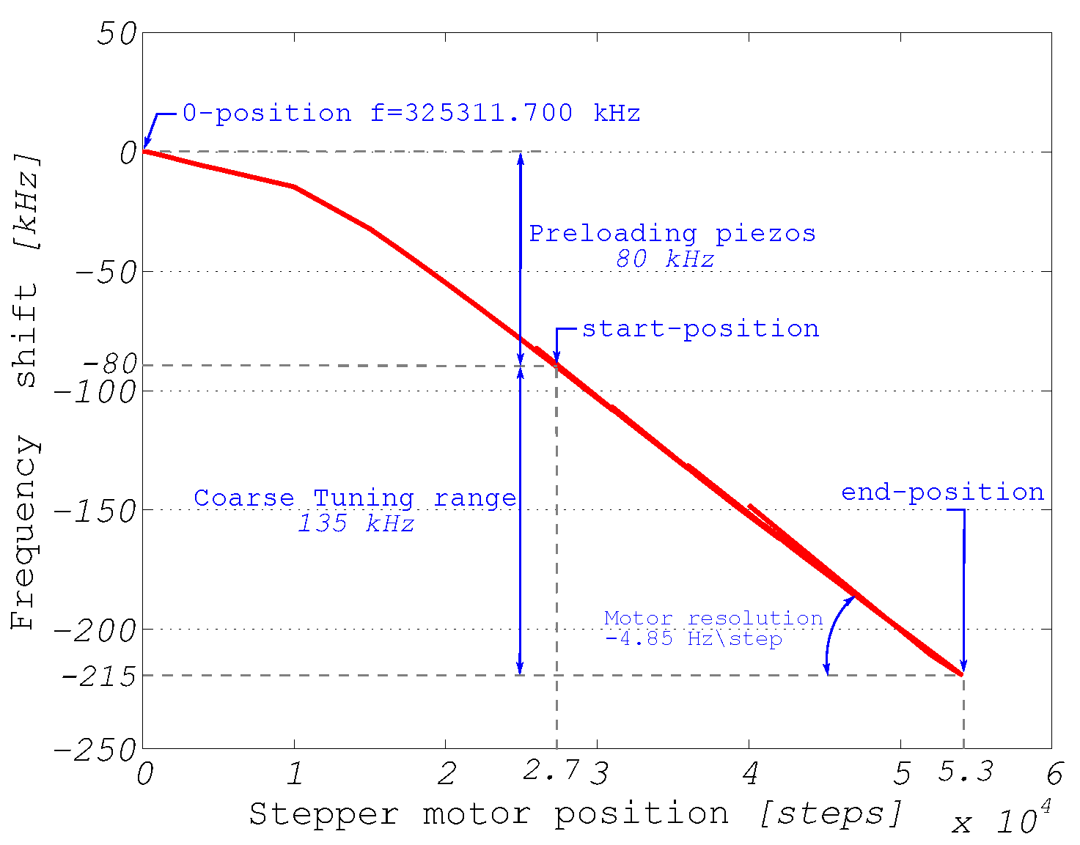
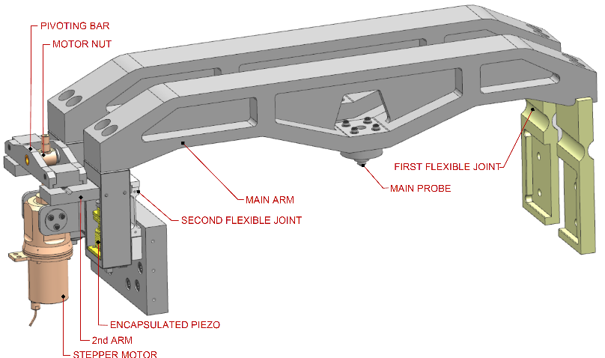
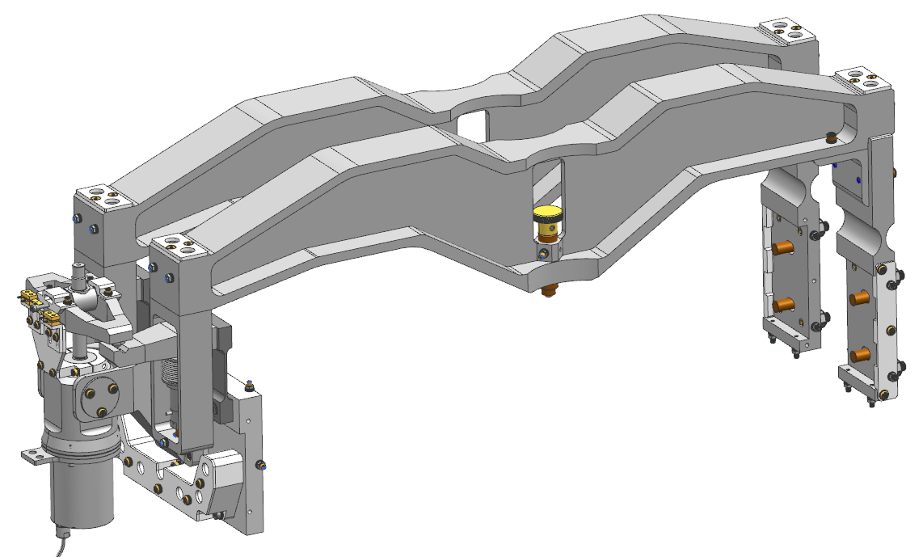
SSR1 tuner: status
Prototype SSR1 tuner
Design completed and one unit was prototyped [1]
Successfully tested at 293K and cold temperature [2]
Production SSR1 tuner
Design on the way of completion
10 units will be procured (+2 units from IIFC)
Qualification at STC will be performed
Main changes:
Reliability of the piezos: integrating pre-encapsulated piezos stacks
Easier installation
Easier handling: reducing the overall weight
Prototype SSR1 tuner
Production SSR1 tuner
[1] SSR1 Tuner Mechanism: Passive and Active Device, D. Passarelli et al., Proceedings of LINAC2014, Geneva, Switzerland
[2] Performance of the Tuner mechanism for SSR1 Resonators During Fully Integrated Tests at Fermilab, D. Passarelli et. al., SRF2015, Canada

Slide 15
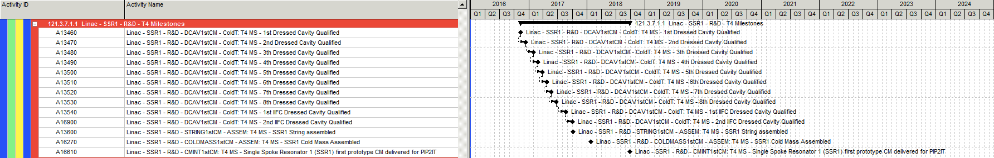
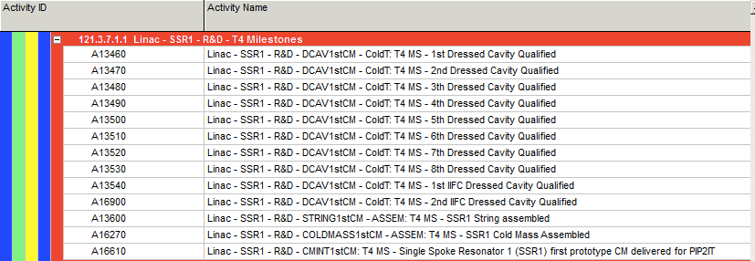
SSR1 CM Schedule
Charge Item: #3
Lari

Slide 16
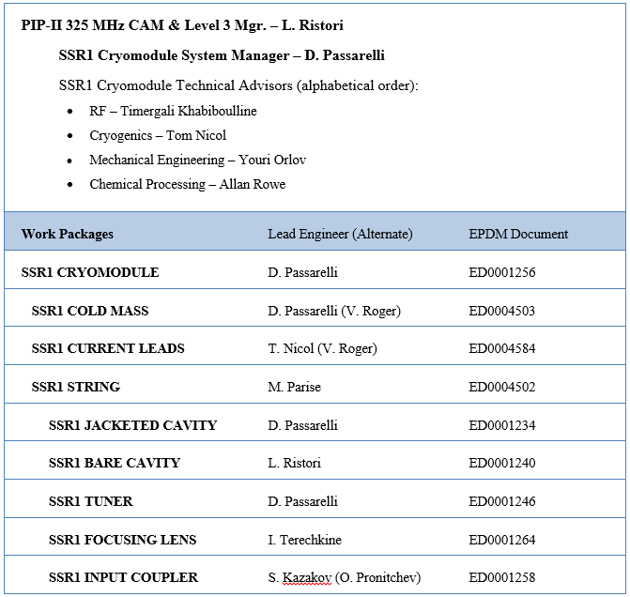
SSR1 Cryomodule Work Packages
Charge Item: #4
Mitchell
Lead Engineers appointed for each work package
EPDM sheets managed in Teamcenter by each Lead Engineer
EPDM sheets promoting adherence to Fermilab Engineering Manual
EPDM sheets provide “bookmarks” to relevant documentation in TC
ED0004600

Slide 17
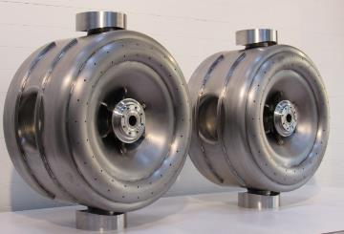
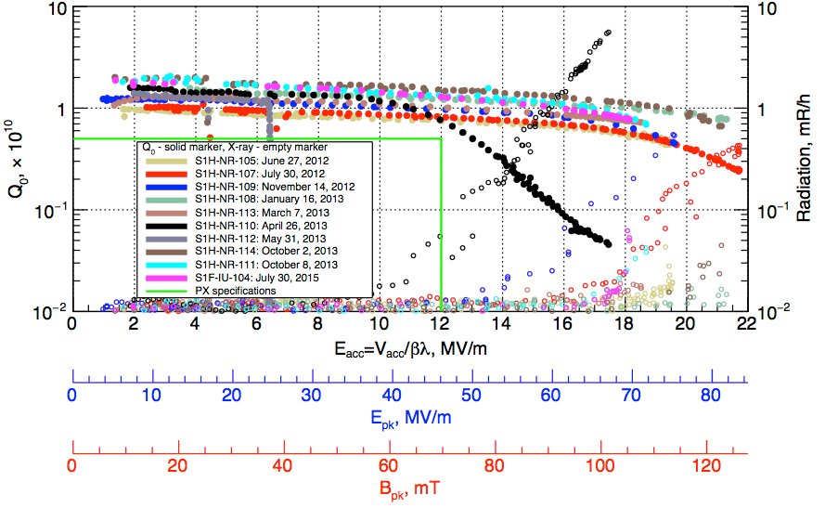
IIFC on SSR1 cryomodule: status
Charge Item: #6
Mishra
IIFC SSR1 cavities
Two bare SSR1 cavities were received from IUAC, chemically processed and cold-tested at Fermilab [1].
S104 yielded excellent results, S103 presented issues.
Jacketing will happen at BARC.
Delivery to FNAL by May 2017 for qualification and integration in SSR1 CM
Additional actions after receiving: QC inspection, Processing, Qualification at STC
IIFC SSR1 tuner
The design of the production SSR1 tuner will be completed in several weeks and the entire package of drawings will be shared with Indian collaborators.
Delivery of two units to FNAL by July 2017
[1] Cold Tests of SSR1 Resonators Manufactured by IUAC for the Fermilab PIP-II Project, L. Ristori et. al, SRF15 Conference

Slide 18
Summary
The design of the SSR1 cryomodule is advanced. Critical components that have been prototyped have met the requirements.
Technical and cost risks associated with the performance of the SSR1 cryomodule are mitigated for the most part by qualifying all production cavities with coupler and tuner in the Spoke Test Cryostat (STC).
The technical team is formed by engineers, scientists and technicians with previous experience in SRF. Work packages and lead engineers are clearly identified.
Collaboration within IIFC on SSR1 is well defined. We expect to have successful contributions to the construction of the first SSR1 cryomodule.
Delivery of the first SSR1 cryomodule to PIP2IT is expected by September of 2018.

Slide 19
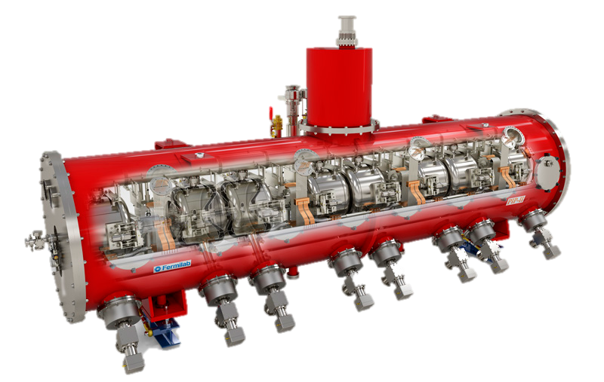
Thank you for you attention
On behalf of the SSR1 team

