Slide 1
LB650 Cavity and Cryomodule Status
Tom Nicol
DOE Independent Project Review of PIP-II
15 November 2016

Slide 2
Tom Nicol – Fermilab
SPM for LB650 cavities, HB650 cavities and cryomodules, LB/HB650 couplers.
Working on PIP-II since 2006 – Spoke test cryostat, SSR1 cryomodule design, HB650 cryomodule design.
Mechanical engineer at Fermilab since 1977 – Tevatron quadrupole and spool designs, LBQ cryostat design, SSC dipole cryostat design, BTeV cryostat design, LHC high gradient quad cryostat design, and many others.

Slide 3
Outline
Program scope.
Milestones and schedule.
R&D status.
Division of responsibility.
Five-cell cavity development.
Ancillary hardware development.
Current status and summary.

Slide 4

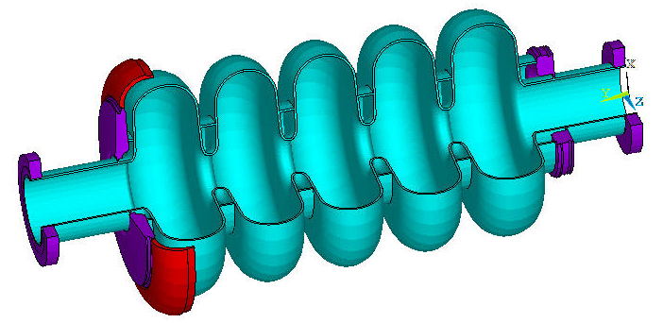
PIP-II
33 LB650 cavities in 11 cryomodules

Slide 5
Cavity performance parameters from the FRS
Parameter | Value
Frequency | 650 MHz
Shape, number of cells | Elliptical, 5 cells
Geometric beta β_{g} | 0.61
Bandwidth | 65 Hz
Energy gain at optimal beta | 11.9 MeV
Surface RF electric field E_{peak} | < 40 MV/m
Surface RF magnetic field B_{peak} | < 75 mT
Cavity quality factor Q₀ at 2K | >1.5*10¹⁰
Dynamic cryogenic load | ≤ 27 W
Parameter | Value
Operating mode | Pulsed with CW capability
Beam Current | ≤5 mA
Max Leak Rate (room temp) | < 10⁻¹⁰ atm-cc/sec
Maximum Gain per cavity in VTS | > 14 MeV
Sensitivity to He pressure fluctuations | < 25 Hz/mbar (dressed cavity)
Lorentz Force Detuning coefficient | <1 Hz/(MeV/m)²
Field Flatness dressed cavity | > 90%
Operating temperature | 2.0 K
Operating Pressure | 30 mbar
MAWP | 2 bar (RT), 4 bar (2K)
RF power input per cavity | up to 60 kW (CW, operational gradient)
Cavity half-bandwidth | 29 Hz
Cavity longitudinal stiffness | < 5 kN/mm
Tuning sensitivity | > 180 kHz/mm
Operational requirements
From LB650 cavity FRS (ED0001834)

Slide 6
Cryomodule performance parameters from the FRS
General
 | Physical beam aperture, mm | 118
 | Overall length (flange-to-flange), m | 5.25
 | Overall width, m | ≤1.6
 | Beamline height from the floor, m | 1.3
 | Cryomodule height (from floor), m | ≤2.00
 | Ceiling height in the tunnel, m | 3.20
 | Max allowed heat load to 70 K, W | 100
 | Max allowed heat load to 5 K, W | 15
 | Max allowed heat load to 2 K, W | 100
 | Maximum number of lifetime thermal cycles | 50
 | Intermediate thermal shield temperature, K | 45-80
 | Thermal intercept temperatures, K | 5 and 45-80
 | Cryo-system pressure stability at 2 K (RMS), mbar | ~0.1
 | Environmental contribution to internal field | <0.1 mG
 | Transverse cavity alignment error, mm RMS | <0.5
 | Angular cavity alignment error, mrad RMS | ≤5
 | Beam duration for operation in pulsed regime, ms | ≤1
 | Repetition rate for operation in pulsed regime, Hz | ≤20
Cavities
 | Number, total per cryomodule | 3
 | Frequency, MHz | 650
 | β geometric | 0.61
 | Operating temperature, K | 2
 | Operating mode | CW
 | Operating energy gain, MV/m | 17.7
 | Coupler power rating (TW, full reflection), kW | 100
Operational requirements from the LB650 cryomodule FRS (ED0001830)

Slide 7
LB650 milestones and schedule*
Major Milestone | Delivery Date
Fabricate 1-cell LB650 Cavity | Complete
Process and test 1-cell LB650 cavity at Fermilab | Complete
Finalize the design of 5-cell LB650 cavity | Q1FY17
Design review of 5-cell LB650 cavity | Q2FY17
Fabrication of 1st 5-cell LB650 cavity | Q3FY18
Processing and vertical testing 1st 5-cell cavity | Q4FY18
Fabrication of 5-cell LB650 helium vessel and its interface to the end group at DAE laboratories | Q1FY19
Dressing LB650 cavity | Q2FY19
Testing of 1st 5-cell dressed LB650 at Fermilab | Q3FY19
Fabrication of 2nd 5-cell LB650 Cavity | Q1FY19
Processing and Vertical testing 2nd 5-cell cavity | Q2FY19
Dressing 2nd LB650 Cavity | Q3FY19
Testing of 2nd 5-cell dressed LB650 at Fermilab | Q4FY19
R&D deliverable
*: This new schedule takes into account of the presentations made by DAE Sub Project Managers at the January and July 2016 meetings of the IIFC in Mumbai.

Slide 8
LB650 milestones and schedule
Major Milestone | Delivery Date
Design of LB650 slow and fast tuner | Complete
Design of 5-cell LB650 tuner interface | Complete
Fabrication of 5-cell LB650 tuner, motor, readout and its interface to the end group at DAE laboratories | Q3FY18
Design of 650 MHz power coupler | Q3FY18
Fabrication of 650 MHz power coupler | Q3FY19
Design of 650 MHz LB/HB cryomodule DAE laboratories and Fermilab | Q3FY18

Slide 9
IIFC single-cell LB650
Charge Item: #1
Technical design
To ensure the RF and mechanical design is sound, a single-cell LB650 niobium cavity was designed and developed by VECC with the help of Electron Beam Welding (EBW) facility at IUAC, New Delhi.
The cavity was sent to Fermilab/ANL in March 2016 for processing and testing in vertical test stand at 2 K.
It achieved an accelerating gradient of 34.5 MV/m.
Although the required operating accelerating gradient is 17 MV/m with Q₀=1.5E+10, the cavity reached up to 34.5 MV/m with Q₀=1.5E+10.
This cavity was not N-doped leading to somewhat lower Q₀.

Slide 10
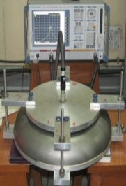
IIFC single-cell LB650 (at VECC)
Half Cells were formed at local industry in Kolkata, India.
Machining at VECC Workshop.
CMM inspection at VECC and frequency measurement.
EB welding at IUAC, Delhi.
  Welding fixtures were manufactured at local Industry
  Development of weld parameters for future multi-cell cavities
  Past experience of IUAC helped to complete successful welding
Forming set up
Half-cell machining
CMM inspection
of half-cell
RF measurement of half cell
EBW,IUAC

Slide 11
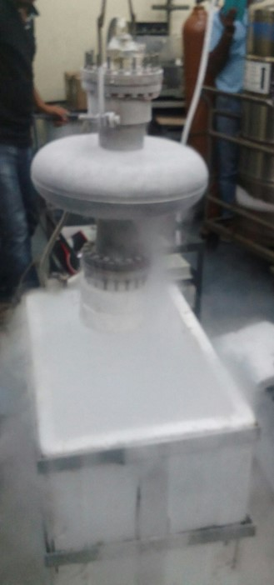
IIFC single-cell LB650 (at VECC)
Cavity Inspection after welding.
  Cold-shocking with LN₂ : 3 cycles
  Leak check
  RF measurement
EBW,IUAC
Cold-shocking
MSLD
RF measurement

Slide 12
IIFC single-cell LB650 (at Fermilab/Argonne)
Inner conductor of VTS couplers were trimmed to the required length.
RF measurement with VTS couplers.
Electro polishing at Argonne in May 2016.
  120 µm bulk EP (Total process time : 560 minutes).
  Ultrasonic thickness measurement after EP.
  Process parameters were strictly controlled during the process.
RF measurement
EP at ANL
Before EP
After EP

Slide 13
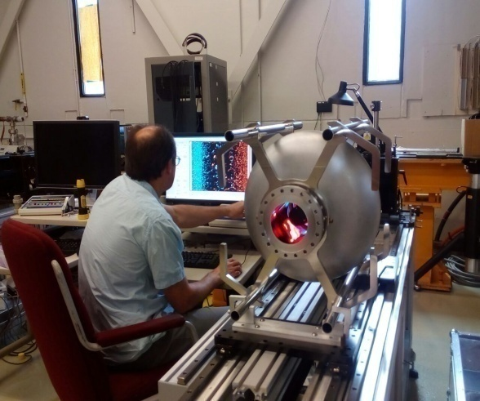
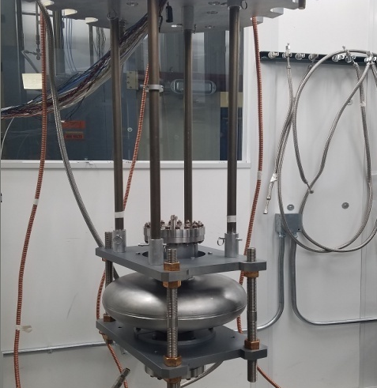
IIFC single-cell LB650 (at Fermilab/Argonne)
High pressure rinsing at Argonne.
800°C baking at FNAL for 3 hours at Fermilab in June 2016.
Optical Inspection of cavity RF surface at FNAL.
Final HPR at Argonne.
VTS Assembly at Fermilab on 30th June 2016.
HPR, ANL
Baking, FNAL
Optical inspection
VTS insert assy

Slide 14
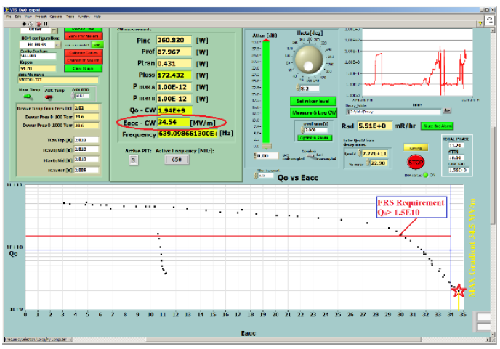
VTS test results of LB650 VECC single-cell cavity
Maximum gradient: 34.5 MV/m @2 K.
No quench at full RF power ~200 W.
30 MV/m Eacc at unloaded cavity quality factor Q₀=1.5E+10.
Eacc & Q₀ - greater than required in FRS.
VTS Test Results on 6th July 2016

Slide 15
LB and HB650 responsibilities
Charge Item: #6
IIFC
Low beta cavities
  Fermilab – RF and end group design
  VECC – Bare and dressed cavity mechanical design and fabrication
Low beta cryomodule
  DAE and Fermilab – Complete cryomodule design with specifications from Fermilab
Tuner design and fabrication
  Fermilab – Prototype tuner design and fabrication
Input coupler design and fabrication
  Fermilab – Prototype coupler design and fabrication

Slide 16
LB650 mechanical design dimensions
Dimensional parameters | Cold dimension (as designed) (mm) | Cold dimension Pre- BCP treatment of 250 μm (mm) | Warm dimension (for fabrication) (mm)
Equator radius | 194.646 | 194.396 | 194.674
Iris radius | 41.5 | 41.25 | 41.30899
A | 52.14 | 51.89 | 51.9642
B | 56 | 55.75 | 55.82972
a | 12.95 | 13.2 | 13.21888
b | 23.55 | 23.8 | 23.83403
Iris radius (for end cell) | 59 | 58.75 | 58.83401
A (for end cell) | 53.52 | 53.27 | 53.34618
B (for end cell) | 48 | 47.75 | 47.81828
a (for end cell) | 10.8 | 11.05 | 11.0658
b (for end cell) | 25.7 | 25.95 | 25.98711
Equator flat (end cell) | 3.79 | 3.79 | 3.79542
Iris flat (mid cell) | 2.61 | 2.61 | 2.613732
Half cell length (L/2) | 70.335 | 70.335 | 70.43488

Slide 17
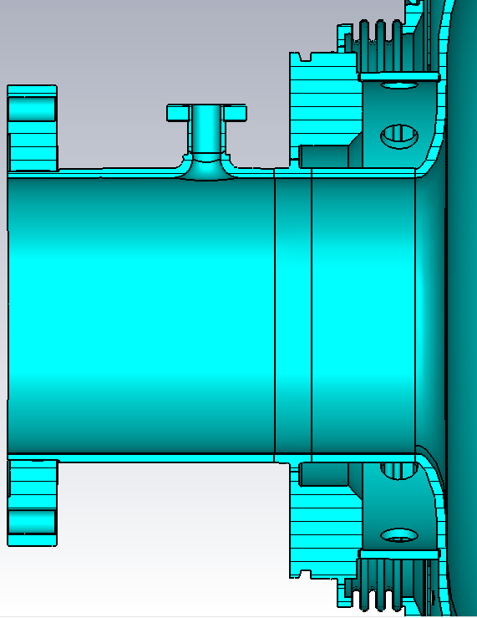
LB650 cavity end group
Field probe and tuner end group
Tuner end group design details developed at Fermilab and made available to VECC for low beta cavity design.
Ø=12 mm
L=89.5mm
L=91 mm
The end group and iris designs were changed specifically to allow the LB and HB650 cavities to utilize the same tuner and coupler.
L=176 mm
Ø=118 mm

Slide 18
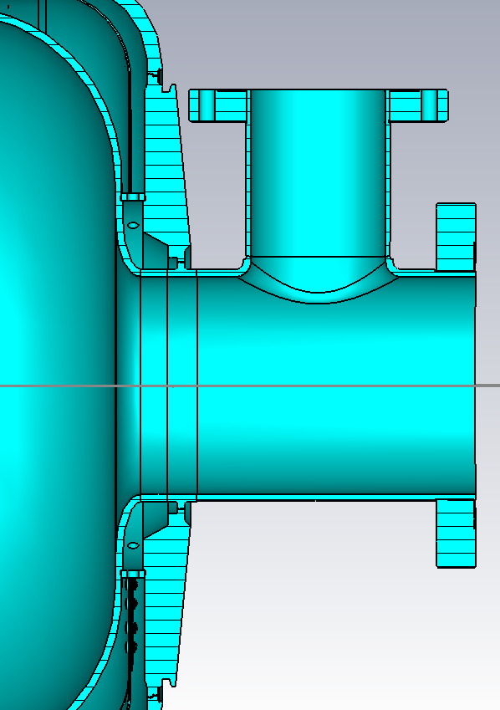
LB650 cavity end group
Power coupler end group design details developed at Fermilab and made available to VECC for low beta cavity design
FPC end group
Ø=72.9 mm
L=160 mm
L=98 mm
Ø=118 mm
Lbeam_Pipe=183 mm

Slide 19
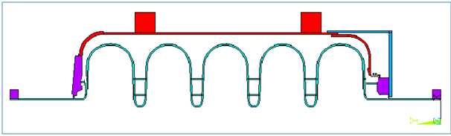
Stiffening ring optimizations
Two stiffener rings for mid cells & one for end cells (R-mid=70/109 mm,R-end= 100 mm)
R_{1mid}=70 mm from central axis
R_{2mid}=109 mm from central axis
R_{end}=100 mm from central axis
59 mm end cell iris radius
41.5 mm mid-cell iris radius
 | Present FRS Criteria | Tuner Stiffness=68kN/mm
LFD(Hz/(MV/m)2) | 1 .3(modified) | 1.21
dF/dP(Hz/mbar) | 25 | 10.5
Modified FRS criteria is satisfied

Slide 20
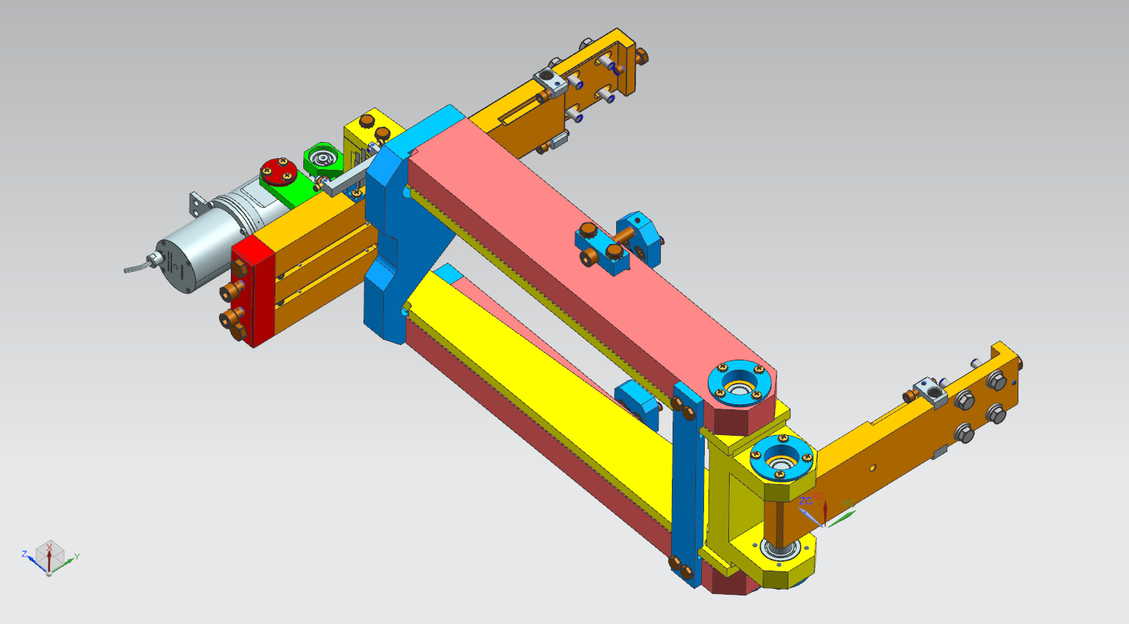
LB and HB650 tuner concept

Slide 21
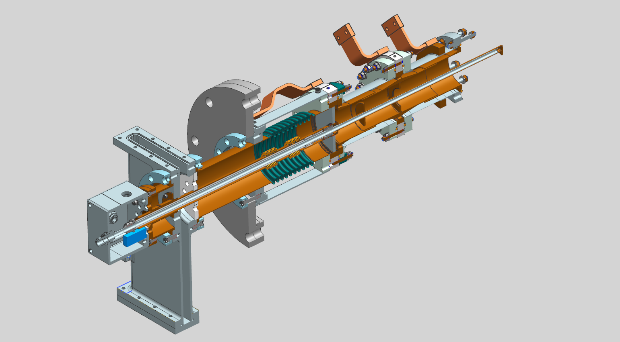
LB and HB650 coupler concept

Slide 22
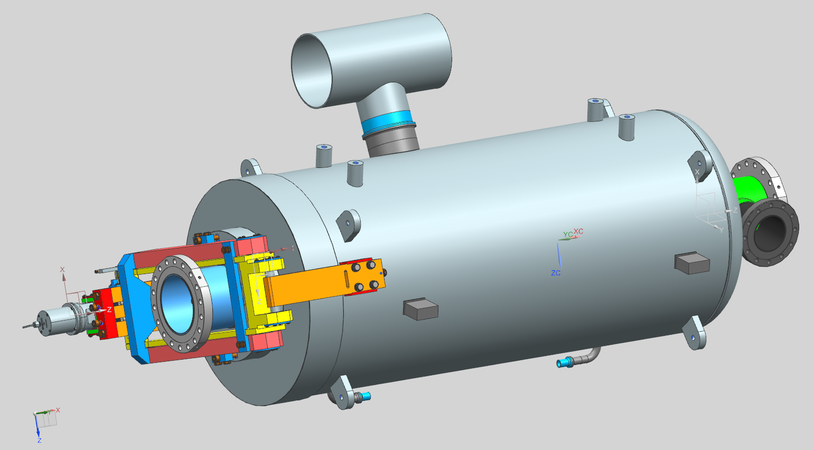
LB650 dressed cavity concept
Power coupler port
Tuner
Helium vessel and pipe connections are compatible with HTS-2

Slide 23
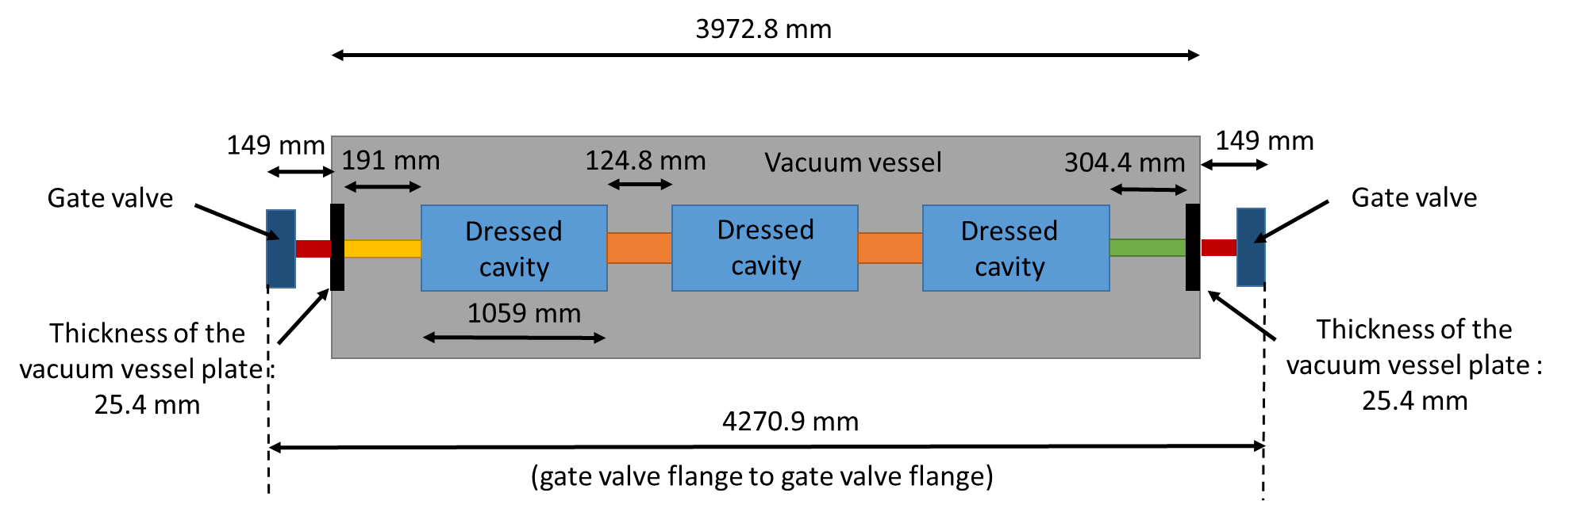
LB650 cryomodule concept

Slide 24
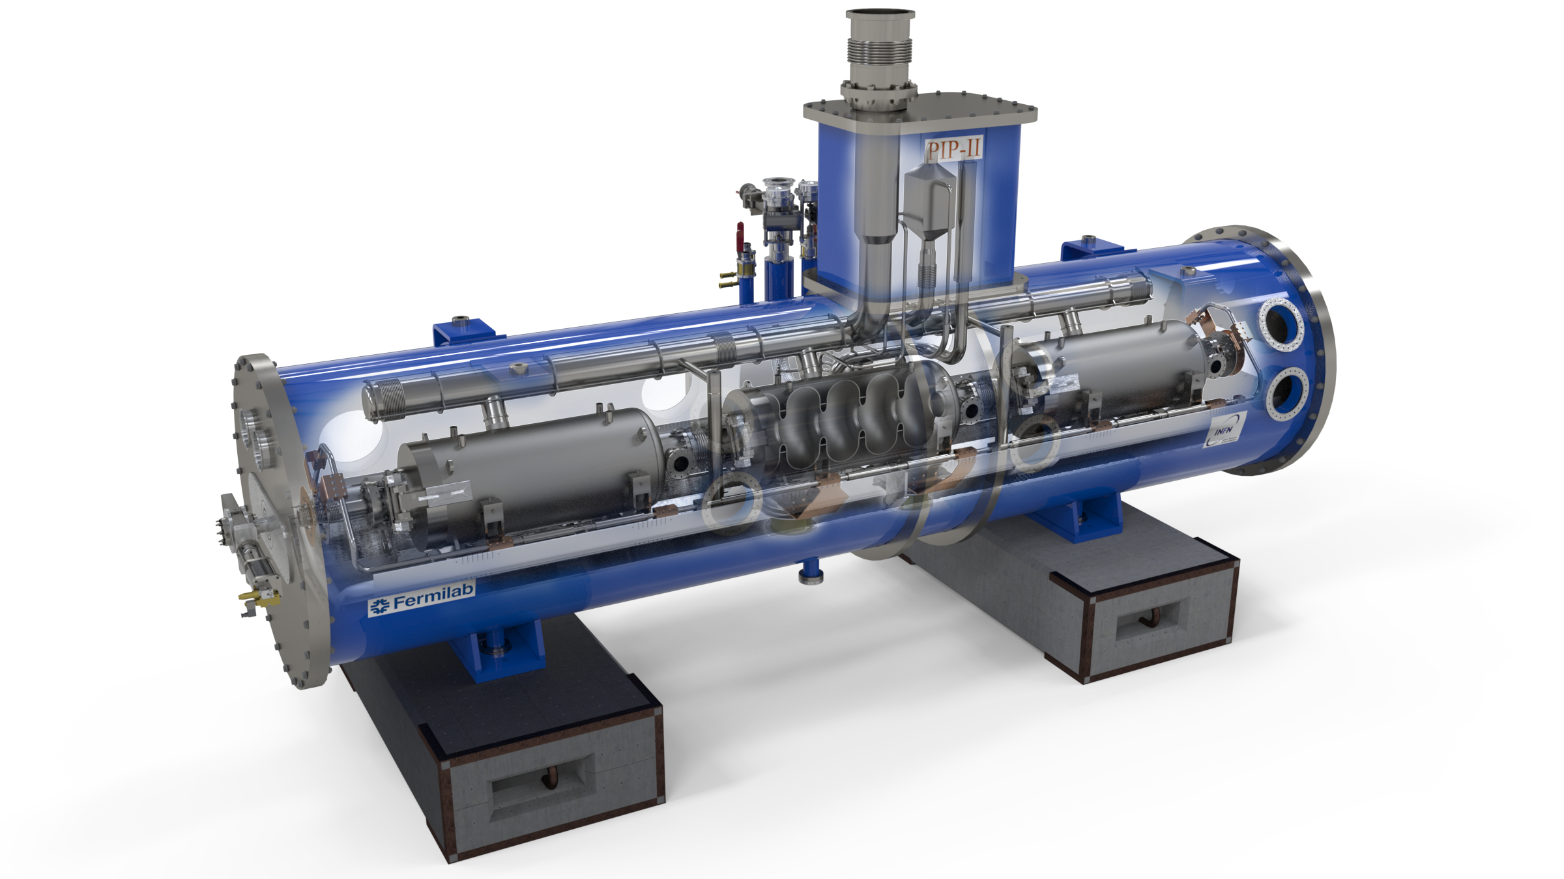
LB650 cryomodule concept

Slide 25
Current status and summary
The first single cell LB650 cavity was tested successfully in VTS to a gradient of 34.5 MV/m.
EM design of the 5-cavity has been done and optimization of the stiffening ring size and position is being carried out to meet the FRS criteria for LFD, dF/dP and cavity stiffness.
The mechanical design of the 5-cell LB650 bare cavity is in progress.
After stiffening ring optimization, structural and modal analysis will be carried out for the LB650 cavity to finalize design.
Helium vessel, tuner, and coupler designs similar to the HB650 designs continue at Fermilab.
Fabrication of a 5-cell LB650 cavity will start after a review of the final design.
Fabrication of the first 5-cell LB650 cavity is expected to be completed within 24 months of the final design review.
Design of the LB650 cryomodule will follow.

