Slide 1
SSR2 Status and R&D Program
Srinivas Krishnagopal (BARC, DAE)
Paolo Berrutti (FNAL)

Slide 2
Srinivas Krishnagopal
Technical Coordinator (DAE), IIFC
Sub-Project Coordinator, IIFC, for SSR2 Design
Head, High Intensity Proton Linac Section, BARC
Accelerator physicist with 30 years experience. Worked on beam-beam interaction, free-electron lasers, photocathode guns, electron linacs, RFQ, DTL, superconducting proton linacs, beam dynamics and space charge, laser wakefield acceleration.
Paolo Berrutti
2

Slide 3
Outline
Introduction
SSR2 R&D Schedule
Cavity EM parameters
Cavity geometry
Multipacting studies and mitigation
HOM analysis
Quadrupole field asymmetry
SSR coupler Qext calculation
Summary
3

Slide 4
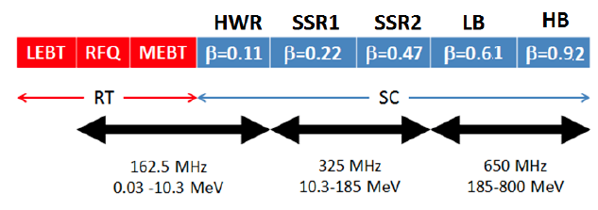
Introduction
PIP-II technology map
SSR2 is part of the SC LINAC of PIP-II, it will accelerate the H⁻ beam
from the end of SSR1 (MeV) to the beginning of the first 5-cell cavity
section (185 MeV).
The total number of SSR2 cavities needed is 35 divided into 7 cryomodules, having 5 resonators each.
SSR2 beam pipe aperture is 40 mm
Peak fields limitations are 40 MV/m for electric and 70 mT for magnetic field.
Focusing is achieved with solenoids, having integrated quadrupole and dipole correctors coils.
4

Slide 5
SSR2 Schedule (From JPD)
Milestone | Major Milestone | Quantity | Responsibility | Proposed Delivery Date | Remarks
1 | Development of SSR2 Design, and review |  | DAE | Mar 2017
2 | Fermilab will supply Nb, SS and Ti for SSR2 | 2 | FNAL | 31 Dec2016
3 | Fabrication of SSR2 Cavities | 2 | DAE | Mar 2019 (1st) | #1, #2
4 | Processing and Vertical Testing of SSR2 cavities at Fermilab | 2 | FNAL | Aug 2019 (1st)
#1:Material being provided by FNAL will not be sufficient for 2 cavities (with contingency). This has been discussed and it is agreed that a final decision on the number of cavities to be delivered will be made at a later stage.
#2: Subject to finalization of TRS by Mar 2017.
5

Slide 6
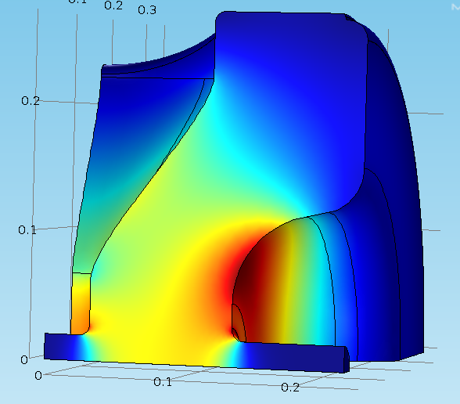
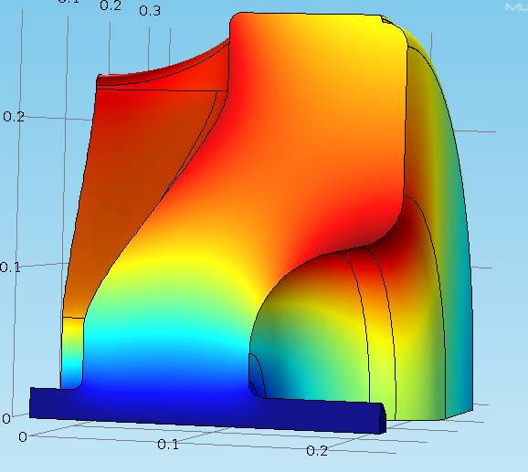
Cavity design and EM parameters
Value of beta has been optimized for PIP-II.
The RF design has been finalized.
EM parameters allow 5.17 MeV energy gain at max peak fields.
3D EM fields are shown below E on the left and H on the right.
Parameters | SSR2 v 2.6
Optimal beta β_{opt} | 0.475
Geometrical beta β_{g} | 0.402
Aperture [mm] | 40
Frequency [MHz] | 325
Effective length 2β_{opt}λ/2 [m] | 0.438
Epeak/Eacc | 3.38
Bpeak/Eacc [mT/(MV/m)] | 5.93
G [Ohm] | 115.2
R/Q [Ohm] | 296.6
Max Epeak [MV/m] | 40
Max Bpeak [mT] | 70
Max energy gain [MeV] | 5.17
Max gradient [MV/m] | 11.8
6

Slide 7
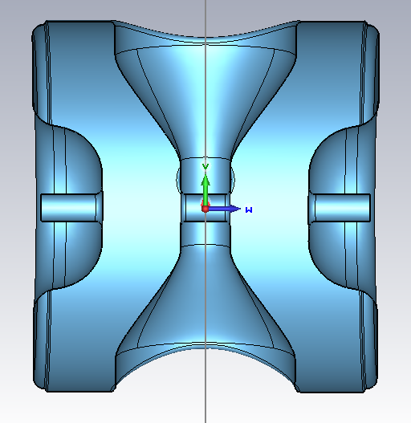
Electromagnetic Design - I
All dimensions are for the cold cavity (2K)
R_spoke
Parameter | Length [mm]
L_cav | 500
R_cav | 271.6
R_spoke | 130.71
D_aperture | 40
Gap_to_gap | 185.9
W_spoke | 72.26
L_cav
D_aperture
Gap_to_gap
W_spoke
R_cav
Z-Y cavity cross section
7

Slide 8
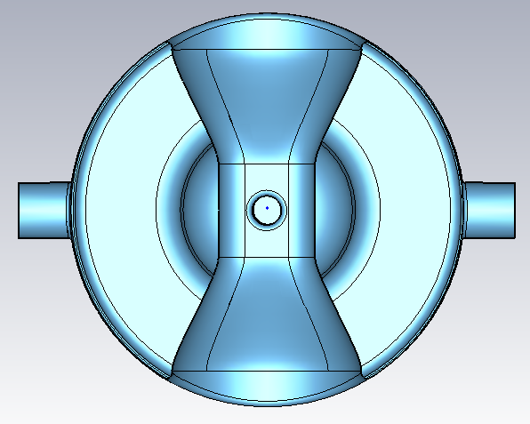
Electromagnetic Design - II
Parameter | Length [mm]
CP_to_center | 337
CP_diam | 76.90
H_spoke | 133
R-cav | 271.6
R_cav
CP_to_center
H_spoke
X-Y cavity cross section
8

Slide 9
Elliptical spoke base
Electromagnetic simulations were performed after changing the spoke base geometry from circular to elliptical. Optimizing D1 and D2, we found that for a ratio of 1,32, B_{peak}/E_{acc} reduces by 5%.
D
Advantage of using an elliptic base is small, so we stick to a circular spoke base
9

Slide 10
Multipacting simulations
10

Slide 11
Multipacting Simulation
Multipacting simulations were performed using MW CST, Particle-in–cell module.
Systematic simulations were performed to study the dependence of mesh density, particle number, number of bunches, initial electron energy and simulation time on the secondary electron emission yield.
Corner radius of curvature was varied to study the effect of the multipacting results.
Effect of change in the curvature radius on the rf parameters was also studied.
11

Slide 12
Multipacting Mitigation
Most severe multipacting take place near transition of cylindrical part to end walls. Several design options of this transition were considered. Most significant improvement was achieved after introducing additional step in the transition area.
SSR2 v1
SSR2 v2.6
SSR2 v2.6
Modification of this transition reduce multipacting in operating range of cavity fields.
12

Slide 13
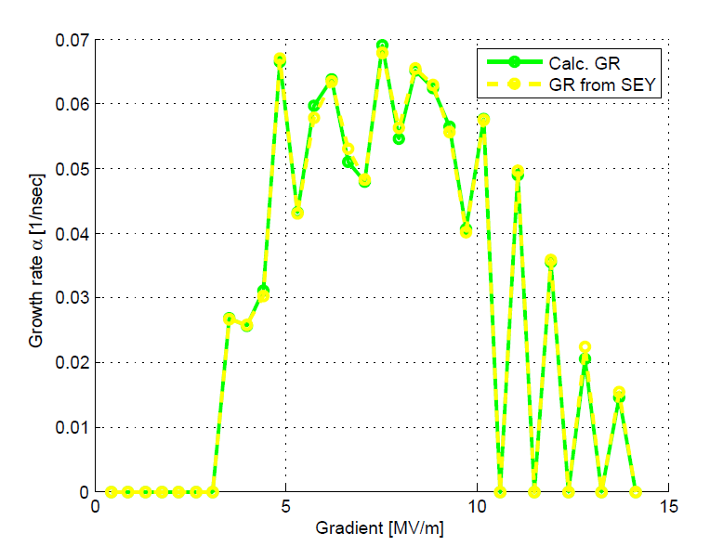
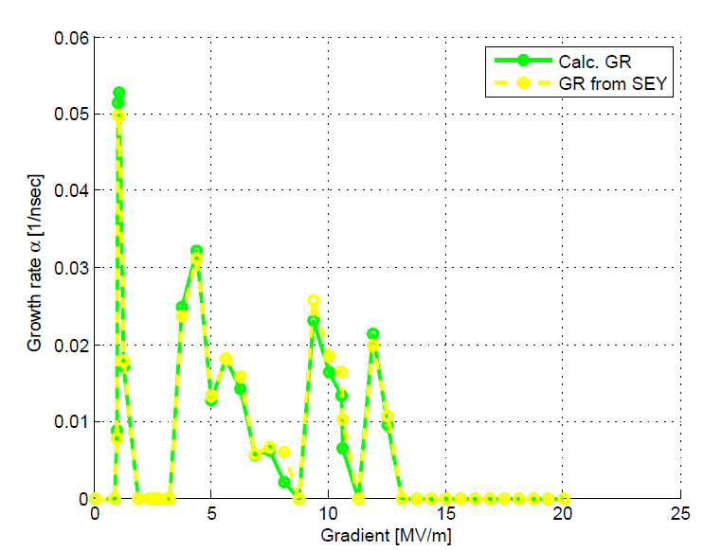
Multipacting Growth Rate
When the multipacting condition occurs one can define the growth rate as the exponential coefficient of the particle number vs time. N(t)=N₀e^{αt}
The old SSR2 design (left) showed high growth rate for all the gradient range used in PIP-II.
The new design (right) has a considerably lower growth rate throughout the whole gradient range.
SSR2 v1
SSR2 v2.6
13

Slide 14
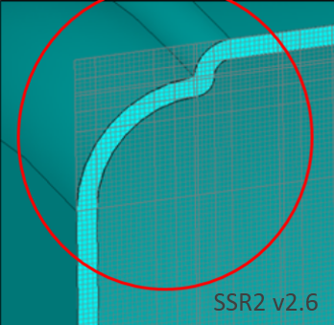
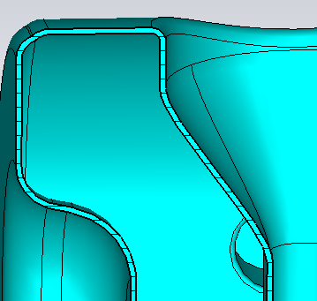
Corner curvature – Risk mitigation 1
Small radius of curvature could be difficult to fabricate. To reduce risk, we studied the effect of an increase in radius on multipacting as well as peak fields
SSR2 v2.6
SSR2 v3.0
3 mm curvature radius
7 mm curvature radius
Radius (mm) | Epk/Eacc | Bpk/Eacc (mT/(MV/m)) | R/Q (ohm) | Growth rate (nsec⁻¹)
3 | 3.42 | 5.93 | 294 | 0.037
5 | 3.42 | 5.98 | 296 | 0.042
7 | 3.42 | 6.01 | 297 | 0.042
14

Slide 15
Corner curvature – Risk mitigation 2
SSR2 v3.0
SSR2 v2.6
SSR2 v3.0 reduces fabrication risks without compromising on multipacting
15

Slide 16
SSR2 v3.0 – Growth rates and fields
The observation that the growth rate is not much affected by the corner radius was checked at different field gradients.
Gradient (MV/m) | Growth rate ($ns^{−1}$) | Epk/Eacc | Bpk/Eacc (mT/(MV/m))
1 | 0.004 | 3.35 | 5.98
1.5 | 1.011 | 3.38 | 5.958
2 | 0.005 | 3.385 | 5.98
2.5 | 0.0006 | 3.38 | 5.992
3 | 0.008 | 3.39 | 6.08
4.8 | 0.042 | 3.42 | 6.01
6 | 0.023 | 3.42 | 6.05
7 | 0.017 | 3.42 | 6.12
8 | 0.00532 | 3.428 | 6.05
10 | 0.0188 | 3.43 | 6.08
11 | 0.0092 | 3.43 | 6.13
12 | 0.015 | 3.43 | 6.13
16

Slide 17
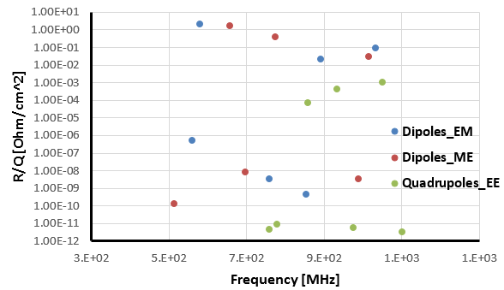
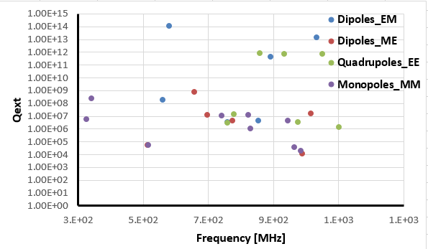
HOM Analysis-I
R/Q and Qext have been calculated for all the HOMs: monopoles, dipoles and quadrupoles.
The pics below show R/Q for all dipoles and quadrupoles, on the left, and Qext calculation, on the right including monopoles.
17

Slide 18
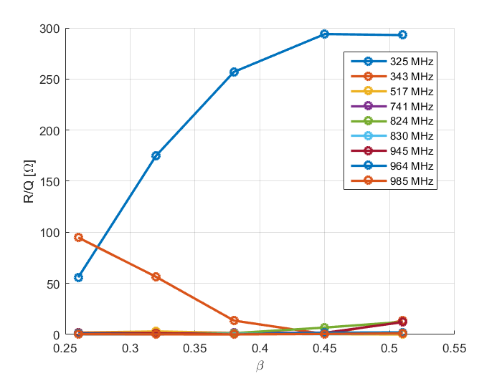
HOM Analysis-II
R/Q for monopoles modes has been calculated as a function of the particle beta, in the energy range of SSR2 cavity.
The zero mode (343 MHz) R/Q is higher than the accelerating mode R/Q, being the frequency ≈18 MHz away from the accelerating mode it should not be a dangerous resonance, it needs to be checked (beam harmonic analysis).
18

Slide 19
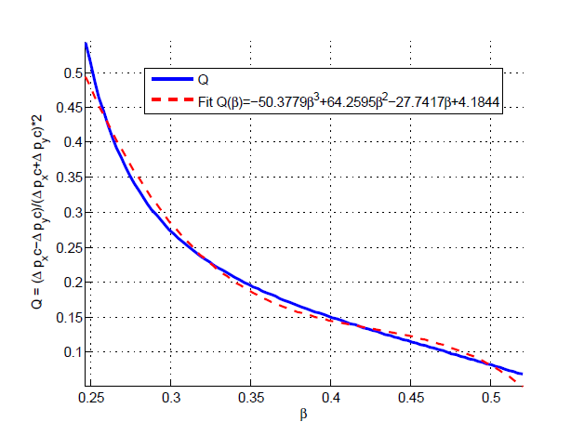
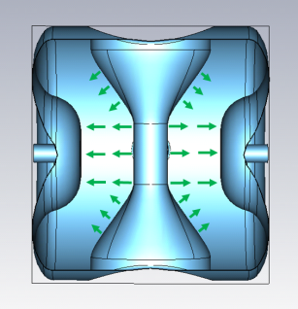
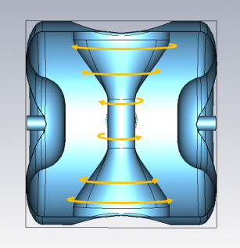
Quadrupole field asymmetry
Spoke resonators have a central electrode that lies on one of the axes perpendicular to the particles motion, breaking axial symmetry of the cavity.
Electric and magnetic field SSR2 fundamental mode sketch.
Q vs particle beta for the whole energy range of SSR2
The quadrupole field asymmetry of SSR2 has been studied and it is within the range of the quadrupole corrector integrated in the solenoids.
19

Slide 20
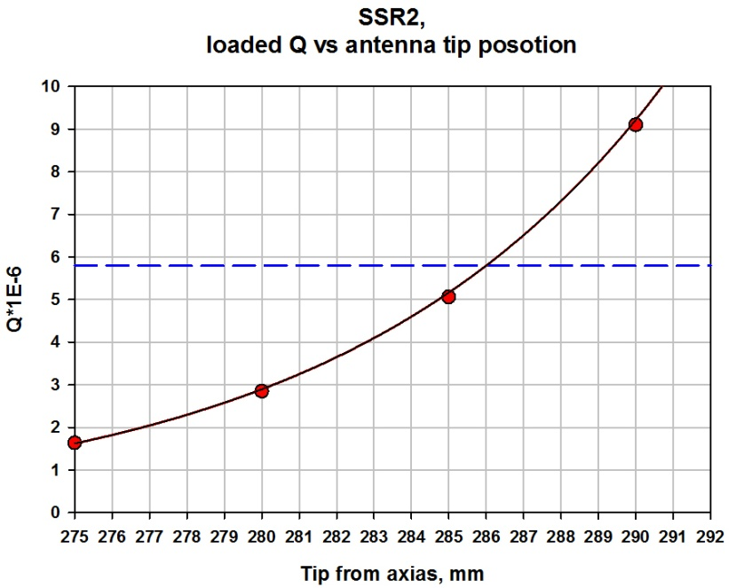
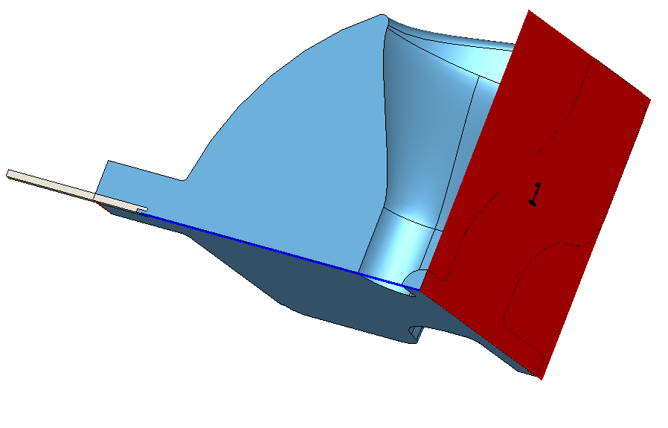
Coupler Qext simulation
The coupler used for SSR2 cavities is going to be the same as SSR1.
Nominal position of the antenna tip has been simulated to match the Qext required for operation.
Qext approx. 5.8E6 at 286 mm distance from the cavity center, for comparison: Qext SSR1 approx. 3.75E6 at 255 mm.
The coupler satisfies the project specification for Qext.
S. Kazakov
Antenna tip position, mm | S21, dB | Radiated power through full port (0.5W in), W | Radiated power trough port (1 J), W | Qext
275 | -52.782 | 1.054E-5 | 1.249E+3 | 1.635E+6
280 | -55.191 | 6.052E-6 | 707.2 | 2.847E+6
285 | -57.689 | 3.405E-6 | 403.5 | 5.061E+6
290 | -60.237 | 1.894E-6 | 224.4 | 9.101E+6
295 | -62.837 | 1.041E-6 | 123.3 | 1.656E+7
20

Slide 21
Summary
SSR2 EM parameters satisfy PIP-II project needs
Multipacting has been mitigated: SSR2 3.0 cavity shows MP levels lower
than SSR1 (built and tested)
Quadrupole asymmetry is within the corrector range
Qext target value for SSR2 is achievable using the same coupler used for SSR1
HOMs analysis shows no modes represent an issue for operation in PIP-II, even the zero mode at 342 MHz.
Bottom Line: SSR2 EM design meets PIP-II design specs
21

Slide 22
Back-up slides
22

Slide 23
Multipacting Simulation
Table.1: Variation with number of mesh points.
No. of mesh cells (million) | Simulation time (nsec) | No. of bunches | No. of particles | Electron energy (eV) | Growth rate (ns⁻¹)
20 | 100 | 1 | 1200 | 0.00167 | 0.05
50 | 100 | 1 | 1200 | 0.00167 | 0.036
100 | 100 | 1 | 1200 |  | 0.034
No. of mesh cells (million) | Simulation time (nsec) | No. of bunches | No. of particles | Electron energy (eV) | Growth rate (ns⁻¹)
20 | 100 | 1 | 1200 | 0.00167 | 0.05
50 | 100 | 1 | 1200 | 0.00167 | 0.036
100 | 100 | 1 | 1200 |  | 0.034
Table 2: Variation with simulation time.
No. of mesh cells (million) | Simulation time (nsec) | No. of bunches | No. of particles | Electron energy (eV) | Growth rate (ns⁻¹) | Comments
50 | 100 | 1 | 1200 |  | 0.036 | Not saturated
50 | 150 | 1 | 1200 | 0.00167 | 0.037 | saturated
No. of mesh cells (million) | Simulation time (nsec) | No. of bunches | No. of particles | Electron energy (eV) | Growth rate (ns⁻¹) | Comments
50 | 100 | 1 | 1200 |  | 0.036 | Not saturated
50 | 150 | 1 | 1200 | 0.00167 | 0.037 | saturated
Table 3: Variation with number of bunches.
No. of mesh cells (million) | Simulation time (nsec) | No. of bunches | No. of particles | Electron energy (eV) | Growth rate (ns⁻¹)
50 | 150 | 1 | 1200 | 0.00167 | 0.037
50 | 150 | 3 | 1200 | 0.00167 | 0.037
23

Slide 24
Multipacting Simulation
Table 4: Variation with electron energy.
No. of mesh cells (million) | Simulation time (nsec) | No. of bunches | No. of particles | Electron energy (eV) | Growth rate (ns⁻¹)
50 | 150 | 1 | 1200 | 0.00167 | 0.037
50 | 150 | 1 |  | 4 | 0.037
No. of mesh cells (million) | Simulation time (nsec) | No. of bunches | No. of particles | Electron energy (eV) | Growth rate (ns⁻¹)
50 | 150 | 1 | 1200 | 0.00167 | 0.037
50 | 150 | 1 |  | 4 | 0.037
Table 5: Variation with number of particles.
No. of mesh cells (million) | Simulation time (nsec) | No. of bunches | No. of particles | Electron energy (eV) | Growth rate (ns⁻¹)
50 | 150 | 1 | 1200 | 0.00167 | 0.037
50 | 150 | 1 |  | 0.00167 | 0.037
No. of mesh cells (million) | Simulation time (nsec) | No. of bunches | No. of particles | Electron energy (eV) | Growth rate (ns⁻¹)
50 | 150 | 1 | 1200 | 0.00167 | 0.037
50 | 150 | 1 |  | 0.00167 | 0.037
The above results shows that, the growth rate is primarily determine by the mesh density and simulation time
24

