Slide 1
HB650 Status
Vikas Jain
DOE Independent Project Review of PIP-II
15 November 2016

Slide 2
Vikas Jain
Working on SRF cavity and associated technology development for PIP-II
Relevant Experience:-
    Bachelor in Mechanical engineer- 1992
    Ph.D. in 2011 from Indian Institute of Technology, Bombay, Mumbai.
    Joined Institute for Plasma Research, Gandhinagar, 1994 (Tokamak research)
    Working at RRCAT, Indore from 2001 (Accelerator research), presently on leave from RRCAT.
    Worked corrector magnets for LHC 2002-2005
    Associated with IIFC since 2009; Presently working as Guest Engineer in TD, FNAL since Sept. 2015.

Slide 3
Outline
HB650 SRF program for PIP-II
HB650 Division of Responsibility
HB650 Cavity Analysis
Fabrication Methodology of the SRF Cavity
HB650 Tuner Design
HB650 Coupler design
FNAL and RRCAT progress toward cavity fabrication
Schedule for HB650
HB650 Cryomodule status & Schedule
Summary

Slide 4
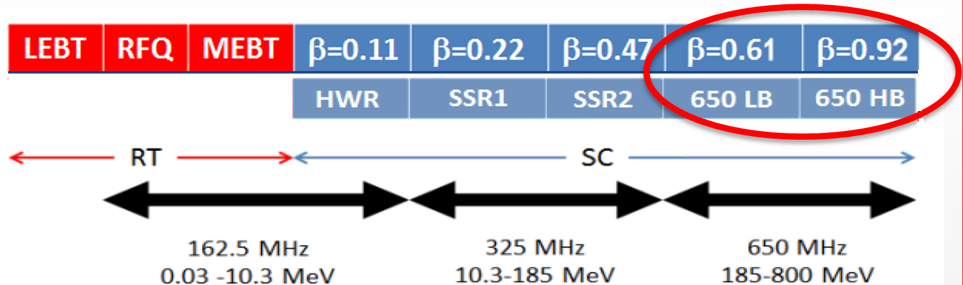
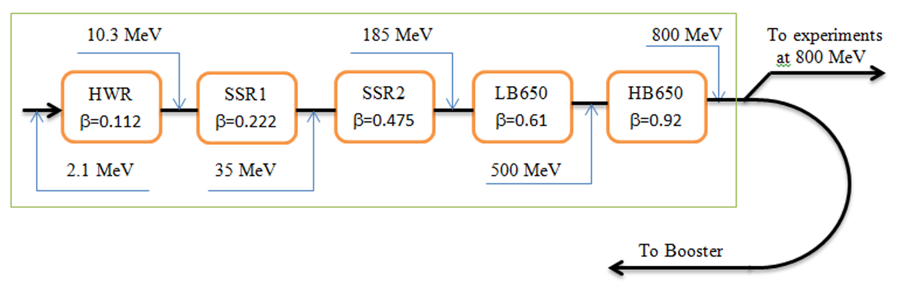
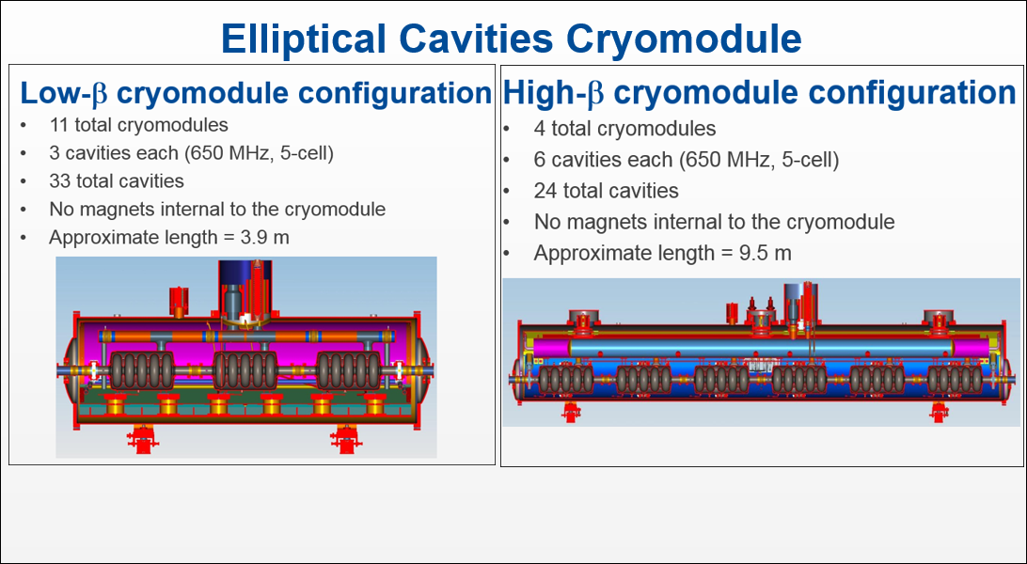
HB650 R&D Plan
Charge Item: #1
β = 0.9
β = 0.9
β = 0.9
β = 0.92
β = 0.92
β = 0.92
Prototype HB 650 Cryomodule will have 3 Fermilab & 3 RRCAT cavities

Slide 5
HB650 division of responsibility for R&D phase
High beta (0.92) cavities
  Fermilab – RF design and bare & dressed mechanical design
  RRCAT – Bare and dressed cavity fabrication
High beta (0.90) cavities (beta 0.90 is an earlier design which was superseded by 0.92)
  Fermilab – Bare and dressed cavity design and fabrication
High beta cryomodule
  Fermilab and RRCAT – Complete cryomodule design
  Fermilab - Fabrication of 1st pCM of HB650
Tuner design and fabrication
  Fermilab – Prototype tuner design and fabrication
Input coupler design and fabrication
  Fermilab – Prototype coupler design and fabrication

Slide 6
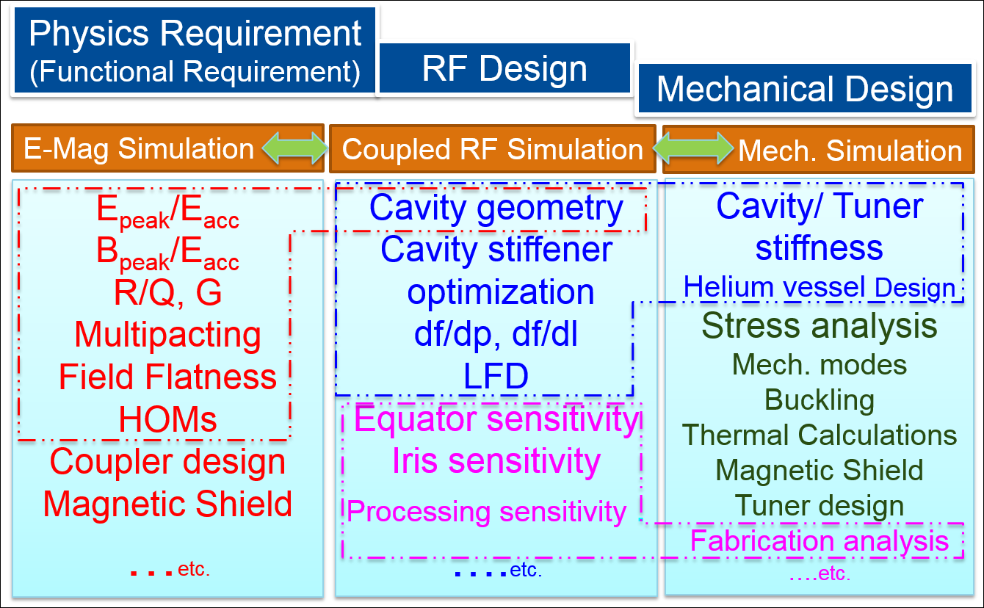
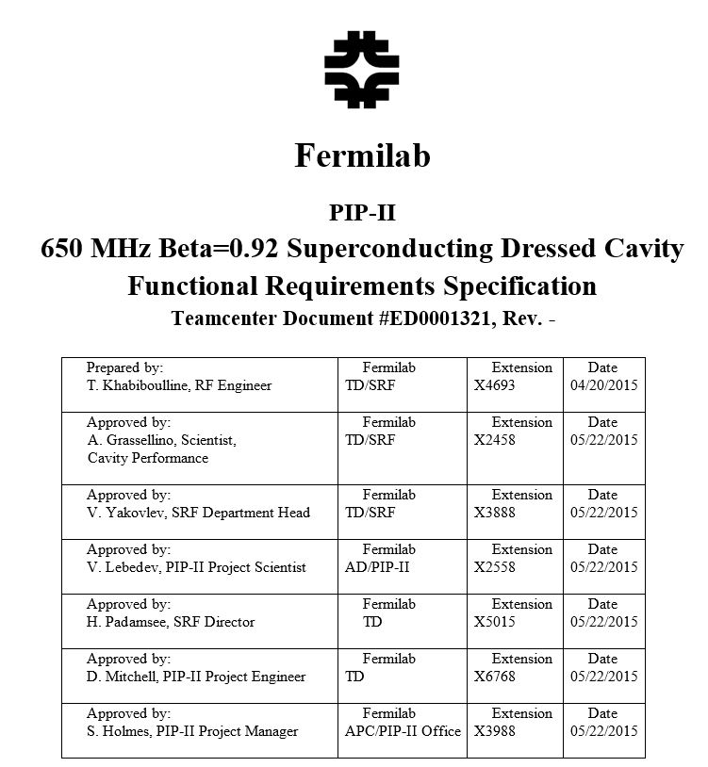
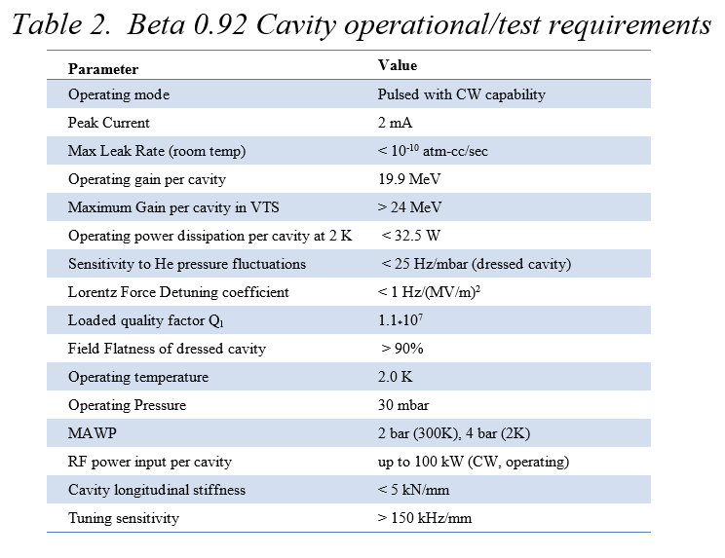
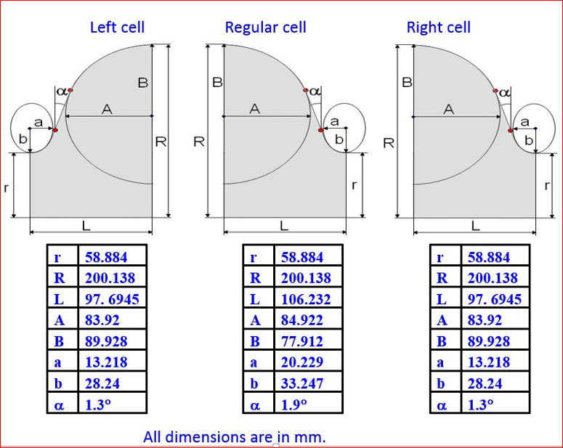
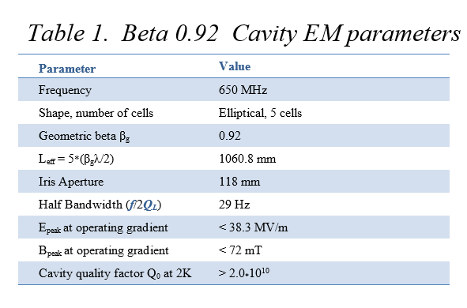
650 MHz Cavity Design
Methodology Adopted
HB650 β=0.92 ➔ 500 MeV to 800 MeV
E-Mag Data
➔
RF Dimension ➔

Slide 7
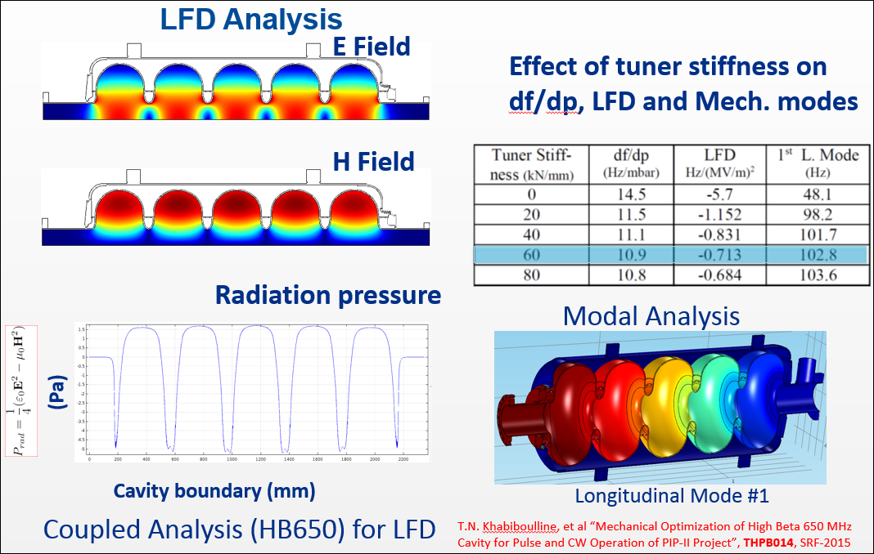
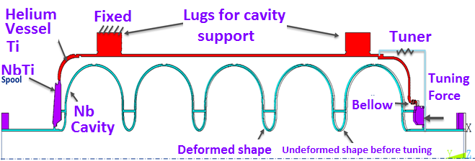
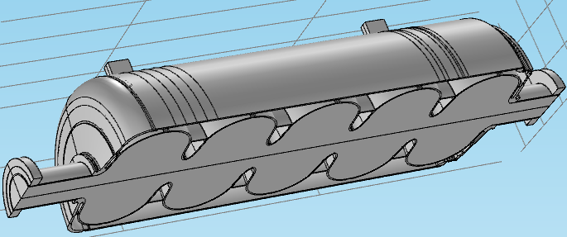
Coupled Analysis (HB650) for Mechanical Design
2D
Cavity domain
RF Domain
3D

Slide 8
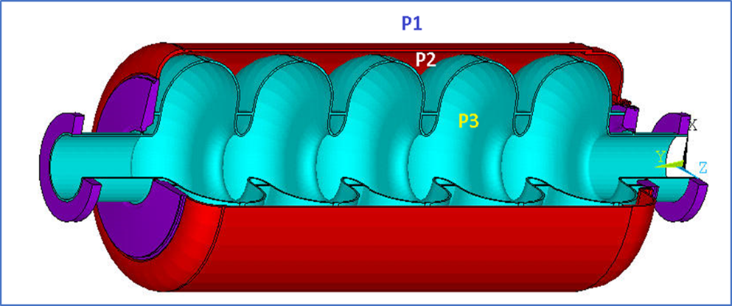
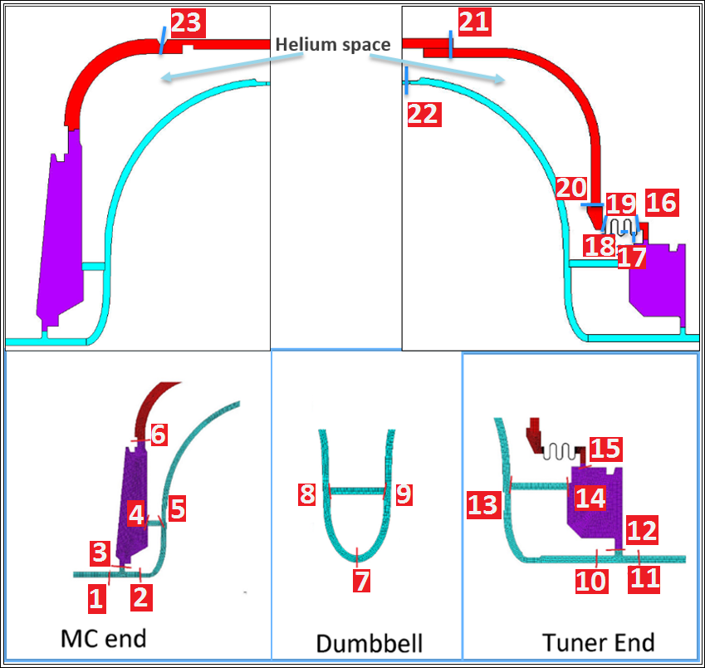
HB650 Loads Cases for
Stress Analysis as per ASME
Different loads applicable to cavity
Gravity
Liquid helium pressure head
P2 = 2 bar at room temp. p1=p3=0
Cool-down shrinkage to 2K
P2 = 4 bar at room temp. p1=p3=0
Tuner extension and
Cavity vacuum failure loads p3=1bar
Results
5 load cases with different combination were qualified.
All applicable stress categories have been evaluated at the stress classification lines.
It was found that in all cases the stresses are below the allowable values.
SCLs
V. Jain, et al “650 MHz Elliptical Cavities for PIP-II Project”, WEB3C003, NAPAC-2016

Slide 9
Dressed cavity fabrication
Bare Cavity Fabrication & qualification
    The development of bare cavity
    Qualifications consists of leak tests, inspection, and RF QC tests.
    Processing CBP, EP, HPR ➔ VTS testing
Cavity Dressing
    Fabrication of helium vessel, bellow and end transition ring.
    The following tools/fixtures are used for cavity dressing:-
        a. Insertion device (medium bertha) for preparing cavity for dressing.
        b. Rotating fixture to revolve cavity during welding.
        c. Glove box for welding 5-cell 650 cavities in inert atm.
    During the entire fabrication process the dressed cavity RF frequency is monitored and kept within the specified limit.

Slide 10
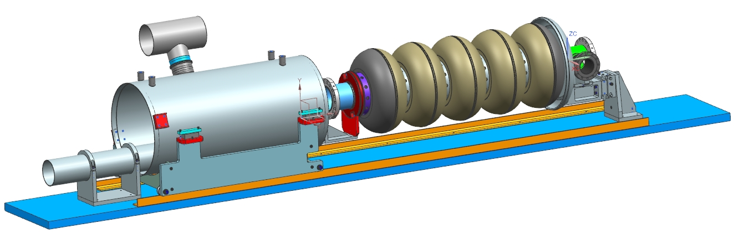
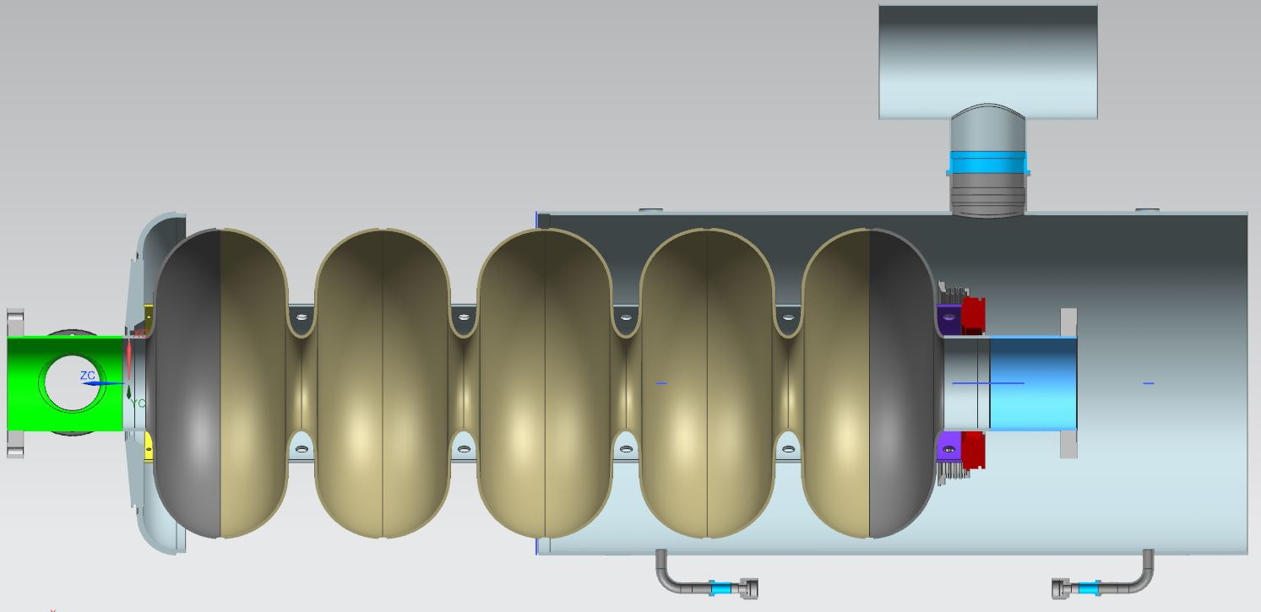
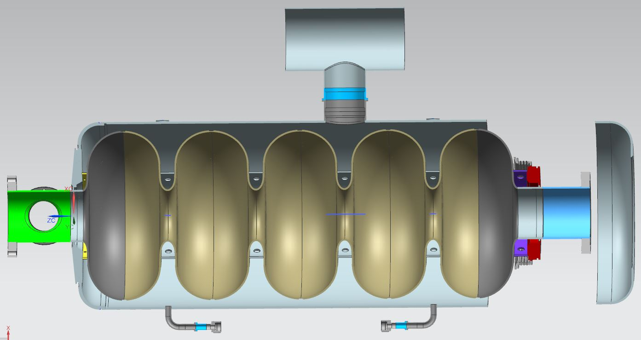
Dressed cavity preparation by tack welding
Titanium Helium Tank
Insertion device (medium bertha) for cavity dressing
Titanium Transition Ring
Dressing the Bare Cavity
CAVITY DRESSING STEPS

Slide 11
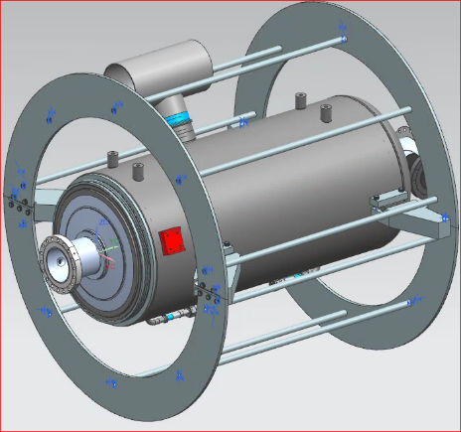
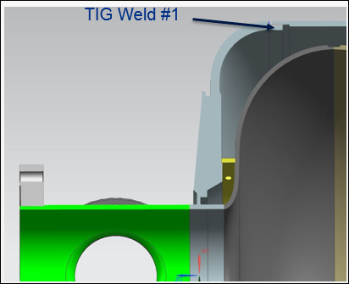
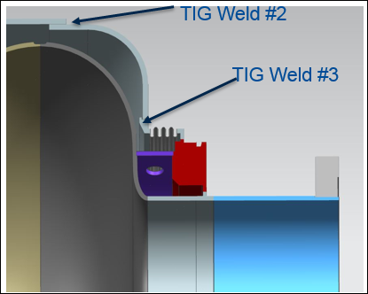
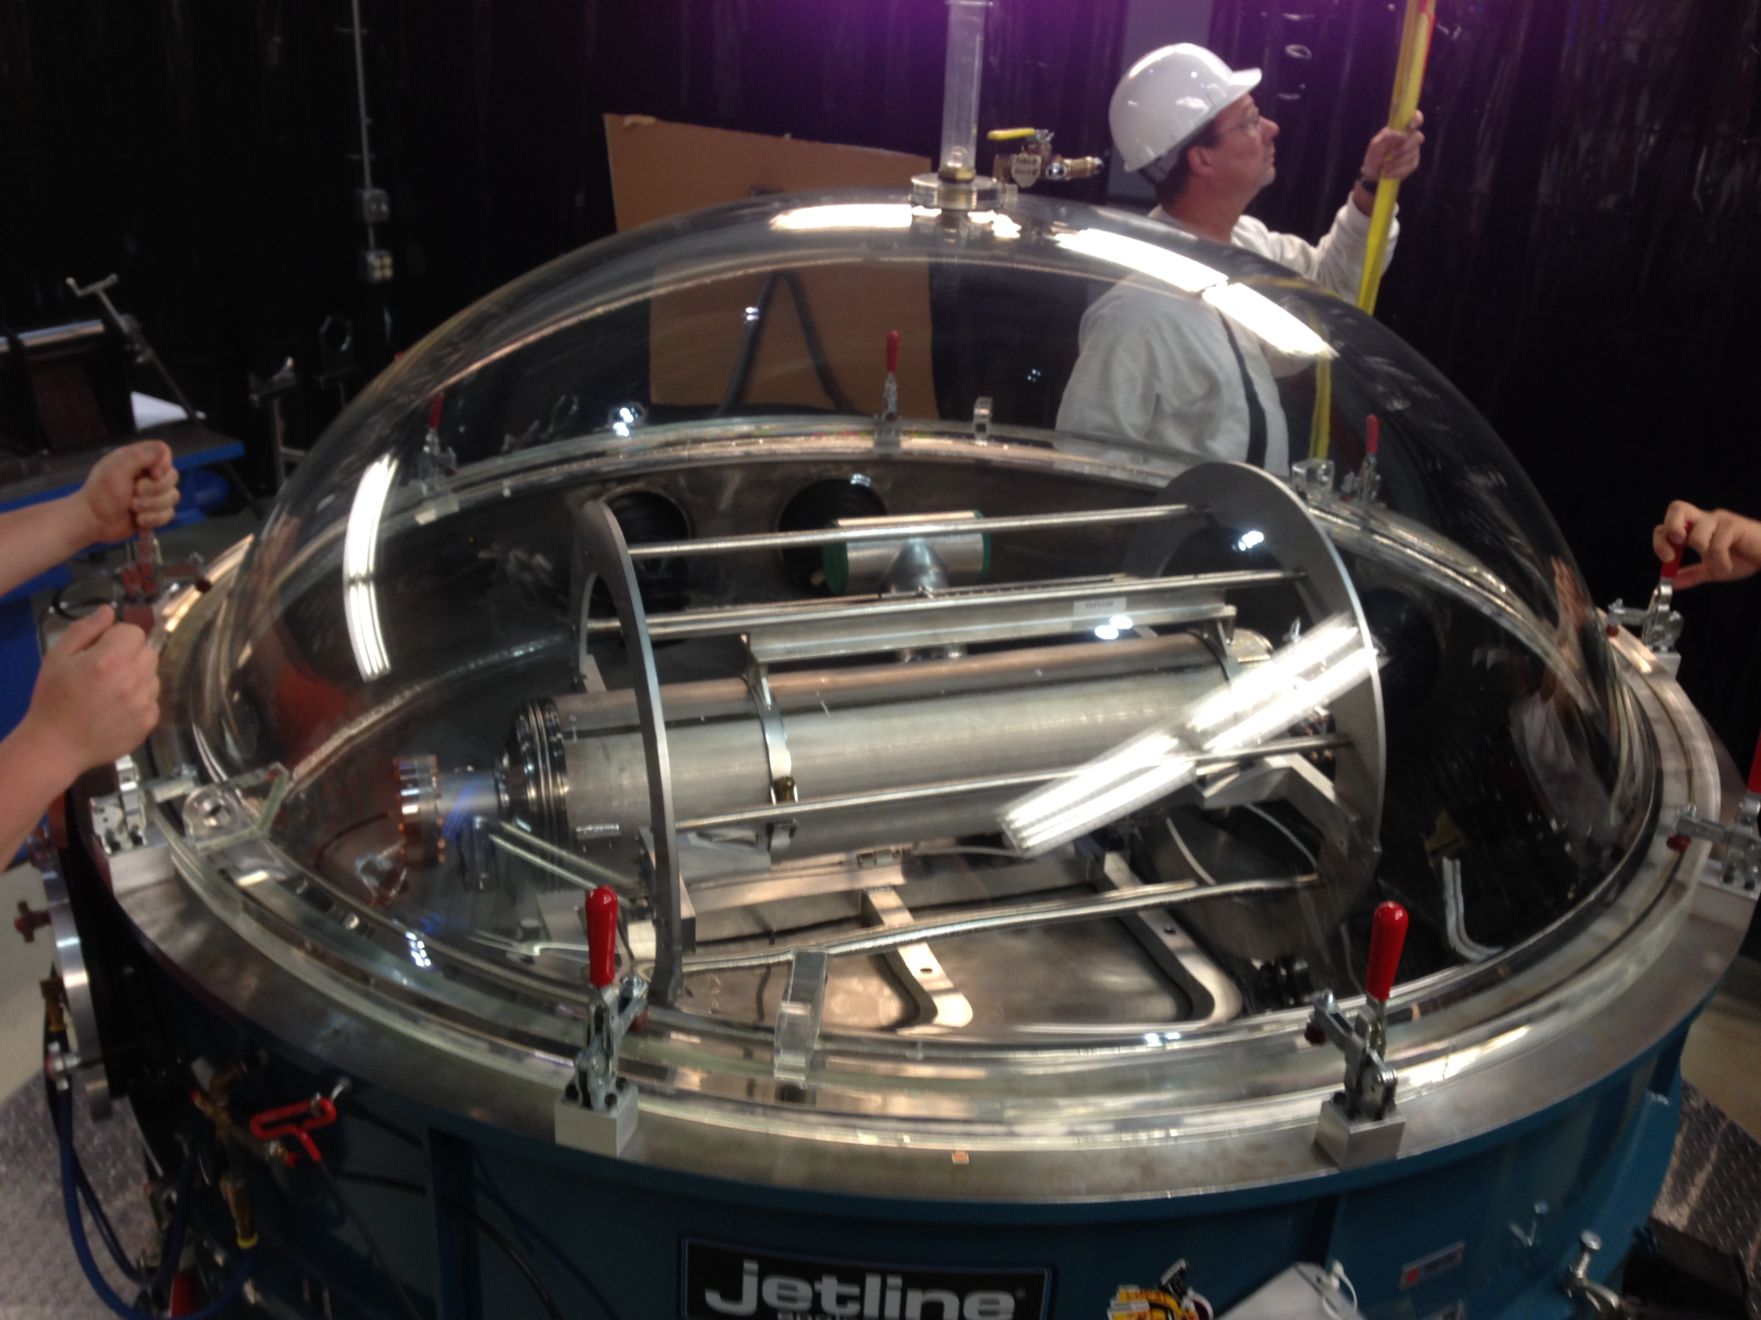
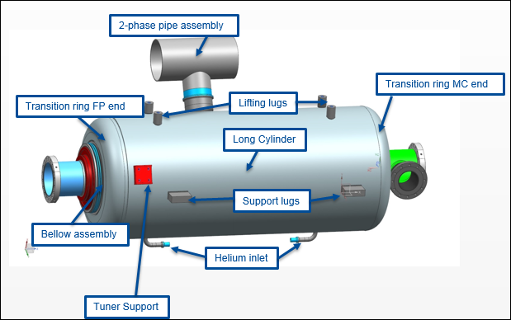
Cavity Dressing
Glovebox TIG Welding
360 º Rotation fixture
➔ Tacked cavity and helium vessel assembly is rotated inside GB
Components of HB650 same/ similar to LB650 :
➔ MC & FP End groups, Helium vessel Tuner, Coupler, Magnetic shield

Slide 12


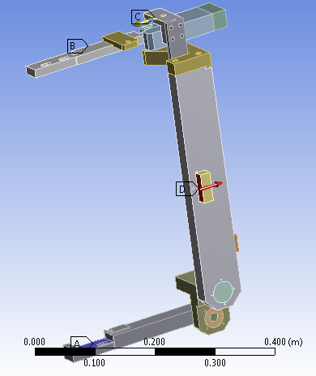
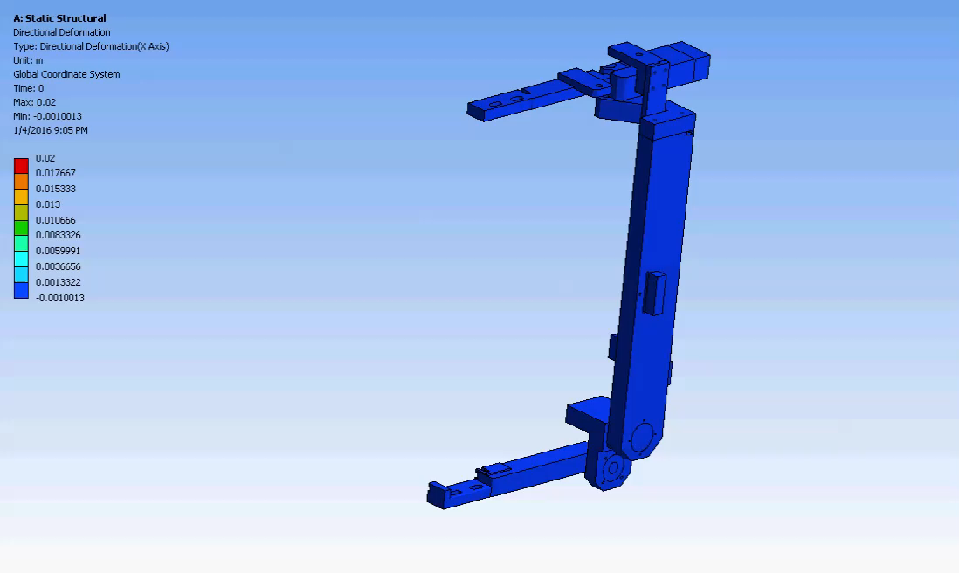



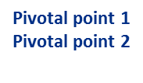
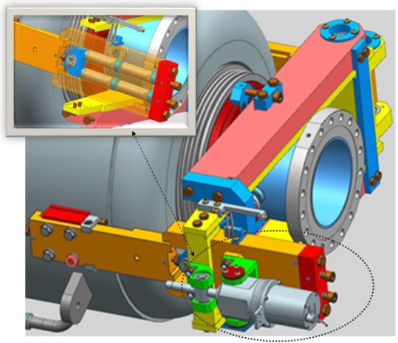
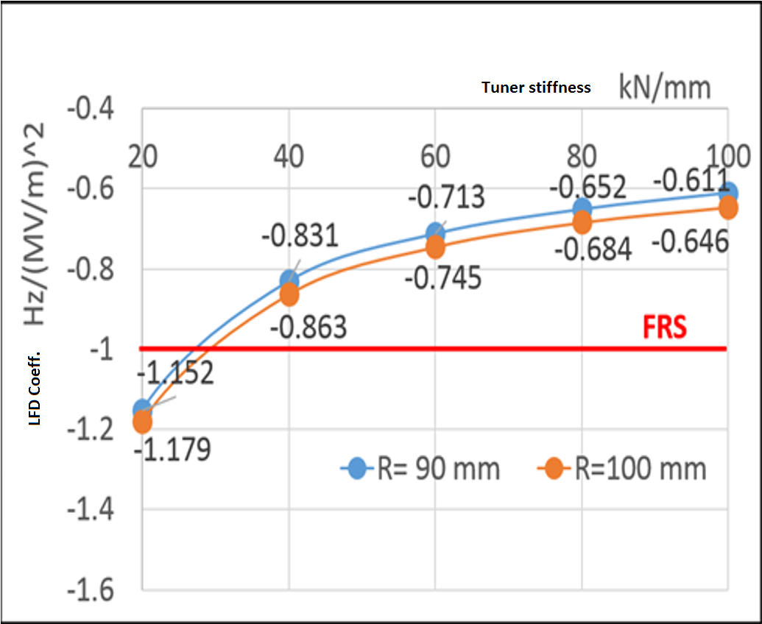
Tuner for 650MHz SCRF cavity
Charge Item: #1
W. Schappert
Analysis of tuner
Tuning ratio for motor ~ 20
Tuning ratio for piezo ~ 2
Tuner Stiffness ~ 68 kN/mm
Half model of tuner with boundary conditions
Common tuner for LB & HB cavities
Equivalent spring model
I.V. Gonin, E. Borissov, T.N. Khabiboulline, Y.M. Pischalnikov, V.P. Yakovlev, "Design of a Compact Lever Slow/Fast Tuner for 650 MHz Cavities for Project X“, LINA2014, Geneva, Switzerland

Slide 13
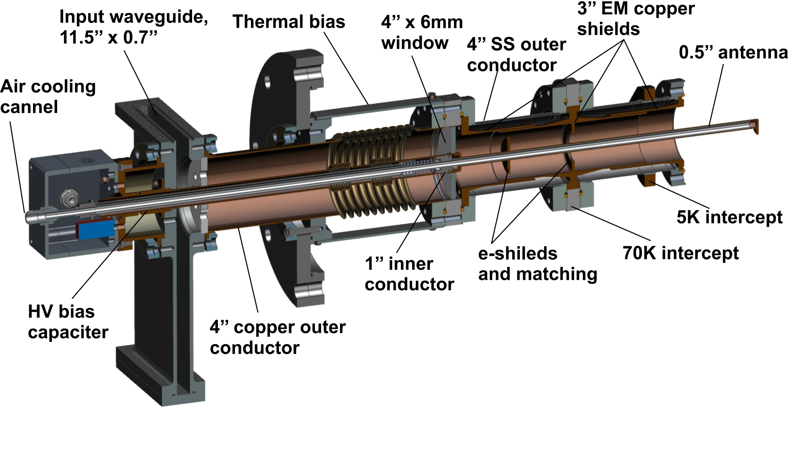
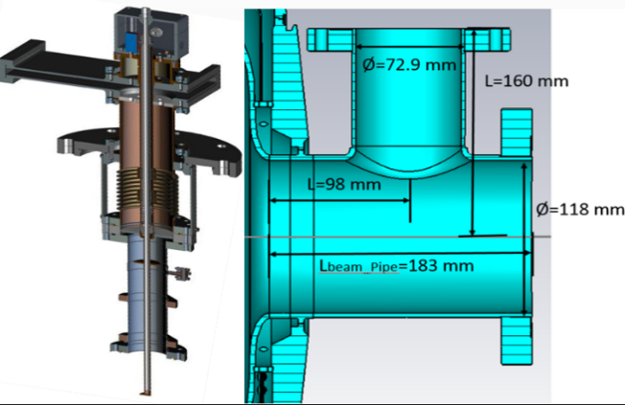
Coupler for HB 650 MHz design
Current status:
  Electrical, thermal designs are done.
  Mechanical design is done.
  Review is scheduled at the end of November.
  Test stand will be design by Q2 CY17
The RF coupler for LB650 and HB650 cavities is same.
Coupler has a single room temperature coaxial ceramic window.
The window diameter is 4’’. Central conductor of the coupler is cooled by air.
Main Coupler Port
S. Kazakov et al., “Design of Main Coupler for 650 MHz SC Cavities of PIP-II Project”, MOPOB24, NAPAC 2016

Slide 14
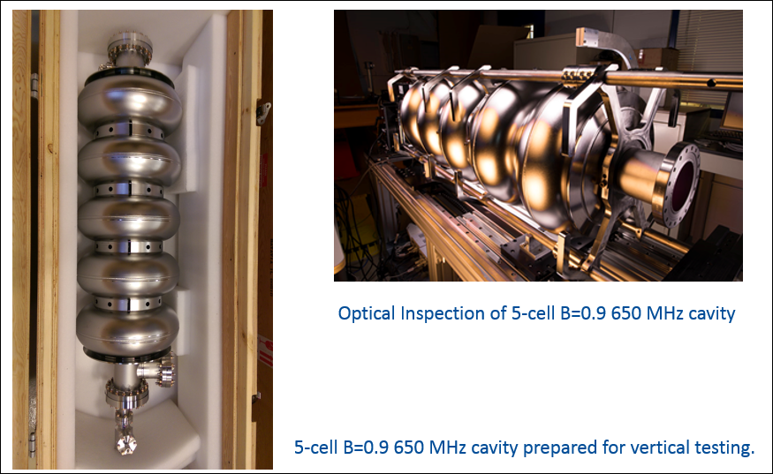
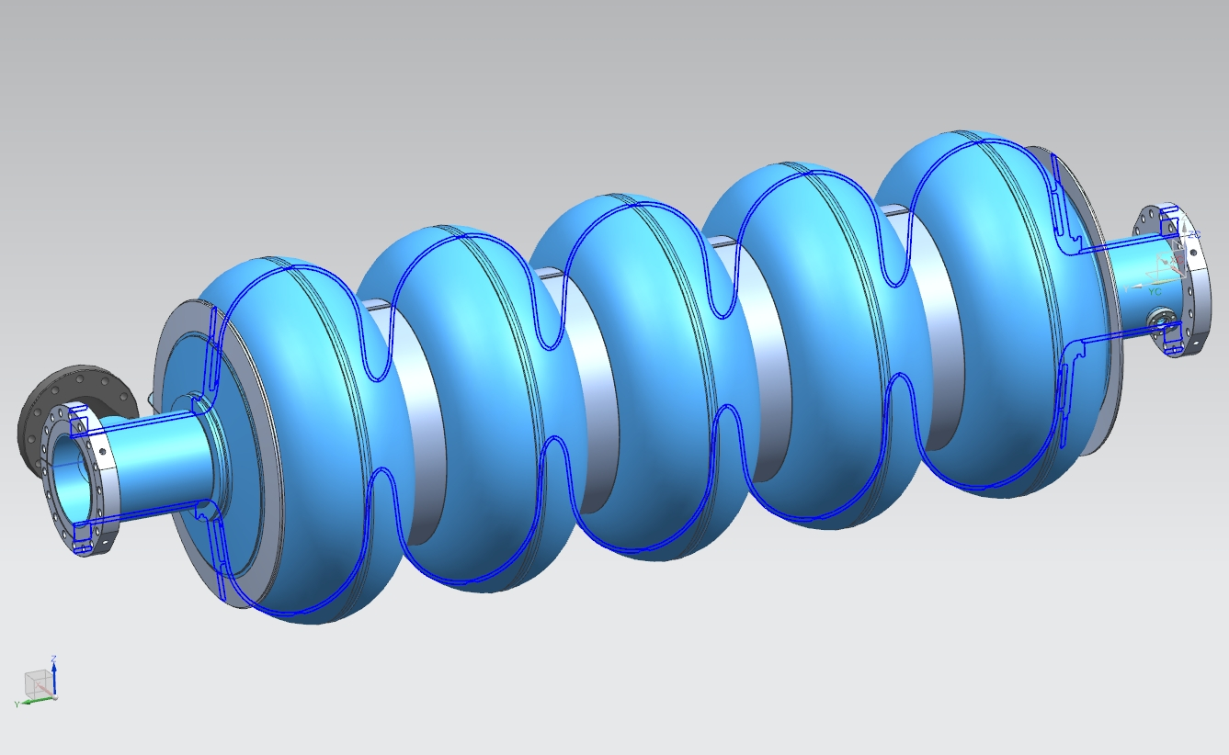
650 MHz β = 0.9 Bare cavity work at FNAL
Total 5 bare cavities at FNAL (4 from AES+1 PAVAC)

Slide 15
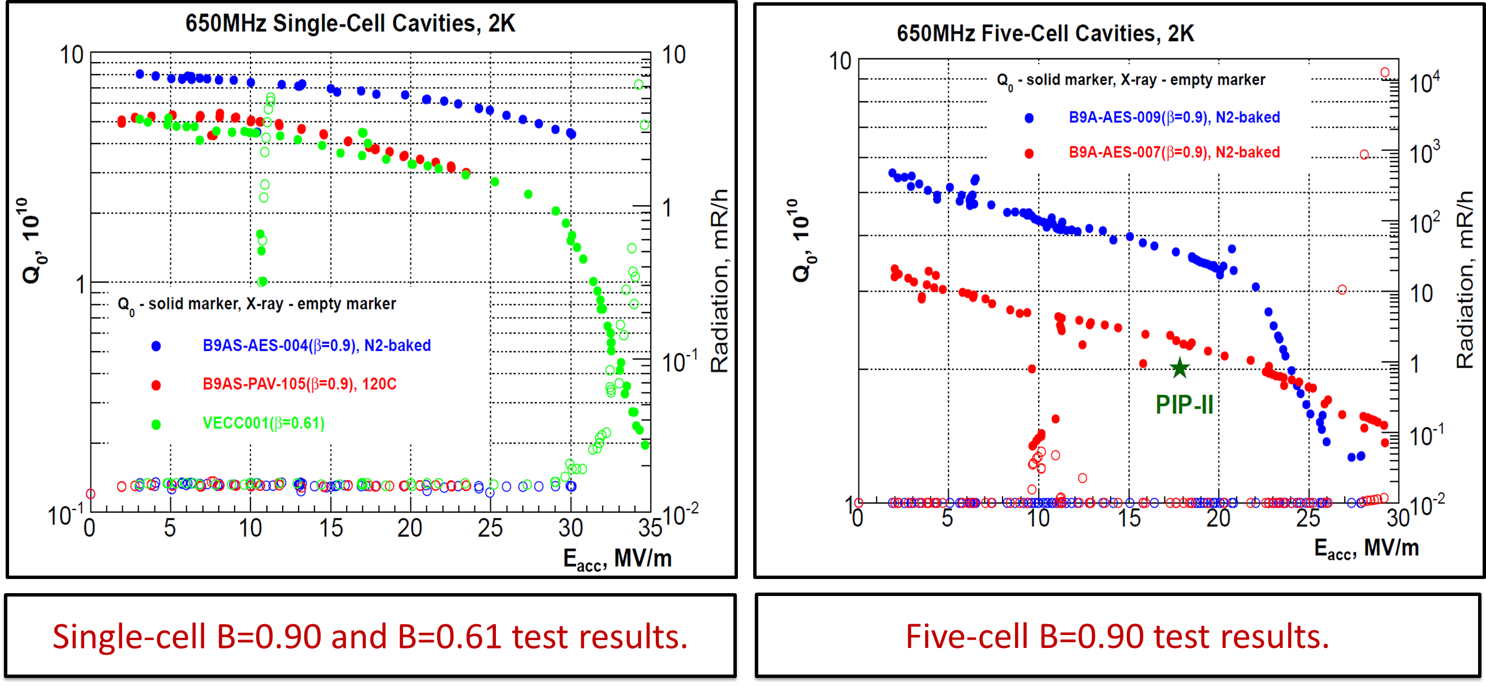
HB650 Cavity performance testing at FNAL
*A. M. Rowe, et al , CAVITY PROCESSING AND PREPARATION OF 650 MHz ELLIPTICAL CELL CAVITIES FOR PIP-II, LINAC 2016

Slide 16
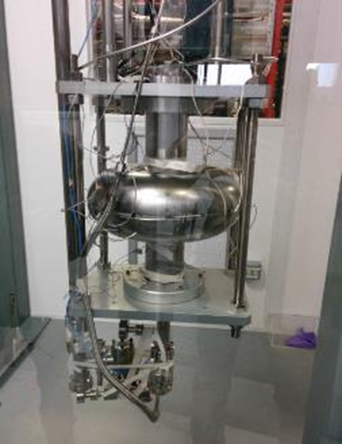
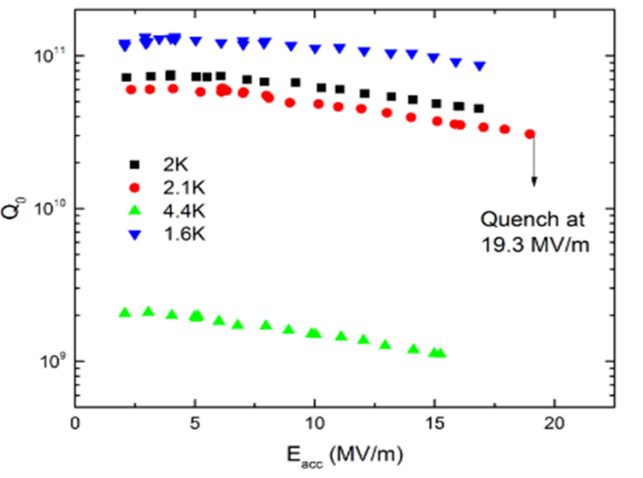
IIFC Progress: 1-cell HB650 (RRCAT)
RRCAT/IUAC Fabricated one Nb HB650 650 MHz single-cell cavity (July 2013).
  Processed & tested at FNAL/ANL
  The cavity achieved E_{acc} 19.3 MV/m with Q > 4E10 at 2K.
FNAL—Grassellino, Menlnychuk, Sergatskov, et al.
RRCAT -- Puntambekar, et al.

Slide 17
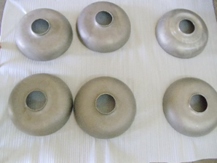
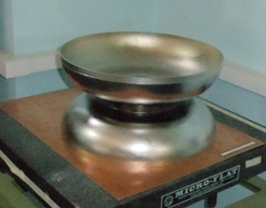
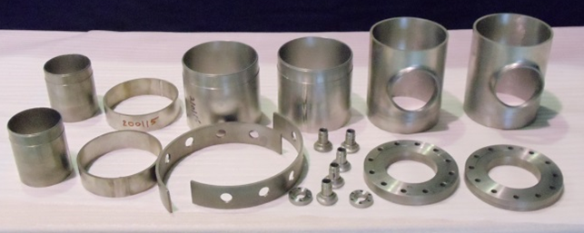
IIFC Progress: 5-cell HB650 Cavity work at RRCAT
The drawings for 5-cell bare HB650 cavity fabrication were released by Fermilab on 10 February 2016
The drawings for dressed HB650 cavity fabrication and prototype tuners were released by Fermilab on 30 June 2016
Based on these drawings, RRCAT has initiated work on 5-cell HB650 cavity fabrication.
  Prototype mid and end half cells have been formed.
  Components for end group are machined and ready for welding.
  Three Dumb-bells are fabricated.
Formed Half cells
1st Dumb-bell B=0.92
HB650 B=0.92 End Group Components

Slide 18
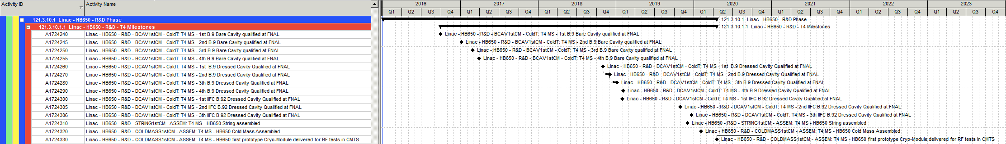
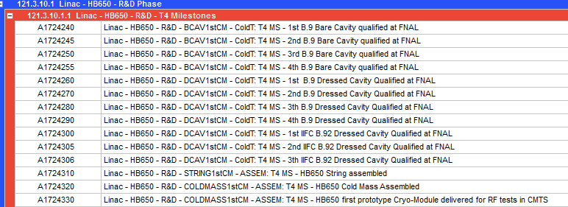
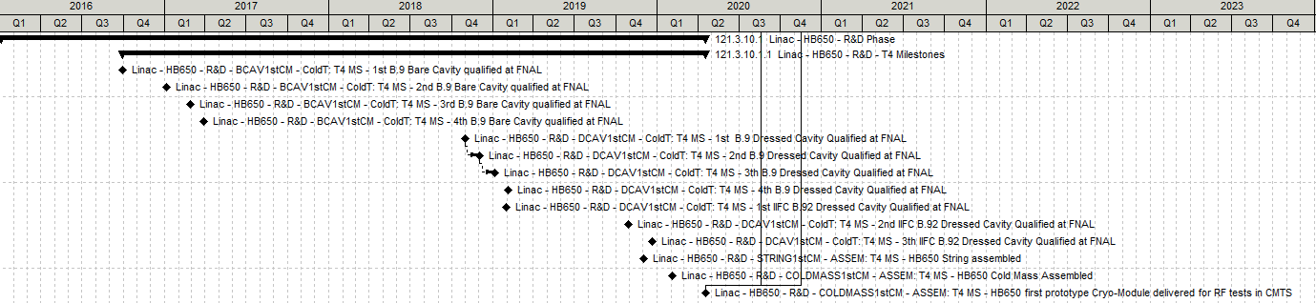
Resource Loaded Schedule for HB650

Slide 19
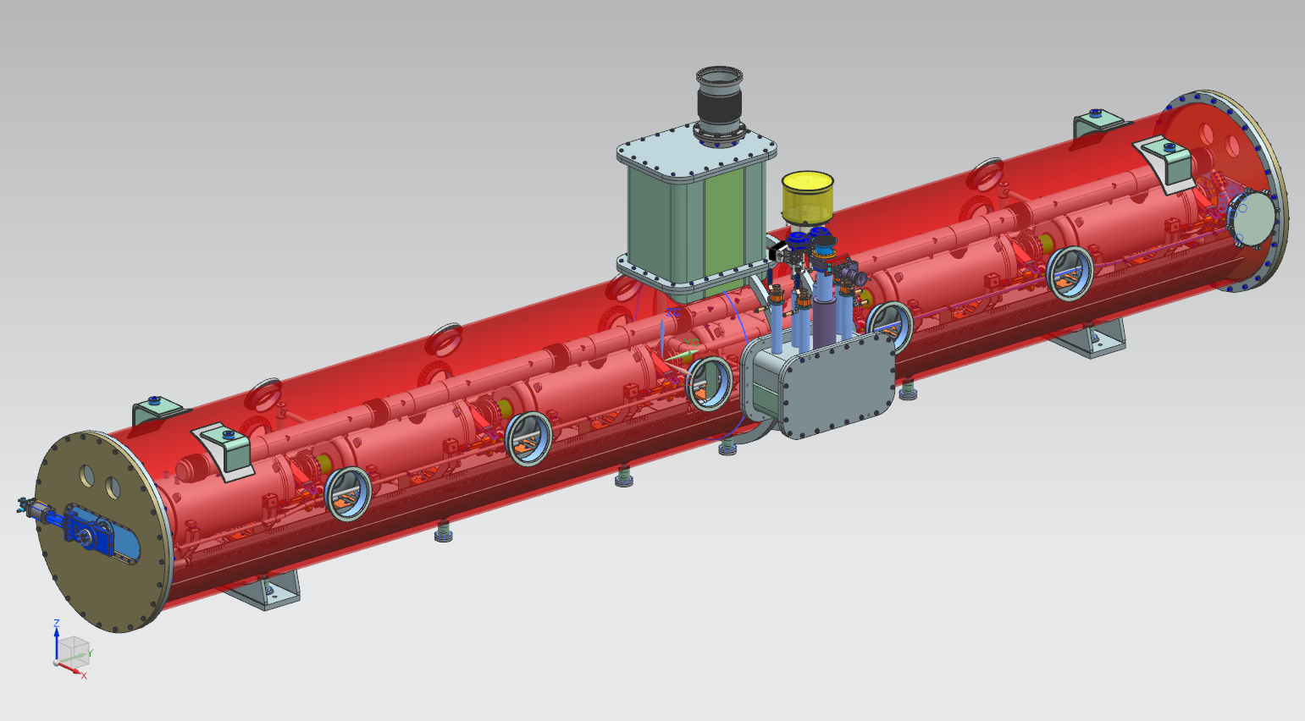
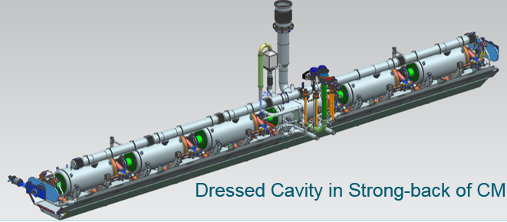
High beta 650 MHz cryomodule
High beta cryomodule being developed jointly between Fermilab and RRCAT
Heat exchanger and relief line
Valves and transfer line connections
Tuner access ports
The design being developed will house both beta 0.90 and 0.92 dressed cavities

Slide 20
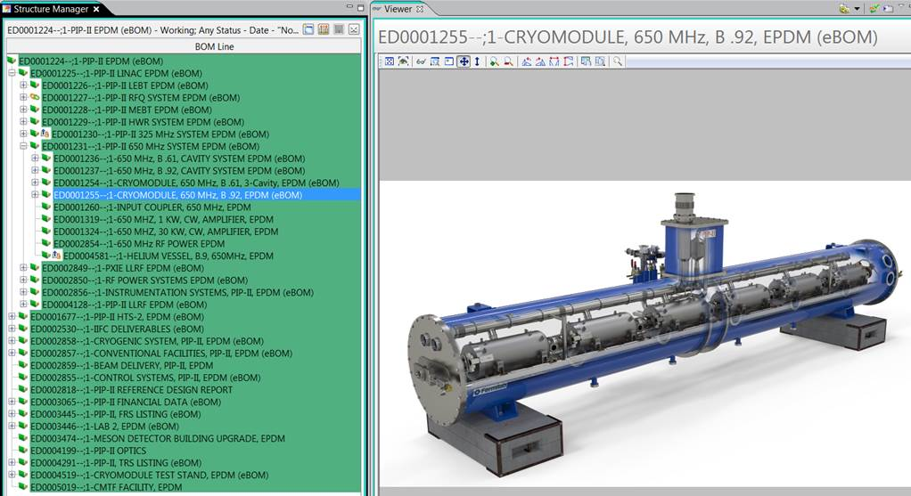
HB 650 Prototype Cryomodule Status

Slide 21
Summary
Development of 650 MHz elliptical cavities has been initiated for PIP-II project.
Multi-cell cavity results to date meet current performance specifications, but gap exists with 1-cell performance. Improvements likely with additional processing and testing R&D
FNAL is working on dressing of b=0.9 650 MHz cavity. HB650 B=0.9 Dressed cavity #1 processing and VTS Complete by Sept 2017.
RRCAT is working for the development of b=0.92 650 MHz cavity. 1st HB650 B=0.92 Dressed cavity processing and VTS Complete in early 2018.
Cryomodule for HB650 is being developed jointly.
1st or Prototype HB650 CM (pCM) will have three β=0.92 650 MHz cavities & three β=0.9 650 MHz cavities.
Fabrication of HB650 CM is to be complete by Q1 of CY2020.
THANKS FOR YOUR KIND ATTENTION

Slide 22
Backup slides

Slide 23
Elliptical cavities for PIP-II
HB650 β=0.92 ➔ 500 MeV to 800 MeV

Slide 24
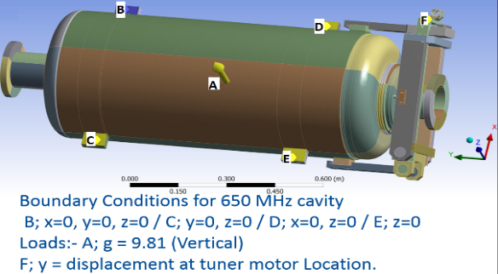
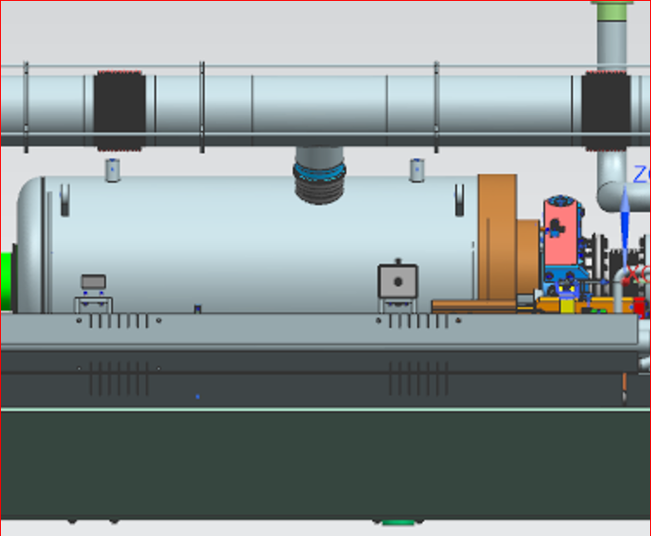
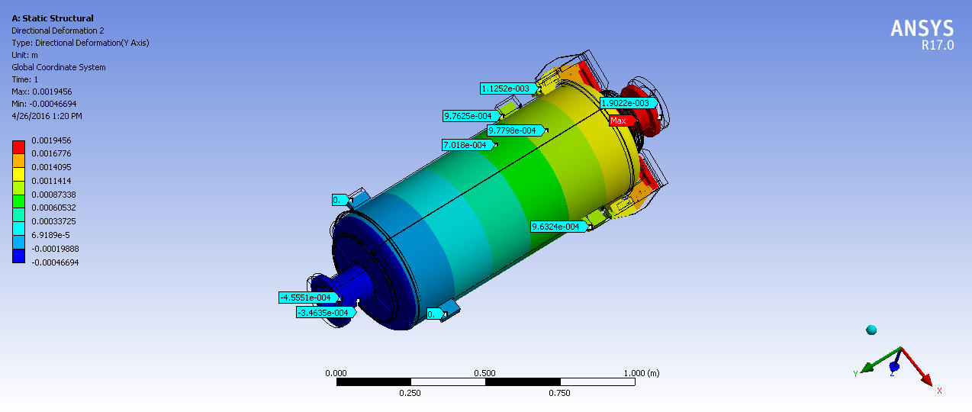
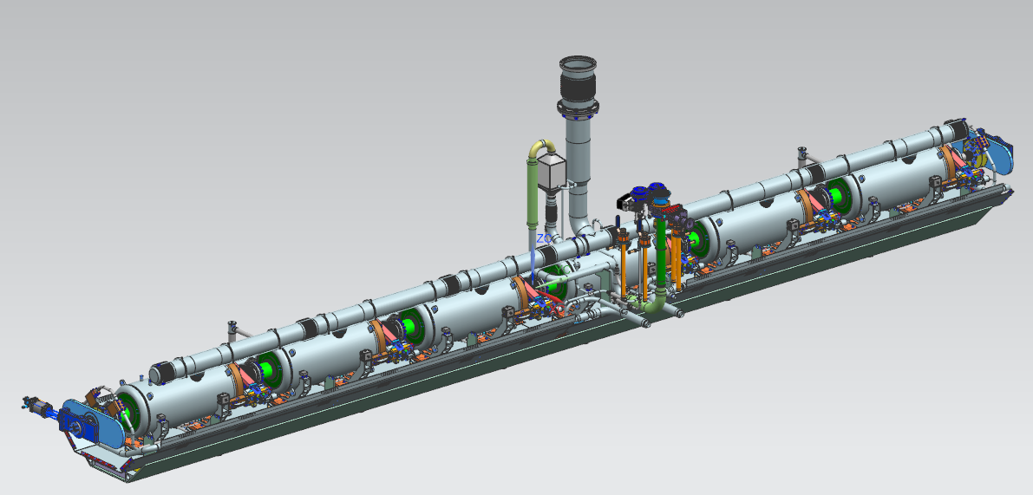
Mechanical Analysis
Maximum shrinkage of cavity due to cool-down to 2K
  1.9 mm at tuner end and
  0.455mm at coupler end.
Bottom supported cavity in CM

Slide 25
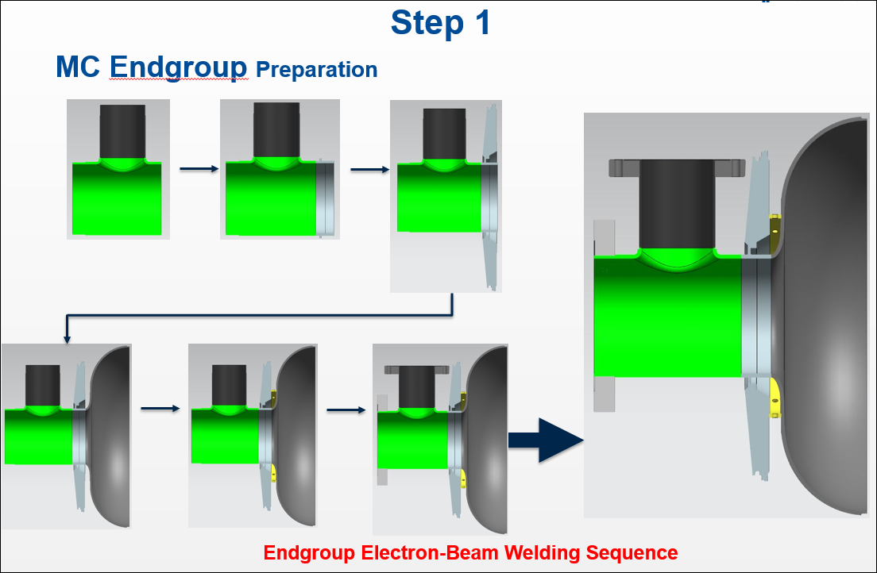
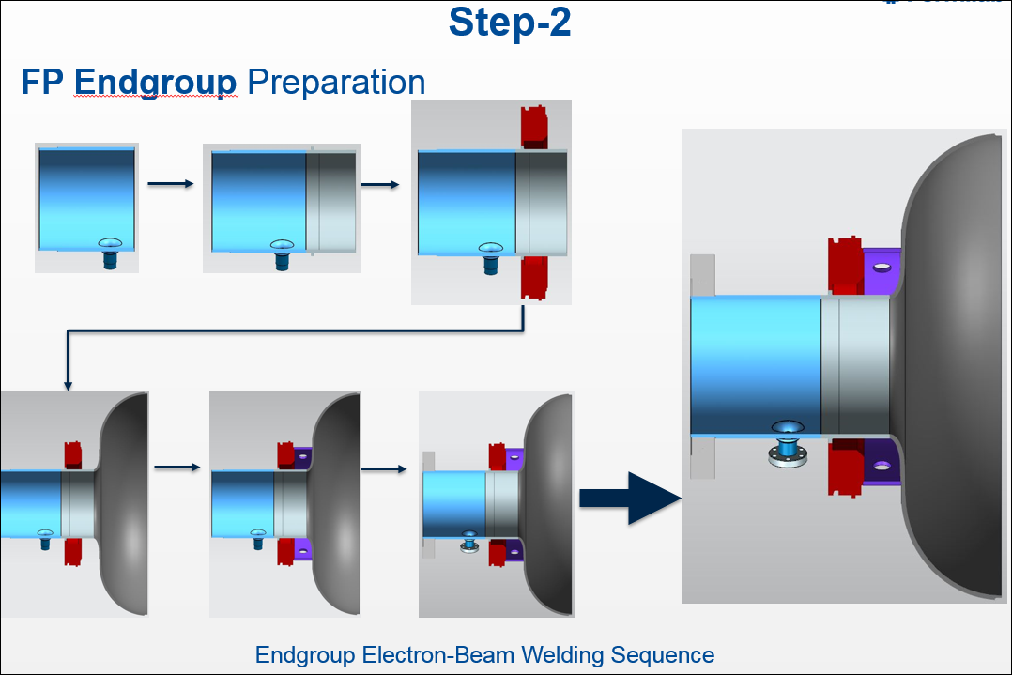
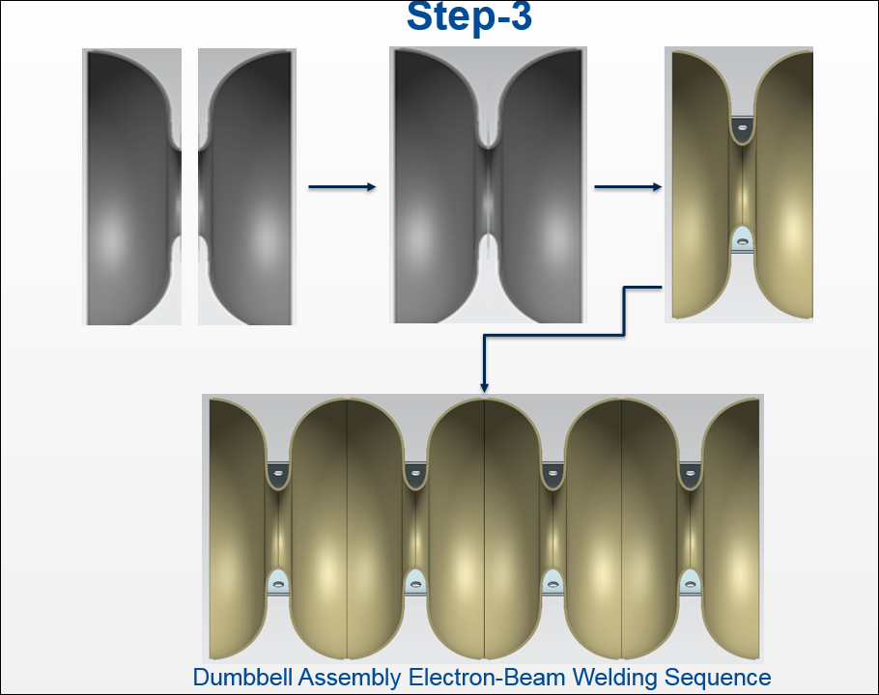
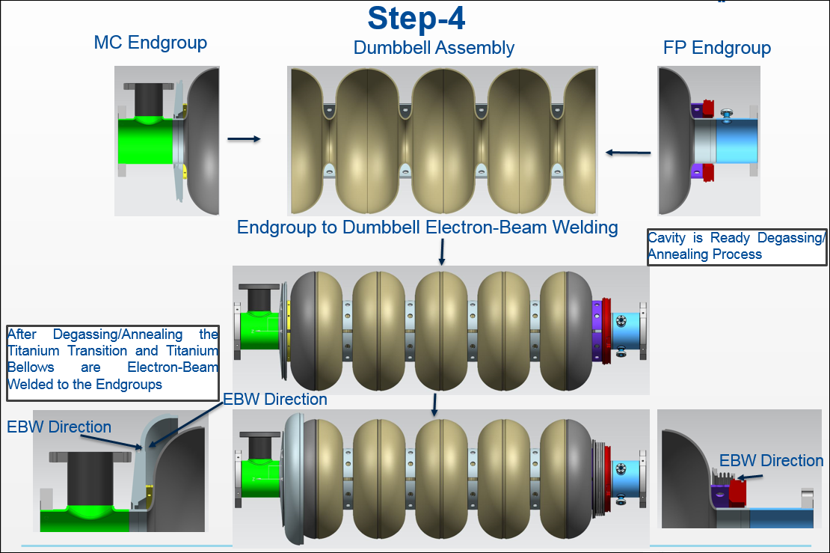
BARE CAVITY FABRICATION STEPS

