Slide 1
MCenter Planning Meeting
Mandy Rominsky FTBF Coordinator

Slide 2
Meeting Goals
To distribute information to all interested parties
How MCenter is currently configured
What its potential use cases are
Discuss timing of various operations within MCenter
Shutdowns
Planned users
Pose questions about MCenter
How should we proceed to develop this beamline?

Slide 3
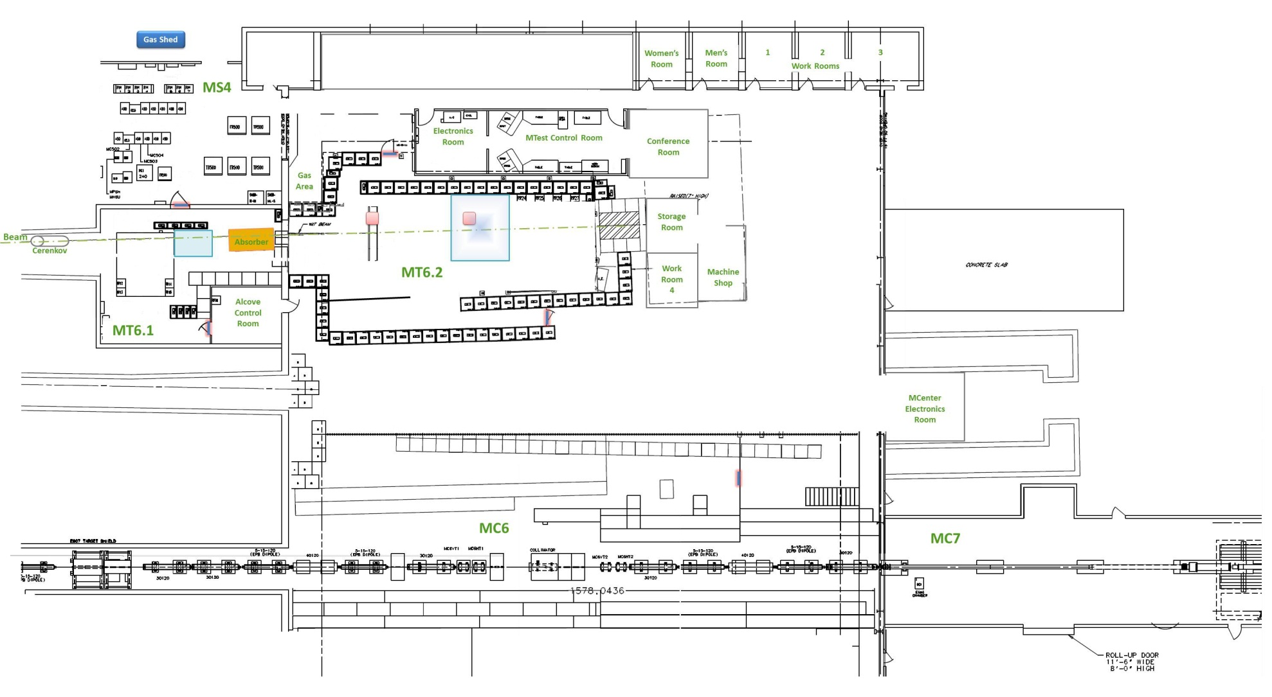
Facility Layout
Experimental Areas
Work Areas
Control Rooms

Slide 4
Facility Infrastructure
Equipment | MCenter | MTest
Gas Lines | ✔️ (Only for MWPCs currently) | ✔️
HV, signal, network connections | ✔️ | ✔️
Cameras |  | ✔️
Helium Tubes |  | ✔️
Laser alignment |  | ✔️
Motion Tables |  | ✔️
Crane coverage |  | ✔️
DAQ | ✔️ (LArIAT DAQ) | ✔️ (In progress)
Climate Control | ✔️ (Limited) | ✔️
Beamline Instrumentation | ✔️ (Some) | ✔️

Slide 5
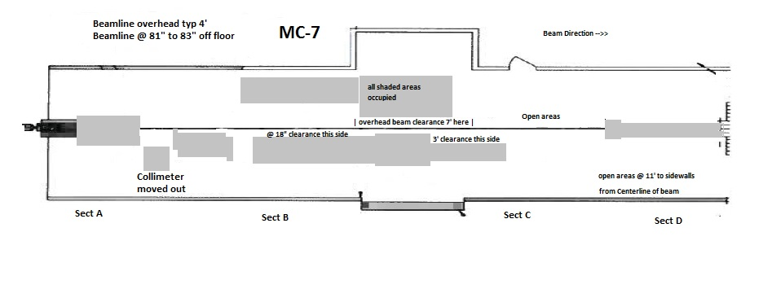
MC7 (Upstream) Close up
Shaded areas are occupied.
Supports secondary and tertiary beam.

Slide 6
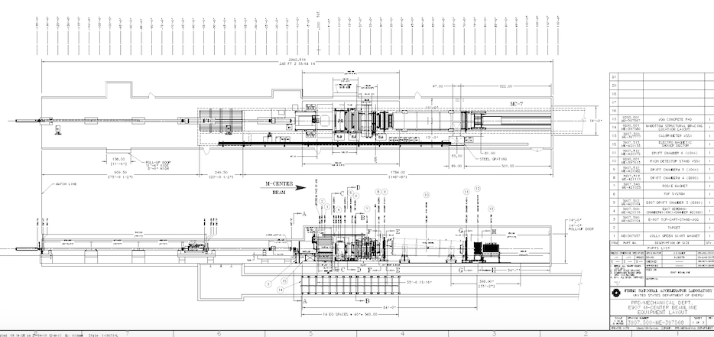
MC7 Enclosure
Full enclosure picture
Shaded area shown on previous slide

Slide 7
Restrictions for MCenter
To come in from the roll up door by LArIAT, can only have about 2 ft by 6 feet.
The same as a regular door.
Can use carts to lift heavy things
Fire restrictions
Low risk installations should be okay.
Would need significant work for higher risk installations
Long cable runs from Control room to enclosure
100-150 feet to LArIAT
Possible to extend into area behind control room (MWest) for electronics room?

Slide 8
Usage for the next 3 years
LArIAT will continue their run
Finish next summer at the shutdown
pLAPPDs will run in the fall
Really would like to use tracking chambers and secondary beam
Also need the LArIAT DAQ
Beam plug for ProtoDUNE
TSW in progress
Liked MCenter, but chose MTest for infrastructure

Slide 9
Usage Continued
Jen’s Early Career
More later
NOvA test beam
Significant work will be required
Some timing issues because of when work can be accomplished
Emulsion Detectors (US-Japan collaboration)
Seeking funding currently
Would do initial tests at Fermilab in the next year
Beam tests in 2018/2019

Slide 10
Open Questions
Should we pursue refurbishing the magnets (Jolly Green Giant and Rosie?)
Magnetic fields are interesting to some groups, but no concrete proposals yet
Or do we find another solution for magnetic fields?
Build another tertiary beamline?
There is definitely some interest in this
Beamline instrumentation
Tertiary beamline is pretty well covered, but the secondary is not
Do we plan to have work done during the next shutdown (FY17)?
Start planning that now to make sure we have labor
Do we use time when beam is running instead? Would cut down on users
Move the electronics from control room?
Reduce cable runs
Costly because of climate control issues
Data Acquisition?
Support both MIDAS and LArIAT daq in both beamlines?
Would need extra help with these issues
Could possibly benefit more than just the test beam

Slide 11
Next
Michael Backfish will discuss the beamline
We’ll hear from several users
Jen Raaf, NOvA
Open discussion

Slide 12
Meson Center Beamline
Michael Backfish
September 27, 2016

Slide 13
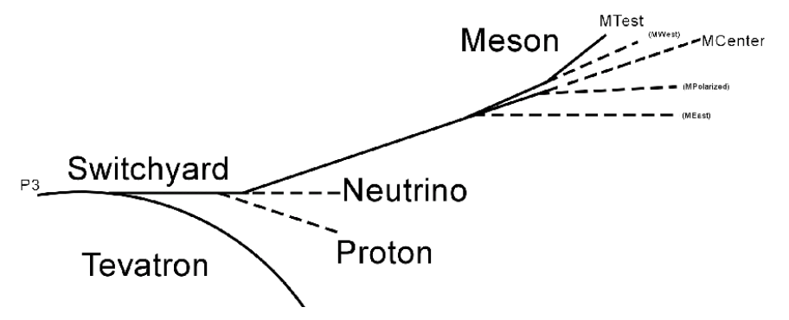
Accelerator Overview

Slide 14
MI Bunch Structure

Slide 15
½ Integer Resonant Extraction Python Simulation by Adam Watts
Transverse Phase Space (X vs X’)

Slide 16
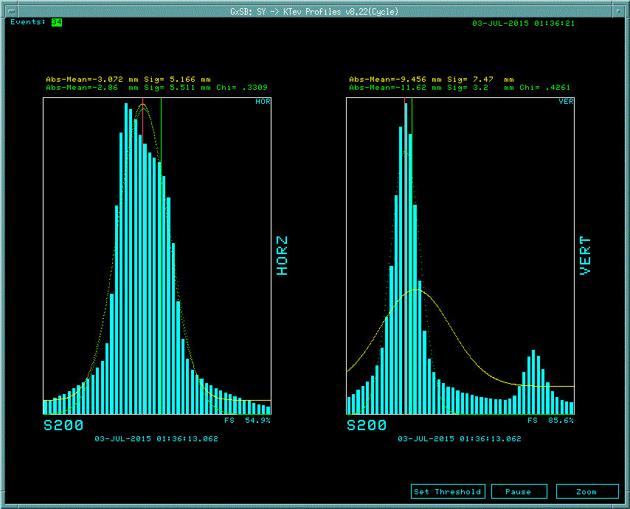
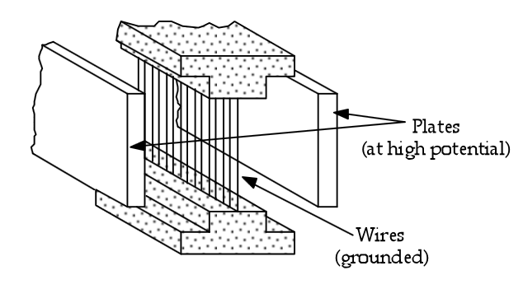
Splitting Beams
SQ
Meson
Meson Septa (Mseps)
FTBF
SeaQuest
Not used

Slide 17
Meson Center/Meson Test Split Occurs at Fsepta (Fseps)
MCenter
MTest
(Fseps)

Slide 18
120 GeV Primary Beam Target and Shielding We Can Send 1E11 Protons Per 4 Second Spill every 60 Seconds
Copper Target
Vertical (cm)
Longitudinal (cm)

Slide 19
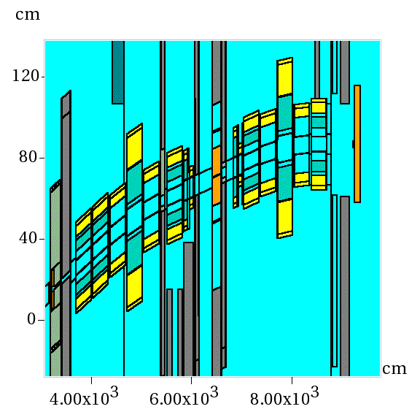
Secondary Beamline ($≈$4 to 80 GeV) Vertical Momentum Selection accomplished with CV (Vertical Collimator)
Q4
D3
Q5
D4
Q6
CV
Q2
D2
Q3
Vertical
Q1-2
D1
Q1-1
Longitudinal
Notes:
575 Amps is the limit of MC6D….low end is limited by lack of vacuum in the second half of the line. Scattering

Slide 20
Wire Chambers the Eyes of the Operator

Slide 21
Secondary Target makes Tertiary Beam at 13˚ Production Angle

Slide 22
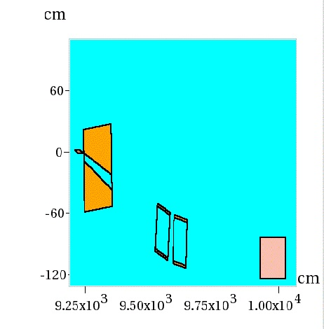
Tertiary
MCAN at 100 Amps Selects 616 MeV Particles
Collimator
MCAN at 50 Amps Selects 308 MeV Particles
Target
Horizontal (cm)
13$°$
MC7AN
TPC
Longitudinal (cm)

Slide 23
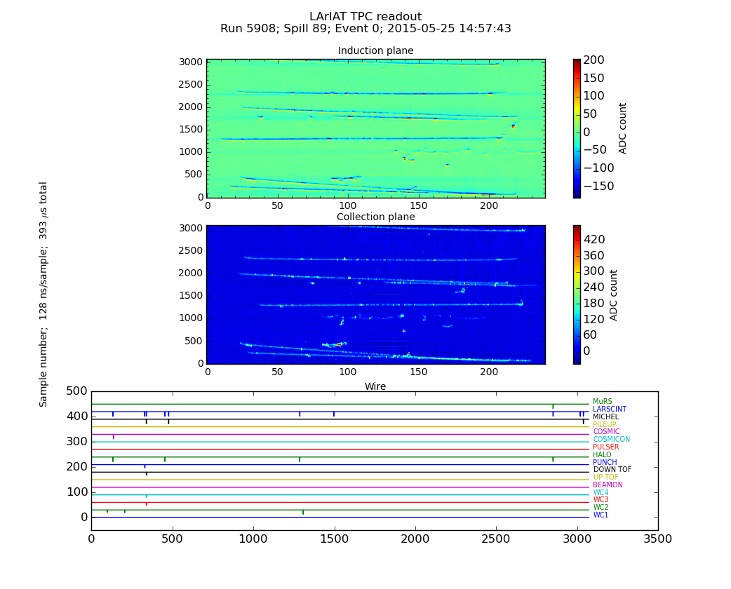
Muon Challenges and Lariat
11 uSec per Main Injector orbit
588 Buckets per Main Injector Orbit
18709 buckets within a 350 uSec Drift time
We Can Overwhelm the TPC!!!!

Slide 24
The Official End

Slide 25
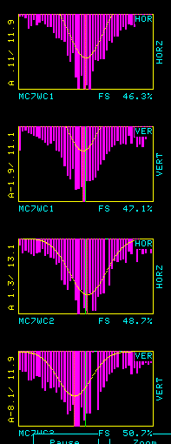
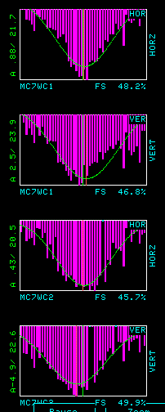
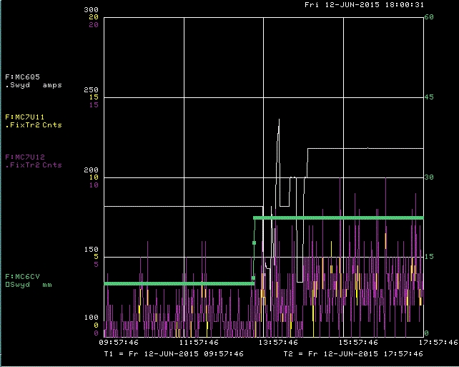
Example of Incremental Progress Open Up the Momentum Collimator couple with a small tweak in Focus using 2 Quadrupoles
Collimator 10 mm
Increased MC7U11 and U12
Without increasing Unwanted Signals
Collimator 22.4 mm

